Slide 1
Regulation NMS and Market Quality
Kee H. Chungª and Chairat Chuwonganant^{b}
ª State University of New York (SUNY) at Buffalo, Buffalo, NY 14260, USA
^{b} Kansas State University, Manhattan, KS 66506, USA

Slide 2
Purpose of the study
Regulation NMS (Reg NMS) is arguably one of the most comprehensive and controversial regulatory changes in the U.S. financial markets in 30 years.
We examine the impact of Regulation NMS (Reg NMS) on various dimensions of market quality using data before and after its implementation.

Slide 3
In Particular,
We analyze the effects of the two new rules, the Order Protection Rule and the Access Rule, on
execution cost
execution speed and execution probability
price impact
price improvement
the efficiency of price discovery

Slide 4
Order Protection Rule (OPR)
The Order Protection Rule (OPR) requires “trading centers to establish, maintain, and enforce written policies and procedures reasonably designed to prevent the execution of trades at prices inferior to protected quotations displayed by other trading centers, subject to an applicable exception.”
OPR differentiates markets into fast and slow.
The primary purpose of OPR is to provide protection against trade-throughs for all NMS securities.

Slide 5
Order Protection Rule (OPR)
OPR is prompted in large part by the SEC’s concern that the increased fragmentation of trading and quoting across venues may reduce liquidity.
SEC fears that brokers executing trades in one market may trade-through better quotes in other markets, reducing the incentive to post the best possible quotes.
If they get traded through frequently, liquidity providers may be less willing to supply liquidity, reducing overall market liquidity.

Slide 6
Access Rule (AR)
The Access Rule (AR) requires fair and non-discriminatory access to quotations displayed by Self Regulatory Organization (SRO) trading centers through private linkages.
AR complements OPR because it helps protect the best displayed quotes against trade-through by allowing broker-dealers and trading centers to access those quotes easily and cheaply.
AR also increases the accuracy of displayed quotations by establishing an upper bound on the cost (i.e., the access fee) of accessing such quotations.

Slide 7
SEC’s View
The SEC believes that the protection of public limit orders provided by OPR would help reward liquidity suppliers, encourages competition among traders, and thus increases market liquidity and reduces trading costs.
The SEC also believes that strong intermarket price protection offers greater assurance that investors who submit market orders receive the best available prices.
The 3-2 SEC vote result shows the divisiveness in the member opinion.

Slide 8
Others Disagree
Blume (2002, 2007) and O’Hara (2004) hold that Reg NMS does not properly recognize the diversity and differential needs of traders.
O’Hara (2004) suggests that OPR would lead to a deterioration of liquidity because some traders may bypass better quotes on the NYSE for speedier trades on an automated system.
OPR prohibits institutional investors from accessing large amounts of liquidity at prices slightly worse than the inside quote.

Slide 9
Access Rule (AR)
Supporters of AR believe that it is desirable to put a limit on access fees because it levels the playing field across trading centers.
Opponents argue that competition alone would be sufficient to address high fees that distort quoted prices.

Slide 10
What We Do
Compare various measures of liquidity and market quality between the pre- and post-Reg NMS periods, after controlling for changes in stock attributes.
We also employ a difference-in-difference approach using the control group of stocks that are similar to the test sample to measure the net effect of Reg NMS on liquidity and market quality after controlling for the effect of the credit market crisis and other market-wide changes.
We analyze the changes in execution speed and probability and how these changes affected market shares of different venues.

Slide 11
Dates and Data
Both AR and OPR were first implemented on July 9, 2007 for a pilot sample of 250 NMS stocks (i.e., 100 NYSE stocks, 100 NASDAQ stocks, and 50 AMEX stocks).
The full industry compliance of the rules began on August 20, 2007 and was completed on October 8, 2007.
After omitting stocks with incomplete data, our final study sample consists of 98 NYSE, 48 AMEX, and 96 NASDAQ stocks for the pilot group and 2,343 NYSE, 837 AMEX, and 2,757 NASDAQ stocks for the main group.

Slide 12
Study Periods for Pilot Group
We use 30 trading days before July 9, 2007 (i.e., May 24, 2007 to July 6, 2007) as the pre-NMS period
We use 30 trading days from July 9, 2007 (i.e., July 9, 2007 to August 17, 2007) as the post-NMS period (see Figure 1).

Slide 13
Study Periods for Main Group
We use 30 trading days before August 20, 2007 (i.e., July 9, 2007 to August 17, 2007) as the pre-NMS period.
We use 30 trading days from August 20, 2007 (i.e., August 20, 2007 to October 1, 2007) as the post-NMS period.

Slide 14
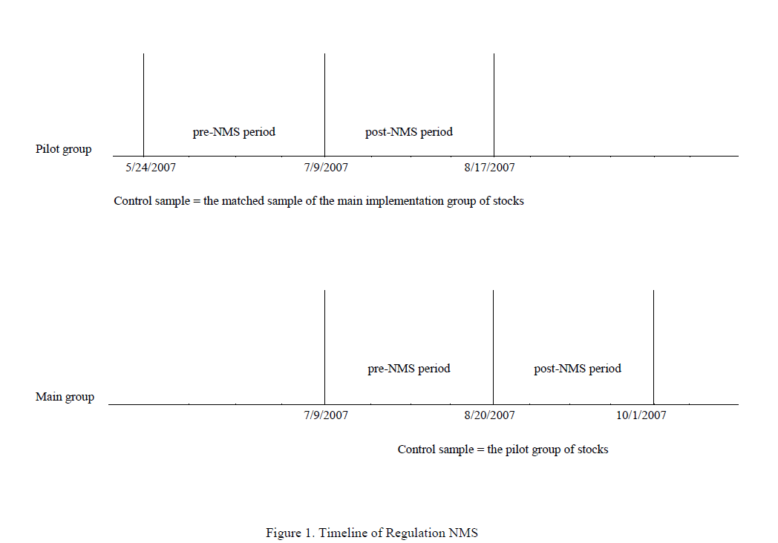

Slide 15
Market Quality Measures
Quoted dollar spread_{i,t} = Ask_{i,t} – Bid_{i,t};
Quoted percentage spread_{i,t} = (Ask_{i,t} – Bid_{i,t}) / M_{i,t};
Effective dollar spread_{i,t} = 2D_{i,t}(P_{i,t} – M_{i,t});
Effective percentage spread_{i,t} = 2D_{i,t}(P_{i,t} – M_{i,t}) / M_{i,t};
Market quality index_{i,t} =
½ (Bid size_{i,t} + Ask size_{i,t}) / [(Ask_{i,t} – Bid_{i,t}) / M_{i,t},];
Price impact_{i,t} = D_{i,t}(M_{i,t+5} – M_{i,t});

Slide 16
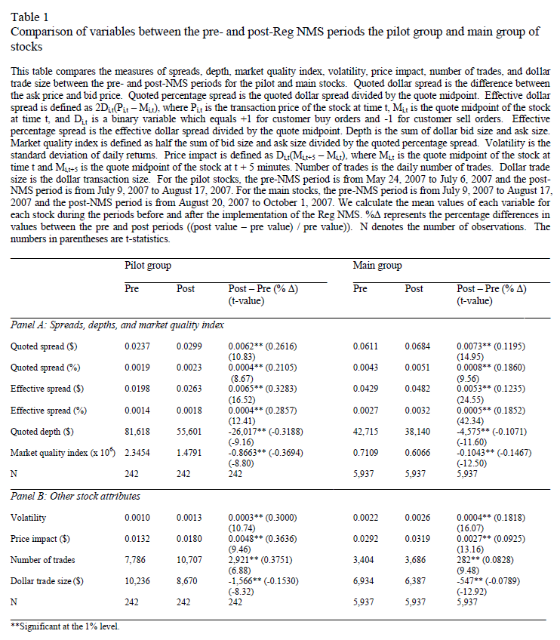

Slide 17
VAR_{i}^{post} – VAR_{i}^{pre} = β₀ + Σβ_{k} (X_{ki}^{post} – X_{ki}^{pre}) + ε_{i};
VAR_{i} = the quoted spread, effective spread, dollar depth, or market quality index of stock i;
X_{k} ( k = 1 through 4) = one of the four stock attributes (i.e., share price, dollar trading volume, return volatility, and return);
βs = the regression coefficients;
ε_{i} = the error term.

Slide 18
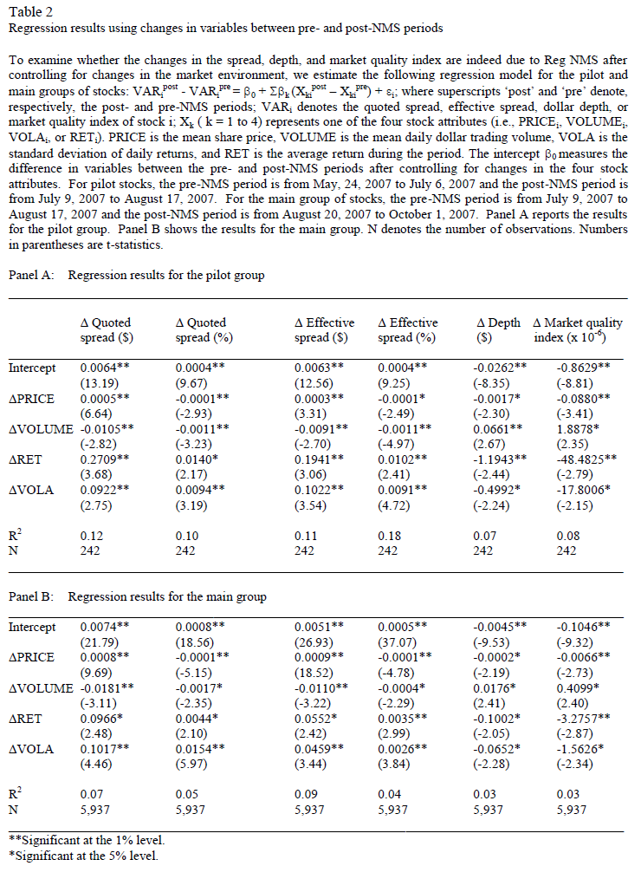

Slide 19
Control for Concurrent Events
U.S credit markets experienced a significant deterioration in the prices of mortgage-related products in 2007. Major credit rating agencies downgraded a number of mortgage tranches in June and July of 2007, which led to a significant increase in risk premiums in the bond market.
NMS became effective in the middle of the so‐called “quant meltdown.”
To the extent that liquidity depends on the financial condition of liquidity suppliers, this event could have first‐order effects on market liquidity.
Other market-wide confounding events include the repeal of the uptick rule on July 6, 2007.

Slide 20
Matching samples
We calculate Composite Match Score (CMS) of each pilot stock against each and every stock with the same two-digit SIC code in the main implementation group:
CMS = Σ[(X_{k}^{pilot} - X_{k}^{main})/{(X_{k}^{pilot} + X_{k}^{main})/2}]²,
X_{k} = one of the four stock attributes and Σ denotes the summation over k = 1 to 4
Then, for each pilot stock, we select the stock in the main group with the lowest score.
This procedure results in 146 matching pairs of pilot and main NYSE/AMEX stocks and 96 pairs of pilot and main NASDAQ stocks.

Slide 21
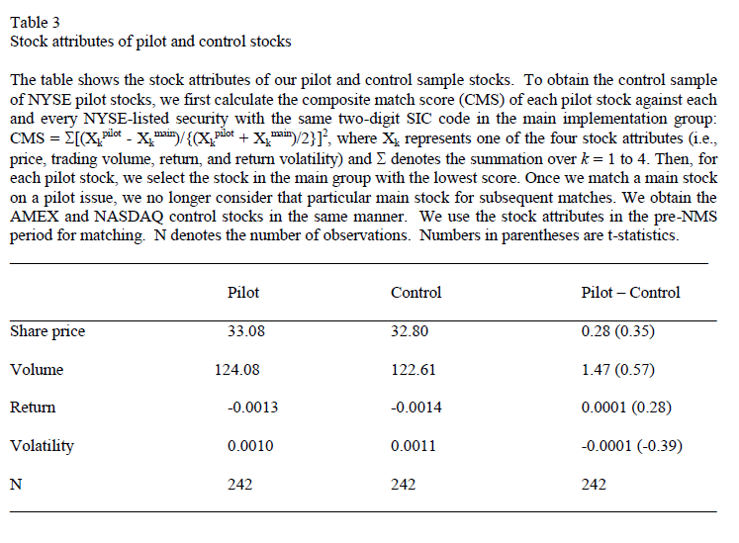

Slide 22
Error Structure
The residuals of a given firm may be correlated across days (time-series dependence) and/or the residuals of a given day may be correlated across different firms (cross-sectional dependence).

Slide 23
Difference in Difference Regression – Pilot sample
VAR_{i,t}^{pilot} – VAR_{i,t}^{control} = β₀ + β₁D_{t}^{NMS}
+ Σβ_{k} (X_{i,t,k}^{pilot} – X_{i,t,k}^{control}) + λ_{i} + θ_{t} + ε_{i,t};
VAR_{i,t} = each market quality measure
D_{t}^{NMS} = an indicator variable for post-NMS days
X_{i,t,k} = stock attributes
λ_{i} = a matched pair fixed effect and
Θ_{t} = dummy variables for each trading day

Slide 24
Difference in Difference Regression – Main sample
VAR_{i,t}^{main} – VAR_{i,t}^{control} = β₀ + β₁D_{t}^{NMS}
+ Σβ_{k} (X_{i,t,k}^{main} – X_{i,t,k}^{control}) + λ_{i} + θ_{t} + ε_{i,t};

Slide 25
Different Estimation
To assess the sensitivity of our results, we also employ the following three methods:
(i) drop θ_{t} from regression model and use standard errors clustered by firm;
(ii) drop λ_{i} from regression model and use standard errors clustered by time; and
(iii) drop both θ_{t} and λ_{i} from regression model and use standard errors clustered by firm and time.

Slide 26
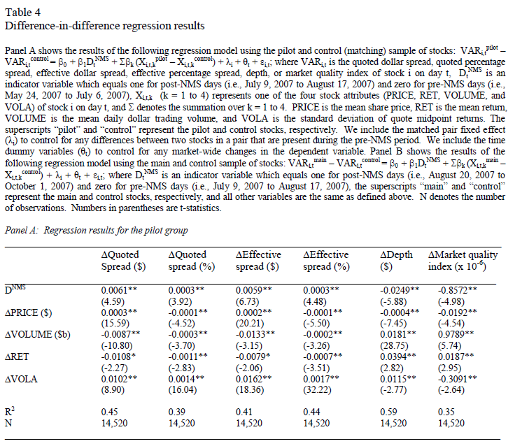

Slide 27
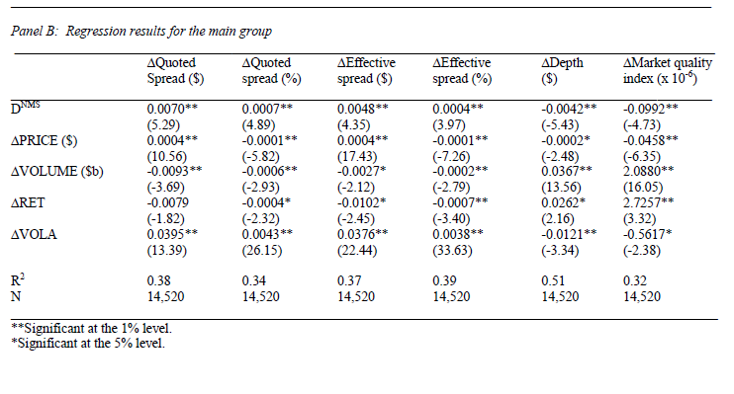

Slide 28
Interpretation/Explanation (1)
Benveniste, Marcus, and Wilhelm (1992) show that a specialist who actively differentiates between informed and uninformed traders through his long-term relationship with brokers can achieve equilibria that Pareto-dominate a pooling equilibrium in which he does not differentiate between the two types of traders.
Hendershott and Moulton (2009) suggest that the decrease in floor trading brought on by the Hybrid market reduces human intermediation and thus increases adverse selection costs.
The lower liquidity after Reg NMS may be attributed, at least in part, to the reduced role of the specialist (and floor brokers) in handling information asymmetry problems as more traders bypass superior specialist quotes on the NYSE for speedier trades on an automated system.

Slide 29
Interpretation/Explanation (2)
Many market observers believe that Reg NMS caused the explosion of high-frequency traders (HFT) who take advantage of other traders’ intention to buy or sell. HFT use computer programs to detect the footprints of larger players and trade off of the order flow for small gains.
OPR prohibits institutional investors from accessing large amounts of liquidity at prices slightly worse than the inside quote.

Slide 30
Interpretation/Explanation (3)
The lower liquidity after Reg NMS may also be explained by the reduced role of NYSE specialists and floor brokers as the liquidity providers of last resort.
During the Flash Crash (on May 6, 2010), several major HFT firms shut down their systems to protect themselves and thus did not provide any liquidity to the market.

Slide 31
Interpretation/Explanation (4)
To the extent trading centers need to recoup the initial investment and other recurring costs, liquidity providers who are affiliated with these trading centers may have to quote larger spreads than they did prior to the implementation of Reg NMS because of the larger order processing component of the spread.

Slide 32
Interpretation/Explanation (5)
Another possible explanation for the increased spread and reduced depth may be the newly imposed upper limit (i.e., $0.003) on access fees by AR.
Access fees are likely to be greater when markets pay larger rebates to liquidity providers. For example, a number of ECN trading centers charge access fees to incoming orders that execute against their displayed quotations and they pass a substantial portion of the access fee on to limit order customers as rebates for supplying the liquidity.
To the extent that AR decreased the access fee and consequently reduced the rebate to liquidity providers, they might have increased spreads and reduced depths to recoup the reduced revenues from the rebate. Hence, the increase in spreads and the decrease in depths may be attributed, at least in part, to the newly imposed cap on access fees.

Slide 33
Market Efficiency/Pricing Error
One of the intended purposes of Reg NMS is to raise the information efficiency of asset price by integrating all equity trades into a common computerized trading system
SEC believes that OPR will promote market efficiency by more effectively integrating trading centers into a common trading system.

Slide 34
Empirical Measure
Hasbrouck (1993) decomposes security transaction prices into a random-walk and stationary components and identifies the random-walk component as the efficient price.
Hasbrouck suggests the dispersion of the pricing error (which measures how closely actual transaction prices track random walk) as a reasonable measure of market quality.
Because the pricing error has zero mean, its volatility measures the magnitude of the pricing error as well.

Slide 35
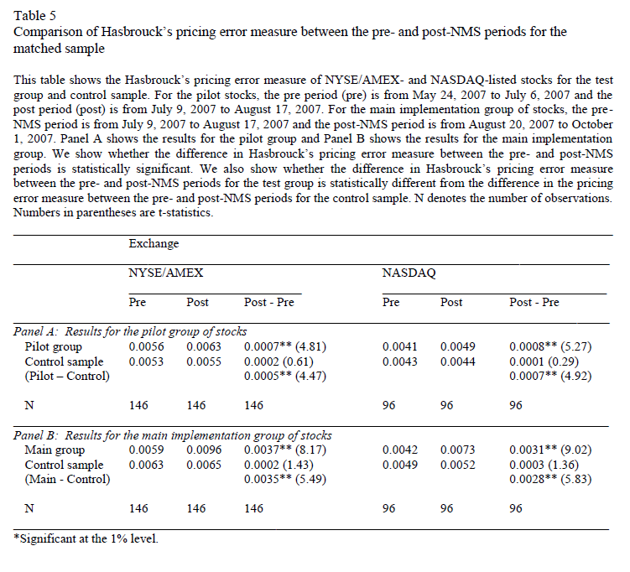

Slide 36
Interpretation/Explanation
The lower pricing efficiency in the post-NMS period may be attributed to the reduced role of specialists and floor brokers as information intermediaries and/or the reduced incentive to collect information due to the increased opportunistic trading by high-frequency traders.
Front running decreases the profits that informed traders make and thus those who can trade profitably will invest less in information collection than they would if front runners did not front run their trades. Front running of informed trades therefore drives informed traders from the market, making prices less informative.

Slide 37
Rule 605 Data
The Securities and Exchange Commission (SEC) adopted Rule 605 on November 15, 2000 to improve public disclosure of execution quality. Under Rule 605, market centers are required to make the monthly disclosure of execution quality for each stock.
We collect the Rule 605 data from the website of Transaction Auditing Group. The pre- and post-NMS periods for the 605 execution quality data are May/June 2007 and September/October 2007, respectively.

Slide 38
Rule 605 Market Quality Measures
the effective dollar spread for executions of covered orders
the price impact for executions of covered orders
the proportion of shares that are executed at the quote, with price improvement, and outside the quote
the share-weighted average duration of time in seconds from the time of order receipts to the time of order execution for shares executed at the quote, with price improvement, and outside the quote
the proportion of shares that are executed at the receiving market center (Fill rate), executed at other venues (Away rate), and cancelled prior to execution (Cancelled)

Slide 39
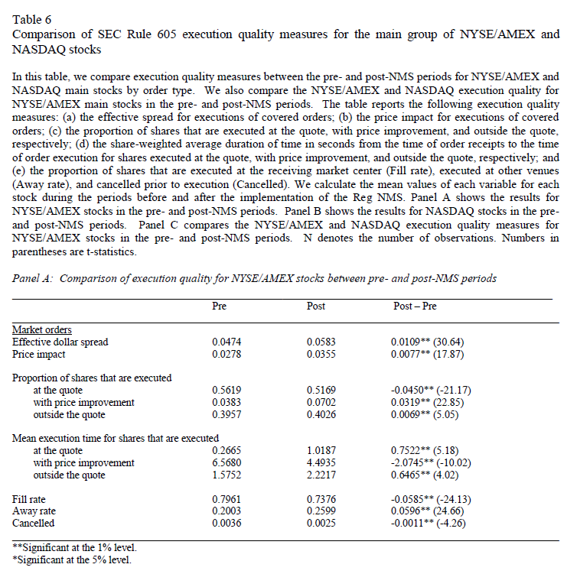

Slide 40
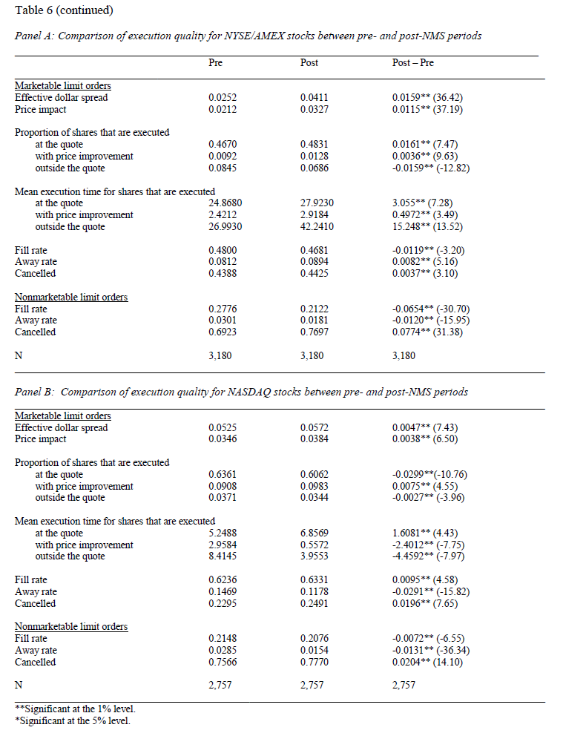

Slide 41
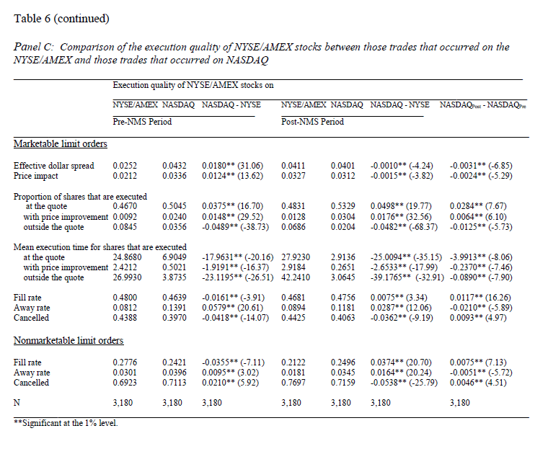

Slide 42
Execution quality of NYSE/AMEX stocks on the NYSE/AMEX and NASDAQ
NASDAQ provided better executions than the NYSE in terms of smaller effective spreads, smaller price impact, higher proportion of trades that received price improvement, lower proportion of trades that are executed outside the quote, faster execution speed, higher fill rates, and lower order cancellation rates in the post-NMS period.
NASDAQ also provided better executions in the post-NMS period than in the pre-NMS period in these market quality metrics, except for higher order cancellation rates.
Based on these considerations, we conjecture that Reg NMS leads to an increase in the market share of NASDAQ and a decrease in the market share of the NYSE/AMEX.

Slide 43
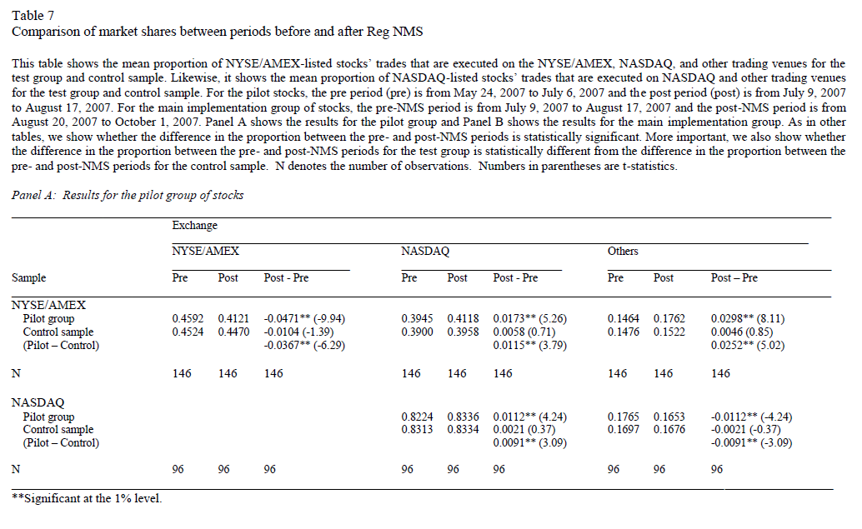

Slide 44
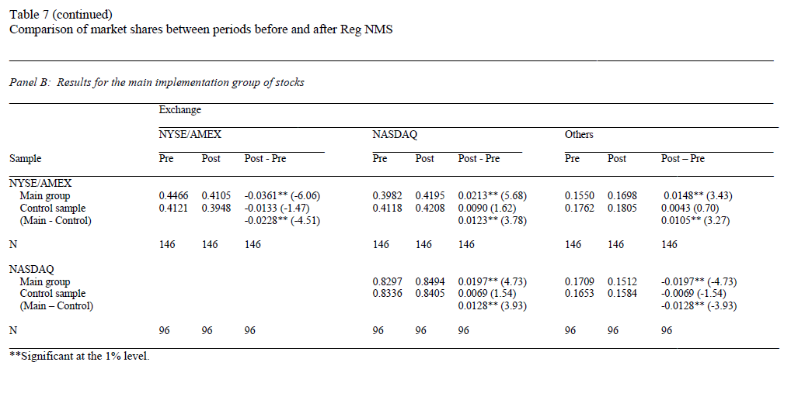

Slide 45
Summary and Conclusion (1)
The effects of Reg NMS on market quality are qualitatively identical between the pilot and main implementation groups of stocks.
Both the quoted and effective spreads increased and the quoted dollar depth decreased significantly after the implementation of Reg NMS.
We also find a higher price impact of trades and greater transitory price movements (i.e., pricing error) in the post Reg NMS period.

Slide 46
Summary and Conclusion (2)
Overall, Reg NMS resulted in greater trading costs, smaller market depths, and lower market efficiency.
We also find evidence of slower execution speed, lower order fill rates, and higher order cancelation rates for the majority trades after the implementation of Reg NMS.

Slide 47
Summary and Conclusion (3)
NASDAQ exhibits better execution quality in terms of both faster execution speeds and higher execution probability than the NYSE/AMEX.
NASDAQ gained additional market shares from the NYSE/AMEX and other trading venues, indicating that the NASDAQ stock market benefited most from Reg NMS.
These results are consistent with our expectation that traders are more likely to send orders to the market (i.e., NASDAQ) that offers a fast and high probability of execution in the post-NMS period than in the pre-NMS period.

Slide 48
Summary and Conclusion (4)
Recently market observers suggest that the SEC should rethink and revise Reg NMS because it led to an increase in high-frequency trading and a deterioration of market liquidity and execution quality. Our empirical results are generally consistent with these observations.

Slide 49
Summary and Conclusion (5)
Our results also support the view of those who opposed Reg NMS that OPR will reduce market liquidity because it reduces the role of NYSE specialists and floor brokers as the liquidity providers of last resort and as information intermediaries.

Slide 50
Conclusion
SEC may need to
revisit and revise Reg NMS!!!

