Slide 1
Prior research
The investor inattention hypothesis predicts that the market response to earnings announcement is muted on days of investor inattention (Hirshleifer et al., 2009; Hirshleifer et al., 2011).
The transaction cost hypothesis posits that trading costs deter informed traders from aggressively arbitraging pricing errors at the time of earnings announcements (Bhushan, 1994; Ke and Ramlingegowda, 2005; Sadka, 2006; Ng et al., 2008; Chordia et al., 2009).
The information risk hypothesis explains that information risk or information uncertainty deters investors from reacting fully to the information in earnings announcements (Mendenhall, 2004; Zhang, 2006; Garfinkel and Sokobin, 2006; Francis et al., 2007, Zhang, Cai, and Keasey, 2013).

Slide 2
What we do
We analyze how strategic informed trading that arises from the information asymmetry between the liquidity demander and the liquidity provider affects both the immediate market reaction to earnings announcements and the post-earnings announcement drift (PEAD).

Slide 3
Motivation
Prior studies do not provide an analytical framework for measuring the extent of market underreaction during the earnings announcement period.
Our study contributes to the literature by developing a theory-based empirical metric of the strategic informed trading-driven underreaction that can be used to predict the size of the post-earnings announcement drift.

Slide 4
Main Analytical Result
The market reaction to earnings announcements (ERC) and post-earnings announcement drift (PEAD) depend on both the information content of earnings and the information asymmetry between traders.
ERC = k(1- ρ²) and PEAD = k ρ²
where k = information content
ρ = correlation coefficient between order
imbalance and earnings surprise

Slide 5
Key Assumptions of the Model
Some market participants have better information processing skills than others, which gives rise to information asymmetry between market participants.
The market participants who possess better information processing skills have an information advantage and exploit the advantage through strategic trading.

Slide 6
We invoke the assumption that some market participants better utilize earnings information than others from the fact that:
(a) a typical earnings announcement contains a large amount of information and data that are subject to different interpretations; and
(b) there are multiple sources of earnings forecasts with different information.

Slide 7
An Example
Apple’s financial results for its 2021fourth quarter available at the following website:
https://www.apple.com/newsroom/2021/10/apple-reports-fourth-quarter-results/
There were more than 30 analysts providing earnings forecasts for Apple in the fourth quarter of 2021.

Slide 8
Prior Research
Kim and Verrecchia (1994)
Kaniel, Liu, Saar, and Titman (2012)
Incorporate stylized facts into our analytical model

Slide 9
Traders in the Model
Liquidity provider posts price quotes based on the noisy earnings information that is shared by both the liquidity provider and the liquidity demander at the time of earnings announcement.
Liquidity demander trades based on the noisy earnings information that is used only by the liquidity demander at the time of earnings announcements.
Utilitarian trader trades for non-informational reasons.

Slide 10
Model
Two types of information about earnings surprise
Timeline

Slide 11
and
One may interpret and as two imperfect understandings (or knowledge) in period 2 on the pricing implication of the announced earnings, and as earnings surprise constructed as if it were precision-weighted knowledge:

Slide 12


Interpretation of
Let
IEA = the information contained in a firm’s earnings
report
IEF = the information contained in earnings forecast
= a composite measure of earnings surprise (i.e.,
actual – predicted) that is implied by all the
information contained in both IEA and IEF
The liquidity demander extracts information and from IEA and IEF and utilizes them in trading, while the liquidity provider extracts only information because of their inferior information processing skills.

Slide 13
IEA | IEF
y | y
z | z

Slide 14
Definition
Information asymmetry
Information content

Slide 15
Model
Liquidity demander submit order to liquidity provider based on his available information
Utilitarian trader also submit order based on his random needs
Two orders are batched together and liquidity provider only observes the order imbalance

Slide 16
Pricing Decision of Liquidity Provider
Liquidity provider conjectures that liquidity demander’s order is a linear function of two information signals in the form of
and set the price as the expectation of conditional on the available information at the time. That is, .

Slide 17
Order Decision of Liquidity Demander
The liquidity demander decides his order based on a conjecture that the price chosen by the liquidity provider is a linear function of the information available to the liquidity provider at the time. That is, we can express the liquidity demander’s conjecture as

Slide 18
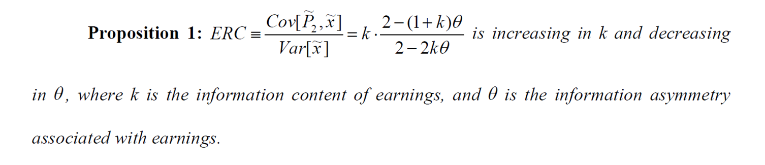
Main Analytical Result 1
.
Observations:
If θ = 0, ERC = k.
If θ > 0, ERC < k.
If θ = 1, ERC = k/2.

Slide 19
Intuition
Price fully and instantly impounds the noisy earnings information used by both the liquidity demander and the liquidity provider.
The superior (but noisy) earnings information used only by the liquidity demander gets into price only partially because (1) the liquidity demander trades strategically and (2) the liquidity provider cannot perfectly infer the superior earnings information from the total order received.
When θ is larger, a larger portion of earnings information gets into price through the liquidity demander’s order, and thus a smaller portion of earnings information gets into price at the time of announcement (i.e., a smaller ERC ) and a larger portion gets into price during the post-earnings announcement period (i.e., a larger PEAD).

Slide 20
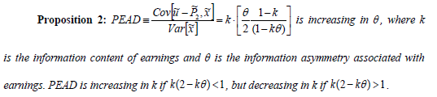
Main Analytical Result 2
Observations:
If θ = 0, PEAD = 0.
If θ > 0, PEAD > 0.
If θ = 1, PEAD = k/2.

Slide 21
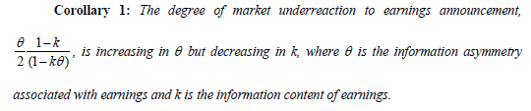
Main Analytical Result 3

Slide 22
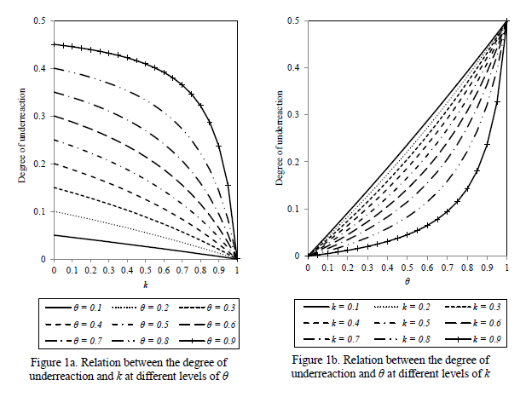
Underreaction as a function of information asymmetry and information content

Slide 23
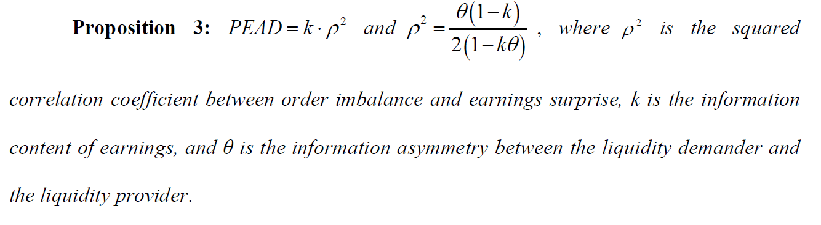
Main Analytical Result 4
Intuition
As information asymmetry (θ) increases, more earnings information gets into price through the liquidity demander’s order and thus ρ² increases. Hence, ρ² measures the degree of underreaction. ρ² is an empirical metric that relates the degree of underreaction to both information asymmetry and information content.

