Slide 1
Competition on the Nasdaq and the Impact of Recent Market Reforms
James P. Weston

Slide 2
New Order-Handling Rules
Permits public limit orders to compete directly with dealer quotes
Quotations on proprietary trading systems made public
  ECNs, like INSTINET, are used mostly by dealers to trade with each other anonymously. Quotes on these networks were allegedly often narrower than public quotes. The new SEC rules force greater public access to these proprietary systems.

Slide 3
Outline
Dealers’ rent component of the spread
Difference between Nasdaq spread and NYSE spread
Greater competition leads to exit of market maker

Slide 4
Component of spread and the effect of new regulation
Order-processing costs
  No effect
Inventory-holding costs
  More difficult to adjust quotes for inventory purposes
Adverse-information costs
  No effect. Since adverse-information costs depend on proportion of informed trading and frequency of information events
Market maker rents
  If new regulation leads to greater competition, then rents will decrease

Slide 5
Sample data
Nasdaq began implementing new rules in a number of phases
  First phase took effect on Jan. 20 and affected 50 stocks
  Second phase took effect on February 10 and affected 50 stocks
Require 90 days before and 90 days after the new regulation, and require that no stock split during the period
88 stocks left in the sample

Slide 6


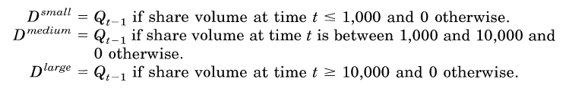

Slide 7
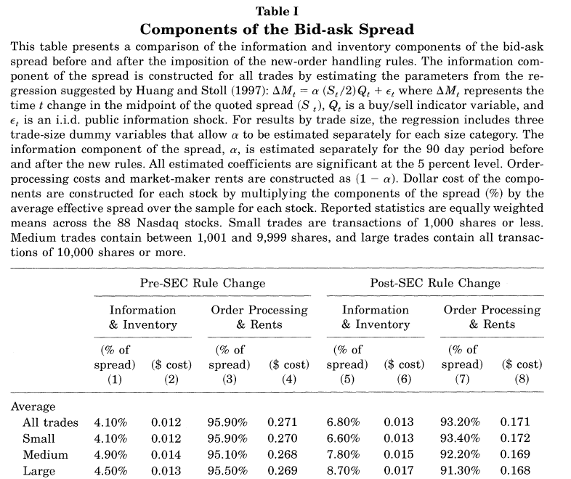

Slide 8



Slide 9
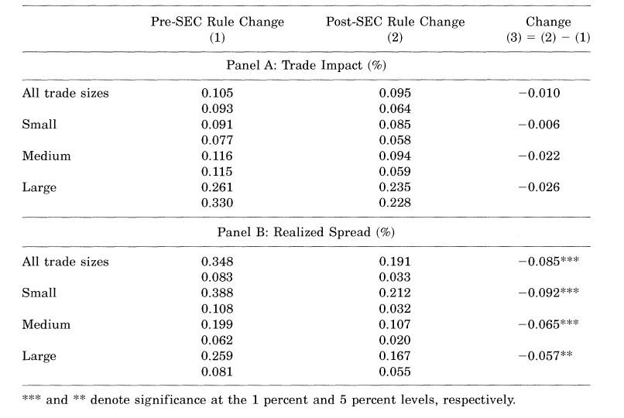

Slide 10
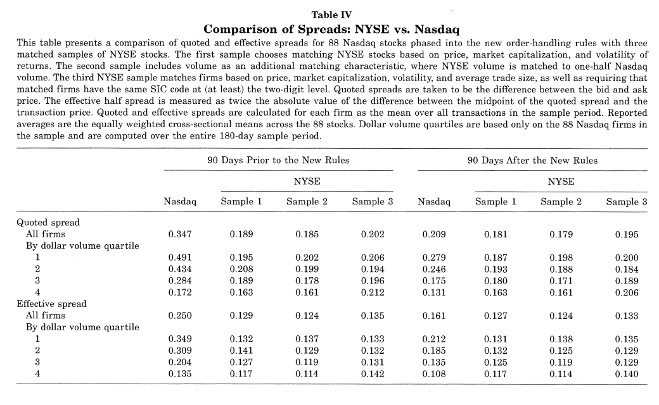

Slide 11
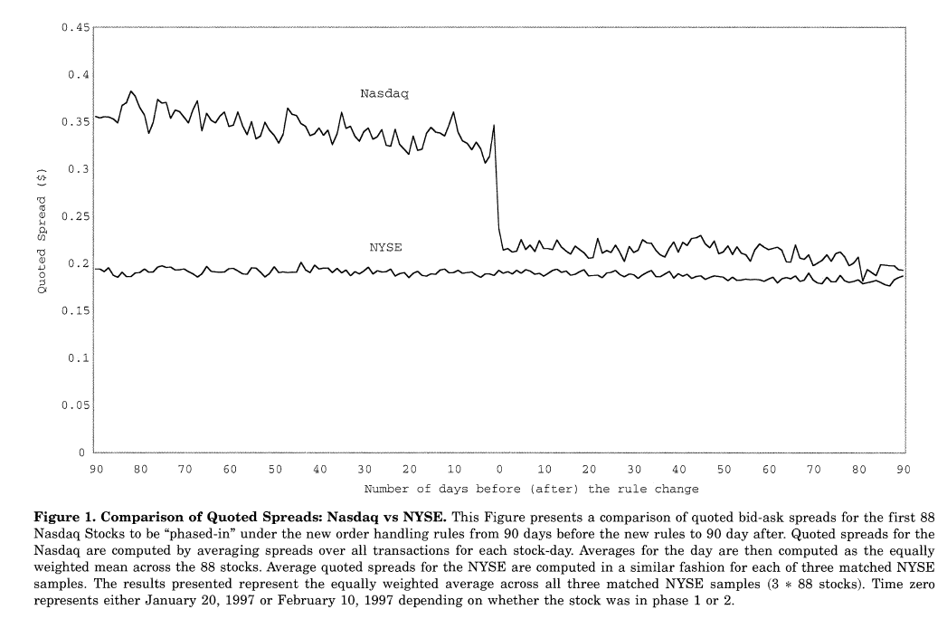

Slide 12
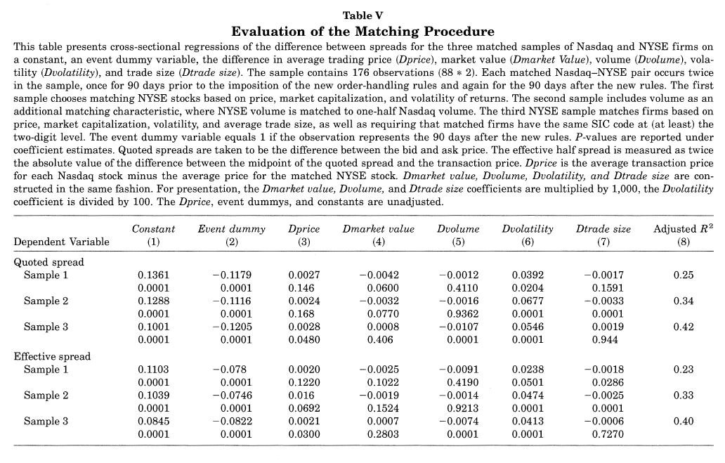

Slide 13
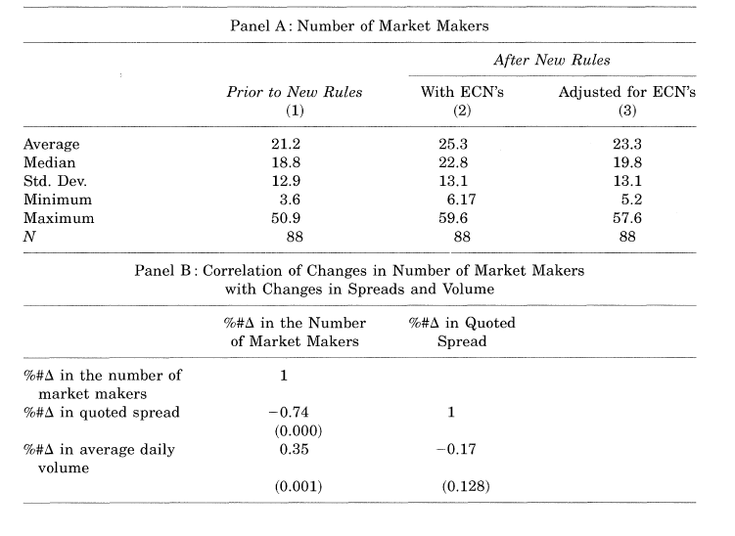

Slide 14
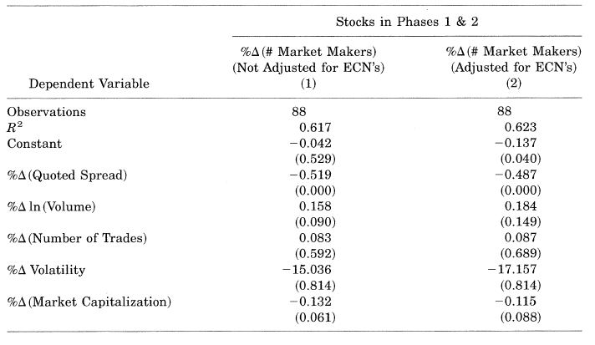

Slide 15
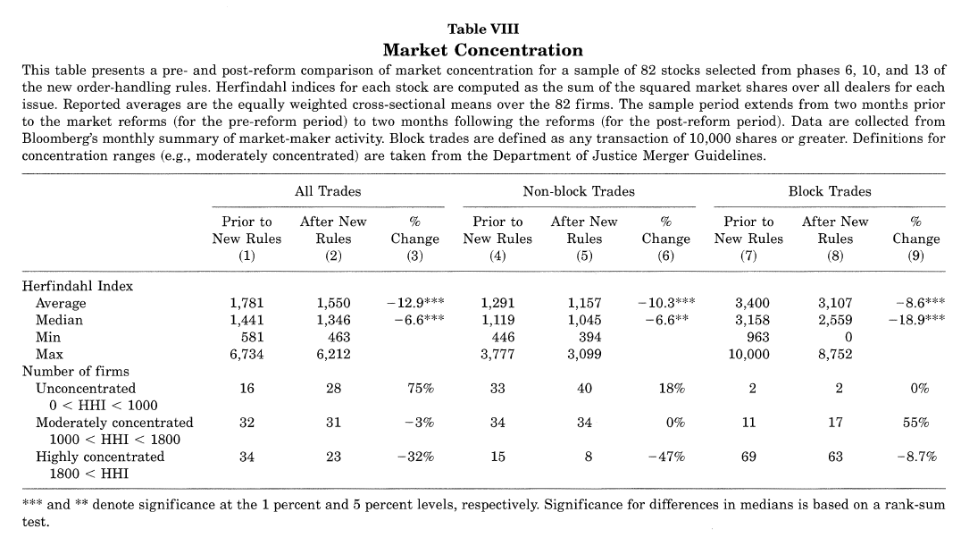

Slide 16
Conclusion
Dealers’ rents (economic profits) decrease after the new order-handling rules
The difference between NYSE and Nasdaq spreads have greatly diminished with the new rules
Reforms have resulted in an exit from the industry of market making
Reforms have improved competition on the Nasdaq

