Slide 1
Entry, Exit, Market Makers, and the Bid-Ask Spread
Sunil Wahal

Slide 2
Background
The main objective is to understand the relation between competition of dealer market and entry (exit) of market makers
Source of competition
Instinet, other exchanges, SOES, institutions
End-of-day quoted spread as a measure of competition
Pro and con
Determinants of entry and exit of market markers for stocks on NNM
trading volume, number of trade, volatility, quoted spread, price, market cap

Slide 3
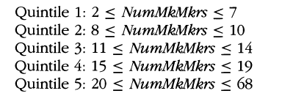
Sample
5569 NNM stocks between 1982 and 1993
Calculate daily trading volume, number of trades volatility, spread for each stocks using data period in which number of market makers remain unchanged
Sample sorted into quintile

Slide 13
Conclusion
Probability of entry and exit is affected by trading intensity, volatility, and quoted spread
Entry (exit) is associated with spread decline (increase) after controlling for trading intensity and volatility
Larger scale of entry (exit) is associated with larger decline (increase)
Spread changes are larger in magnitude for issues with few market makers
The results are consistent with the competitive model of dealer pricing

