Slide 1
The cost of Transacting
Harold Demsetz
The Quarterly Journal of Economics 1968

Slide 2
This paper…
Studies the cost of transacting on the NYSE
Examines the presence of scale economies in transacting
Also investigates the effects of competing markets on the transacting costs

Slide 3
The definition and measurement
Transaction cost is defined narrowly as the cost of using the NYSE to accomplish a quick exchange of stock for money
Brokerage fees and ask-bid spread
The ask-bid spread is the markup that is paid for predictable immediacy of exchange
The price of immediacy
“Waiting costs would seem to dominate the determination of spread” (p41)

Slide 4
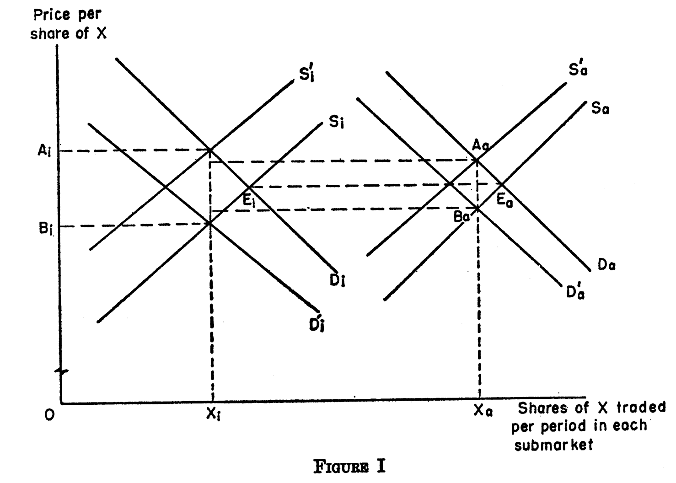
Ask-bid spread and trading volume (Figure 1)
Inactive and active security (i, a)

Slide 5
The determinants of the ask-bid spread(1)
The time rate of transactions
Scale economies in a particular security:
The greater the frequency of transacting, the lower will be the cost of waiting, and therefore the lower will be the spreads
Scale economies with respect to the individual trader’s transaction(?): Individual trader’s marginal cost of transacting will decrease as the rate at which he transacts increases (conflicting evidence)

Slide 6
The determinants of the ask-bid spread(2)
Competition
keep the observed spreads close to underlying costs
Types of competition
1) Rivalry for the specialist’s job, 2) competing markets, 3) outsiders who submit limit orders, 4) floor traders who bypass the specialists, 5) other specialists
Alternative interpretation on the relationship between the spread and the number of competing markets
Securities listed on more exchanges may tend to be more actively traded

Slide 7
Table 1

Slide 8
The determinants of the ask-bid spread(3)
A security’s price
Spread per share will increase in proportion to an increase in the price per share so as to equalize the cost of transacting per dollar exchanged
Otherwise, those who submit limit orders will find it profitable to narrow spreads on those securities for which spread per dollar exchanged is larger
It might not be strictly proportionate because of disproportionate brokerage commission

Slide 9
The determination of the transaction rate
Short-run transaction rate
Short-lived rumor, an accidental convergence of trading in the stock or the overall market activity
Measured as the number of transactions per day based on data for two (nonadjacent days of trading)
Long-run transaction rate
The number of persons presently owning shares will be positively related to the number of market participants
Measured as the number of shareholders

Slide 10
Variables and data
Variables
S=the ask-bid spread measured in dollars per share
T=the number of transactions per day
P=the price of per share
N=the number of shareholders
M=the number of markets on which the security is listed
Data
200 securities listed on the NYSE
Jan. 5 and Feb 28, 1965

Slide 11
Regressions
Regression equations
S=f(T, P, M)
S=g(N, P, M)
T=h(N)
Expected sign
(1) S_{T}<0, (2) S_{TT}>0, (3) S_{P}>0, (4)S_{N}<0, (5)S_{NN}>0
6) S_{PP}<=0, (7) S_{M}<=0

Slide 12
Statistical results
All coefficients take on the expected signs and all except the M coefficient are highly significant

Slide 13
Statistical results
Transaction rate is determined primarily by the number of shareholders

Slide 14
Summary
The cost of exchanging a security declines as trading activity increases
Centralized and organized exchanges would lower the transacting costs
The markups required to market additional shares will be less for larger companies than for smaller companies (→ differences in borrowing rates)

