Slide 1
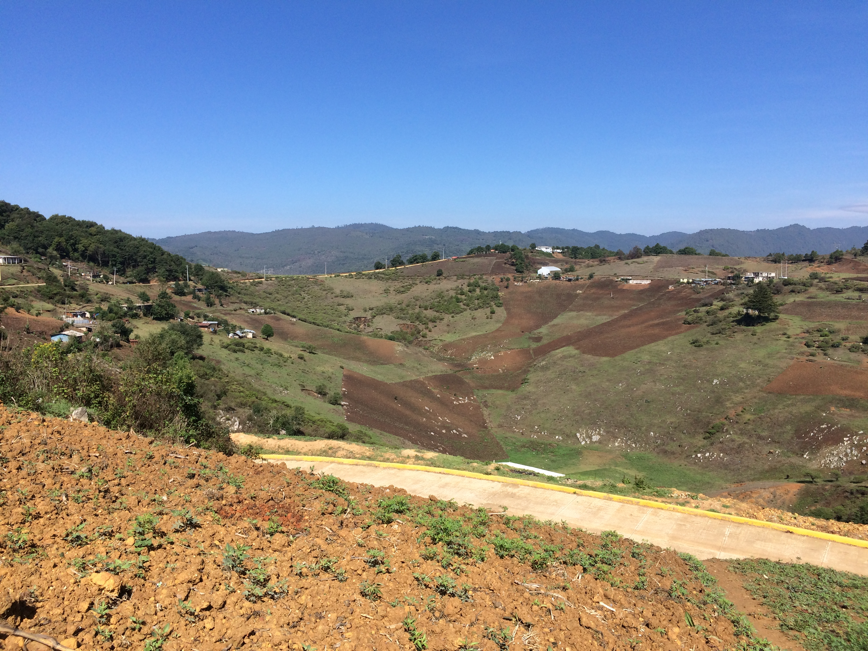
Endoclitic morphophonology in Itunyoso Triqui
Linguistics 460/560
The Structure of Itunyoso Triqui
Christian DiCanio
Spring 2024

Slide 2
1. What’s an endoclitic?
We can distinguish between (a) the pronominal enclitics which simply apply to the end of a word and (b) the pronominal endoclitics that apply to the end of a word and alter the stem’s phonology.
Enclitics Endoclitics
ɾa³ʔa³=sih³ ‘his hand’ ɾa³ʔah⁵ ‘my hand’
ɾa³ʔa³=ũh³ ‘her hand’ ɾa³ʔa⁴=ɾeʔ¹ ‘your hand’
ɾa³ʔa³=tʃuh³ ‘its hand (anim)’ ɾo³ʔoʔ⁴ ‘our (du) hand’
ɾa³ʔa³=a³niʔ²sih³ ‘their (masc) hand’ ɾa³ʔa³=h⁵ɾeʔ¹ ‘your (pl) hand’

Slide 3
What falls into each category?
Enclitics include all third person pronouns in the singular and plural as well as the 1st person exclusive and inclusive.
Endoclitics include the 1st person singular, 2nd person singular, 1st person dual, and the 2nd person plural.
Note that the category of endoclitic is also somewhat pragmatically cohesive – these are all speech act participants, or people who are part of at least a small conversation.

Slide 4
General principles of cliticization
All clitics apply to derived stems in nouns (or verbs, when they are aspect-marked). We can think of this as either a two-stage derivational process or of nominal/verbal stem formation as “stored.”
Root: ko³no³ʔo⁴ ‘medicine’
Stem: si³-ko¹no¹ʔo¹=sih³ ‘his medicine’
poss’d-medicine=3m
si³-ko¹no¹ʔoh¹ ‘my medicine’ (endoclitic)
poss’d-medicine.1s

Slide 5
But how do you know?
When marked for 1st person singular, low register tone stems take a low tone /1/. Stems where the final syllable has a low register tone undergo this.

Slide 6
2. The 1st person singular
The most complex morphophonology in Triqui.
The major segmental alternation here is a morphophonological toggle, which involves deletion or insertion of /h/ at the end of the stem (DiCanio et al 2020). The /h/ toggle is almost exceptionless.
If a stem ends with /h/, delete it. If it does not, insert it (replacing a glottal stop, if need be).
Many tonal alternations occur too (to be discussed).

Slide 7
No final /h/ in stem Final /h/ in stem
so³ʔo³ ‘to be deaf’ ja³ʔah³ ‘chile pepper’
so³ʔoh⁵ ‘I am deaf’ ta³ʔa⁴³ ‘my chile pepper’
ja³ʔa³² ‘cord’ sã³ʔãh² ‘money’
ta⁴ʔah⁴ ‘my cord’ si³-sã¹ʔã¹ ‘my money’
tʃi³ ‘ancestor’ tʃeh³ ‘father’
tʃih⁵ ‘my ancestor’ tʃe⁴³ ‘my father’

Slide 8
You must know how what nominal (possessed) stems look like before you apply the rules for endoclitic marking.

Slide 9
This can produce homophony between stems and cliticized stems
a⁴nĩ⁴³ ‘to stop’ a⁴nĩh⁴ ‘to get dirty’
a⁴nĩh⁴ ‘I am stopping...’ a⁴nĩ⁴³ ‘I am getting dirty’
a³tʃĩh⁵ ‘to ask for’ a³tʃĩʔ³ ‘to bury’
a³tʃĩ⁴³ ‘I am asking for’ a³tʃĩh⁵ ‘I am burying...’
a⁴ko⁴³ ‘to cry’ a⁴koh⁴ ‘to peel wood’
a⁴koh⁴ ‘I am crying’ a⁴ko⁴³ ‘I am peeling wood’

Slide 10
Irregular segmental changes
Certain stems ending with a /ʔ/ undergo a vowel reduplication pattern rather than replacement of the glottal stop with /h/; we add /Vh/ instead.

Slide 11
Tonal changes with the 1st person singular
The tonal changes on stems marked for the 1st person singular vary depending on whether or not the /h/ is deleted or inserted.
Several patterns are very regular, but others have some irregularity (there are weird exceptions).
We will use an inflectional database of 970 Triqui roots/stems and their endoclitic forms to show the most common patterns.

Slide 12
Summary of patterns
When the stem has a lower register tone (2, 1, 31), the 1s form has a low tone /1/ (regardless of /h/ deletion or insertion).
When a stem has an upper register tone (3, 4, 5, 32), the output tone is higher.

Slide 13
Low register tone changes with the 1s endoclitic.

Slide 14
Interaction with the potential aspect
If the potential-marked verb has complete tonal overwrite (see last week), the 1st person form will always have tone /1/.

Slide 15
For upper register tones:
If /h/ is inserted, /5h/.
If /h/ is deleted, /43/.

Slide 16
Special case: 43 > 4h
The 1st person singular form for a word with a high falling tone is not /5h/, but /4h/.
This is very regular, as loanwords usually take this tone as well.
ɾu³kʷi⁴ʔi⁴³ ‘peach’
si³-ɾu³kʷi⁴ʔih⁴ ‘my peach’
tʃu⁴mã⁴³ ‘to arrive’
tʃu⁴mãh⁴ ‘I am arriving’
me⁴sa⁴³ ‘table’
si³-me⁴sah⁴ ‘my table’
tʃi⁴lu⁴³ ‘knife < cuchillo’
si³-tʃi⁴luh⁴ ‘my knife’

Slide 17
It’s mostly regular, but complicated
When we combine the stem formation processes with their own tonal processes alongside the 1st person singular, we get quite a bit of complexity.
Root Stem formation 1s form
ka³siʔ³ si³-ka²siʔ³ si³-ka²sih⁵
‘honey’ ‘honey of’ ‘my honey’
Process: si³-⁽²⁾ 3ʔ > 5h (both regular)

Slide 18
3. The 1st person dual/plural
The first person dual can be used as a generic 1st person plural as well. It is distinct from the 1st person plural exclusive /=ũh⁴/ and the 1st person plural inclusive /=neʔ⁴/.

Slide 19
Morphophonology
In every context, the 1st person dual/generic involves the insertion of a coda /ʔ/ to the stem, replacing whatever final glottal consonant is present.
It also is accompanied by tonal changes that are... sensitive to the tonal register of the stem.
nĩ³ʔĩ³ ‘to know’ nĩ³ʔĩʔ⁴ ‘we (du) know’
ri³² ‘to take out’ riʔ³ ‘we are taking (it) out’

Slide 20
Examples
If the stem already has a coda /ʔ/, the glottal stop applies vacuously, but the associated tonal changes still apply.

Slide 21
The back vowel alternation
If the stem has /a/, applying the 1du changes it to /o/. Similarly, if it has /ã/, it changes it to /ũ/. This co-occurs with the /ʔ/.

Slide 22
Summary of tonal patterns
When the stem has a lower register level tone (2, 1), no tone changes occur.
Tones /32, 43, 4/ undergo truncation or no tone change.
Most upper register tones /3, 5, 31, 13/ raise to /4ʔ/.

Slide 23
No tonal change with low register tones

Slide 24
No tonal change with upper register level tones

Slide 25
Truncation of falling tones
Recall that we never observe contour tones before a coda /ʔ/. Insertion of the glottal stop truncates falling tones so that they are level.

Slide 26
Tonal raising of many stems to /4ʔ/

Slide 27
What’s going on with tone /3/? /31/?
Some words with stem tones /3/ and /31/ have some irregularity. We have a story coming up...
ni³tʃi¹ ‘to be near’ a³ˀmĩh³ ‘to speak’
ni⁴tʃiʔ⁴ ‘we are near’ a³ˀmĩʔ³ ‘we are speaking’
na³ne¹ ‘air, voice’ ni³jah³ ‘to be wet’
si³-na¹neʔ¹ ‘our voice(s)’ ni³joʔ⁴ ‘we are wet’

Slide 28
But first... more accidental homophony

Slide 29
4. The 2nd person singular
The 2nd person singular has an associated clitic /=ɾeʔ¹/, but it is categorized as an endoclitic because it conditions tonal changes on the stem it attaches to.
In spontaneous speech, this clitic may simply be produced as /=ɾ̥/, where the rime portion is missing. This is more common in the context where it induces tone raising (DiCanio 2022).

Slide 30
Summary of tonal changes (and your HW)
When the stem has a falling tone or /4h/, the 2s conditions low tone spreading one syllable to the left.
When the stem has tone /3/, it conditions a tone /4/ one syllable to the left.
Otherwise, no changes occur.

Slide 31
Low tone spreading
There is no tone change with words with a /3.4/ melody, but low tone spreading when the word has a tone /4.4h/ melody. Maybe the latter is secretly /4.3/?
This pattern is only found in Itunyoso Triqui.

Slide 32
Tone raising /3 > 4/
This pattern is found in all Triqui varieties.

Slide 33
No tone changes – is it now an enclitic?
Where the 2s clitic does not condition any stem tonal changes, is it suddenly an enclitic?
What would Haspelmath (2023) say?

Slide 34
5. The 2nd person plural
For non-1st person pronouns, plural number is marked several ways:
plural nĩʔ² + clitic tʃa⁴³=nĩʔ²=sih³ ‘they (masc) ate’
(a³nĩ²ʔĩ³ ~ nĩ²ʔĩ³ ~ nĩʔ²)
generic/ neh³ + (clitic) tʃa⁴³=neh³=sih³ ‘they (masc) ate’
plural tʃa⁴³=neh³ ‘they (generic) ate’

Slide 35
Morphophonology
The 2nd person clitic /=ɾeʔ¹/ conditions a tone raising process on tone /3/ stems, e.g. ɾa³ʔa³ ‘hand’ > ɾa³ʔa⁴=ɾeʔ¹ ‘your hand’
The 2nd person plural does something similar when it attaches to an overt plural, but it carries tone /5/ and the accompanying /h/.
k-a⁴tʃĩ⁴³=nĩ²ʔĩ⁽³⁾=h⁵ɾeʔ¹ [ka⁴tʃĩ⁴³=nĩ²ʔĩh⁵ɾ̥eʔ¹]
perf-pass=pl=2p
‘you all passed by’

Slide 36
Application with and without the plural
The previous example has both a plural enclitic and then the 2nd person plural endoclitic, but the inclusion of the plural is optional except for in one context.
k-a⁴tʃĩ⁽⁴³⁾h⁵ɾeʔ¹ The tones on the stem-final
perf-pass.2p syllable are replaced with /5h/
[ka⁴tʃĩh⁽⁴⁾⁵ɾ̥eʔ¹] (or half-replaced?).
‘you all passed by’ The form is /=h⁵ɾeʔ¹/.

Slide 37
Examples with different stem types

Slide 38
Is the entire final tone replaced?
I don’t know! It’s really hard to tell. There is sometimes a noticeably lengthening of the final vowel, suggesting to me that it is trimoraic or something.
On single syllable words like tʃa⁴³ ‘perf.eat / ate’, I hear the 2p form as distinct.
tʃa⁴=(a)⁵hɾeʔ¹ ≠ ttʃah⁵=ɾeʔ¹
‘you all ate’ ‘your (sg) tortilla’

Slide 39
Anti-homophony effects
What happens if you apply the 2nd person plural to a stem that already has a tone /5/ at the end? You can’t! The plural clitic is required here.
The 2p would be synonymous with the 2s. This is avoided.

Slide 40
6. SAP stems
Where apparent exceptions occur in the endoclitic morphophonology in Itunyoso Triqui, these are mostly principled.
A set of about 100 roots seem to act altogether differently. These roots take an alternate stem shape only with the 1s, 1du, 2s endoclitics.
We call these stems are called “speech act participant stems,” or SAP stems. In all cases, they take tone /4/ or /43/ as the stem shape only with the SAP clitics.

Slide 41
SAP stems

Slide 42
How do you determine the tones here?

Slide 43
Examples

Slide 44
7. Clitics, revisited
Recall our conversation last week about whether pronouns in Triqui were properly clitics or suffixes.
How does the current data fit in with this perspective? with the theoretical discussion?
Complex segmental/tonal alternations with the 1s, 1du pronouns
The 2s and 2p pronouns condition tonal changes on stems for some stems, but not all. Is the former type of allomorph an endoclitic while the latter is an enclitic? What does it mean for a pronoun to be both an enclitic and an endoclitic?
SAP roots!
If one can model the phonological alternations in stems via concatenative rules in autosegmental-metrical theory, is this concatenation?
Are clitics definitionally concatenative?

