Slide 1
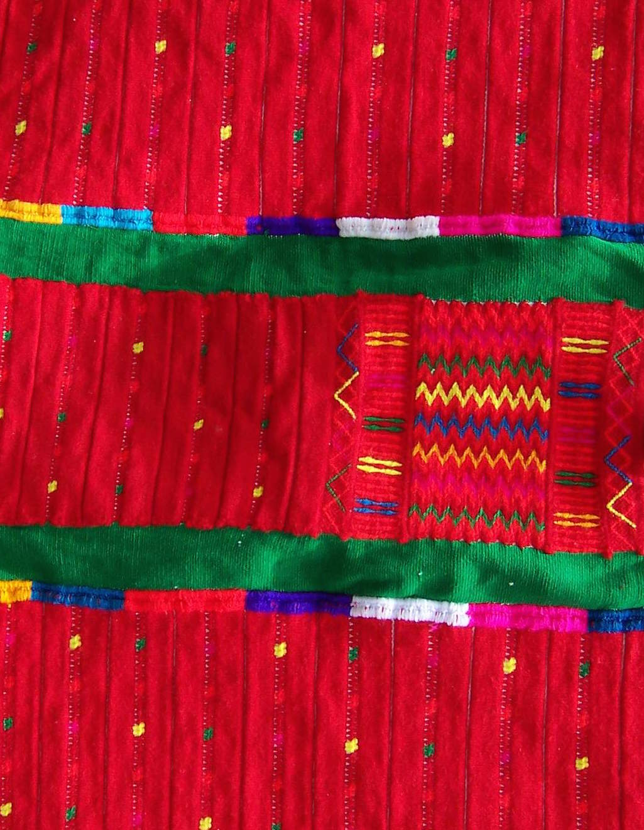
Week 3
Prosody and tone
Linguistics 460/560
The Structure of Itunyoso Triqui
Spring 2024
Christian DiCanio

Slide 2
A. Syllable structure and prosodic structure
All non-final syllables in Triqui are open. Codas occur in root-final (stressed) syllables, the only two being /h, ʔ/.
When final syllables are open, the vowel is long. In addition to other factors, this suggests that final syllables are bimoraic.

Slide 3
Minimal words

Slide 4
Onset clusters
Some onset clusters are permitted, but most of them are oddly disharmonic - /st̪, sk, skʷ, sm, sn, ɾt̪, ɾk, ɾkʷ, ɾm/. The exception is /kj/. Clusters seem more common in word-initial position.
sta³ɾe⁴ | ‘spider’ | si⁴sno⁴³ | ‘man’
ske³ʔeh³ | ‘jaguar’ | ɾku³tʃih³ | ‘purple’
a¹skʷa¹ʔa³ | ‘a little while ago’ | kkʷeh³² ɾta³ʔyə̃¹ | ‘hierbamora’ Solanum nigrescens
sma³t̪e³ʔe³ | ‘rat’ | ɾkʷe³tʃaʔ¹ | ‘tejamanil’
ni³kjə̃h⁵ | ‘Tlaxiaco’ | jjah³² ɾma³u³ | Begonia gracilis

Slide 5
How big can words get?
Most roots (~65%) are disyllabic in the language. About 8-10% are trisyllabic.
Up to two prefixes (each a CV syllable) may occur on verbs – an aspect marker preceding the verb root; and an iterative or causative prefix before this.
Only one prefix may precede nouns – that marking possessed status.
With enclitics, words can be up to 6 syllables, but this is rare in actual speech.

Slide 6
(1) ku³-tu³-tʃu³ˀβiʔ³=sih³=ũh³
perf-caus-be.afraid=3m=3f
‘He scared her.’
(2) na³-ɾu³nũ⁴=ũh³ βeʔ³
iter-paint=3f house
‘She repainted the house.’
(3) (ki²)-na²-ɾu³nũ⁴=ũh³ βeʔ³
(pot)-iter-paint=3f house
‘She will repaint the house.’

Slide 7
B. Foot structure?
We are initially positing that final syllables are bimoraic, but the evidence for this comes from the tonal system, which we haven’t gotten to describe much yet. We’ll return to this.
Possible analyses: 1σ 2σ 3σ 4σ
  No feet σ_{μμ} , σ_{μ}σ_{μμ} , σ_{μ}σ_{μ}σ_{μμ} , σ_{μ}σ_{μ}σ_{μ}σ_{μμ}
  Iterative Iambic feet (σ_{μμ}), (σ_{μ}σ_{μμ}), (σ_{μ})(σ_{μ}σ_{μμ}), (σ_{μ}σ_{μ})(σ_{μ}σ_{μμ})
  Non-iterative iambic feet (σ_{μμ}), (σ_{μ}σ_{μμ}), σ_{μ}(σ_{μ}σ_{μμ}), σ_{μ}σ_{μ}(σ_{μ}σ_{μμ})

Slide 8
2. Lexical tone
There are nine lexical tones in Itunyoso Triqui:
  Five level tones: /1, 2, 3, 4, 5/
  Three falling tones: /43, 32, 31/
  One rising tone: /13/
The distribution of tones is asymmetrical within the word. All tones occur on monosyllabic words, but when some of the tones occur on polysyllabic words, they are spread across the word.

Slide 9
Contrasts by final syllable type
DiCanio et al 2020

Slide 10

Tone in monosyllables and disyllables
ββeh⁽³⁾⁵ ‘straw mat / petate’ tʃi³ˀjoh⁵ ‘swamp / ciénaga’
ββe⁴ ‘hair / pelo’ ka³to⁴ ‘shirt / camisa’
nne³ ‘plough / arado’ na³ɾa³ ‘refill / rellenar’
nne² ‘to lie / mentir’ a²mə̃² ‘when / cuando’
nne¹ ‘naked / desnudo’ na¹ka¹ ‘new / nuevo’
nne³² ‘water / agua’ a³βi³² ‘leave / salir’
nne³¹ ‘meat / carne’ a³nĩ¹ ‘explode / estallar’
tʃe⁴³ ‘my father / mi padre’ a⁴ne⁴³ ‘chew / masticar’
ᵑɡa¹³ ‘when (subord) / cuando’ kə̃¹ʔə̃³ ‘four (N) / cuatro'

Slide 11
Tonal association (DiCanio et al, 2020)
Moraic tonal specification: A mora may be associated with only a single tone.
No floating tones: Every tone must be associated with a mora.
These principles mean that contours must only be possible on final syllables, as they are bimoraic.

Slide 12
Contours in polysyllabic roots
Contour tones /13/ and /31/ do not surface on the final syllable of a polysyllabic word; *1.13, *3.31
Instead, these tones are spread across the word.
The other contour tones, /32, 43/, surface on the final syllable but the penult tone is a copy of the leftmost tone level, e.g. 4.43, 3.32.

Slide 13
Leftward tonal association (a tonal rule)
While there are words where penult tones are contrastive (especially with verbal aspect), in most words the penultimate syllable tone is predictable based on the final tone.
Tones associate to penultimate syllables, but there default/underlying position is on the final syllable.
This is true for all Triqui languages (DiCanio 2008, DiCanio et al 2020, Hernández Mendoza 2017, Hollenbach 1984).

Slide 14
Leftward association convention:
Assign a tone or tone contour, right to left, starting on the rightmost mora (tone-bearing unit) of the word and then associate the leftmost tone in the word to all preceding moras within the word.
(DiCanio et al 2020)

Slide 15
Why is tone /13/ different?
Rising tones take longer to produce than falling tones (Zhang 2004).
Restrictions on the distribution of rising tones are more common than those on falling tones.
One possibility is that the rise is “broken up” across syllables so that it is easier to perceive for listeners.

Slide 16
How is tone /31/ different?
While we observe the leftward tonal association rule for all the tones, tone /31/ is different.
Instead of /3.31/ or /3.3.31/ on polysyllabic roots, we observe /3.1/ and /3.1.1/. This is unlike all other contour tones.
nĩ³¹ ‘night’ ki³nĩ¹ ‘good night’ a³tʃi¹ʔi¹ ‘to begin’
(anocheció)

Slide 17
Low tone /1/ spreading (another tone rule)
Low tone spreading: A low /1/ tone associated to the rightmost mora must spread leftward iteratively to the leftmost edge of the phonological (prosodic) word (DiCanio et al. 2020).

Slide 18
What tones can occur in penultimate syllables?
Sometimes penultimate tones are not predictable. What patterns co-occur? Tone /3/ can occur, as can tone /2/, but many patterns are unattested.
final penult | 5 | 4 | 3 | 2 | 1 | 43 | 32 | 31 | 13
4 |  | yes |  |  |  | yes
3 | yes | yes | yes | yes | yes | yes | yes
2 |  |  | yes | yes |  |  | yes | yes
1 |  |  | yes |  | yes

Slide 19
Tonal register and tonal distribution
We never observe lower tones /2, 1, 32, 13/ co-occurring with higher tones /4, 5, 43/ on roots in Itunyoso Triqui.
There is a general prohihition of upper register tones on the same root as lower register tones, e.g. *2.5, *4.1, *1.43...

Slide 20
Tone /3/ as a default tone
About 30% of all roots in Itunyoso Triqui have tone /3/ on their final syllable.
When the tone on the penult is not predictable via leftward tonal association, we usually observe tone /3/.
a⁴tʃĩ⁴³ ‘to pass’ a³tʃĩ⁴³ ‘I am asking’
(< a³tʃĩh⁵ ‘to ask’)

Slide 21
Tone in /Vh/ final syllables
Some of the tones sound different when the final syllable is /Vh/. Note that we do not observe contours at all on the final syllable of polysyllabic words, e.g. *CV³CVh³², *CV⁴CVh⁴³.
There is a contrast between tone /4/ and /43/; and between /3/ and /32/ on monosyllables with a coda /h/.
nnə̃h⁴³ ‘mom!’ ββe³² ‘maguey cactus’
nnah⁴ ‘to stay’ ββeh³² ‘cave’
βeh³ ‘already’

Slide 22
Some tones with coda /h/.
a³tʃĩh⁵ ‘to ask for’
a⁴tʃĩh⁴ ‘to sneeze’ a⁴tʃĩ⁴³ ‘to pass by’
a³ˀβih³ ‘to prick’ a³tʃĩ³ ‘to lack’
a³tʃih² ‘to grow’ a³βi³² ‘to leave’
tʃi²tʃeh² ‘right(s)’
tʃi¹tĩh¹ ‘generally’
The hardest contrast (for me) is between 3.3h and 3.2h.

Slide 23
Tones on words with final glottal stops
Only tone levels /1, 2, 3/ contrast in roots with a coda /ʔ/ in Itunyoso Triqui, though morphology introduces additional contrasts.
tsiʔ¹ ‘sweet’
ttʃiʔ² ‘ten’
sĩʔ³ ‘child’
but nnĩ³ ‘mother’ > nnĩʔ⁴ ‘our mother’

Slide 24
3. Prosodic structure and tone
Recapping the evidence for final stress (in roots)
Nasal vowels only occur in final syllables.
Glottal consonants only occur in final syllables.
Prenasalized stops only occur in final syllables.
Full tonal contrasts (all 9 tones) only occur in final syllables.
Final syllables license contrasts in pre-final syllables.

Slide 25
What about higher levels of prosodic structure?
High tones (/4/) are restricted to the iambic foot.
Spanish loanword adaptation prefers disyllabic structure.
Variable deletion of extrametrical vowels
Vowel shortening in extrametrical vowels

Slide 26
(a) The distribution of high tones
Tones on most pre-tonic syllables mostly result from leftward association from the final stressed syllable.
This predicts high tone /4/ will spread leftward across the word, but it does not. Instead, we get tone /3/ as a default here.

Slide 27
What is the domain that tone /4/ is permitted to spread? It appears to be just one syllable to the left.
Tone /4/ is restricted to the final two syllables of the root – to a unit like an iambic foot.

Slide 28
(b) Spanish loanwords
Words from Spanish with penultimate stress are almost always borrowed with tone /43/ on the final syllable and tone /4/ on the penult.
Spanish Triqui
pera [ˈpeɾa] pe⁴ɾa⁴³ ‘pear’
queso [ˈkeso] ke⁴su⁴³ ‘cheese’

Slide 29
Words from Spanish with final stress are borrowed with tone /43/ on the final syllable but tone /3/ on the penult.
Spanish Triqui
cartón [kaɾˈton] ka³ɾtũ⁴³ ‘cardboard’
camión [kaˈmjon] ka³mjũ⁴³ ‘truck’
But there is a strong preference for loanwords to be disyllabic.

Slide 30
What about words with more than 2 syllables?
Longer words are shortened to a two syllable-sized unit.

Slide 31
What about words with one syllable?
Shorter words are lengthened to two syllables.

Slide 32
(c) Variable deletion and reduction of extrametrical
(pre-penultimate) vowels
In many Triqui varieties, there is a pattern whereby pre-tonic vowels are lost.

Slide 33
Extrametrical vowels (in antepenults) are variably deleted and reduced more than penults are.
The vowel in /tu³-/ is almost gone here.

Slide 34
The same prefix is not reduced in
/tu³-tʃa⁴³=neh³/
caus-eat=3p
‘They made (her) eat...’
This is now a disyllabic stem.

Slide 35
Phonetic shortening of antepenults
Different

Slide 36
All these pieces of evidence converge
The evidence here converges on a two syllable unit being important in Triqui prosody
  An iambic foot is the domain of high tone /4/
  Spanish loanwords are preferably borrowed as single iambic feet.
  Antepenults are reduced or deleted more than penults are.
In addition to suggesting that Triqui words are mostly iambic feet, it seems like antepenults are extrametrical.

Slide 37
4. The prosodic word
Is there evidence of any higher prosodic level in Itunyoso Triqui?
To explore this, we have to examine the morphology of words.
In the process, we’ll introduce some basic patterns in the language’s morphology. Though, we delve into this in greater depth next week.

Slide 38
Evidence for the prosodic word
Prefixation can generate words with up to four syllables in Itunyoso Triqui. How are such syllables parsed on the left edge of the foot?
The prosodic word is the domain of three types of tonal processes related to Triqui morphology.
  The prosodic word is the domain of possessed stems and two stem-level tonal changes associated with stem formation.
  The prosodic word is the domain of aspect-marked verbs and tonal changes associated with aspectual prefixes.

Slide 39
Nominal possession
Alienably-possessed nouns require a possessed prefix /si³-/.
This prefix is required regardless of whether the possessor is an endoclitic (4), an enclitic (5), or a separate noun phrase (6).

Slide 40
Prefix-conditioned tone changes
This prefix conditions tone changes on roots with tone /3/ or /32/.
Tone /3/ > 2.3
Tone /32/ > 2

Slide 41
Representation of possessed stems as prosodic words with stem tonal alternations. The underlying roots do not show the output of the leftward tonal association rule. Thus, non-final syllables in roots are tonally-unspecified.

Slide 42
Prefixed stems as the domain of low tone spreading
Low tone spreading applies across not just morphemes, but prefixed nouns where tone /3/ is absorbed (DiCanio, 2008; DiCanio et al., 2020).
‘illness’
‘illness of...’

Slide 43
What is the domain here?
It could be the nominal stem, but that’s a morphological domain and not strictly-speaking a phonological one.
It could also be a phonological domain like the prosodic word.

Slide 44
Verbal aspect marking as a prosodic domain
Vowel-initial verbs take a /k-/ prefix for aspect marking and consonant-initial verbs take a /kV-/ prefix. Note the potential aspect tone.

Slide 45
Overwrite with the potential aspect tone
Certain verbs undergo complete tonal overwrite with potential aspect tone /2/.

Slide 46
Prosodic representation of /na⁴tuh⁴/ ‘to fall’ with potential aspect prefixation. Note that there is no underlying tone on the penult of the verb stem here, as the penult receives its tonal assignment via leftward tonal association when no potential prefix is present.

Slide 47
Parallelism across prefixed words
Note the parallelism here between (a) nominal prefixation and tonal changes on stems and (b) verbal prefixation and tonal changes on stems.
Both involves processes which overwrite roots with a low tone.
The domain here could be disyllabic, trisyllabic, or quadrisyllabic.
This appears to be a prosodic domain like the prosodic word.

Slide 48
In a trisyllabic root like /tʃu³tʃu⁴βa⁴³/ ‘peanut’, there would be two extrametrical syllables.

Slide 49
Summary of evidence for prosodic structure

Slide 50
Returning to our hypotheses
Possible analyses: 1σ 2σ 3σ 4σ
  No feet σ_{μμ} , σ_{μ}σ_{μμ} , σ_{μ}σ_{μ}σ_{μμ} , σ_{μ}σ_{μ}σ_{μ}σ_{μμ}
  Iterative Iambic feet (σ_{μμ}), (σ_{μ}σ_{μμ}), (σ_{μ})(σ_{μ}σ_{μμ}), (σ_{μ}σ_{μ})(σ_{μ}σ_{μμ})
  Non-iterative iambic feet (σ_{μμ}), (σ_{μ}σ_{μμ}), σ_{μ}(σ_{μ}σ_{μμ}), σ_{μ}σ_{μ}(σ_{μ}σ_{μμ})
Itunyoso Triqui has final iambic feet, but stem formation processes occur on prosodic words which may be longer.

