Slide 1
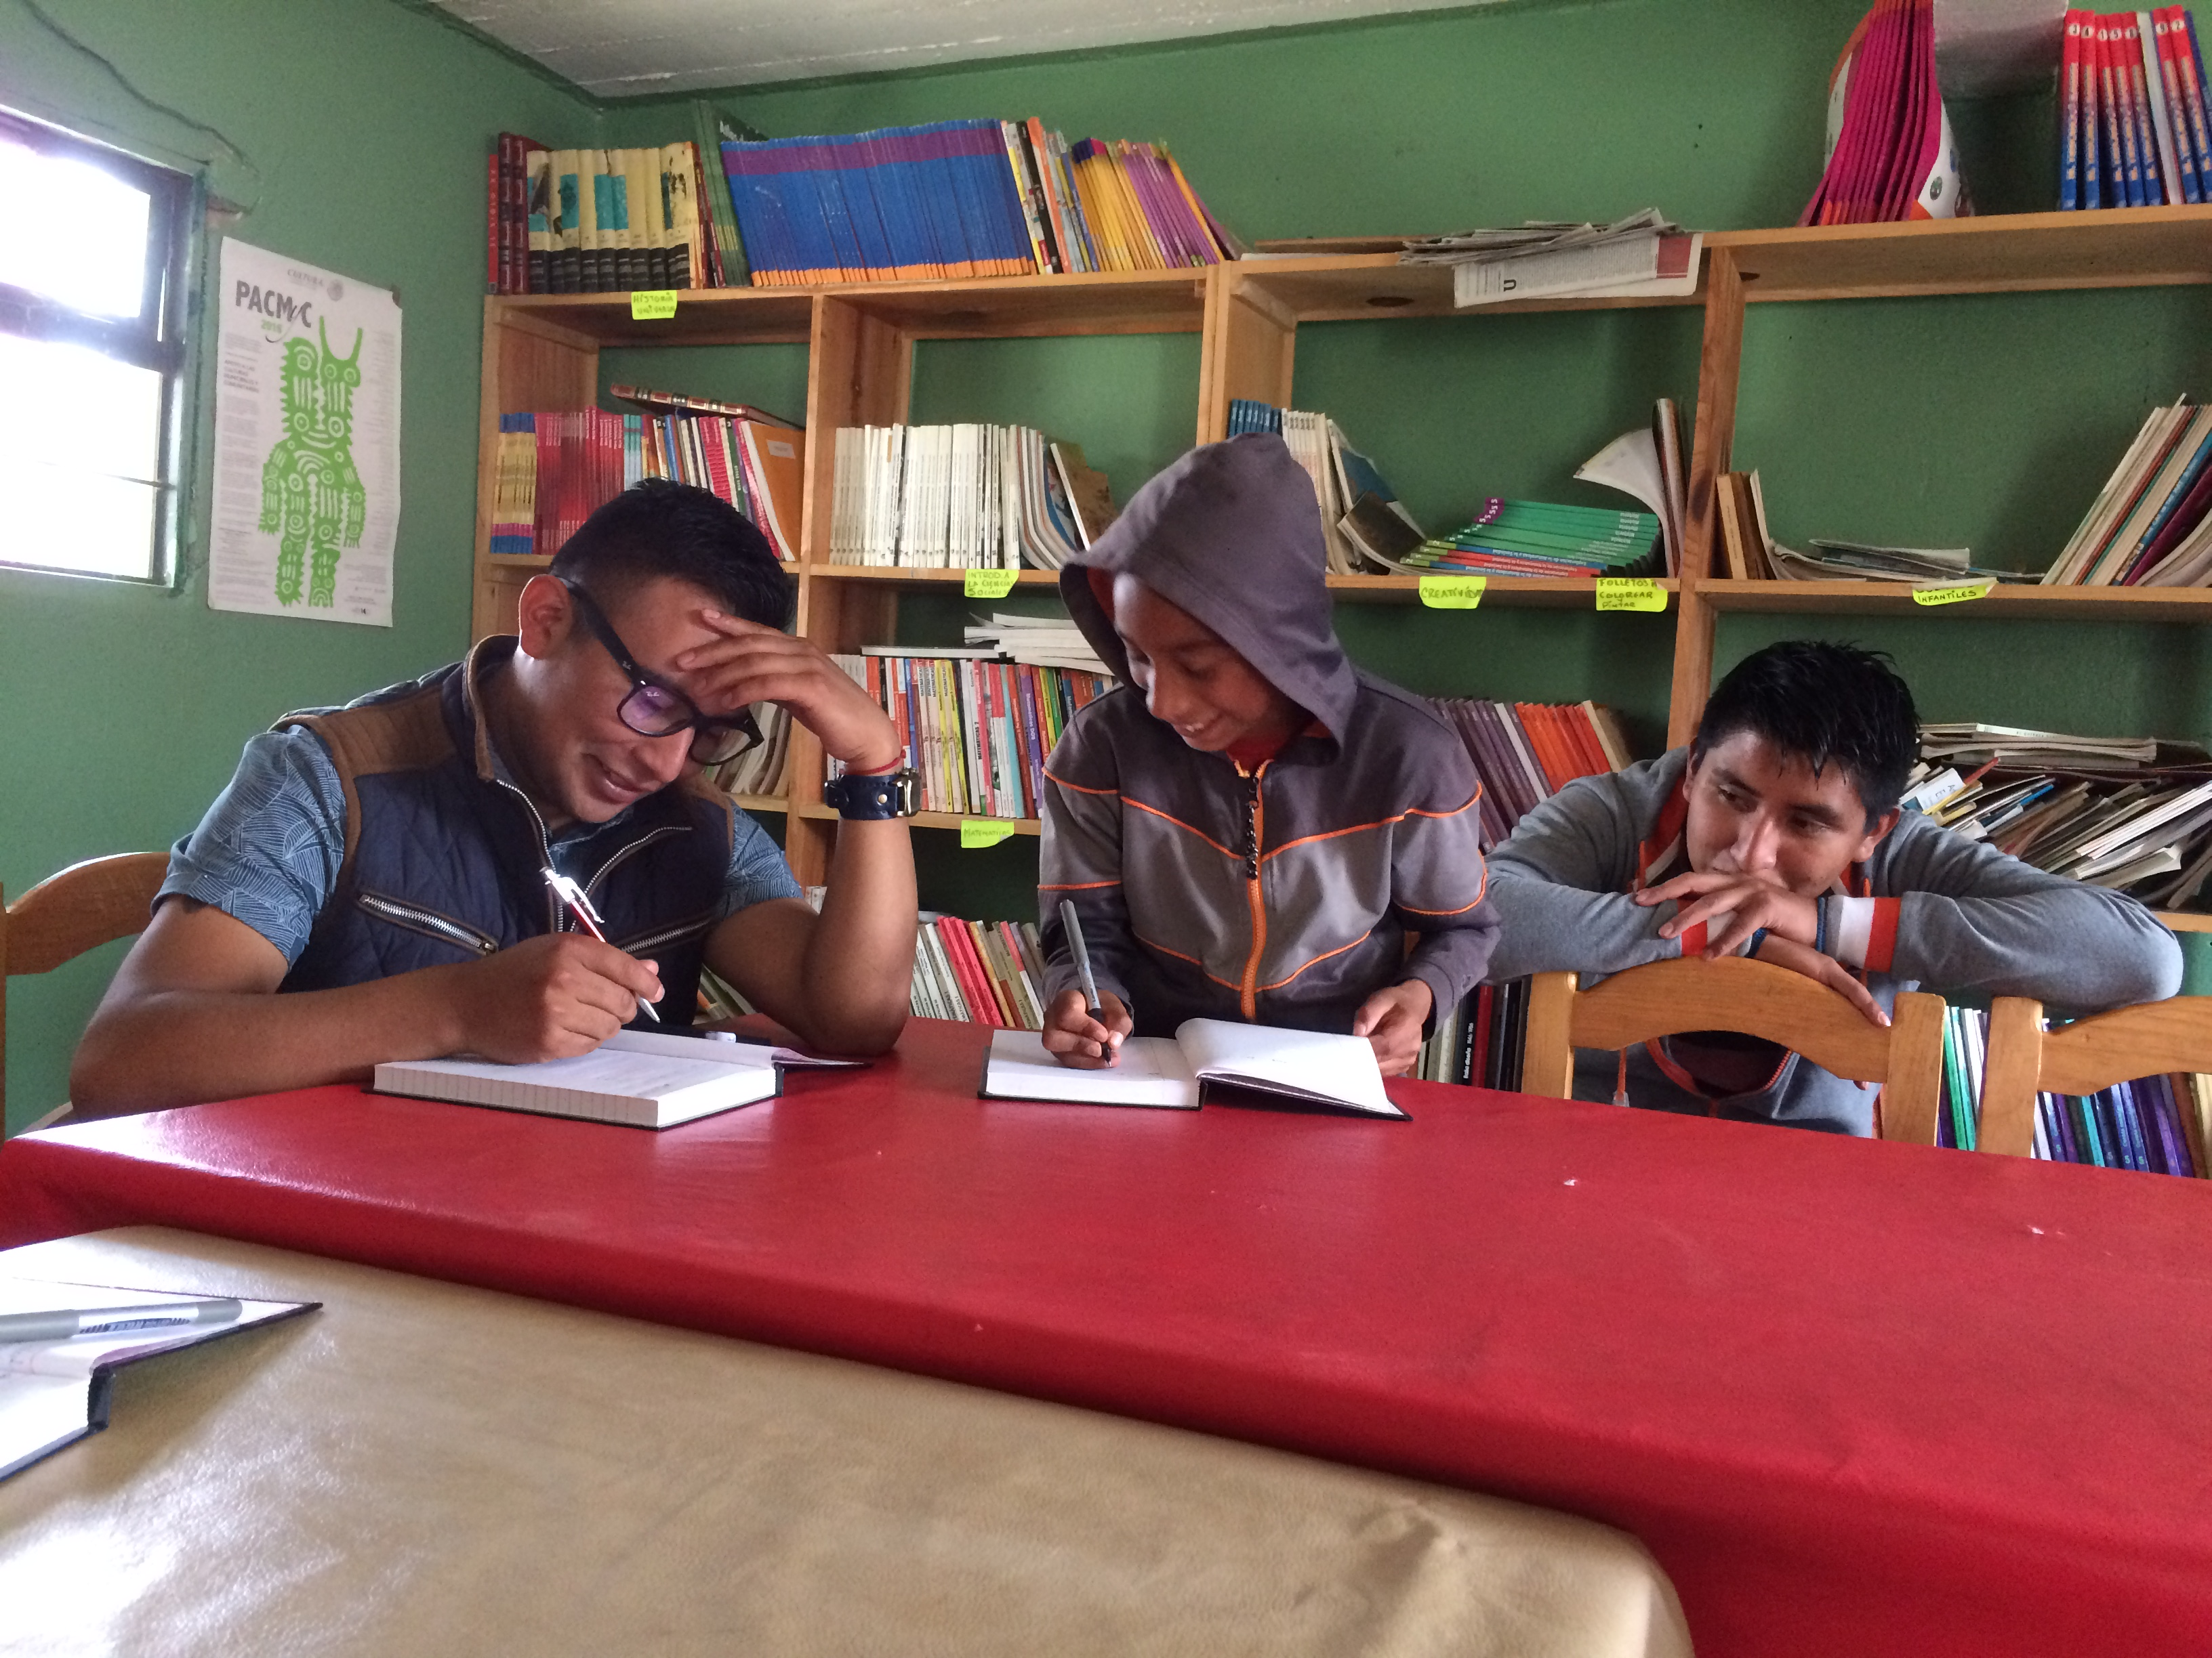
Triqui phonetics and phonology
Linguistics 460/560
Spring 2024
Week 2
Professor DiCanio

Slide 2
1. Symmetry, stress, and the inventory
In languages like English, we tend not to think of phonemic contrasts in terms of stress, but in Triqui, we have to.
We talk about allophony in terms of stress though, e.g. aspiration in English.
[əˈpʰiɹ] [ˈpʰeɪpɚ] [ˈæpɫ̩] [ˈpʰɹ̥apɚɾi] [pʰəˈtʰeɪɾoʊ]
'appear’ 'paper' 'apple' 'property' 'potato’

Slide 3
In Itunyoso Triqui, and in the Triqui languages more generally, all the major contrasts occur on the final syllable of roots/morphemes.

Slide 4
We may call this type of patterning in Triqui “stress”, but it differs somewhat from what some linguists may consider to be their prototype of a stress system.
“Depending on the language, stress is diagnosed in different ways: through a combination of physical properties, speaker intuitions, and phonological properties such as segmental constraints and processes.”
(p.66, Gordon and van der Hulst, 2020)
In practice, many linguists think primarily of the physical properties and the speaker intuitions over segmental constraints and processes.
In Triqui, since pitch is used for marking tone, pitch on the root-final syllable is not necessarily any different than on any other syllable. Pitch is not a cue for stress.

Slide 5
There are additional languages motivating a perspective of stress primarily based on distributional properties rather than the physical ones.
In Ibibio (Cross-River), Punu (Bantu), and Lulamogi (Bantu), the distribution of segmental and tonal contrasts are restricted to stem-initial or word-penultimate positions, but other cues to word stress/accent are absent (Hyman, 2019).
Hyman argues that these languages demonstrate prominence relations via distributional restrictions and patterns of reduction/assimilation.

Slide 6
Phonetic patterns
In Triqui, final syllables are still longer than non-final syllables though. So, duration plays a role too. Observe the following from the chapter on Triqui prosody.
This syllable duration for disyllabic words with different coda types: /ʔ/ - /h/ - no coda in both utterance-final position (the right panel) and in utterance-non-final position (the left panel).
This is durational data averaged across 11 speakers and a number of different experimental trials.
Note that final syllables are about 50% longer than penults and even longer than penults in utterance-final position.

Slide 7
There are both phonological and phonetic cues to stress in Triqui, but if we ignored stress, we would need to include many caveats whenever we discussed different segment types.
If we just looked at the segmental inventory here, we might be misled to believe that everything was contrastive everywhere in the word.

Slide 8
2. The Triqui inventory

Slide 9

The stop system
The stop system includes /p, t̪, k, kʷ/. These are all voiceless stops. There are no voiced stops. In the onsets of stressed syllables, they are variably realized with some preaspiration.

Slide 10
There are in fact some voiced stops and fricatives, but these occur in only a couple native words.
Loanwords from Spanish include voiced stops and fricatives too.

Slide 11
Affricates
For most speakers, there is one phonemic affricate in Itunyoso Triqui - /tʃ/. However, there are two additional affricate allophones.
Older speakers distinguish a retroflex: /ʈʂ/ and a palatoalveolar /tʃ/, e.g. /ʈʂeh³²/ 'path' vs. /tʃeh³/ 'his/their father.’
Younger speakers have merged these two affricates to /tʃ/, though you can hear a more retracted affricate sometimes before back vowels with speakers, e.g. /tʃeh³²/ 'path' but /ʈʂũ³/ 'tree.'
The post-dental affricate [t̪s] is an allophone of /t̪/ before /i/.

Slide 12
Sonorants
The sonorant series is rather simple: /m, n, β, l, ɾ, j/.
Note that the bilabial "fricative" is given here. It is normally produced with either no frication [ β̞ ] or with some frication [β]. However, it patterns with the sonorants.
The "tap" actually varies quite a bit - it can be voiceless or voiced, a tap, trill, or retroflex flap: [ɾ, ɽ, r, ɾ̥, ɽ̊, r̥].

Slide 13
βeʔ³ | li⁴³ | ɾã³¹ | ju³ˀβe³² | mã³ | nã³
'house' | 'small' | 'lightning' | ‘ice’ | 'that (distal)' | 'this (proximal)’
tʃu³βe³ | ku³li³² | tʃi³ɾah⁵ | ma²jah³¹ | tʃu³mãʔ³ | tʃi³neh⁵
'dog' | 'magpie' | 'back, behind' | 'yellow' | 'town, community' | ‘cliff, precipice'

Slide 14
Pre-glottalization in sonorants
There is a series of prenasalized stops in the language as well /ⁿd, ᵑɡ, ᵑɡʷ/. These occur only in root-final syllables in native words. The velar prenasalized stop is much more common than the alveolar one.
ⁿduh³ ⁿda¹ ᵑɡo² ᵑɡa¹ ᵑɡʷi³¹
'pimple' 'until, up to' 'one’ 'with’ 'person'
ku²ⁿdu³ tʃa³ᵑɡo⁴ tʃi³ᵑɡa⁴ tʃu³ᵑɡʷi¹ tu³ᵑɡʷa³
'short' 'ground wasp' 'garden' 'world’ 'San Juan Mixtepec'

Slide 15
Glottalized sonorants
There are pre-glottalized sonorants in Itunyoso Triqui - all sonorants and the prenasalized stops can have a preceding glottal stop. This can occur for some consonants in word-initial position, though pre-glottalization only occurs in the root-final syllable.
ˀnĩh⁵ ˀnaʔ³ ˀβi¹ ˀjã³¹ ˀjah³
'corn’ 'to come' 'raw, uncooked' 'scar’ 'to do'
ni³¹ na⁴na⁴ βĩ³ jã³² jah³²
'night’ 'long ago' 'to be (equative)' 'salt’ 'flower'

Slide 16
It can be hard to hear the contrast between plain and pre-glottalized in word-initial position when these words are in isolation. You can hear it when another word (or prefix) precedes these roots though.
Glottalized sonorants most often occur in word-medial position - it is easier to hear the glottalization here for both Triqui speakers (and probably for the rest of us).
ta³ˀnĩh⁵ | ka³-ˀnaʔ³ | βa² ˀβi¹ | tʃa³ˀjãh³ | a³ˀmã³
'child of' | 'perf-come' | 'to.be+raw' | 'coyote' | 'to heat up’
a³ˀᵑɡa³² | ku³ˀⁿdiʔ³ | t̪o³ˀlo³ | ni²ˀɾua⁴³
'to be born' | 'prickly pear' | 'rooster' | 'much'

Slide 17
The IPA has not historically had a consistent practice for transcribing preglottalization or prenasalization. Linguists variably transcribe these as sequences or with superscripts, e.g. /nd/ vs. /ⁿd/, /ʔn/ vs. /ˀn/ (Keating et al. 2021).
This variation in transcriptional practice is independent from whether the linguist is arguing that these are single segments are not.
On the basis of many phonetic descriptions, including DiCanio (2010), Keating et al. (2021) propose superscripts for the IPA transcription of preaspiration, preglottalization, and prenasalization.
When we're using IPA for Triqui, we'll be following this practice. However, in the transcriptional orthography, everything is written as a sequences. This is used in the dictionary and texts and later in the course.

Slide 18
The marginal pre-stopped nasal
Itunyoso Triqui has a pre-stopped nasal which begins as palatal and is released into an alveolar nasal /ᶜn/. It is found in a few common words, but it is undergoing loss/shift for many speakers, merging with /n/ or /t̪/.
ᶜnãh⁵ ‘brother’
nãh⁵ final particle expressing obligation
nːãh⁵ ‘to wash’

Slide 19
3. Consonant length
There is a contrast between short and long consonants, but only in the onset of monosyllabic roots. There are more contrasts among the sonorants than obstruents.

Slide 20
βa¹ ‘already, yet’ βːa¹ ‘sharp’
tʃaʔ³ ‘music’ tʃːa³ ‘tortilla’
kaʔ³ ‘spool-lifting kːaʔ³ ‘candle’
stick for weaving’
kʷi³ ‘day, sun’ kʷeh​³² ‘edible green’
li⁴³ ‘small (adj)’ lːih³ ‘small (N)’
mã³ ‘that (distal)’ mːã¹ ‘there is (imp)’
nãh⁵ ‘oblig. final part.’ nːãh⁵ ‘to wash’
t̪a³ ‘this (disc)’ t̪ːa³ ‘field’

Slide 21
The phonetics of length
It is hard to hear the contrast between long and short voiceless stops in Itunyoso Triqui, but when we put them in a sentence, we can hear and see the length difference.
We will normally transcribe the long consonants with a doubled consonant instead of IPA [ː].
Example from DiCanio (2012a).

Slide 22
Examples in context
ki³-ni⁴ka⁴³ tʃːiʔ² tʃːeh⁵ tʃːũ³
perf-bring.1S ten load wood
‘I brought ten loads of wood.’
kʷeh⁴ tʃa³t̪a³² tʃa³¹ ra³ʔa³ tʃːũ³
perf.jump eagle head arm tree
‘The eagle flew/jumped to the tree branch.’

Slide 23
The length differences are robust in carrier sentences (ibid).

Slide 24
Why is length only contrastive word-initially?
Consonantal length contrasts tend to occur word-medially in languages of the world (Dmitrieva, 2012; Ladefoged and Maddieson, 1996; Maddieson, 1985; Muller, 2001; Thurgood, 1993). Word-initial geminates are rare.
Of 30 known languages with word-initial geminates, 24/30 (80%) also have a length contrast word-medially (Muller, 2001).
6/30 languages have word-initial geminates but not word-medial geminates: Pattani Malay, Sa’ban, Leti, Nhaheun, Yapese, and Itunyoso Triqui (DiCanio, 2008).

Slide 25
The origin is pre-tonic vowel loss.

Slide 26
But it also started pre-Triqui
Note common historical */(j)V-/ on all Proto-Mixtec words from Josserand (1983).

Slide 27
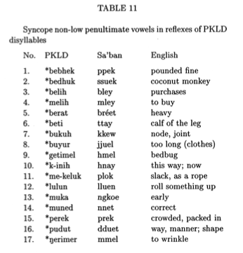
Similar changes in Sa’ban (Austronesian)
Proto-Kelabit-Lun-Dayeh (Northern Sarawakan; Austroniesian) had longer words.
Stress shifted to final syllables and pre-tonic high vowels were lost, conditioning gemination in only monosyllables in the language (Blust 2001, p.288).
Sound familiar?

Slide 28
4. Vowel contrasts and nasalization
There are five oral vowels in Triqui: /i, e, a, o, u/ and three nasal vowels /ĩ, ã, ũ/.
The quality of the low nasal vowel is [ə̃], not [ã].
Contrastive nasalization on vowels is restricted to... the final syllable of the root.

Slide 29
DiCanio (2010)

Slide 30
kkih³ ‘mountainside’ kkĩh³ ‘corn masa/dough’
kka³² ‘espiga de maíz’ kkə̃³ ‘sandal’
tʃa³tu⁴³ ‘jerk, a$$hole’ tʃa³tũ³ ‘runt of litter’
Nasalization is equally contrastive before a coda glottal consonant as it is in open syllables.

Slide 31
Progressive and contrastive nasalization
After nasal consonants, high vowels are obligatorily nasalized [ĩ, ũ], but this does not happen with low vowels [e, o, a].
nũ³² ‘to be inside’
a³nĩ³ ‘to squeeze’
There is a phonological contrast between a nasal and non-nasal low vowel after a nasal consonant.
nã⁴ ‘sunbeam’ a⁴nãh⁴ ‘to weave’
na⁴ ‘a long time ago’ a⁴nah⁴ ‘to work the field’

Slide 32
Regressive nasalization spreading
Nasalization spreads from a final vowel onto preceding syllables if the intervening consonants are glottal consonants or a glide.
/jã³²/ ‘salt’ > [jə̃³² ~ ɲə̃³²]
/βĩ³/ ‘to be’ > [βĩ³ ~ mĩ³]
/ra³ʔã³/ ‘mushroom’ > [rə̃³ʔə̃³]
/tʃi³jãh⁵/ ‘town, place’ > [tʃĩ³jə̃h⁵ ~ tʃĩ³ɲə̃h⁵]
/ki³ˀjãh³/ ‘party, festival’ > [kĩ³ˀjə̃h³ ~ kĩ³ˀɲə̃h³]

Slide 33
5. Glottal consonants
The glottal stop occurs as an onset in final root syllables, e.g. /ɾa³ʔa³/ ‘hand.’ These are disyllabic words in Itunyoso Triqui since you can get sequences of different vowels and you observe syllable-final lengthening, [ɾa³.ʔaː³].
There is an important contrast among words which end with a /ʔ/, /h/, and no coda. This distinguishes many words in the Triqui lexicon -- about 50% of all roots end with a glottal coda.
Glottal codas are the only codas permitted in the language. It is typologically very rare for /h/ to only occur as a coda, not an onset.

Slide 34
Final glottal contrasts
Non-final syllables do not have codas and always have short vowels.
Final syllables either have short vowels with a glottal coda, /ah, aʔ/, or a long vowel /aː/. Since the length is predictable (via the absence of a coda), it is not usually transcribed.
a³ˀᵑɡa³² ‘to be born’ a³t̪a³ ‘to carry/load’
a³ˀᵑɡaʔ³ ‘to laugh’ a³t̪aʔ³ ‘to lift up on top’
a³ˀᵑɡah³ ‘to be hurting’ a³t̪ah² ‘to say’

Slide 35
Lenited vs. non-lenited glottal stops
ne³ʔeɦ³ ‘child’
nneʔ³ ‘straw rope’
Figures from DiCanio (2012a)

Slide 36
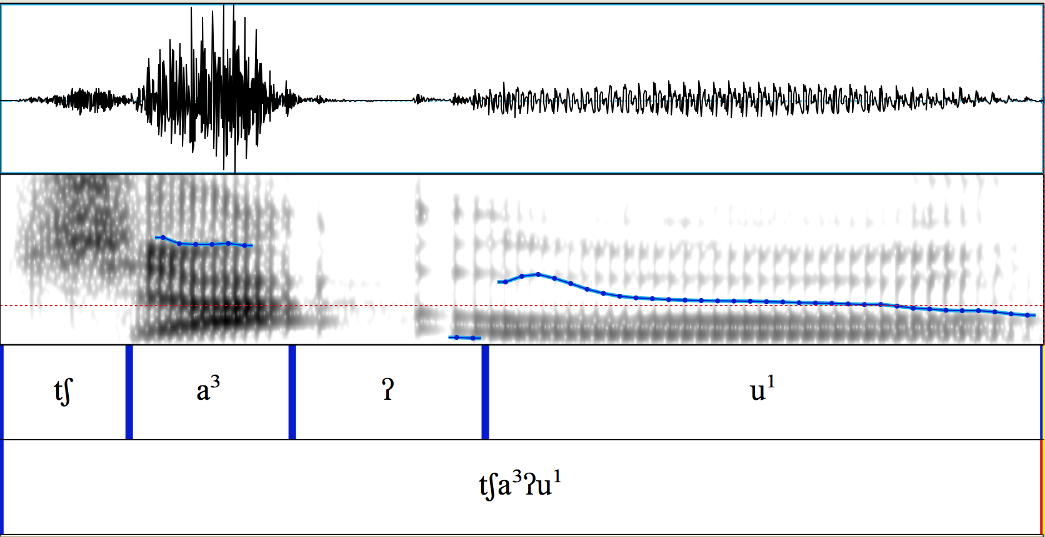
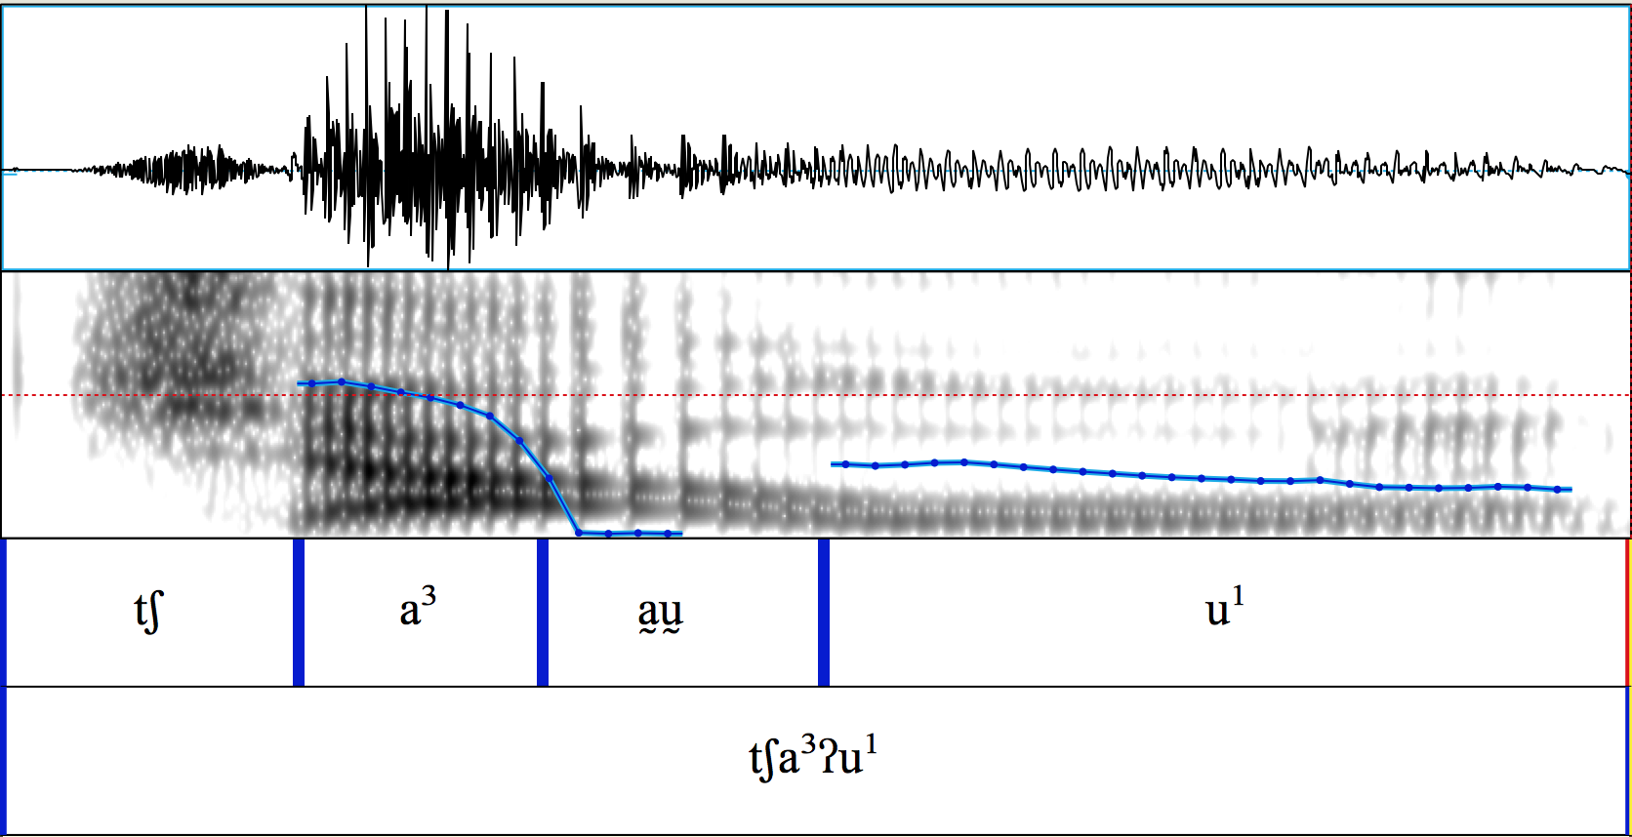
Variation in glottal stops
Medial glottal stops can be realized with complete closure (above)
or without complete closure (below)
/tʃa³ʔu¹/ ‘barn owl / tecolote’
Both sound like they have closure, right?

Slide 37
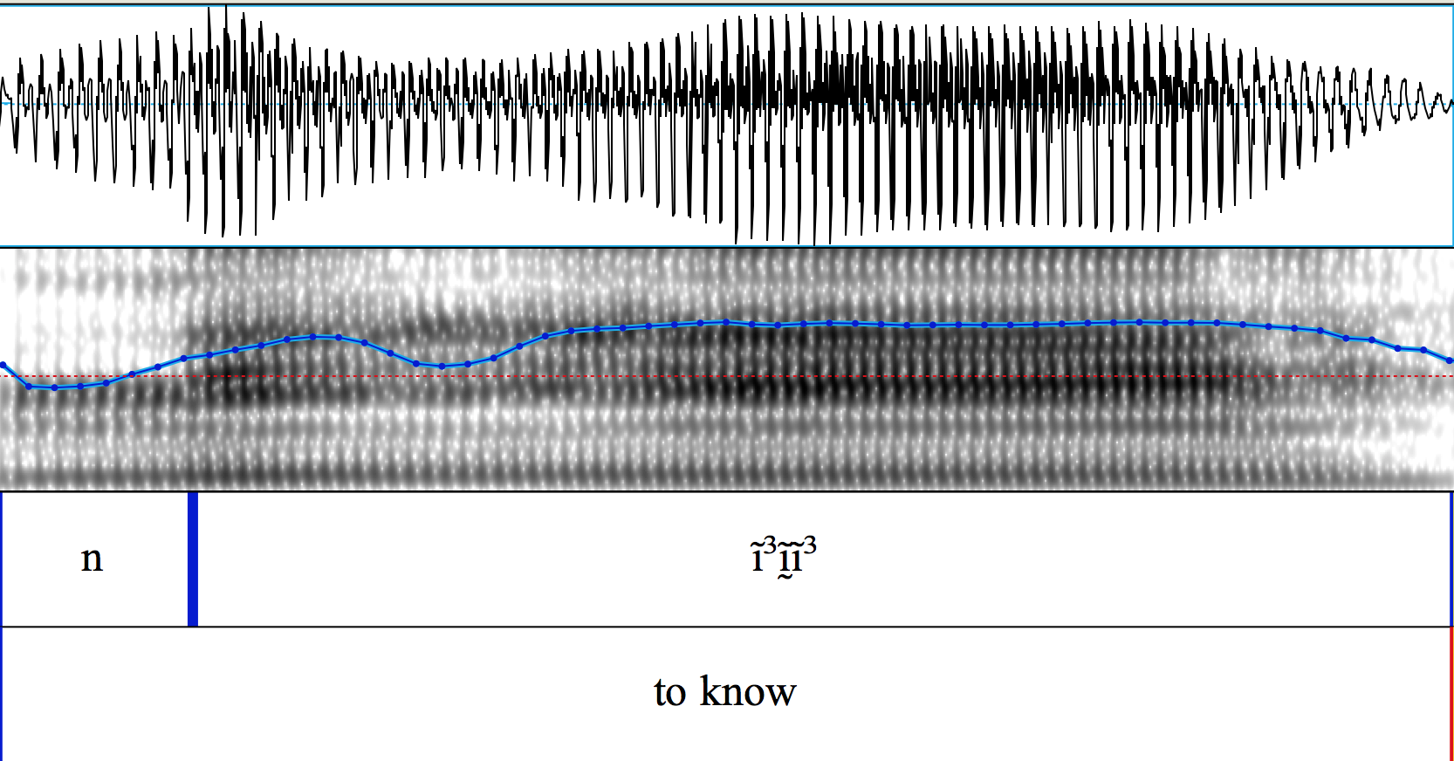
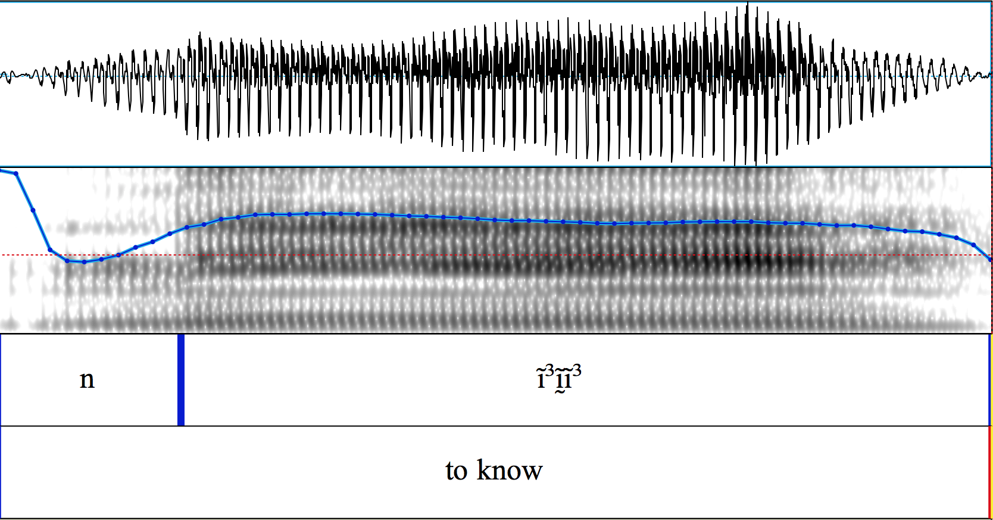
But medial glottal stops can also be realized with non-modal phonation (creak, vocal fry, diplophonia)
or only very subtle visible changes in voice quality
/ni³ʔi³/
‘to know / saber~conocer’

Slide 38
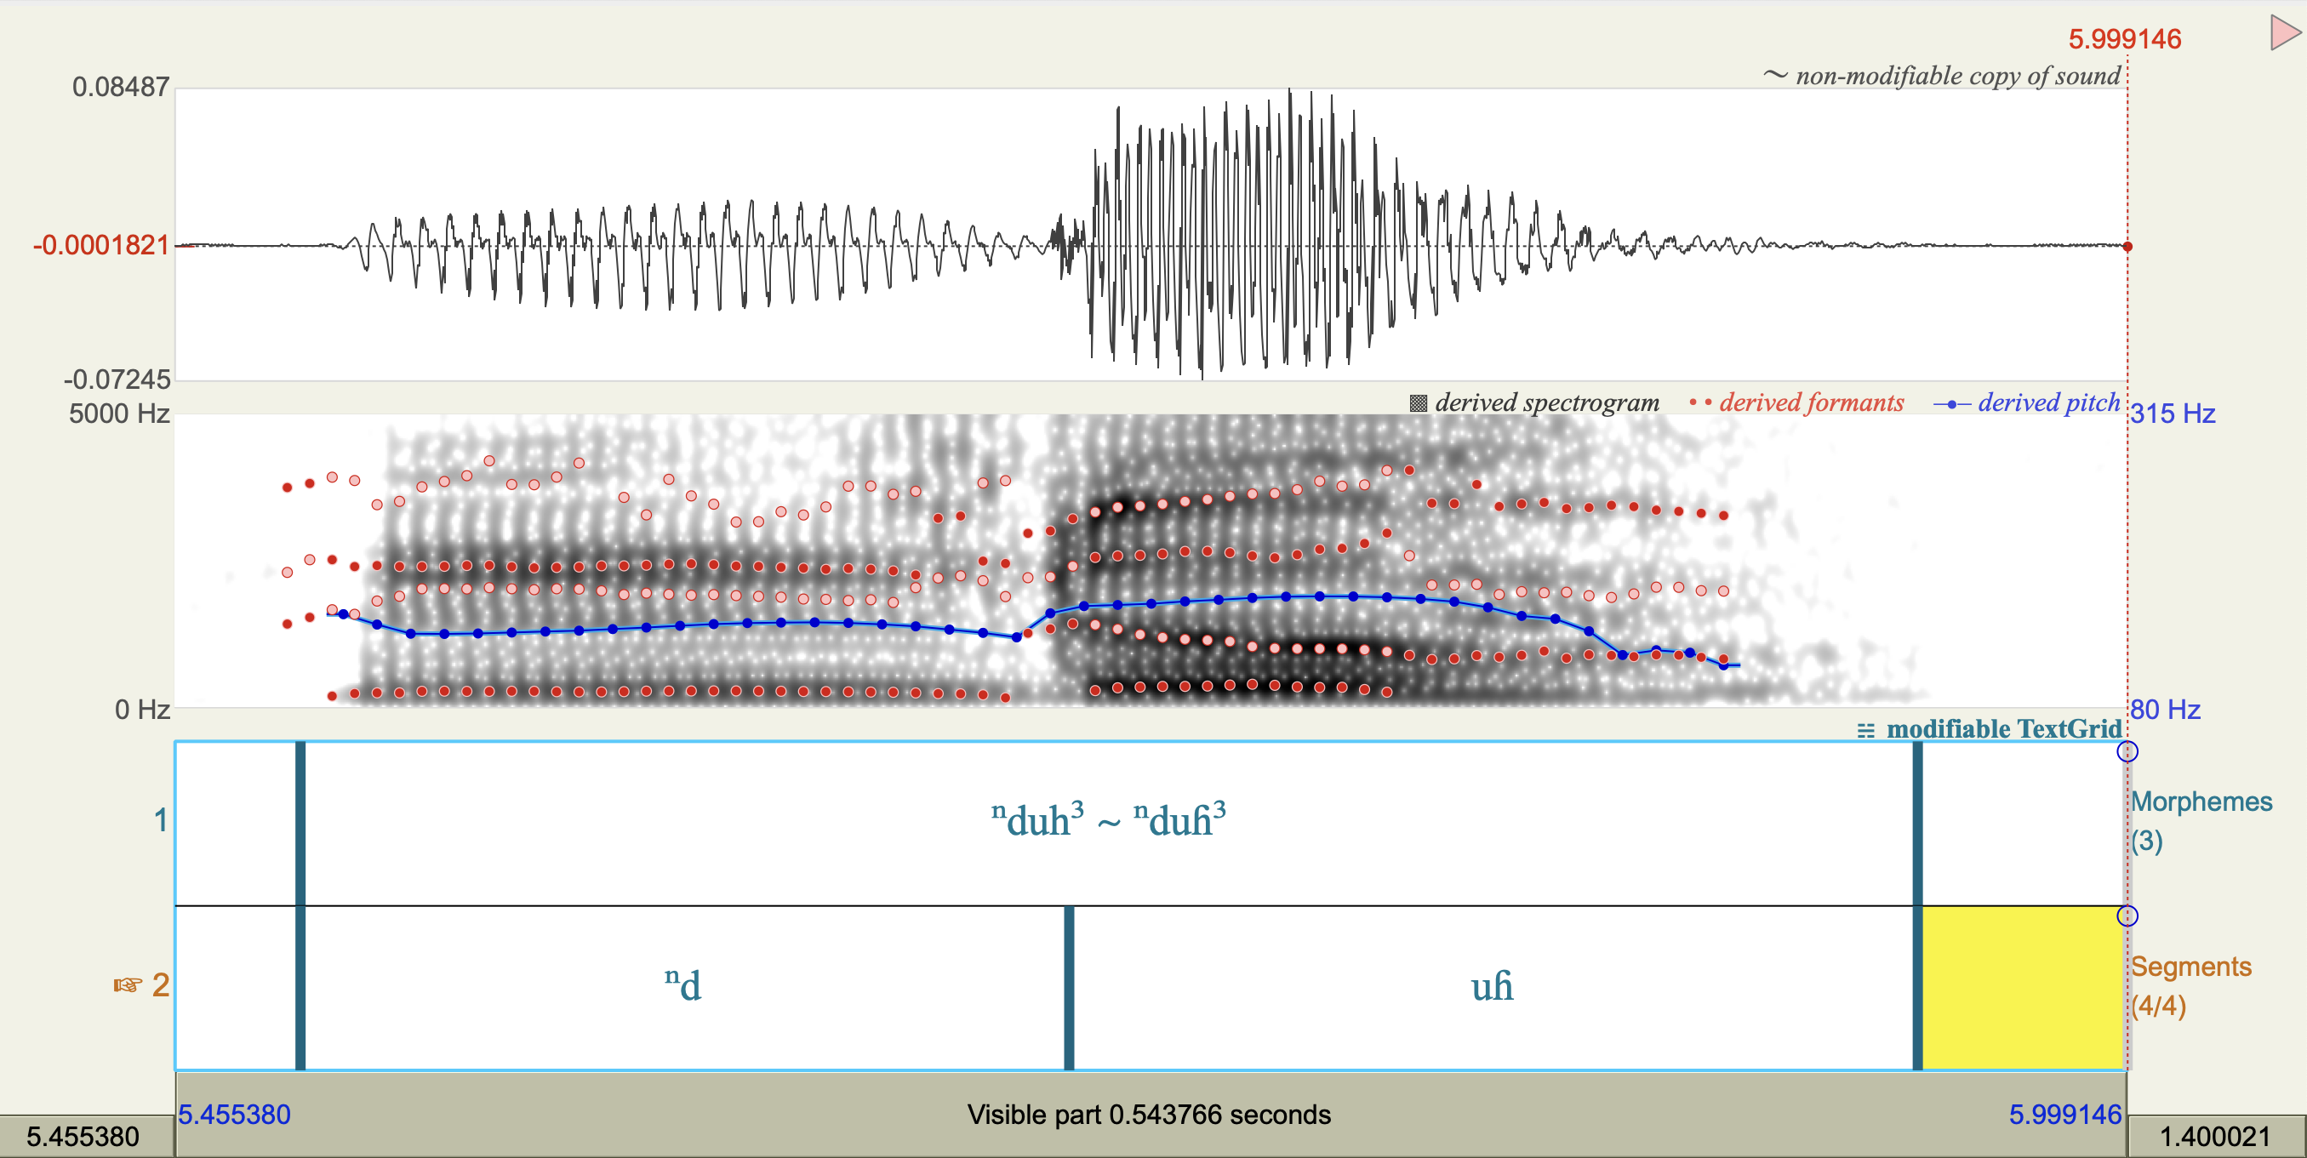
The final /h/ also varies in its production – it can be variably realized as [h] or [ɦ], with the latter being more common.
Aspiration starts here.
Voicing persists here.

Slide 39
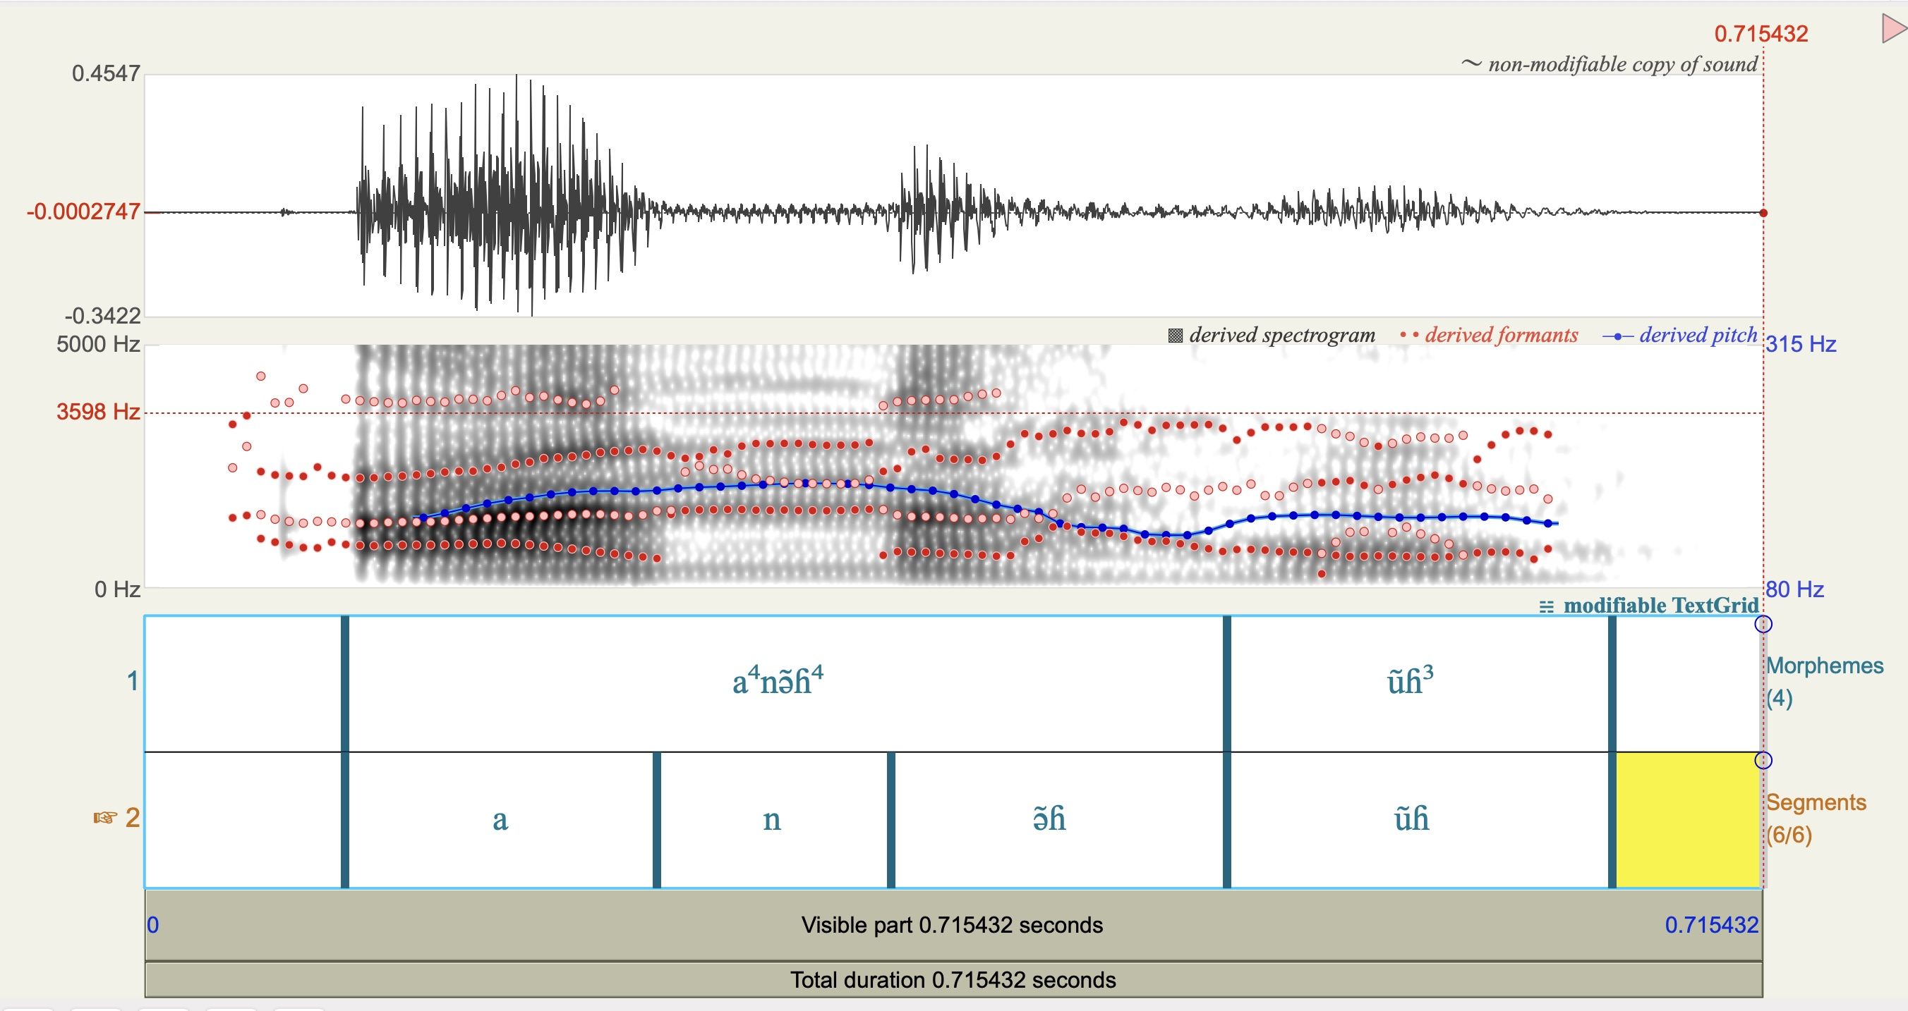
[a⁴nə̃ɦ⁴=ũɦ³] ‘she is weaving’
No loss of voicing here

Slide 40
Final glottal consonants and tone
Final glottal consonants both restrict the range of tonal contrasts and influence the phonetics of tone production (DiCanio 2012b, DiCanio et al. 2020).

Slide 41
Final glottal contrasts and morphology
This contrast is rather important in Triqui morphology.
a³t̪a³ ‘to carry/load’
a³t̪ah⁵ ‘I carry’
a³t̪ah³ ‘they (mentioned) carry’
a³t̪oʔ⁴ ‘we carry’
Note that /a/ > /o/ with the 1st person plural, but other vowels do not change.

Slide 42
References
Blust, R. A. (2001). Language, dialect, and riotous sound change: the case of Sa’ban. In Thurgood, G. W., editor, Papers from the Ninth Annual Meeting of the Southeast Asian Linguistics Society, pages 249–360. Arizona State University, Program for Southeast Asian Studies.
DiCanio, C. T. (2008). The Phonetics and Phonology of San Martín Itunyoso Trique. PhD thesis, University of California, Berkeley.
DiCanio, C. (2010). Illustrations of the IPA: San Martín Itunyoso Trique. Journal of the International Phonetic Association, 40(2):227–238.
DiCanio, C. (2012a). The Phonetics of Fortis and Lenis Consonants in Itunyoso Trique. International Journal of American Linguistics, 78(2):239–272.
DiCanio, C. (2012b). Coarticulation between tone and glottal consonants in Itunyoso Trique. Journal of Phonetics, 40(1):162–176.
DiCanio, C., Martínez Cruz, B., Cruz Martínez, B., and Martínez Cruz, W. (2020). Glottal toggling in Itunyoso Triqui. Phonological Data & Analysis, 2(4):1–28.
Dmitrieva, O. (2012). Geminate typology and the perception of consonant duration. PhD thesis, Stanford University.
Gordon, M. K. and van der Hulst, H. (2020). Word-stress systems. In Gussenhoven, C. and Chen, A., editors, The Oxford Handbook of Language Prosody, chapter 5, pages 66–77. Oxford University Press.

Slide 43
Harris, J. and Hyman, L. M. (2022). Segmental prominence and the modulated carrier signal. In Udoh, I. I. and Ekpenyong, M. E., editors, Current Issues in Descriptive Linguistics and Digital Humanities: A Festschrift in Honor of Professor Eno-Abasi Essien Urua, pages 487–499. Singapore: Springer Nature Singapore.
Hyman, L. M. (2019). Positional Prominence versus Word Accent: Is there a difference? In Goedemans, R., Heinz, J., and van der Hulst, H., editors, The Study of Word Stress and Accent: Theories, Methods and Data, chapter 2, pages 60–75. Cambridge University Press.
Josserand, J. K. (1983). Mixtec Dialect History. PhD thesis, Tulane University.
Keating, P., Wymark, D., and Sharif, R. (2021). Proposal for superscript diacritics for prenasalization, preglottalization and preaspiration. Journal of the International Phonetic Association, 51(1):75–90.
Ladefoged, P. and Maddieson, I. (1996). Sounds of the World’s Languages. Oxford: Blackwell, 425 pages.
Maddieson, I. (1985). Phonetic cues to syllabification. In Fromkin, V. A., editor, Phonetic linguistics: essays in honor of Peter Ladefoged, pages 203–221. Academic Press: New York.
Muller, J. S. (2001). The Phonology and Phonetics of Word-Initial Geminates. PhD thesis, The Ohio State University.
Thurgood, G. (1993). Geminates: a cross-linguistic examination. In Papers in honor of Frederick H. Brengelman on the occasion of the twenty-fifth anniversary of the Department of Linguistics, CSU Fresno, pages 129–139. Department of Linguistics, California State University, Fresno.

