Slide 1
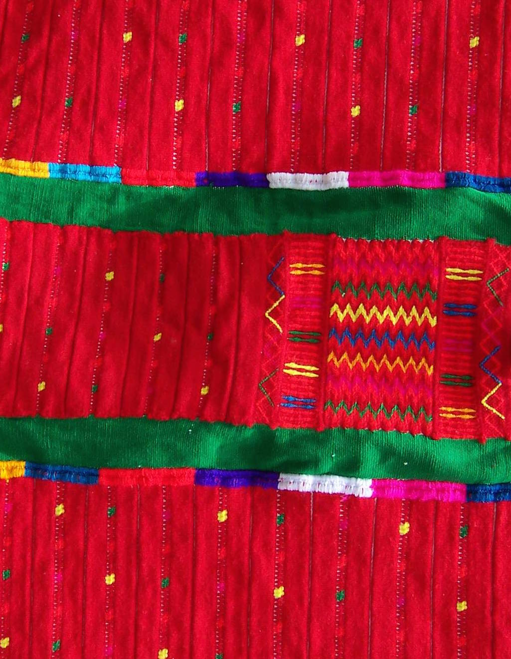
Motivating the prosodic hierarchy in Itunyoso Triqui
Christian DiCanio
University at Buffalo
cdicanio@buffalo.edu

Slide 2
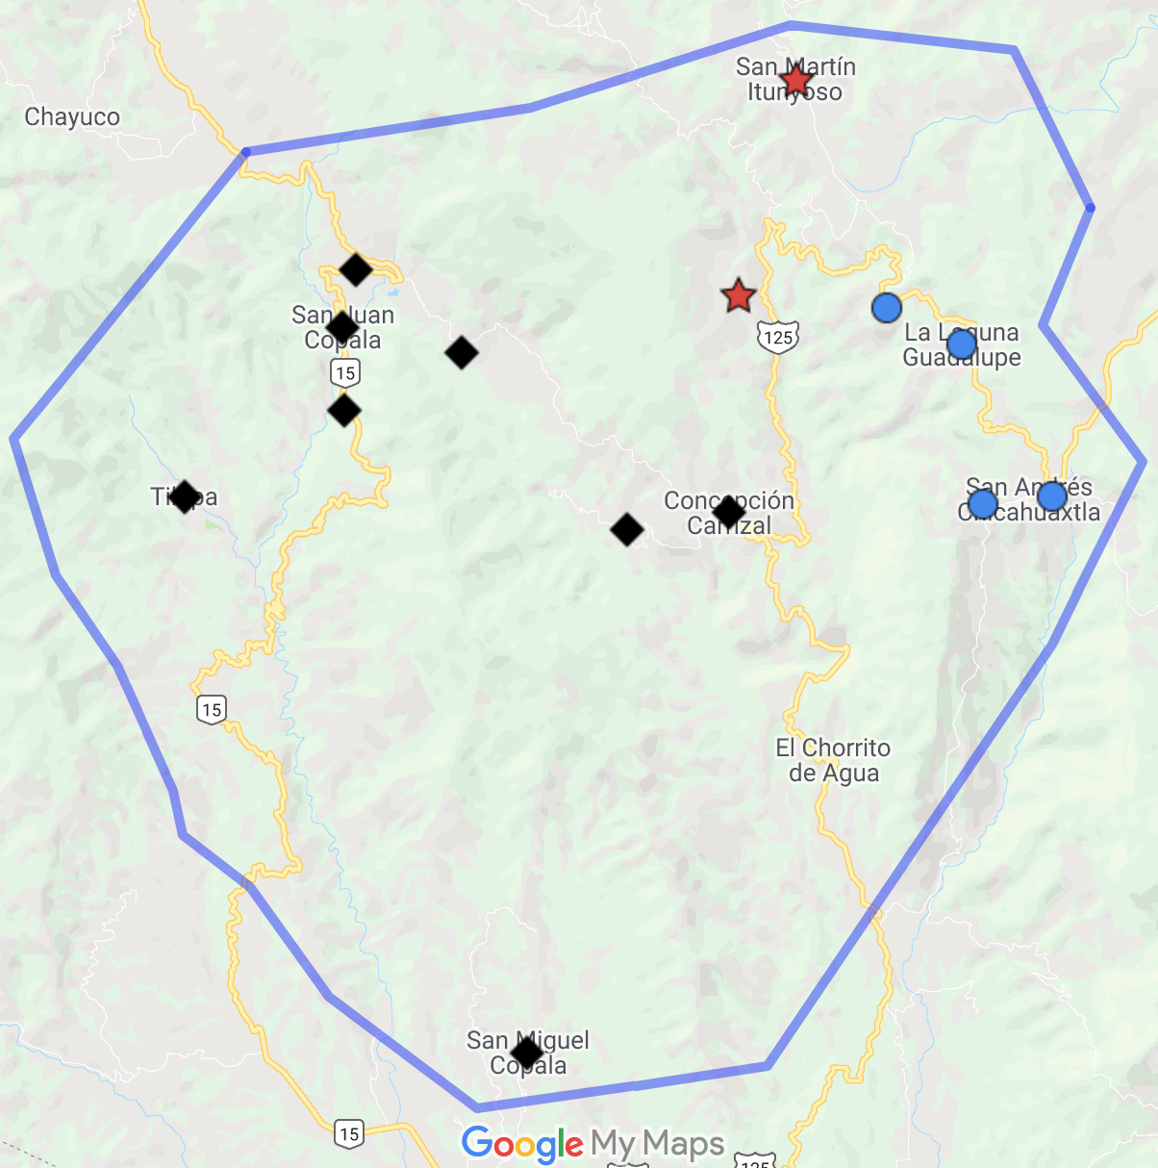
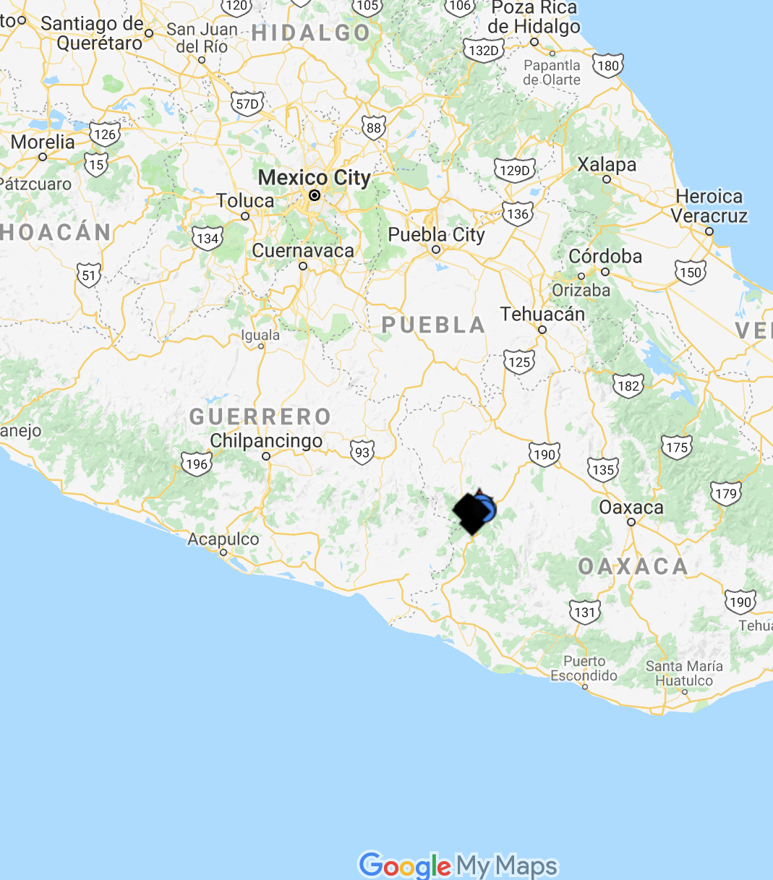
Triqui languages
2630 m
Itunyoso Triqui
(2,700 speakers)
1550 m
3 major language variants with limited mutual intelligibility.
All complex tone languages within the Mixtecan family.
Average distance between the major Triqui regions is ~5 km, but it is very mountainous terrain with large elevation differences.
2370 m
Copala Triqui
(30K speakers)
Chicahuaxtla Triqui
(4K speakers)

Slide 3
Genetic affiliation (Otomanguean: Eastern)
Mixtecan
(3-7 kya)
Mixtecan-Cuicatecan
Cuicatec
Mixtec
(1.6-1.8 kya)
Triqui
Itunyoso-Chicahuaxtla
Copala
Itunyoso
Chicahuaxtla
Tepeuxila
Teutila
12 languoids
~60 spoken varieties

Slide 4
Scientific questions
Prosodic phrasing is often motivated by variable suprasegmental phenomena (pitch, lengthening, phonation type, etc) in different languages (Bennett and Elfner, 2019).
Given the extremely high functional load of suprasegmental contrasts within words in Otomanguean languages, such variable phenomena are much harder to examine (DiCanio and Bennett, 2020). Though, domains within the tonal phonology may be revealing.
Can we motivate some sort of prosodic hierarchy in Triqui?

Slide 5
Status of my scholarship on Itunyoso Triqui
2004 – 2008 Dissertation research, focus on phonetics and phonology of tone/phonation/length.
2009 – 2014 Post-doctoral research (France, US), focus on perception of tone, phonation; tonal coarticulation
2014 – 2019 NSF DLI/DEL documentation grant, focus on text collection, transcription, morphophonology, and prosody
2020 – 2022 Continued focus on translation and documentation; UB Humanities institute grant
2023 – present Focus on reference grammar; NEH fellowship grant
2004 – present The Triqui-Spanish dictionary

Slide 6
Roadmap
Final stress and motivating the iambic foot with evidence from distributional asymmetries and foot-level phonological processes.
Iambic foot with unfooted extrametrical syllables on the left edge that constitute a prosodic word (cf. Hernández Mendoza, 2017, in Chicahuaxtla Triqui), with evidence from tonal distribution, tonal morphophonology, and speech reduction.
Prosodic word compounds as a domain for the phonological phrase?

Slide 7
Phonetic possibilities are functionally limited
9 lexical tones (5 levels, 4 contours) that are also heavily used in the morphology. There is little space for shifting F0.
Half of Triqui morphemes end with open syllables and half end with coda glottal consonants. These are often realized with non-modal phonation. There is little space for shifting voice quality.
Duration is the main cue used by speakers and listeners in distinguishing CV: and CVʔ/CVh syllables (DiCanio, 2012, 2014). There is little space for shifting duration.
There is stem-final and utterance-final lengthening, but no noticeable change to tones in different prosodic positions and no declination (DiCanio and Hatcher, 2018).

Slide 8
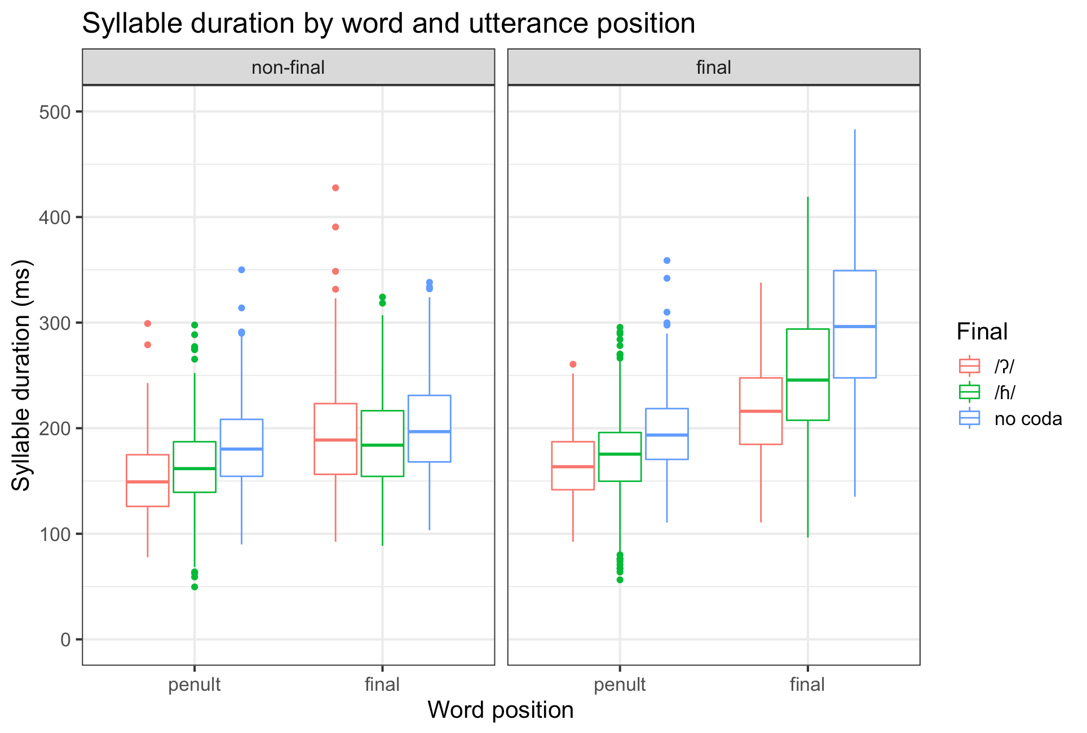
II. Final stress
Final syllable lengthening and utterance-final lengthening
(DiCanio and Hatcher 2018)

Slide 9

Tone in monosyllables and disyllables
ββeh⁽³⁾⁵ ‘straw mat / petate’ tʃi³ˀjoh⁵ ‘swamp / ciénaga’
ββe⁴ ‘hair / pelo’ ka³to⁴ ‘shirt / camisa’
nne³ ‘plough / arado’ na³ɾa³ ‘refill / rellenar’
nne² ‘to lie / mentir’ a²mə̃² ‘when / cuando’
nne¹ ‘naked / desnudo’ na¹ka¹ ‘new / nuevo’
nne³² ‘water / agua’ a³βi³² ‘leave / salir’
nne³¹ ‘meat / carne’ a³nĩ¹ ‘explode / estallar’
tʃe⁴³ ‘my father / mi padre’ a⁴ne⁴³ ‘chew / masticar’
ᵑɡa¹³ ‘when (subord) / cuando’ kə̃¹ʔə̃³ ‘four (N) / cuatro'

Slide 10
Morphological load of tone
Sole exponent for verbal aspect tʃa⁴³ tʃa²
perf.eat pot.eat
Exponent for 1s, 1p clitics tʃah⁴ tʃah¹
perf.eat.1s pot.eat.1s
tʃoʔ⁴ tʃoʔ²
perf.eat.1p pot.eat.1p
Exponent of topical and tʃah³ tʃah²³
emphatic/optative marking perf.eat.top pot.eat.top
tʃaʔ⁴ tʃaʔ²⁴
perf.eat.emph pot.eat.opt

Slide 11
Tonal contrasts by final syllable type
DiCanio et al 2020

Slide 12
Moraic structure and leftward tonal association
Final syllables are bimoraic.
In most morphemes, the penultimate syllable tone is predictable based on the final tone. Tones associate to penultimate syllables.
This is argued for all Triqui languages (DiCanio 2008, DiCanio et al 2020, Hernández Mendoza 2017, Hollenbach 1984).

Slide 13
Leftward association convention:
Assign a tone or tone contour, right to left, starting on the rightmost mora (tone-bearing unit) of the word and then associate the leftmost tone in the word to all preceding moras within the word.
(DiCanio et al 2020)

Slide 14
Final stress – lots of evidence (but not just phonetic)
Phonetic evidence: stem-final syllables are longer than preceding syllables within the morpheme (DiCanio 2010, DiCanio and Hatcher 2018).
Phonological evidence:
  Nasal vowels only occur in final syllables.
  Glottal consonants only occur in final syllables.
  Prenasalized stops only occur in final syllables.
  Full tonal contrasts (all 9 tones) only occur in final syllables.
  Final syllables license contrasts in pre-final (non-final) syllables.
Virtually identical properties are found throughout Triqui languages (DiCanio, 2008, 2010, 2016; DiCanio et al., 2020; Elliott et al., 2016; Hollenbach, 1984; Hernández Mendoza, 2017).

Slide 15
What about other units?

Slide 16
III. Foot structure
What type of foot parsing might be possible?
Evidence comes from three sources:
  high tone /4/ is restricted to the foot
  Spanish loanword adaptation
  variable deletion or shortening of extrametrical vowels
Possible analyses: 1σ 2σ 3σ 4σ
  No feet σ_{μμ} , σ_{μ}σ_{μμ} , σ_{μ}σ_{μ}σ_{μμ} , σ_{μ}σ_{μ}σ_{μ}σ_{μμ}
  Iterative Iambic feet (σ_{μμ}), (σ_{μ}σ_{μμ}), (σ_{μ})(σ_{μ}σ_{μμ}), (σ_{μ}σ_{μ})(σ_{μ}σ_{μμ})
  Non-iterative iambic feet (σ_{μμ}), (σ_{μ}σ_{μμ}), σ_{μ}(σ_{μ}σ_{μμ}), σ_{μ}σ_{μ}(σ_{μ}σ_{μμ})

Slide 17
(a) The distribution of high tones is limited to the foot
Tones on most pre-tonic syllables mostly result from leftward association from the final stressed syllable.
This predicts high tone /4/ will spread leftward across the word, but it does not. Instead, we get tone /3/ as a default here.

Slide 18
(b) Spanish loanwords
Words from Spanish with penultimate stress are almost always borrowed with tone /43/ on the final syllable and tone /4/ on the penult.
Spanish Triqui
pera [ˈpeɾa] pe⁴ɾa⁴³ ‘pear’
queso [ˈkeso] ke⁴su⁴³ ‘cheese’

Slide 19
Words from Spanish with final stress are borrowed with tone /43/ on the final syllable but tone /3/ on the penult.
Spanish Triqui
cartón [kaɾˈton] ka³ɾtũ⁴³ ‘cardboard’
camión [kaˈmjon] ka³mjũ⁴³ ‘truck’
But there is a strong preference for loanwords to be disyllabic.

Slide 20
What about words with more than 2 syllables?
Longer words are shortened to a two syllable-sized unit.

Slide 21
What about words with one syllable?
Shorter words are lengthened to two syllables.

Slide 22
An iambic template for loanwords
There is a strong tendency for loanwords to satisfy a 2 syllable, iambic template.
Similar templatic structure is suggestive of foot-based units in languages like Japanese (Poser 1990).

Slide 23
(c) Variable deletion and reduction of extrametrical
(pre-penultimate) vowels
In many Triqui varieties, there is a general pattern whereby pre-tonic vowels are lost.

Slide 24
Extrametrical vowels (in antepenults) are variably deleted and reduced more than penults are.
The vowel in /tu³-/ is almost gone here.

Slide 25
The same prefix is not reduced in
/tu³-tʃa⁴³=neh³/
caus-eat=3p
‘They made (her) eat...’
This is now a disyllabic stem.

Slide 26
Phonetic shortening of antepenults
Different

Slide 27
All these pieces of evidence converge
The evidence here converges on a two syllable unit being important in Triqui prosody
  An iambic foot is the domain of high tone /4/
  Spanish loanwords are preferably borrowed as single iambic feet.
  Antepenults are reduced or deleted more than penults are.
In addition to suggesting that Triqui words are mostly iambic feet, it seems like antepenults are extrametrical.

Slide 28
IV. Evidence for the prosodic word
Prefixation can generate words with up to four syllables in Itunyoso Triqui. How are such syllables parsed on the left edge of the foot?
The prosodic word is the domain of three types of tonal processes related to Triqui morphology.
  The prosodic word is the domain of possessed stems and two stem-level tonal changes associated with nominal stem formation.
  The prosodic word is the domain of aspect-marked verbs and tonal changes associated with aspectual prefixation.

Slide 29
a. Nominal possession
Alienably-possessed nouns require a possessed prefix /si³-/.
This prefix is required regardless of whether the possessor is an endoclitic (4), an enclitic (5), or a separate noun phrase (6).

Slide 30
Prefix-conditioned tone changes
This prefix conditions tone changes on roots with tone /3/ or /32/.
Tone /3/ > 2.3
Tone /32/ > 2

Slide 31
Representation of possessed stems as prosodic words with stem tonal alternations. The underlying roots do not show the output of the leftward tonal association rule. Thus, non-final syllables in roots are tonally-unspecified.

Slide 32
Prefixed stems as the domain of low tone spreading
Low tone spreading applies across not just morphemes, but prefixed nouns where tone /3/ is absorbed (DiCanio, 2008; DiCanio et al., 2020).
‘illness’
‘illness of...’

Slide 33
What is the domain here?
It could be the nominal stem, but that’s a morphological domain and not strictly-speaking a phonological one.
It could also be a phonological domain like the prosodic word.

Slide 34
b. Verbal aspect marking as a prosodic domain
Vowel-initial verbs take a /k-/ prefix for aspect marking and consonant-initial verbs take a /kV-/ prefix. Note the potential aspect tone.

Slide 35
Overwrite with the potential aspect tone
Certain verbs undergo complete tonal overwrite with potential aspect tone /2/ (DiCanio 2023)

Slide 36
Prosodic representation of /na⁴tuh⁴/ ‘to fall’ with potential aspect prefixation. Note that there is no underlying tone on the penult of the verb stem here, as the penult receives its tonal assignment via leftward tonal association when no potential prefix is present.

Slide 37
Parallelism across prefixed words
Note the parallelism here between (a) nominal prefixation and tonal changes on stems and (b) verbal prefixation and tonal changes on stems.
Both involves processes which overwrite roots with a low tone.
The domain here could be disyllabic, trisyllabic, or quadrisyllabic.
This appears to be a prosodic domain like the prosodic word.

Slide 38
In a trisyllabic root like /tʃu³tʃu⁴βa⁴³/ ‘peanut’, there would be two extrametrical syllables.

Slide 39
Summary of evidence for prosodic structure

Slide 40
Returning to our hypotheses
Possible analyses: 1σ 2σ 3σ 4σ
  No feet σ_{μμ} , σ_{μ}σ_{μμ} , σ_{μ}σ_{μ}σ_{μμ} , σ_{μ}σ_{μ}σ_{μ}σ_{μμ}
  Iterative Iambic feet (σ_{μμ}), (σ_{μ}σ_{μμ}), (σ_{μ})(σ_{μ}σ_{μμ}), (σ_{μ}σ_{μ})(σ_{μ}σ_{μμ})
  Non-iterative iambic feet (σ_{μμ}), (σ_{μ}σ_{μμ}), σ_{μ}(σ_{μ}σ_{μμ}), σ_{μ}σ_{μ}(σ_{μ}σ_{μμ})
Itunyoso Triqui has final iambic feet, but stem formation processes occur on prosodic words which may be longer.

Slide 41
V. Discussion
What about phonological words? Are there higher levels still?
  Yes, “compounds” fall into this group, but they have a quirk in Triqui/Mixtecan – they must be two prosodic words.
What about pronominal clitics?
  Endoclitics fall within the domain of the prosodic word, but enclitics may comprise an intermediate domain higher than the prosodic word.
Aside from these categories, there does not seem to be much phonological or phonetic evidence for higher level prosodic parsing.

Slide 42
The cliticized word

Slide 44
Conclusions
Most arguments for a prosodic hierarchy lean heavily on variable processes found in non-tonal languages, e.g. relative prominence. That’s just not available in complex tone languages.
The hierarchy here is not modulated by variable processes involving pitch given its high functional load in the language.
The prosodic hierarchy in Itunyoso Triqui is best motivated by examining the locus of phonological contrast (cf. Harris, 1997), phonetic domains of reduction, and the relation between phonological and morphophonological processes related to tone.

Slide 45

Acknowledgements
Basileo Martínez Cruz and Benigno Cruz Martínez
Funding support from the National Endowment for the Humanities Grant FN-291125-23 A reference grammar of Itunyoso Triqui [ISO 639-3 trq].
ku²ru⁴a⁴³ a³ni²ʔĩh⁵reʔ¹!

Slide 46
References
Bennett, R. and Elfner, E. (2019). The syntax-prosody interface. Annual Review of Linguistics, 5:151–171.
DiCanio, C. (2008). The Phonetics and Phonology of San Martín Itunyoso Trique. PhD thesis, University of California, Berkeley, Berkeley.
DiCanio, C. (2010). Illustrations of the IPA: San Martín Itunyoso Trique. Journal of the International Phonetic Association, 40(2):227–238.
DiCanio, C. (2012). Coarticulation between tone and glottal consonants in Itunyoso Trique. Journal of Phonetics, 40(1):162–176.
DiCanio, C. (2014). Cue weight in the perception of Trique glottal consonants. Journal of the Acoustical Society of America, 135(2):884–895.
DiCanio, C. (2016). Abstract and concrete tonal classes in Itunyoso Trique person morphology. In Palancar, E. and Léonard, J.-L., editors, Tone and Inflection: New Facts and New Perspectives, pages 225–266. Berlin: De Gruyter Mouton.
DiCanio, C. (2023). Aspecto verbal en triqui de Itunyoso. In San Giacomo Trinidad, M., Hernández Mendoza, F., and Swanton, M., editors, Estudios sobre lenguas mixtecanas, chapter 9, pages 321–344. Universidad Nacional Aut ́onoma de México. Ciudad Universitaria, Coyoacán, Ciudad de México, 04510.

Slide 47
DiCanio, C. and Bennett, R. (2020). Mesoamerica. In Gussenhoven, C. and Chen, A., editors, The Oxford Handbook of Language Prosody, chapter 28, pages 408–427. Oxford University Press.
DiCanio, C. and Hatcher, R. (2018). On the non-universality of intonation: Evidence from Triqui. Journal of the Acoustical Society of America, 144:1941.
DiCanio, C., Martínez Cruz, B., Cruz Martínez, B., and Martínez Cruz, W. (2020). Glottal toggling in Itunyoso Triqui. Phonological Data & Analysis, 2(4):1–28.
Elliott, A. R., Edmondson, J. A., and Sandoval Cruz, F. (2016). Illustrations of the IPA: Chicahuaxtla Triqui. Journal of the International Phonetic Association, 46(3):351–365.
Harris, J. (1997). Licensing inheritance: an integrated theory of neutralisation. Phonology, 14:315–370.
Hernández Mendoza, F. (2017). Tono y fonología segmental en el triqui de Chicahuaxtla. PhD thesis, Universidad Nacional Autónoma de México, Mexico City.
Hollenbach, B. E. (1984). The Phonology and Morphology of Tone and Laryngeals in Copala Trique. PhD thesis, University of Arizona, Tucson.
Poser, W. (1990). Evidence for foot structure in Japanese. Language, pages 78–105.

Slide 48
Appendix 1: How big can words get?
Most roots (~65%) are disyllabic in the language. About 8-10% are trisyllabic.
Up to two prefixes (each a CV syllable) may occur on verbs – an aspect marker preceding the verb root; and an iterative or causative prefix before this.
Only one prefix may precede nouns – that marking possessed status.
With enclitics, words can be up to 6 syllables, but this is rare in actual speech.

Slide 49
(1) ku³-tu³-tʃu³ˀβiʔ³=sih³=ũh³
perf-caus-be.afraid=3m=3f
‘He scared her.’
(2) na³-ɾu³nũ⁴=ũh³ βeʔ³
iter-paint=3f house
‘She repainted the house.’
(3) (ki²)-na²-ɾu³nũ⁴=ũh³ βeʔ³
(pot)-iter-paint=3f house
‘She will repaint the house.’

Slide 50
Appendix 2: Compounds as two prosodic words
Compounds involve two prosodic words. They are always head-initial and often the modifier undergoes tonal replacement to tone /2/.

