Slide 1
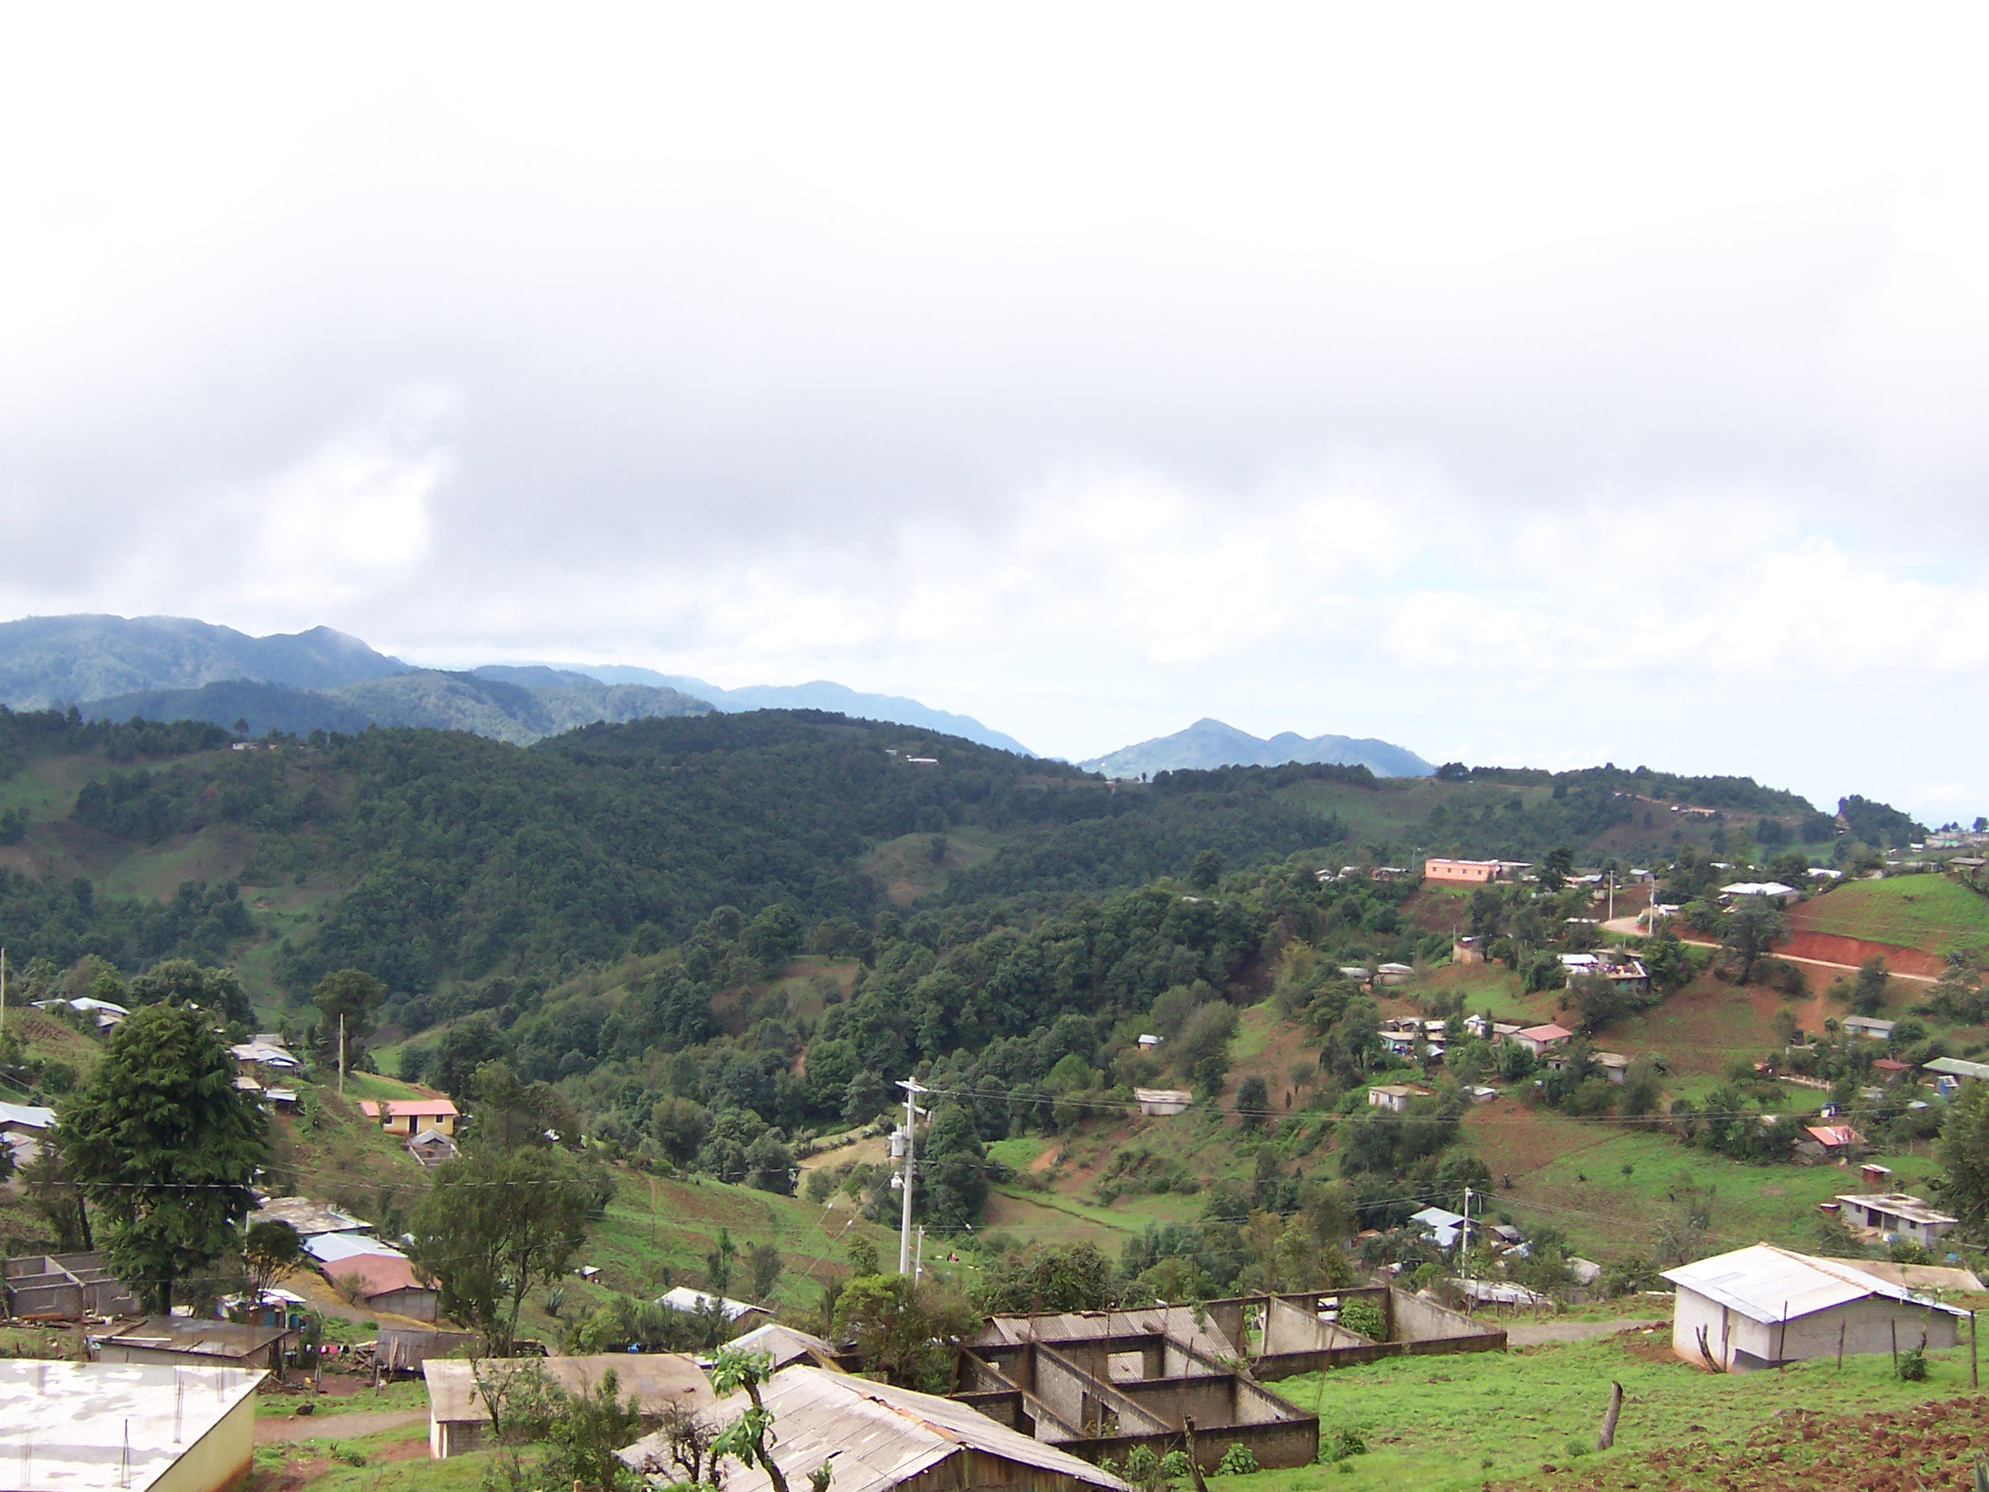
Prosody without intonation
Christian DiCanio
University at Buffalo
cdicanio@buffalo.edu
Richard Hatcher
Hanyang University
richard.j.hatcher.jr@gmail.com

Slide 2
What is intonation?
The linguistically-structured, post-lexical realization of suprasegmentals in human language (Ladd 2008).
Structure = intonational phonology
  Prosodic domains (feet, prosodic words, accentual phrases, utterances)
  Pitch accents (H*+L, L*, H*, etc)
  Boundary tones (H%, L%, etc)
  f0 range/scaling parameters (PENTA model; Xu and Prom-On 2014)
Notes:
We want to focus explicitly on the structural aspects here, as these are inherently testable. Scaling parameters are part of some models

Slide 3
What is not intonation?
Sentence particles do a lot of pragmatic work in tonal and and non-tonal languages, but these are decidedly not intonation per se (Panov 2020, Sybesma and Li 2007, Torreira et al 2014).¹
The arousal state of the speaker (angry, sad, etc) because it is usually not linguistically structured.
Low-level coarticulatory effects, e.g. consonant-induced f0 perturbations (DiCanio 2012, Kirby 2018).
¹ Though, see Hyman and Monaka (2011).

Slide 4
What could be intonation?
Gradient shifts in f0 range and register can be prosodically-delimited.
Upward/downward shifts in f0 register associated with specific prosodic constituents, e.g. in Akan (Genzel and Kügler 2018, Kügler and Genzel 2011) and Mandarin (Xu 1999)
f0 range expansion/contraction associated with information structure, or utterance position, e.g. in Yoloxóchitl Mixtec (DiCanio et al 2018).

Slide 5
Why does this matter?
Many structural units are absent in lexical tone languages, meaning we have to look for intonation outside of the structural categories.
  Pitch accents are either minimal or do not occur: in Mandarin (Xu 1997), Mambila (Connell, 2017), Yoloxóchitl Mixtec (DiCanio et al 2018), and Yoruba (Laniran and Clements, 2003)
  Boundary tones may be absent or may only co-occur with certain tones: in Akan (Kügler 2017), Bàsàá (Makasso et al. 2017), Mandarin (Xu 1999), Taiwanese (Peng 1997), Tswana (Zerbian, 2017), Yoruba (Laniran and Clements, 2003)
Notes:
(Be quick with this slide – there is no reason to name all the languages.) The important point is that we can NOT just look everywhere for intonational effects – we need a constrained theory of what we anticipate.

Slide 6
What does intonation do?
Intonation is delimitative and pragmatic.
We can make strong assumptions about the presence of intonational structure in a language if we have a robust theory about its pragmatic structure.
Grosso modo, we do not expect intonation to do as much pragmatic work in many tone languages as in non-tonal languages (Brunelle et al 2012, Torreira et al. 2014).

Slide 7
Specific claims
Itunyoso Triqui (Otomanguean) is heavily tonal and lacks evidence of intonational structure, though prosodic structure is present.
Experimental work demonstrates that tones are unaffected by utterance position and f0 declination is absent, regardless of the tonal target.
The pragmatic work is done by (a) syntactic structuring, (b) information structural clitics, and (c) a very large set of sentence-final particles.
There is no intonational system in Itunyoso Triqui.

Slide 8
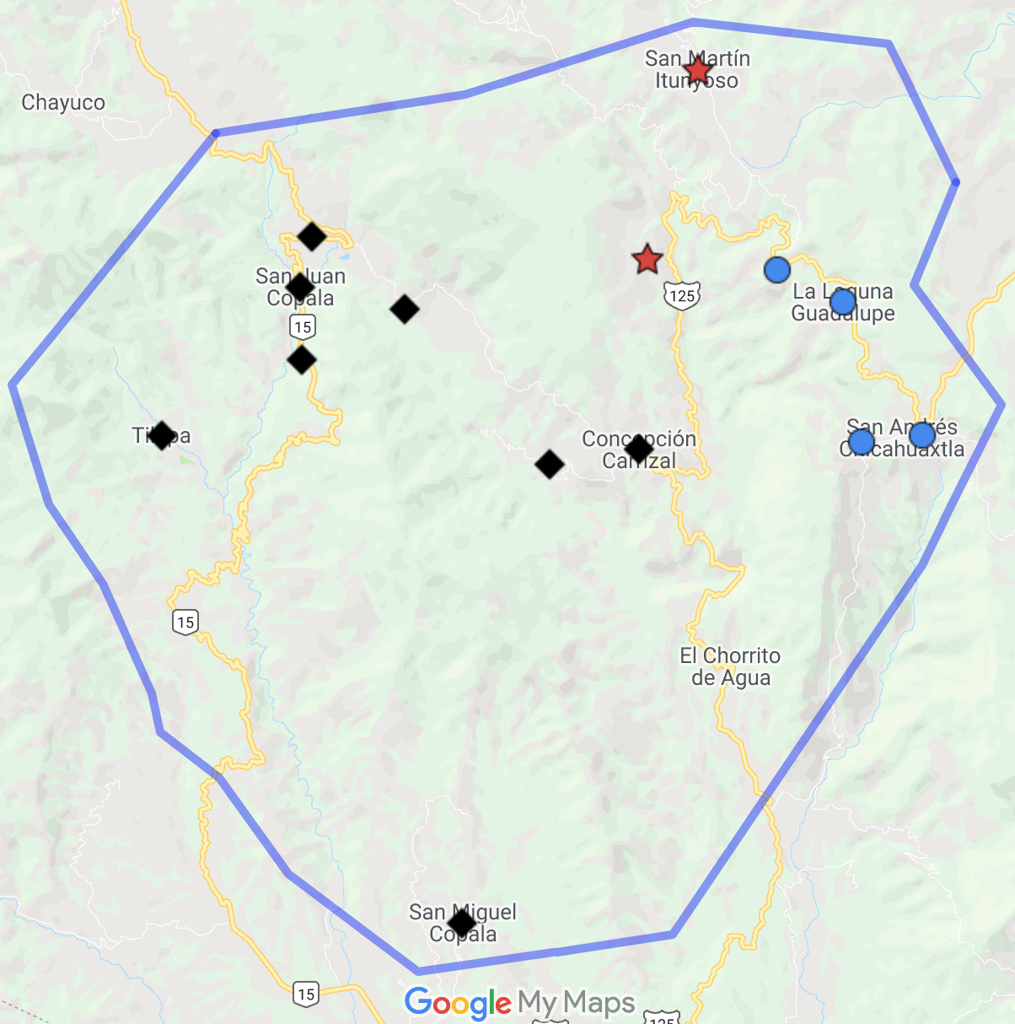
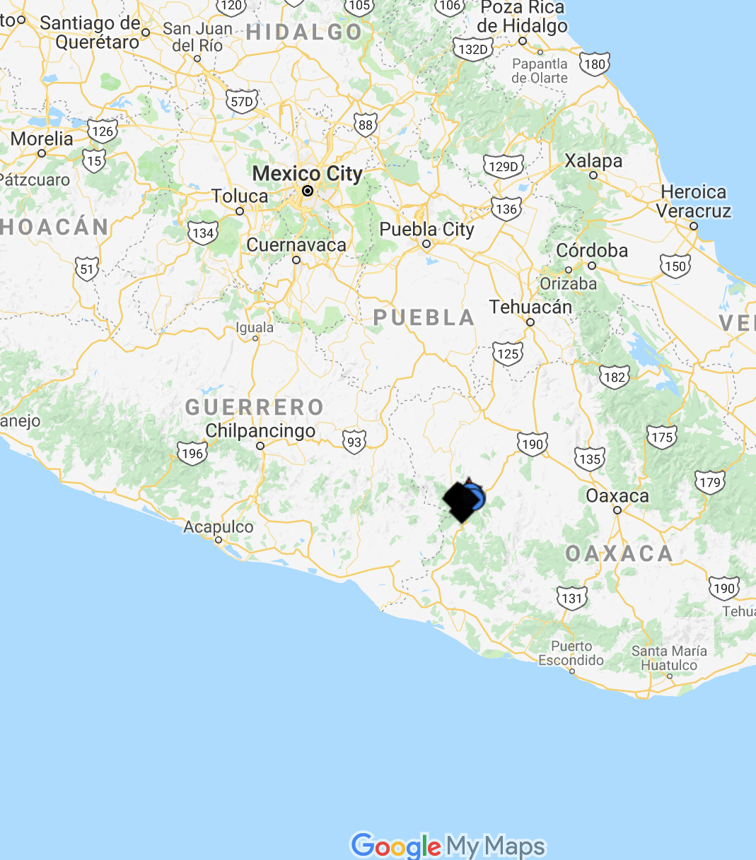
II. Triqui
2630 m
Itunyoso Triqui
(2,700 speakers)
1550 m
2370 m
3 major language variants with limited mutual intelligibility.
All complex tone languages within the Otomanguean (Mixtecan) family.
Copala Triqui
(30K speakers)
Chicahuaxtla Triqui
(4K speakers)

Slide 9
Tone in Triqui
Nine lexical tones /5, 4, 3, 2, 1, 43, 32, 31, 13/ (5 = high)
No tonally-unmarked syllables/morphemes.
Open syllables, but word-final codas /ʔ, h/.
Mostly disyllabic word structure, but tone on non-final syllables is often predictable.
atʃĩ:⁴³ a⁴tʃĩ:⁴³ tone /4/ spreads
‘to pass’ leftward from final σ
Tone is also heavily morphological, encoding verbal aspect, person, topicality, and optative mood.

Slide 10

Tone in monosyllables and disyllables
ββeh⁽³⁾⁵ ‘straw mat / petate’ tʃi³ˀjoh⁵ ‘swamp / ciénaga’
ββe⁴ ‘hair / pelo’ ka³to⁴ ‘shirt / camisa’
nne³ ‘plough / arado’ na³ɾa³ ‘refill / rellenar’
nne² ‘to lie / mentir’ a²mə̃² ‘when / cuando’
nne¹ ‘naked / desnudo’ na¹ka¹ ‘new / nuevo’
nne³² ‘water / agua’ a³βi³² ‘leave / salir’
nne³¹ ‘meat / carne’ a³nĩ¹ ‘explode / estallar’
tʃe⁴³ ‘my father / mi padre’ a⁴ne⁴³ ‘chew / masticar’
ᵑɡa¹³ ‘when (subord) / cuando’ kə̃¹ʔə̃³ ‘four (N) / cuatro'
Notes:
Skip this for time, but it’s there.

Slide 11
Evidence for final stress
Stem-final syllables are longer than preceding syllables within the morpheme (DiCanio 2010, DiCanio and Hatcher 2018).
Distributional evidence – nasal vowels, glottal consonants, prenasalized stops, and contour tones only occur in final syllables.
Virtually identical properties are found throughout Triqui languages (DiCanio, 2008, 2010, 2016; DiCanio et al., 2020; Elliott et al., 2016; Hollenbach, 1984; Hernández Mendoza, 2017).

Slide 12
Foot structure (DiCanio, in progress)
Iambic feet are also important in Triqui prosody
  Final syllables have long vowels or codas
  An iambic foot is the domain of high tone /4/
  Spanish loanwords are preferably borrowed as single iambic feet.
  Antepenults are reduced or deleted more than penults are.
Antepenults are the domain of tonal processes associated with nominal stem formation and verbal aspect, but are otherwise extrametrical.

Slide 13
Triqui prosodic words
Up to two extrametrical syllables are possible.
tʃu³tʃu⁴βa⁴³
‘peanut’
si³-tʃu³tʃu⁴βa⁴³
‘peanut of ...’
si³-tʃu³tʃu⁴βa⁴³=sih³
‘peanut of him’ ~
‘his peanut’

Slide 14
Pragmatic work in Triqui
Enclitics mark degree of backgrounding of pronominal referents, while constituent fronting marks focus.
Speech acts are marked by the presence of sentence-final particles (SFPs), which have been investigated via an NSF language documentation project (2014 – 2019) and an NEH reference grammar project (2023 – present).
Transcription and translation of a spontaneous speech documentation corpus of about 400K words – ongoing work on SFPs.

Slide 15
39 unique SFPs have been identified in Triqui speech
ah³/anh³ | negative focus question | nej³ | ‘also’, additionally | sah¹ | question when considering alternatives
aj³/aj⁵ | tag question w/perfective verbs | nej⁵ | negative commands | sa³yoj³ | counter expectations
bej¹ | strong commands, ‘already!’ | nun² ne⁴³ | expression of anger | staj³ | ‘at all!’
kah¹³ | ‘neither’, negative option | oh¹ | content question | stej³ | already, used w/commands
kaj³⁴ | more than presumed | oj³ | demand for action | stinh⁴ | negative tag question
kaj¹ | tag question w/potential verbs | oj¹ | question used as a response | stoj³ | expresses obligation
koh¹ | manner question | nih⁴ | polar question | toj¹ | expresses lack of understanding
manj⁵ | negative focus statement | noh¹ | repeated question | trunj⁵ | used when suggesting prohibited options
manh³ | negative quotation | raj¹ | lack of certainty | un⁴³ | emphatic questions
minh³ | surely, expression of certainty | rej³ | reported speech | yoj³² | expresses common speaker belief w/out certainty
nanh¹³ | personal belief of speaker | riaj⁵ | used w/giving advice | yu³be³² | confirmation of truthhood
nanj¹³ | distinguishing between quantities | runj³ | partial question | (ya)hnej⁵ | SFP between men
nanj⁵ | expression of finality | saj⁵ | counter expectations | ya³rij⁵ | SFP between women

Slide 16
What’s left for intonation to do in Triqui?
If information structure and speech acts are grammatically-encoded, only the delimitative aspect of intonation remains.
Two experimental studies examined this
  Experiment 1: The effect of utterance position on the production of lexical tone; are there positional allotones in Triqui?
  Experiment 2: The presence of declination while controlling for lexical tone.

Slide 17
III. Experiment 1: Methods
10 tonal melodies were analyzed (3.5, 4.4, 4.43...) in disyllabic words in non-final contexts (before a PP/Adv) and utterance-final contexts.
a. ki³-rãh⁴=neh³ ngo² tʃi³nãh⁵
perf-buy=3p one huipil
‘They bought a huipil gown’
b. ki³-rãh⁴=neh³ ngo² tʃi³nãh⁵ ni³kjãh⁵
perf-buy=3p one huipil Tlaxiaco
‘They bought a huipil gown in Tlaxiaco’
Notes:
Don’t go through the example.

Slide 18
The pre-target word always had tone /2/. The post-target word always had tone /3/, words with glottal codas and open syllables.
400 tokens/speaker (50 words x 2 conditions x 4 repetitions); 11 speakers (6M/5F)
Initial transcription in ELAN and segmentation in Praat. We used a script to analyze F0 dynamics and duration.
Normalized F0 trajectories extracted over 5 time points and converted to log-normal values. Syllable duration also extracted.

Slide 19
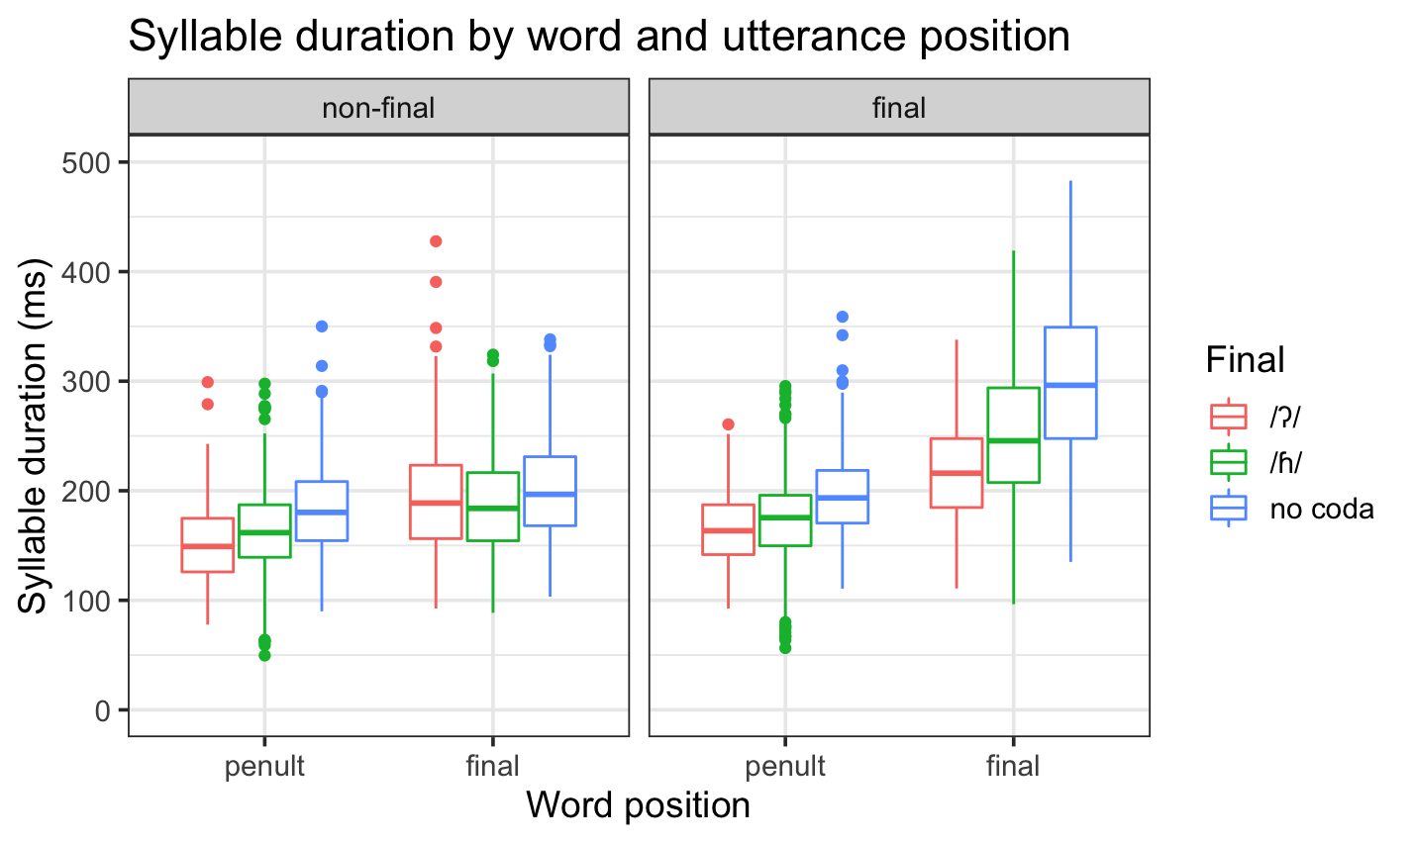
Results: Duration
Final syllables are systematically longer than non-final syllables (stress).
Utterance-final lengthening occurs as well and is (measurably) largest when the target has no coda.

Slide 20
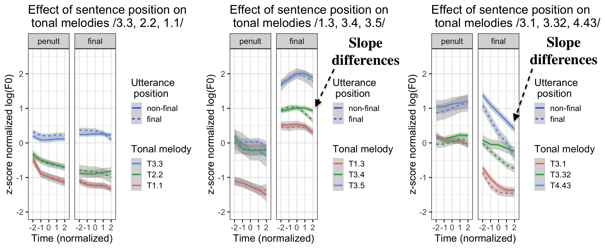
Results: Tone – apparent final lowering

Slide 21
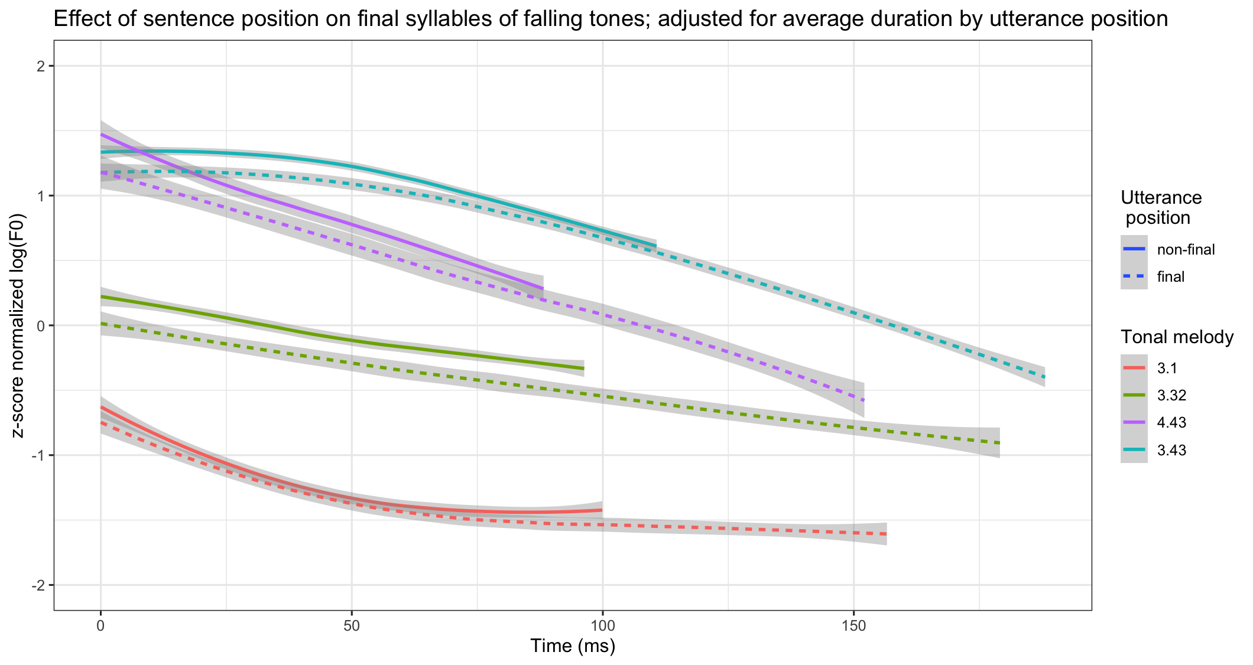
But... it’s due to time normalization!

Slide 22
Interim discussion
Final syllables are longer than non-final syllables and lengthened in utterance-final position.
Minimal eﬀect of utterance position on F0 of falling tones, but no eﬀect on any other tonal melody.
When we undo time normalization, the slope on the falling tones across utterance positions revealed them to be equivalent.
Tones are not qualitatively different in utterance medial vs. final position.
There are no boundary tones.

Slide 23
IV. Experiment 2: Methods
The same population of speakers participated in Experiment 2 as in Experiment 1.
F0 data encoded similarly, but we visualize f0 from the end of the utterance (not all tonal contexts had sentences of the same size).
Intensity contours also extracted.
Generalized additive mixed models (GAMMs) were used to estimate f0 changes across the utterance.

Slide 24
Stimuli – sequences of identical tones
Notes:
“We controlled for the tonal sequence – all words had the same tone in the utterance.”

Slide 25
Results: F0 does not vary across the utterance
k-a³ju³ ne³tã³ ɾi³ki³ tʃi³lu³ All tone /3/
perf-fall bean stomach cat
‘The beans fell under the cat.’

Slide 26
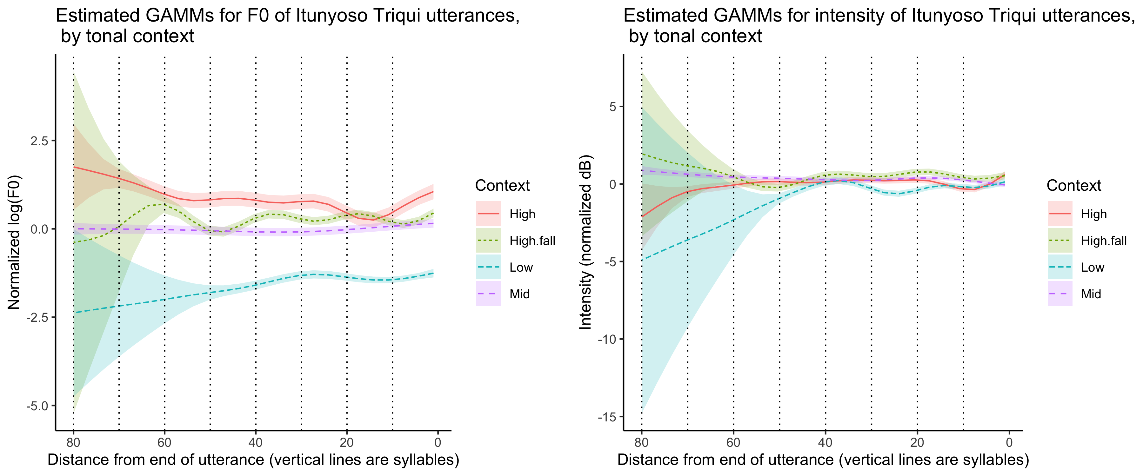
Neither f0 nor intensity significantly varied across the utterance.

Slide 27
V. Discussion
While there is clear evidence of prosodic structure in Triqui, there is neither evidence for intonational structure nor any other utterance-level shifts in f0 associated with declination.
With the exception of utterance-final lengthening, variable, delimitative aspects of intonation appear to be absent.
If neither structural nor delimitative aspects of intonation are observed, Triqui must lack intonation.

Slide 28
Phrasal effects occur in tone languages – a tone may have an alternate realization in different positions of the utterance (c.f. DiCanio et al. 2021 for a discussion).
Why might Triqui lack intonation? It has several unique features:
  A large inventory with 5 tone levels and morphological tone
  An exceedingly large number of sentence-final particles (39!)
  Alternate grammatical means for marking information structure
SFPs in Triqui all have underlying tones, but it remains an open question whether these can be modulated with pragmatics (c.f. Luksaneeyanawin 1998 on Thai).

Slide 29
Should we keep looking for intonation? No.
If we make a universalist assumption about intonation, then it is unclear what evidence ever counters our findings.
Absence of observed contrasts in phonological inventories is often evidence for a lack of contrast.
If the null hypothesis is “there is no intonation”, we have to motivate all structure with evidence. We have found no motivation for intonation so far (after 21 years of fieldwork).

Slide 30

Acknowledgements – Thank you!
Basileo Martínez Cruz and Benigno Cruz Martínez
Support from NSF DEL/RI grant 1603323, Understanding Prosody and Tone Interactions through Documentation of Two Endangered Languages
Funding support from the National Endowment for the Humanities Grant FN-291125-23 A reference grammar of Itunyoso Triqui [ISO 639-3 trq].
ku²ru⁴a⁴³ a³ni²ʔĩh⁵reʔ¹!

Slide 31
References
Brunelle, M., Hạ, K. P., & Grice, M. (2012). Intonation in Northern Vietnamese. The Linguistic Review, 29, 3–36.
Connell, B. (2017). Tone and Intonation in Mambila. In Downing, L. J. and Rialland, A., editors, Intonation in African Tone Languages, pages 132–166. Berlin/Boston: De Gruyter.
DiCanio, C. (2010). Illustrations of the IPA: San Martín Itunyoso Trique. Journal of the International Phonetic Association, 40(2):227–238.
DiCanio, C. (2012). Coarticulation between tone and glottal consonants in Itunyoso Trique. Journal of Phonetics, 40(1):162–176.
DiCanio, C. (in progress). A reference grammar of Itunyoso Triqui. Language Science Press.
DiCanio, C., Benn, J., and Castillo García, R. (2018). The phonetics of information structure in Yoloxóchitl Mixtec. Journal of Phonetics, 68:50–68.
DiCanio, C., Benn, J., and Castillo García, R. (2021). Disentangling the effects of position and utterance-level declination on the production of complex tones in Yoloxóchitl Mixtec. Language and Speech, 64(3):515–557.
DiCanio, C. and Hatcher, R. (2018). On the non-universality of intonation: Evidence from Triqui. Journal of the Acoustical Society of America, 144:1941.
Elliott, A. R., Edmondson, J. A., and Sandoval Cruz, F. (2016). Illustrations of the IPA: Chicahuaxtla Triqui. Journal of the International Phonetic Association, 46(3):351–365.
Genzel, S. and Kügler, F. (2018). Production and perception of question prosody in Akan. Journal of the International Phonetic Association, (1–32).

Slide 32
Gussenhoven, C. (2004). The Phonology of Tone and Intonation. Research Surveys in Linguistics. Cambridge University Press.
Gussenhoven, C. (2016). Foundations of intonational meaning: Anatomical and physiological factors. Topics in Cognitive Science, 8:425–434.
Hernández Mendoza, F. (2017). Tono y fonología segmental en el triqui de Chicahuaxtla. PhD thesis, Universidad Nacional Autónoma de México, Mexico City.
Hollenbach, B. E. (1984). The Phonology and Morphology of Tone and Laryngeals in Copala Trique. PhD thesis, University of Arizona, Tucson.
Hyman, L. M. and Monaka, K. C. (2011). Tonal and Non-tonal Intonation in Shekgalagari. In Frota, S., Elordieta, G., and Prieto, P., editors, Prosodic categories: Production, Perception, and Comprehension, pages 267–290. Springer Verlag.
Kirby, J. P. (2018). Onset pitch perturbations and the cross-linguistic implementation of voicing: Evidence from tonal and non-tonal languages. Journal of Phonetics, 71:326–354.
Kügler, F. (2017). Tone and intonation in Akan. In Downing, L. J. and Rialland, A., editors, Intonation in African Tone Languages, pages 89–129. Berlin/Boston: De Gruyter.
Kügler, F. and Genzel, S. (2011). On the prosodic expression of pragmatic prominence: The Case of Pitch Register Lowering in Akan. Language and Speech, 55(3):331–359.
Ladd, D. (2008). Intonational phonology. Cambridge University Press, Cambridge, UK, 2nd edition.

Slide 33
Laniran, Y. O. and Clements, G. N. (2003). Downstep and high raising: interacting factors in Yoruba tone production. Journal of Phonetics, 31(2):203–250.
Luksaneeyanawin, S. (1998). Intonation in Thai. In Hirst, D. and Di Cristo, A., editors, Intonation Systems: A survey of twenty languages, chapter 21, pages 376–394. Cambridge University Press.
Makasso, E.-M., Hamlaoui, F., and Lee, S. J. (2017). Aspects of the intonational phonology of Bàsàá. In Downing, L. J. and Rialland, A., editors, Intonation in African Tone Languages, pages 167–193. Berlin/Boston: De Gruyter.
Ohala, J. J. (1983). Cross-language use of pitch: An ethological view. Phonetica, 40:1–18.
Ohala, J. J. (1994). The frequency code underlies the sound symbolic use of voice pitch. In Hinton, L., Nichols, J., and Ohala, J. J., editors, Sound Symbolism, pages 325–347. Cambridge University Press.
Panov, V. (2020). Final particles in Asia: establishing an areal feature. Linguistic Typology, 24(1):13–70.
Peng, S.-h. (1997). Production and perception of Taiwanese tones in different tonal and prosodic contexts. Journal of Phonetics, 25(3):371–400.
Sybesma, R. and Li, B. (2007). The dissection and structural mapping of Cantonese sentence final particles. Lingua, 117(10):1739–1783.
Torreira, F., Roberts, S. G., and Hammarström, H. (2014). Functional trade-off between lexical tone and intonation: typological evidence from polar-question marking. In Proceedings of the 4th Tonal Aspects of Language Symposium, pages 100–103. Nijmegen, the Netherlands.

Slide 34
Xu, Y. (1997). Contextual tonal variations in Mandarin. Journal of Phonetics, 25:61–83.
Xu, Y. (1999). Effects of tone and focus on the formation and alignment of F0 contours. Journal of Phonetics, 27(1):55–105.
Xu, Y. and Prom-on, S. (2014). Toward invariant functional representations of variable surface fundamental frequency contours: Synthesizing speech melody via model-based stochastic learning. Speech Communication, 57:181–208.
Zerbian, S. (2017). Sentence intonation in Tswana (Sotho-Tswana group). In Downing, L. J. and Rialland, A., editors, Intonation in African Tone Languages, pages 393–433. Berlin/Boston: De Gruyter.

Slide 35
Is intonation primitive, universal, or emergent?
A set of biological bases for pitch variation drive intonational patterning in many languages (Gussenhoven 2004, 2016)
  Frequency code: pitch height is associated with dominance (Ohala 1983, 1994)
  Eﬀort code: articulatory eﬀort (F0 height) is iconic with degree of linguistic emphasis
  Production/respiratory code: Boundary-related F0 eﬀects are associated with breathing and are related to topicality, finality, etc.

Slide 36
Declination is sensitive to tone category in Yoloxóchitl Mixtec (DiCanio et al. 2021)
Sequences of low tones (T1) and mid tones (T3) undergo utterance-level declination, but high tones (T4) undergo raising.
Observed and statistically modeled data shown.

Slide 37
Morphological load of tone
Sole exponent for verbal aspect tʃa⁴³ tʃa²
perf.eat pot.eat
Exponent for 1s, 1p clitics tʃah⁴ tʃah¹
perf.eat.1s pot.eat.1s
tʃoʔ⁴ tʃoʔ²
perf.eat.1p pot.eat.1p
Exponent of topical and tʃah³ tʃah²³
emphatic/optative marking perf.eat.top pot.eat.top
tʃaʔ⁴ tʃaʔ²⁴
perf.eat.emph pot.eat.opt

Slide 38
Tones in carriers (from DiCanio 2012)
Notes:
This is here to provide people with expectations.

