Slide 1
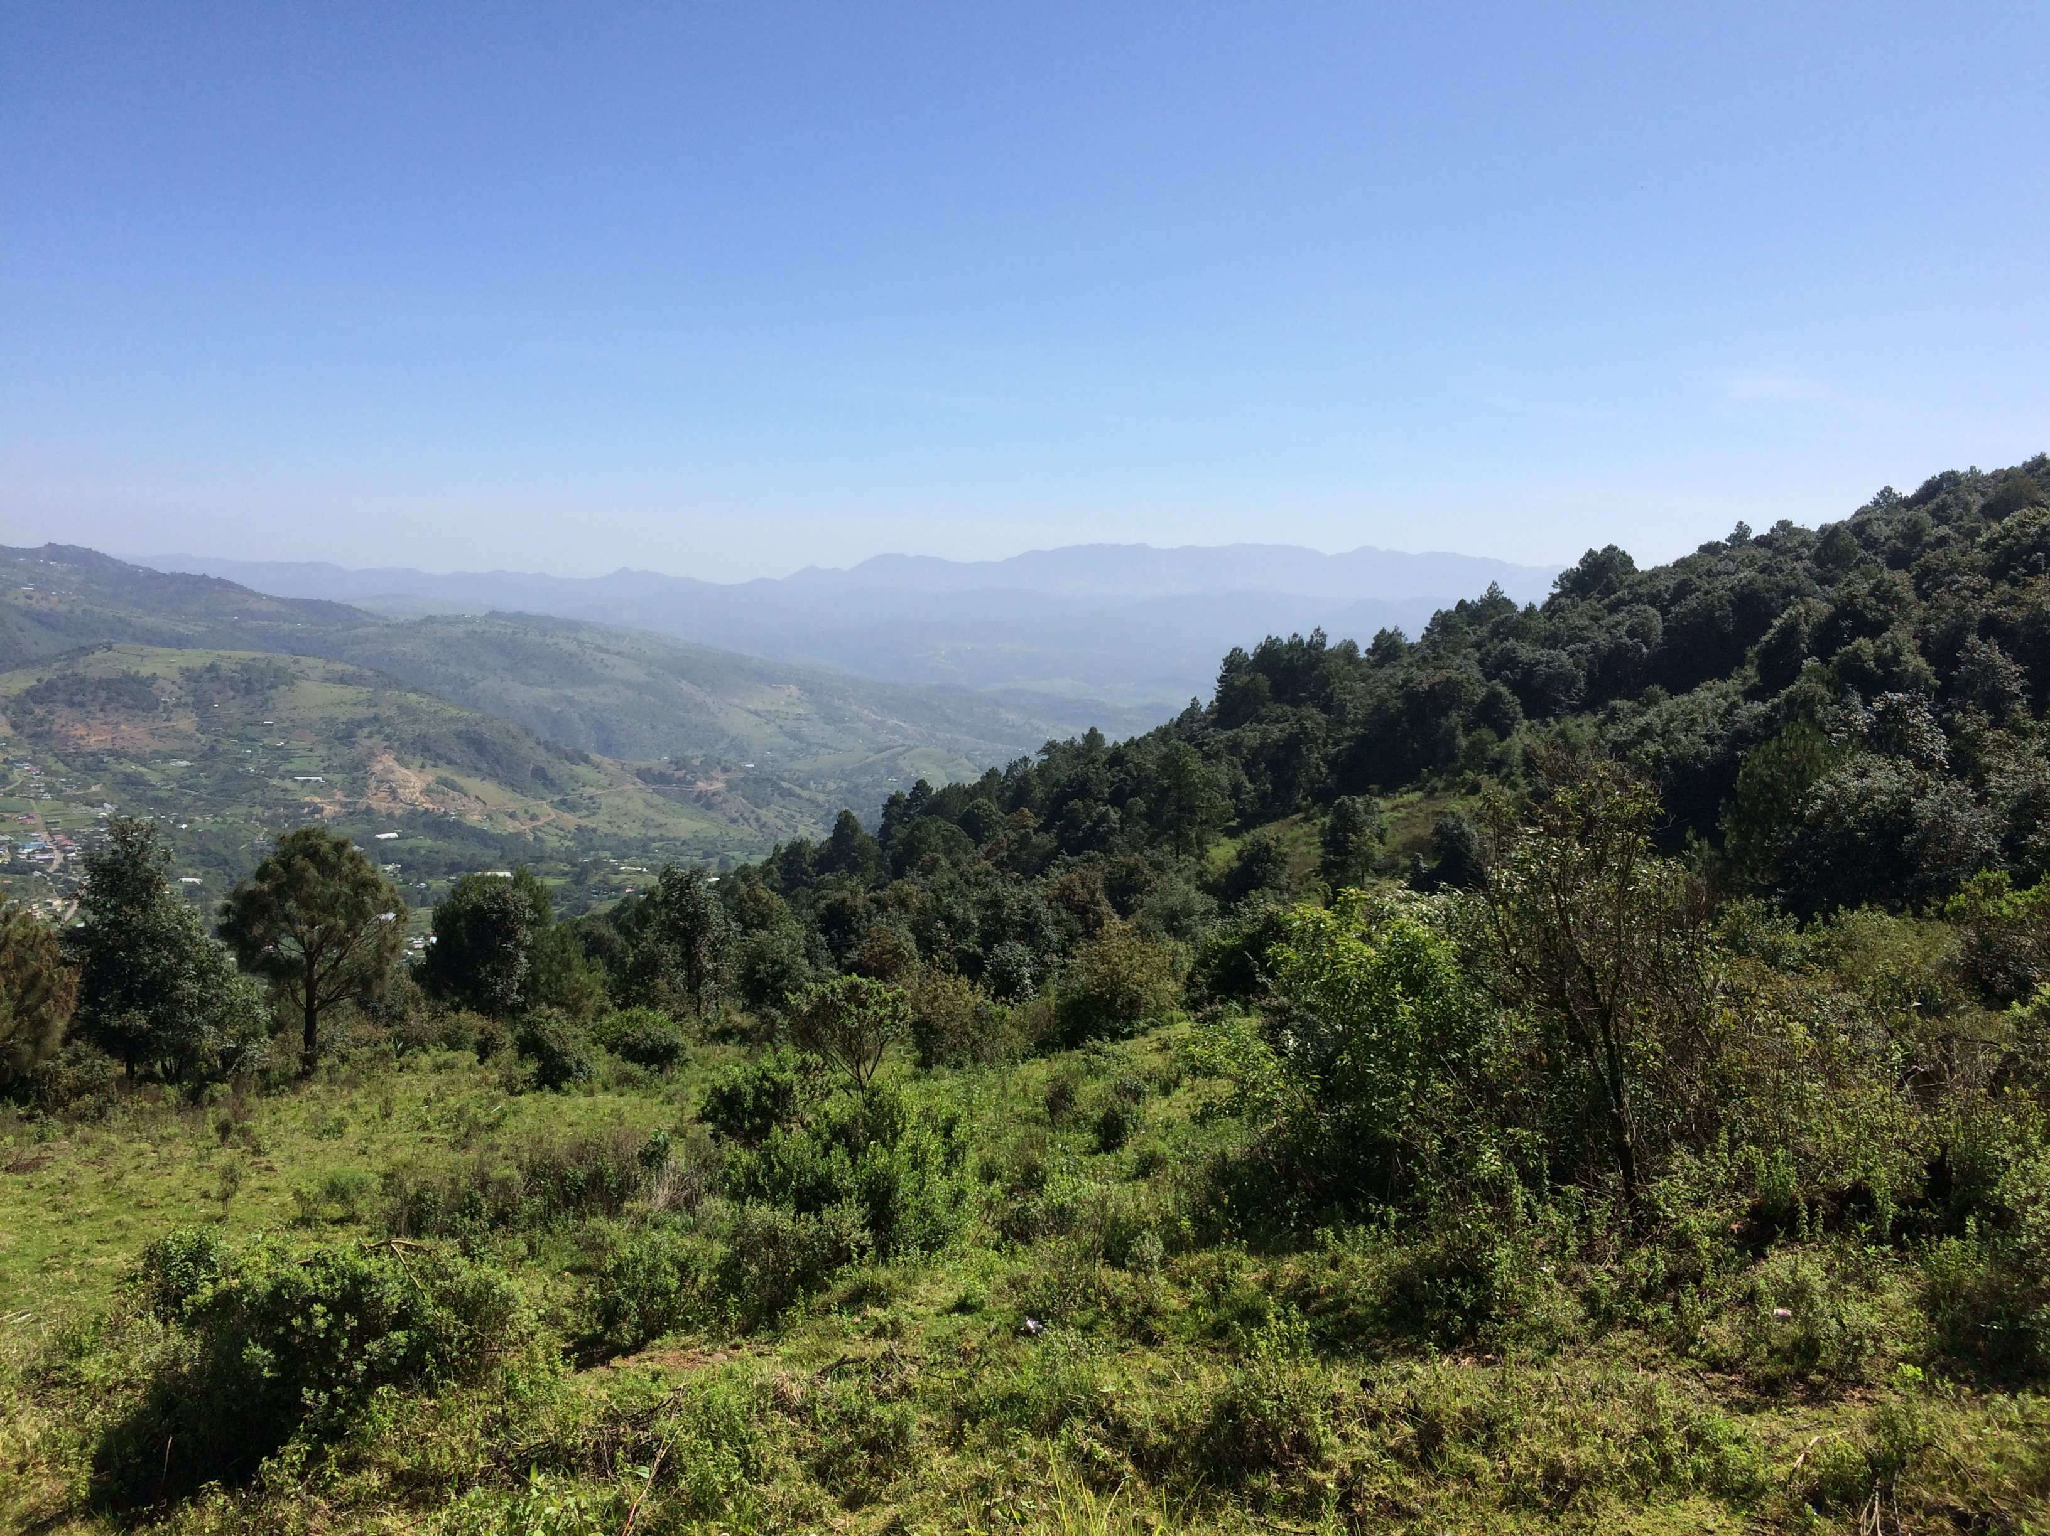
The Structure of Itunyoso Triqui: an overview Linguistics 460/560 Spring 2024
Christian DiCanio
University at Buffalo
cdicanio@buffalo.edu

Slide 2
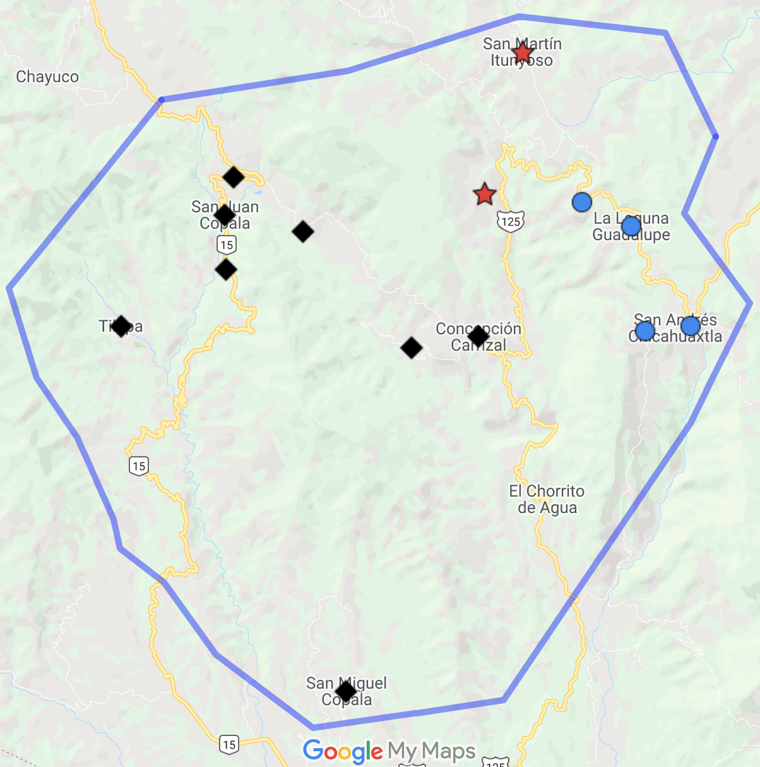
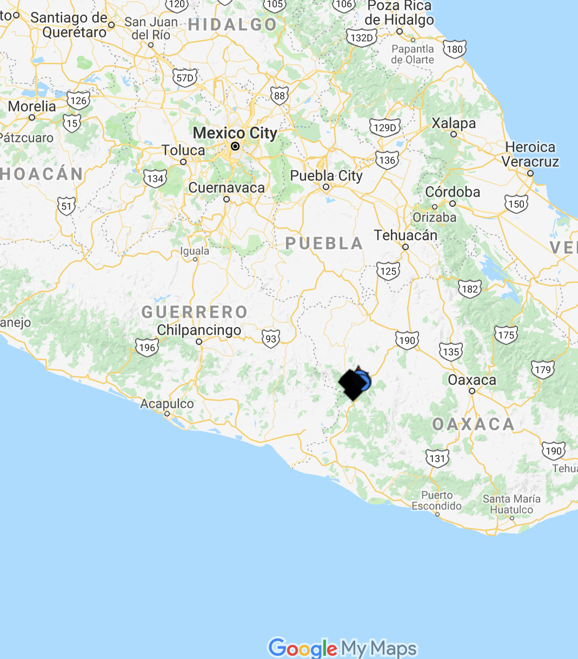
I. Triqui languages
2630 m
Itunyoso Triqui
(2,700 speakers)
1550 m
3 major language variants with limited mutual intelligibility.
All complex tone languages within the Mixtecan family.
Average distance between the major Triqui regions is ~5 km, but it is very mountainous terrain with large elevation differences.
2370 m
Copala Triqui
(30K speakers)
Chicahuaxtla Triqui
(4K speakers)

Slide 3
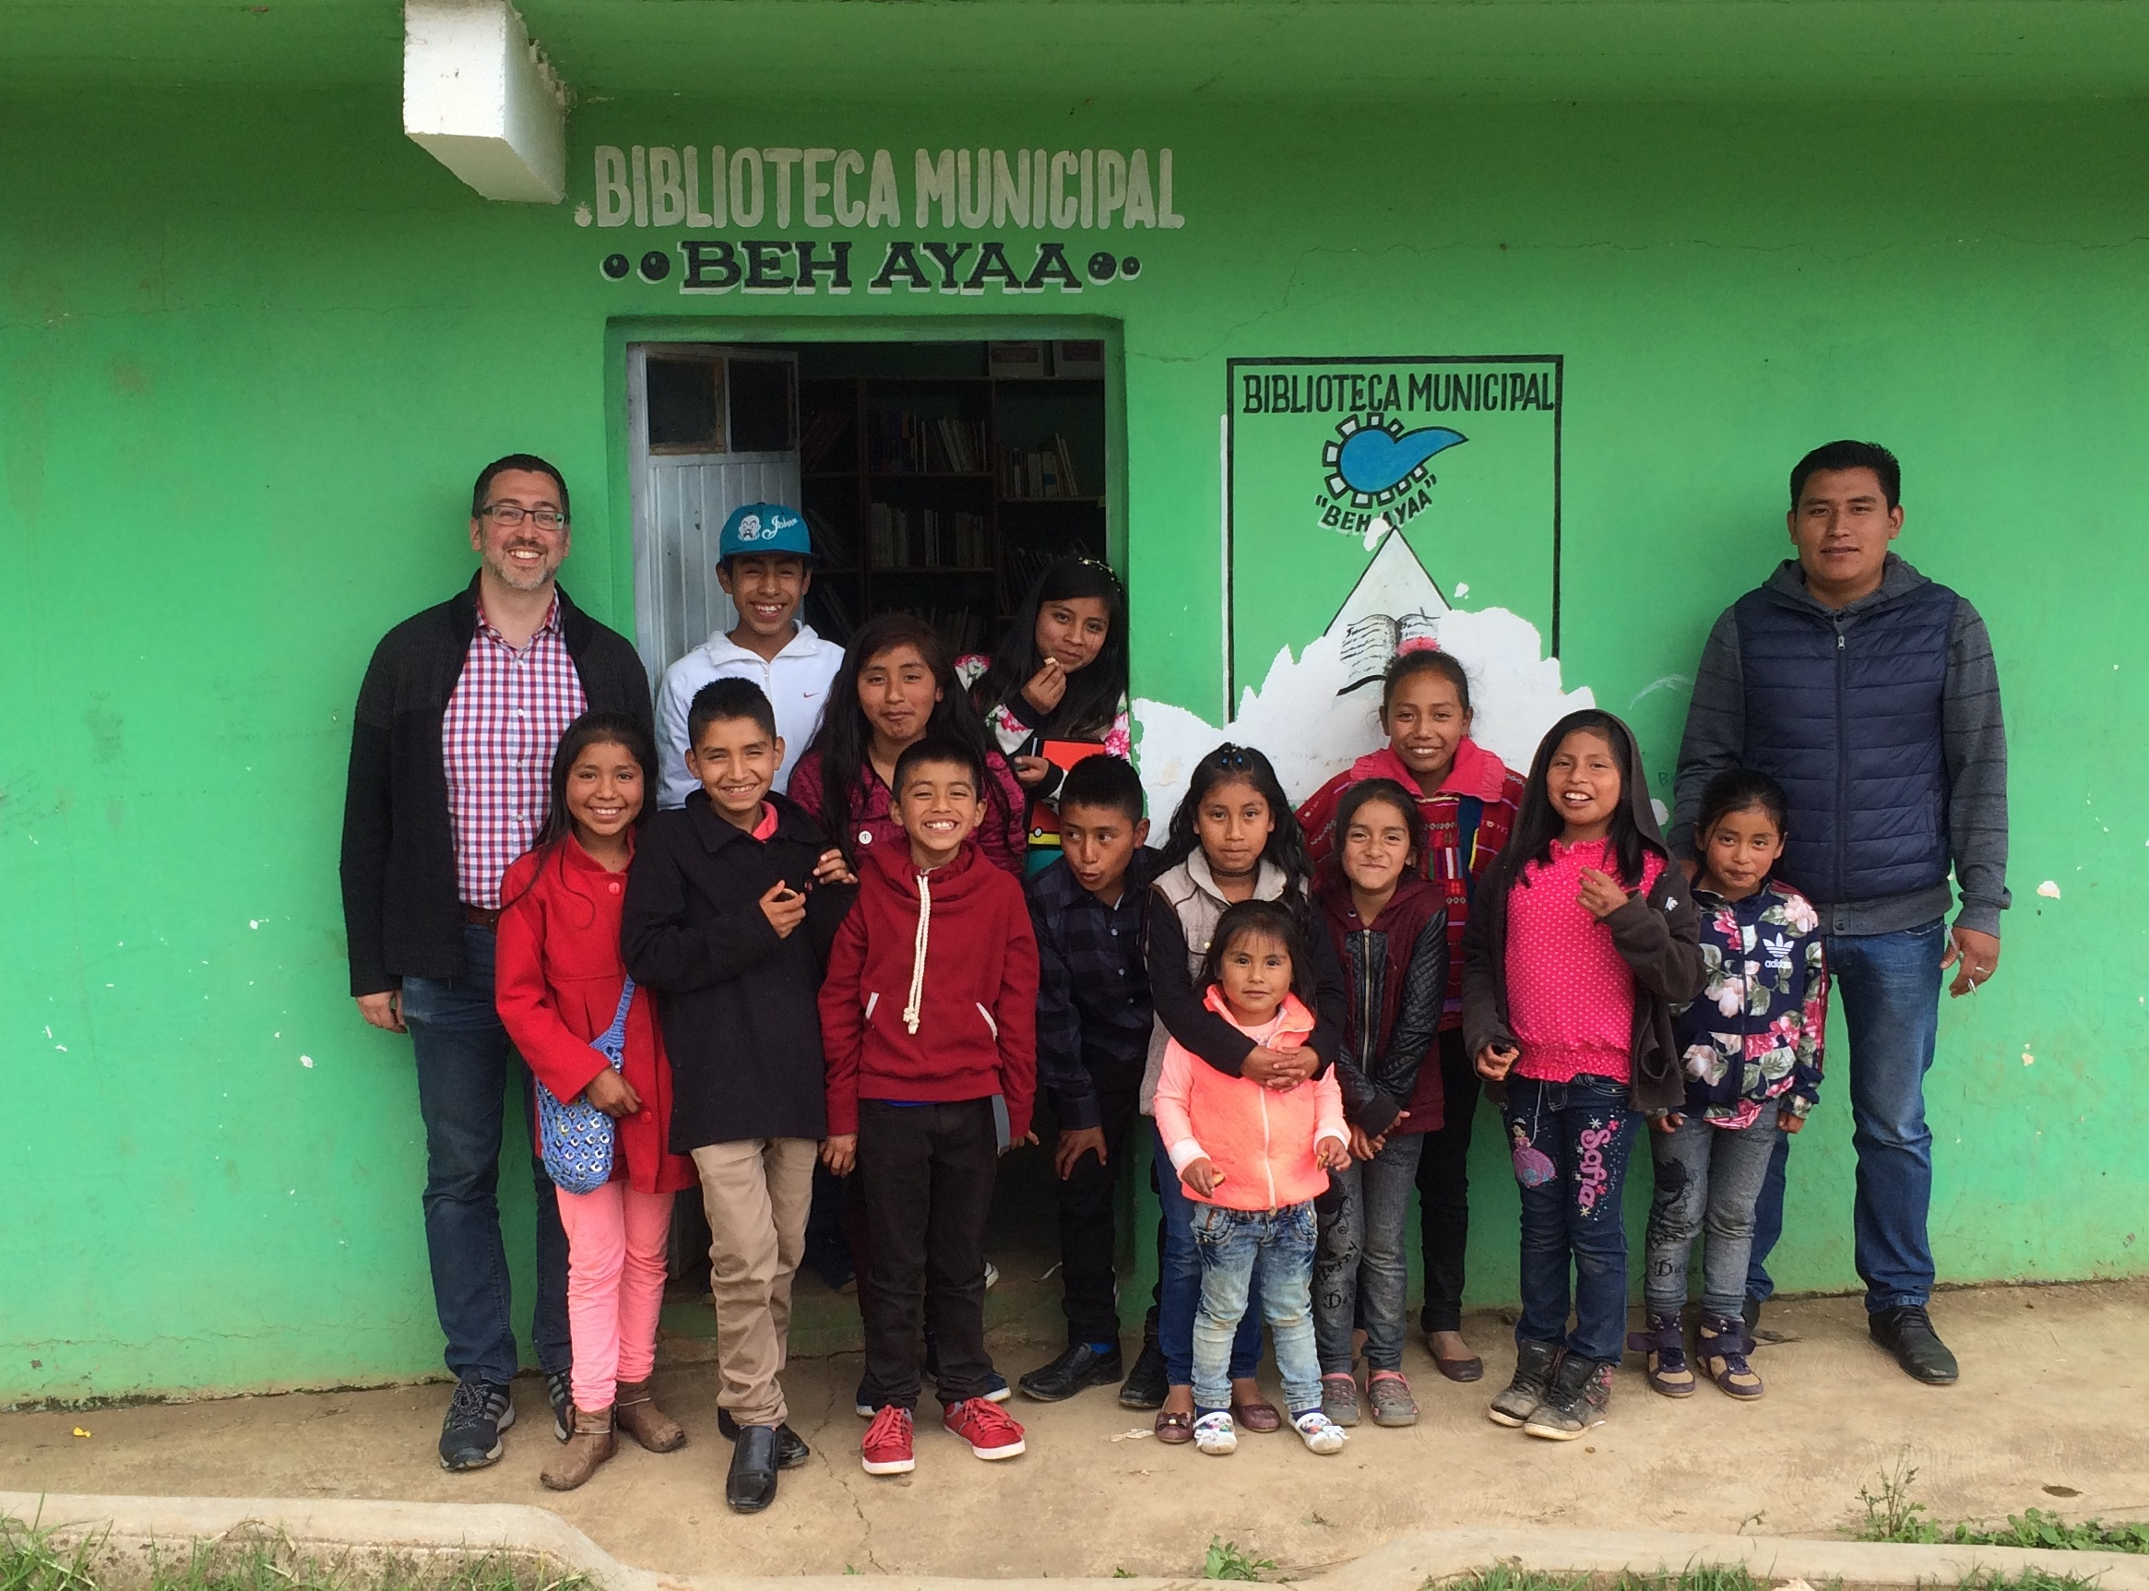
Language vitality
Most people identifying as Triqui in Mexico speak Triqui, including children.
The situation is very different in expatriate communities that have moved away from the Triqui region.
Most people under 50 are bilingual in Spanish.

Slide 4
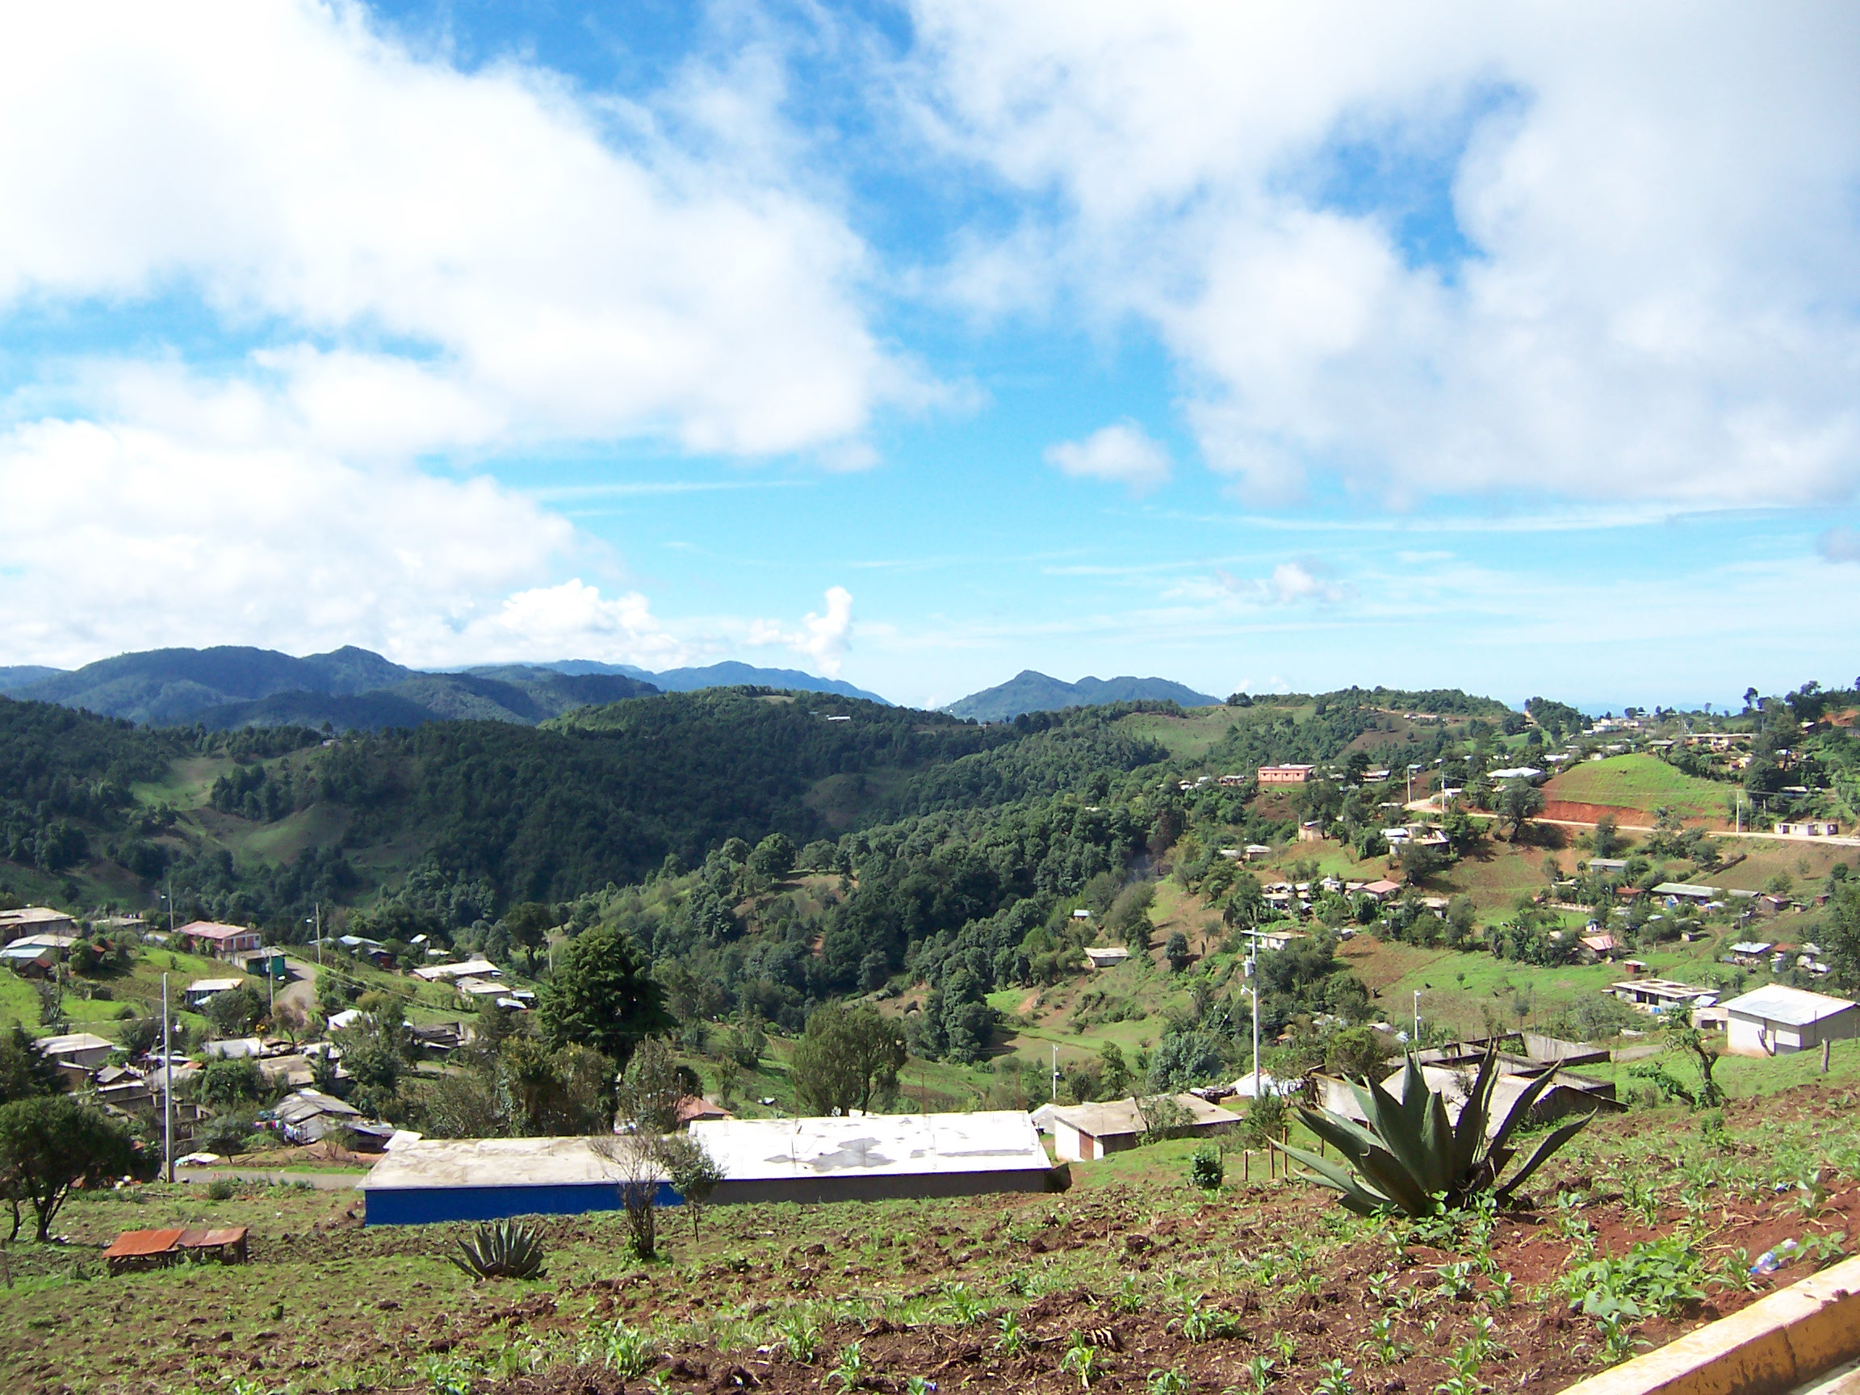
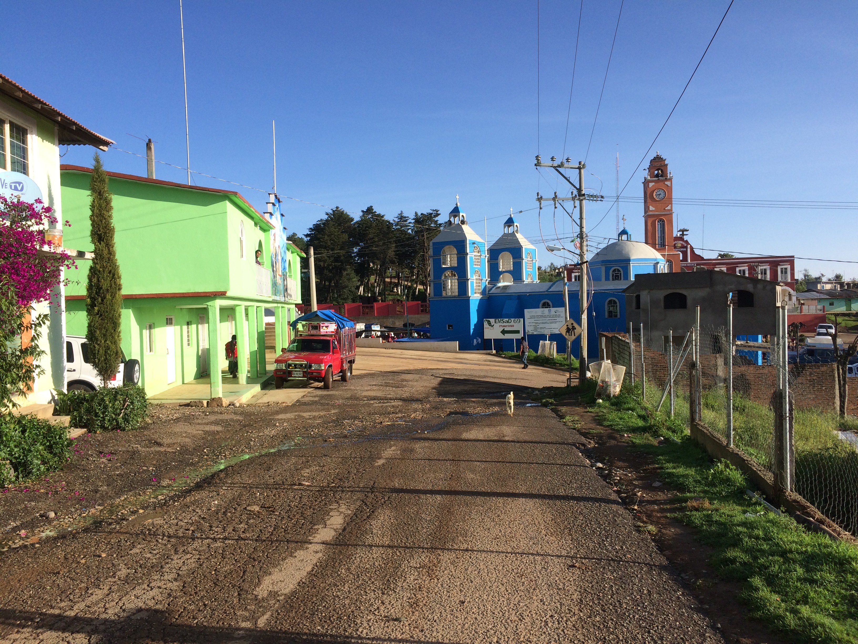
San Martín Itunyoso
There are two towns where Itunyoso Triqui is spoken: San Martín Itunyoso (shown) and the smaller agencia of La Concepción Itunyoso (not shown), which is a 5-10 minute drive away on the other side of the valley.

Slide 5
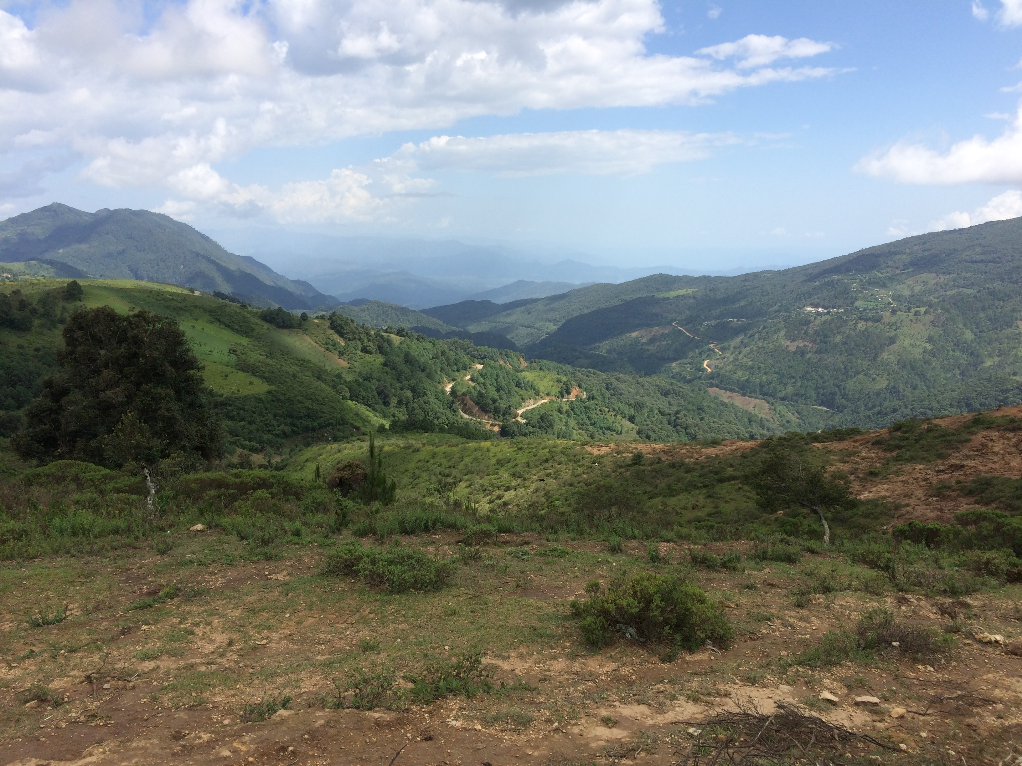
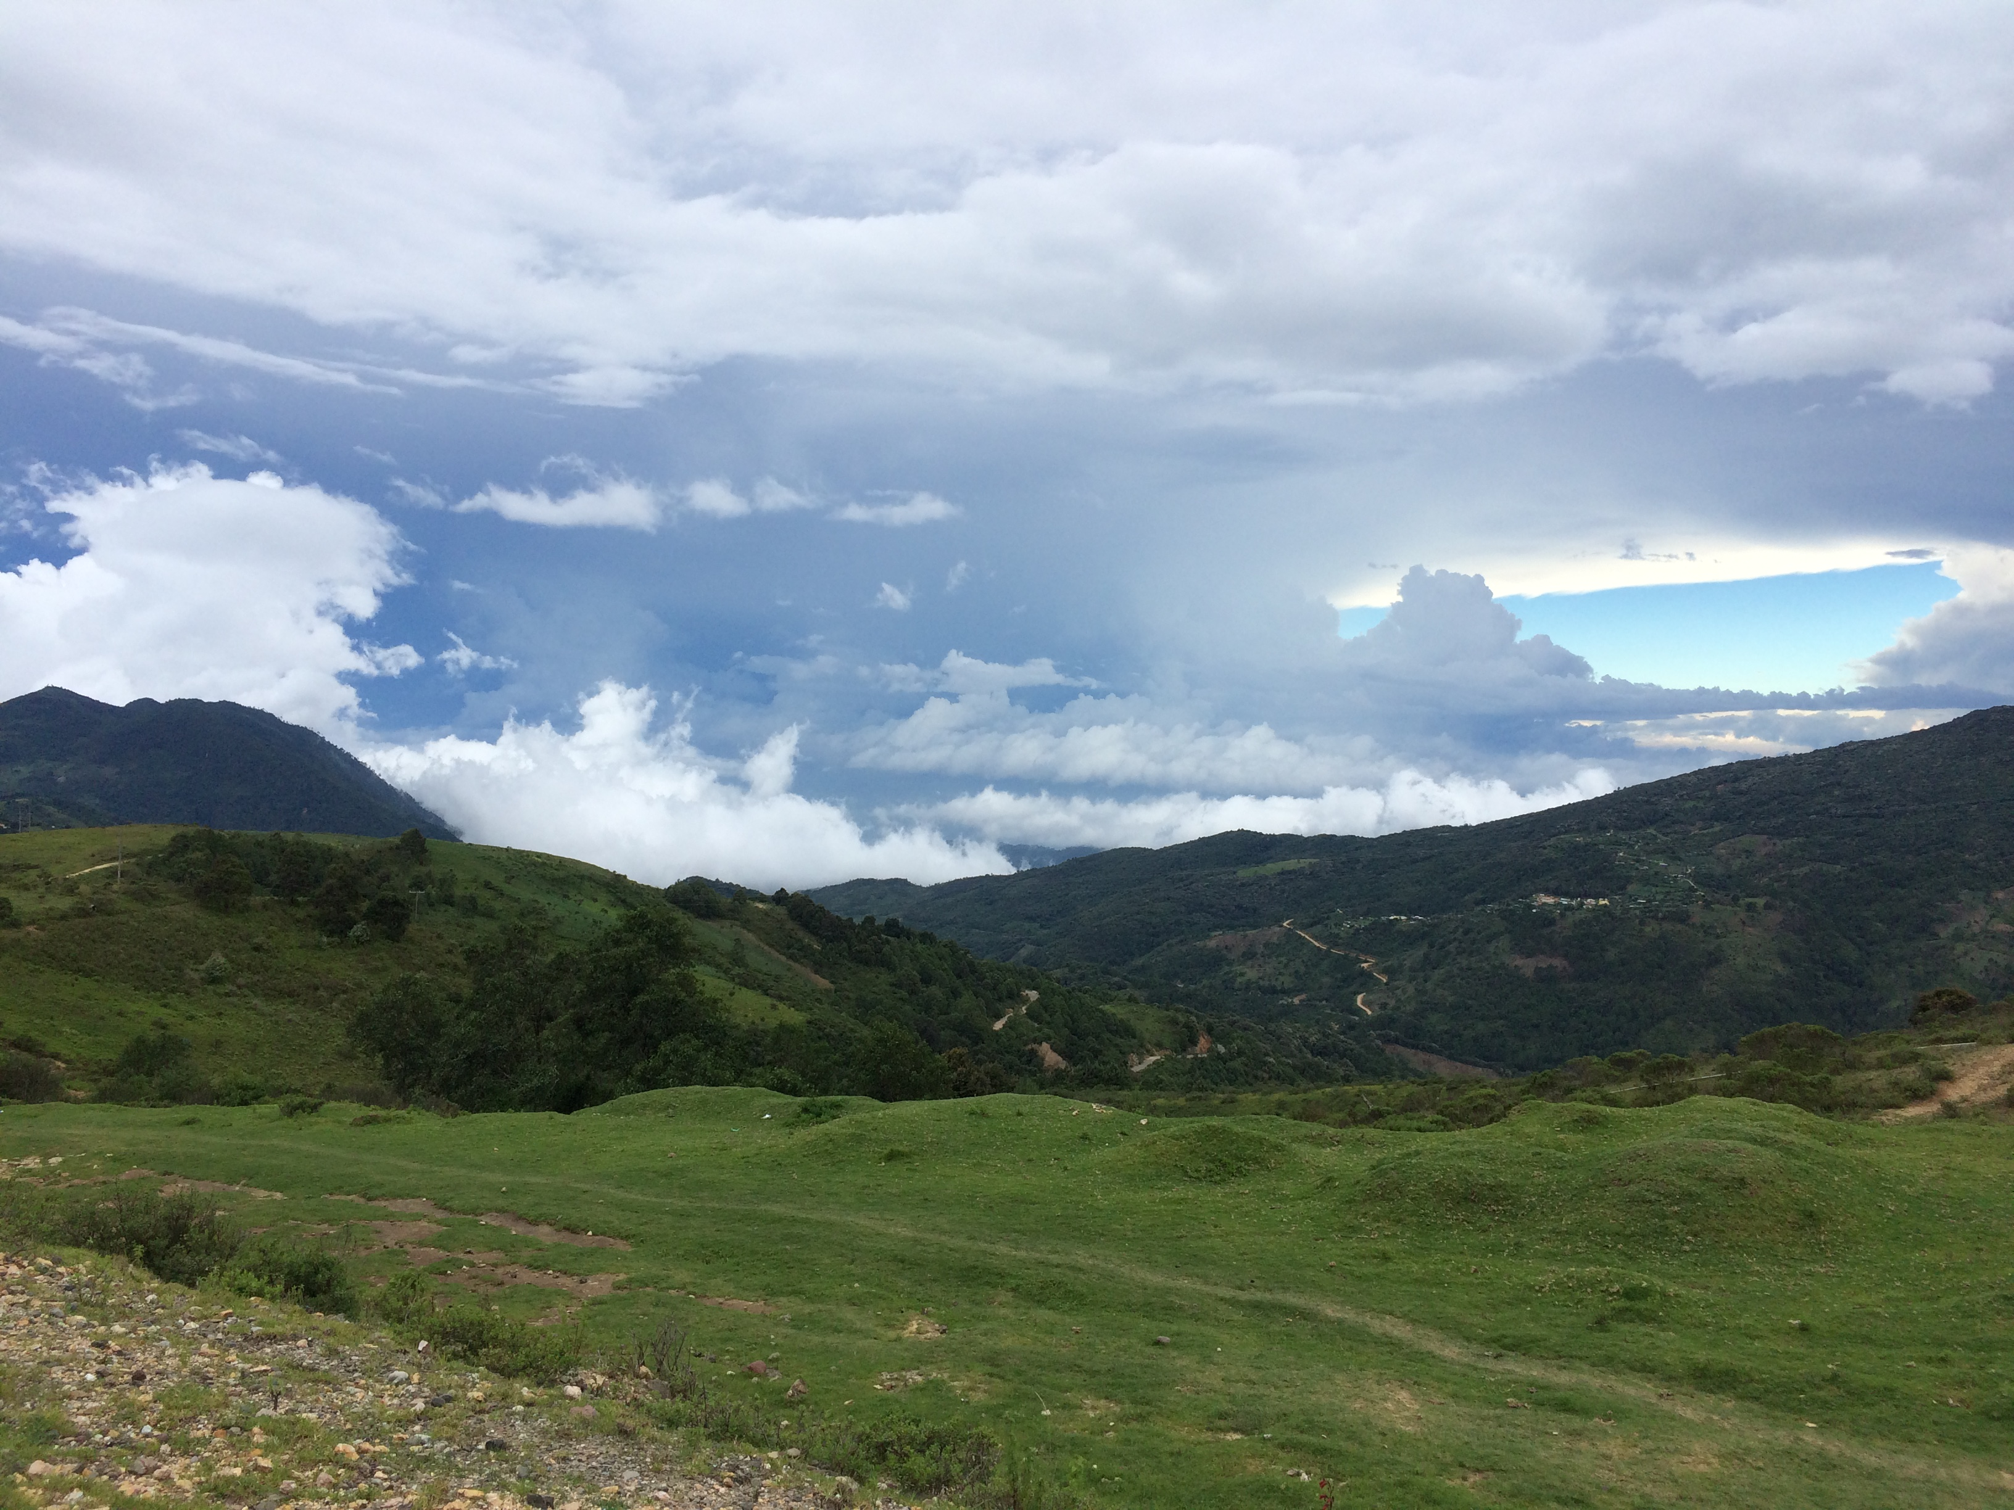
At 2600 meters, it is a very mountainous region. From certain points you look “down” on the clouds. Clouds roll in most afternoons to cover the town in a thick fog.

Slide 6
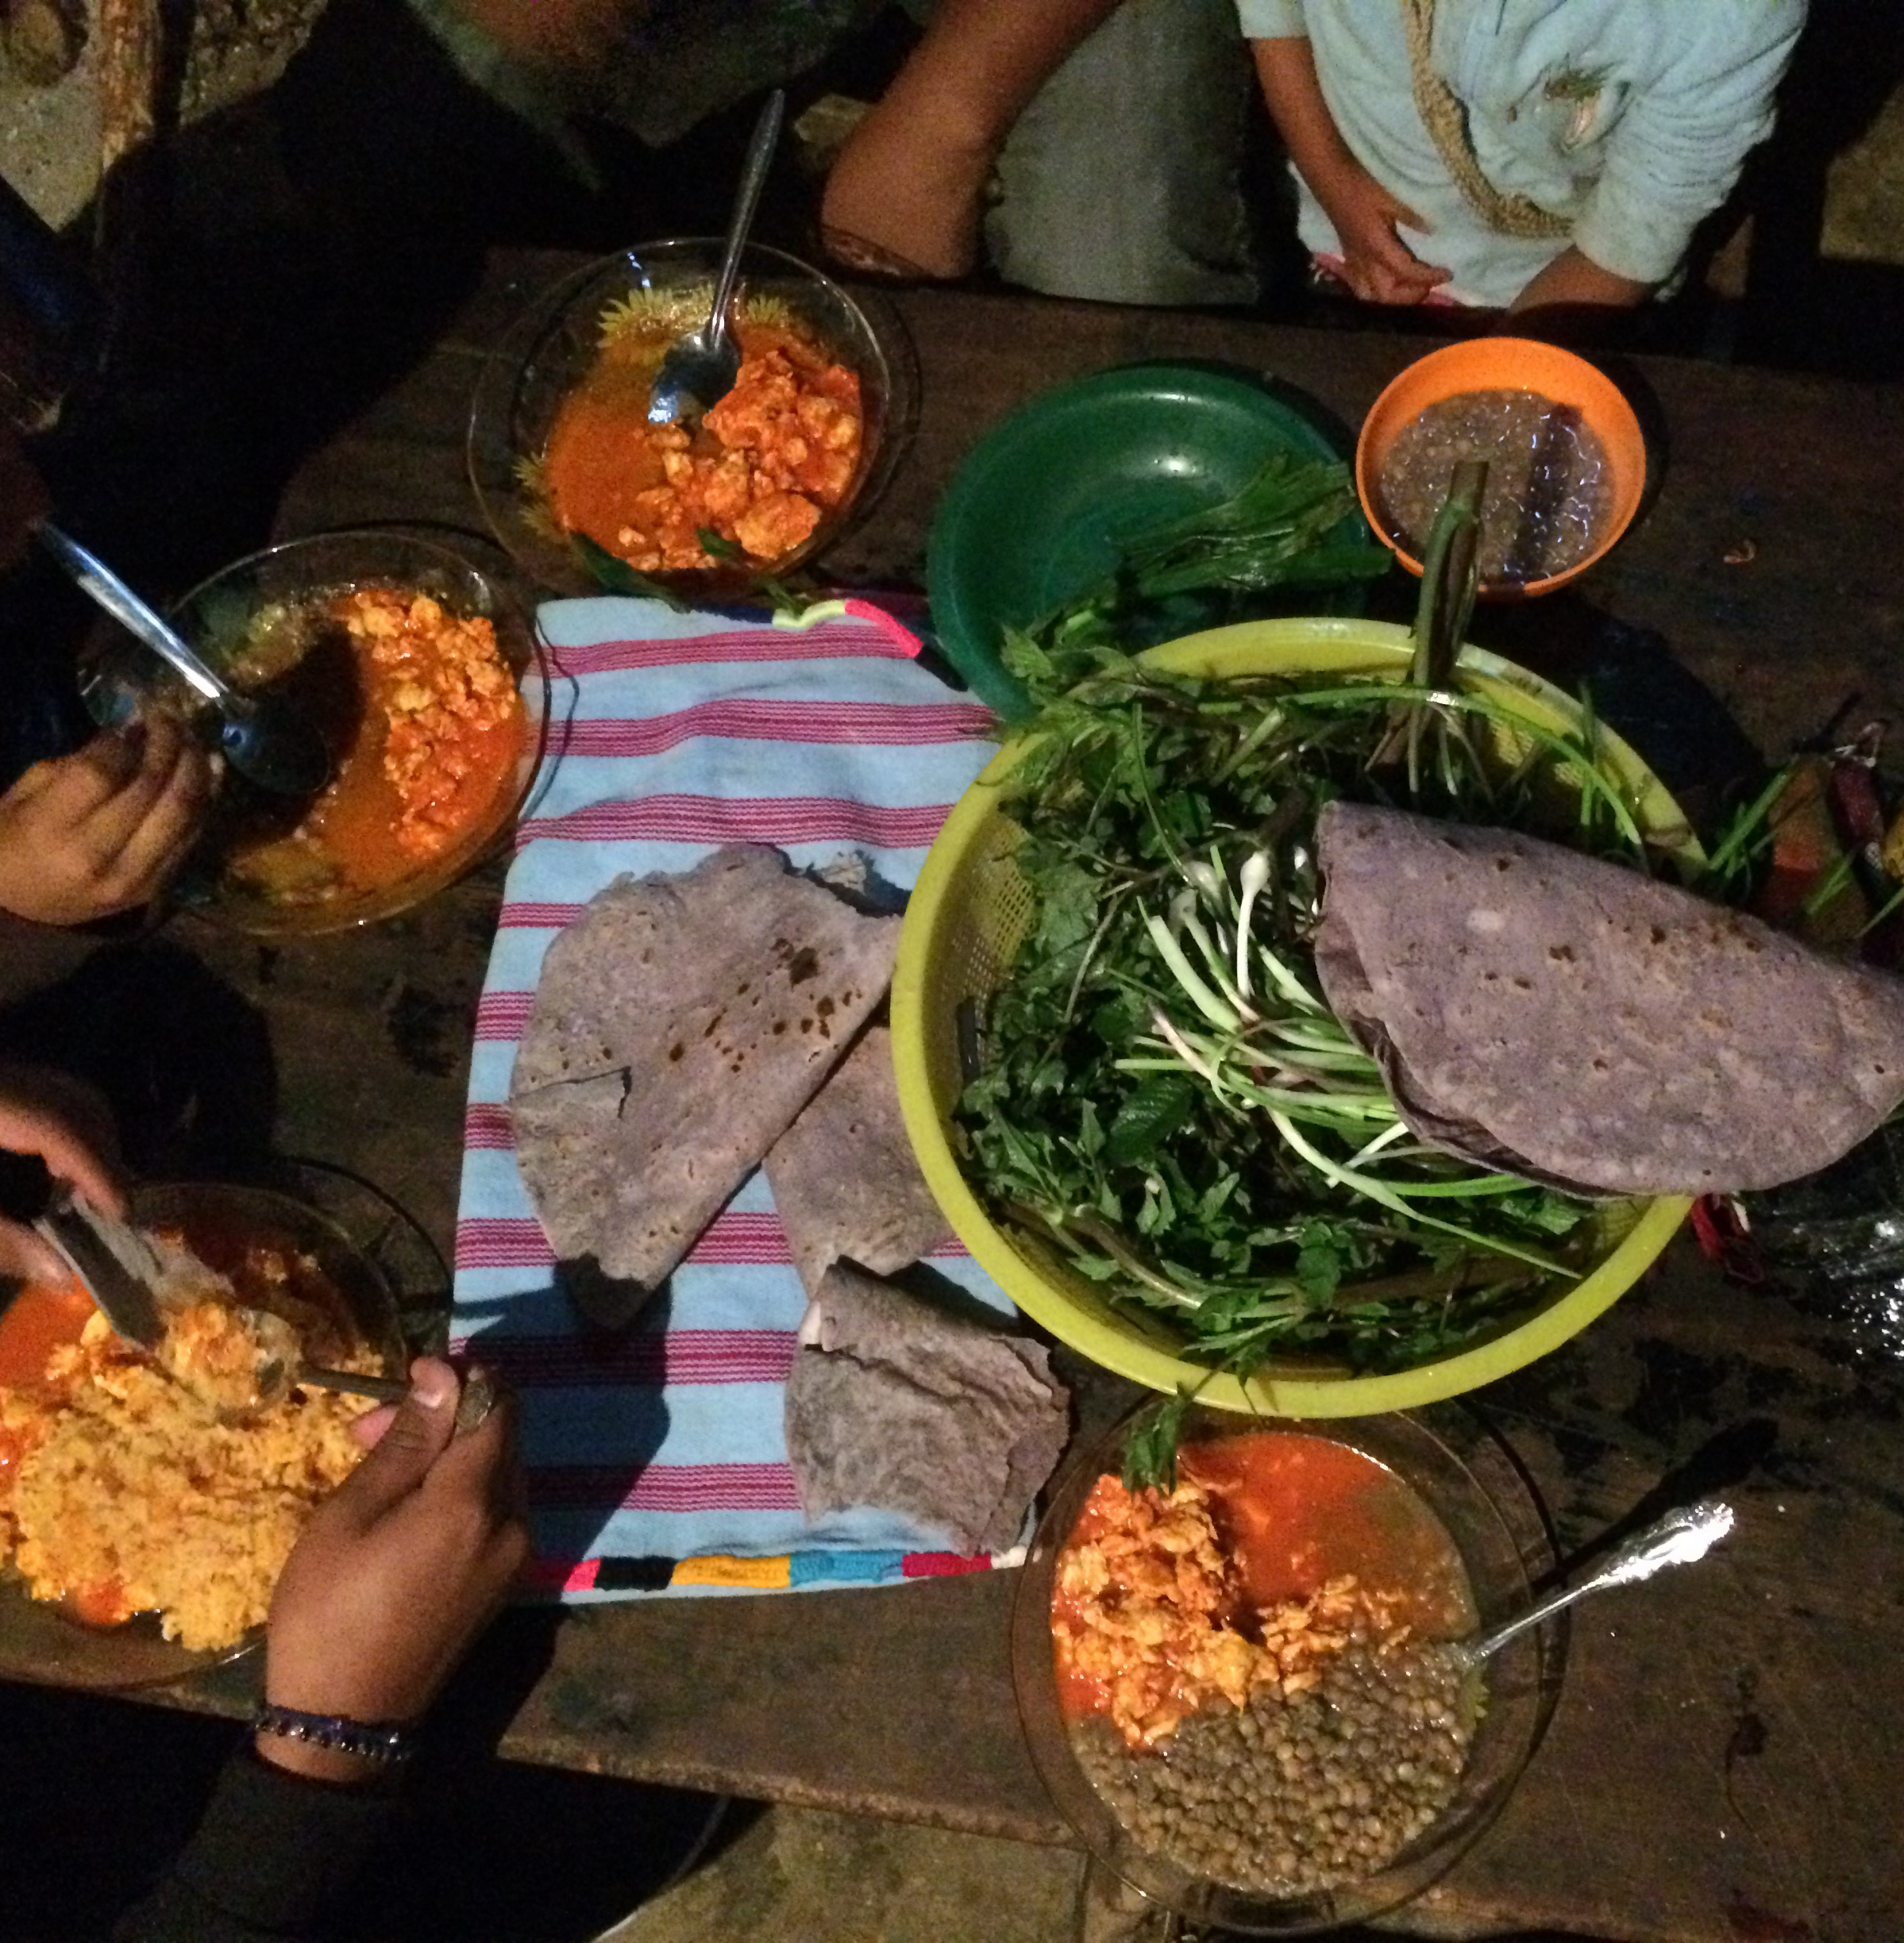
Triqui food/agriculture
Most work in the town is subsistence agriculture, with some foods sold at local markets. Women sell woven goods (bags, shawls, purses, laptop covers, huipiles).
There are over 40 types of quelites (edible greens) that are eaten locally. They are either harvested or foraged.

Slide 7
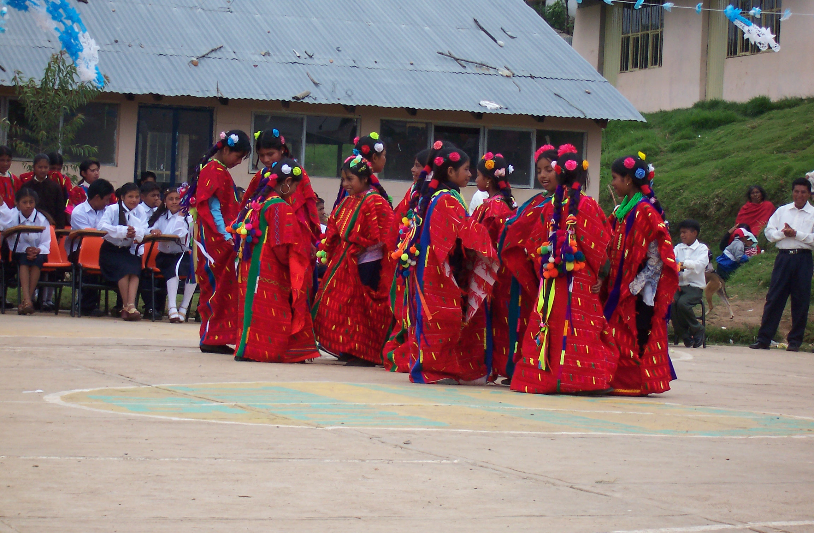
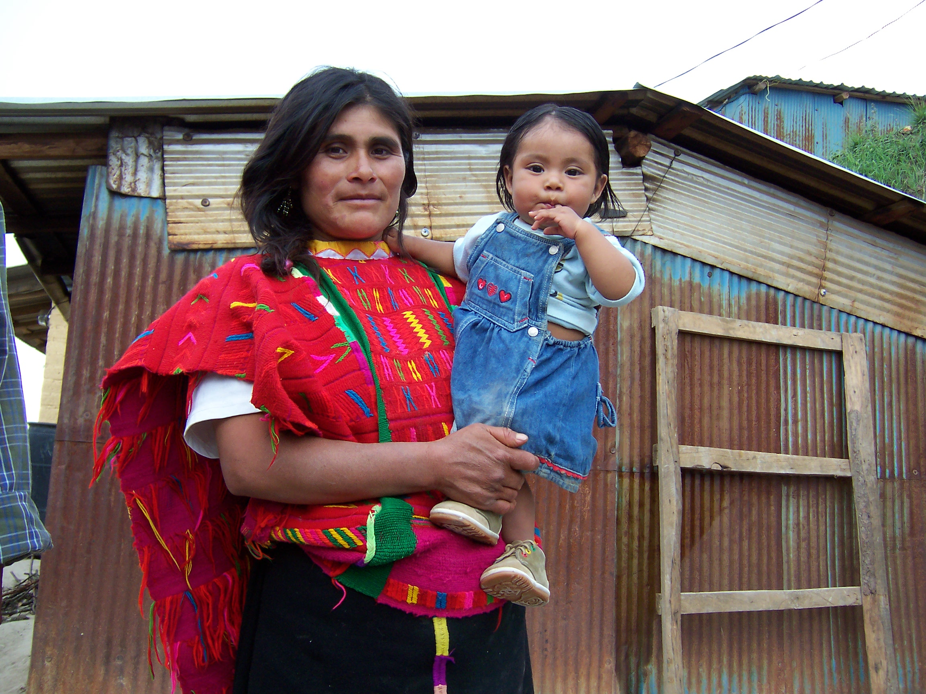
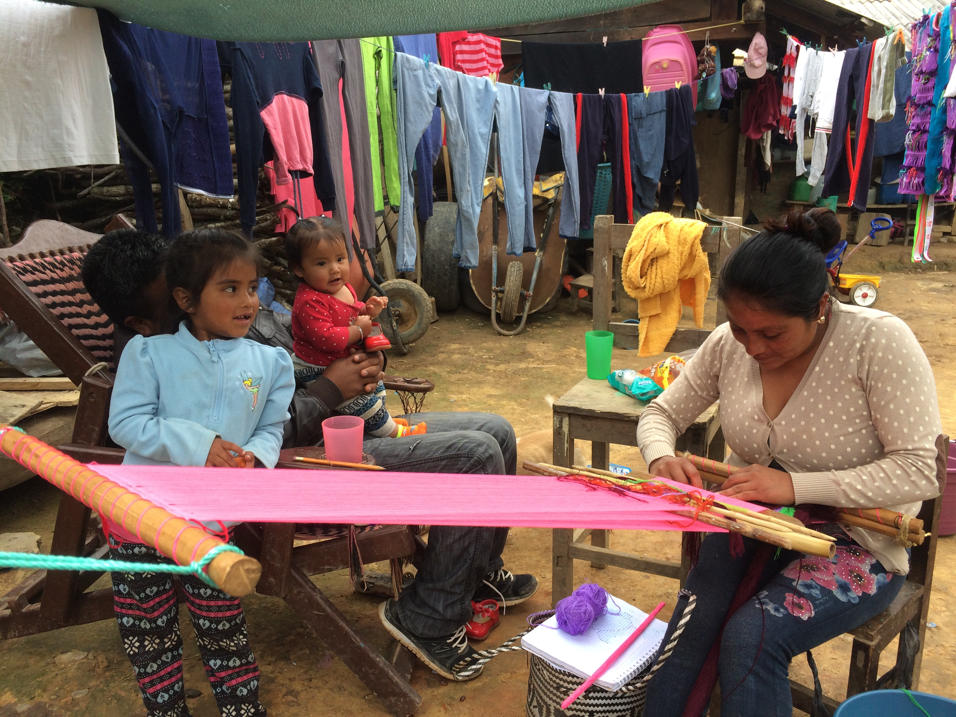
Weaving is extremely elaborate and completed by hand on a loom tied to a tree/post at one end and a mecapal (weaving belt) tied around the weaver’s waist at the other end.
The large red dress is a huipil [wiˈpil] and it is traditionally worn by women in the village.

Slide 8
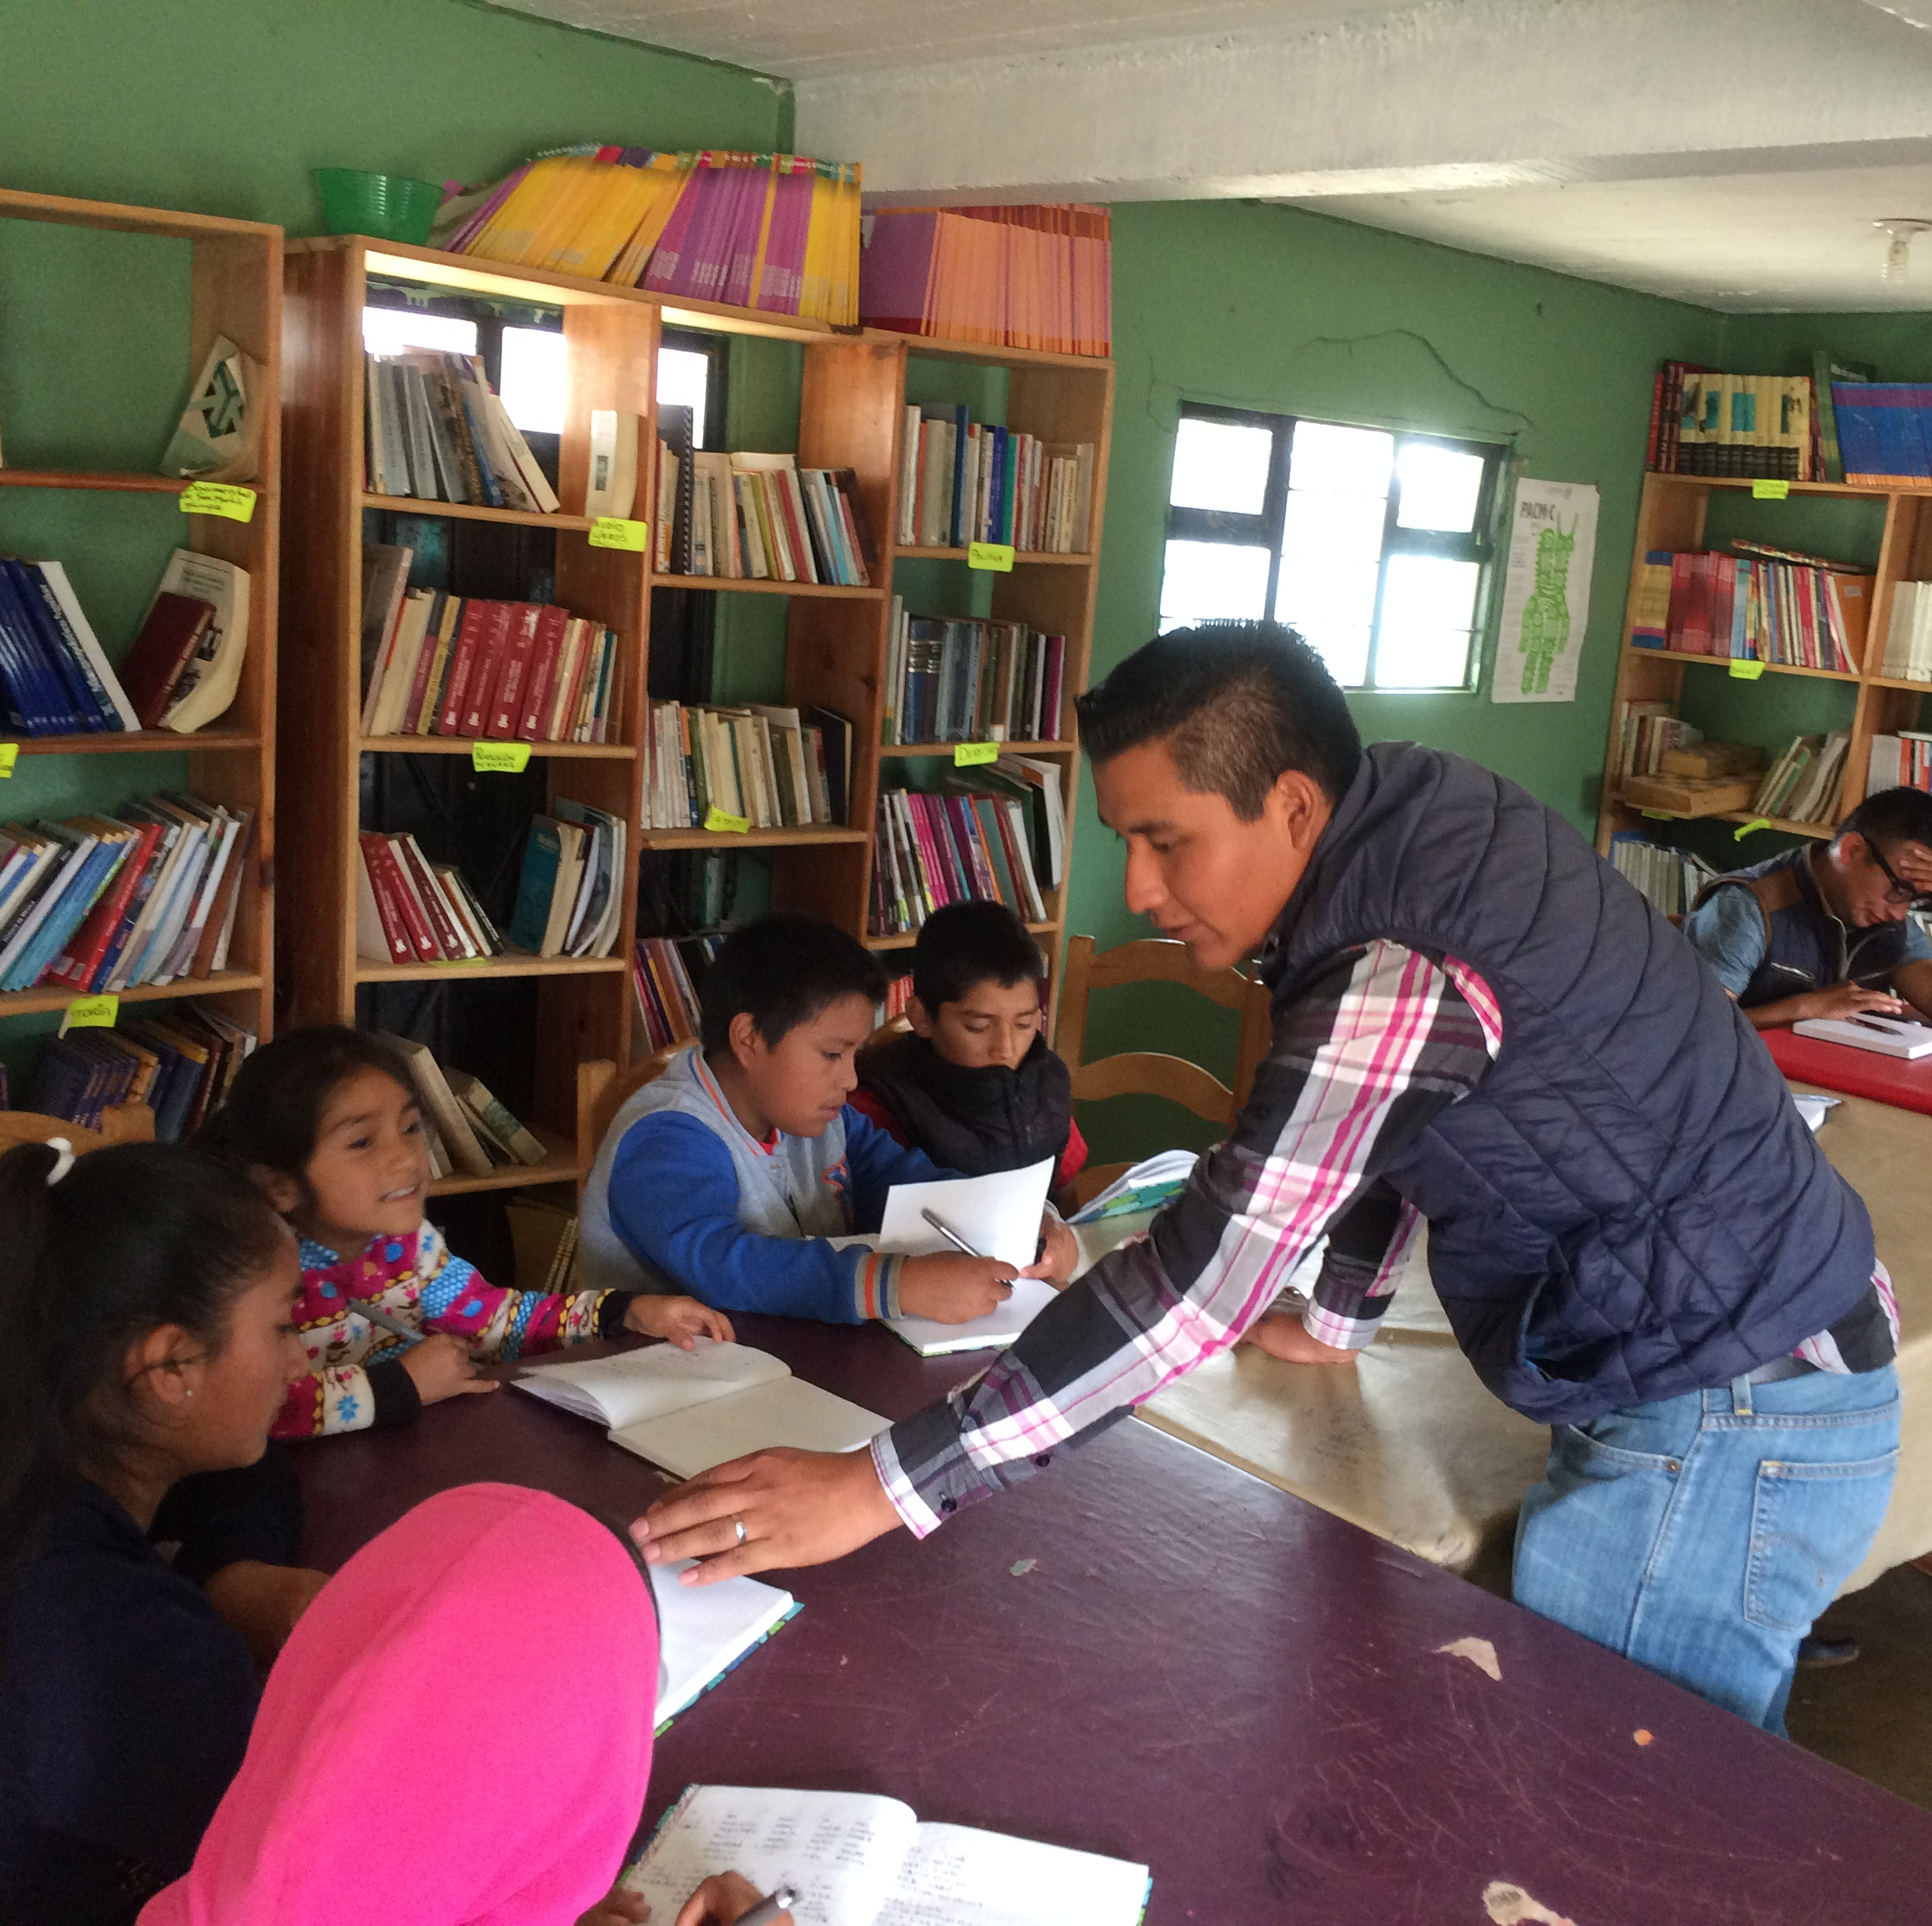
Literacy
There is no widespread literacy in the language, but that is gradually changing with literacy workshops and training.

Slide 9
Genetic affiliation (traditional)
Mixtecan (3-7 kya)
Mixtecan-Cuicatecan
Cuicatec
Mixtec (1.6-1.8 kya)
Triqui
Itunyoso-Chicahuaxtla
Copala
Itunyoso
Chicahuaxtla
Tepeuxila
Teutila
12 languoids
~60 spoken varieties

Slide 10
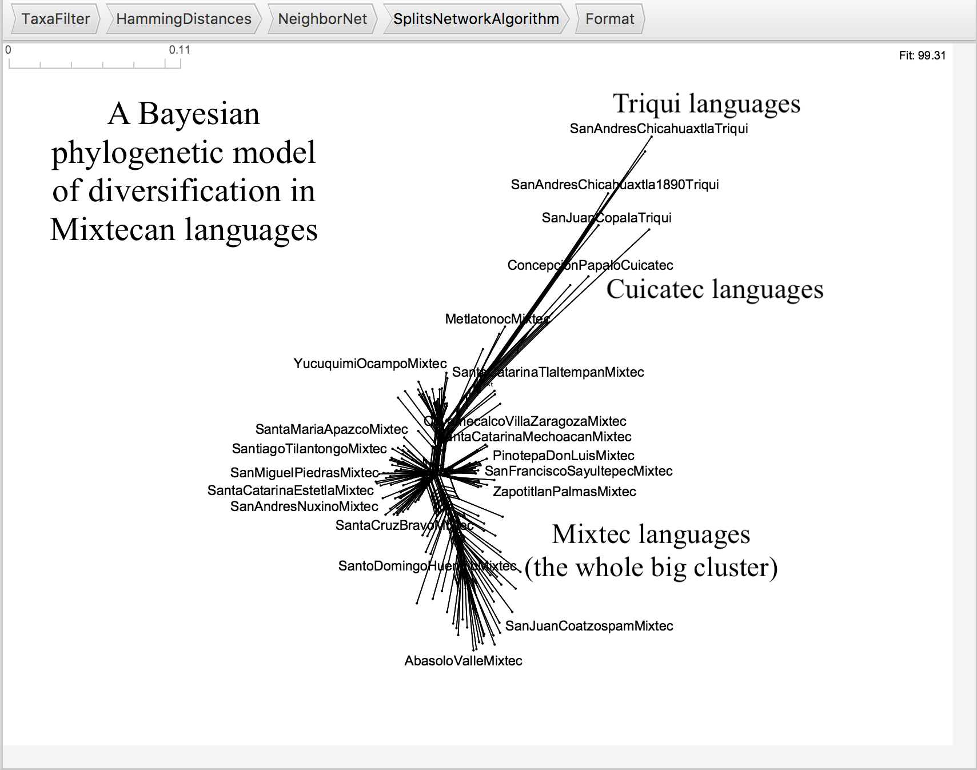
Genetic “distance” (recent) (Auderset, Campbell, DiCanio, and Greenhill, 2023)

Slide 11
Several branches to Otomanguean
With 180 languages/varieties, Otomanguean is the largest language family in the Americas. The diversity is on par with Indo-European, but in an area the size of New York State!

Slide 12
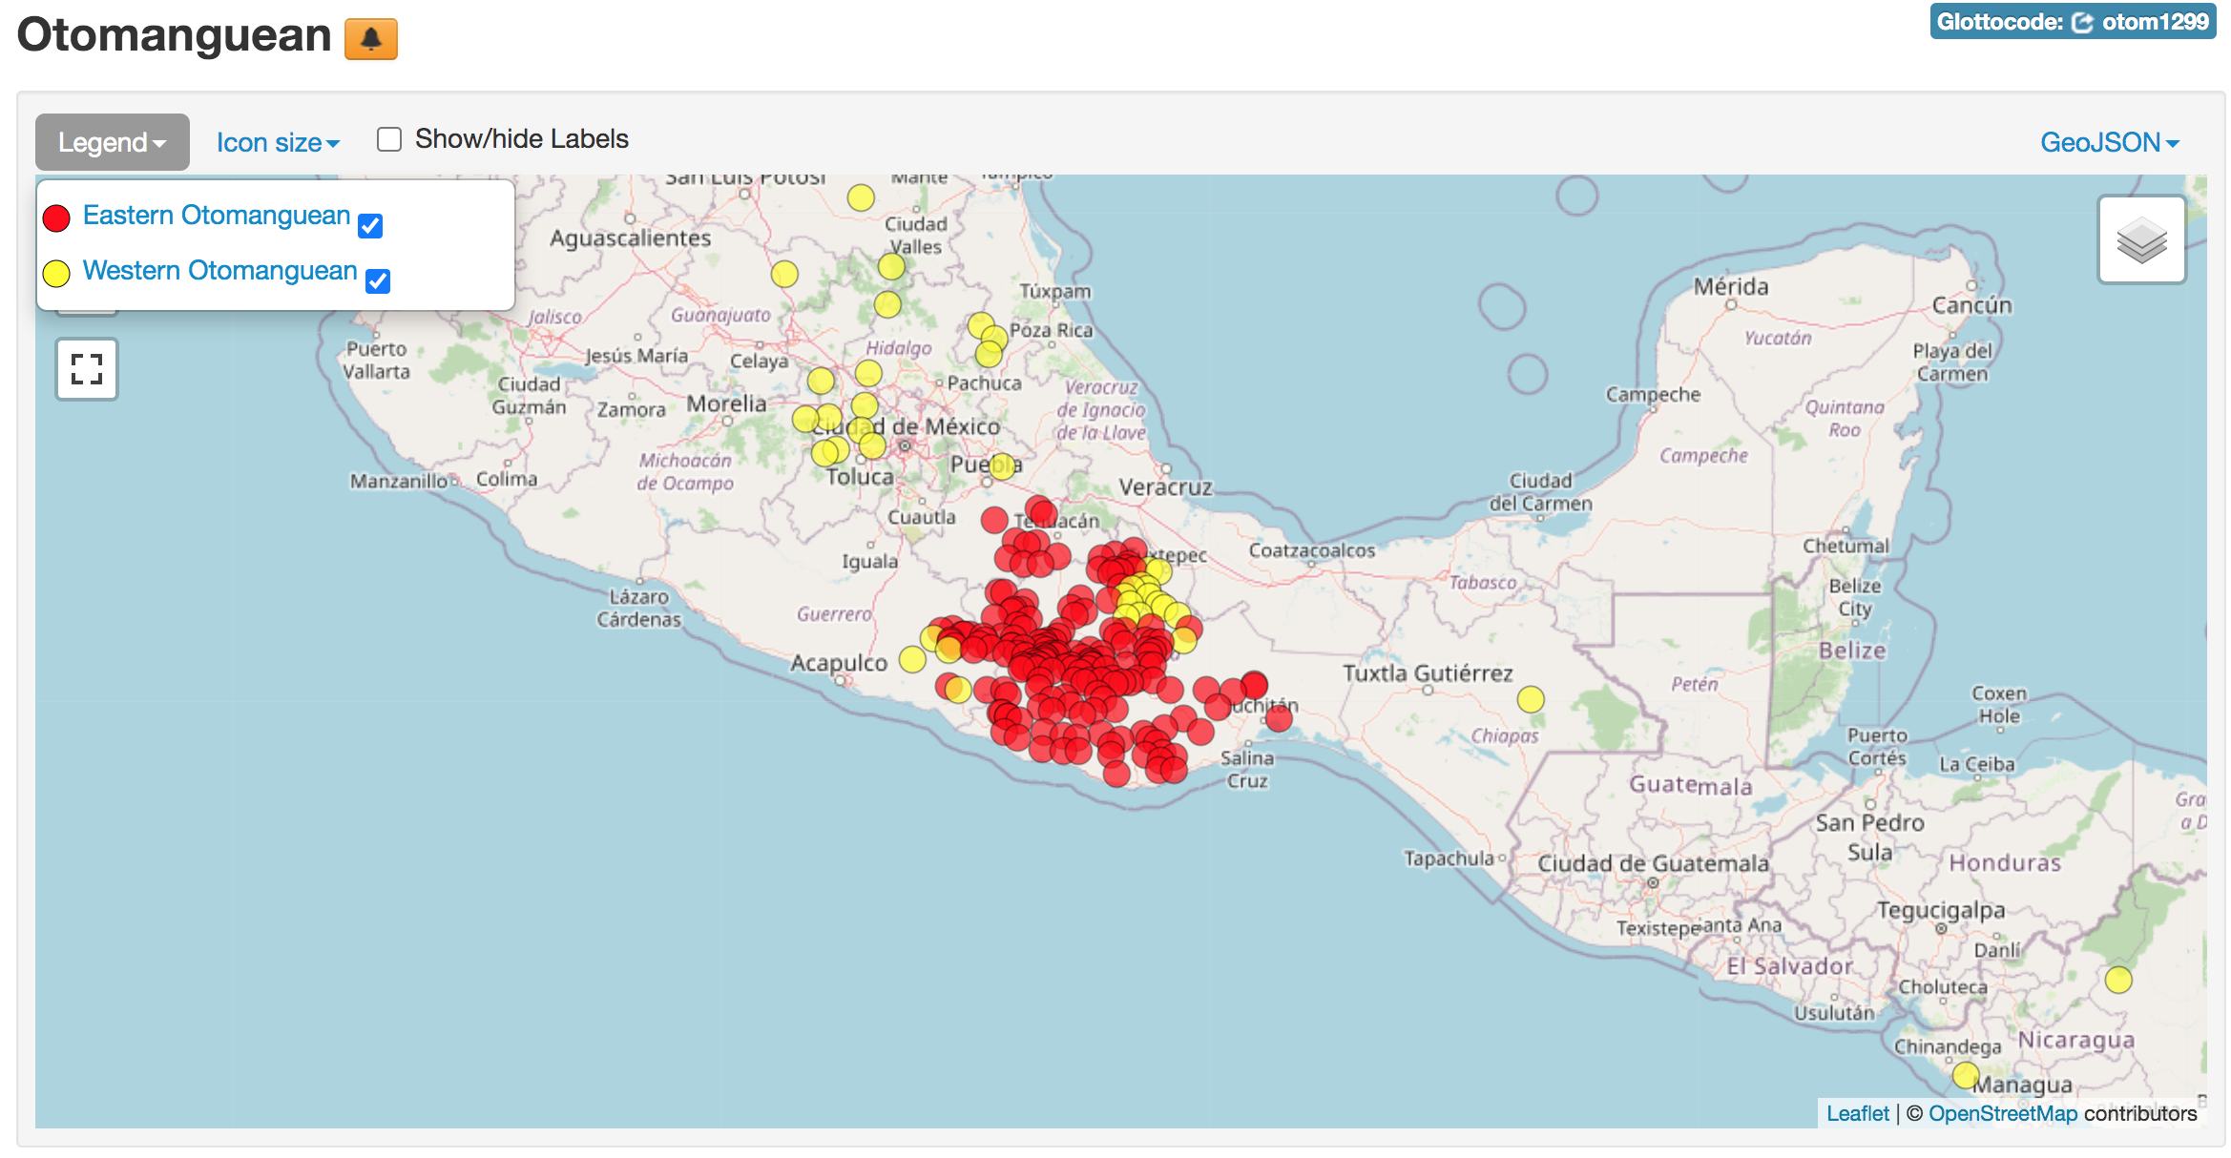
The region of eastern Guerrero and most of Oaxaca has the greatest linguistic diversity in Mexico; more than 180 languages are spoken in this region.

Slide 13
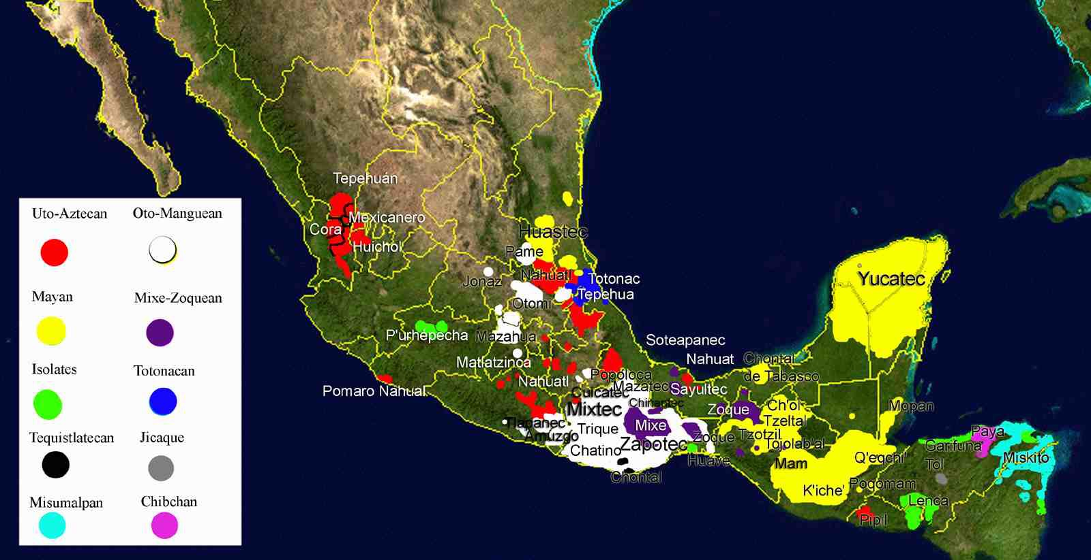

Slide 14
The size of the Otomanguean language family
The Zapotec empire spread throughout Oaxaca from 2,500 – 1,500 years ago. The Mixtec empire began to spread between 1100 – 1300 CE.
As a result, both Mixtec and Zapotecan languages diversified greatly within Southern Mexico. Speakers settled in new areas and the language variants further diversified.
This led to Otomanguean becoming a much larger language family than others (the largest known family in the Americas).
A similar process probably also occured with the Aztecs/Nahuatl speakers – there are many Nahuatl varieties/languages.

Slide 15
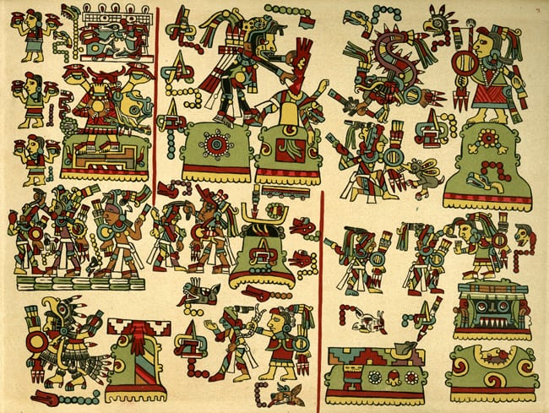
Mixtec expansion/empire
Between the 12th and 14th centuries, Mixtecs united and began to expand beyond their region.
The figure Eight-Deer Jaguar Claw led Mixtecs in battles against people in the region. This greatly expanded Mixtec languages.
Nutall codex – tells the story of Eight-Deer; UC San Diego Library

Slide 16
Typological features of Otomanguean
Unlike Uto-Aztecan, Mayan, and Mixe-Zoquean, all Otomanguean languages are tonal. Most also have morphological tone.
The morphology is mostly fusional with some affixation on verbs, but it is otherwise fairly isolating.
Virtually all Otomanguean languages have verb-initial word order.
Vigesimal numeral systems (base 20)
Relational nouns
Verbs of emotion/cognition are all formed via a specific type of compounding.

Slide 17
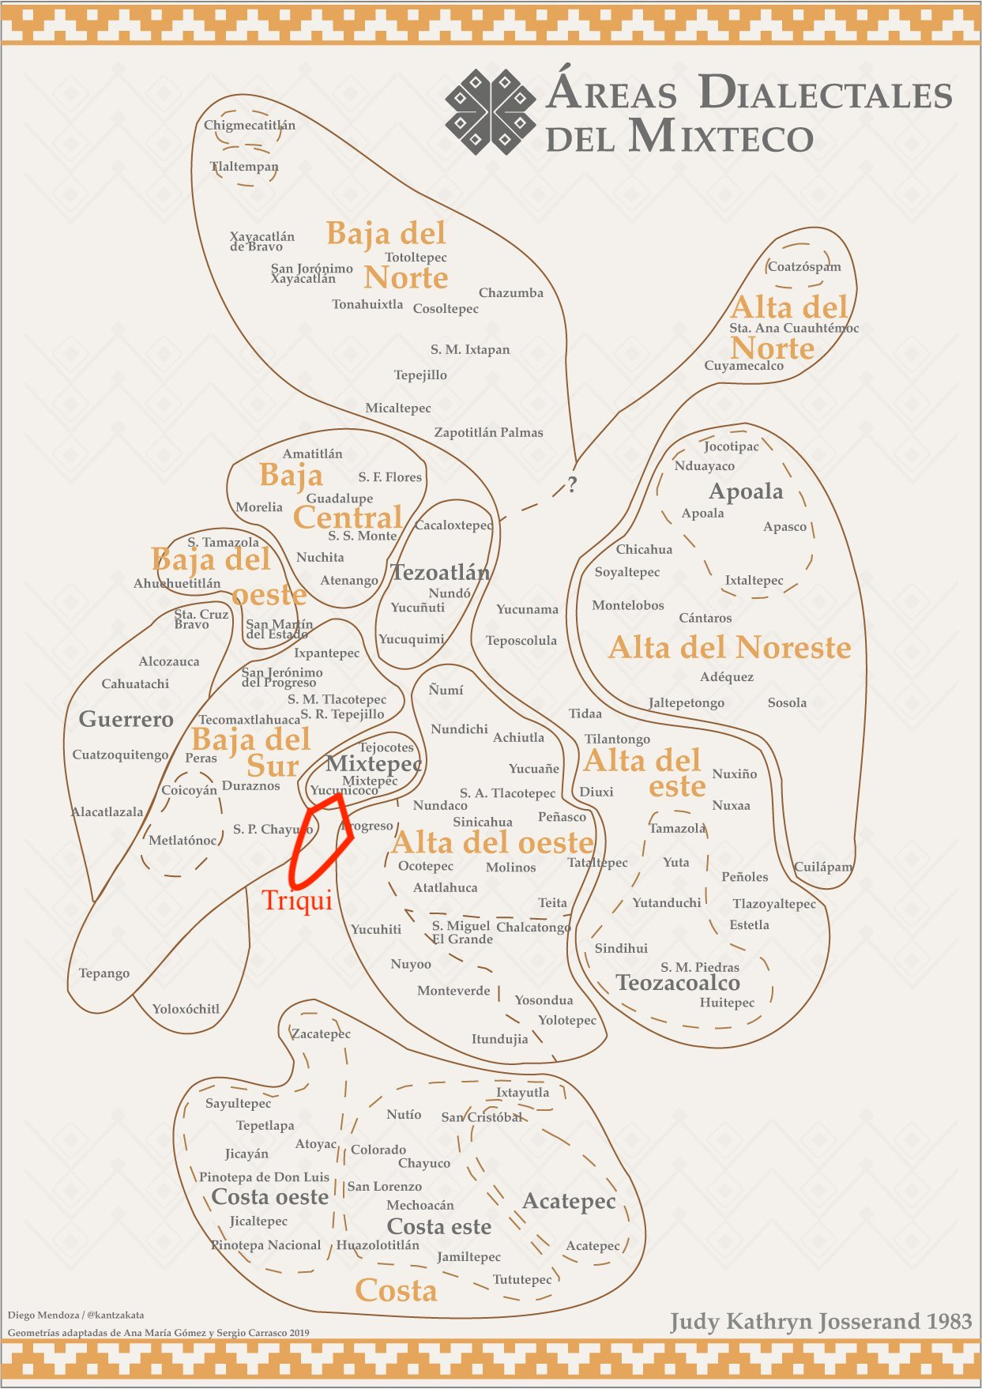
Triqui is surrounded by Mixtec varieties
The Triqui speaking area is surrounded by the many different varieties of Mixtec, shown here superimposed over a map from Josserand’s dialectological survey of Mixtec, published in 1983.

Slide 18
Intelligibility among varieties/dialects
There is about 60% intelligibility between the Itunyoso and Chicahuaxtla Triqui varieties, but Copala Triqui is more divergent from the other varieties. It is not intelligible as the same language.
Itunyoso Triqui | Chicahuaxtla Triqui | Copala Triqui
tʃãʔ¹ ‘tasty’ | ʃiãh²³ | tʃi³ʔãh¹
tʃu³tah³ ‘deer’ | ʃu³tah³ | ʃtah³
tʂuh³ ~ tʃuh³ ‘pot’ | ruh³ | ʃuh³

Slide 19

What does Itunyoso Triqui sound like?
Se⁴ chi³yun³² ka³-hnah³ rian³² beh³,
NEG bat PERF-come face house
chi³nunh³ ka³-hnah³ rian³² beh³
hawk PERF-come face house
‘It wasn’t a bat that landed in front of the house, (but) a hawk landed in front of the house.’

Slide 20
What are all those numbers? There are 9 tones.
Triqui languages have complex tonal systems and important distinctions between roots which end with /h/ and /ʔ/.
For many Otomanguean languages, researchers focus on phonological aspects of the languages because:
(a) the phonology is very complex (b) the phonology is important to the morphology (grammatical tone)
βːeɦ⁵ ‘straw mat’
βːe⁴ ‘hair’
nːe³ ‘plough’
nːe² ‘to lie (to someone)’
nːe¹ ‘naked’
tʃe⁴³ ‘my father’
nːe³² ‘water’
nːe³¹ ‘meat’
nːãɦ¹³ ‘towards here’

Slide 21
Linguistic characteristics (a snapshot)
Most roots in Triqui are disyllabic, with monosyllabic roots displaying additional phonological complexity.
Complex tone (thoughout varieties). Copala Triqui has 8 tones, Itunyoso Triqui has 9 tones, Chicahuaxtla Triqui has 10 tones.
Tone is morphological too – it is used for marking verbal aspect, person marking, possession, negation, and even some syntactic phenomena.
VSO, with fronted constituents conditioned by information structure.
Complex pragmatics with very elaborate final particle system.

Slide 22
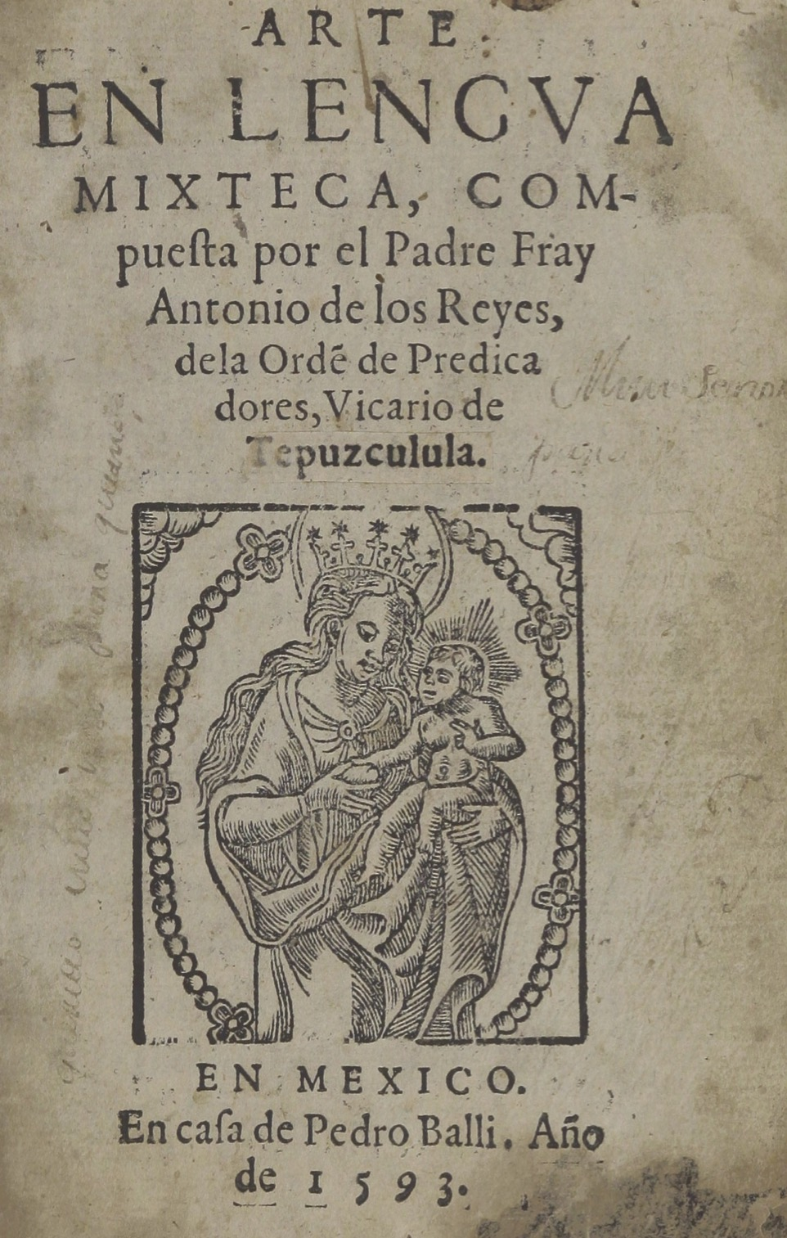
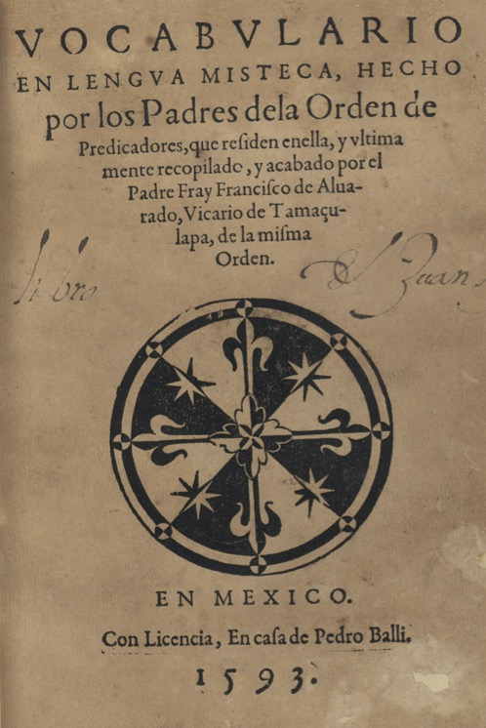
Early scholarship on Mixtecan languages
Some of the earliest dictionaries of languages in the Americas were on Mesoamerican languages.
Fray Francisco de Alvarado’s Mixtec dictionary and Fray Antonio de los Reyes grammar are both from 1593.

Slide 23
Early scholarship on Triqui languages (minimal)
Chicahuaxtla Triqui Belmar, F. (1897). Lenguas del Estado de Oaxaca: Ensayo sobre lengua Trique. Imprenta de Lorenzo San-Germán.
Longacre, R. E. (1952). Five phonemic pitch levels in Trique. Acta Linguistica, 7:62–81. (SIL)
Longacre, R. E. (1959). Trique Tone Morphemics. Anthropological Linguistics, 1(4):5–42. (SIL)
Copala Triqui
Hollenbach, B. E. (1973). La aculturación lingüística entre los triques de Copala, Oaxaca. América Indígena, 33:65–95. (SIL)
Hollenbach, B. E. (1984). The Phonology and Morphology of Tone and Laryngeals in Copala Trique. PhD thesis, University of Arizona, Tucson. (SIL)

Slide 24
Later work (red indicates Triqui linguist work)
Itunyoso Triqui
DiCanio, C. (2008). The Phonetics and Phonology of San Martín Itunyoso Trique. PhD thesis, University of California, Berkeley, Berkeley.
...and 11 additional publications from 2010 – 2022, mostly in phonetics/phonology
Chicahuaxtla Triqui (by year)
Hernández Mendoza, F. (2009). Daj nadure’ sinugun’: Los usos de la lengua Nanj Nïn’ïn y del español en las comunidades Triquis de Chicahuaxtla. Master’s thesis, Universidad Mayor de San Simón, Bolivia.
Elliott, A. R., Sandoval Cruz, F., and Santiago Rojas, F. (2012). Notes from the Field: Chicahuaxtla Triqui Digital Wordlist and Preliminary Observations. Language Documentation and Conservation, 6:208–236.
Hernández Mendoza, F. (2014). Prominencia silábica en el Triqui de Chicahuaxtla. In Bennett, R., Dockum, R., Gasser, E., Goldenberg, D., Kasak, R., and Patterson, P., editors, Proceedings of the Workshop on the Sound Systems of Mexico and Central America.
Elliott, A. R., Edmondson, J. A., and Sandoval Cruz, F. (2016). Illustrations of the IPA: Chicahuaxtla Triqui. Journal of the International Phonetic Association, 46(3):351–365.
Hernández Mendoza, F. (2017). Tono y fonología segmental en el triqui de Chicahuaxtla. PhD thesis, Universidad Nacional Autónoma de México, Mexico City.
Hernández Mendoza, F. (2021). La frase nominal simple en el triqui de Chicahuaxtla. In Arellanes Arellanes, F. and Guerrero, L., editors, Volumen conmemorativo: Seminario de lenguas indígenas. México: Instituto de Investigaciones Filológicas.
Hernández Mendoza, F. (2021). Morfofonología de los clíticos tonales en el triqui de Chicahuaxtla. Cuadernos de Linguística de El Colegio de México, 8:1–53.

Slide 25
Copala Triqui (by year)
Hollenbach, B. E. (1973). El parentesco entre los triques de Copala, Oaxaca. América Indígena, 33:167–186.
Hollenbach, B. E. (1976). Tense-negation interplay in Copala Trique. International Journal of American Linguistics, 42:126–132.
Hollenbach, B. E. (1977). Phonetic vs. phonemic correspondence in two Trique dialects. In Merrifield, W. R., editor, Studies in Otomanguean Phonology, number 54 in Publications in Linguistics, pages 35–67. Summer Institute of Linguistics, Dallas.
Hollenbach, B. E. (1984). Copala Trique tone and universal features. Coyote Papers, 5:96–119.
Hollenbach, B. (1985). Vowel length in copala trique: an abstract laryngeal analysis. International Journal of American Linguistics, 51(4):455–457.
Hollenbach, B. E. (1992). A syntactic sketch of Copala Trique. In Bradley, C. H. and Hollenbach, B. E., editors, Studies in the syntax of Mixtecan Languages, volume 4. Dallas: Summer Institute of Linguistics and University of Texas at Arlington.
Hollenbach, B. E. (2004). Gramática popular del triqui de Copala. Summer Institute of Linguistics, Mexico, Mexico City.
Hollenbach, B. E. (2007). Vocabulario breve del triqui de San Juan Copala. SIL International.
Vidal López, R., Broadwell, G. A., Matsukawa, K., Martín del Campo, E., Scipione, R., and Perdomo, S. (2009). The origin of the sun and the moon: A Copala Triqui legend. Munich: Lincom Europa.
Albany Triqui Working Group. (2014-20). A Copala Triqui – Spanish – English dictionary, http://copalatriqui.webonary.org
Rodriguez, J. S. (2021). The syntax and phonology of grammatical tone in Copala Triqui. PhD thesis, University at Albany.
López Espinoza, E. (2022). Las construcciones relativas en el triqui de Copala. Master’s thesis, Centro de Investigaciones y Estudios Superiores en Antropología Social (CIESAS): Sureste.
Broadwell, G. A. (to appear). The emergence of accusative case in Copala Triqui. Linguistic Discovery.

Slide 26
Status of my scholarship on Itunyoso Triqui
2004 – 2008 Dissertation research, focus on phonetics and phonology of tone/phonation/length.
2009 – 2014 Post-doctoral research (France, US), focus on perception of tone, phonation; tonal coarticulation
2014 – 2019 NSF DLI/DEL documentation grant, focus on text collection, transcription, morphophonology, and prosody
2020 – 2022 Continued focus on translation and documentation; UB Humanities institute grant
2023 – present Focus on reference grammar; NEH fellowship grant
2004 – present The Triqui-Spanish dictionary

Slide 27
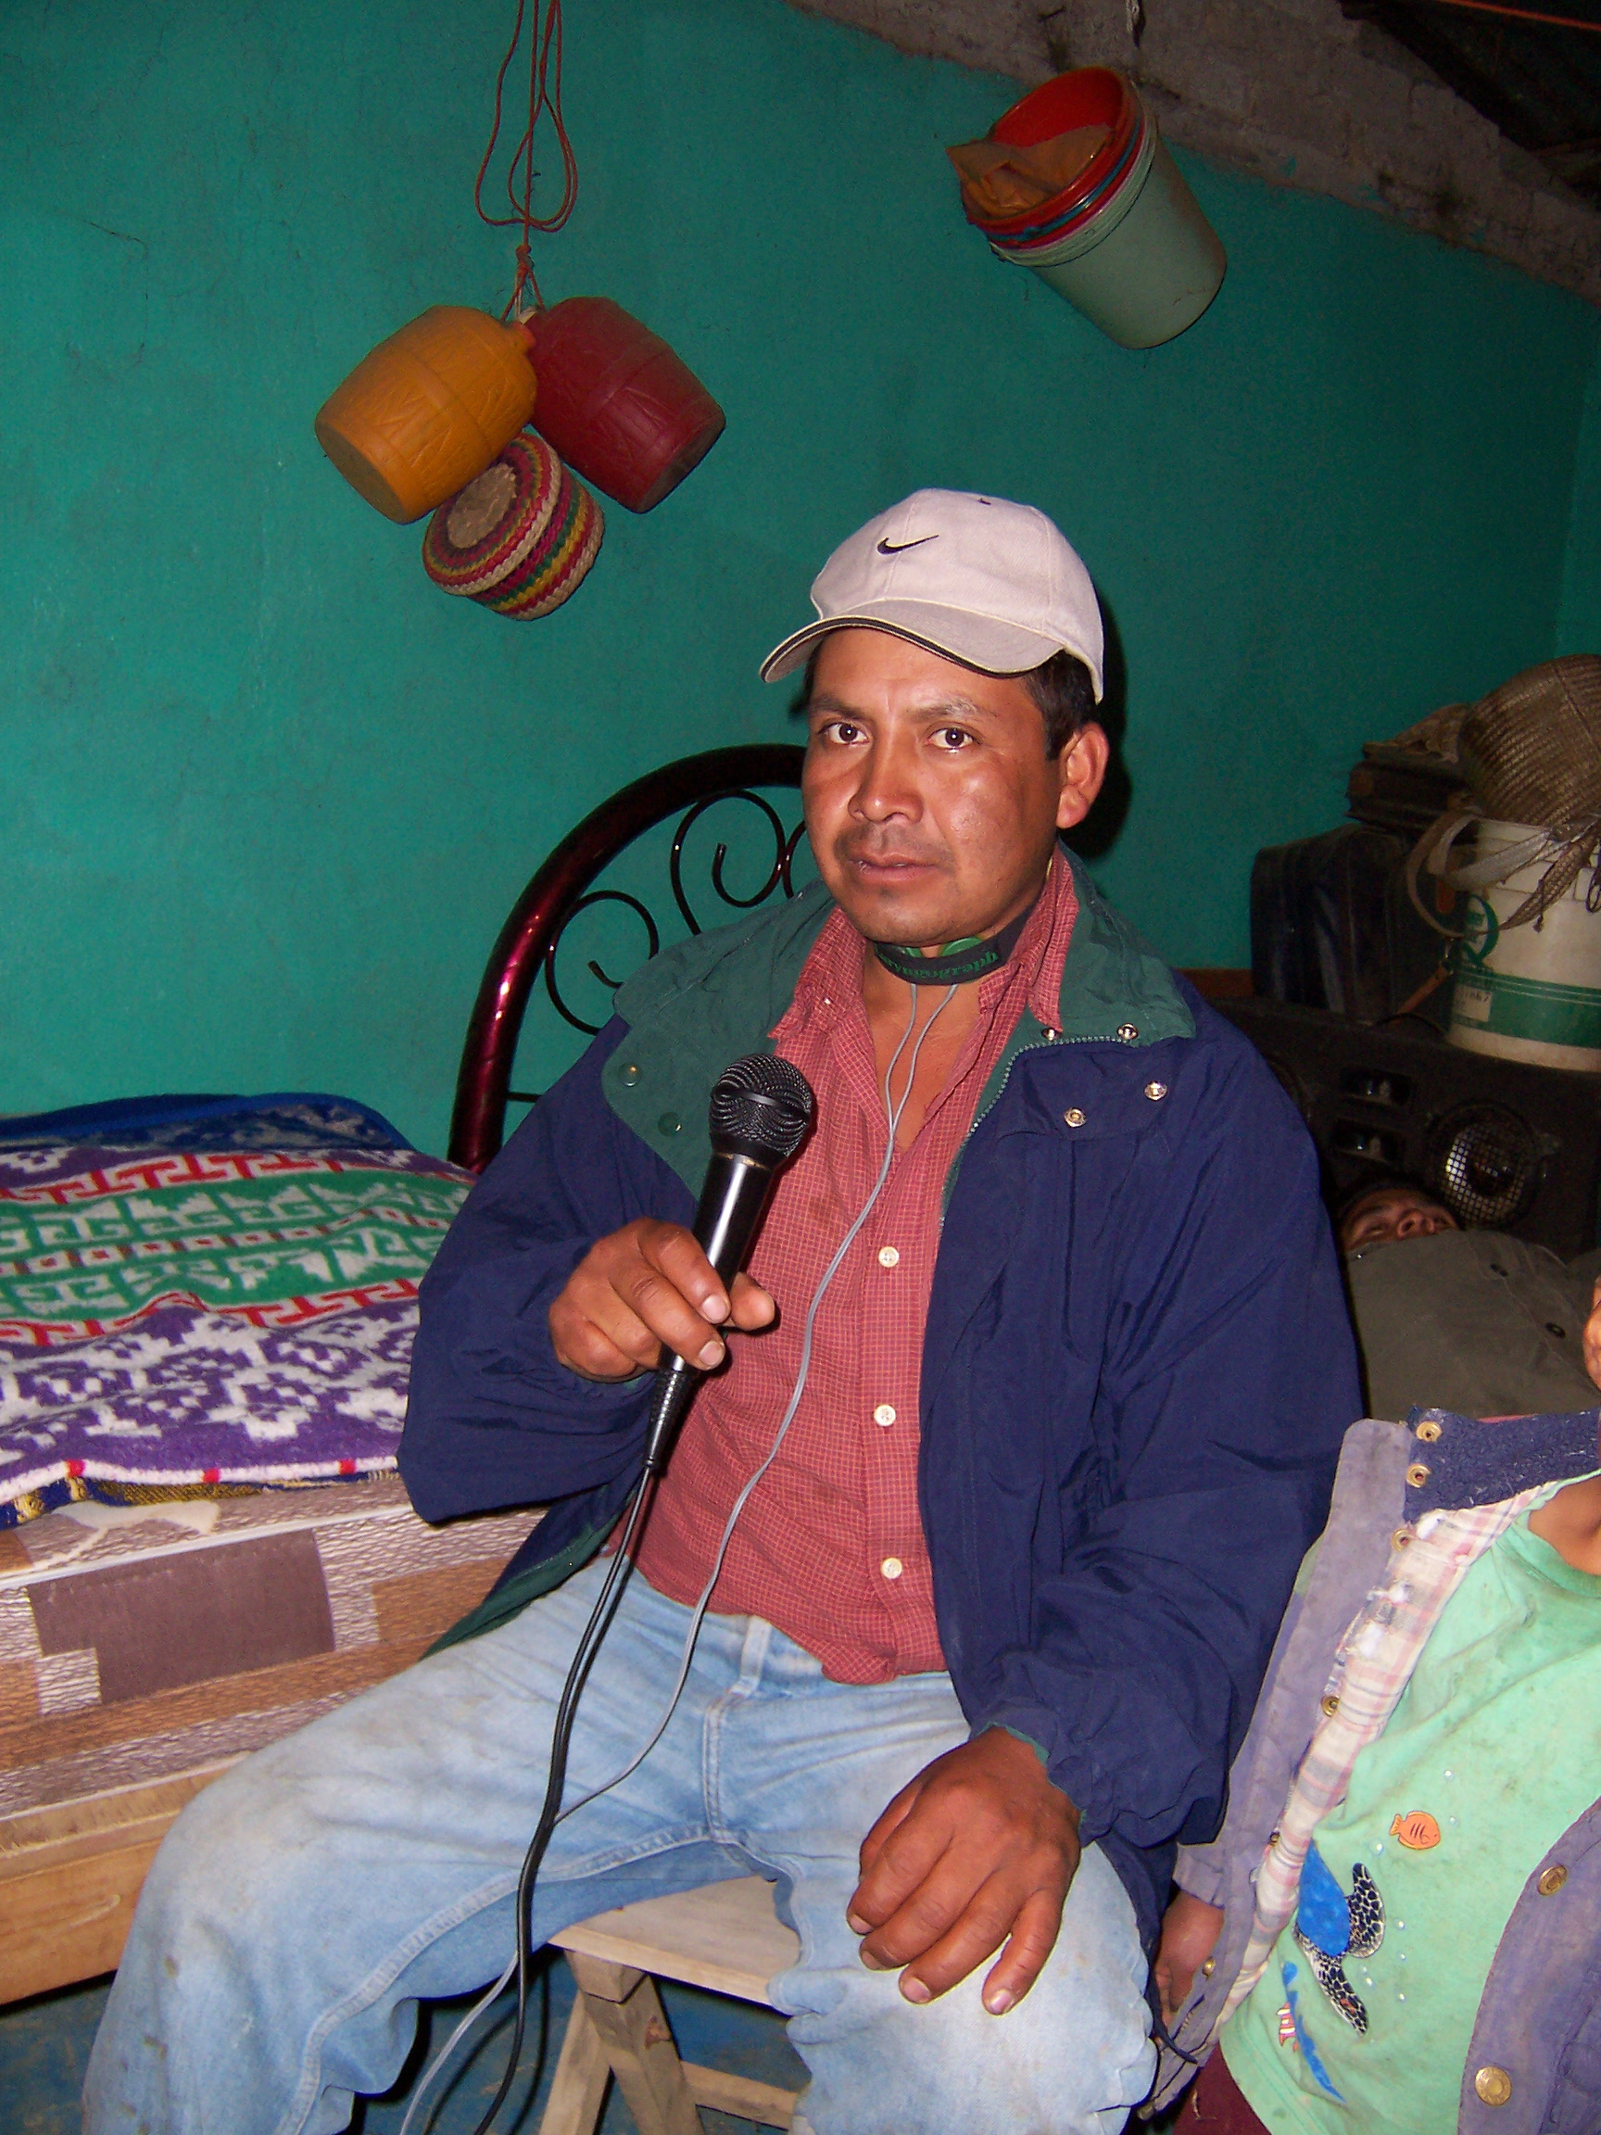
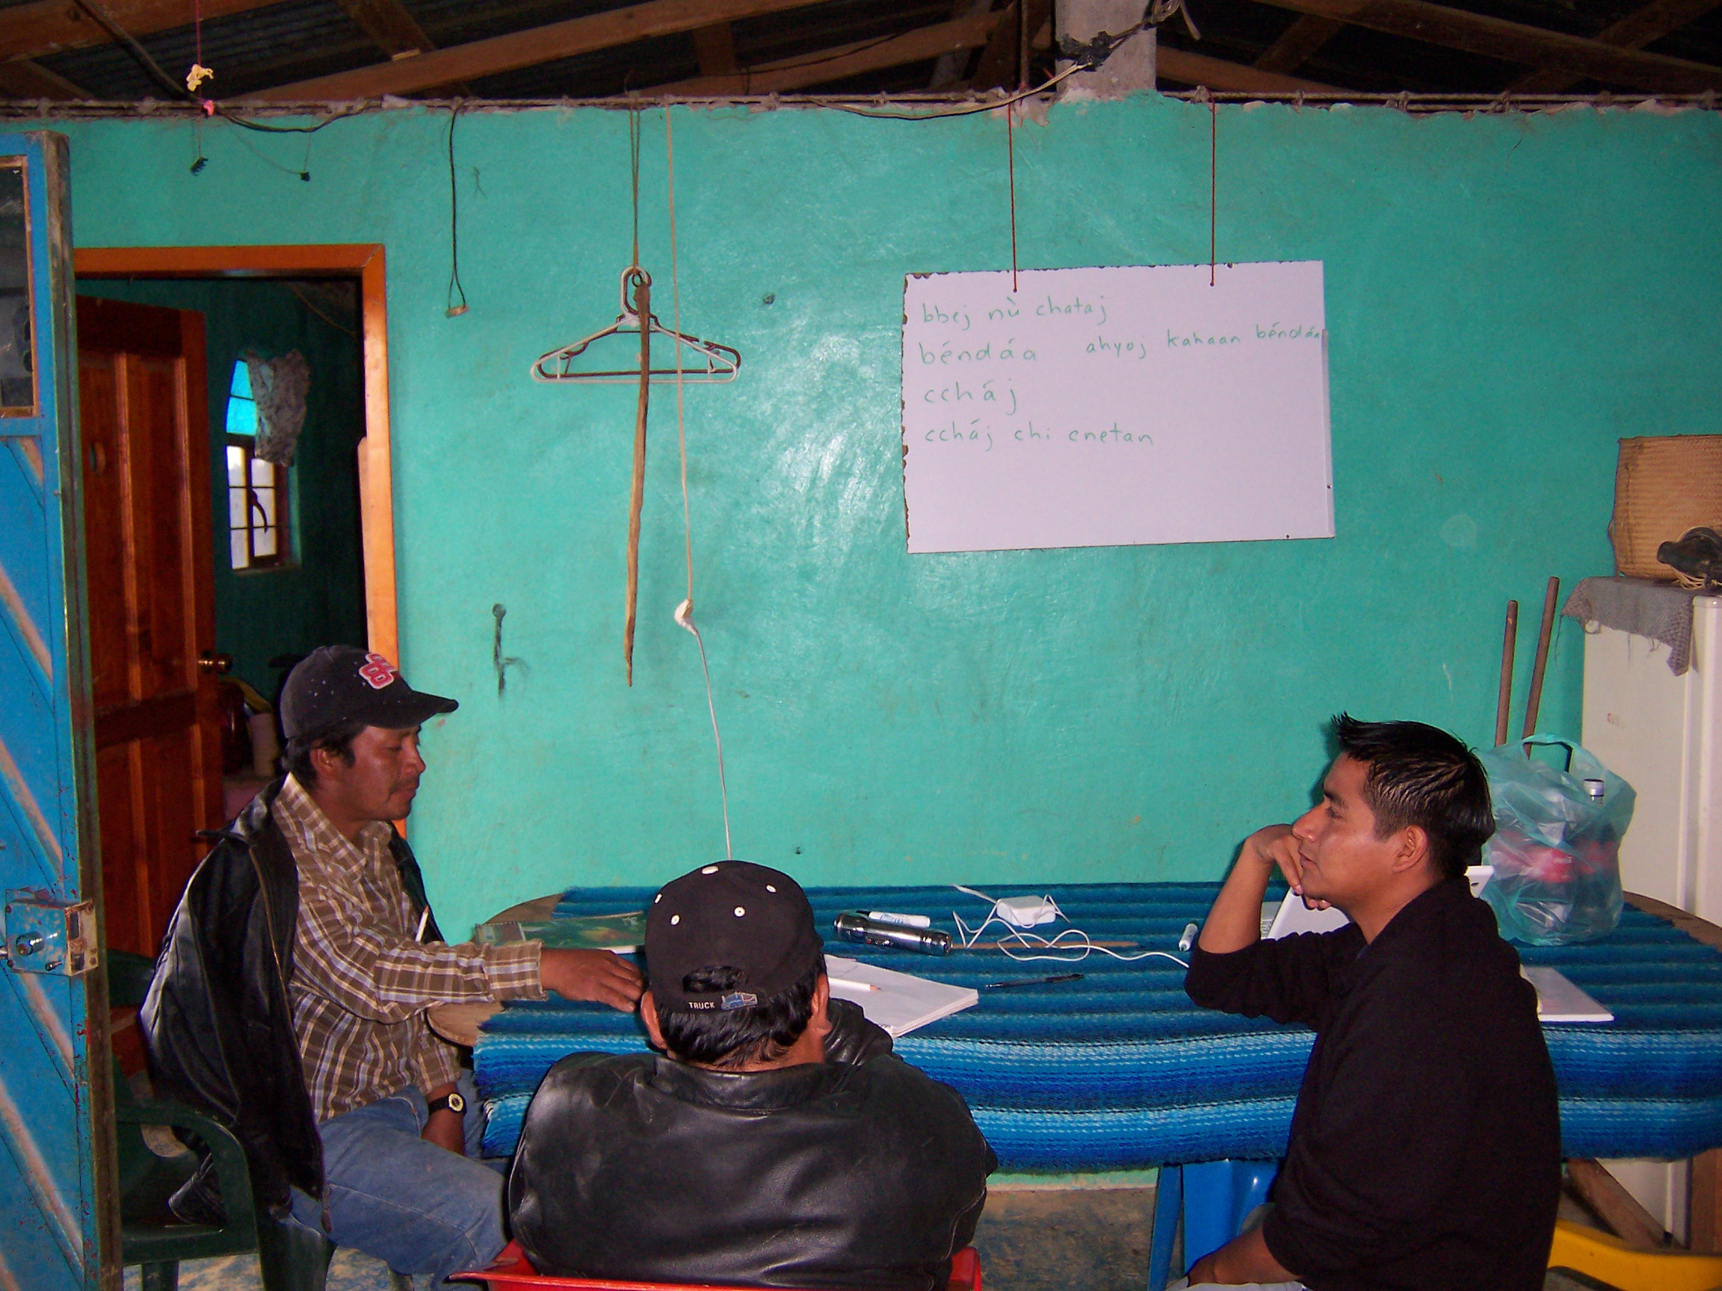
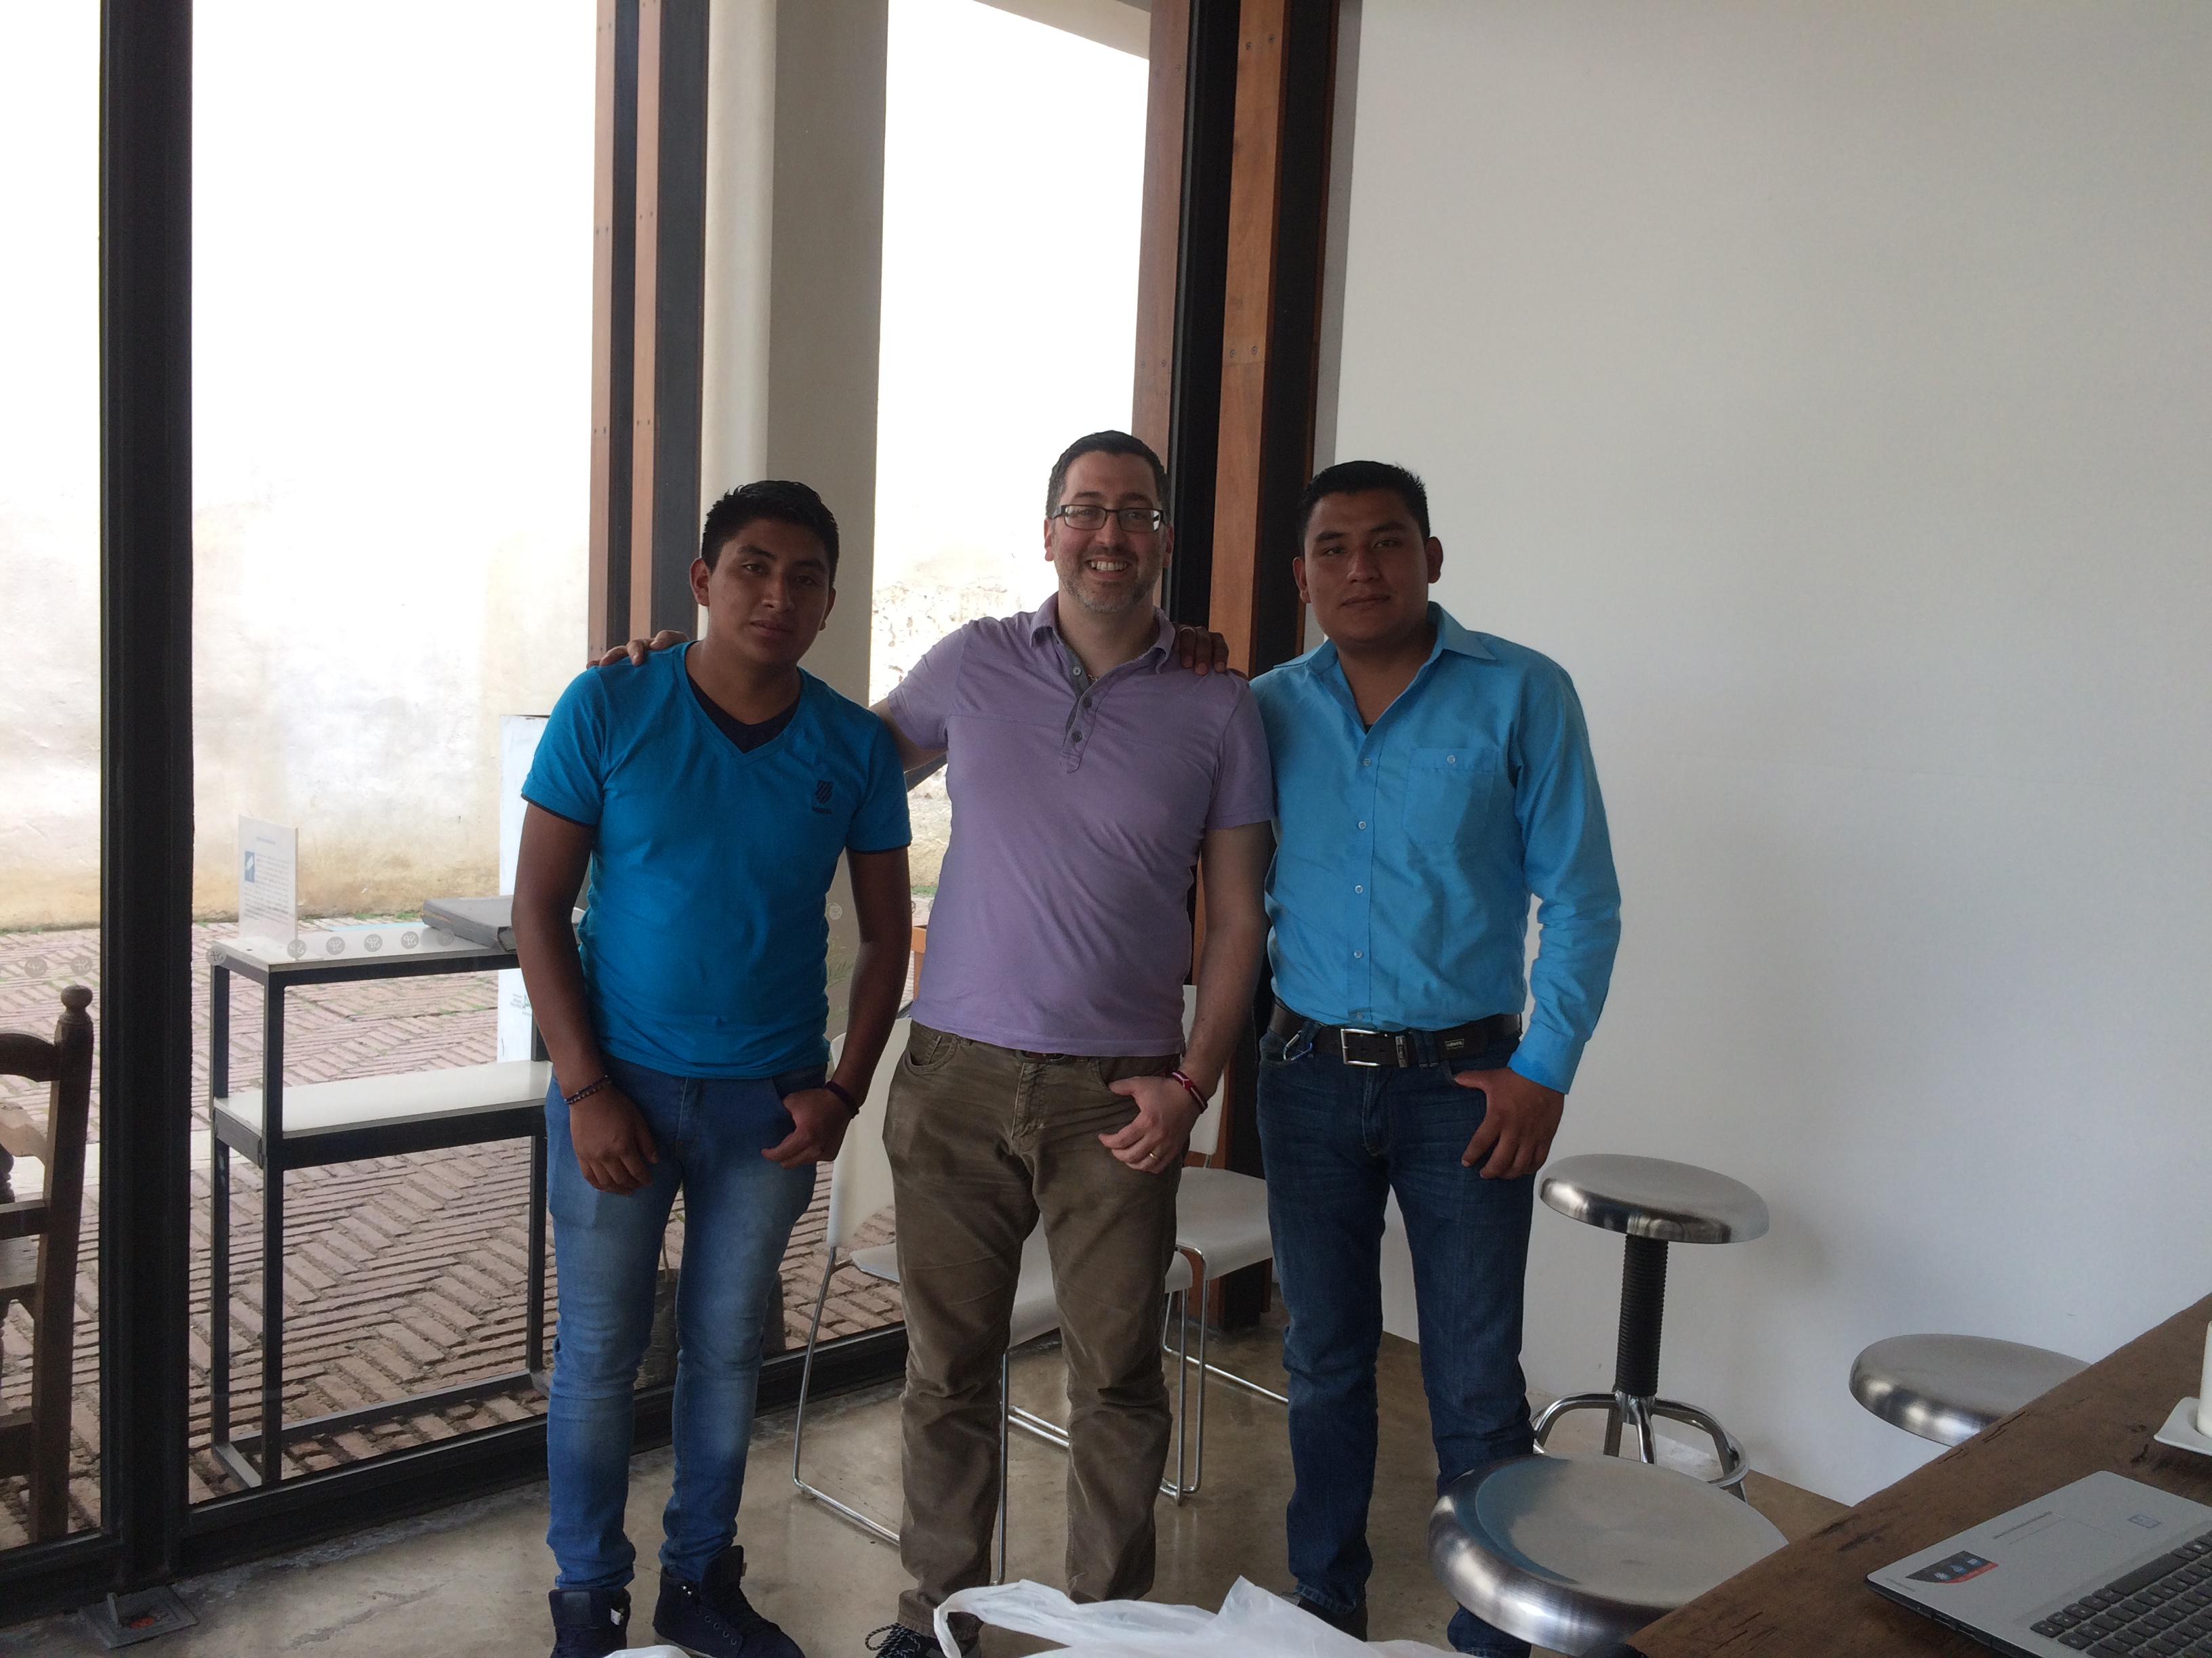
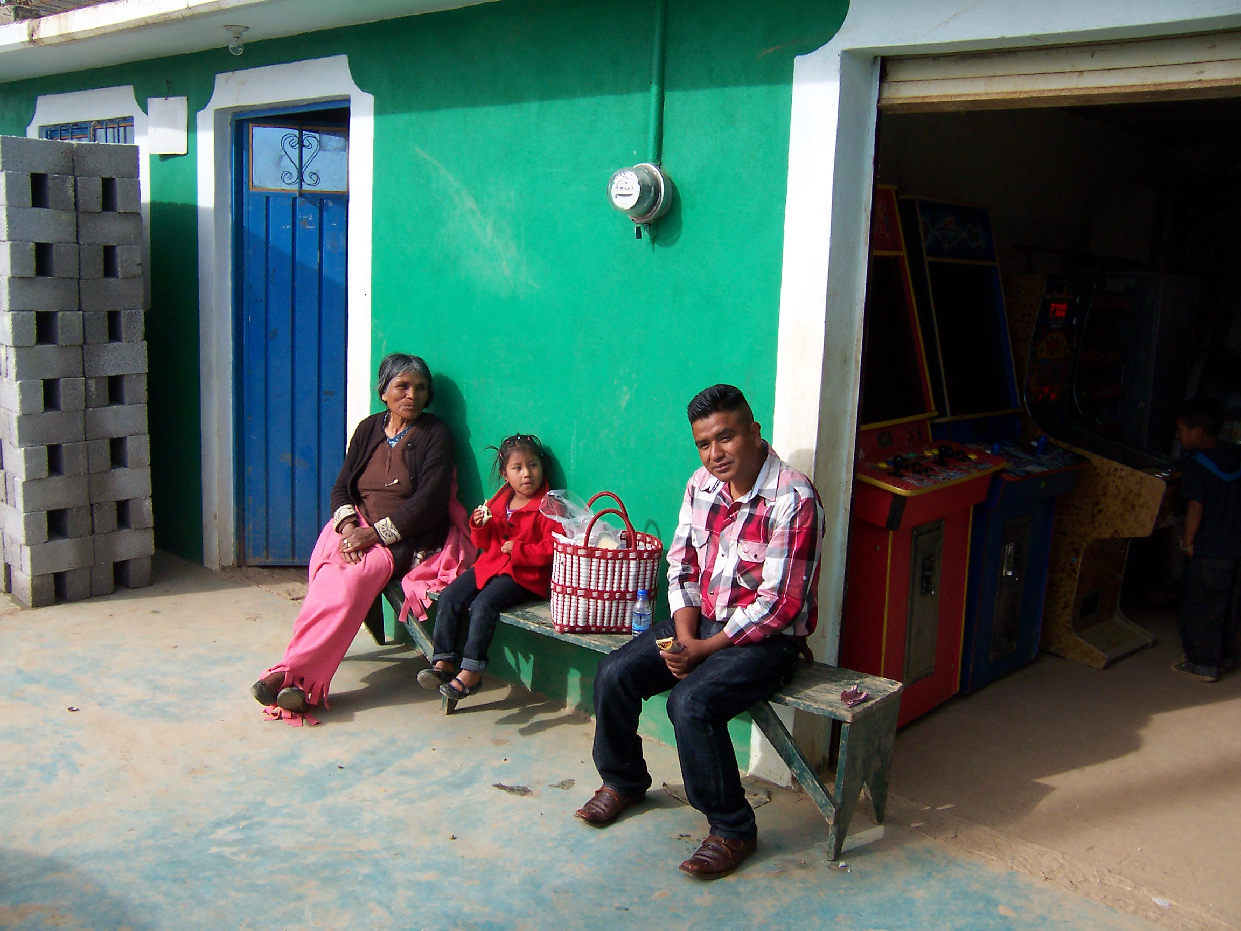
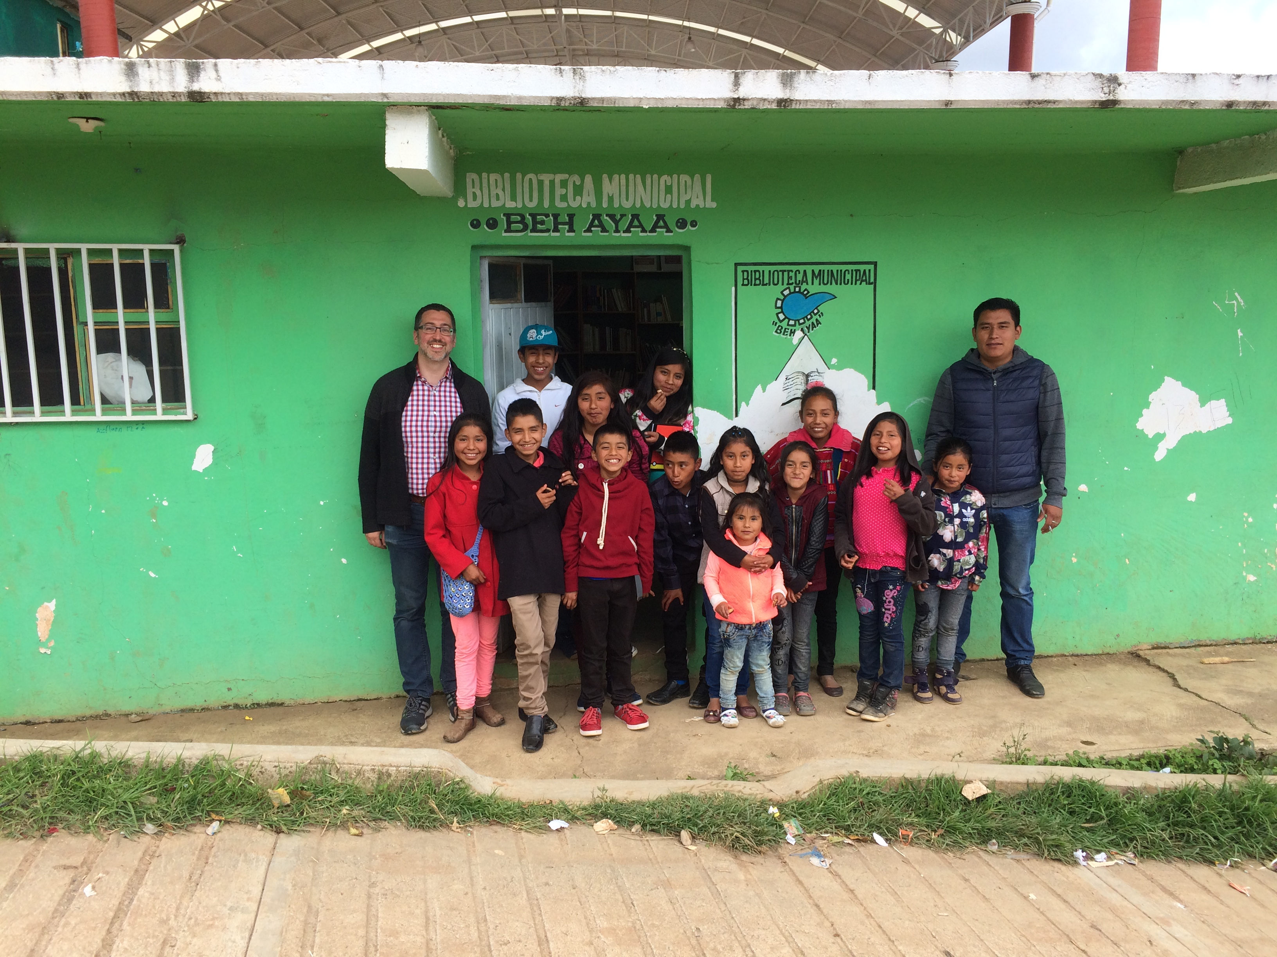
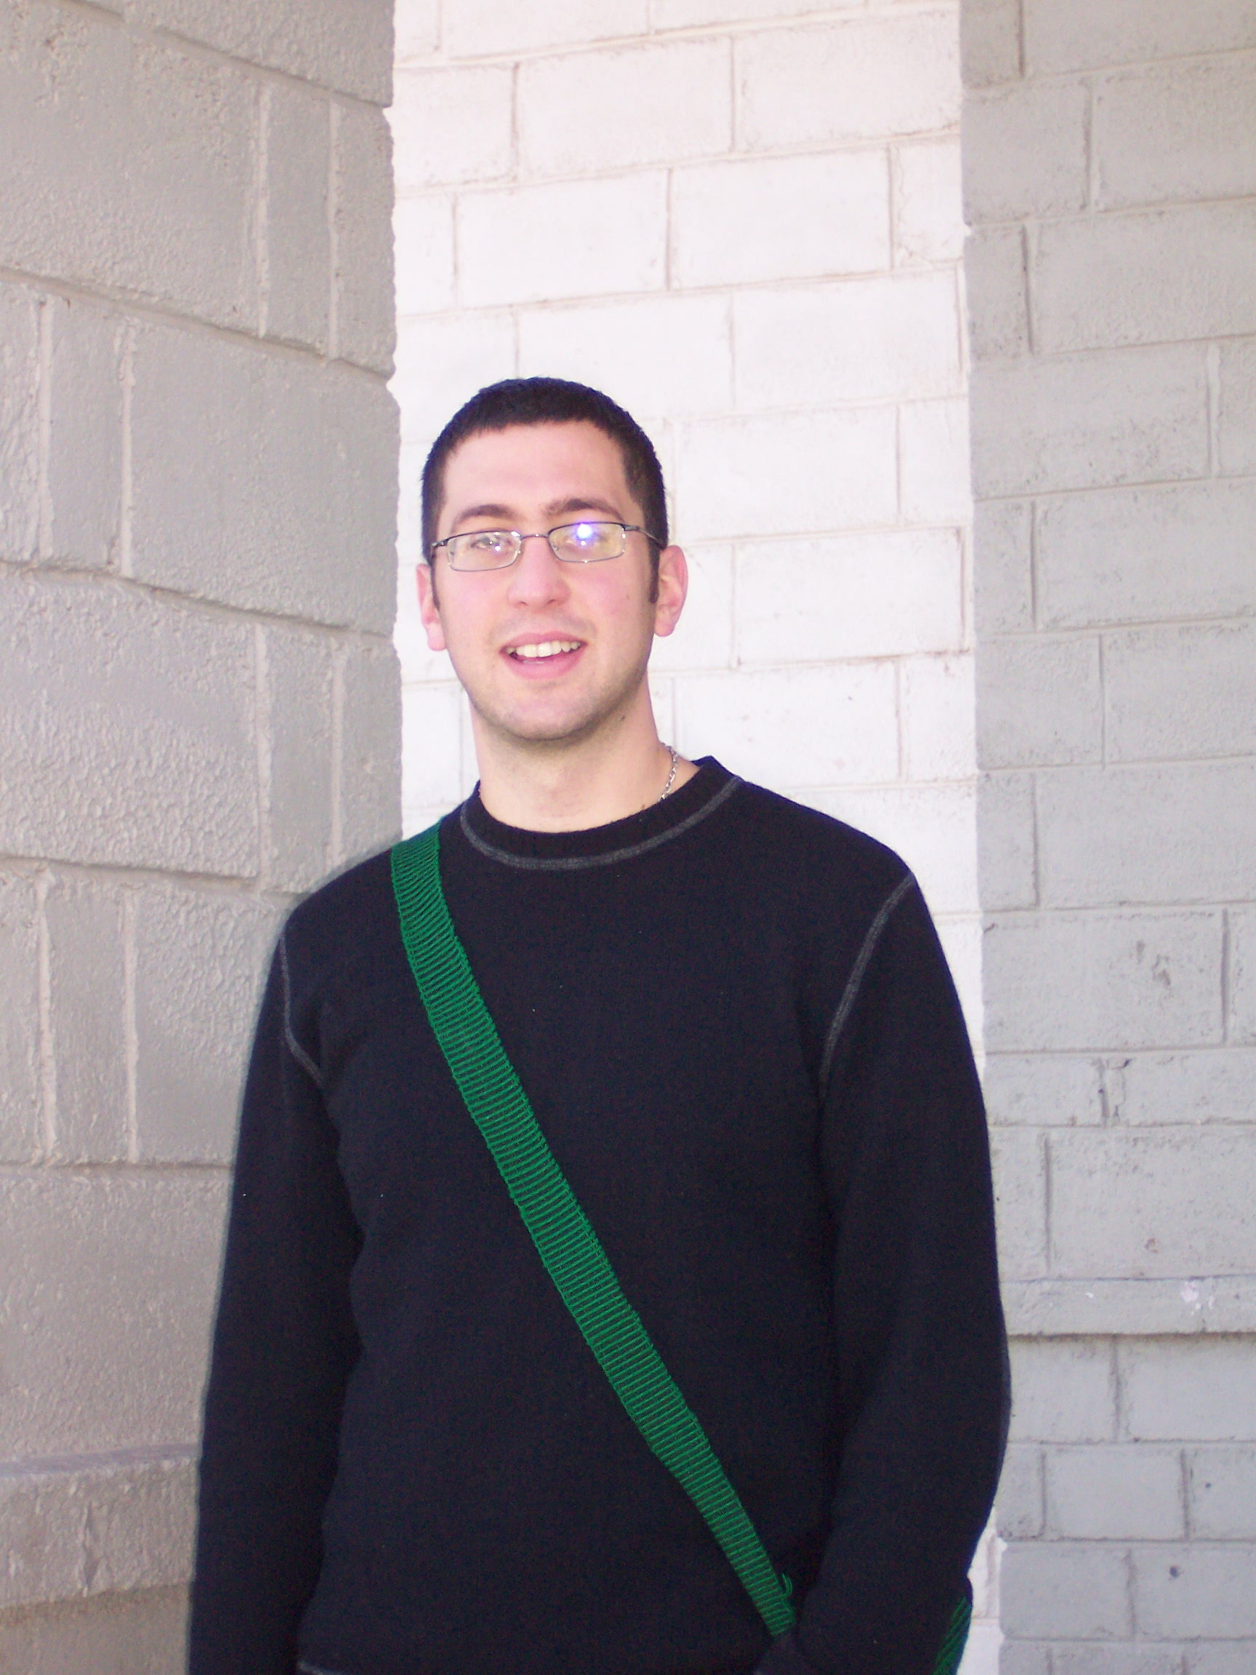

Slide 28
Course information
Readings most weeks of the semester examine various topics pertaining to Otomanguean or Triqui grammar. These are up on UB Learns under Readings.
There are 3 homework assignments and a final project
HW1: on sound structure of Triqui
HW2: on morphology or syntax of Triqui
HW3: on a topic of your choice from the existing materials
The final project involves exploring some aspect of Triqui grammar from the corpus or dictionary. It may involve creating a Triqui lesson/game.

Slide 29
Types of materials we will access in the course
The Triqui-Spanish dictionary
Inflectional database
400K word text corpus in ELAN with Triqui transcriptions and translations into Spanish
Additional elicitation recordings (~50 hours) targeting specific contrasts.
Fieldnotes from 2004 – present.

Slide 30
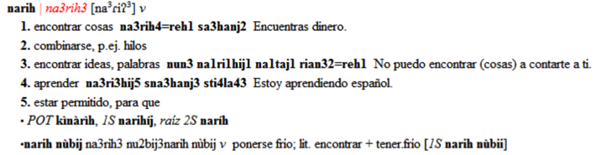
A Triqui-Spanish dictionary (FLEx)
Since 2004, we’ve been working on a Triqui-Spanish dictionary. It currently has about 2,758 entries (2072 words, 686 compounds).
Access via the web, but this is the exported version.

Slide 31
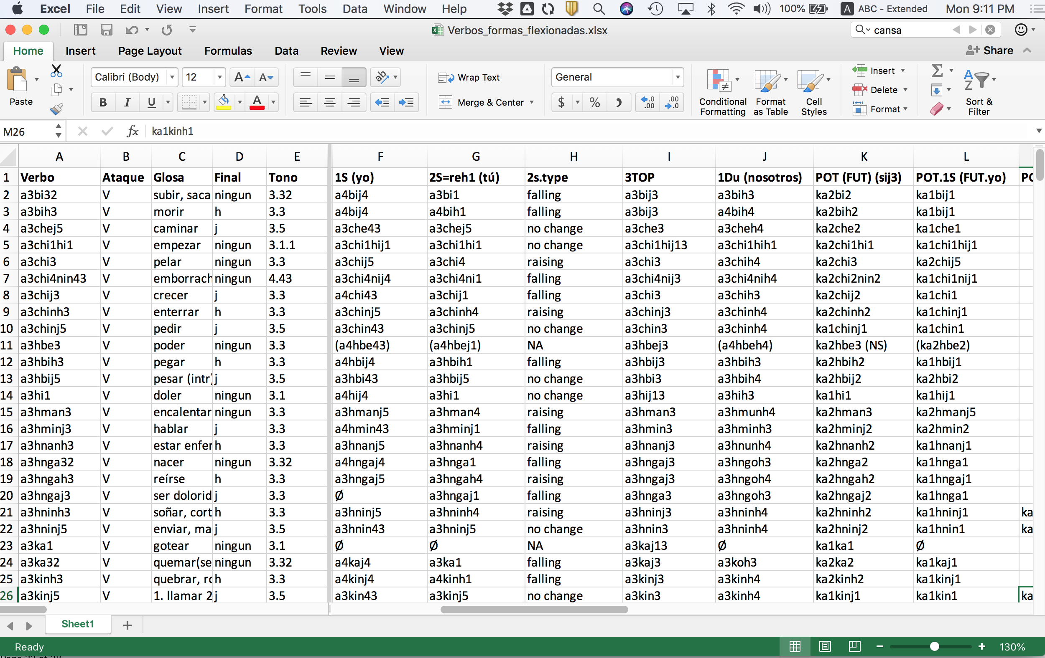
Inflectional database
We also have a database of tonal inflectional paradigms (970 main entries).
It contains 5,342 sub-entries for inflected words
(see DiCanio et al 2020).

Slide 32
The text corpus (ELAN)
In addition to about 40 hours of elicitation and experimental recordings, we have 29 hours of spontaneous/unscripted speech from 34 speakers.
Content is Triqui culture, ethnobiology, history, narratives, and folktales. Most involve conversational dyads with separately mic’d speakers; 289 recordings.
All transcribed and time-aligned in ELAN.

Slide 33
But also, my grammar chapters
There is a popular grammar of Copala Triqui (Hollenbach 2004) and a syntactic sketch of Copala Triqui (Hollenbach 1992), but no reference grammar on any Triqui language.
A comprehensive reference grammar is underway with chapters on aspects of the language’s phonetics and phonology, chapters on aspects of the clitic, nominal, and verbal morphology, chapters on syntactic structure, and chapters on semantics/pragmatics.
I’m writing this right now, so if there are open questions/issues you see in the chapters, please tell me! These could also be projects to work on.

Slide 34
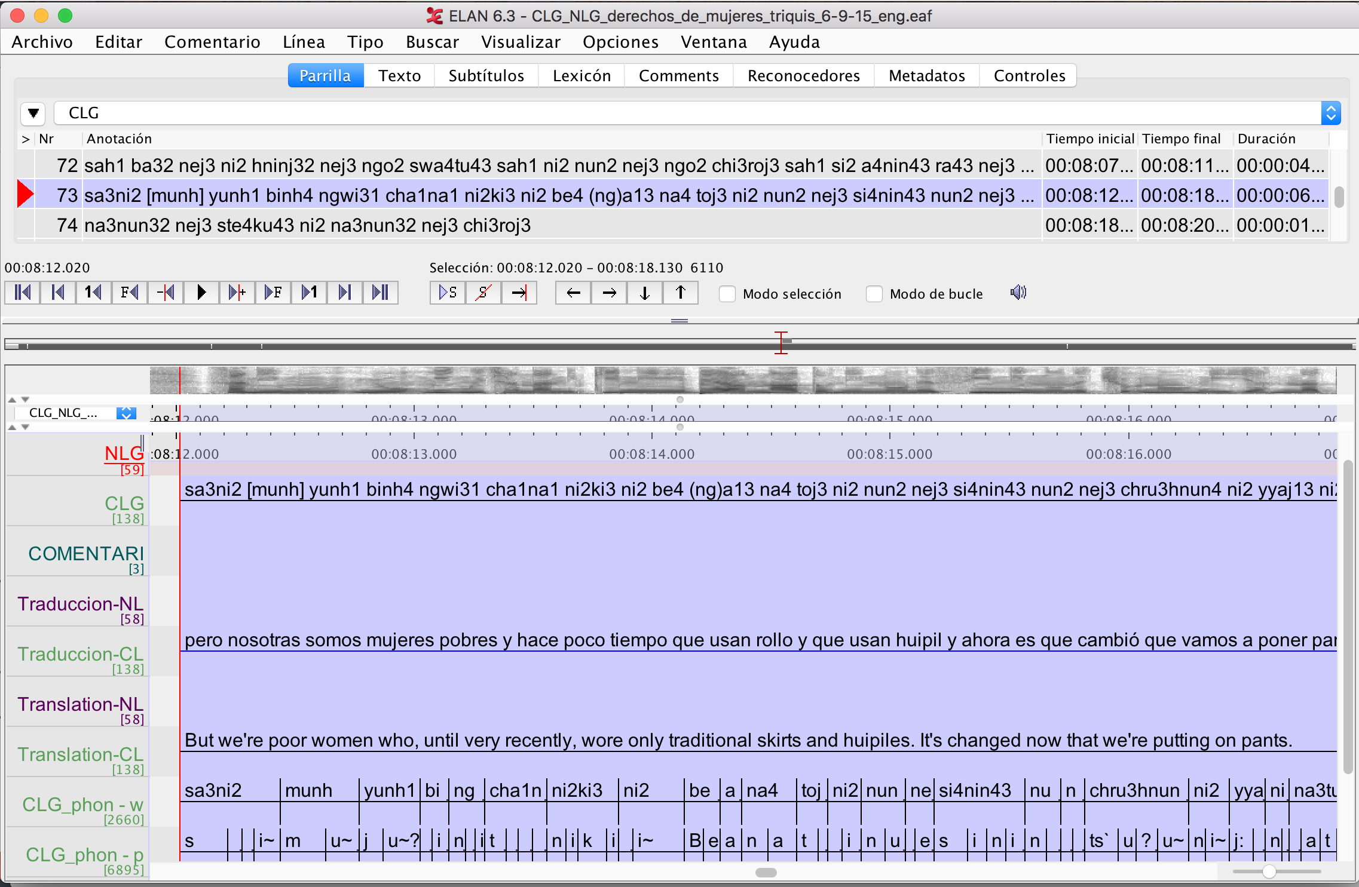
Why write a grammar?
You learn a lot through years of fieldwork.
After a documentation project has ended, where does this knowledge go?

Slide 35
Why? (cont)
The NSF documentation grant (2014 – 2019) involved training speakers in literacy in Triqui and running literacy workshops in the community.
I taught Basileo Martínez Cruz, Benigno Cruz Martínez, and Wilibaldo Martínez Cruz literacy and they spent 3-6 years transcribing recordings.
They have transcribed 29 hours of Triqui speech.
We reviewed many of the recordings they transcribed (~12 hours) over this period. This includes years of work correcting tonal transcriptions.
We have translated about 6-7 hours of Triqui speech.
We know a lot and want this knowledge to be recorded and used/learned by others.

Slide 36
Topics of interest in Triqui grammar
I’ve published on... | Interesting ongoing projects
Segmental phonetics and phonology (glottalization and length, especially) | Triqui has over 40 final particles marking pragmatic differences (but no intonation)
Tonal phonetics and phonology | Complex possession system with unique constructions for animals and inalienables
Tonal morphology w/rt clitic pronouns | Complex system of negation (several negators, morphological toggling)
Verbal aspect morphology | VSO word order but main verb final with clefts, causatives, ”infinitival constructions”
Speech variation | Marginal morphological contrasts (optative marking, obviative marking) involve very unique phonological patterns.
Prosody and information structure | Complex verb+adverb marking

Slide 37
Tonal morphology
It can take years to understand the subtleties of tonal phonologies in different Otomanguean languages.
But it is intertwined with the morphology (which can also take some time to figure out).
So, linguists sometimes never leave the morphophonology.
oʔ³ ‘to hit’
oɦ⁵ ‘I am hitting’
oʔ⁴ ‘we are hitting’
oh³ ‘the mentioned person is hitting’
k-oʔ¹ POT-hit
koɦ¹ ‘I will hit’
koʔ¹ ‘we will hit’
koɦ¹³ ‘the mentioned person will hit’

Slide 38
This took me 10 years to figure out!
DiCanio, C., Martínez Cruz, B., Cruz Martínez, B., and Martínez Cruz, W. (2020). Glottal toggling in Itunyoso Triqui. Phonological Data & Analysis, 2(4):1–28.

Slide 39
But there is so much more to investigate!
The standard negator involves a morphological toggle – the perfective and potential forms flip under negation, c.f. Baerman (2007).

Slide 40
Optative marking? (with tone)
Itunyoso Triqui permits two constructions for the expression of epistemic modality.
Use of a³hbe³ ‘able to’ + verb (periphrasis)
k-a²hbe³ na²ki³hyoh⁴
pot-able perf.fix.1p
‘We will be able to fix it.’
Vowel reduplication on stems

Slide 41
This is a rare contrast not found elsewhere.
In (11), the speaker is describing how to prepare a medicinal plant. In (12), the speaker is describing an edible green. The implied sense is that one can boil the green as a possible way to prepare it.
(from texts ‘Etnobiología de kkoj yaka’ and ‘Etnobiología de kkweej chabì’ by Francisco Fernández López.)

Slide 42
Ongoing projects
I am writing a grammar and I have 8/16 chapters done. This is the main project I am working on with Triqui.
Several projects have been offshoots of the grammar and these can all involve additional work or collaborations.

Slide 43
Project 1: Final particles (with Jürgen Bohnemeyer)
Initial investigation into evidentiality with final particle use with my Triqui consultants.
Probably fits in well into a chapter on pragmatics and discourse.
Requires close work involving elicitation because it is exceedingly hard to examine meanings of these particles independently from a corpus.

Slide 44
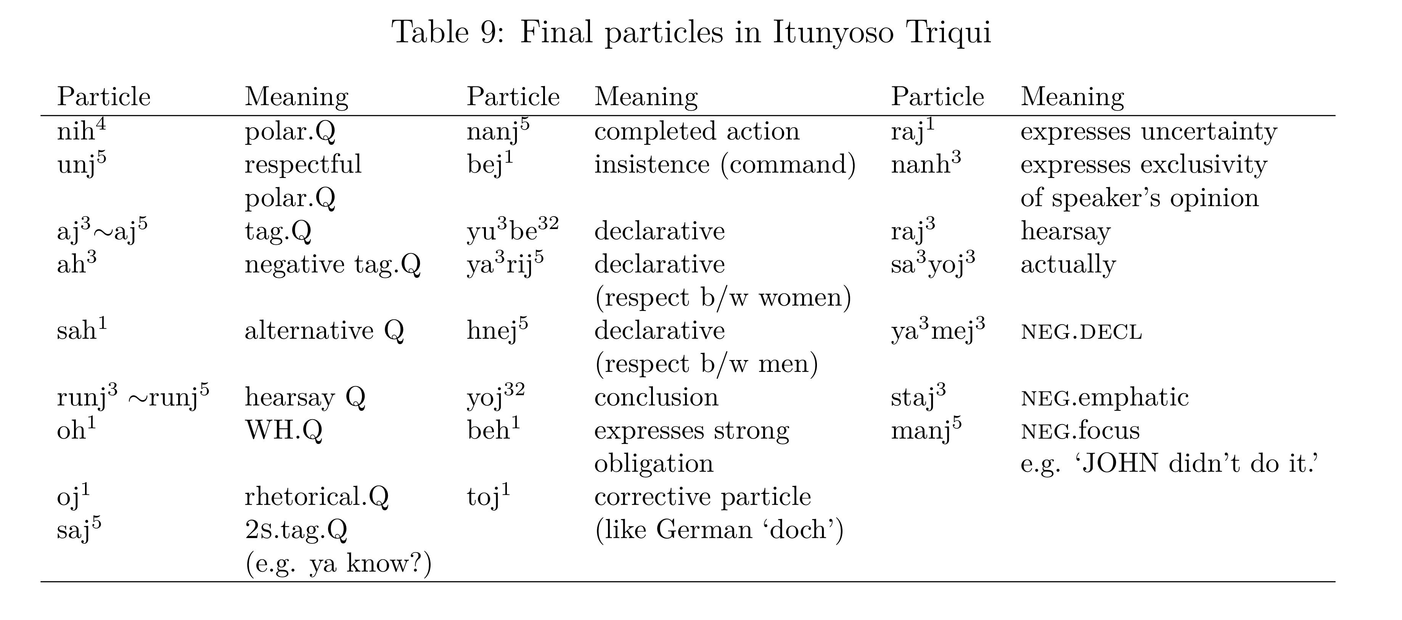
Pragmatic complexity
This is just over half the final particles!

Slide 45
Pragmatic complexity
The word for ‘male elder’ is taj⁴ /taɦ⁴/, but a glottal stop is appended to indicate that a question is being asked, resulting in tah⁴ /taʔ⁴/.
The final particle sah¹ indicates an option out of a list of entities.

Slide 46
This type of distinction is subtle.
In addition to so many final particles, pragmatics is also changing segmental content on address terms (and only on address terms – it’s not a general suffix).

Slide 47
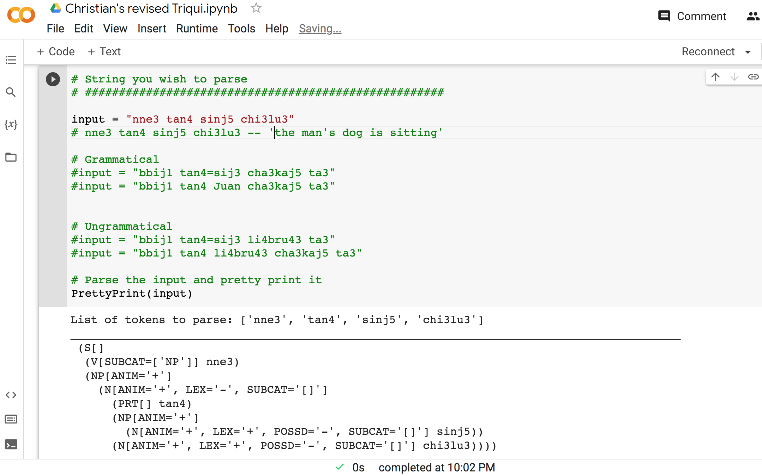
Project 2: Unification grammar of Triqui
Creation of syntactic parser with Rui Chavez using NLTK on Google Collab.
Write-up is collaborative using Overleaf.

Slide 48
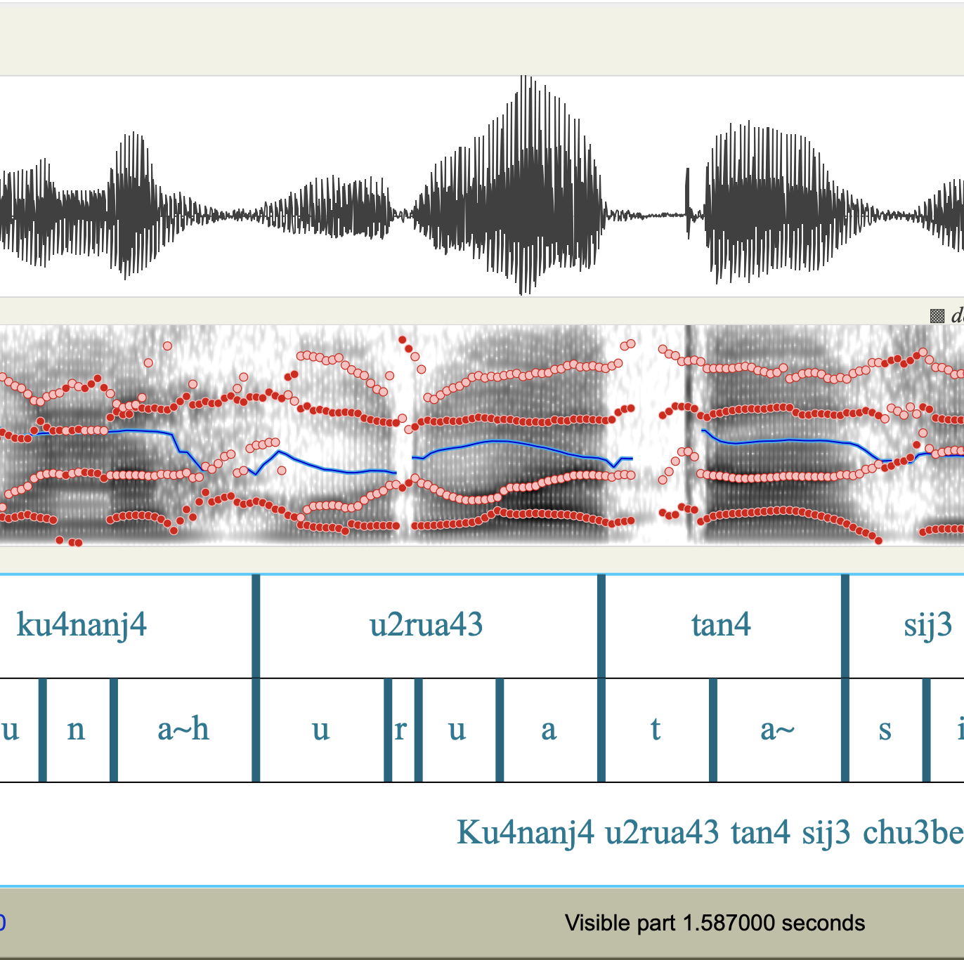
Project 3: Phonetic variation in speech
I’ve done work on Triqui phonetics in the past (DiCanio 2008, 2010, 2012a, 2012b, 2012c, 2014; DiCanio and Hatcher 2018). In 2023, I re-recorded 12 speakers producing all of the major contrasts in the language. This is 2,160 recordings of words in isolation and 2,160 recordings of words in carrier sentences.
These recordings and the larger text corpus create opportunities to explore variation in production.

Slide 49
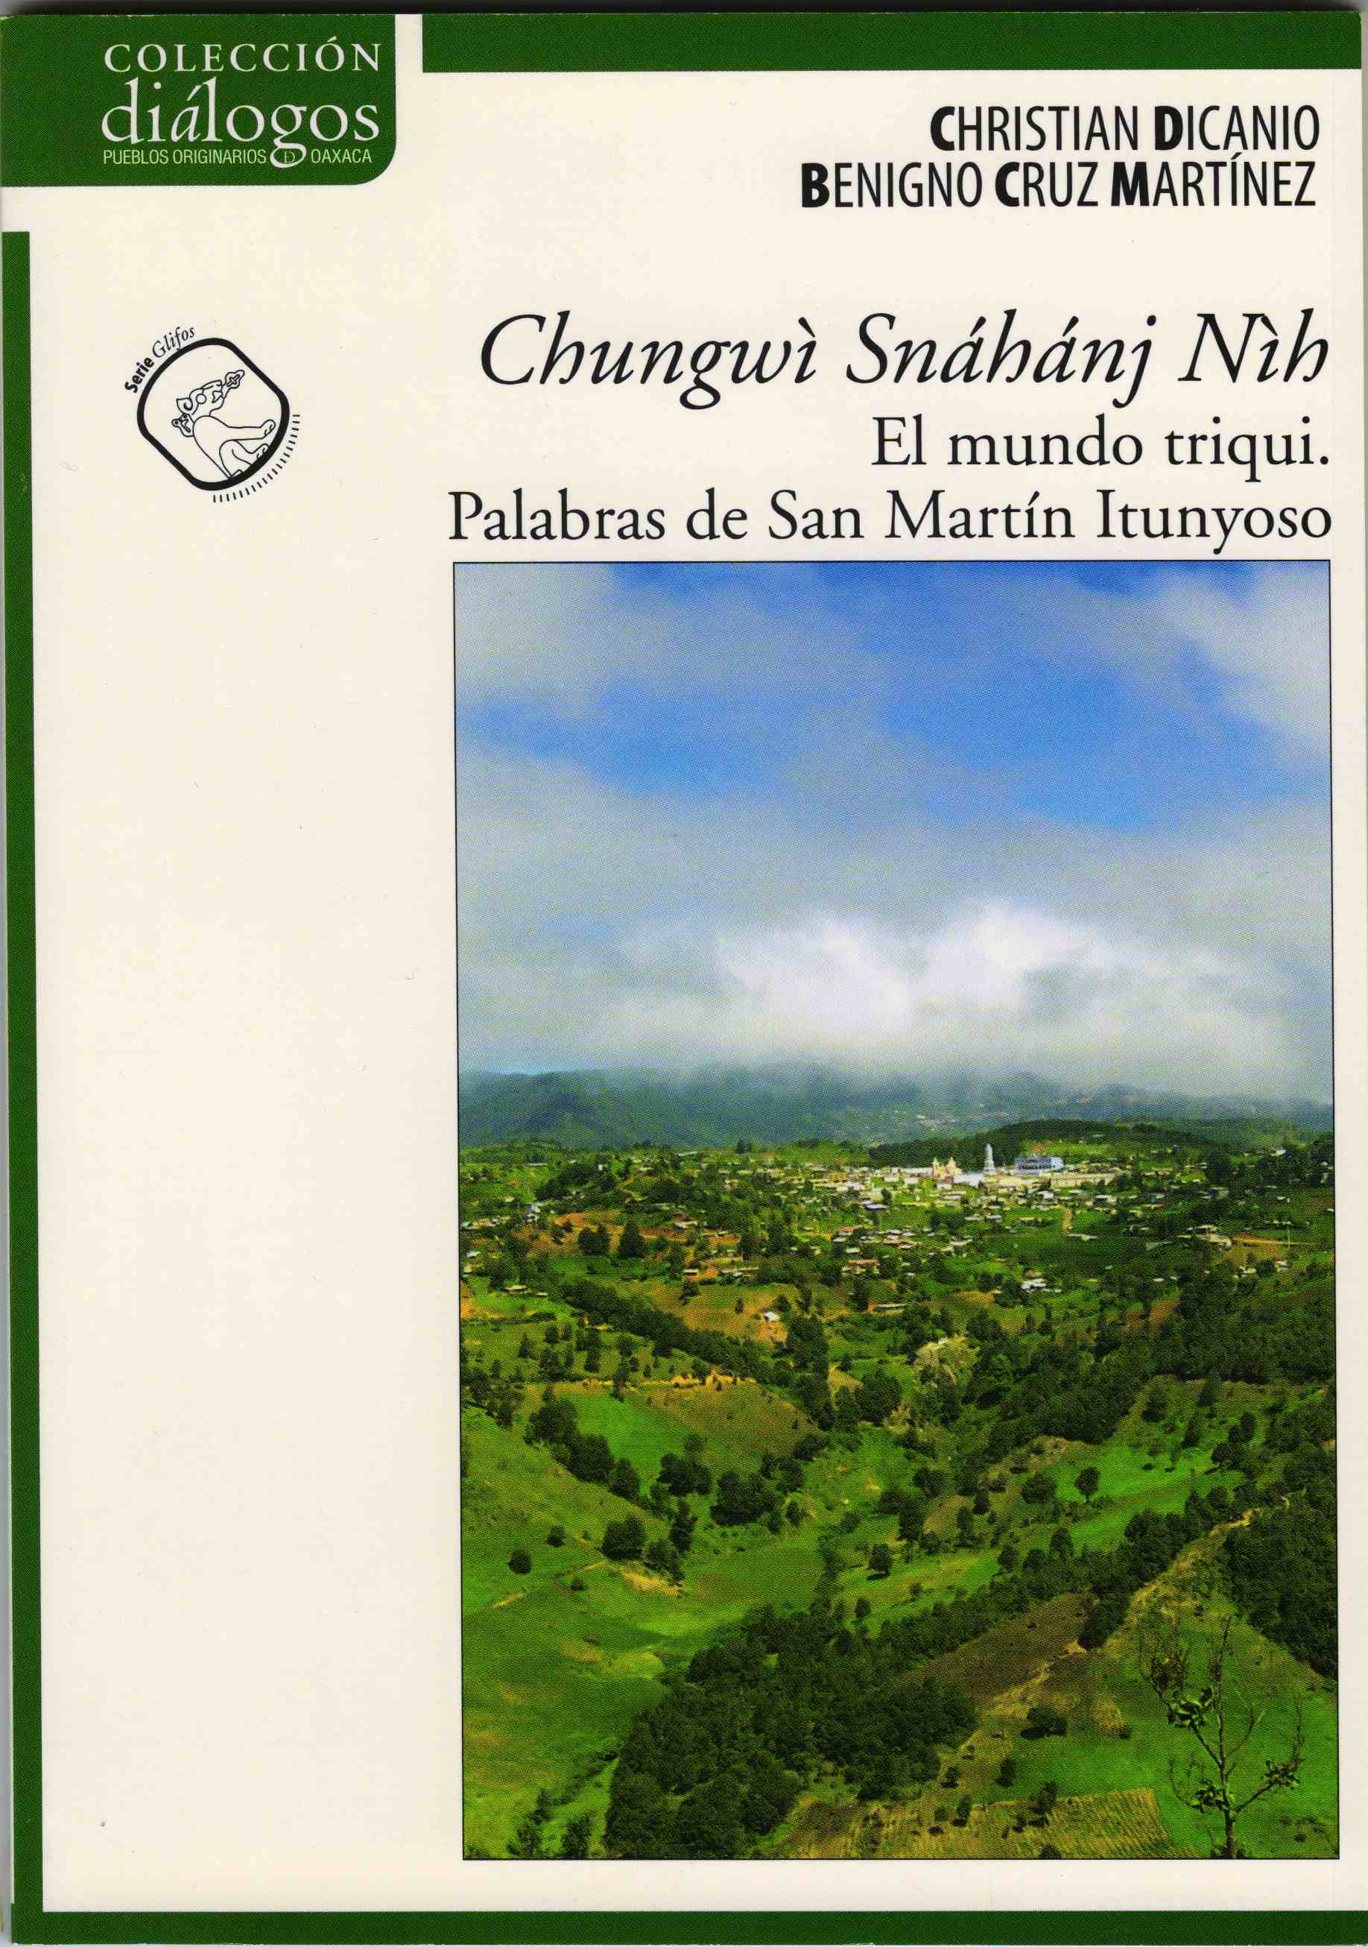
Final project ideas
Any of these ongoing projects could involve additional collaboration –or there could be projects that develop as offshoots.
Close involvement with the community (literacy workshops, creation of pedagogical materials to teach literacy) also means there is a need for additional types of things that could be final projects:
An app that includes the dictionary – currently in XHTML via FLEx.
A digital keyboard for Triqui texting (c.f. Mateo Toledo’s work)
Language games for teaching literacy (paper or digital)
Illustrations for existing stories/texts for publication with Storyweaver.

