Slide 1
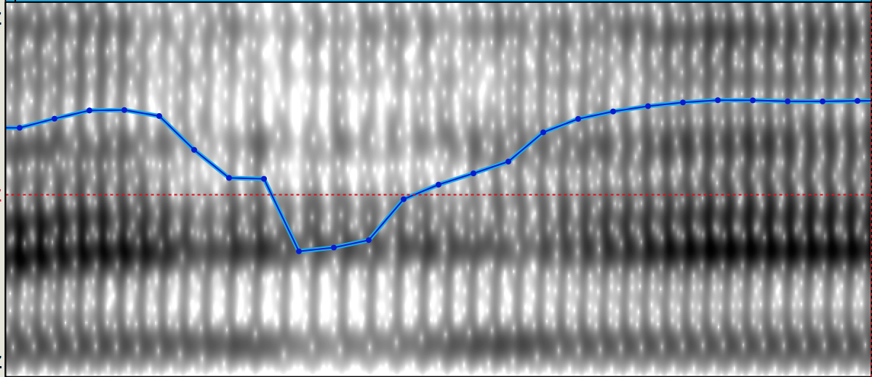
Phonetic variation in the production of glottal stops and glottalization
Dr. Christian DiCanio
University at Buffalo
cdicanio@buffalo.edu

Slide 2
Goals
An overview of the observed patterns of variation.
Glottal contrasts in Mixtecan languages (general) and in Triqui (specific)
How might we categorize variation in production?
(data show and tell)
What are the outstanding issues for analysis?

Slide 3
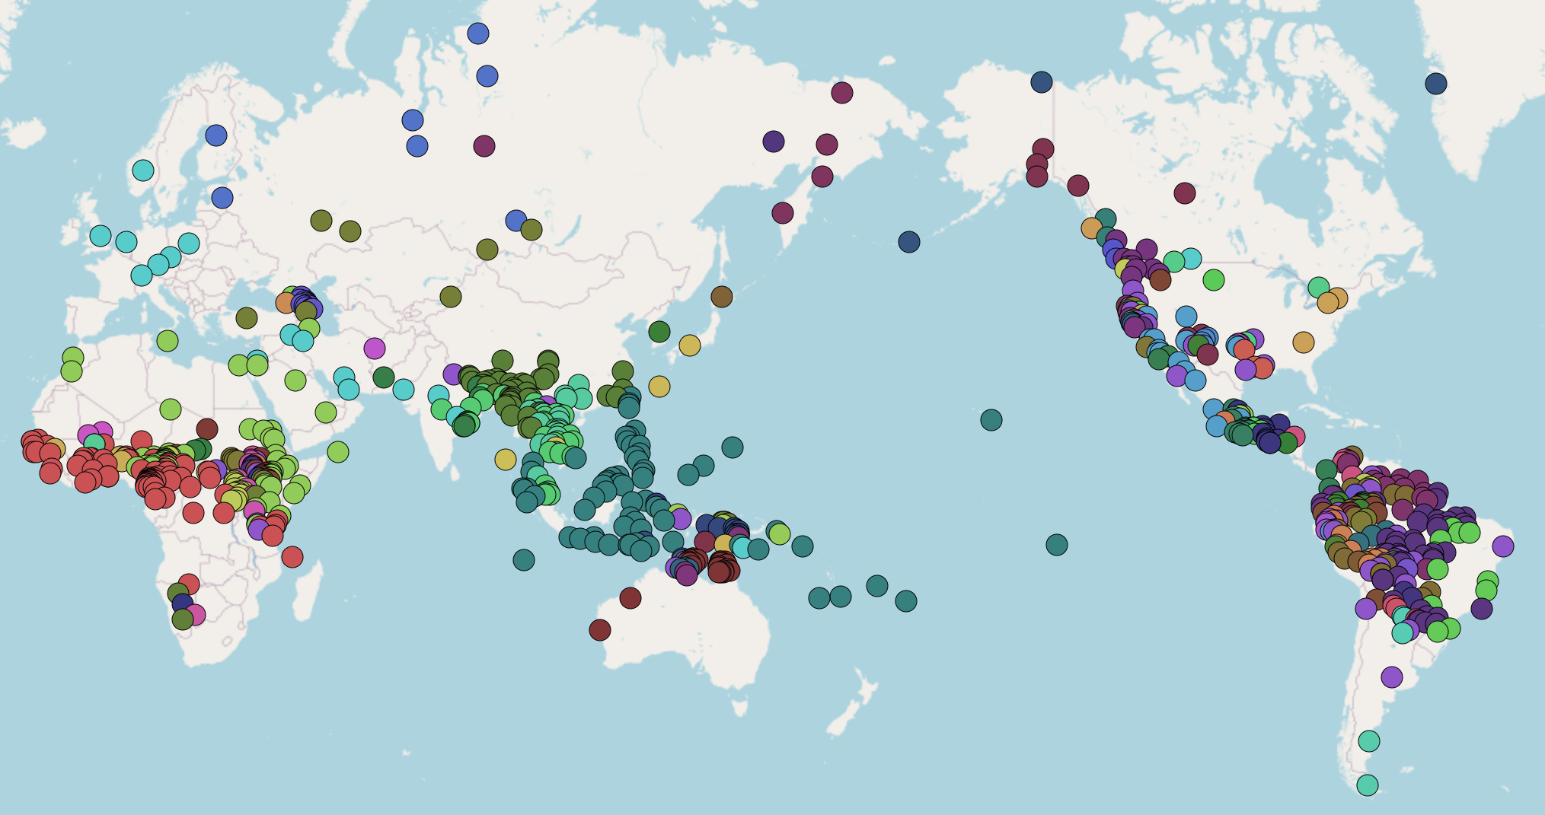
I. A typological perspective – a very common sound
Glottal stops are frequent in the languages of the world.
They are listed as allophones in 1131/3020 (37.5%) of the consonant inventories in PHOIBLE (Moran & McCloy 2019).

Slide 4
What qualifies as a glottal stop (in phonetics)?
In isolated words produced during careful speech, a glottal stop is often produced with full glottal closure.
What counts as full glottal closure though? 20 ms silence during closure? 40 ms?
Phonological descriptions of languages of the world frequently focus on carefully-produced allophones produced in elicitation contexts. This obscures observed variation.
(DiCanio et al 2015, to appear; DiCanio & Whalen 2015, Keating & Huffman 1984, Koopmans van Beinum 1980)

Slide 5
How do we categorize glottal features (in phonology)?
What is transcribed as a glottal stop may be analyzed as a:
  vocalic feature (Arellanes Arellanes 2009, Chávez Peón 2010, Covarrubias Acosta 2020, Hernández Luna 2019)
  prosodic feature (DiCanio 2008, Hollenbach 1984)
  tonal feature (Hollenbach 1984, Matisoff 1999, Yip 2002)
  morphological feature (Macaulay & Salmons 1995)
  segment/phoneme (Davidson 2021, DiCanio 2008, 2010)
A common trend is to assume that productions involving incomplete closure or non-modal phonation constitute evidence that glottalization is non-segmental/non-phonemic. These two factors are orthogonal.

Slide 6
Variation in speech production is the norm regardless of phonological status
Three major phonetic variants of glottal stops:
  full stops [aʔa]
  non-modal phonation – either creak or vocal fry or diplophonia [aa̰a]
  omitted [aː] (but do subtle intensity perturbations count?)
In languages where glottal stops are unequivocally phonemes, they are usually just produced as non-modal phonation and no closure, e.g.
  Arapaho /ʔ/: full glottal closure 25-27% of the time, omitted 13-18% of the time, non-modal phonation 55-62% of the time (Whalen et al 2016).
  Hawaiian /ʔ/: full glottal closure just 7% of the time, omitted 20% of the time, non-modal phonation 73% of the time (Davidson 2021).

Slide 7
Variation, duration, and prosodic boundaries
Full glottal closure occurs more often in contexts of increased duration whereas non-modal phonation occurs more often in shorter duration contexts.
  Ixcatec glottalized stops (DiCanio 2011)
  Arapaho glottal stops (Whalen et al 2016)
  Hawaiian glottal stops (Davidson 2021)
Full glottal closure is more common at prosodic boundaries in Itunyoso Triqui (DiCanio 2012).
Incomplete closure is a type of speech reduction, but it is far more common with glottal stops than with oral stops.

Slide 8
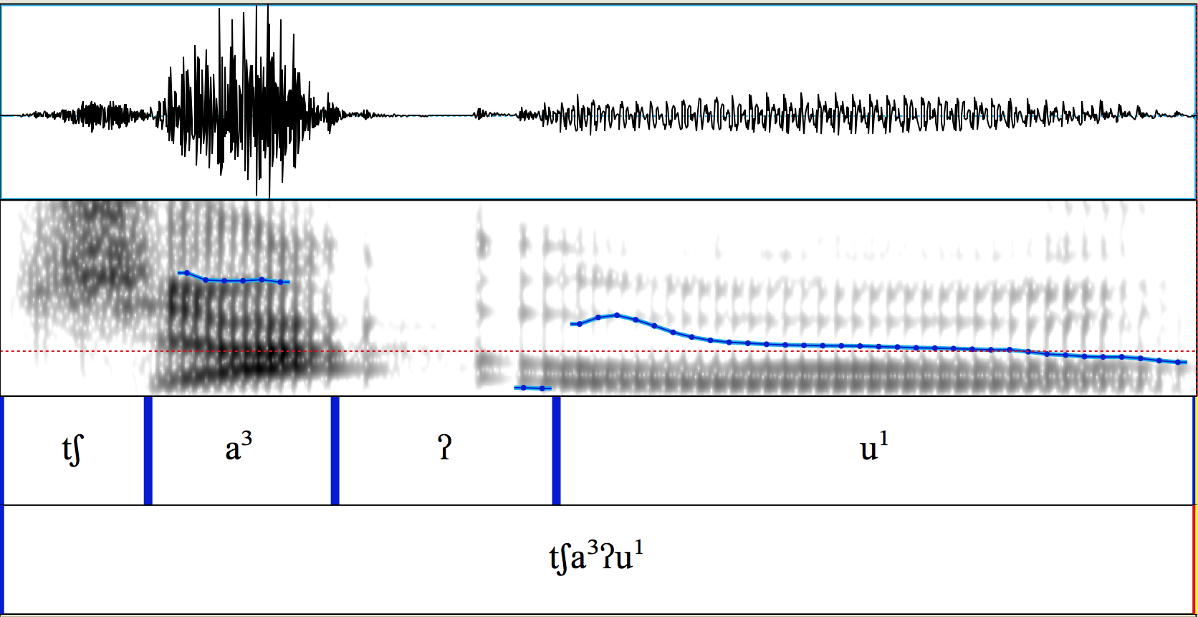

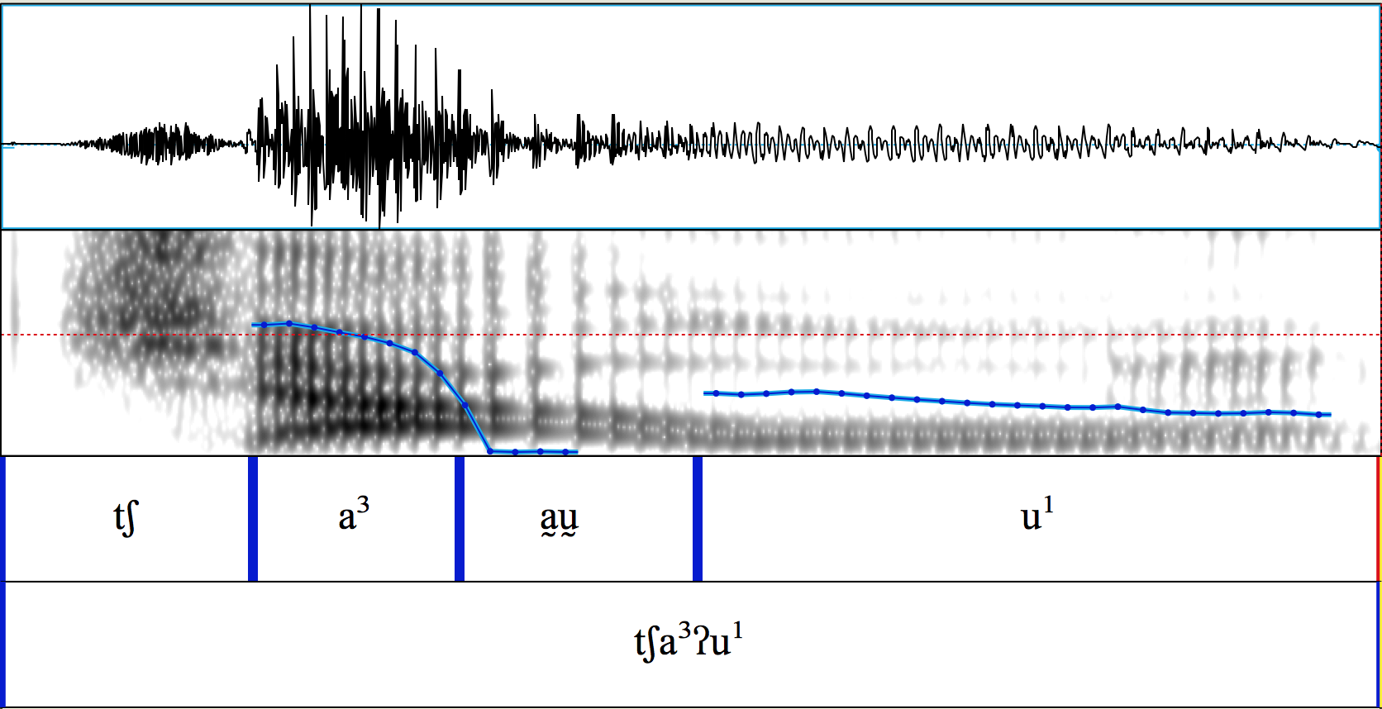
Variation I
In Itunyoso Triqui (Otomanguean), medial glottal stops can be realized with complete closure (above)
or without complete closure (below)
/tʃa³ʔu¹/
‘barn owl / tecolote’
Both sound like they have closure, right?

Slide 9
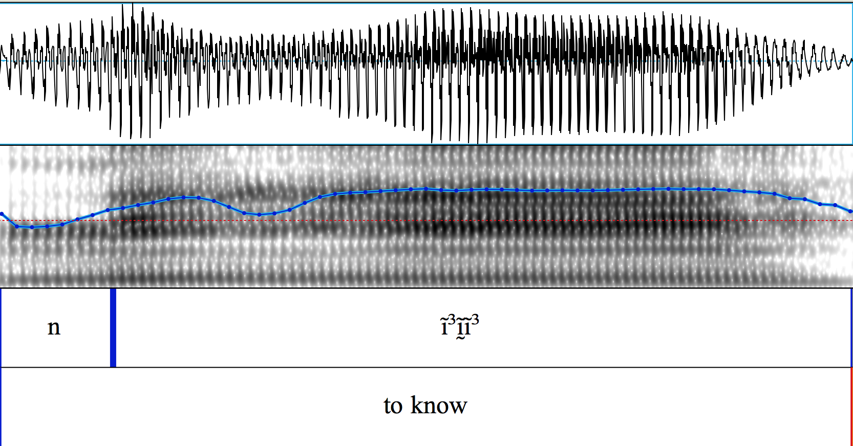
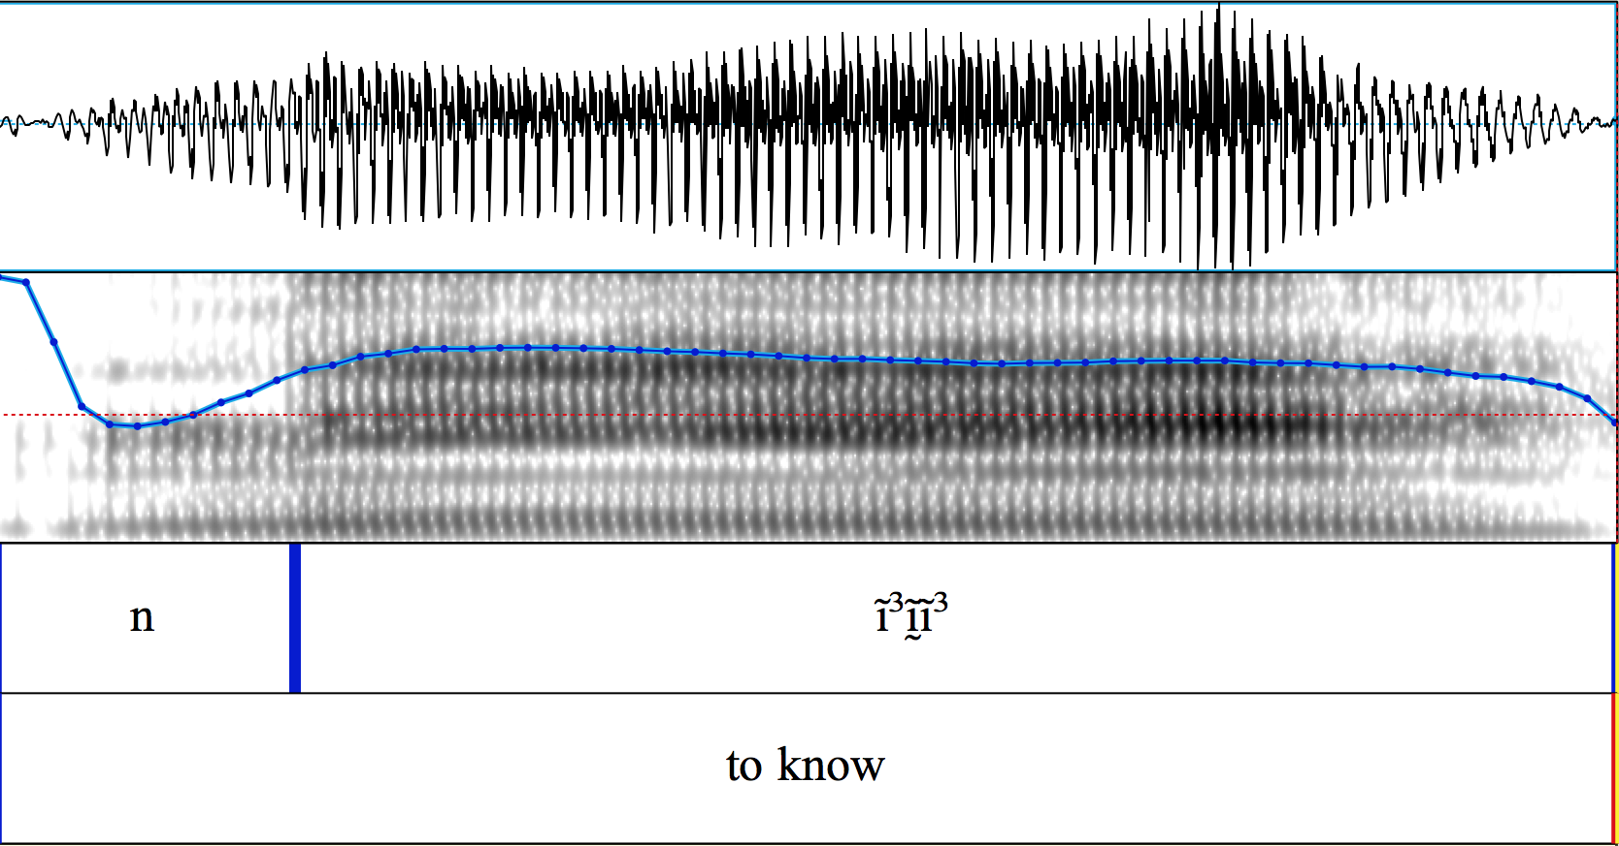
Variation II
But medial glottal stops can also be realized with non-modal phonation (creak, vocal fry, diplophonia)
or only very subtle visible changes in voice quality
/ni³ʔi³/
‘to know / saber~conocer’

Slide 10
Previous accounts of production variation
In the great majority of languages we have heard, glottal stops are apt to fall short of complete closure, especially in intervocalic positions.
p.75, Ladefoged and Maddieson (1996) (cited in Davidson, 2021)
Also, it is not uncommon to find segments described as glottal stops surfacing phonetically in one of the following articulatory forms: (1) glottal stops or creaky transitions; (2) glottal approximants; (3) voiced laryngealized transitions between vowels. Some of the questions raised by these facts are: if glottal stops are not always phonemes or stops, what are they? Features? Suprasegmentals? Are they linked to stress or syllable boundaries? Do they operate at larger prosodic levels, for instance, the prosodic word or phonological phrase?
p.352, Storto & Demolin (2012) (on South American languages)

Slide 11
Small perturbations = “glottalization”
Speakers use small, local f0, intensity and H1-H2 perturbations as cues to the presence of glottalization in intervocalic position (Gerfen & Baker 2005, Hillenbrand & Houde 1996).
Listeners can use even more subtle cues – just a 2Hz, 3dB perturbation induces the perception of glottalization at >90% in Coatzospan Mixtec listeners.
Figure from Gerfen & Baker (2005) with Coatzospan Mixtec listeners

Slide 12
Why does this phonetic variation matter?
Non-modal phonation as the primary realization of a glottal stop involves overlap with adjacent speech sounds, making segmentation/parsing particularly challenging.
In many languages, glottalization and glottal stops have a high functional load, meaning that it is important for morphological identification.
Acoustic landmark detection of non-modal phonation often requires accurate f0 estimation (e.g. spectral tilt), but it is precisely during non-modal phonation that one can not reliably estimate f0.

Slide 13
It is important for speech but a very difficult thing to recognize/detect.
(see also – nasalization)

Slide 14
Approach – human categorization
Several recent studies have attempted to categorize variation in the production of glottal stops (Davidson 2021, Whalen et al 2016).
Coming up with reliable inter-transcriber categories is a challenge, but it is also rewarding since computational models can be trained on them.
A DNN trained on minimal human categorization of stop allophones is able to accurately categorize lenited stop allophones at over 90% accuracy (DiCanio, Chen, Benn, Amith, and Castillo García, to appear in J.Phonetics).

Slide 15
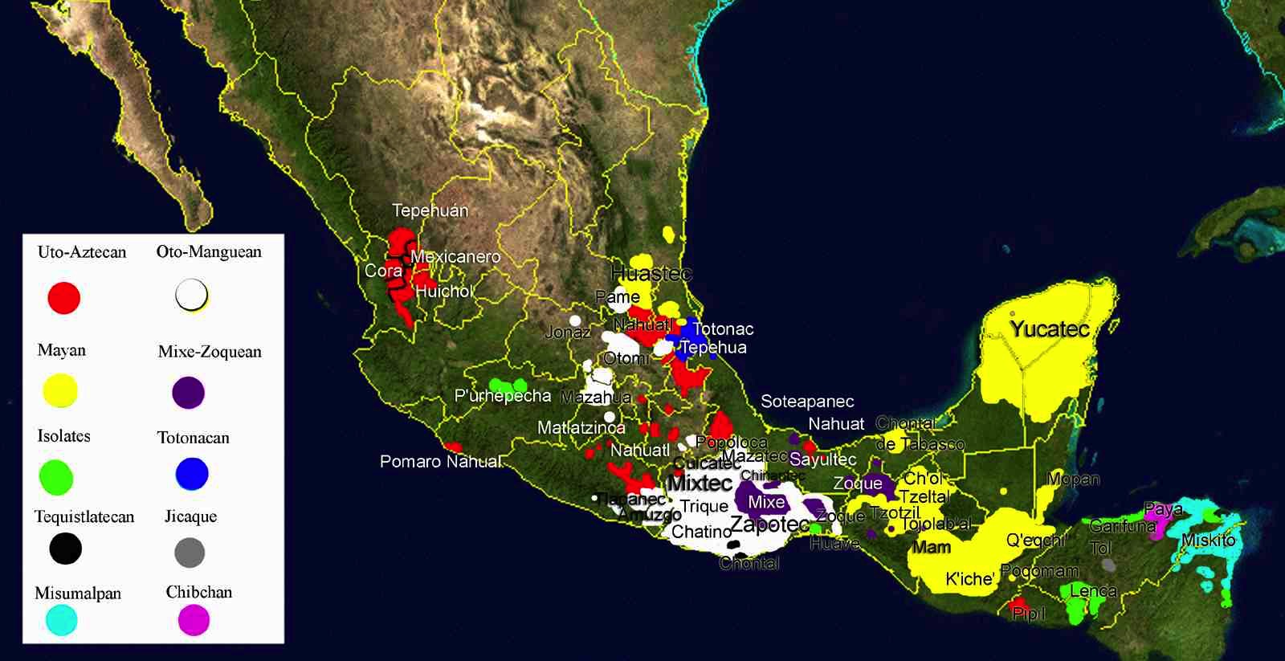
II. Test case – Itunyoso Triqui (Otomanguean)
Otomanguean languages, spoken Southern Mexico, have contrastive glottalization and/or glottal stops.

Slide 16
Otomanguean language family
About 180 language varieties within the family, making it the largest language family in the Americas.
Most communities are small (500– 5,000) speakers.

Slide 17
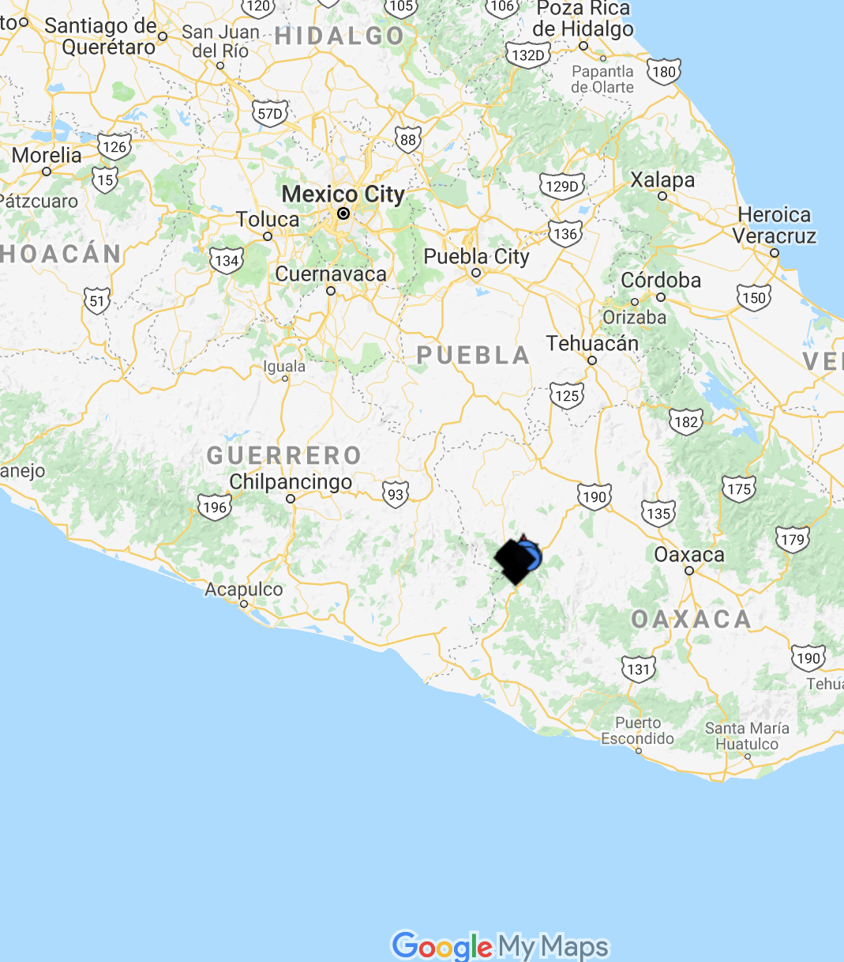
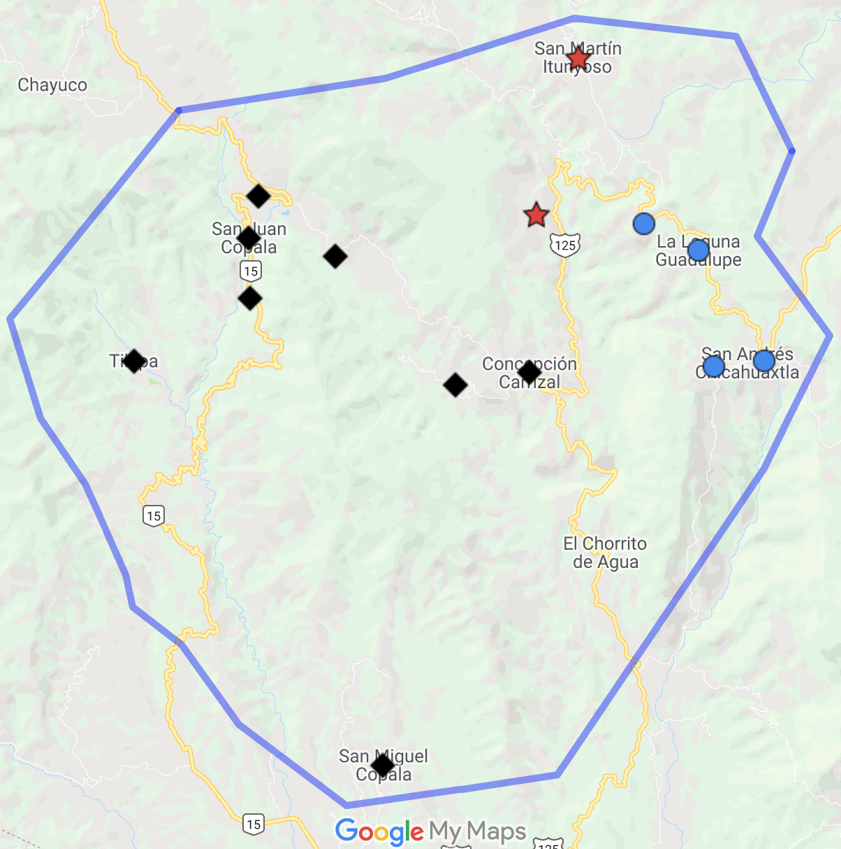
Itunyoso Triqui – about 2,500 speakers

Slide 18
Previous work on Itunyoso Triqui
Topic of extensive fieldwork (DiCanio 2008, 2010, 2012a, 2012b, 2016, 2019, DiCanio et al. 2020, DiCanio & Hatcher, submitted).
Plain consonants (left) and glottalized consonants (above)

Slide 19
Tone and syllable structure
All syllables are open in non-final syllables, but two glottal consonant codas are possible in final syllables. There are nine lexical tones.
Contour tones do not occur before a coda /ʔ/, but otherwise, tone and glottal consonants are orthogonal.

Slide 20
Itunyoso Triqui tone
βːeh⁵ ‘straw mat’
βːe⁴ ‘hair’
nːe³ ‘plough’
nːe² ‘to lie (to someone)’
nːe¹ ‘naked’
tʃe⁴³ ‘my father’
nːe³² ‘water’
nːe³¹ ‘meat’
nːãh¹³ ‘towards here’
DiCanio 2008; 2020

Slide 21
Stress and length
Final syllables are stressed in Triqui – most of the segmental contrasts occur in final syllables (including all glottal consonants) and this is the domain of syllabic lengthening (DiCanio 2008, 2010; DiCanio & Hatcher, submitted).
A major 3-way distinction between
  Final syllables with no coda and lengthening e.g. [a³taː³] ‘to load’
  Final syllables with a coda /ʔ/ e.g. [a³taʔ³] ‘to lift up’
  Final syllables with a coda /ɦ/ e.g. [a³taɦ³]
  ‘the day before yesterday’

Slide 22
Final glottal consonants have a high functional load
48% of all roots in the lexicon have final, open sylables, while 17% have a coda /ʔ/ and 35% have a coda /ɦ/.
The presence/absence -/ɦ/ marks 1st person singular and 3rd person topic morphology. The insertion of /-ʔ/ marks 1.EXCL morphology as well as foregrounding morphology, e.g. tʃu³βe³ ‘dog’ vs. tʃu⁴βeʔ⁴ ‘that dog’
nne³ ‘to sit’ stĩ⁴ ‘fingernail’
nneɦ⁵ ‘I sit’ stĩɦ⁵ ‘my fingernail’ 1.s
nneɦ³ ‘one sits’ stĩɦ³ ‘one’s fingernail’ 3.top
nneʔ⁴ ‘we sit’ stĩʔ⁴ ‘our fingernail’ 1.pl.excl

Slide 23
Glottal features in Itunyoso Triqui
Phonemic glottal stops occur
  intervocalically as onsets of root-final syllables, e.g. [ɾã³ʔãː³] ‘mushroom’
  in codas of root-final syllables, e.g. [ɾãʔ³] ‘to happen’
Pre-glottalized sonorants occur
  in word-initial position of monosyllables, e.g. [ˀnĩɦ³²] ‘to hold up’
  [nĩɦ³²] ‘to fall down’
  intervocalically as onsets of root-final syllables, e.g. [ba¹ˀnĩ³] ‘three of them’

Slide 24
Previous phonetic research
Intervocalic glottal stops are more rarely produced with full stop closure than coda glottal stops (DiCanio 2012a).
Vowels preceding a coda glottal consonant are much shorter than vowels in open syllables and listeners rely on vowel duration to as a cue for coda glottalization (DiCanio 2012a, 2014).
Additional acoustic cues to glottalization include corrected spectral slope measures like H1-H2, H1-A3 (DiCanio 2012a).

Slide 25
Lenited vs. non-lenited glottal stops
ne³ʔeɦ³ ‘child’
nneʔ³ ‘straw rope’
Figures from DiCanio (2012a)

Slide 26
Glottalization and tone
Glottalization perturbs f0 targets. This predicts that for languages where f0 is also contrastive, tone and glottal targets may be timed so as to prevent acoustic overlap and maintain tonal recoverability (Silverman 1997).
Caveat – linguists are likely to transcribe glottalization as [ʔ] ~ [ˀ]. Transcriptional practice biases phonological accounts to assume separability, i.e. if it’s transcribed as [ʔ] instead of [a̰], it must always be a stop, right?
For Triqui, prosodic position appears to play a more important role in glottal stop realization than tone.

Slide 27
III. Categorization
Human categorization of allophony in running speech is useful not only for descriptive/empirical purposes but also for the construction of predictive models trained on the acoustics.
Arapaho classification of glottal stop realizations (Whalen et al 2016)
  Full glottal stop
  Creaky phonation.
  Creaky phonation with local glottalization.
  No glottalization.
  “Problematic” (hard to classify)

Slide 28
Arapaho results (from Whalen et al)
Realization | ASE | Percent | MKU | Percent
Full glottal stop | 58 | 25.3 | 111 | 27.4
Creaky phonation | 92 | 40.2 | 121 | 29.9
Creaky phonation with local glottalization | 39 | 17.0 | 74 | 18.3
No glottalization | 30 | 13.1 | 72 | 17.9
Problematic stop | 10 | 4.4 | 27 | 6.7
TOTAL (COUNTS) | 229 |  | 405
*ASE and MKU are different Arapaho speakers

Slide 29
Categorization of stop allophony in Yoloxóchitl Mixtec spontaneous speech
Even in languages with frequent stop lenition, full closure for voiceless stops is more the norm than the exception.
DiCanio, Chen, Benn, Amith, and Castillo García (to appear)

Slide 30
DNN model trained on categories

Slide 31
Categorization of Triqui glottal stops
What does the variation in Triqui spontaneous speech look like?
The Itunyoso Triqui documentation corpus contains about 30 hours of transcribed recordings; approximately 12 hours have been checked and force-aligned.
Results from the initial categorization of some of the hand-corrected portion of the aligned corpus, done by three categorizers: Christian DiCanio (UB), Richard Hatcher (UB), and Lisa Davidson (NYU)

Slide 32
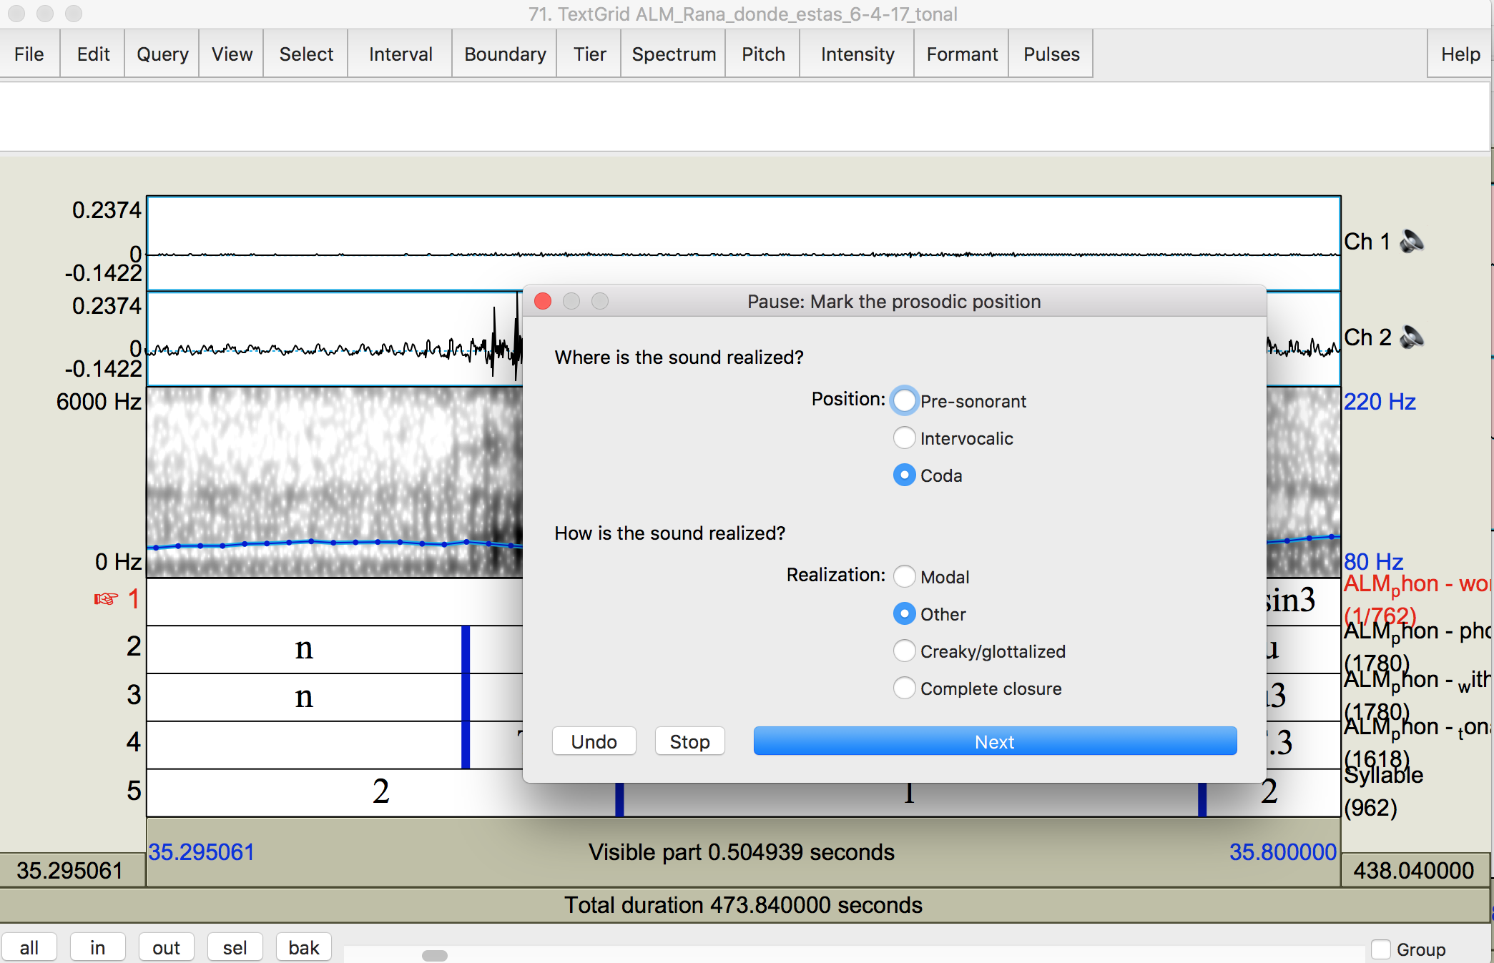
Methods
We used a categorization script written for Praat that allows users to visually examine an annotated portion of the speech signal, click the qualitative judgment, and then proceed to the next annotation.

Slide 33
Spontaneous speech sample
We examined the text “Derechos de Mujeres Triquis” - a 14 minute 15 second conversation between two women (who speak somewhat quickly).
There were 604 glottal stops in the recording.
Five categories were used:
  Glottal stop (closure at least 20 ms)
  Aperiodic – some clear loss of periodicity
  Perturbation – periodic but with some intensity/f0 dip
  Modal – periodic with no apparent change in intensity/f0
  Unsure

Slide 34
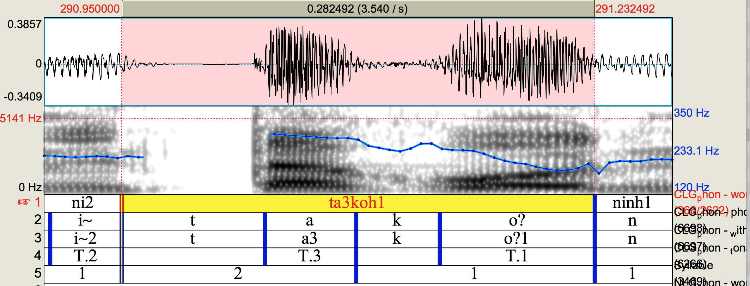
Perturbation
Increased shimmer in production
ta³koʔ¹ ‘hangs’

Slide 35
Inter-categorizer reliability
Richard and Christian – 70.8% agreement
Christian and Lisa – 69.4% agreement
Lisa and Richard – 67.5% agreement
Most of the disagreement was between the categories “aperiodic” and “perturbation.” If we merge these categories, we agree more often.
Richard and Christian – 84.3% agreement
Christian and Lisa – 77.0% agreement
Lisa and Richard – 76.3% agreement

Slide 36
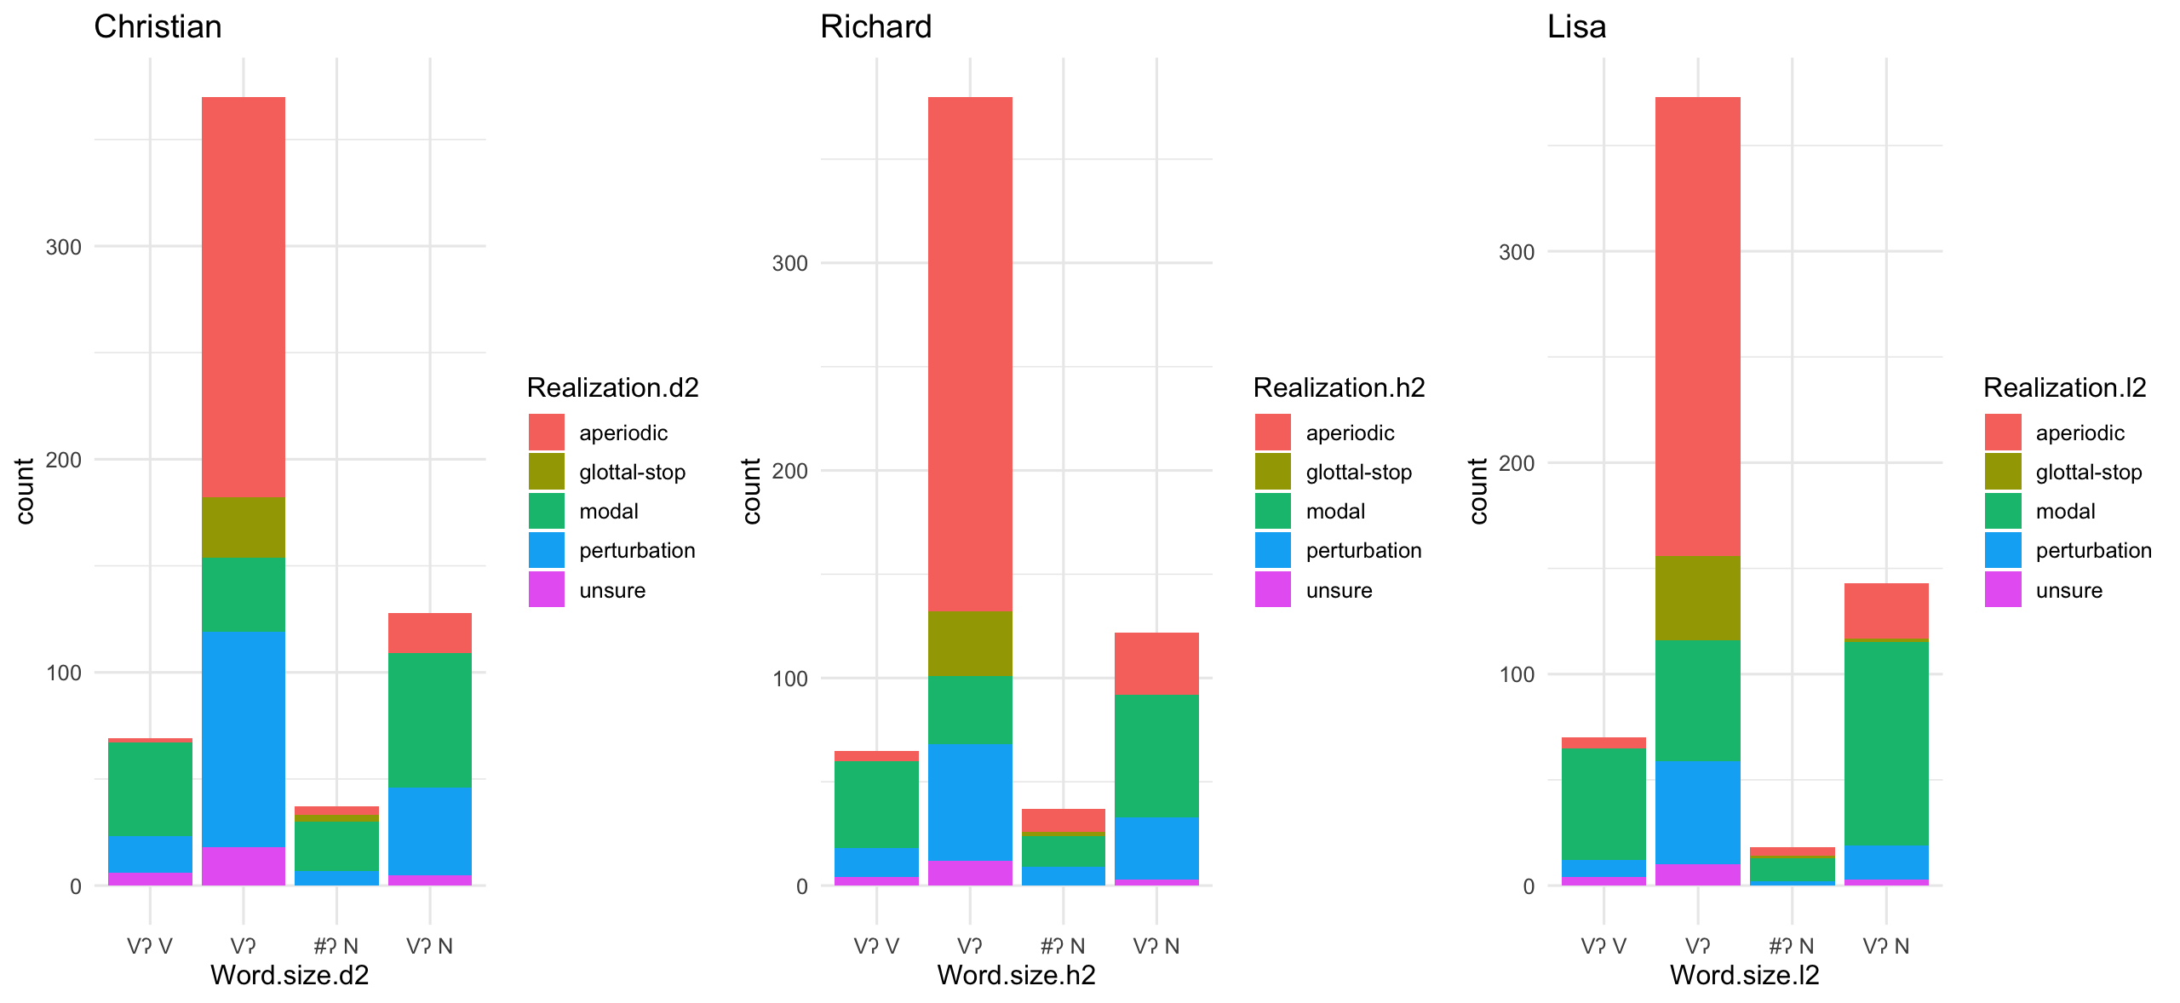
Our categorizations

Slide 37
How often is a glottal stop a stop? Rarely.
Realization | Frequency across categorizers
Glottal stop | 5.1 – 7.1%
Aperiodic | 35.2 – 48.7%
Perturbation | 12.4 – 27.5%
Modal | 24.6 – 35.9%
Unsure | 2.8 – 4.8%

Slide 38
Prosodic influence on production
28-40 realizations of the complete glottal stops occurred in root-final position, but none occurred in intervocalic position.
This finding mirrors past work suggesting that prosodic position plays a role in the realization of glottal stops (cf. Davidson 2021).

Slide 39
Does the presence of tonal contrast matter?
The proportion of glottal stop realizations (5-7%) is very close to values reported for Hawaiian (Davidson 2021).
Hawaiian is non-tonal and Itunyoso Triqui is heavily tonal.
The degree to which glottal stops are realized as non-modal phonation seems to independent from whether they may influence tone, contra Silverman (1997).

Slide 40
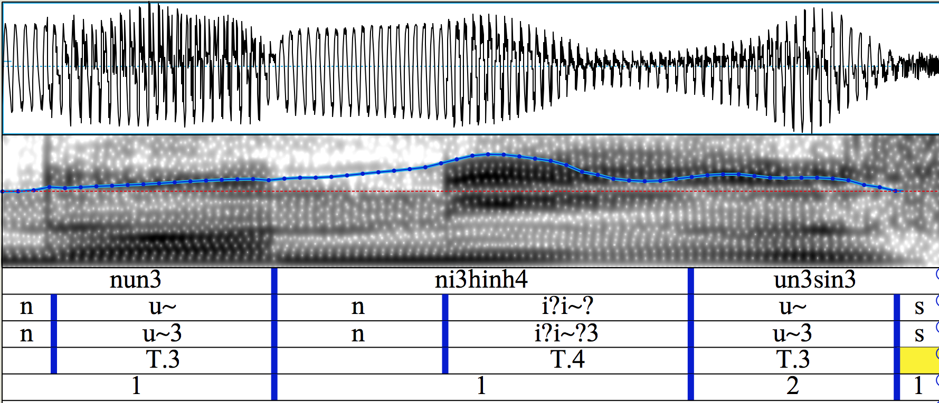
IV. Outstanding issues: Triqui
In the Triqui data, it is difficult to identify what an f0 perturbation looks like when tones change in the word or across word boundaries.
The intervocalic glottal stop is missing here and the tone on /ni³ʔi⁴ʔ/ is higher than the following tone.
The early fall in f0 and intensity is a perturbation, not tonal coarticulation

Slide 41
Lexical frequency effects are persistent
Some of the glottal lenition patterns are biased due to lexical frequency. Frequent lexemes often have deleted glottal stops.
kã³ʔãɦ² ‘went’ > [kãɦ³²]
ki³ˀjaɦ³ ‘did’ > [kjaɦ³]
nĩ³ʔĩ³ ‘see’ > [nĩː³]
a³kʷa⁴ˀniː⁴³ ‘now’ > [kʷa⁴niː⁴³]
If we exclude these, rates of deletion are probably lower.

Slide 42
Phonological factors in interaction?
Several empirical questions remain open:
  Is glottal reduction more common in contexts with higher tones? (since glottalization lowers f0)
  Is glottal reduction more common in contexts where multiple glottal consonants occur in the same syllable? Does laryngeal crowding cause reduction in running speech?
  ja³ʔaː³ ‘comb’
  ja³ʔaɦ³ ‘chile pepper’
  to³ʔoʔ⁴ ‘our chile pepper’

Slide 43
Outstanding issues: general
Keating et al. (2015) propose a set of refined categories for what is often labelled “creaky phonation.”
  Vocal fry
  Multiply pulsed voice
  Aperiodic voice
  Nonconstricted creak
  Tense/pressed phonation
In practice, it is quite difficult to classify glottalization in spontaneous speech using these categories.

Slide 44
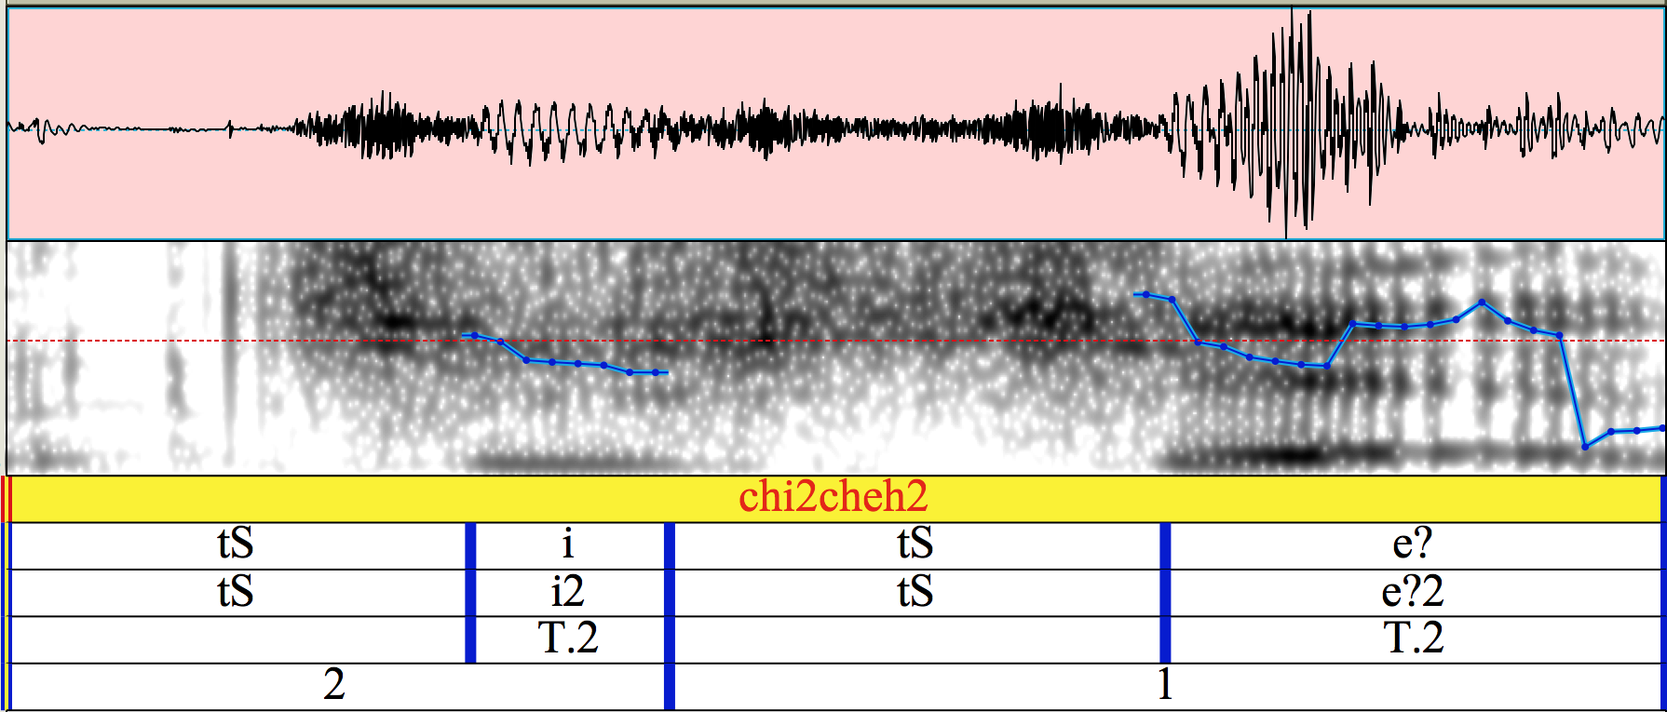
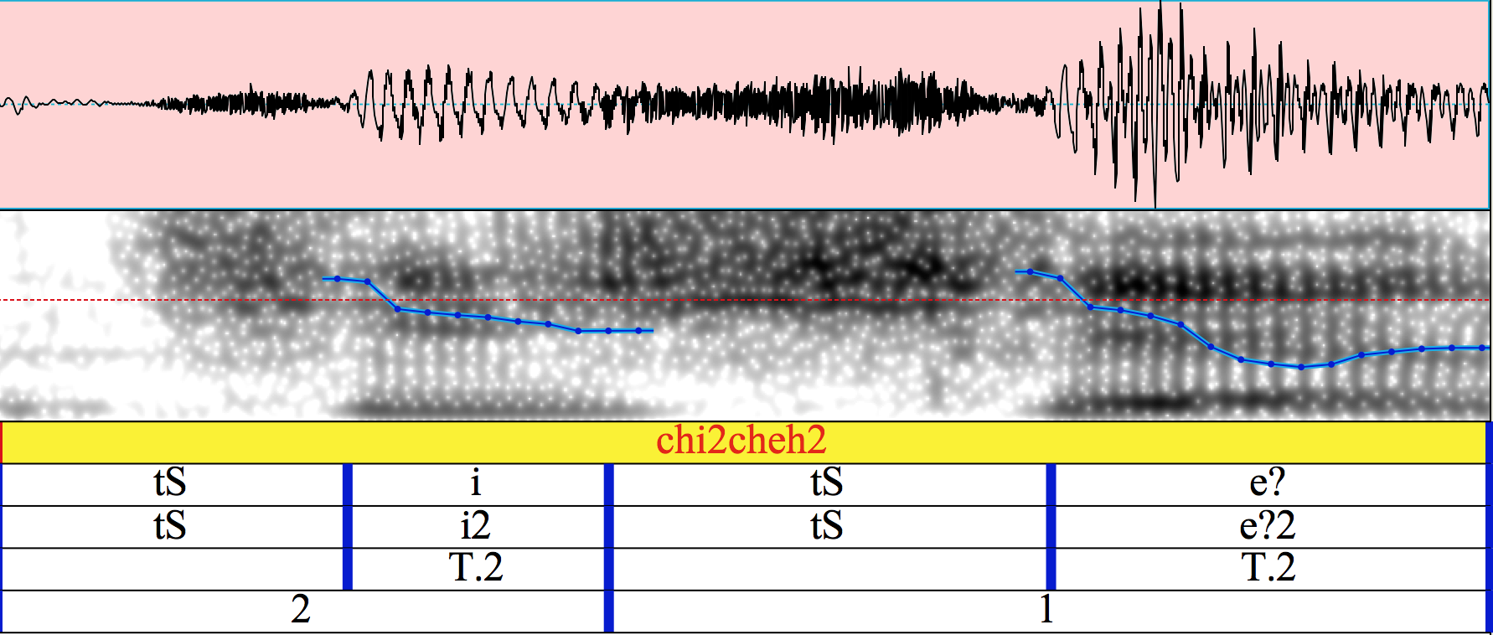
The figure above shows aperiodic voice for the final glottal stop in the word /tʃi²tʃeʔ²/ ‘right(s).’
The figure below shows some type of perturbation in the middle of the vocalic portion.
Same speaker, same word, separated by 5 seconds.

Slide 45
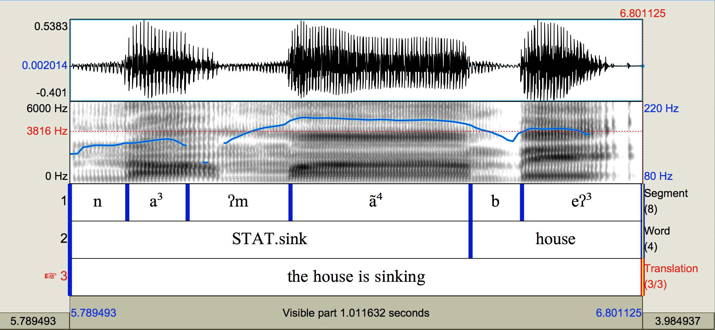
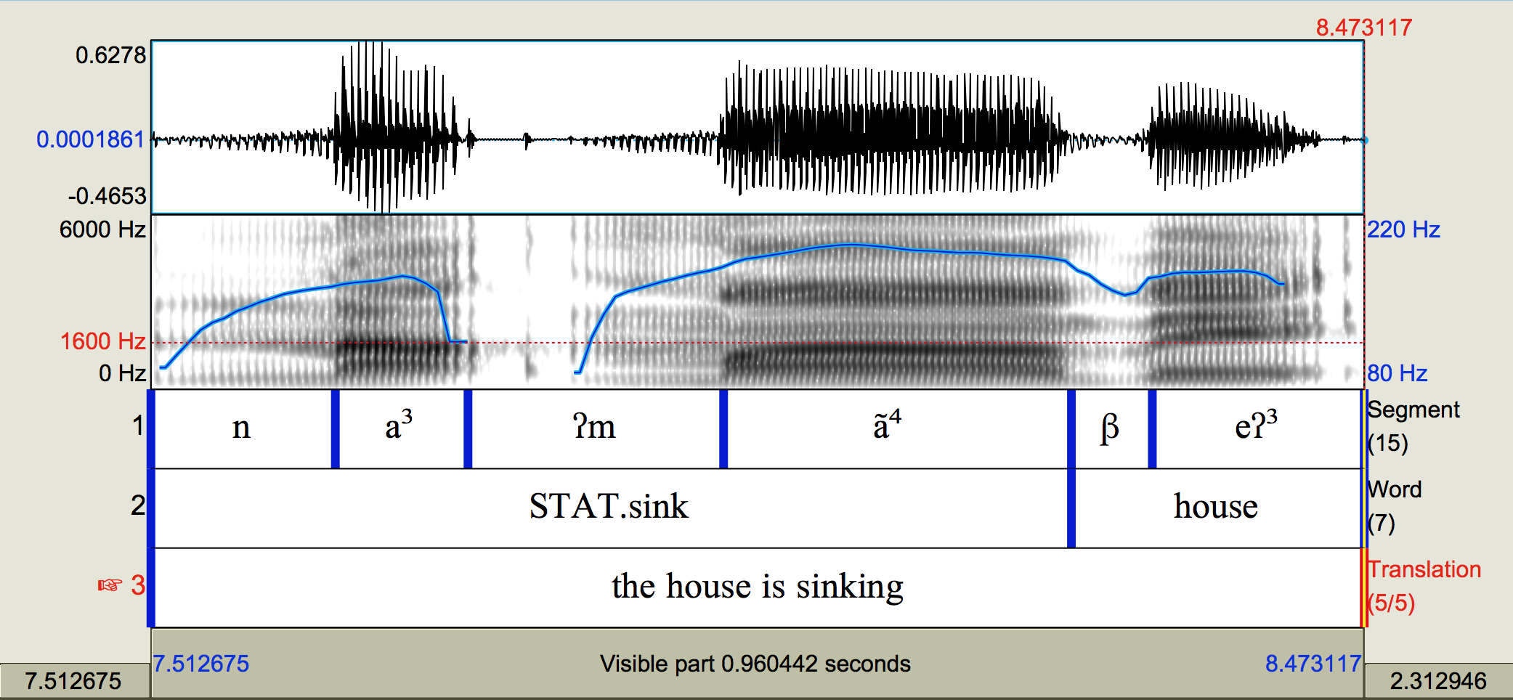
Not everything that “sounds like a stop” is a stop.

Slide 46

Future directions
Analyze and categorize more data from the corpus.
Examine relationship between acoustic duration and glottal lenition as well as potential interactions with lexical frequency and tonal categories.
Larger corpora for corpus phonetic research are available for future analysis.
Acknowledgements: Richard Hatcher and Lisa Davidson

Slide 47
References
Arellanes Arellanes, F. (2009). El sistema fonológico y las propiedades fonéticas del zapoteco de San Pablo Güilá - Descripción y análisis formal. PhD thesis, Colegio de México, D.F.
Beam de Azcona, R. (2004). A Coatlán-Loxicha Zapotec Grammar. PhD thesis, University of California, Berkeley.
Chávez Peón, M. E. (2010). The interaction of metrical structure, tone, and phonation types in Quiaviní Zapotec. PhD thesis, The University of British Columbia.
Covarrubias Acosta, A. (2020). Fonología del Dizdea: Zapoteco de San Bartolo Yautepec. Tesis de Licenciatura: ENAH.
Davidson, L. (2021). Effects of word position and flanking vowel on the implementation of glottal stop: Evidence from Hawaiian. Journal of Phonetics, 88:1–14.
DiCanio, C. T. (2008). The Phonetics and Phonology of San Mart ́ın Itunyoso Trique. PhD thesis, University of California, Berkeley.
DiCanio, C. T. (2010). Illustrations of the IPA: San Mart ́ın Itunyoso Trique. Journal of the International Phonetic Association, 40(2):227–238.

Slide 48
DiCanio, C. T. (2011). Laryngeal timing in Ixcatec consonants. 19th meeting of the Manchester Phonology Meeting.
DiCanio, C. (2012a). Coarticulation between tone and glottal consonants in Itunyoso Trique. Journal of Phonetics, 40(1):162–176.
DiCanio, C. T. (2012b). The Phonetics of Fortis and Lenis Consonants in Itunyoso Trique. International Journal of American Linguistics, 78(2):239–272.
DiCanio, C. T. (2014). Cue weight in the perception of Trique glottal consonants. Journal of the Acoustical Society of America, 135(2):884–895.
DiCanio, C. T. (2016). Abstract and concrete tonal classes in Itunyoso Trique person morphology. In Palancar, E. and Léonard, J.-L., editors, Tone and Inflection: New Facts and New Perspectives, volume 296 of Trends in Linguistics Studies and Monographs, chapter 10, pages 225–266. Mouton de Gruyter.
DiCanio, C. T. (2019). Itunyoso Triqui Collection of Christian DiCanio. The Archive of the Indigenous Languages of Latin America (www.ailla.utexas.org); https://ailla.utexas.org/islandora/object/ailla%3A243683.
DiCanio, C., Martínez Cruz, B., Cruz Martínez, B., and Martínez Cruz, W. (2020). Glottal toggling in Itunyoso Triqui. Phonological Data & Analysis, 2(4):1–28.
DiCanio, C., Chen, W.-R., Benn, J., Amith, J. D., and Castillo García, R. (to appear). Extreme stop allophony in Mixtec spontaneous speech: data, prosody, and modelling. Journal of Phonetics.
DiCanio, C. and Hatcher, R. (submitted) Is intonation universal? Fieldwork, phonologization, and phonetics.

Slide 49
DiCanio, C., Nam, H., Amith, J. D., Castillo García, R., and Whalen, D. H. (2015). Vowel variability in elicited versus spontaneous speech: evidence from Mixtec. Journal of Phonetics, 48:45–59.
DiCanio, C. and Whalen, D. H. (2015). The interaction of vowel length and speech style in an arapaho speech corpus. In Proceedings of the 18th International Congress of the Phonetic Sciences, Glasgow, Scotland, pages 513–517.
Dilley, L., Shattuck-Hufnagel, S., and Ostendorf, M. (1996). Glottalization in word- initial vowels as a function of prosodic structure. Journal of Phonetics, 24:423–444.
Gerfen, C. and Baker, K. (2005). The production and perception of laryngealized vowels in Coatzospan Mixtec. Journal of Phonetics, 33(3):311–334.
Hernández Luna, M. U. (2019). Fonología del Miahuateco. Sincronía, diacronía y clasificación. PhD thesis, Colegio de México.
Hillenbrand, J. M. and Houde, R. A. (1996). Role of F0 and Amplitude in the Perception of Intervocalic Glottal Stops. Journal of Speech and Hearing Research, 39:1182–1190.
Hollenbach, B. E. (1984). The Phonology and Morphology of Tone and Laryngeals in Copala Trique. PhD thesis, University of Arizona.
Keating, P. A. and Huffman, M. K. (1984). Vowel variation in Japanese. Phonetica, 41:191–207.

Slide 50
Keating, P., Garellek, M., and Kreiman, J. (2015). Acoustic properties of different kinds of creaky voice. Proceedings of the 18th International Congress of the Phonetic Sciences, pages 1–5, Glasgow. University of Glasgow.
Koopmans van Beinum, F. (1980). Vowel contrast reduction, an acoustic and perceptual study of Dutch vowels in various speech conditions. PhD thesis, University of Amsterdam, The Netherlands., Academische Pers B. V., Amsterdam.
Macaulay, M. and Salmons, J. C. (1995). The Phonology of Glottalization in Mixtec. International Journal of American Linguistics, 61(1):38–61.
Matisoff, J. A. (1999). Tibeto-Burman Tonology in an Areal Context. In Kaji, S., editor, Cross-linguistic Studies of Tonal Phenomena: Tonogenesis, Typology, and Related Topics, pages 3–32. Institute for the Study of Languages and Cultures of Asia and Africa, Tokyo University of Foreign Studies.
Moran, Steven & McCloy, Daniel (eds.) 2019. PHOIBLE 2.0. Jena: Max Planck Institute for the Science of Human History. (Available online at http://phoible.org, Accessed on 2021-12-15.)
Silverman, D. (1997). Phasing and Recoverability. Outstanding Dissertations in Linguistics. Routledge.
Storto, L. R. and Demolin, D. (2012). The phonetics and phonology of South American languages. In Campbell, L. and Grondona, V., editors, The indigenous languages of South America: A comprehensive guide, pages 331–390. De Gruyter.
Whalen, D. H., DiCanio, C., Geissler, C., & King, H. (2016). Acoustic realization of a distinctive, frequent glottal stop: The Arapaho example. The Journal of the Acoustical Society of America, 139, 2212–2213.
Yip, M. (2002). Tone. Cambridge University Press, Cambridge, UK.

