Slide 1
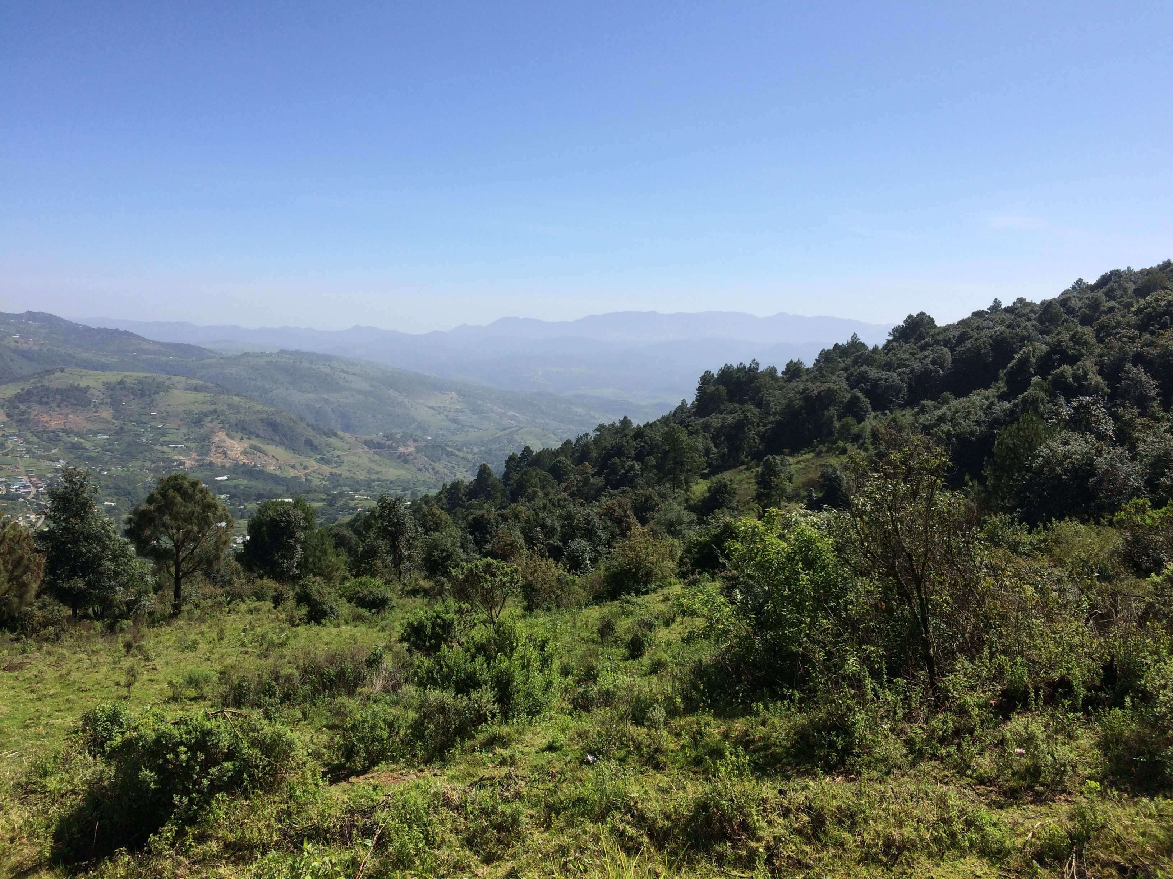
Final particles in Itunyoso Triqui: towards a Triqui pragmatics
Christian DiCanio
University at Buffalo
cdicanio@buffalo.edu

Slide 2
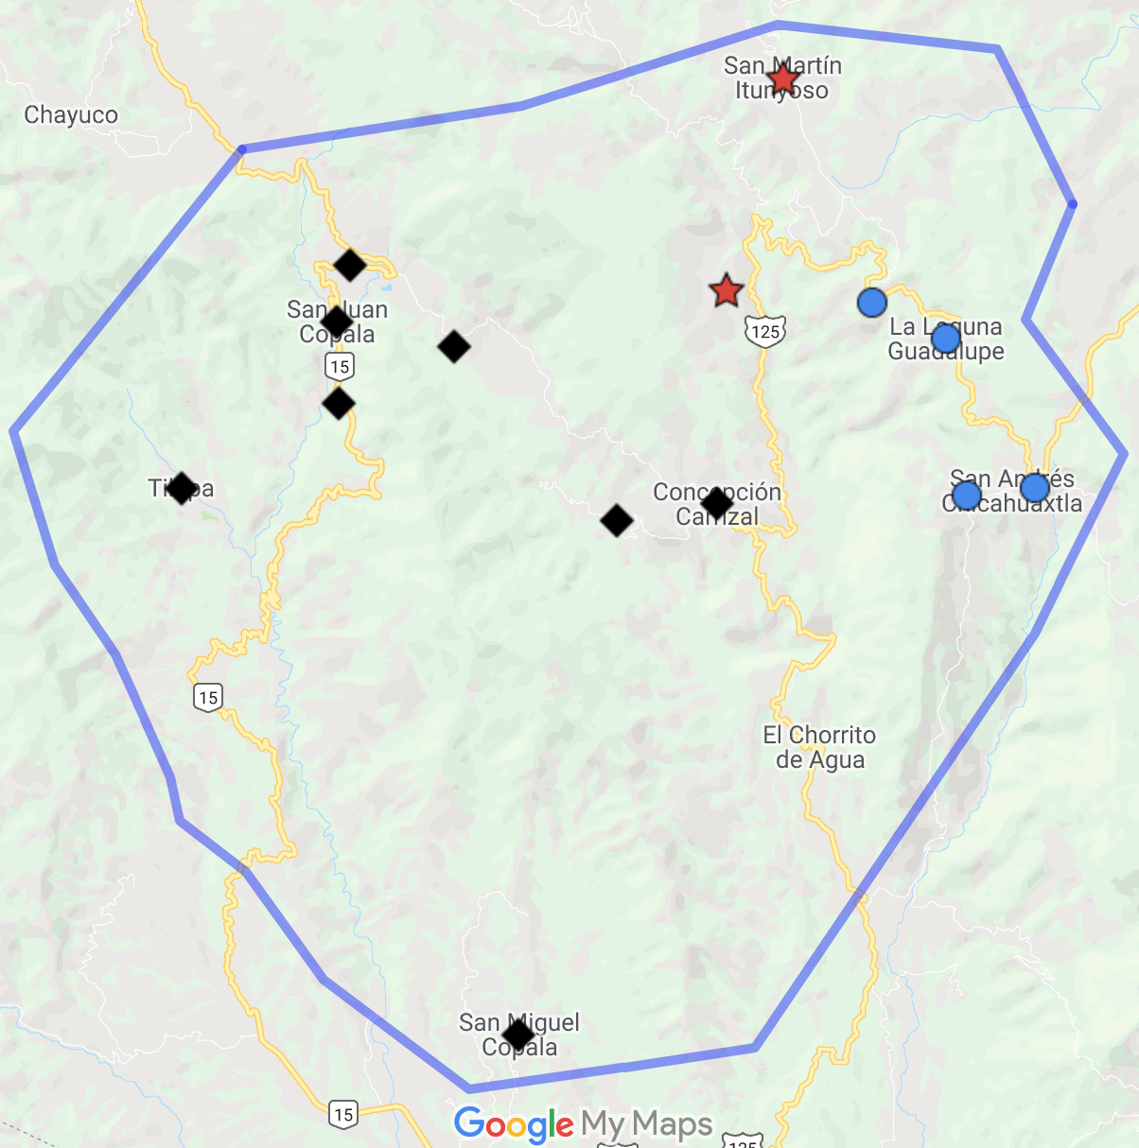
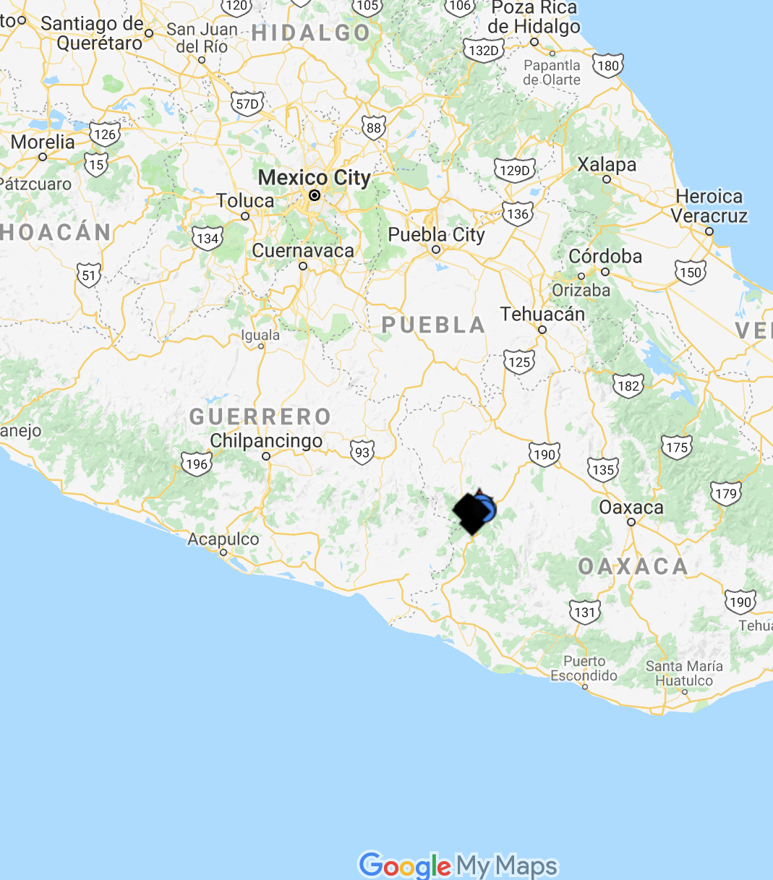
Triqui languages
2630 m
Itunyoso Triqui (2,700 speakers)
1550 m
Three varieties with some intelligibility between Chicahuaxtla and Itunyoso Triqui. Copala Triqui is recognizably ”different” by speakers and not intelligible.
All tonally complex in terms of tonal inventories and the use of tone in the morphology and grammatical constructions.
General inquiry for grammar: what does Triqui pragmatics look like?
2370 m
Copala Triqui
(30K speakers)
Chicahuaxtla Triqui
(4K speakers)

Slide 3
My scholarship on the language
2004 – 2008 Dissertation work on the phonetics and phonology of tone and consonant types.
2009 – 2014 Post-doctoral research in France on the perception of tone and phonation; studies on tonal coarticulation.
2014 – 2019 NSF grant on language documentation; collection and transcription of texts; work on morphophonology and the phonetics of prosody.
2020 – 2022 Translation and transcription research focusing on discussions of women’s rights via a UB Humanities Grant.
2023 – present A reference grammar of Itunyoso Triqui via an NEH fellowship; Language Sciences Press
2004 – present Triqui-Spanish dictionary (on the web)

Slide 4
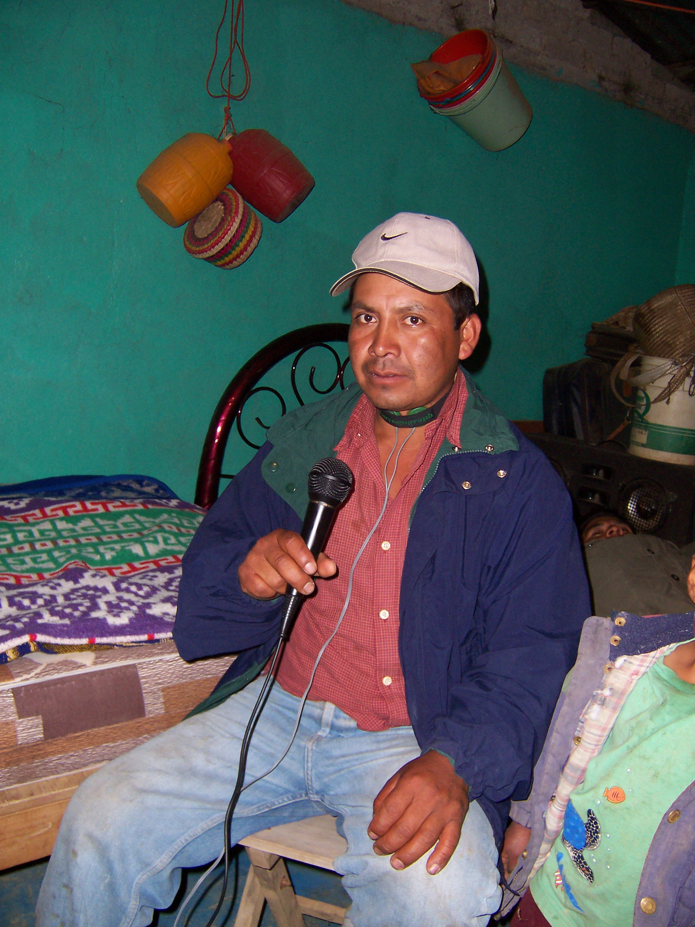
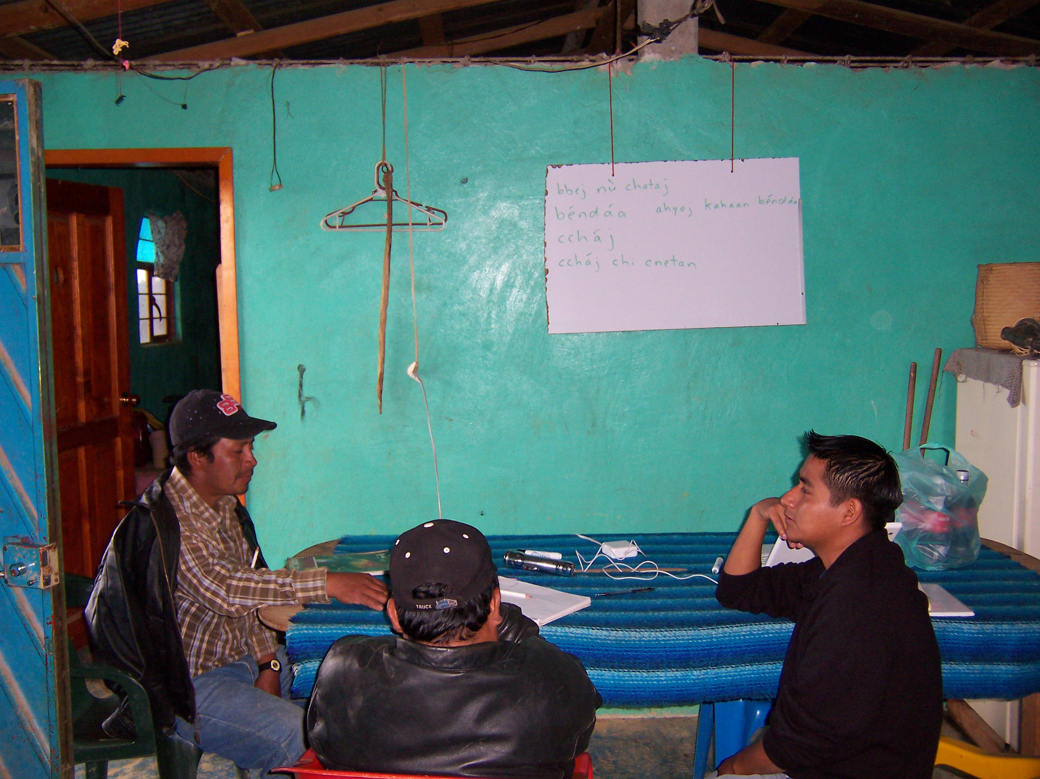
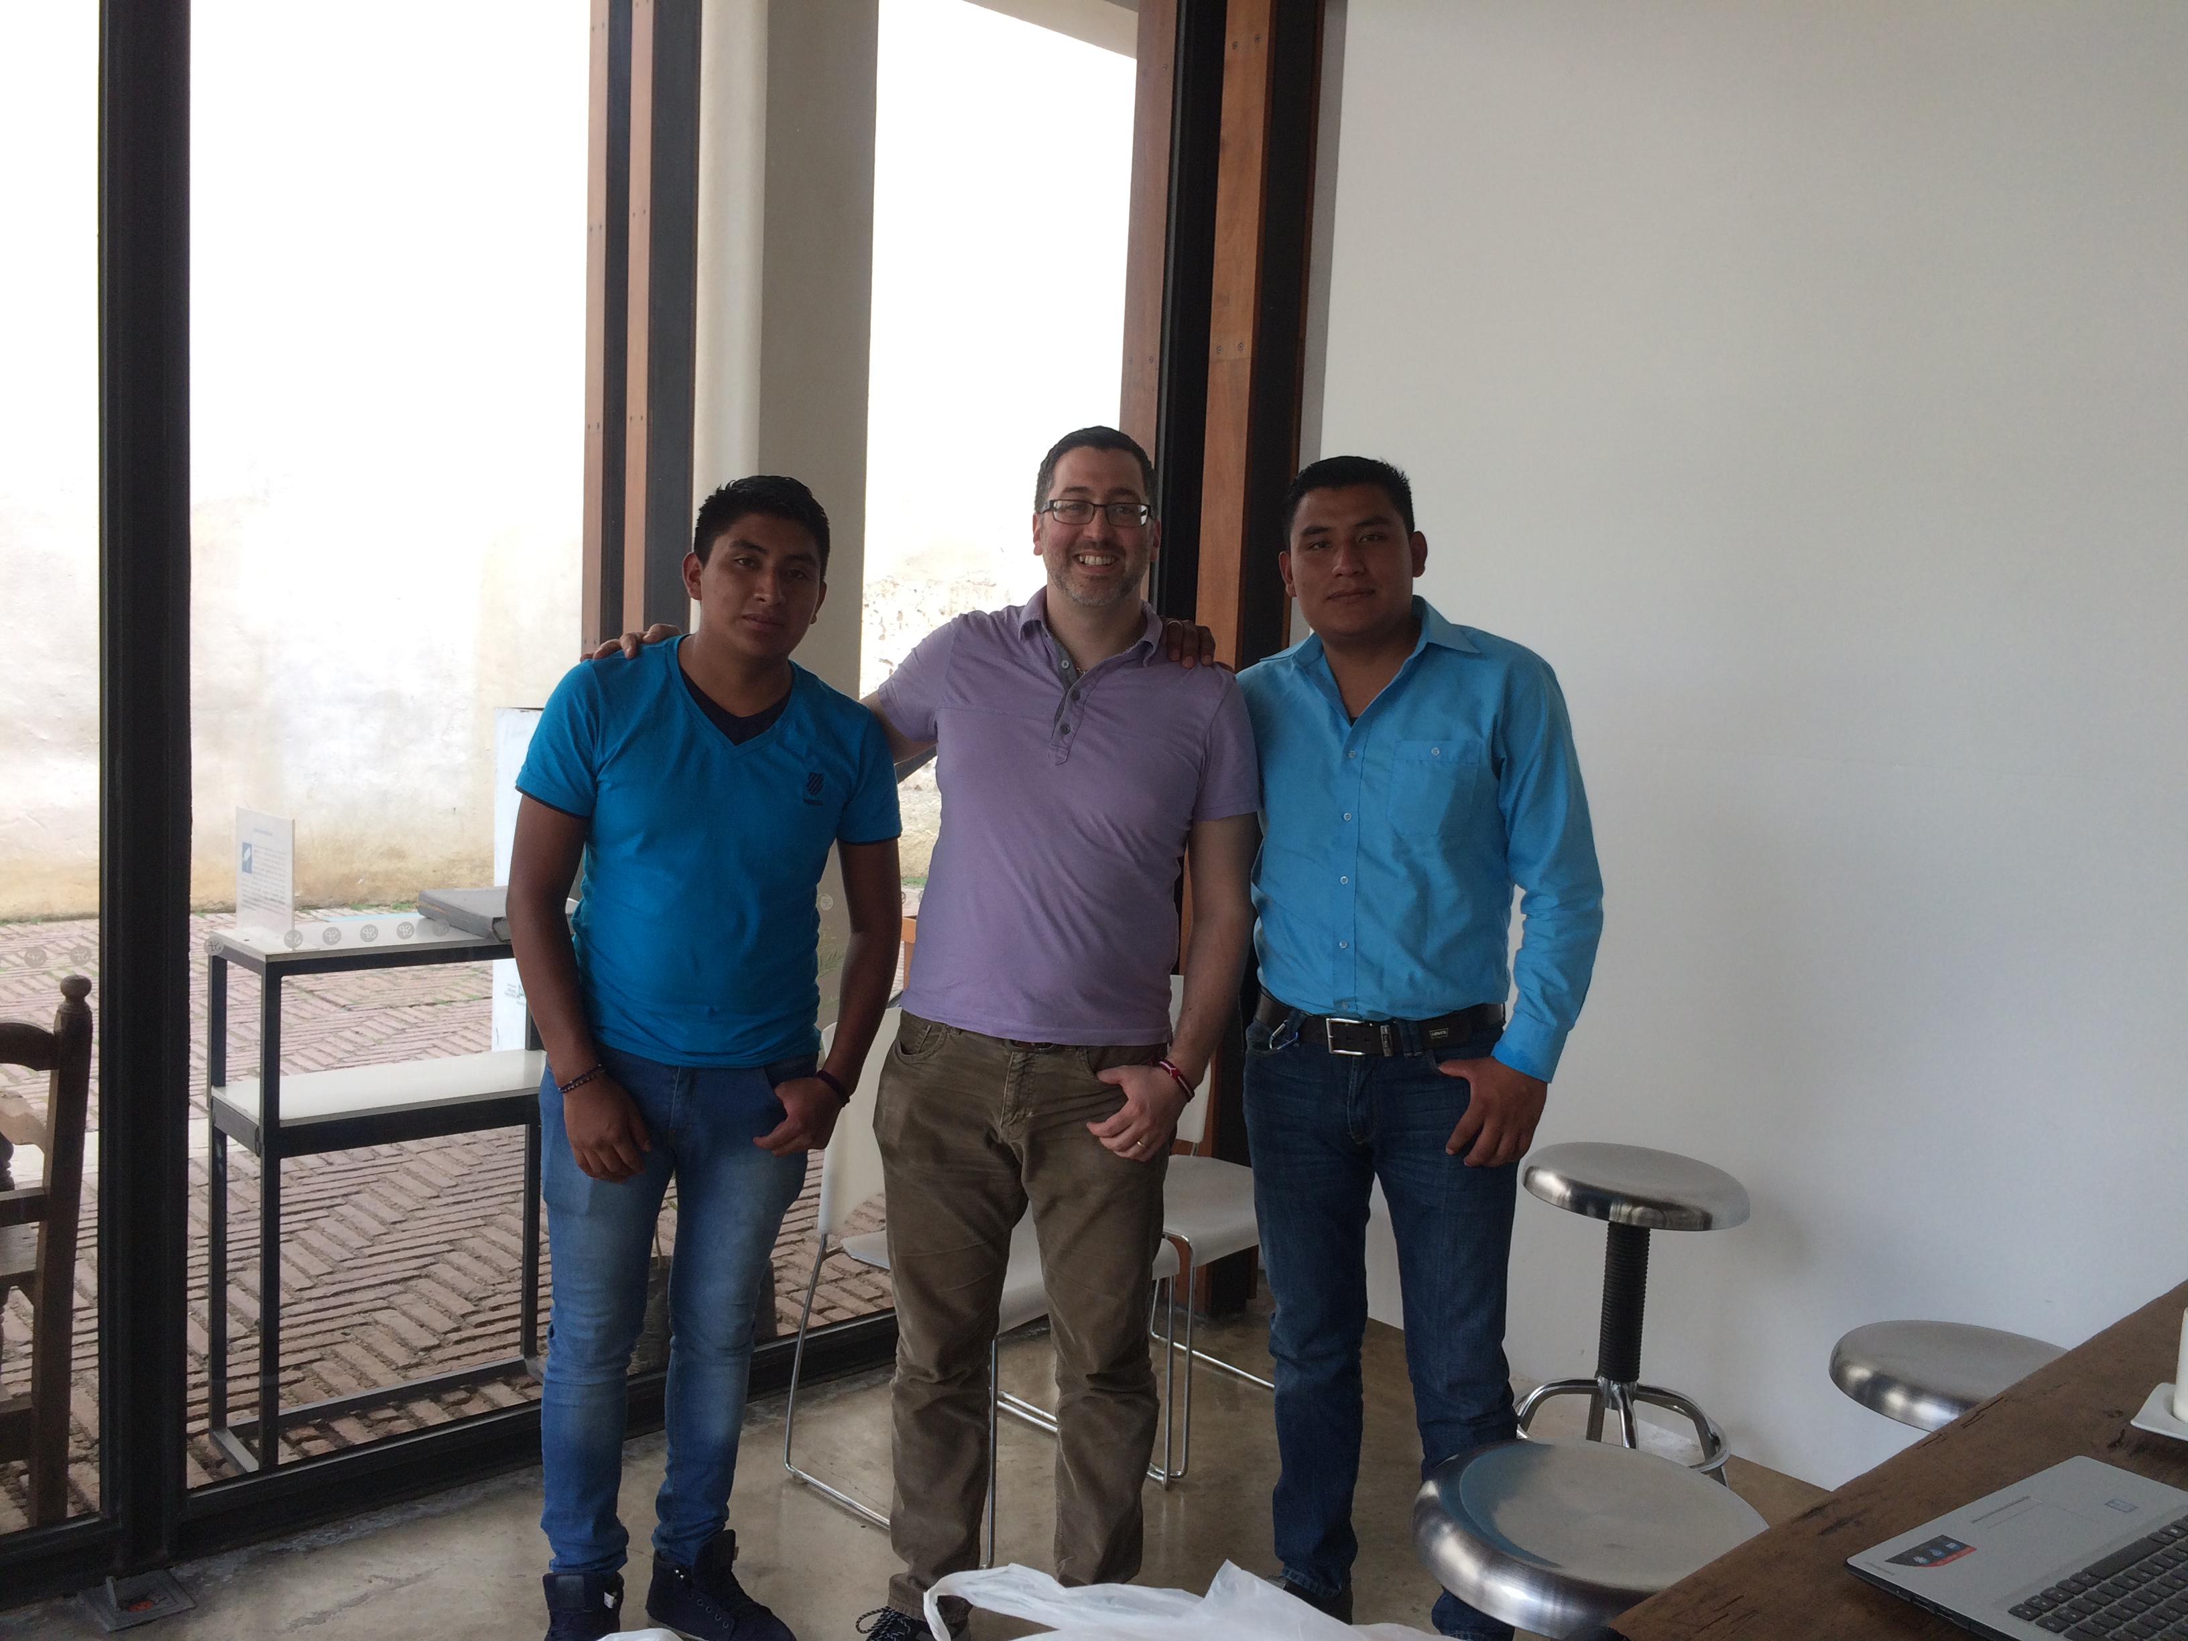
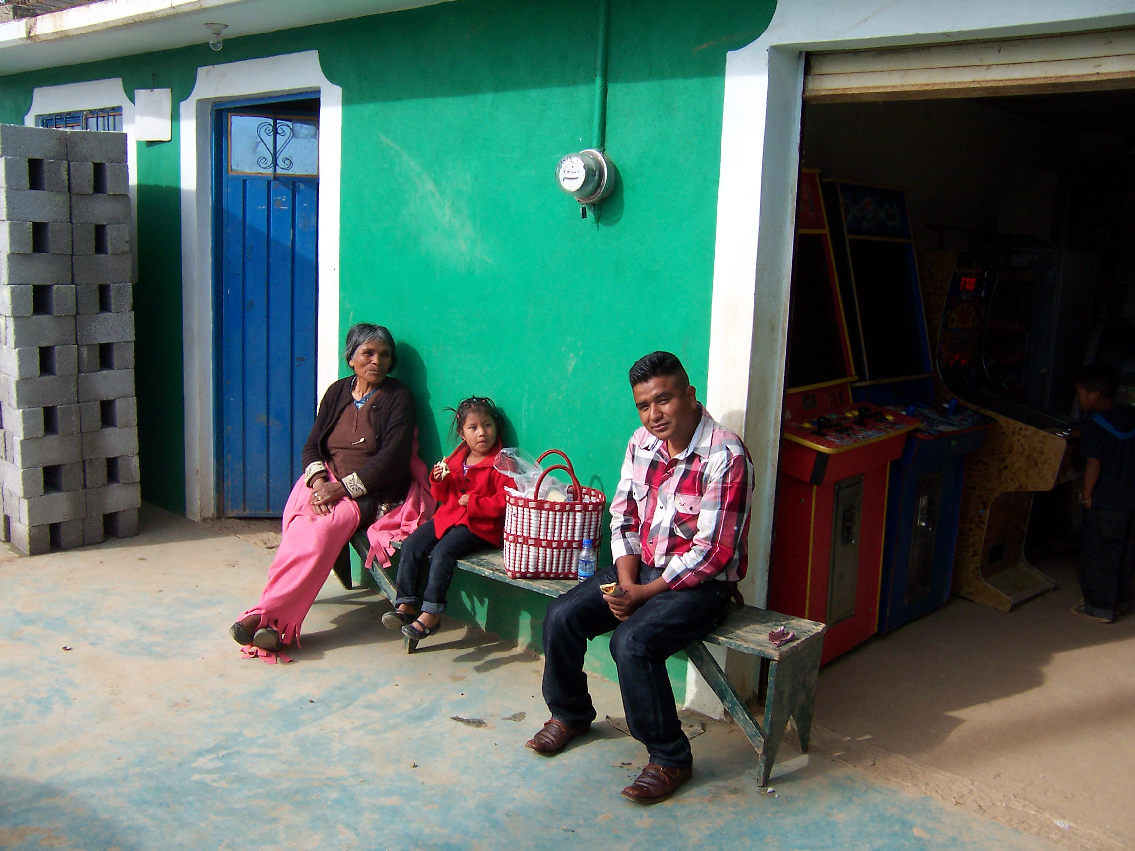
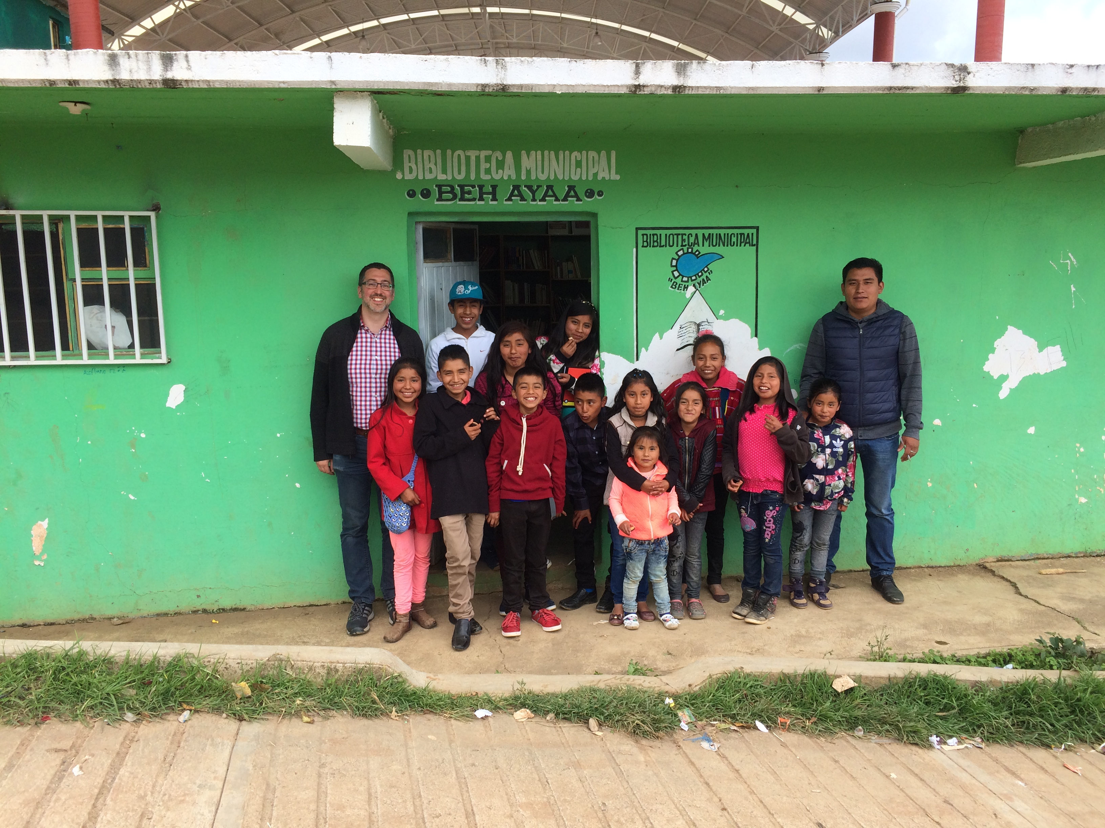
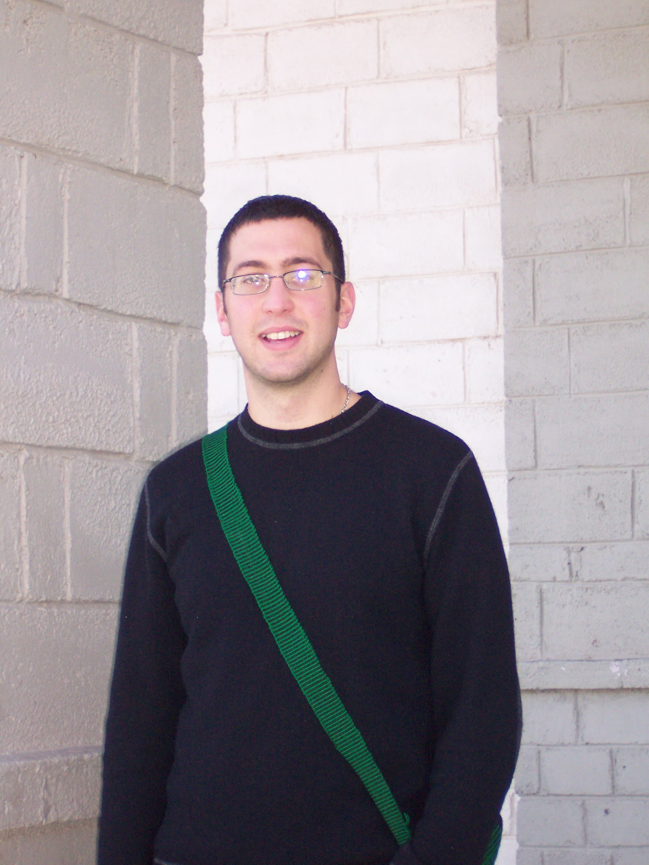

Slide 5
What does a reference grammar include?
1. Introduction and overview | 9. The morphosyntax of clitics
2. How this grammar is structured | 10. The morphophonology of clitics
3. The phonetics and phonology of consonants | 11. Compound words
4. The phonetics and phonology of glottalization and vowels | 12. Parts of speech and basic constituents
5. The phonetics and phonology of tone | 13. The syntax of basic sentences
6. Prosody | 14. The syntax of complex sentences
7. Nominal morphology | 15. Pragmatics: information structure
8. Verbal morphology | 16. Pragmatics: final particles

Slide 6
Pragmatics in tonal and non-tonal languages
In non-tonal languages, intonation can be used to mark speech acts (Ladd 2008).
Tonal and non-tonal languages alike can use grammatical means for indicating speech acts (c.f. Kalinowski 2015) but, statistically, tonal languages are more likely to use grammatical means to mark things like questions (Torreira et al 2014).
Intonational pitch accents or boundary tones are exceedingly rare in tone languages.

Slide 7
What about in a complex tone language?
In complex tone languages there may be no intonational strategies within the pragmatic system (DiCanio y Hatcher 2018, DiCanio et al. 2018, 2021).
Grammatical strategies, like word order or pragmatic particles, are used instead.
Triqui has a set of 39 final particles that are used to distinguish parts of speech, shared information, relations between speakers, and more.

Slide 8
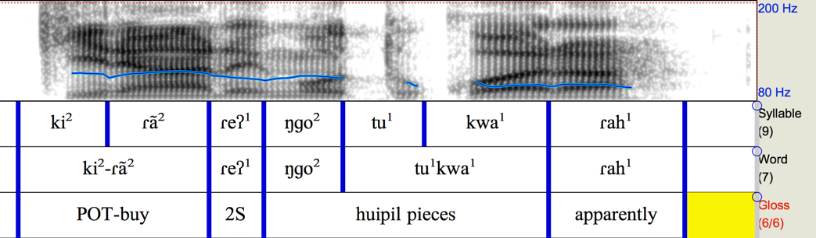

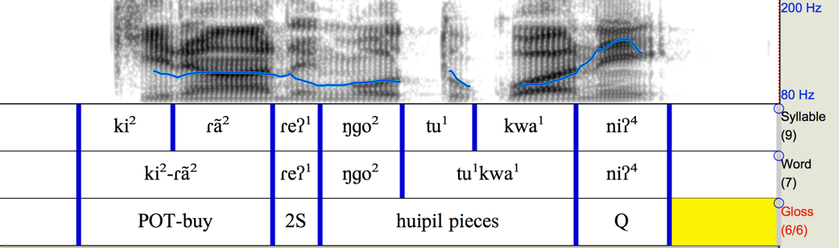
Example – question vs. expression of uncertainty
Ki²ran²=reh¹ ngo² tu¹kwa¹ rah¹
You are going to buy huipil pieces, apparently.
Ki²ran²=reh¹ ngo² tu¹kwa¹ nih⁴
You are going to buy huipil pieces?

Slide 9
Outline
Language description
Final particles in languages of the world
Methods/data on final particles
A review of question SFPs
Discussion

Slide 10
II. Phonological background: tone
bbej⁵ ‘straw mat’ chi³hyoj⁵ ‘swamp’
bbe⁴ ‘hair’ ka³to⁴ ‘shirt’
nne³ ‘plough’ na³ra³ ‘to refill’
nne² ‘to lie’ a²man² ‘when (Q)’
nne¹ ‘naked’ na¹ka¹ ‘new’
nne³² ‘water’ a³bi³² ‘to leave’
nne³¹ ‘meat’ a³nin¹ ‘to explode’
che⁴³ ‘my father’ a⁴ne⁴³ ‘to chew’
nɡa¹³ ‘when’ ka¹han³ ‘four (nominal)'

Slide 11
II. Morphological background: tone
Tone is used in nominal derivation, verbal inflection for aspect, in syntactic constructions, and in information structure.
oh³ [oʔ³] ‘to hit’ k-oh¹ ‘pot-hit’
oj⁵ [oh⁵] ‘I hit’ koj¹ ‘I am going to hit’
oh⁴ ‘we hit’ koh¹ ‘we are going to hit’
oj³ ‘aforementioned hits’ koj¹³ ‘the aforementioned is going to hit’

Slide 12
Is there space to use tone pragmatically? No.
Tone has a very high functional load in Itunyoso Triqui. How is pragmatics marked without tone?
Information structure is primarily marked via word order.
(1) Ka³hanj² Ku³se⁴³ ya³kwej³ ku³ki³ ‘José went to Oaxaca yesterday.’ Statement
perf.go José Oaxaca yesterday
(2) Ku³se⁴³ ka³hanj² ya³kwej³ ku³ki³ ‘José went to Oaxaca yesterday.’ Subject José perf.go Oaxaca yesterday Focus
(response to ‘who went to Oaxaca yesterday?’)

Slide 13
Final particles in languages of the world
Sentence-final particles are a sub-type of discourse marker. Discourse markers are used to indicate speech acts, illocutionary force, evidentiality, strategies to control turn-taking, and other categories like speaker engagement (Evans et al. 2018).
All languages have discourse markers but there is a strong tendency for pragmatic meaning to be marked at the beginning or end of the phrase.
“A fundamental characteristic of discourse markers is that they function beyond the propositional content of the communication.” (Fox Tree 2010)
"... discourse markers focus on the way communication is negotiated rather than on its content" (ibid)

Slide 14
There is a preponderance of sentence-final particles (SFPs) found in languages of East and Southeast Asia (Panov 2020).
The complexity and presence of SFPs in these languages is connected to the lack of intonational systems marking utterance-level pragmatics in many of the languages; (Brunelle et al 2012, Sybesma and Li 2007).
Though descriptions and surveys have focused on SFPs in E/SE Asian languages like Vietnamese (Brunelle et al 2012, Brunelle 2016) and Cantonese (Symesma and Li 2007), they are equally found in in Mande languages (Sherwood 2020), in Niger-Congo more generally (Hyman and Monaka 2011), and in Otomanguean languages like Isthmus Zapotec (Bueno Holle 2019).

Slide 15
Isthmus Zapotec (Bueno Holle 2019)
This question is ungrammatical without the SFP lá^{H}.

Slide 16
SFPs encode a range of meanings
The final particle ma in Mandarin marks questions.
The particles ka ne in Japanese marks tag questions.
The particles khrâp/khâ in Thai are markers of politeness used by men/women (respetively).

Slide 17
Pragmatic dimensions to consider
Speech acts: assertions, hopes, demands, questions, quoted speech, etc.
Relations between speakers: politeness/familiarity, gender, age.
Information perspective: new, old, surprising, expected, etc.
Polarity: positive, negative, neutral
Evidentiality: the source of information; from personal experience, general knowledge, reported speech, personal beliefs
Engagement: grammaticalised systems for monitoring and adjusting intersubjective settings; grammaticalized intersubjectivity (Evans et al 2018a, 2018b).

Slide 18
III. Methods and data
The basis for much of this work is 29 hours of archived, transcribed, and translated Triqui speech from the NSF documentation project. The bulk of these recordings are dialogues. There are 290 distinct recordings from 34 speakers.
This corpus includes about 400K words and includes conversations and shared narratives on Triqui culture, ethnobotany, history, traditional stories, and personal testimonies.
From this corpus, we look for examples with targeted SFPs. Further elicitation with targeted contexts allow us to figure out the specific meaning that is encoded. It’s otherwise quite hard to figure out specific meanings.

Slide 19
39 unique SFPs have been identified in Triqui speech
ah³/anh³ | negative focus question | nej³ | ‘also’, additionally | sah¹ | question when considering alternatives
aj³/aj⁵ | tag question w/perfective verbs | nej⁵ | negative commands | sa³yoj³ | counter expectations
bej¹ | strong commands, ‘already!’ | nun² ne⁴³ | expression of anger | staj³ | ‘at all!’
kah¹³ | ‘neither’, negative option | oh¹ | content question | stej³ | already, used w/commands
kaj³⁴ | more than presumed | oj³ | demand for action | stinh⁴ | negative tag question
kaj¹ | tag question w/potential verbs | oj¹ | question used as a response | stoj³ | expresses obligation
koh¹ | manner question | nih⁴ | polar question | toj¹ | expresses lack of understanding
manj⁵ | negative focus statement | noh¹ | repeated question | trunj⁵ | used when suggesting prohibited options
manh³ | negative quotation | raj¹ | lack of certainty | un⁴³ | emphatic questions
minh³ | surely, expression of certainty | rej³ | reported speech | yoj³² | expresses common speaker belief w/out certainty
nanh¹³ | personal belief of speaker | riaj⁵ | used w/giving advice | yu³be³² | confirmation of truthhood
nanj¹³ | distinguishing between quantities | runj³ | partial question | (ya)hnej⁵ | SFP between men
nanj⁵ | expression of finality | saj⁵ | counter expectations | ya³rij⁵ | SFP between women

Slide 20
Observations and grammatical status
The languages with the most final particles in the typological survey of Panov (2020) have just 6-7. Triqui is apparently a huge outlier.
While the semantic distinction between adverbs and SFPs is not always clear, SFPs have the following properties in Triqui:
They obligatorily occur sentence-finally (but before terms of address)
Only one SFP is possible within a phrase.
Adverbs occur pre-verbally, but SFPs may not.
Many have multiple senses (truer for those not used for questions)

Slide 21
Adverbs and SFPs
(1) Cha¹ngah¹ k-a³hmin³²=sij³ ku³ki³ Preverbal adverb
really perf-speak=3m yesterday
‘He really/actually spoke yesterday.’
(2) K-a³hmin³² cha¹ngah¹=sij³ ku³ki³ Post-verbal adverb
perf-speak really=3m yesterday
‘He really/actually spoke yesterday.’
(3) K-a³hmin³²=sij³ ku³ki³ bej¹
perf-speak=3m yesterday sfp.necessarily
‘He spoke yesterday by/out.of necessity.’
(4) *Bej¹ k-a³hmin³²=sij³ ku³ki³
sfp.necessarily perf-speak=3m yesterday
‘He spoke yesterday by/out.of necessity.’

Slide 22
A large project for the grammar
The analysis of all SFPs in the language is a rather large project for the grammar and too large for a single talk.
The focus here will be on the pragmatic dimensions that are used to distinguish the 12 different types of questions, along with some particles used with other speech acts.

Slide 23
IV. There are 12 SFPs for questions
There is a distinction between polar (yes/no) and content questions in Itunyoso Triqui. They require different SFPs.
(5) Ki³-ranj⁴=reh¹ ngo² ka³min⁴³ nih⁴/*oh¹ nih⁴ polar question
perf-buy=2s one car sfp.polar.q
‘Did you buy a car?’
(6) Un³sin³ ki³-ranj⁴=reh¹ oh¹/*nih⁴ oh¹ content question
what perf-buy=2s sfp.content.q
‘What did you buy?’

Slide 24
This particular dimension is not so novel – English and Spanish both distinguish polar vs. content questions with unique intonational strategies.
Tag questions are also distinguished, p.g. eh?, but in Triqui tag question SFPs have allomorphs based on the tone and nasality of the preceding syllable. Are they clitics?
(7) ka³hanj²=nih²=sij³ nga¹=nej³ aj³?
perf.go=pl=3s with=3p sfp.tag
‘They went with them, eh?'
(8) ni² chanh¹ u²rua⁴³ baj³ a⁴nanj⁴=neh⁴ aj⁵?
and pretty very be.3top weave=1p.incl tag.q
‘It’s very pretty what we weave, eh?'

Slide 25
Allomorphy by tone and nasalization:
aj⁵ after the higher tones (43, 4, 5)
aj³ after the lower tones (1, 2, 3, 32, 31, 13)
anj⁵/anj³ after words which end with a nasal vowel
(9) Ta³ bin³ ngo² kkan³ anj³?
that be one squash tag.q?
‘That’s one squash, right?’

Slide 26
Verbal aspect and SFPs
In the previous examples, the SFP is used for marking a tag question. In turns out that this form can only be used with imperfective or perfective verbs (realis). If the verb has potential aspect marking, a different SFP must be used – kaj¹.
(10) ka³hanj¹=reh¹ ni³gyanj⁵ ku³ki³ aj⁵/*kaj¹
perf.go=2s Tlaxiaco yesterday sfp.tag.q/irr.tag.q
'You went to Tlaxiaco yesterday, eh?'
(11) ka²hanj²=reh¹ ni³gyanj⁵ a³hyoj³ kaj¹/*aj⁵
pot.go=2s Tlaxiaco tomorrow sfp.irr.tag.q/tag.q
'You will go to Tlaxiaco tomorrow, eh?'

Slide 27
Negation, aspect, and SFPs
Itunyoso Triqui has a peculiar pattern where negation requires that aspect “flip”, e.g. a negated potential reading ‘will not go’ requires you use a perfective verb and vice-versa.
Tag question SFPs must match the negated aspect.
(12) Un³sin³ ni² nun³ ku²nanj²=reh¹ kaj¹/*aj³? what/why and/that neg pot.run=2s sfp.irr.tag.q/tag.q
‘Why didn’t you run?’
(13) Un³sin³ ku⁴nanj⁴=reh¹ aj³/*kaj¹?
what/why perf.run=2s tag.q/sfp.irr.tag.q
‘Why did you run?’

Slide 28
Repetition and questions
Repetition is an important dimension that SFPs are sensitive to as well. I’m not sure how to think of this in other ways at the moment.
There is an SFP used for follow-up questions – an initial question gets its own SFP, but following questions requires noh¹.
If you repeat the same question in your response (a “meta”-question), there is a separate SFP for this - oj¹.

Slide 29
(14) Juan: Ki¹-ran¹ ngo² ka³min⁴³ xi³
pot-buy.1s one car large
‘I am going to buy a big car.’
Tú: Taj¹ tu²hbe³ oh¹/*noh¹? Un³taj² sa³hanj² how expensive sfp.content.q/rep.q how.much money
ni³kaj¹=reh¹ noh¹/*oh¹?
carry=2s rep.q/sfp.content.q
‘How expensive is it? How much money do you have?’
Juan: Ni¹ka¹ sa³hanj².
carry.1s dinero
‘I have (the) money.'

Slide 30
The SFP oj1 is used when questioning a question in an answer. What is the pragmatic dimension for metapropositions?
(15) Speaker 1: ka3hanj1=reh1 ya3kwej3 nih4?
perf.go=2s Oaxaca sfp.polar.q
Did you go to Oaxaca?
Speaker 2: Ka4han43 ya3kwej3 oj1?
perf.go.1s Oaxaca sfp.rep.q
Did I go to Oaxaca?

Slide 31
But the same SFP oj¹ can be used when the speaker knows the answer to their own question – even at the beginning of an exchange. In (17), the speaker need not follow another question - (17) is not a response to (16).
(16) Ki³-ranj⁴=sij³ cha³chunj⁵ nih⁴?
perf-buy=3m bread sfp.polar.q
‘Did he buy bread?’
(Speaker does not know the answer.)
(17) Ki³-ranj⁴=sij³ cha³chunj⁵ oj¹? Ki³-ni³ʔih⁵ si³
perf-buy=3m bread sfp.rep.q perf-see.1s comp
ki³-ranj⁴=sij³ cha³chunj⁵
perf-buy=3m bread
‘Did he buy bread? I saw that he bought bread.’

Slide 32
Another example – extension to politeness?
(18) Nih⁴ u³sin³ a³nin¹ yyaj³² ta³ roh⁴-hya³ raj⁴
who.knows what bloom flower dem seem feel.1s
oj¹ o⁴neh⁴.
sfp.shared.info.q comadre.q
‘Who knows in what (month) these flowers bloom, it seems, comadre.’
In this text, the speaker is guiding their comadre in an ethnobotanical description. The speaker knows the answer to the question, but wants to elicit the specific response from their comadre – this is about shared attention (and perhaps respect). So, is oj¹ glossed as marking shared knowledge? repetition? or what?

Slide 33
Negation and information structure
Various SFPs occur only in the context of negation. Questions involving positive focus just use the polar SFP nih⁴, questions involving negative focus involve a separate SFP – ah³/anh³.
(19a) se⁴ xwan⁴³ ki³-ranj⁴ anh³?
not Juan perf-buy sfp.neg.foc.q
‘It wasn’t Juan who bought it?’
This contrasts with the declarative negative focus SFP manj⁵.
(19b) se⁴ xwan⁴³ ki³-ranj⁴ manj⁵
not Juan perf-buy sfp.neg.foc
‘It wasn’t Juan who bought it.’

Slide 34
Extended use – expressions of doubt
(20a) ttaj⁵ ni¹ko³ ngo² ma³ka²ra², ttaj⁵ toj³ be.on.top much one hand.length be.on.top more
ttaj⁵ rianj³ si³raj³ ah³
be.on.top face.3top seem sfp.neg.foc.q
‘There are perhaps more hand lengths/measures more on top of this, it seems, eh?’
(By using ah³, the speaker expresses doubt and seeks confirmation from an elder.)
(20b) ngo² ma³ka²ra² ni² ya⁴kwa⁴han⁴ ra³ha³ ba³² rian³² ru³hnun⁴
one hand.length and another.four hand be face huipil
che¹he¹ ta³ yu³be³²
long dem sfp.conf.
‘One hand length and another four hands are on (are needed) for this long huipil.)
(The use of yu³be³² expresses confidence in the truth of responses.)

Slide 35
Alternative questions
The SFP sah¹ is used when the speaker offers possible responses.
(21) Taj¹ k-a¹toh¹ beh¹ Un³ kwi³ ka³-bin³ nunh³
how pot-say.1du sfp.uncertain which day perf-be dressed.1du
ma²han³ nan² nih⁴? A³si² ta¹ ba³² ngo² ki³hyanj
this dir sfp.polar.q or until exist one party
nun³² cha¹ngoh¹ ma²han³ sah¹?
be.dressed really.1du this sfp.alternative.q
‘How might we say it? On which day was it that we dress up in this (long huipil)? Or is it until there is a party that we actually wear this?

Slide 36
Manner and surprisal
The SFP koh¹ is used when either (a) when it is a question regarding manner or (b) when the speaker is indicating that the question (or answer) is surprising.
(22) Ni² nga¹³ hyaj³ sun³²=j⁵reh¹ sun³² na³sin³ raj¹
and when do work=2p work tomato sfp.uncertain
o³nej³, taj¹ hyaj³=j⁵reh¹ sinh³ ta³ a³hbe³ comadre, how do=2p child dem be.able
u³nu²kwaj³=j⁵reh¹ hyaj³ sun³²=j⁵reh¹ koh¹, o⁴neh⁴?
accomplish=2p do work=2p sfp.surprise comadre.q
‘And when you (all) were working with tomato, comadre? how were you able to manage these children while working?

Slide 37
Partial questions
There is a specific SFP runj³ used only for partial questions.
(23) Speaker 1: Un³cchej³² ku⁴ta¹=reh¹ ko³ho³ oh¹?
where perf.put=2s plate sfp.polar.q
Where did you put the plates?
Speaker 2: Be⁴ ttaj⁵ rian³² me⁴sa⁴³
top be.on.top face table.
They are there on the table.
Speaker 1: Ni² nih¹ ba⁴su⁴³ runj³/*aj⁵ ?
and pl glass sfp.partial.q/tag
And the glasses?

Slide 38
Dimensions of meaning
SFP | Speech act (sub-type) | Aspect | Information perspective | Polarity | Description
nih⁴ | polar:neutral | any | neutral | positive | listener (may) know
oh¹ | content | any | neutral | positive | listener (may) know
oj¹ | polar:neutral | any | neutral | positive | speaker knows and listener (may) know
noh¹ | content | any | neutral | positive | listener (may) know, repeated
koh¹ | content | any | neutral | positive | listener (may) know, surprise
aj³/aj⁵ | tag | realis | neutral | positive | listener confirms
kaj¹ | tag | irrealis | neutral | positive | listener confirms
ah³ | tag | any | focus-sensitive | negative | listener confirms
runj³ | content | any | neutral | positive | listener (may) know, partial
un⁴³ | polar:emphatic | any | neutral | positive | listener (may) know, surprise
sah¹ | content | any | neutral | positive | listener (may) know, alternative
stinh⁴ oj¹ | tag | any | neutral | positive | listener confirms what only the speaker believes

Slide 39
V. Discussion
We’ve only reviewed 10 of 39 particles!
Apart from their primary uses, it is clear that many of the SFPs have extended uses that might be associated with politeness or to elicit specific types of information from the interlocutor.
These particles are very common. For instance, out of the corpus of 400K words, the SFP yoj³², reflecting lack of certainty, occurs 1,700 times.

Slide 40
On our pragmatic dimensions
Many of the SFPs are not neatly defined along the dimensions we list.
Apart from one particle used with reported speech, none of the 39 SFPs encode the source of information at all (personal witness, visual, auditory, etc). Evidentiality is not so important here, though mirativity appears to be relevant (c.f. DeLancey 1997).
Rather, it seems like many of the particles indicate if knowledge is shared or not shared, presumed, surprising, obvious, and so on. Certainty and speaker engagement seems to be relevant (Evans et al 2018a, 2018b).

Slide 41
Engagement: The two most common SFPs
The two most common SFPs are yu³be³² and yoj³². The former is used to express confidence in the assertion, the latter to indicate less confidence.
(24a) Taj¹ ki³-hyaj³=sij³ oh¹?
how perf-do=3m sfp.content
‘How did they do?’
(24b) Ba¹ na³-ki³-hyaj³ sah¹=sij³ estufa yu³be³²/*yoj³².
already iter-perf-do good=3m stove sfp.confident
‘They fixed the stove.’
Context: A repairman comes to your house when you are away. You come home and ask your housemate what happened in the kitchen. You know that your housemate has knowledge that you do not possess.

Slide 42
Use of yoj³² and yu³be³² in a teaching context
(25a) Beni: Ni² ka²hbe³ ka²runj² le⁴cha⁴³ "a” nga¹
and pot.able pot.write.1s letter “a” with
nej³ le⁴cha⁴³ "b” nan² yoj³².
pl letter “b” dir sfp.belief ‘And I can write the letter ‘a’ with ‘b’ letters then.’
(25b) Christian: Ka²hbe³ yu³be³²
pot.able sfp.confident
‘(You) can.’

Slide 43
Ni² yoj³²(?) / and yoj³²?
It is infelicitous to use the SFP yoj³² in contexts where the interlocutor would not have knowledge of the event.
This is a good hint that the particles involve symmetrical access to the speech event, but the interaction requires a hierarchy of authority.
The way in which the knowledge is observed is unimportant. This is not evidentiality.
(Benigno, my consultant): “A clear example would be students using yoj³² when stating something to their teacher. The teacher responds only with yu³be³².”

Slide 44
Problems
Presented here are SFPs which encode “questions,” but the notion of what exactly comprises a question is rather complicated.
Triqui speakers use the pairs yoj³² - yu³be³² a lot in discourse and this involves differences in speaker authority. What does it mean to use an SFP reflecting less confidence?
Since it is only felicitous to use yoj³² - yu³be³² when an exchange is present, is yoj³² a question SFP?

Slide 45
Final points
There is a lot to explore here. The findings here are the result of 2-3 years of fieldwork on SFPs. We’ve scratched the surface.
There is a strong relationship between the use of pitch to mark pragmatic dimensions and the richness of the SFP system in human languages (Brunelle et al 2012, Sybesma y Li 2007).
Since tone has such strikingly high functional load in Triqui, the SFP system is also perhaps strikingly rich.
Little work on SFPs in Otomanguean, but see Bueno Holle (2019).

Slide 46
References:
Aikhenvald, A. Y. and Dixon, R., editors (2003). Studies in Evidentiality. Typological Studies in Language (TSL). John Benjamins Publishing Company.
Brunelle, M. (2016). Intonational phrase marking in Southern Vietnamese. In DiCanio, C., Malins, J., Michelson, K., Jaeger, J., and Keily, H., editors, Proceedings of the 5th Symposium of the Tonal Aspects of Language, pages 60–65. ISCA Archive.
Brunelle, M., Hạ, K. P., & Grice, M. (2012). Intonation in Northern Vietnamese. The Linguistic Review, 29, 3– 36.
Bueno Holle, Juan José (2019). Information structure in Isthmus Zapotec narrative and conversation (Topics at the Grammar-Discourse Interface 3). Berlin: Language Science Press.
Delancey, Scott (1997). Mirativity: The grammatical marking of unexpected information. Linguistic Typology
1:33-52.
DiCanio, C. (2008). The Phonetics and Phonology of San Martín Itunyoso Trique. PhD thesis, University of California, Berkeley.
DiCanio, C. (2016). Abstract and concrete tonal classes in Itunyoso Trique person morphology. In Palancar, E. and Léonard, J.-L., editors, Tone and Inflection: New Facts and New Perspectives, pages 225–266. Berlin: De Gruyter Mouton.
DiCanio, C. and Hatcher, R. (2018). On the non-universality of intonation: Evidence from Triqui. Journal of the Acoustical Society of America, 144:1941.

Slide 47
DiCanio, C., Benn, J., and Castillo García, R. (2021). Disentangling the effects of position and utterance-level declination on the production of complex tones in Yoloxóchitl Mixtec. Language and Speech, 64(3):515–557.
DiCanio, C., Martínez Cruz, B., Cruz Martínez, B., and Martínez Cruz, W. (2020). Glottal toggling in Itunyoso Triqui. Phonological Data & Analysis, 2(4):1–28.
Evans, N., Bergqvist, H., and San Roque, L. (2018a). The grammar of engagement I: framework and initial exemplification. Language and Cognition, 10:110–140.
Evans, N., Bergqvist, H., and San Roque, L. (2018b). The grammar of engagement II: typology and diachrony. Language and Cognition, 10:141–170.
Fox Tree, Jean E. (2010) Discourse markers across speakers and settings. Language and Linguistics Compass 4/5:269-281.
Kalinowski, C. (2015). A Typology of Morphosyntactic Encoding of Focus in African Languages. PhD thesis, University at Buffalo.
Panov, V. (2020). Final particles in Asia: establishing an areal feature. Linguistic Typology, 24(1):13–70.
Sherwood, K. (2010) The prosodic system of Southern Bobo Madaré, PhD dissertation, University of Michigan.
Sybesma, R. and Li, B. (2007). The dissection and structural mapping of Cantonese sentence final particles. Lingua, 117(10):1739–1783.
Torreira, F., Roberts, S. G., and Hammarström, H. (2014). Functional trade-off between lexical tone and intonation: typological evidence from polar-question marking. In Proceedings of the 4th Tonal Aspects of Language Symposium, pages 100–103. Nijmegen, the Netherlands.

Slide 48
Pragmatics
Pragmatics refers to the way in which...
we organize linguistic information, e.g. focus, topic, shared information, new information
we indicate speech acts, e.g. questions, demands, assertions, etc.
we organize the flow of information in conversation, including the relations between speakers, e.g. how we might indicate mutual comprehension or incomprehension

Slide 49
Managing listener expectations
How does ‘more than you think’ get encoded in the pragmatic dimensions we list? The speaker must have beliefs/expectations about what the listener (or others) believe to be true.
(26) Ki³-ranj⁴ Maria toj³ kaj³⁴
perf-buy Maria more sfp.unexp.evid
'Maria bought more than (you’d) think’
(27) K-oh¹ ku³man¹ kaj³⁴
pot-hit rain sfp.unexp.evid
‘It is going to rain more than we’re thinking’
(28) Ngo⁴³ rian³² la³riaj³=soh¹ kaj34 exp.anger face asshole=2s.acc sfp.unexp.evid
‘You’re an even bigger asshole than we thought’

