Slide 1
Finite-Sample Analysis for SARSA with Linear Function Approximation
Shaofeng Zou (UB)
Assistant Professor
joint work with Tengyu Xu (OSU) and Yingbin Liang (OSU)

Slide 2
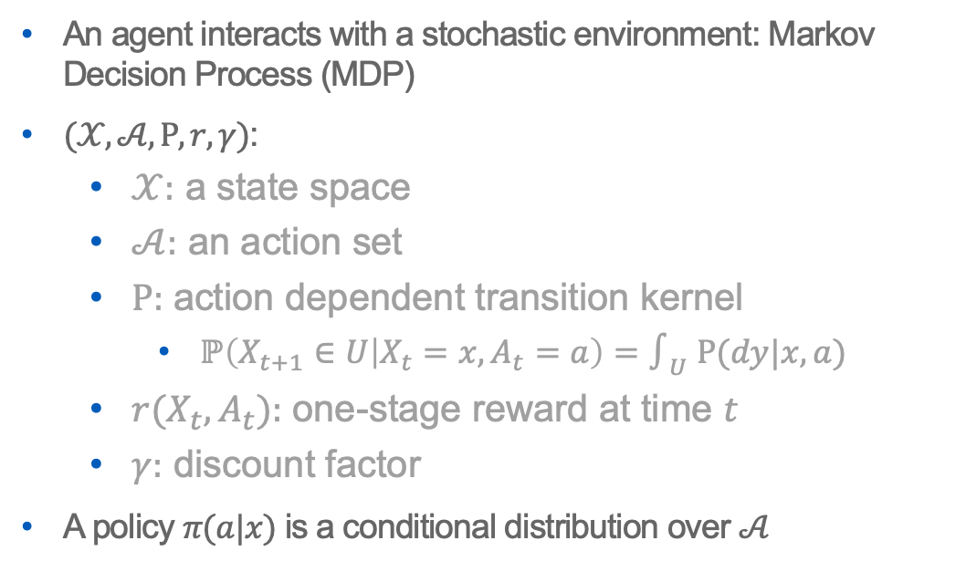
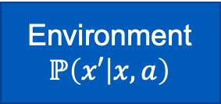
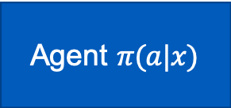
Reinforcement Learning (RL)
An agent interacts with a stochastic environment: Markov Decision Process (MDP)
$(𝒳,𝒜,Ρ,r,γ)$:
$𝒳:$ a state space
$𝒜:$ an action set
$Ρ:$ action dependent transition kernel
$ℙ\left(X_{t+1}∈U | X_{t}=x,A_{t}=a\right)=∫_{U} Ρ(dy|x,a)$
$r(X_{t},A_{t}):$ one-stage reward at time $t$
$γ:$ discount factor
A policy $π(a|x)$ is a conditional distribution over $𝒜$
Agent $π(a|x)$
State: x
& Reward: r
Action: a
Environment
$$ℙ\left(x′ | x, a\right)$$

Slide 3
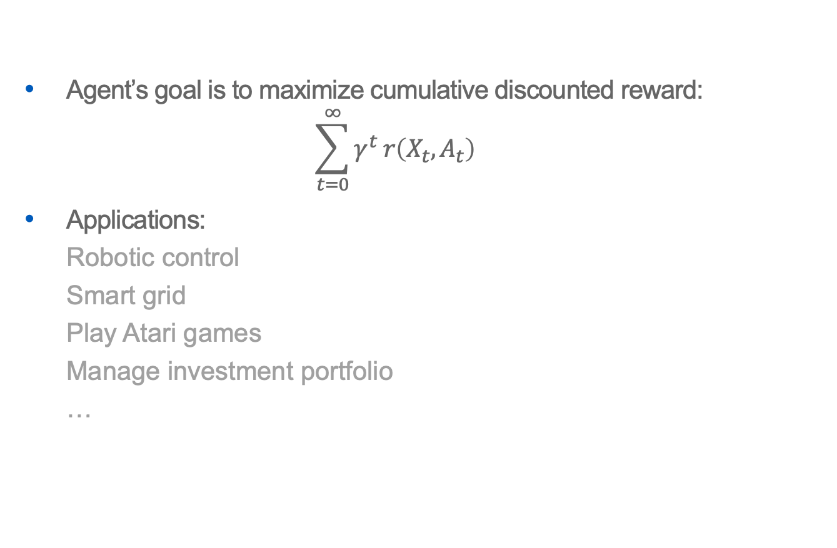
Reinforcement Learning (RL)
Agent’s goal is to maximize cumulative discounted reward: $\sum_{t=0}^{∞}{γ^{t} r\left(X_{t},A_{t}\right)}$
Applications:
Robotic control
Smart grid
Play Atari games
Manage investment portfolio
…
Agent $π(a|x)$
State: x
& Reward: r
Action: a
Environment
$$ℙ\left(x′ | x, a\right)$$

Slide 4
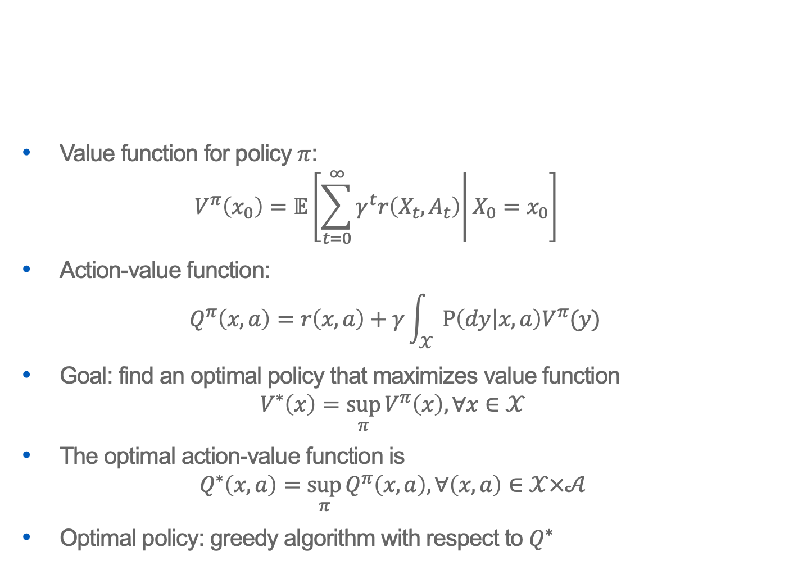
Reinforcement Learning (RL)
Value function for policy $π$: $V^{π}\left(x_{0}\right)=𝔼\left[\left.\sum_{t=0}^{∞}{γ^{t}r\left(X_{t},A_{t}\right)}\right|X_{0}=x_{0}\right]$
Action-value function: $Q^{π}\left(x,a\right)=r\left(x,a\right)+γ\int_{𝒳}{Ρ\left(dy | x,a\right)V^{π}(y)}$
Goal: find an optimal policy that maximizes value function $V^{∗}\left(x\right)=\sup_{π}{V^{π}\left(x\right), ∀x∈𝒳}$
The optimal action-value function is $Q^{∗}\left(x,a\right)=\sup_{π}{Q^{π}\left(x,a\right), ∀\left(x,a\right)∈𝒳×𝒜}$
Optimal policy: greedy algorithm with respect to $Q^{∗}$

Slide 5

Reinforcement Learning Algorithms
Temporal difference(TD) learning: learn the value function of a given policy
Q-learning: an off-policy approach to learn the optimal action-value function $Q^{∗}$
SARSA: an on-policy approach to learn the optimal action-value function $Q^{∗}$

Slide 6
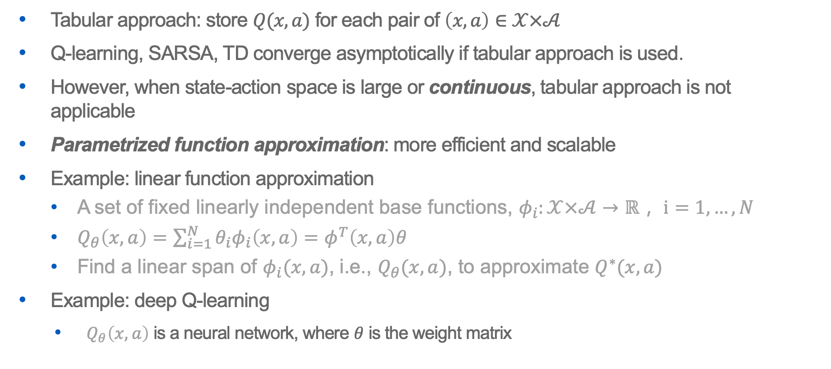
Reinforcement Learning with Function Approximation
Tabular approach: store $Q(x,a)$ for each pair of $\left(x,a\right)∈𝒳×𝒜$
Q-learning, SARSA, TD converge asymptotically if tabular approach is used.
However, when state-action space is large or continuous, tabular approach is not applicable
Parametrized function approximation: more efficient and scalable
Example: linear function approximation
A set of fixed linearly independent base functions, $φ_{i}:𝒳×𝒜→ℝ， i=1,…,N$
$Q_{θ}\left(x,a\right)=\sum_{i=1}^{N}{θ_{i}φ_{i}\left(x,a\right)=φ^{T}\left(x,a\right)θ}$
Find a linear span of $φ_{i}(x,a)$, i.e., $Q_{θ}(x,a)$, to approximate $Q^{∗}(x,a)$
Example: deep Q-learning
$Q_{θ}\left(x,a\right)$ is a neural network, where $θ$ is the weight matrix

Slide 7



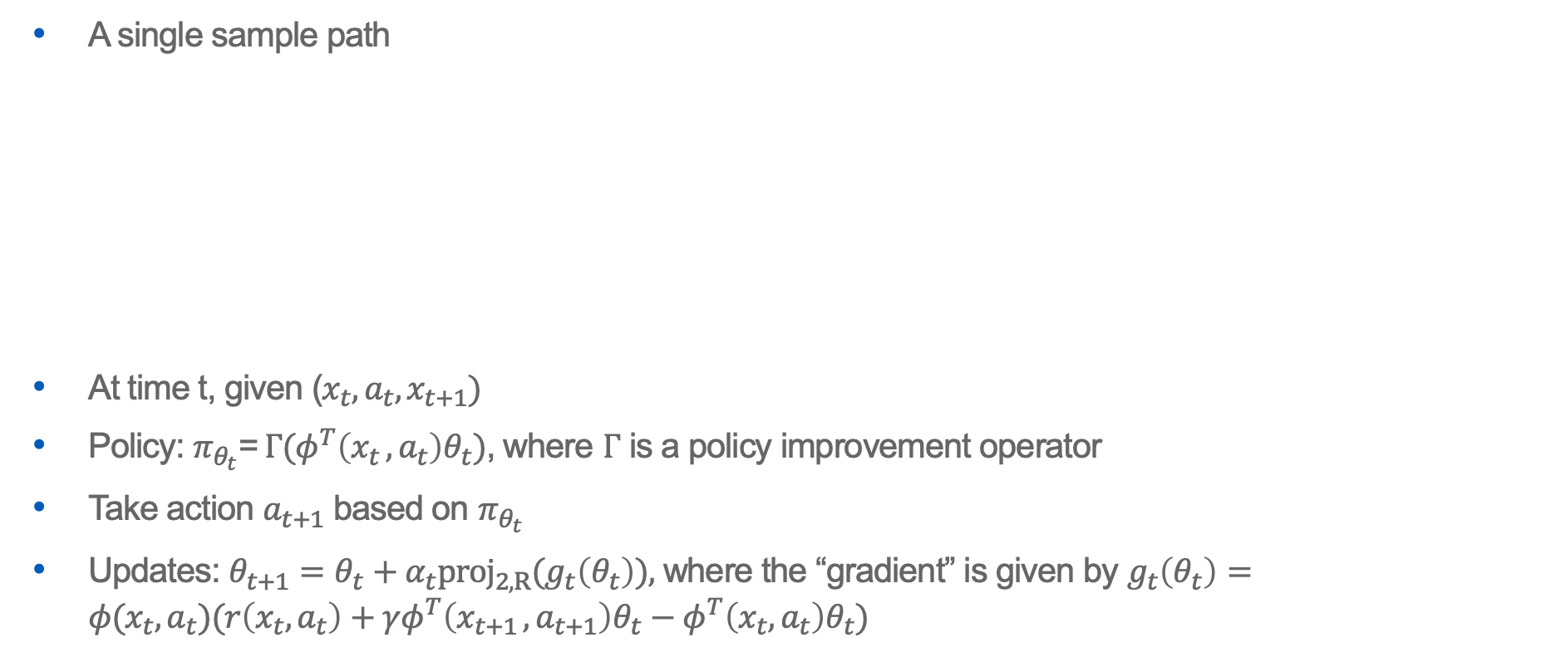















SARSA with Linear Function Approximation
A single sample path
At time t, given ($x_{t},a_{t},x_{t+1})$
Policy: $π_{θ_{t}}$=$Γ(φ^{T}\left(x_{t },a_{t}\right)θ_{t})$, where $Γ$ is a policy improvement operator
Take action $a_{t+1}$ based on $π_{θ_{t}}$
Updates: $θ_{t+1}=θ_{t}+α_{t}{proj_{2,R}(g}_{t}\left(θ_{t}\right)),$ where the “gradient” is given by $g_{t}\left(θ_{t}\right)=φ(x_{t},a_{t})(r\left(x_{t},a_{t}\right)+γφ^{T}\left(x_{t+1 },a_{t+1}\right)θ_{t}−φ^{T}\left(x_{t},a_{t}\right)θ_{t})$
state:
$$x_{t−1}$$
$$x_{t}$$
$$x_{t+1}$$
$$x_{t+2}$$
$$x_{t+3}$$
$$π_{θ_{t−1}}$$
$$π_{θ_{t}}$$
$$π_{θ_{t+1}}$$
$$π_{θ_{t+2}}$$
action:
$$a_{t−1}$$
$$a_{t}$$
$$a_{t+1}$$
$$a_{t+2}$$
$$a_{t+3}$$
$$θ_{t}$$
$$θ_{t+1}$$
$$θ_{t+2}$$
$$θ_{t+3}$$

Slide 8

SARSA with Linear Function Approximation
A single sample path
As $θ_{t}$ is updated, $π_{θ_{t}}$ changes with time
On-policy algorithm, changing behavior policy
Non-i.i.d. data
state:
$$x_{t−1}$$
$$x_{t}$$
$$x_{t+1}$$
$$x_{t+2}$$
$$x_{t+3}$$
$$π_{θ_{t−1}}$$
$$π_{θ_{t}}$$
$$π_{θ_{t+1}}$$
$$π_{θ_{t+2}}$$
action:
$$a_{t−1}$$
$$a_{t}$$
$$a_{t+1}$$
$$a_{t+2}$$
$$a_{t+3}$$
$$θ_{t}$$
$$θ_{t+1}$$
$$θ_{t+2}$$
$$θ_{t+3}$$

Slide 9
Previous Theoretical Studies on Optimal Control
Q-learning with a single sample path
Q-learning with linear function approximation [Melo et al. 2008]
K-nearest neighbor Q-learning: non-i.i.d. sample [Shah and Xie 2018]
More recent studies: [Cai et al. 2019] , [Chen et al. 2019] and [Xu and Gu 2019]
SARSA with a single sample path
Asymptotic analysis: SARSA with linear function approximation [Melo et al. 2008] and [Perkins & Precup 2003], which suggests convergence
Our study: SARSA with a single sample path
Non-asymptotic analysis: How fast the convergence is; and how the convergence rate depends on parameters of RL algorithms and underlying MDP?

Slide 10
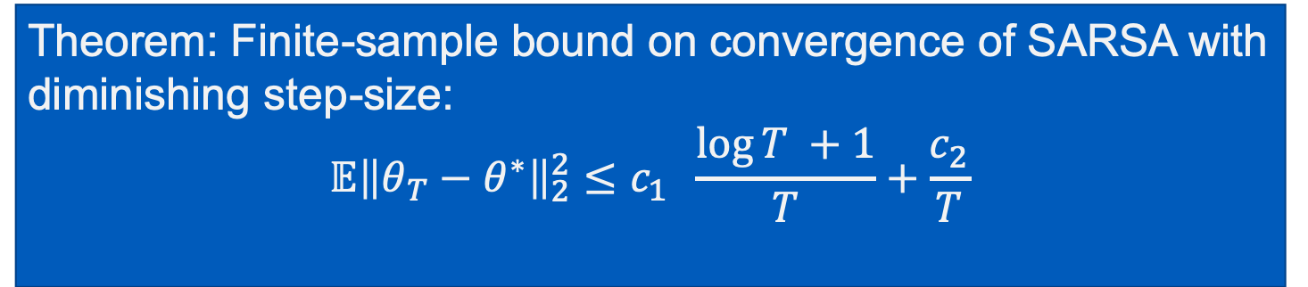

Convergence Results
The limit point $θ^{∗}$ of the projected SARSA [Melo et al. 2008]: $A_{θ^{∗}}θ^{∗}+b_{θ^{∗}}=0$ where $A_{θ^{∗}}=𝔼_{θ^{∗}}\left[φ\left(X,A\right)\left(γφ^{T}\left(Y,B\right)θ^{∗}−φ^{T}\left(X,A\right)θ^{∗}\right)\right]$ and $b_{θ^{∗}}=𝔼_{θ^{∗}}\left[φ\left(X,A\right)r\left(X,A\right)\right].$
The limiting point $θ^{∗}$ is the one such that $𝔼_{θ^{∗}}[g\left(θ^{∗}\right)]=0.$
Theorem: Finite-sample bound on convergence of SARSA with diminishing step-size: $$𝔼{\left\|θ_{T}−θ^{∗}\right\|}_{2}^{2}≤c_{1} \frac{\log{T }+1}{T}+\frac{c_{2}}{T}$$

Slide 11
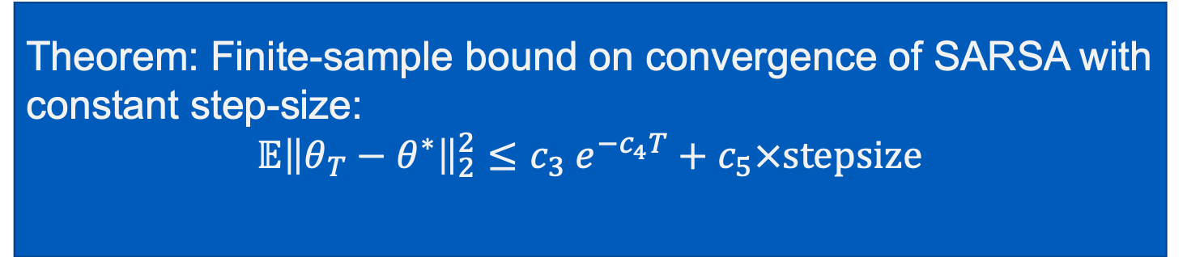

Convergence Results
With constant step-size, SARSA converges faster to a small neighborhood of $θ^{∗}$
Theorem: Finite-sample bound on convergence of SARSA with constant step-size: $$𝔼{\left\|θ_{T}−θ^{∗}\right\|}_{2}^{2}≤{c_{3} e}^{−c_{4}T}+c_{5}×stepsize$$

Slide 12
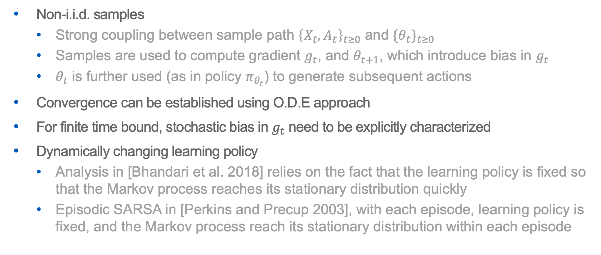
Challenge in Technical Analysis
Non-i.i.d. samples
Strong coupling between sample path ${\left\{X_{t},A_{t}\right\}}_{t≥0}$ and ${{\{θ}_{t}\}}_{t≥0}$
Samples are used to compute gradient $g_{t}$, and $θ_{t+1}$, which introduce bias in $g_{t}$
$θ_{t}$ is further used (as in policy $π_{θ_{t}}$) to generate subsequent actions
Convergence can be established using O.D.E approach
For finite time bound, stochastic bias in $g_{t}$ need to be explicitly characterized
Dynamically changing learning policy
Analysis in [Bhandari et al. 2018] relies on the fact that the learning policy is fixed so that the Markov process reaches its stationary distribution quickly
Episodic SARSA in [Perkins and Precup 2003], with each episode, learning policy is fixed, and the Markov process reach its stationary distribution within each episode
No such nice properties for SARSA!

Slide 13
Proof sketch
Step 1. Error decomposition
Step 2. Gradient descent type analysis
Step 3. Stochastic bias analysis
Step 4. Putting the first three steps together and recursively apply step 1 completes the proof
Key idea: design an auxiliary uniformly ergodic Markov chain to approximate the original Markov chain induced by the SARSA algorithm

Slide 14
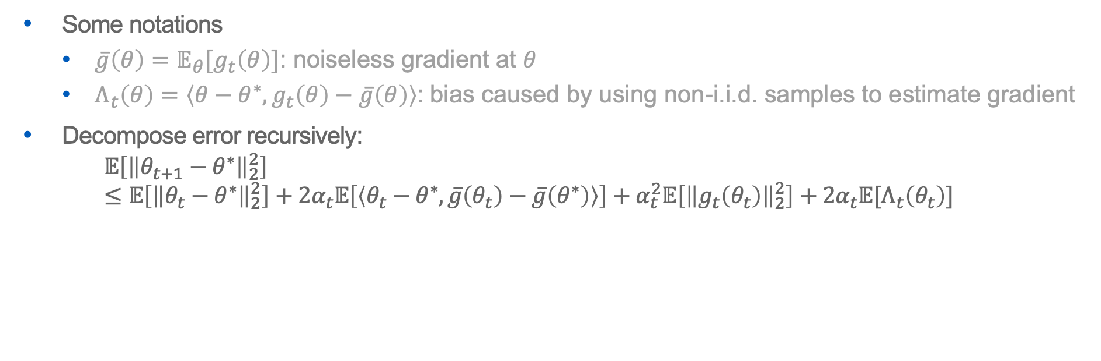
Step 1. Error Decomposition
Some notations
$\overline{g}\left(θ\right)=𝔼_{θ}[g_{t}\left(θ\right)]$: noiseless gradient at $θ$
$Λ_{t}\left(θ\right)=\left\langle θ−θ^{∗},g_{t}\left(θ\right)−\overline{g}\left(θ\right)\right\rangle$: bias caused by using non-i.i.d. samples to estimate gradient
Decompose error recursively: $𝔼\left[{\left\|θ_{t+1}−θ^{∗}\right\|}_{2}^{2}\right]$ $≤𝔼\left[{\left\|θ_{t}−θ^{∗}\right\|}_{2}^{2}\right]+2α_{t}𝔼\left[\left\langle θ_{t}−θ^{∗},\overline{g}\left(θ_{t}\right)−\overline{g}\left(θ^{∗}\right)\right\rangle \right]+α_{t}^{2}𝔼\left[{\left\|g_{t}\left(θ_{t}\right)\right\|}_{2}^{2}\right]+2α_{t}𝔼[Λ_{t}\left(θ_{t}\right)]$
Gradient descent type analysis
Stochastic bias

Slide 15
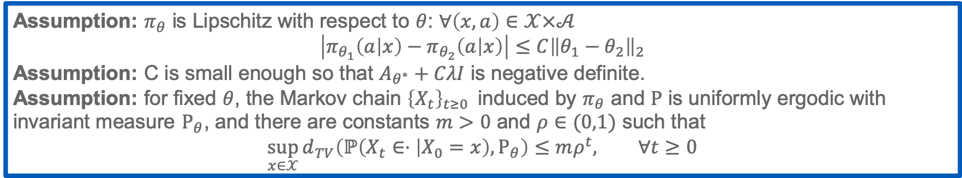
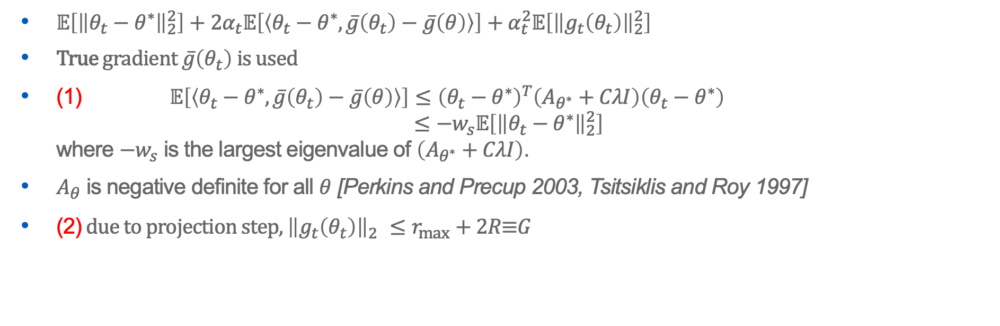
Step 2. Gradient Descent Type Analysis
(1)
(2)
$𝔼\left[{\left\|θ_{t}−θ^{∗}\right\|}_{2}^{2}\right]+2α_{t}𝔼\left[\left\langle θ_{t}−θ^{∗},\overline{g}\left(θ_{t}\right)−\overline{g}\left(θ\right)\right\rangle \right]+α_{t}^{2}𝔼\left[{\left\|g_{t}\left(θ_{t}\right)\right\|}_{2}^{2}\right]$
True gradient $\overline{g}\left(θ_{t}\right)$ is used
(1) $𝔼\left[\left\langle θ_{t}−θ^{∗},\overline{g}\left(θ_{t}\right)−\overline{g}\left(θ\right)\right\rangle \right]≤{\left(θ_{t}−θ^{∗}\right)}^{T}\left(A_{θ^{∗}}+CλI\right)\left(θ_{t}−θ^{∗}\right)$ $≤−w_{s}𝔼\left[{\left\|θ_{t}−θ^{∗}\right\|}_{2}^{2}\right]$ where ${−w}_{s}$ is the largest eigenvalue of $\left(A_{θ^{∗}}+CλI\right)$.
$A_{θ}$ is negative definite for all $θ$ [Perkins and Precup 2003, Tsitsiklis and Roy 1997]
(2) due to projection step, ${\left\|g_{t}\left(θ_{t}\right)\right\|}_{2}^{}≤r_{max}+2R\text{≡}G$
Assumption: $π_{θ}$ is Lipschitz with respect to $θ$: $∀\left(x,a\right)∈𝒳×𝒜$ $$\left|π_{θ_{1}}\left(a | x\right)−π_{θ_{2}}\left(a | x\right)\right|≤C{\left\|θ_{1}−θ_{2}\right\|}_{2}$$
Assumption: C is small enough so that $A_{θ^{∗}}+CλI$ is negative definite.
Assumption: for fixed $θ$, the Markov chain ${\left\{X_{t}\right\}}_{t≥0 }$ induced by $π_{θ}$ and $Ρ$ is uniformly ergodic with invariant measure $Ρ_{θ}$, and there are constants $m>0$ and $ρ∈(0,1)$ such that $$\sup_{x∈𝒳}{d_{TV}\left(ℙ\left(X_{t}∈⋅ | X_{0}=x\right),Ρ_{θ}\right)≤mρ^{t}, ∀t≥0}$$

Slide 16
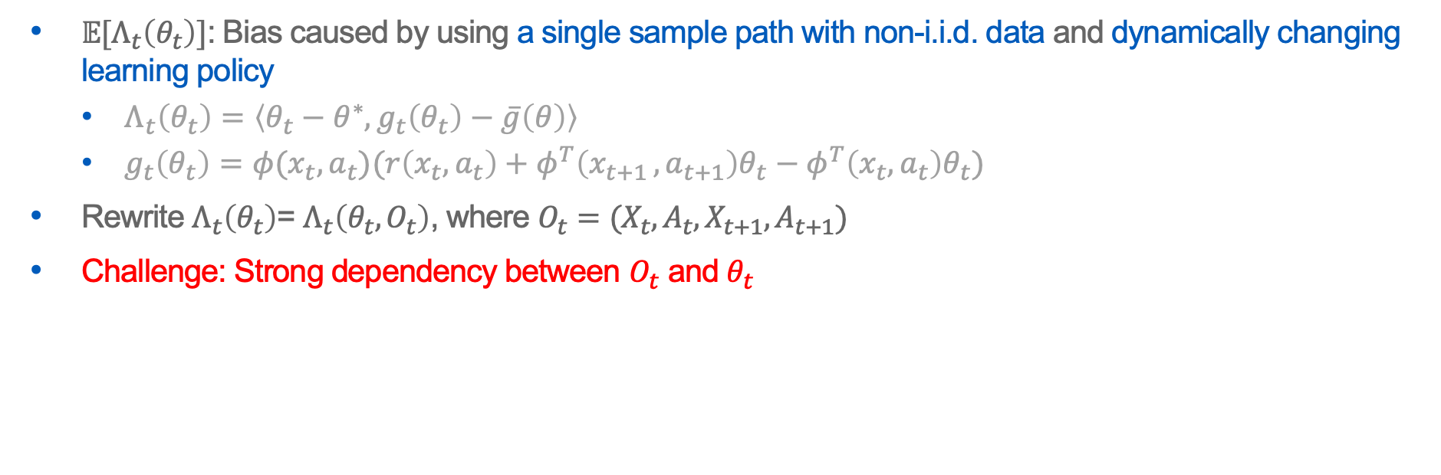
Step 3. Stochastic Bias Analysis
$𝔼[Λ_{t}\left(θ_{t}\right)]$: Bias caused by using a single sample path with non-i.i.d. data and dynamically changing learning policy
$Λ_{t}\left(θ_{t}\right)=\left\langle θ_{t}−θ^{∗},g_{t}\left(θ_{t}\right)−\overline{g}\left(θ\right)\right\rangle$
$g_{t}\left(θ_{t}\right)=φ(x_{t},a_{t})(r\left(x_{t},a_{t}\right)+φ^{T}\left(x_{t+1 },a_{t+1}\right)θ_{t}−φ^{T}\left(x_{t},a_{t}\right)θ_{t})$
Rewrite $Λ_{t}\left(θ_{t}\right)$= $Λ_{t}\left(θ_{t},O_{t}\right)$, where $O_{t}=(X_{t},A_{t},X_{t+1},A_{t+1})$
Challenge: Strong dependency between $O_{t}$ and $θ_{t}$

Slide 17
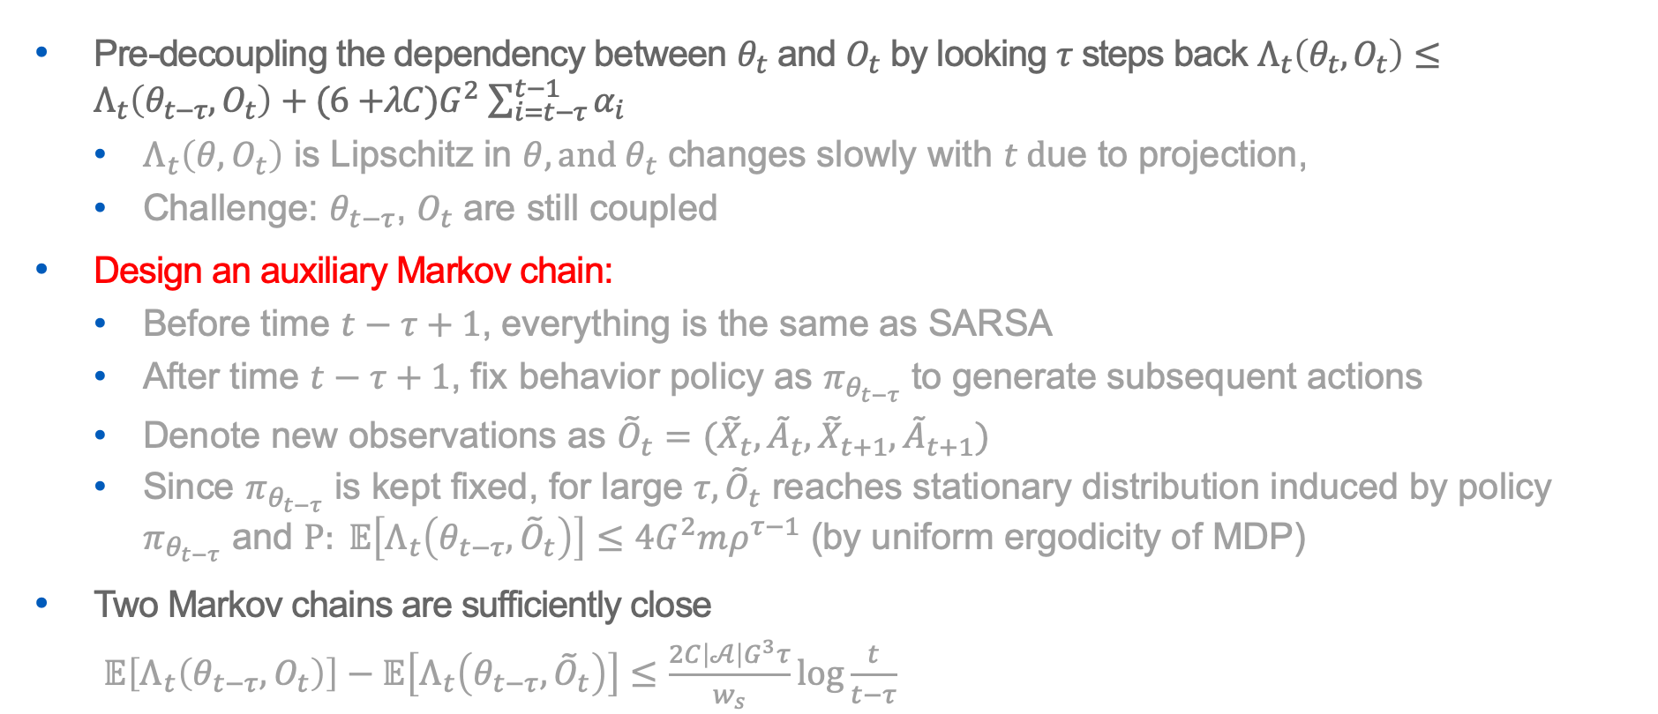
Step 3. Stochastic Bias Analysis
Pre-decoupling the dependency between $θ_{t}$ and $O_{t}$ by looking $τ$ steps back $Λ_{t}\left(θ_{t},O_{t}\right)≤Λ_{t}\left(θ_{t−τ},O_{t}\right)+(6{+λC)G}^{2}\sum_{i=t−τ}^{t−1}{α_{i}}$
$Λ_{t}\left(θ,O_{t}\right)$ is Lipschitz in $θ, and θ_{t}$ changes slowly with $t \text{d}\text{ue} \text{to} \text{projection}\text{,}$
Challenge: $θ_{t−τ}$, $O_{t}$ are still coupled
Design an auxiliary Markov chain:
Before time $t−τ+1$, everything is the same as SARSA
After time $t−τ+1$, fix behavior policy as $π_{θ_{t−τ}}$ to generate subsequent actions
Denote new observations as ${\tilde{O}}_{t}=({\tilde{X}}_{t},{\tilde{A}}_{t},{\tilde{X}}_{t+1},{\tilde{A}}_{t+1})$
Since $π_{θ_{t−τ}}$ is kept fixed, for large $τ, {\tilde{O}}_{t}$ reaches stationary distribution induced by policy $π_{θ_{t−τ}}$ and $Ρ: 𝔼\left[Λ_{t}\left(θ_{t−τ},{\tilde{O}}_{t}\right)\right]≤4G^{2}mρ^{τ−1}$ (by uniform ergodicity of MDP)
Two Markov chains are sufficiently close
$𝔼\left[Λ_{t}\left(θ_{t−τ}, O_{t}\right)\right]−𝔼\left[Λ_{t}\left(θ_{t−τ},{\tilde{O}}_{t}\right)\right]≤\frac{2C\left|𝒜\right|G^{3}τ}{w_{s}}\log{\frac{t}{t−τ}}$

Slide 18
Step 4.
Putting the first three steps together
Recursively applying Step 1 completes the proof

Slide 19
Summary
Non-asymptotic analysis for RL algorithm: SARSA
Linear function approximation
A single sample path
Non-i.i.d. data
Novel technique to handle dynamically changing policy (SARSA)
https://arxiv.org/abs/1902.02234 Neurips 2019, Vancouver, Canada
Our related works:
Finite-sample analysis for TDC, Neurips 2019, Vancouver, Canada

Slide 20
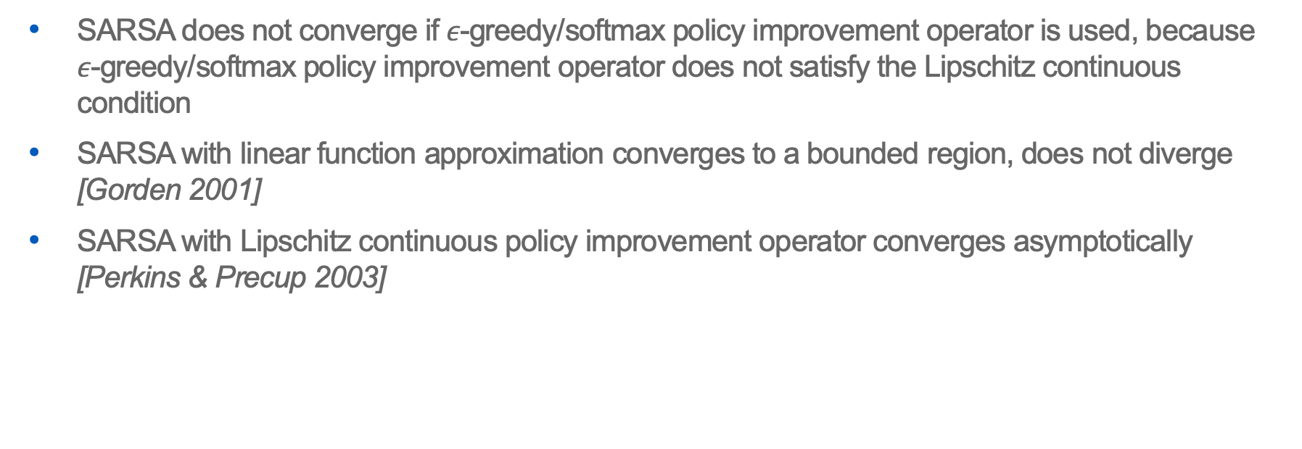
Convergence of SARSA with Linear Function Approximation
SARSA does not converge if $ε$-greedy/softmax policy improvement operator is used, because $ε$-greedy/softmax policy improvement operator does not satisfy the Lipschitz continuous condition
SARSA with linear function approximation converges to a bounded region, does not diverge [Gorden 2001]
SARSA with Lipschitz continuous policy improvement operator converges asymptotically [Perkins & Precup 2003]

Slide 21


Choice of Projection Radius
$r_{max}≔\max_{\left(x,a\right)∈𝒳×𝒜}{r(x,a)}$
$w_{l}<0:$ the largest eigen value of $A_{θ^{∗}}$
Lemma: For the projected SARSA algorithm,
${\left\|θ^{∗}\right\|}_{2}≤−\frac{r_{max}}{w_{l}}$.

Slide 22
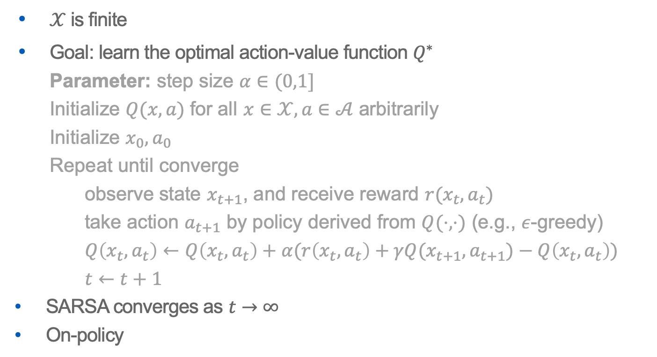
SARSA
$𝒳$ is finite
Goal: learn the optimal action-value function $Q^{∗}$
Parameter: step size $α∈(0,1]$
Initialize $Q(x,a)$ for all $x∈𝒳,a∈𝒜$ arbitrarily
Initialize $x_{0}, a_{0}$
Repeat until converge
observe state $x_{t+1}$, and receive reward $r(x_{t},a_{t})$
take action $a_{t+1}$ by policy derived from $Q(⋅, ⋅)$ (e.g., $ε$-greedy)
$Q\left(x_{t},a_{t}\right)←Q\left(x_{t},a_{t}\right)+α(r\left(x_{t},a_{t}\right)+γQ(x_{t+1},a_{t+1})−Q\left(x_{t},a_{t}\right))$
$t←t+1$
SARSA converges as $t→∞$
On-policy

