Slide 1
Land Suitability Evaluation for Cropland in Erie County Based on GIS and Statistic Method
Jianqiao Liu
GEO559

Slide 2
2. Objective
1. Find two different ways to conduct suitability evaluation and build the evaluation model
2. The correlation coefficient test between two models and evaluate them.

Slide 3
3. Study Area, method design
Study Area: Erie County
Method Design:
GIS method:
Convert, Vectorization, Resample, Mask, Point extract
Statistic method:
AHP (Analytic Hierarchy Process): The AHP using expert decision and experience, building a weight matrix that can be used in the ArcGIS.
PLS(Partial Least Squares Regression): A statistic method that is similar to stepwise regression, which can find out most suitable variable for the regression model, the dependent variable: Original AGB(Above ground biomass), independent variable: vegetation index.

Slide 4
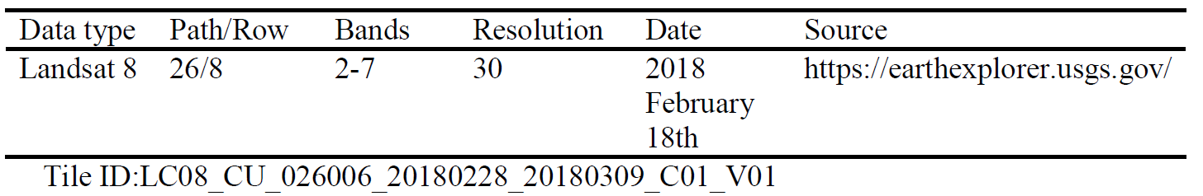
4. Data Layers
1. Remote sensing data
2. Vegetation index:
NDVI green, Simple Ratio, CI green, NDVI, EV1, EV2, WDRVI, WDRVI green, MSAVI2, Colorations Index, HI, BI, RI, GSI, NDWI, MSI, SOC
2.5. Original biomass data
3. DEM: Slope, Elevation
4. Soil data: Humus, Estimates soil organic C, Texture, pH, Stone
5. Hydrology data: River density, Distribution permafrost, Estimated moisture index
6. Climate data: Estimates Hydro- Thermal Coefficient, Annual average precipitation and temperature

Slide 5
5. Result
The AHP evaluation function:
Suitabilityi = 0.153* Slope +0.091 * Elevation+0.146 * Humus+0.036 * ESOC +0.113* Texture +0.034 * pH +0.032 * Stone +0.121 * EHTC+0.045 * P +0.069 * T +0.093 * River density +0.032 * D+0.035 * E
The PLS regression result for AGB from vegetation indices is:
AGB= -0.331 + 0.415 * CI green +2.125 * NDVI + 0.415 * Simple ratio + 3.860*EV2 + 1.987 * WDRVI + 4.082 * MSAVI
The parameters of regression model:
R2=0.7175, Adjusted R2=0.7139, RMSE=0.897, MSE=0.477
The Pearson correlation between two models: r=0.331

Slide 6
Erie County State Park Site Selection GEO 479
John Osborn

Slide 7
Objectives
Locate an area that can be used for a new State Park
Not near a State Park
Accessible to most people possible
Be substantial in size

Slide 8
Study Area
Erie County, area was selected for its potential for State Parks. While areas surrounding the cities are often developed, extensive natural areas emerge as one moves from the suburbs. This is optimal because forest and undeveloped land is key for the formation of a state park. Also, the fact that these wooded areas begin in close proximity to the suburbs allows for more people to access a new park, if one were to be created.

Slide 9
Things to Consider
Factors
Layers Used
Proximity to current parks
Land Use
Population near park
Area of land
CUGIR LU
Graduated TIGER Census Data
Buffer Around Current Parks
Clearinghouse Civil Boundaries Data

Slide 10
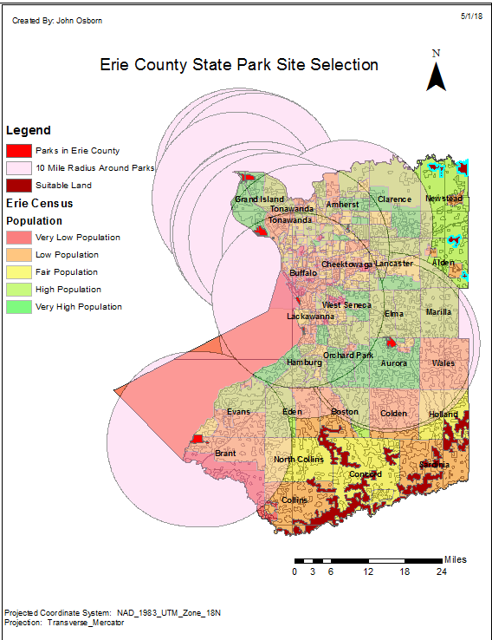
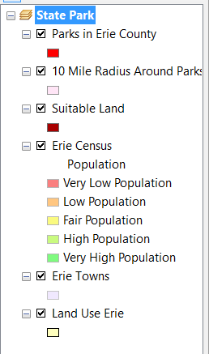
Final Map
Selection in light blue – Optimal locations for park
All layers listed to the right
Best park locations are in 4 areas in Alden and Newstead

Slide 11


Finding a Home for IBEW Local Union 2199
Jonathan Lynch
GEO 559

Slide 12
Objective:
To locate an ideal location for the members of Local Union 2199 to hold their monthly meetings.
Factors to be considered:
Centralized location to members home addresses
Distance from work locations (meetings are held shortly after most members leave work)
Estimated cost of renting the hall

Slide 13
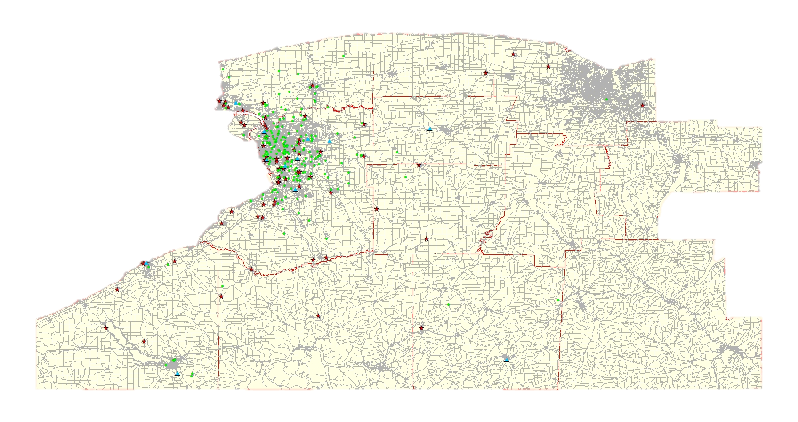
Data:
Union Member Addresses
Union database
Work Locations
Work excel spreadsheet
American Legion / VFW Posts
Google Earth
Counties, Census Tracts, Streets
NYS GIS Clearinghouse

Slide 14
Methodology:
Spatial Join to assign Median Household Income from Census Tracts to Meeting Halls layer.
Normalize Household Income to a range between 1.0 – 2.0
Location-Allocation for Member Homes.
Output layer includes total miles.
Normalize output mileage between 1.0 – 2.0
Combine weights of Household Income & Mileage
Location-Allocation for Work Location
Weigh Facilities (Meeting Halls layer) by the combined Household Income & Mileage from Member Homes.
Ideal Meeting Hall!

Slide 15
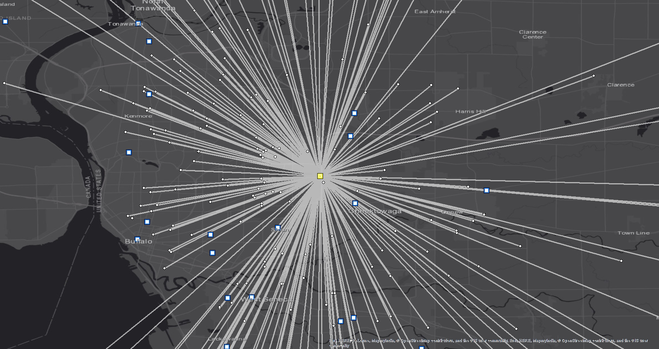
Results:

Slide 16
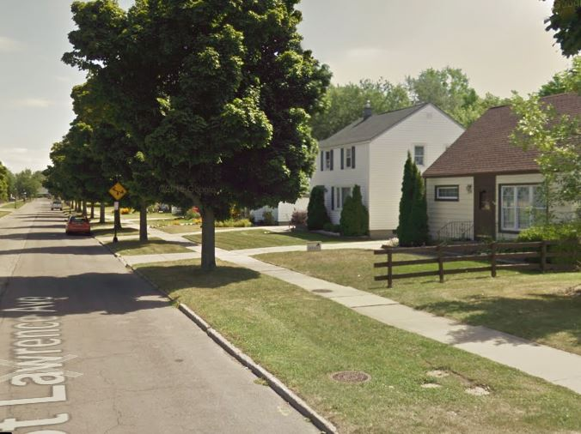
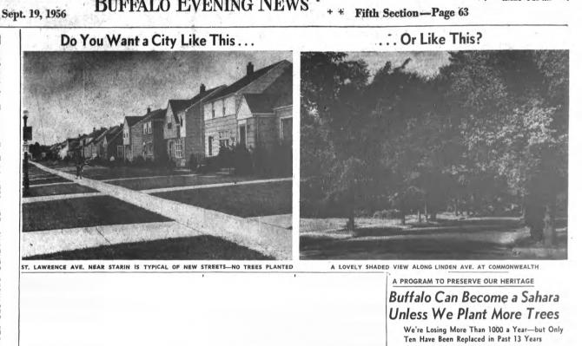
Mapping the Environmental Benefits of Trees based on Income and Race for Census Tracts in Erie County, NY.
Kaitlin Walsh GEO 559

Slide 17
Objectives
Compare concentrations of trees, land use, ecological benefits, and cancer rates based off of income and race for Census Tracts in Erie County NY

Slide 18
Tree Layer
Field Calculator for # trees/ tract
Income Layer
Display Quantities (5 classes)
Method Design:
Landuse Layer
Change symbology
Clip to City of Buffalo Boundaries and join to:
Cancer Rates Layer
Change symbology (5 classes)
Census Tracts Erie County, NY
Weight 1
Total Yearly Ecological Benefits Layer
Weight 2
Pearson’s Regression to test for significance between results
Weight 3
Race Layer
Create Dot Density

Slide 19
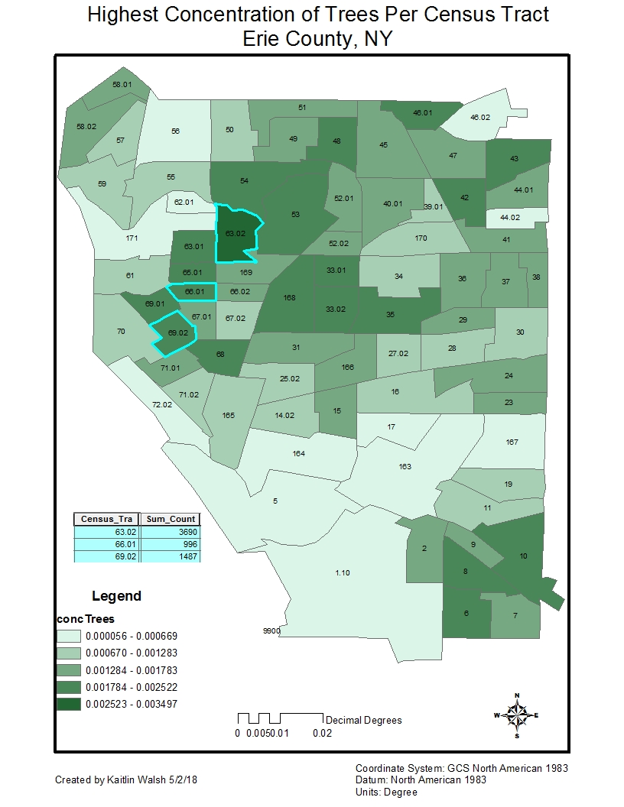
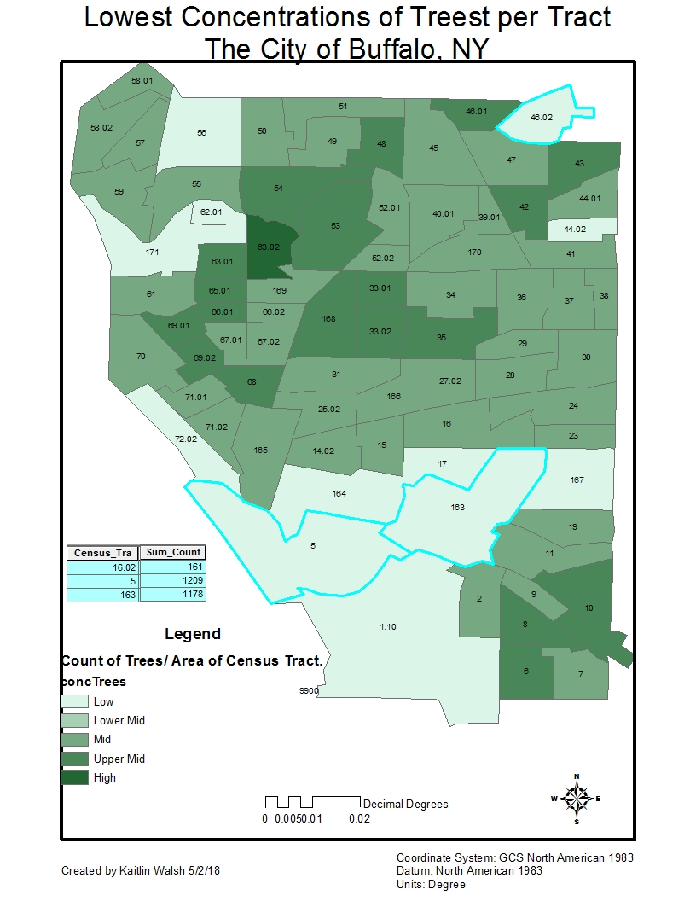
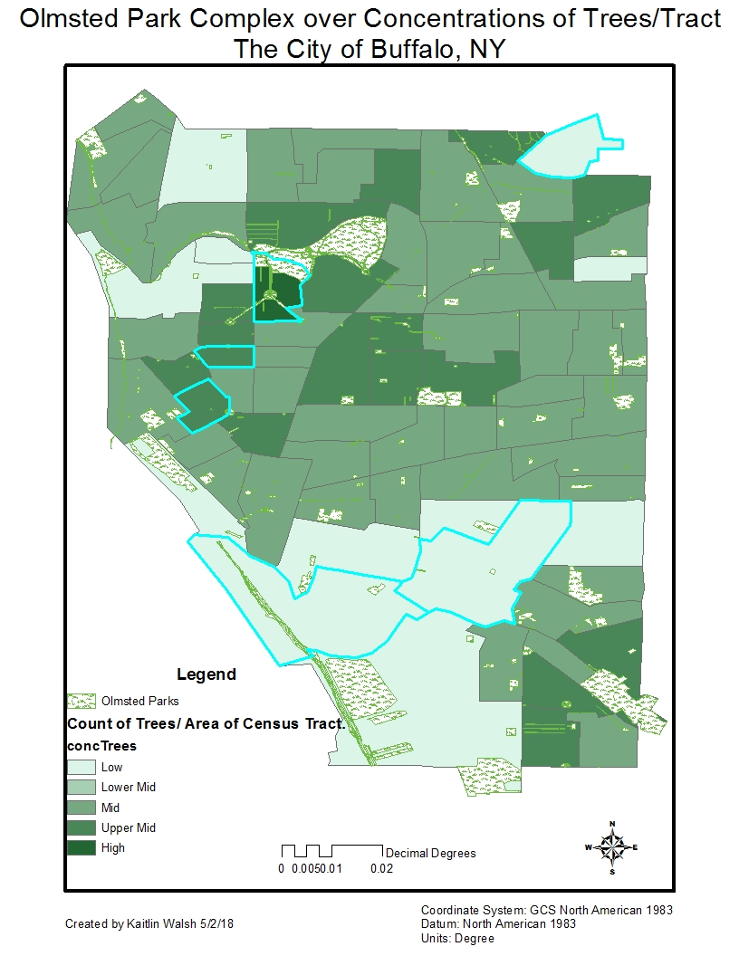
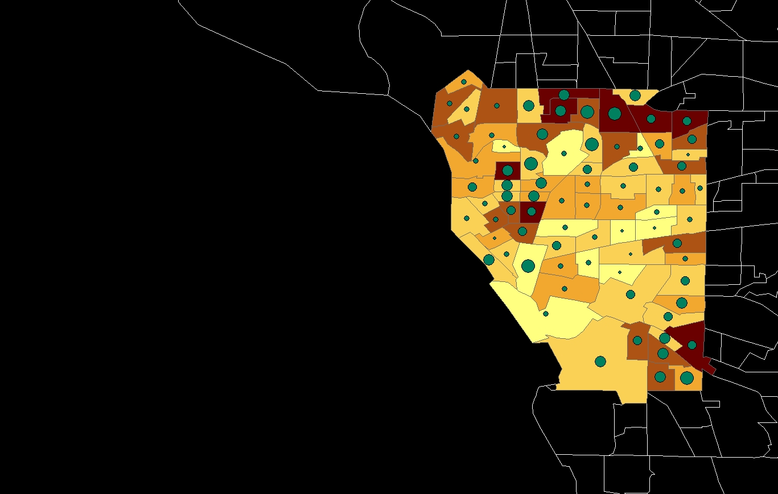
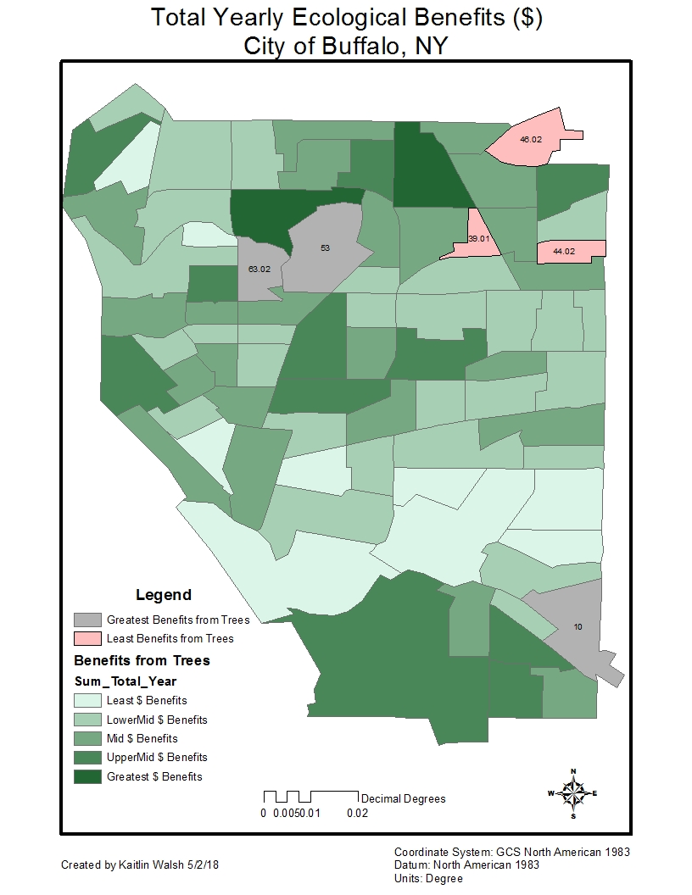
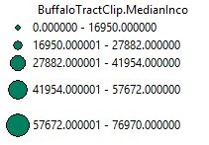
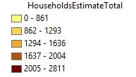
Income over Households

Slide 20
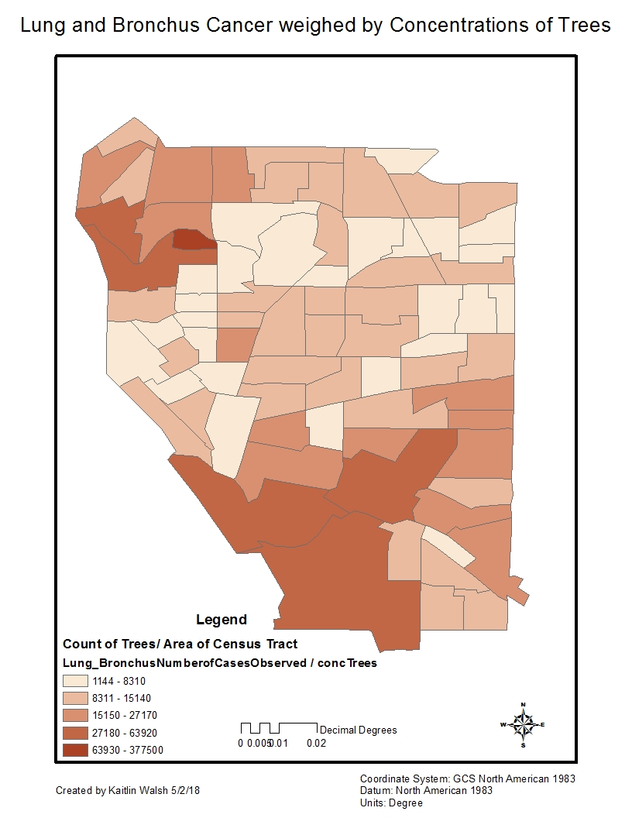
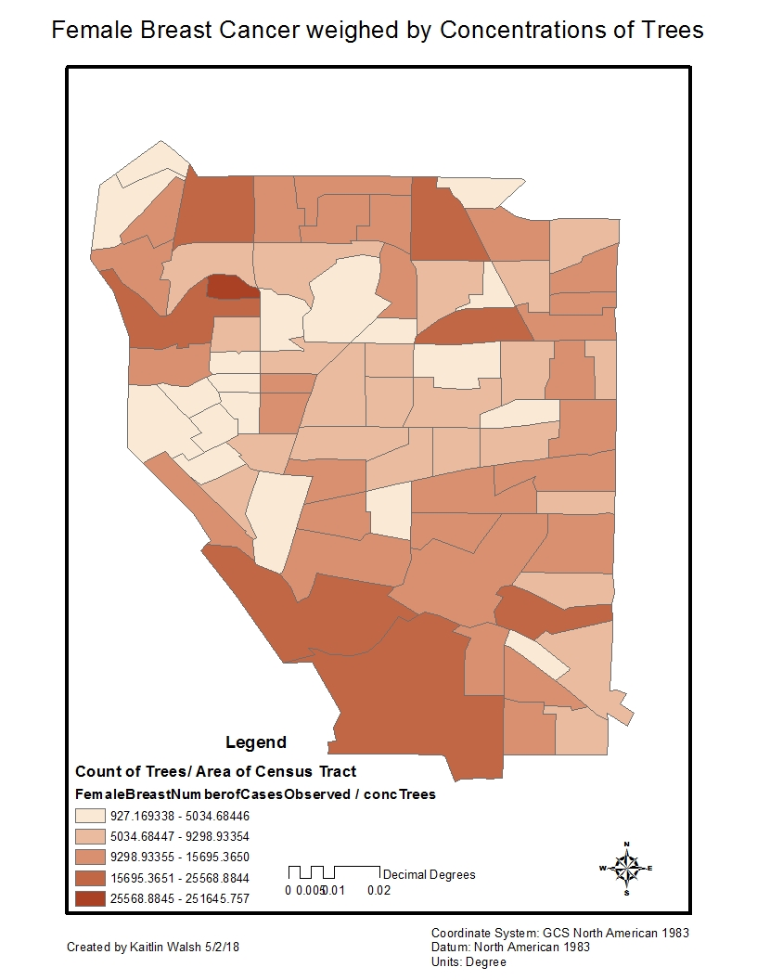

Slide 21
Optimal Campsites in Olympic National Park
GEO479
Maegan Wettlaufer

Slide 22
Objective
Use three main variables to find an optimal camping area
Conveniently accessing trails: distance to trails
Traffic: distance to recreation sites
Accessibility: slope
Validate and compare result with known free camping sites

Slide 23
Study Area: Olympic National Park, WA
Data
Trails: Olympic National Forest Data Library
Recreation sites: Olympic National Forest Data Library
DEM Data: USGS 3D Elevation Program
Free Campsites: Freecampsites.net

Slide 24
Methodology
Suitability map
Six, 50-feet interval buffers of trails and rank
Five, 1-mile interval buffers of recreation sites and rank
Convert DEM to slope data and rank
Weighted Overlay: slope, trail, recreation sites
The influences of slope, trail, recreation sites will be 40%, 35%, 25%
Validate with free campsite point data
Notes:
Buffer Trials: reasoning= dispersed camping rules are guidelines to using federal land to camp for free includes rule that says to generally stay at least 100-200 feet away from any nps trail, road or waterway
Buffering recreation sites: want to be far enough from these high traffic sites
Dem- high slope associated with low accessability
Looking at which point had the highest score from raster calculator The output of the raster calculator will include a score for each point, map this,
compare to what I thought was the best campsite: overlay for validation
Calculated score from freecampsites website variables using field calculator

Slide 25
Results

Slide 26

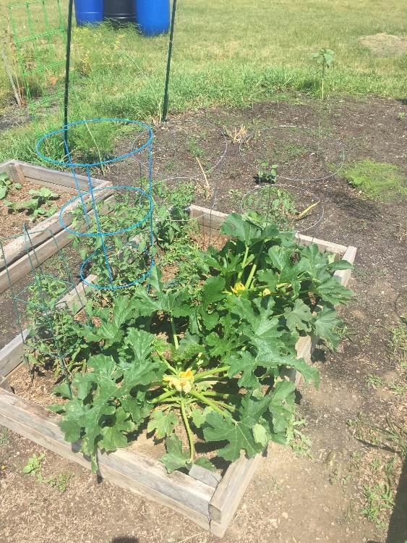
Interactive App to Find Possible Locations For a Community Garden in the City of Buffalo
Maylan Nguyen
GEO479

Slide 27
Objectives
Find a suitable location for a community garden to
Reduce crime through after school activities
(Crime Incidents, Schools)
Promote healthy and affordable eating for poorer neighborhoods
(Income)
Engage the Buffalo community in starting more gardens (Web App)
(M.A.P. and Grassroots advocate for this)

Slide 28
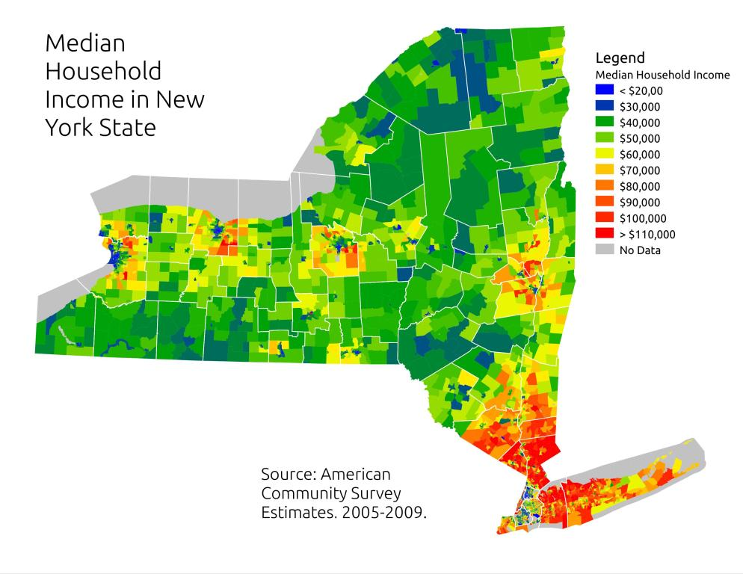
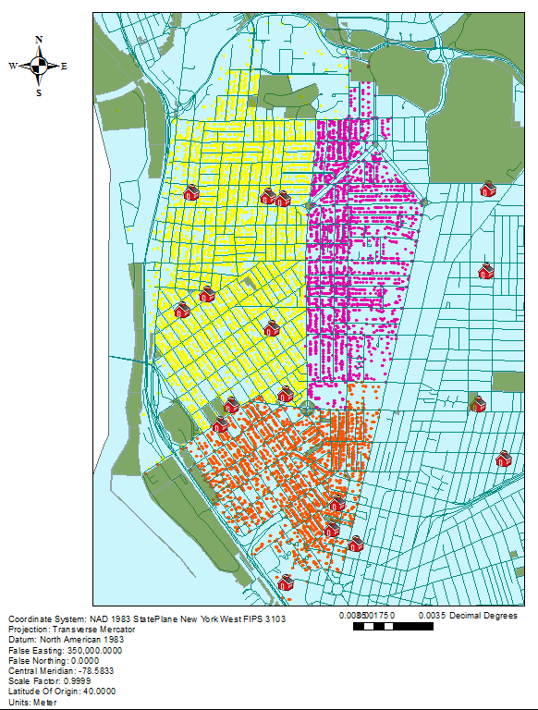
Crime Incidents in the West Side, Buffalo
http://andyarthur.org/map-median-household-income-in-ny-state-middle-class-biased-coloring-2.html

Slide 29
Data
American Fact Finder
Median House Hold Income (2016 Estimates)
Open Data Buffalo
Public School Locations
Crime Incidents
Zoning Codes
TIGER
Census Tracts

Slide 30
Methodology
Prepare data
-Projections
-Select by attributes and export
-Joins
Create Feature Layers
-Choose layer template
-Append data
-Add layers to base map
-Edit symbology
Web App
-Widgets

Slide 31
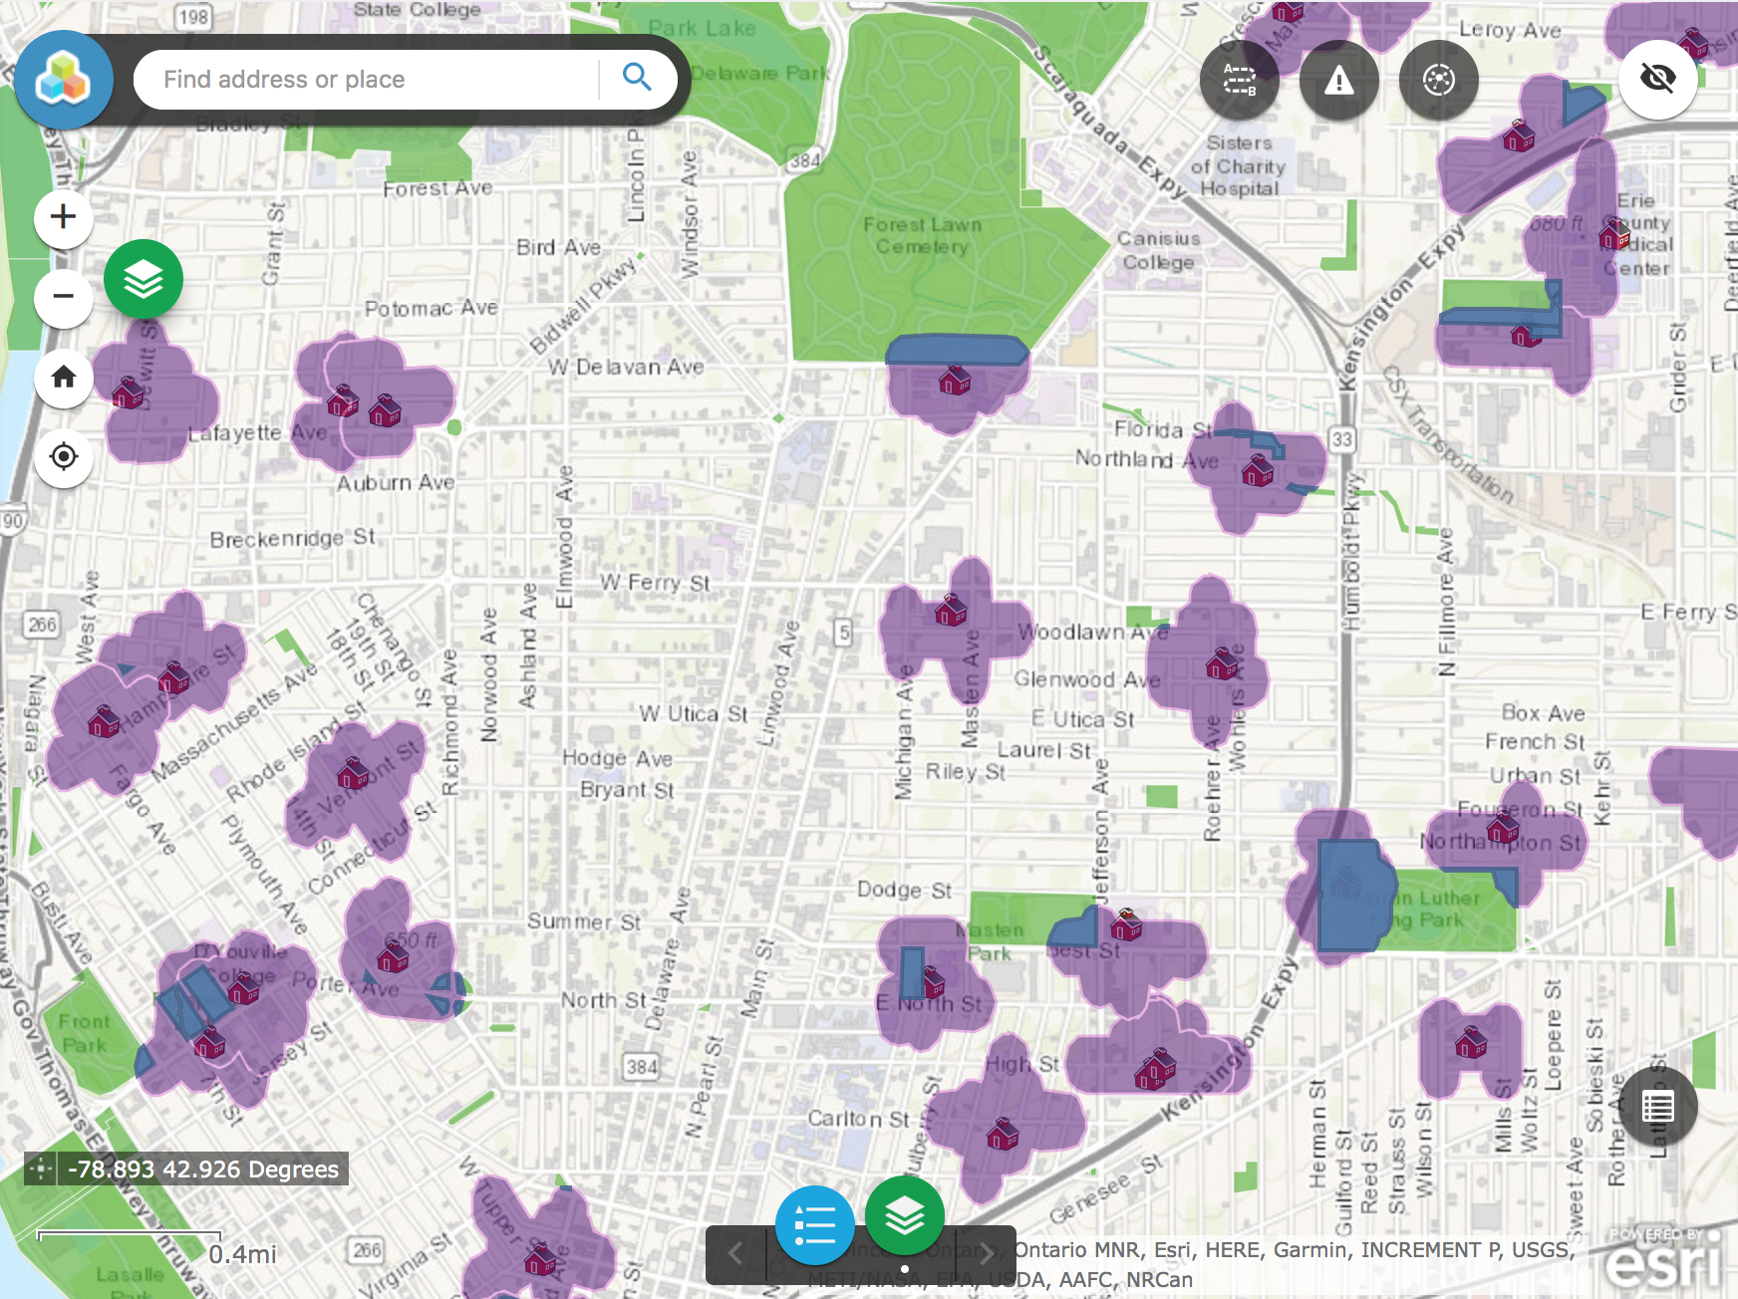
Analysis

Slide 32
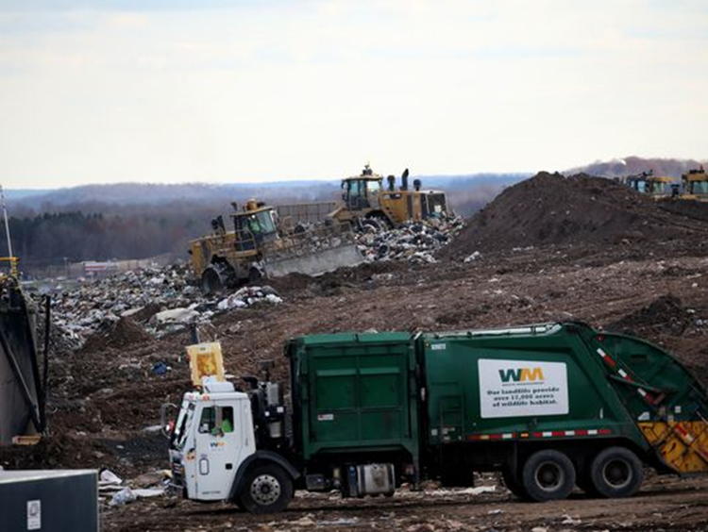
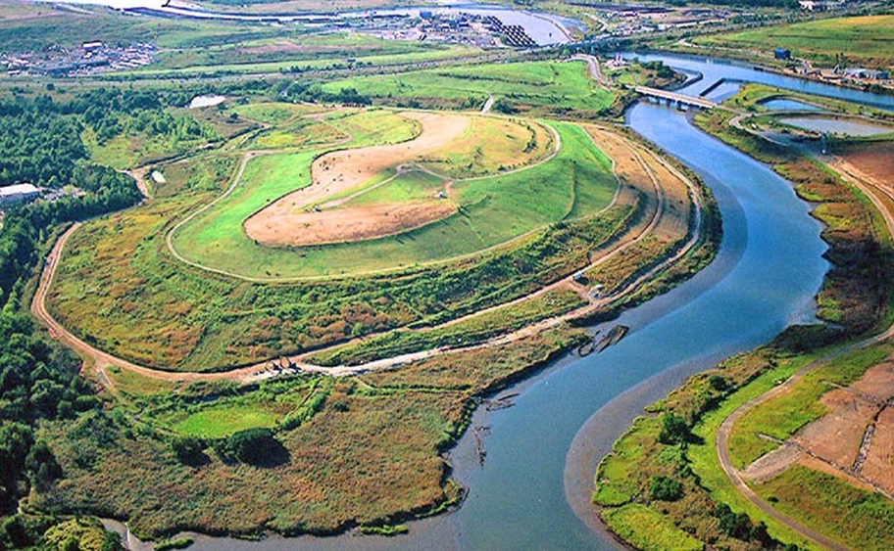
Groundwater Contamination from Landfill Leachate
Created by Robert West
GEO 479

Slide 33
Objectives
To find potential for aquifers to become contaminaion from landfill runoff
Display results clearly on map showing primary aquifers potential for contamination

Slide 34
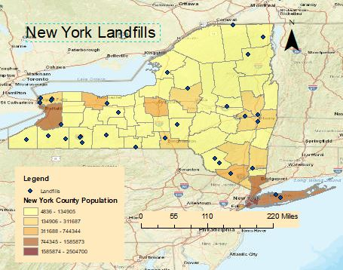
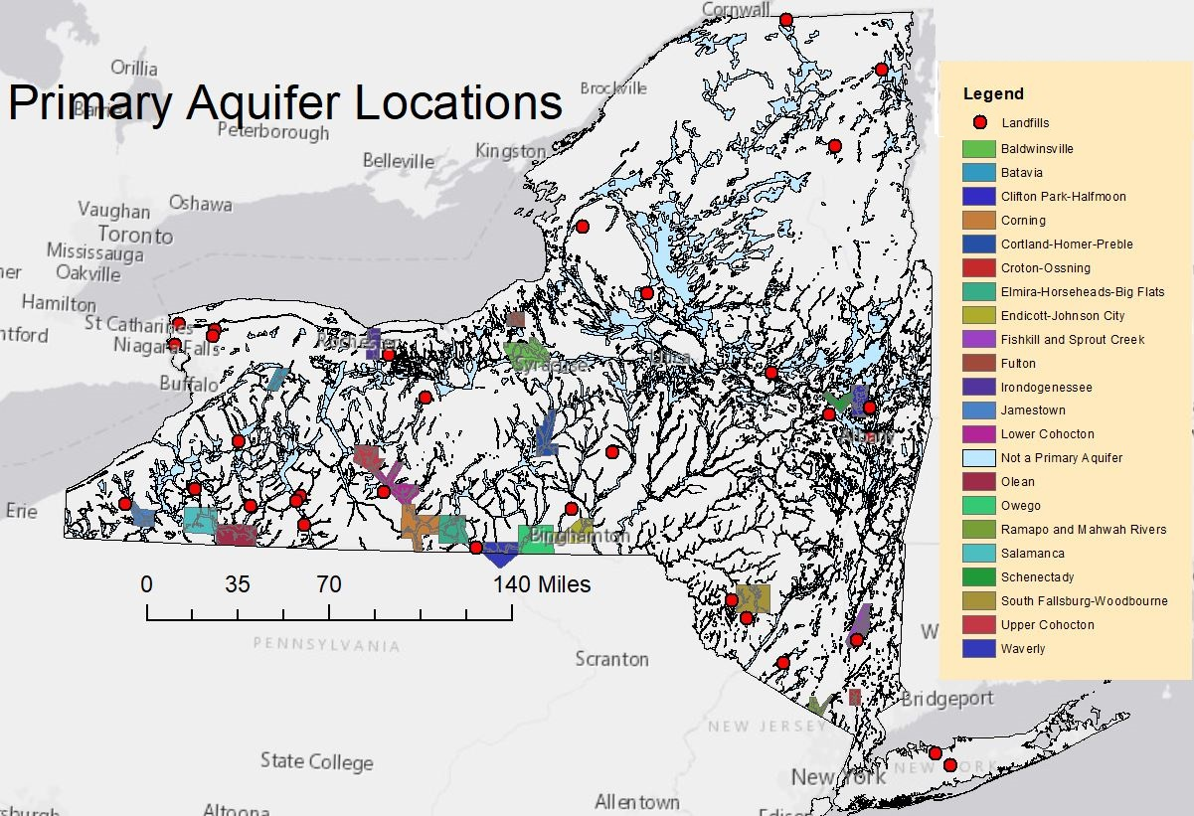
Focusing on New York State
Using the Aquifers, Landfills, and average precipitation as data layers

Slide 35
Factors and Methods
Distance of the aquifers to the landfills
Average perception in the region as this would increase or decrease the volume of the leachate
Yield of the aquifer as this indicates the flow and recharge of the aquifers
The different factors were waited according to their potential for aquifer potential

Slide 36
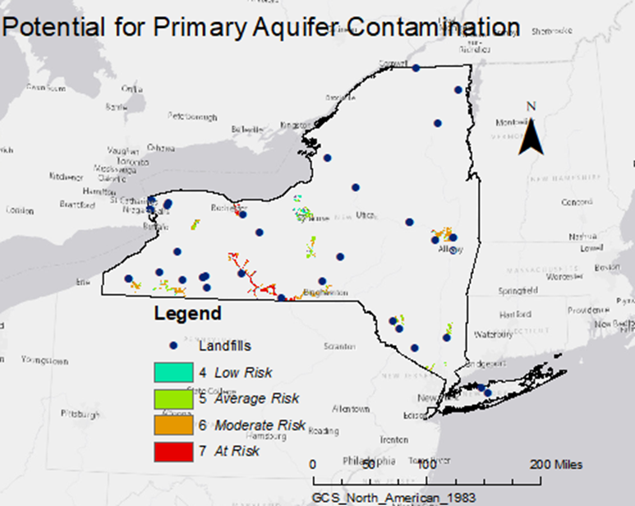

Slide 37
Site Selection: First Tee Facility
Sam Shafer
GEO 479

Slide 38
Objective
Find the most suitable area in Buffalo to build a new first tee golf practice, and youth facility

Slide 39
Study Area: Buffalo NY
Data Layers:
NYS Clearinghouse Public Schools k-12 shapefile
Childhood opportunity data(overall opportunity rank) diversitydatakids.org
Land Use NYS Clearinghouse

Slide 40
Method
Obtain data
Plot points of public schools-->create density heat map of schools.
Add land use layer to view plots of possible locations
Overlay the childhood opportunity data to view areas with a low opportunity index
Find suitable locations for the facility in a high density area of schools, a low childhood opportunity area, and on land that is not already built up.
Found the most suitable location to be in LaSalle park with a runner up of Front Park. Both in south eastern Buffalo.

Slide 41
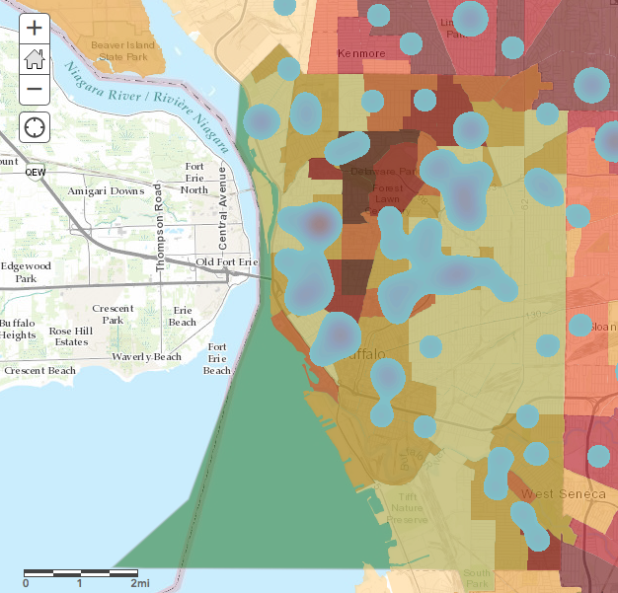
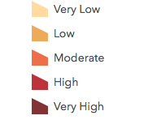
Opportunity Index

Slide 42
Modeling Lakes for Use in Lake Residence Time Estimates
A variable for understanding lake water isotopes
GEO 479
Sandrine Duboscq

Slide 43
Objective
Does lake water residence time affect isotopic composition?
Define a process to find the variables necessary to estimate lake water residence time by GIS analysis.
Find possible study areas near UB.

Slide 44
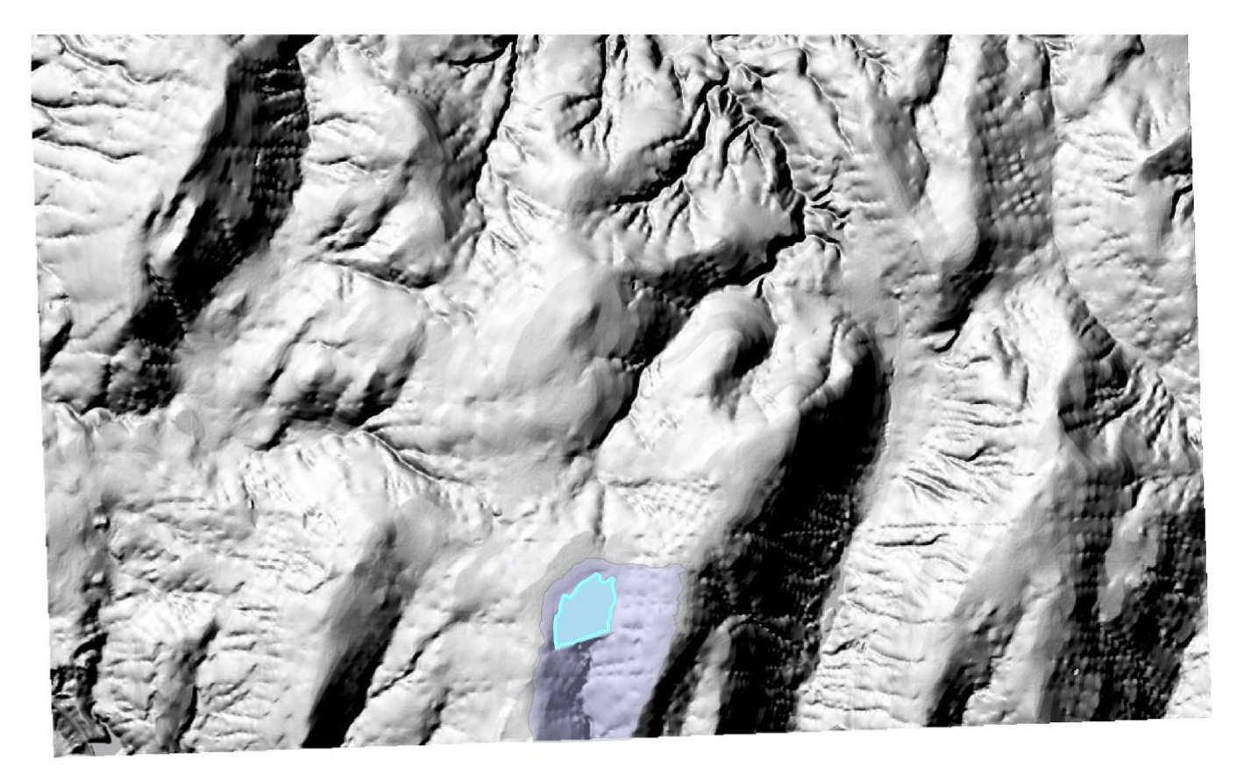
Using GIS
Basin from DEM
Flow direction
Basin
Raster to Polygon
Hillshade (check basin polygon)
Lake surfaces from area vector data
Average annual precipitation value
Depth information from bathymetry maps

Slide 45
Calculations after gathering data
Mean residence time = volume / ice-free season runoff
Volume estimate = 0.5 x maximum depth x surface area
Ice-free season runoff (Q) = catchment area (basin) x annual precipitation / number of ice-free months
Lake | Max depth (ft) | Max depth (m) | Lake area (m2) | Lake volume (m3) | Catchment area (m2) | Precipitation (in) | Precipitation (m) | Ice-free months | Flow rate (Q) (m3/month) | Residence time (months) | Residence time (weeks)
Allen | 20 | 6.096074128 | 208592.9 | 635798.8905 | 1711635.8 | 37.5 | 0.9525 | 8 | 203791.6374 | 3.119847794 | 12.47939118
Canadice | 80 | 24.38429651 | 2924979.167 | 35661779.65 | 38174985.91 | 32.5 | 0.8255 | 8 | 3939181.358 | 9.053094134 | 36.21237654

Slide 46
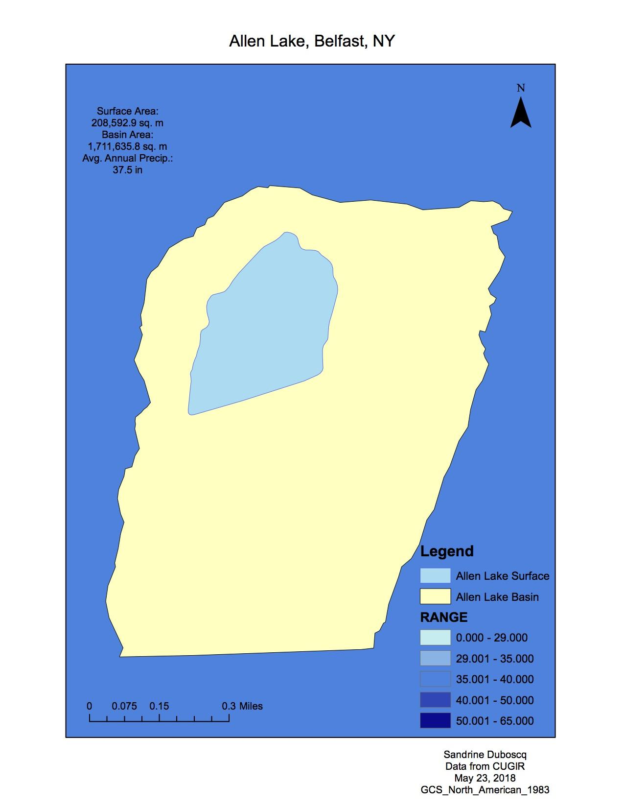
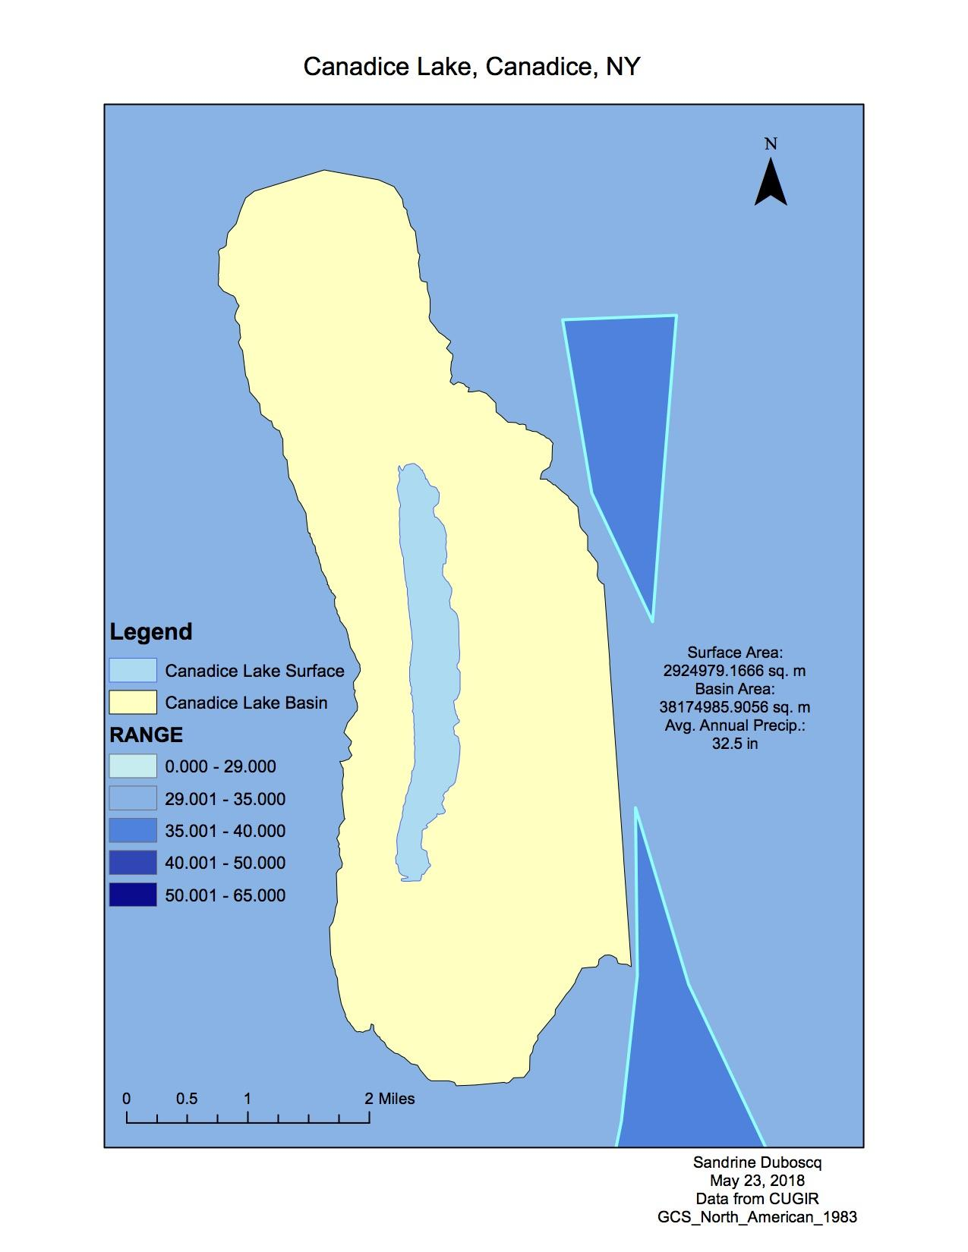

Slide 47
POVERTY AND SHOOTINGS IN BUFFALO , NY
Sean Konovitz-Davern
GEO 559

Slide 48
Data
Census data (ACS using 2010 numbers)
Erie County shapefile from TIGER
Road line shapefile from NYS Clearinghouse-used as guide
Shootings data from Buffalo Police Department that has been geocoded
NYSroads.com-used to find out where highway exits in Buffalo are

Slide 49
Preprocessing
Get data from census tables into Excel and ready for ArcMap-ended up being joined together by census tract
Selecting only the tracts in Buffalo (79 total)
Changing of coordinate system
Creation of point layer from shooting table
Creation of point layer representing location of highway exits
Counted points (shooting incidents) in each tract and created rate based on 2010 population for each tract

Slide 50
Processes
Visualized percent below poverty threshold and median age
Performed Near distance to see distance for tracts to highway exits
OLS regression with shooting rate as dependent variable and percent below poverty, median age, and near distance as independent variables

Slide 51
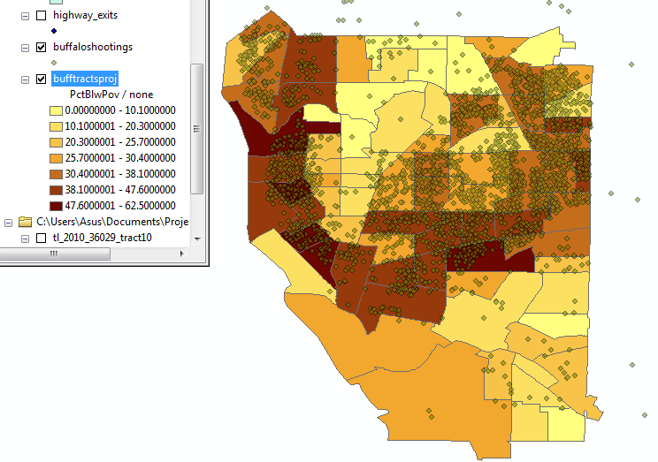
Results
Hard to tell visually from maps
Regression found that, as expected, percent below poverty was significant
Other factors not significant so may need to quantify differently
Maybe look at smaller geographic scale and other variables like race

Slide 52
The Relationship between Income and Land Cover in Erie County
Geo559
Shenyi Liu

Slide 53
Objectives
Try to answer the following questions:
Is there any relationship between annual median household income and land cover in Erie county?
If yes, what’s the exact relationship?

Slide 54
Data
2011 Median household income (unit: census tract) – US Census Bureau
Land cover – (NLCD 2011 edition, USGS)
Reclassify from 15 categories into 9 categories :
Open water
Developed area
Barren land
Forest
Scrub grassland/herbaceous
Pasture/hay
Cultivated crops
Wetlands

Slide 55
Methodology – Regression
Dependent variable
median household income
Independent variables
percentage of each land cover in each census tract
Two regression methods…
Ordinary Least Squares (OLS)
Calculate the regression model with the minimum sum of squared residuals
Geographically Weighted Regression (GWR)
OLS + distance decay function

Slide 56
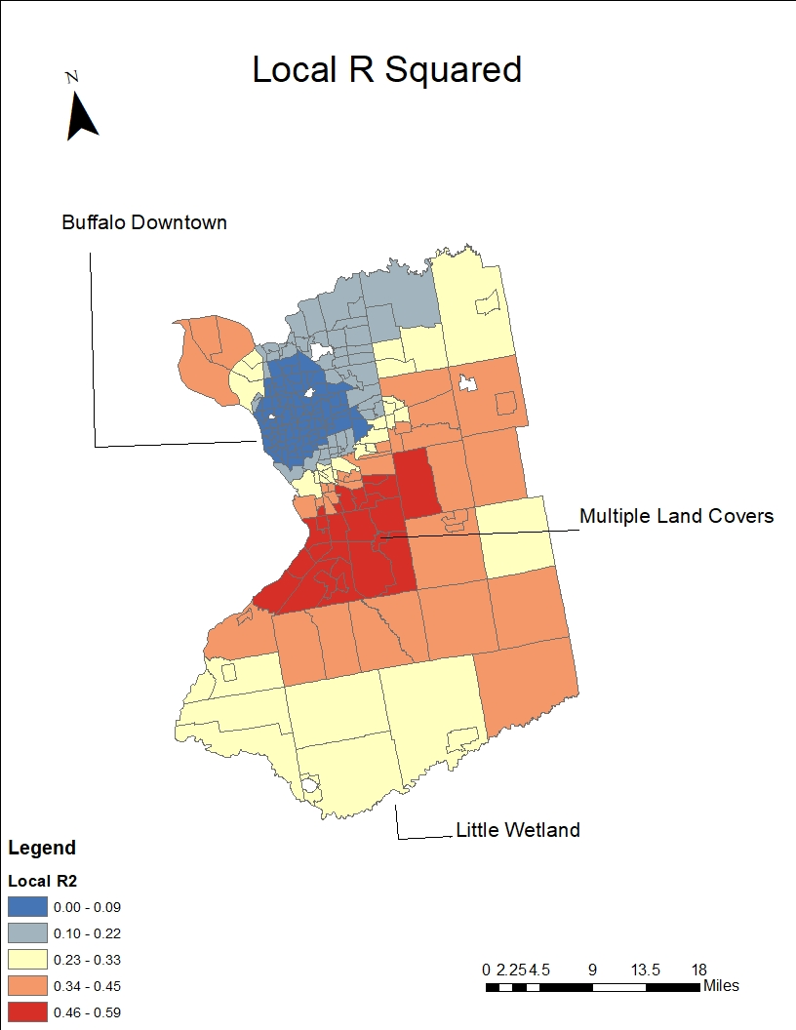
Results
Results from OLS
Adjusted $r^{2}$ = 0.34, p-value = 2.2e-16
Income = 40287.7 + 789.7wetlands + 1286.9pasture/hay - 1236.9cultivated_crops + 254.6forest
Results from GWR
Global adjusted $r^{2}$ = 0.52
Circular distribution
Local r squared changes over space
Global Moran’s I = 0.672504
Local r squared has clustering pattern

Slide 57
Real-Time Flu Disease Surveillance in Buffalo Using Twitter Data
Tian Wen
GEO 559

Slide 58
Objective
Extract tweets which indicate people nearby get flu in terms of corpus
Analyse flu trend over time
Validate and evaluate the result

Slide 59
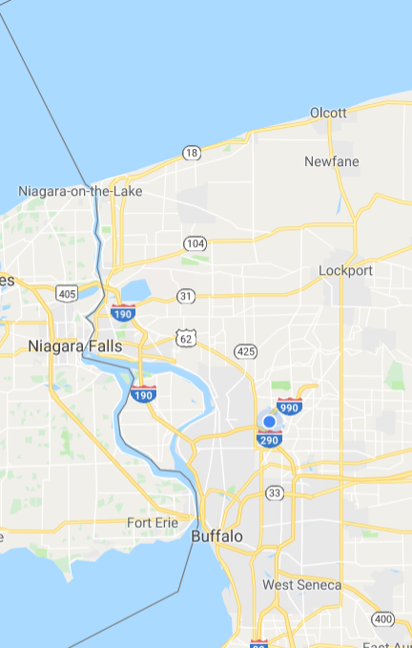
Study Area & Data & Tool
Data: Tweets collected from 2016/10/1 to 2017/5/20 (millions of tweets, 10G)
Tool: Support Vector Machine (SVM)
Study Area: Buffalo, including Erie County and Niagara County

Slide 60

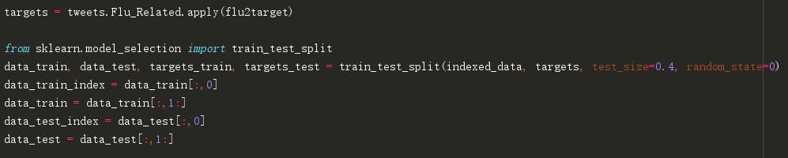
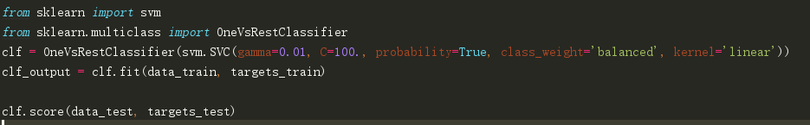
Method
Linear SVM classifier
denotes +1
denotes -1

Slide 61
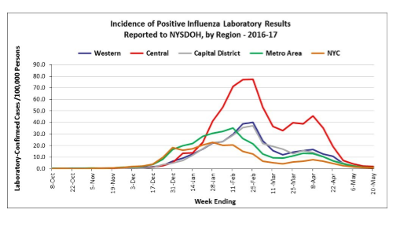
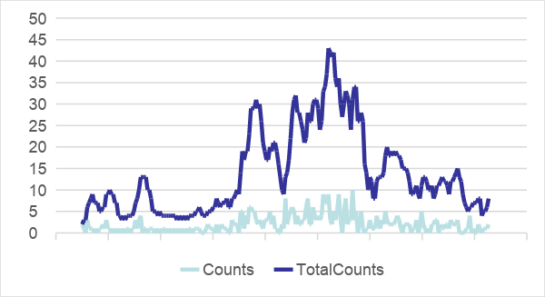
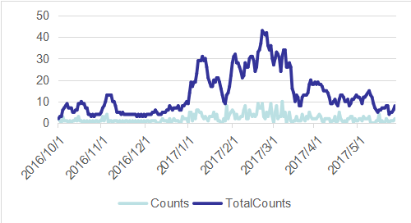
Result
generated by SVM
CDC report
http://www.acsu.buffalo.edu/~twen2/timeslider/

Slide 62
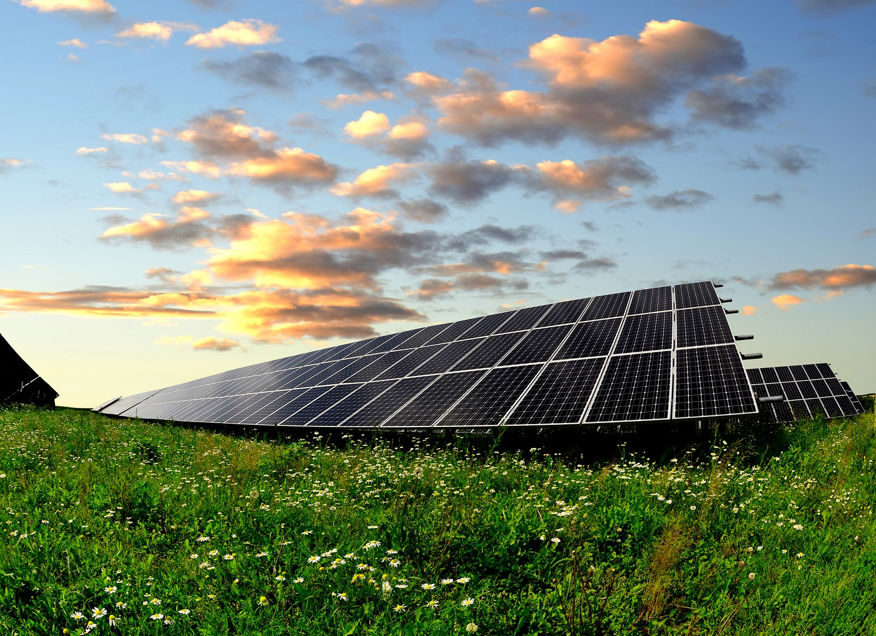
Solar Panel Suitability in Buffalo, NY
Tiffany Green
GEO 479

Slide 63
Objective
Find ideal area for solar panel placement in Buffalo
If possible, find placement near: -Lower income areas -Already degraded lands

Slide 64
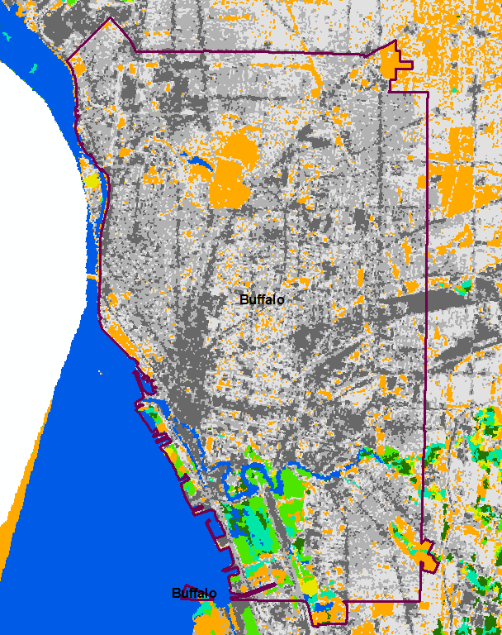
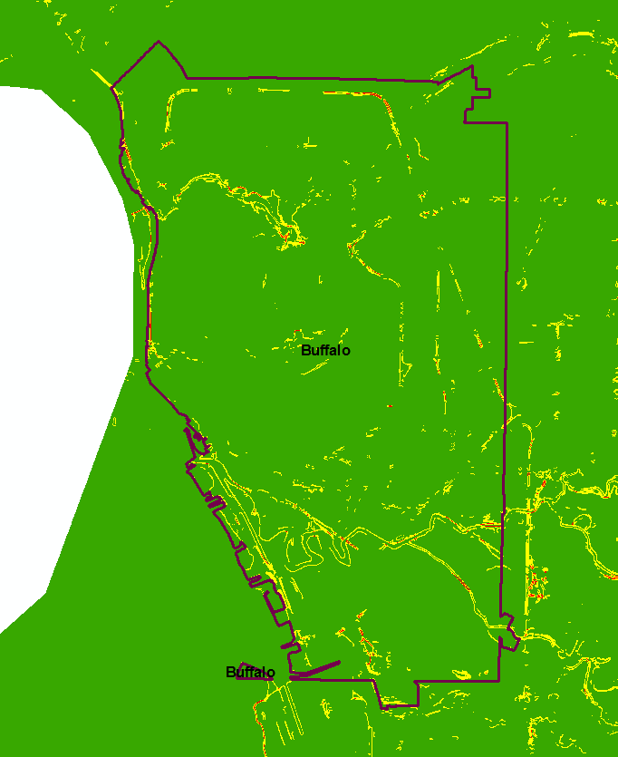
Layers
-USGS NED - DEM for slope and hillshade analysis
-NLCD - LULC
-TIGER - Census
-EPA - Potential Hazardous Sites/Watch Sites
-Electrical grid locations
Notes:
Slope less than 3% Hillshade shows sunlight, 225 for azimuth (SW), and 47 for optimal average fall/spring altitude for Buffalo NY
Lower income areas will have greatest benefit from solar panels

Slide 65
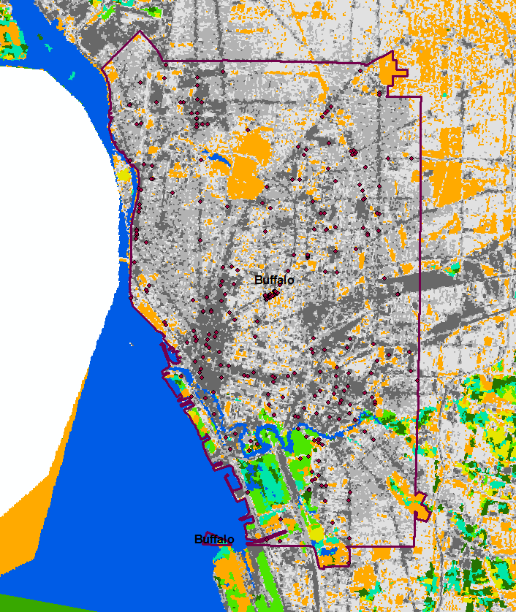
Method
- Suitability Analysis with: -less than 3% elevation change per area -proper amount of sunlight -open space -location to electrical grids
-Income: One standard deviation below mean for low income, overlaid
on suitability analysis
-Brownfields overlaid to see any correlation for best benefit
-Buffers around electrical grids, for ease of hookup
Notes:
Weighting: Elevation: 2/8 Sunlight: 2/8
Open space: 3/8
Grids: ⅛

Slide 66
Results
Notes:
Minimum radiation threshold Impact Analysis statement Ground truth data with base satellite layer to verify what I’m looking at is actually an ideal location

Slide 67
Analysis of social areas in Buffalo-Niagara Falls Metropolitan Area
GEO 559
YiChun Lu

Slide 68
Objectives
Identify and locate the social areas in Buffalo-Niagara Falls Metropolitan Area
Find out the factors that contribute to the formation of social areas

Slide 69
Study area
Data source
1. 2017 “TIGER/Line Shapefiles:
Census tracts shapefiles
All roads features shapefiles
2. 2016 American Community Service (ACS) 5-year (.csv table):
Attributes include total population, sex ratio, age dependency ratio, median age, employment ratio, minority rate, median family income, median property value, and education attainment degree
3. Open data NY (.csv table):
Location of industrial area and food retail shops
289 census tracts in Buffalo-Niagara Falls Metropolitan Area

Slide 70
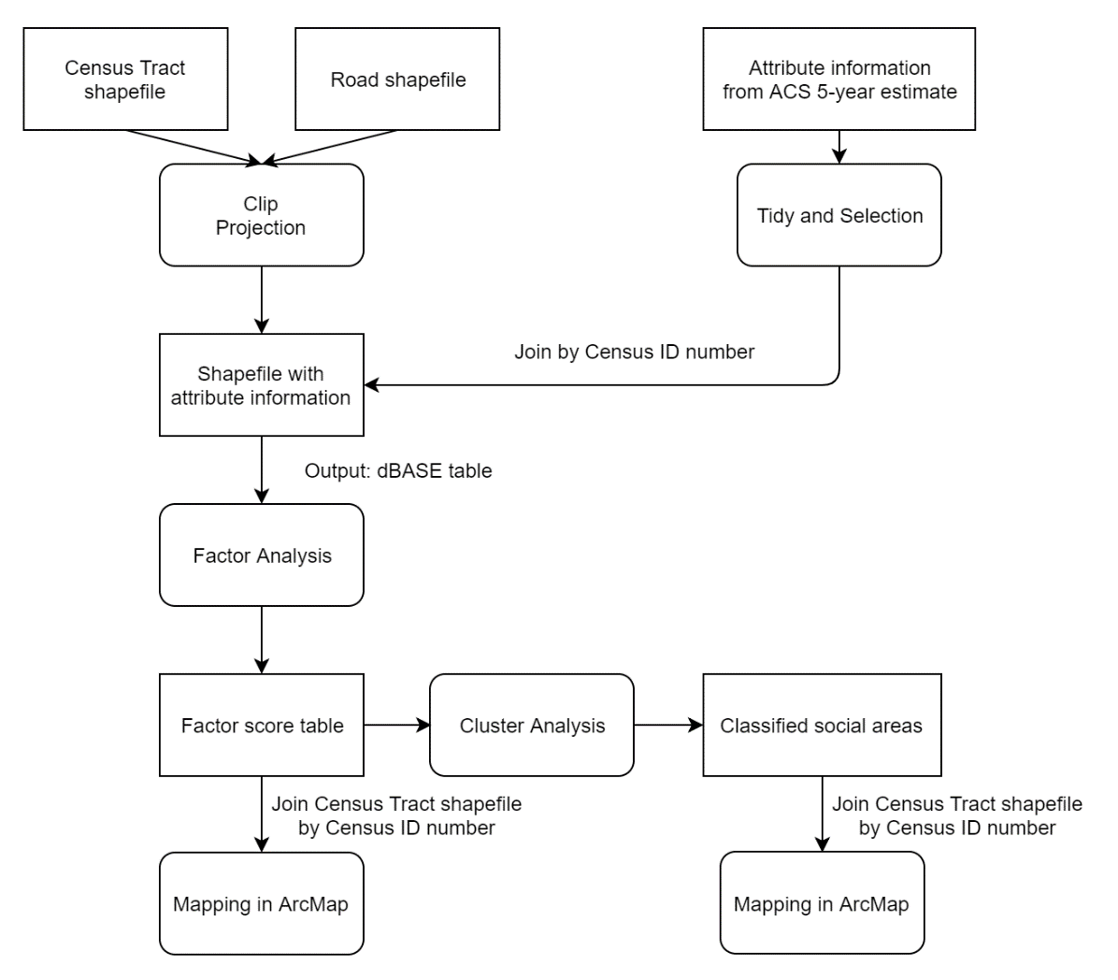
Methodology
ArcMap
Excel
SPSS

Slide 71
Result
Factor scores maps

Slide 72
Result
Social area map

Slide 73
Modeling vegetation Phenology in the Yellowstone National Park
Yuhao Xie
GEO559

Slide 74
Objective:
Build a model between the vegetation phenology time and climate factors and geographic factors.
Use the model to predict the future change of the vegetation phenology.

Slide 75
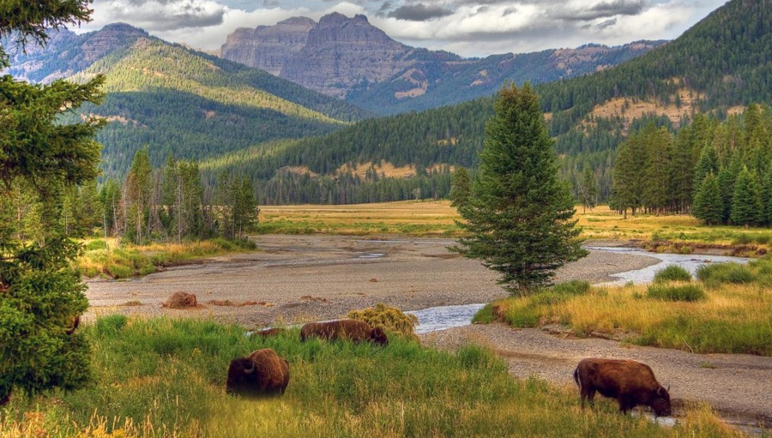
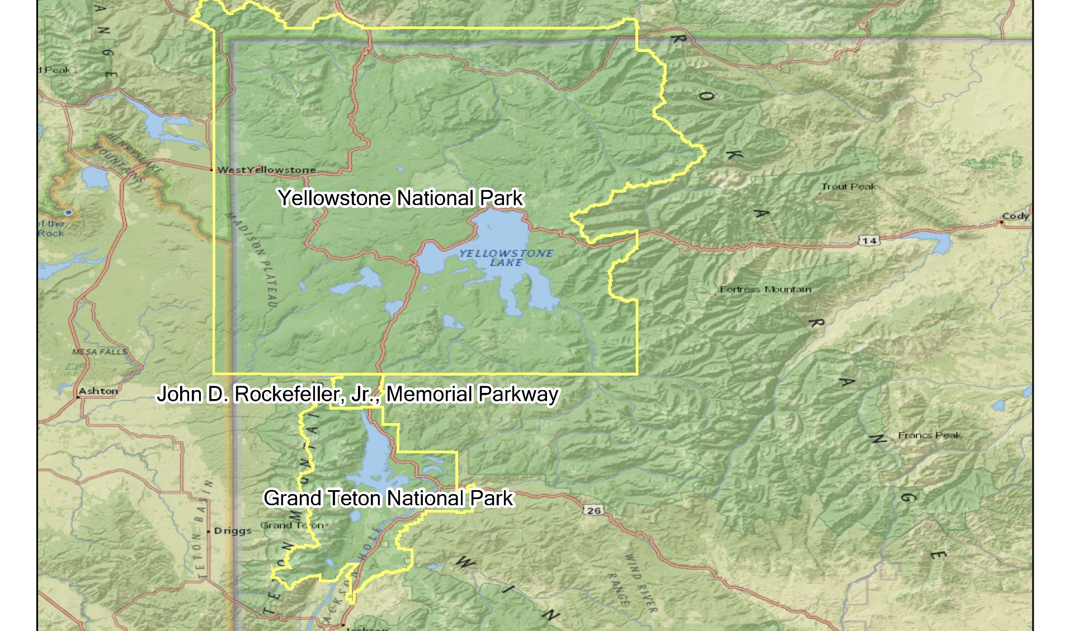
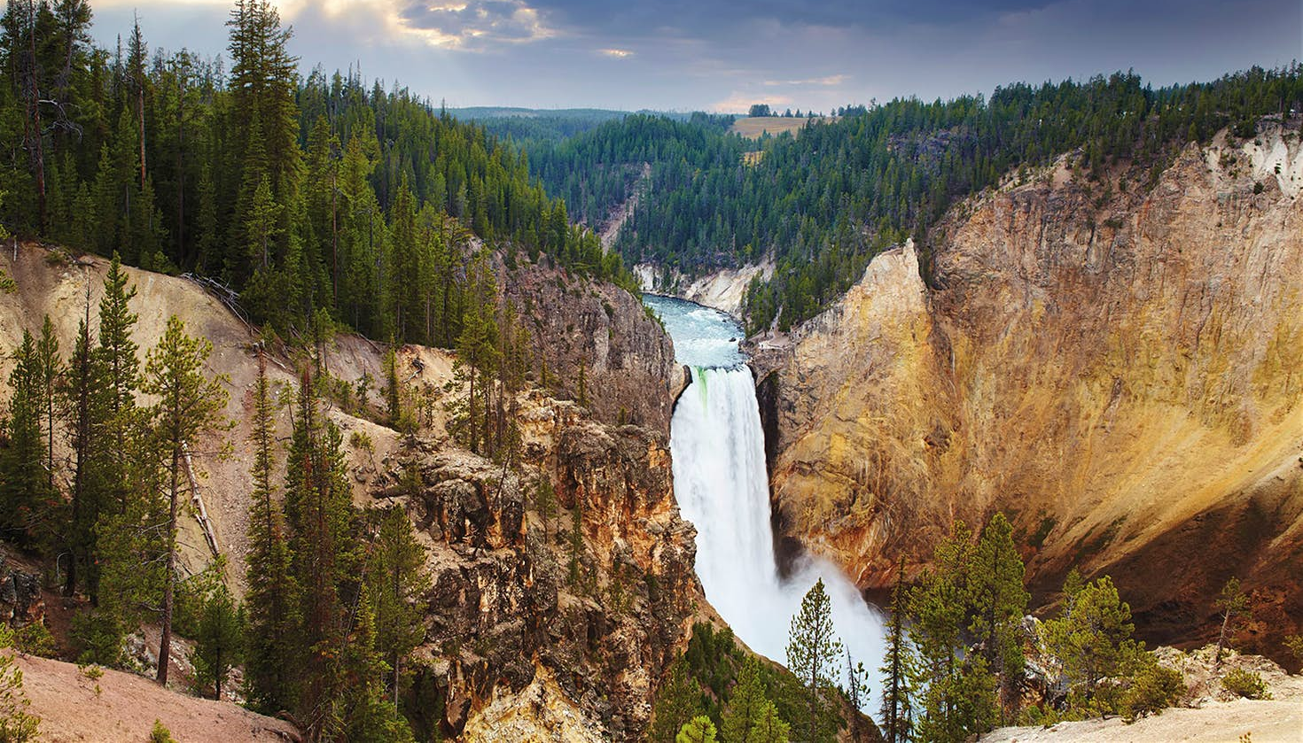
Study Area & Data
Study Area: Yellowstone National Park
Data:
1 arc-second DEM convers the study area.
Source: 3D Elevation Program, USGS
Land cover type of the study area.
Source: National Land Cover Database 2011 (NLCD 2011), USGS&DOI
Monthly average temperature and precipitation in 2016.
Source: Climate Data Online Service, NOAA
Length of growing time of vegetations in the study area.(2016)
Source: eMODIS Remote Sensing Phenology collection, USGS&NASA

Slide 76
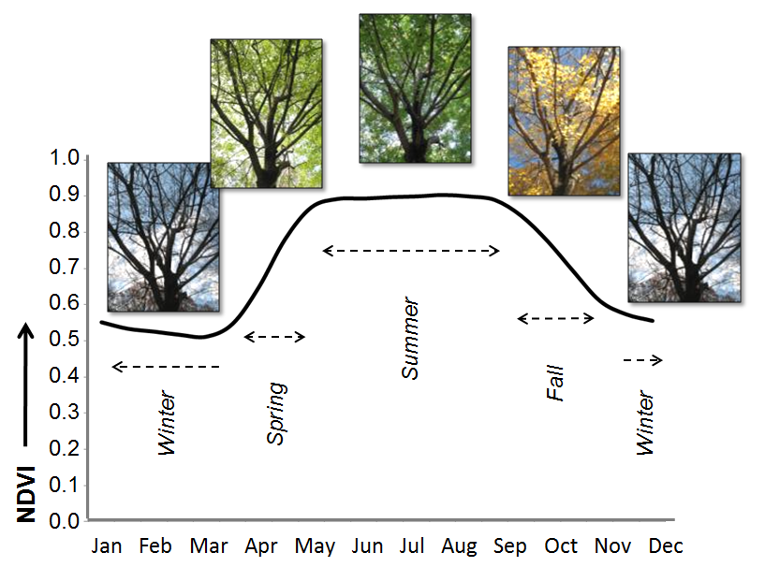
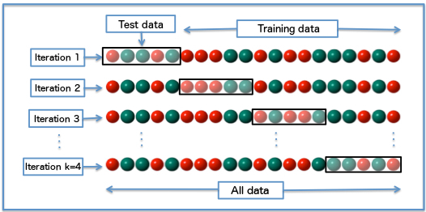
Use Normalized Difference Vegetation Index(NDVI) as indicator of phenology.
Reclassify the landcover data.
Use multiple regression to build model.
DUR = b₁*Tavg_03 + b₂*Tavg_11 + b₃*Prcp_03 + b₄*Prcp_11 + b₅*ELE + b₆*VT+ a
Tavg_03 – Average temperature in March
Tavg_11 – Average temperature in November
Prcp_03 – Average precipitation in March
Prcp_11 – Average precipitation in November
ELE – Elevation of the stations
VT – Vegetation type (Dummy Variables)
Use stepwise regression to improve the model.
Accuracy assessment: K-fold cross validation.

Slide 77
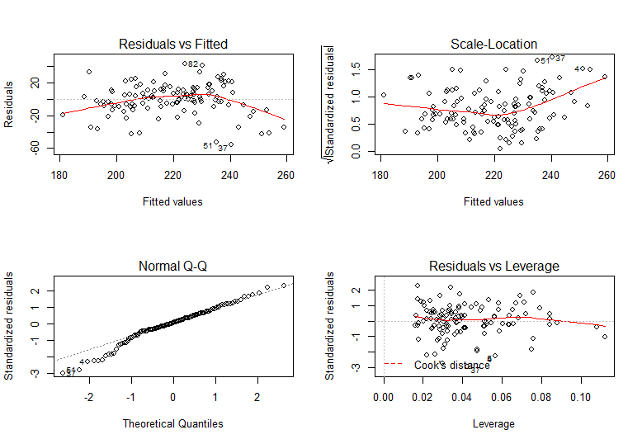
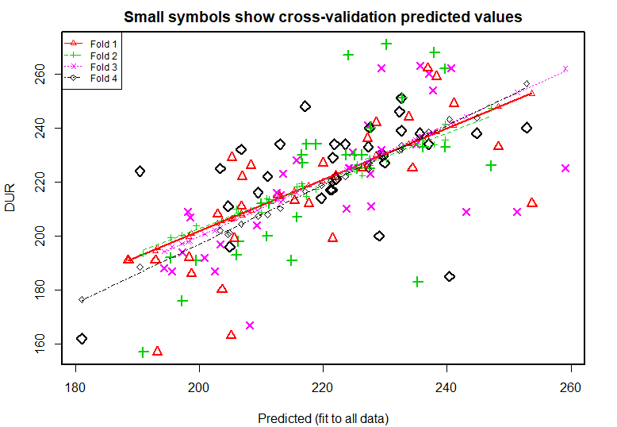
Result
Duration ~ {Temperature in Mar.; Precipitation in Nov.; Elevation; Vegetation Type}
DUR = - 2.04*TAVG_03 – 0.396*PRCP_11 – 0.036*Elevation – 2.89*Type + 324.04
R-square: 0.425

Slide 78
Optimization of UB shuttle route
Zeping He
GEO 479 Final Project

Slide 79
Objective
Optimizing UB north campus shuttle route to cover nearby off-campus apartments

Slide 80


Data Preparation
1: Get road names in the N min drive zone from UB North
2: Use Rental website’s API (Application Programming Interface) to Get the Apartments’ address
3: Geo-Coding the location information

Slide 81
Optimization Criteria
Minimize Number of routes.
Minimize students total travel time to school
Minimize the total bus route length.
Minimize the total walking distance between a bus stop and nearby apartments
Maximize the coverage area of routes

Slide 82

Result
SAME Length (0.9%)
Cover 16 More Off-Campus Apartments

