Slide 1
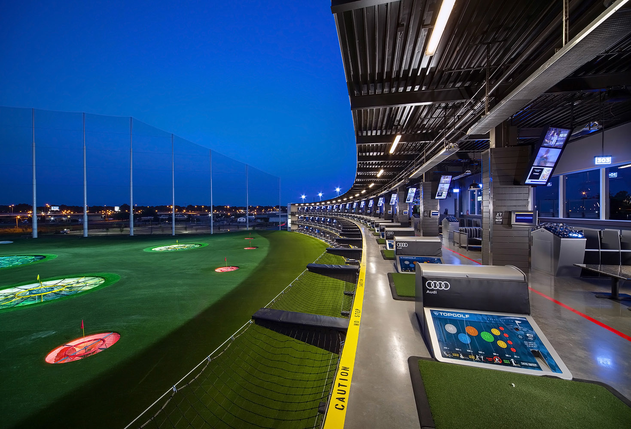
Site Selection: TopGolf Buffalo
By: Cleo Austein
GEO 479

Slide 2
Objectives
TopGolf features fun and competitive golf games for all ages, bowling lanes, food and drink menu, private spaces, and TVs to watch the big game
The average size is 65,000 square feet
The average TopGolf costs $18 million to build
Find a new location in the City of Buffalo by conducting a Site Selection

Slide 3
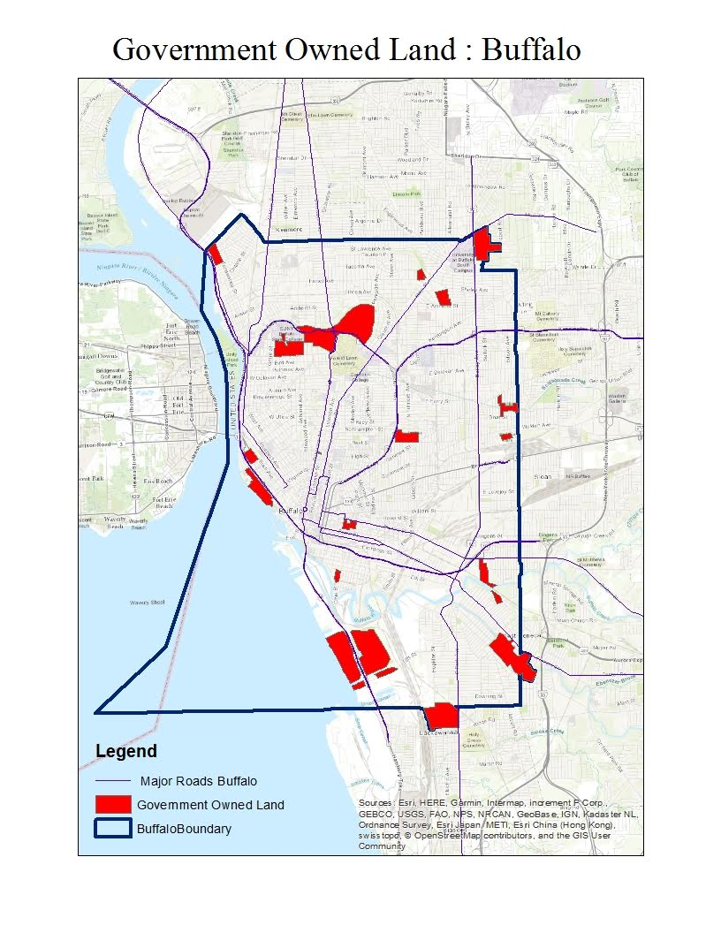
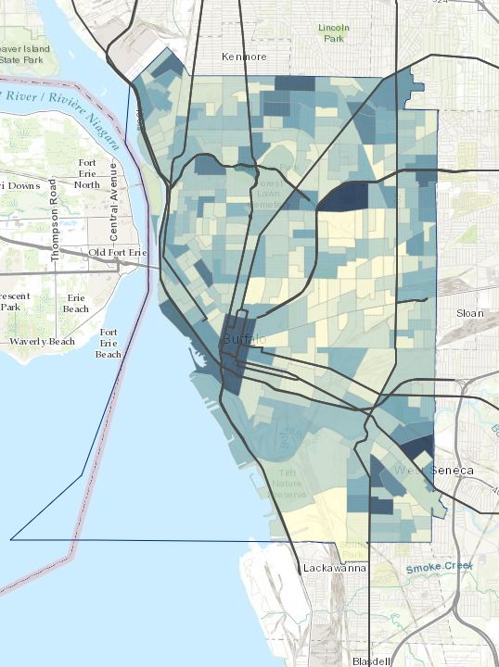
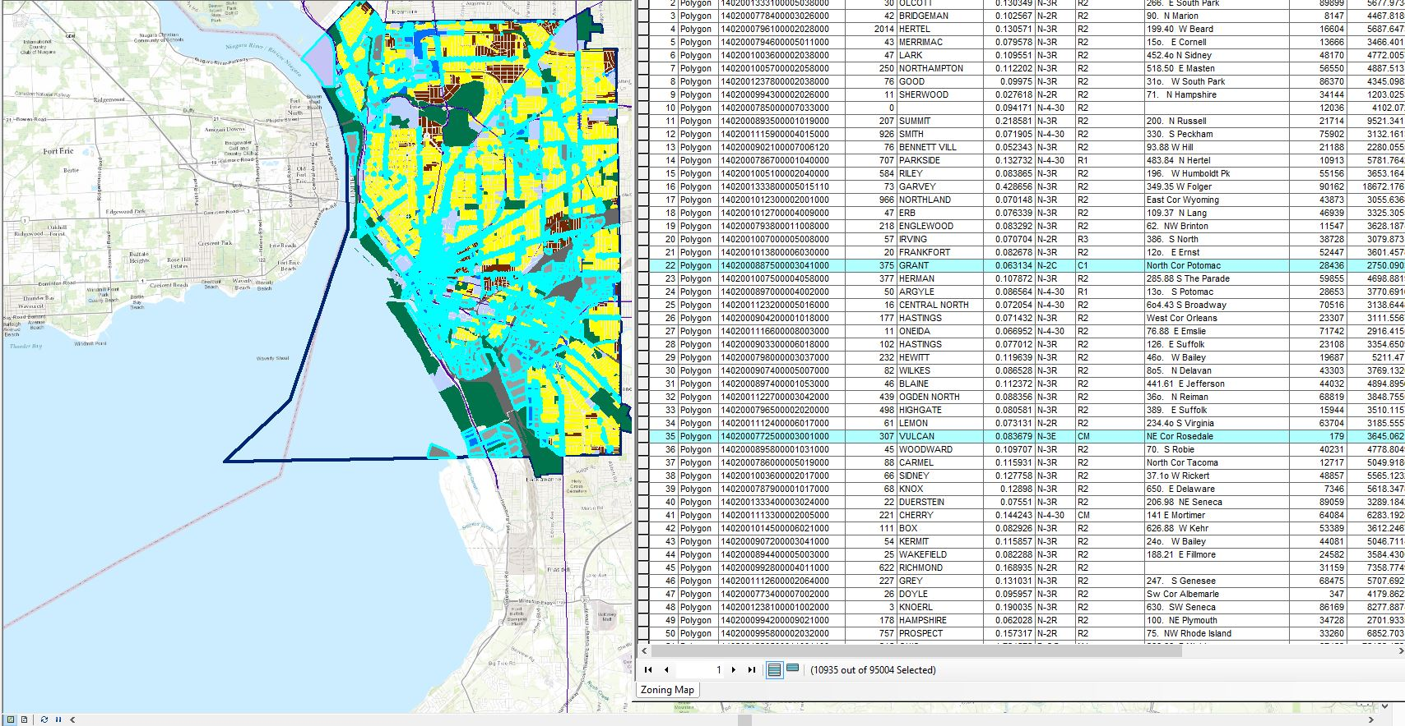
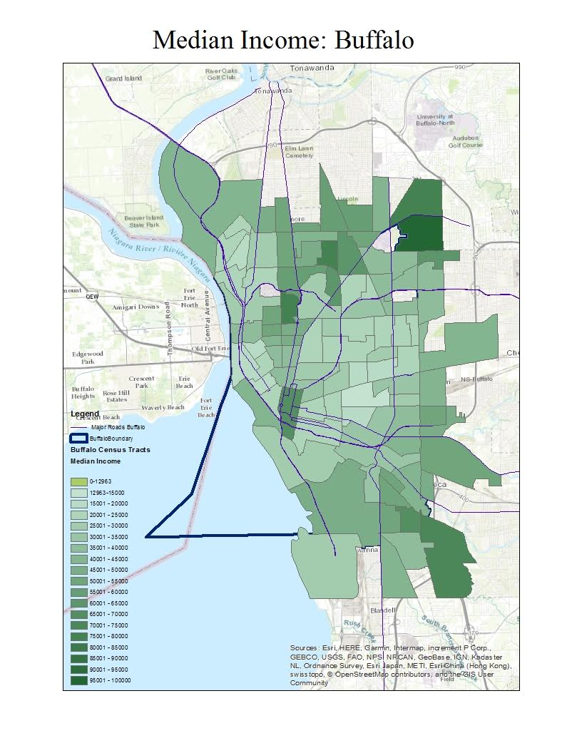
Methods:
Join Census Tracts Data with Median Income Data
Buffer around the Major Roads in Buffalo
Reclassify Landuse.tiff, Euclidean Distance of the Major Roads and Median Household Income Census Data
Focus on High Population Areas & Median Income
Perform a Weighted Overlay
Population

Slide 4
Processing
Weight each layer according to its importance
Suitability Rank = W1 * Landuse + W2 * Roads + W3 * Median Income
In this Weighted Overlay, Land Use has a 45 percent influence, Distance to Major Roads a 35 percent influence, and Median Household Income a 20 percent influence.
Avoid Government owned Land & existing Recreation Spots

Slide 5
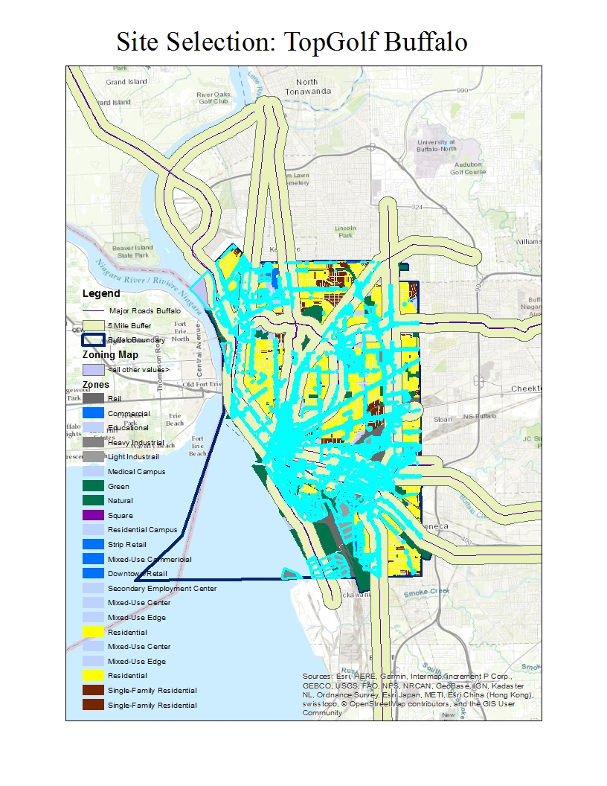
Results
The Weighted Overlay matches the preliminary results,South Buffalo would be a great spot. However there are some limitations to this study. The average TopGolf is built on 65,000 square feet, even though the Land Use was heavily considered, the size of the land was not. A next step in this project would be to examine each suitable location and calculate the size of the land.

Slide 6
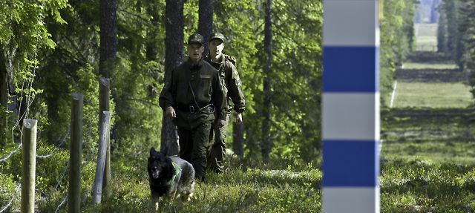
The Border Less Traveled: Archaeological Survey of Finno-Russo Border Frontier Nathan Dubinin GEO 559

Slide 7
Objectives
Create a series of maps visualizing slope, aspect, elevation, and distance to rivers.
Create a simple model for site prospection using a logistic regression model. Dependent variable is site located on the River Transect, and the independent variables are slope, aspect, elevation and distance to rivers.
Visually display the results of the model using its weights in raster calculator, creating a final map showing potential high probability area of sites.

Slide 8
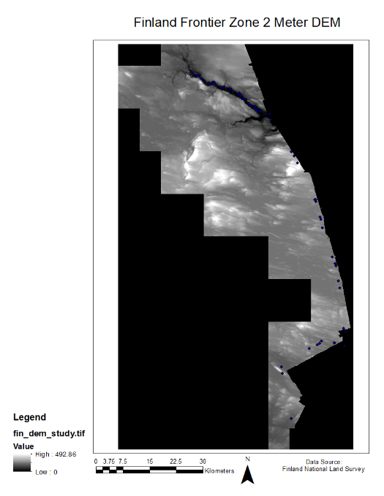
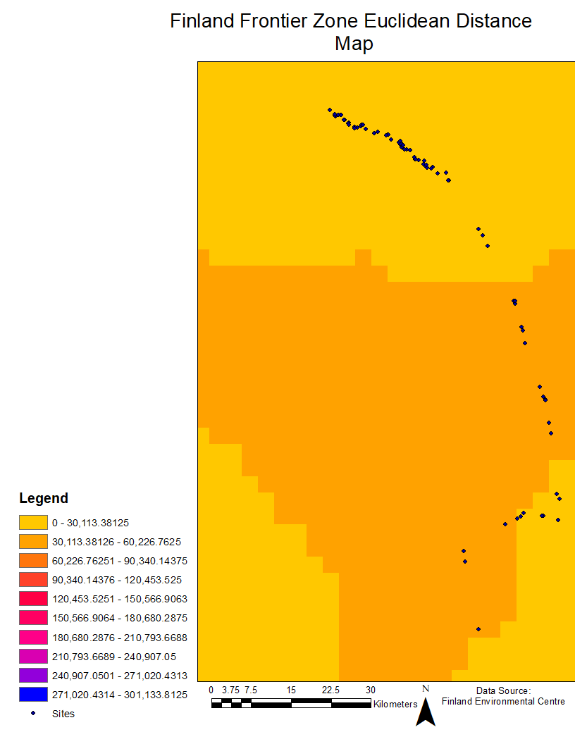
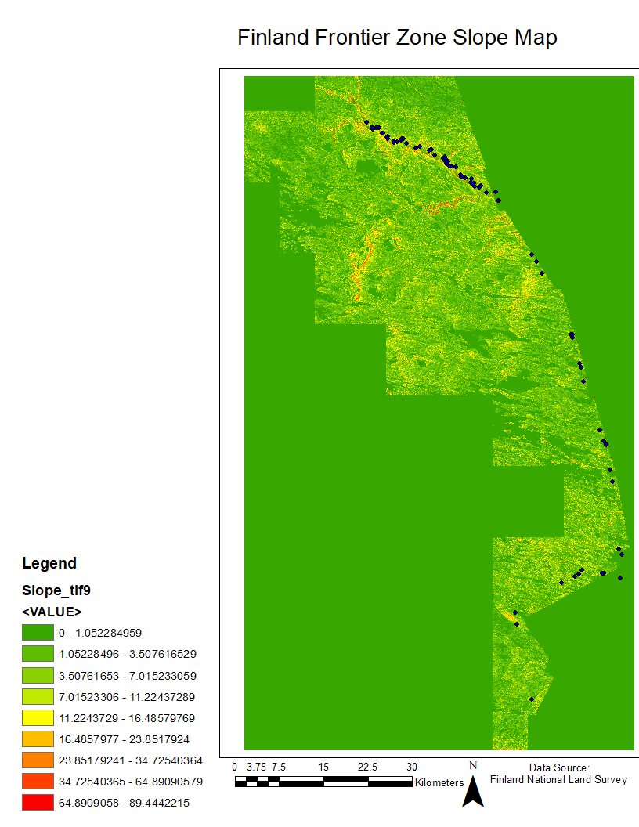
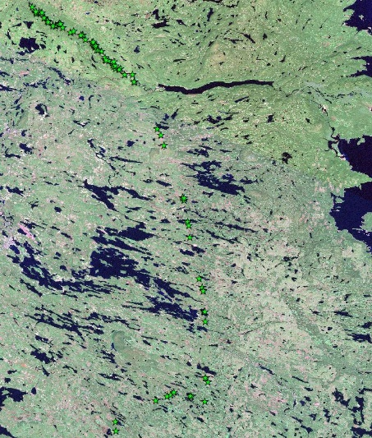
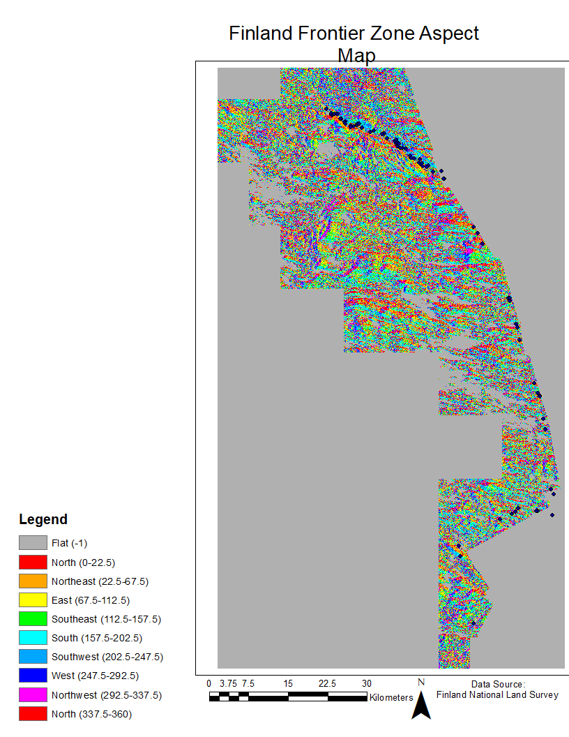
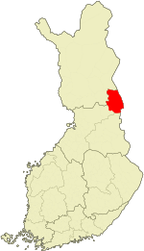
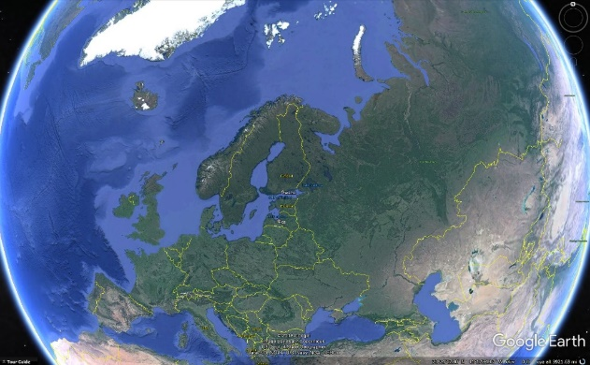
Study Area & Data Layers
Kuusamo Region in Finland. Located roughly 100km south Arctic Circle
Data Layers:
2 m DEM (raster, elevation layer)
Site Data of Kuusamo Region (93 total points)
Major Rivers of Finland (vector, after rasterizing, distance to river layer)
Slope (Calculated from DEM)
Aspect (Calculated from DEM)

Slide 9
Method Design
I will use 71 sites out of the total 93 to compute a logistic regression using SPSS. The dependent variable is site presence on the River Transect as True, whereas all other sites are identified as false. The independent variables are: slope, elevation, distance to major river, and aspect.
22 sites will be randomly chosen to compute a second logistic regression using SPSS. Same parameters will be used as outlined above. This is for validation of the logistic regression model.
Weights may be determined using “B” in “Variables in the Equation” in the Model Summary. Those weights may be used as variables in a series of equations in Raster Calculaator that aided in my final output. The following were used: (3.697) + ( - 0.021) * "Slope_tif9" + (0.013) * "fin_dem_study.tif" + (0.008) * "Aspect_tif1." I then calculated the exponential of the first output. The probability of sites given the weights was found by using the following formula: “ Second Output” / “ Second Output” + 1

Slide 10
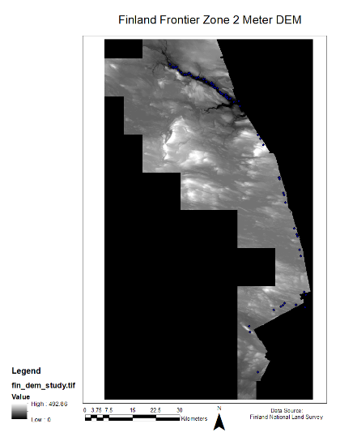

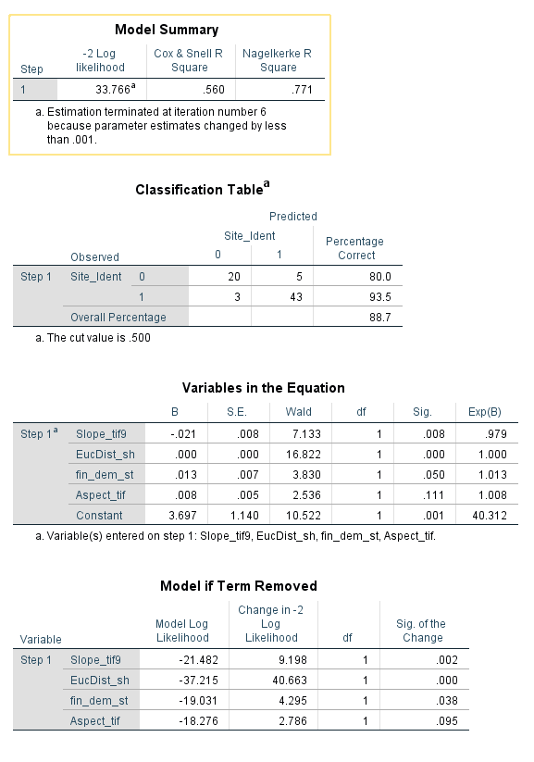
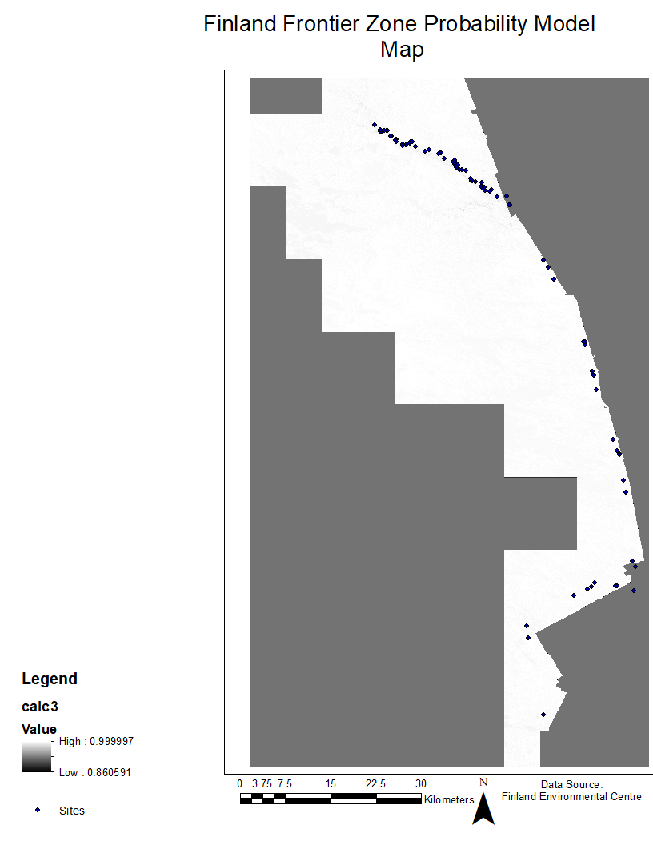
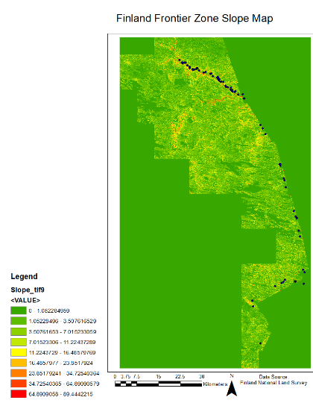
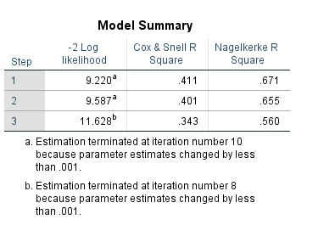
Results
Data Visualization: DEM, Aspect, Slope, Distance to River
Logistic regression results: Initial Sample (Top)
Validation Sample (Bottom)
Site prospection probability visualization

Slide 11
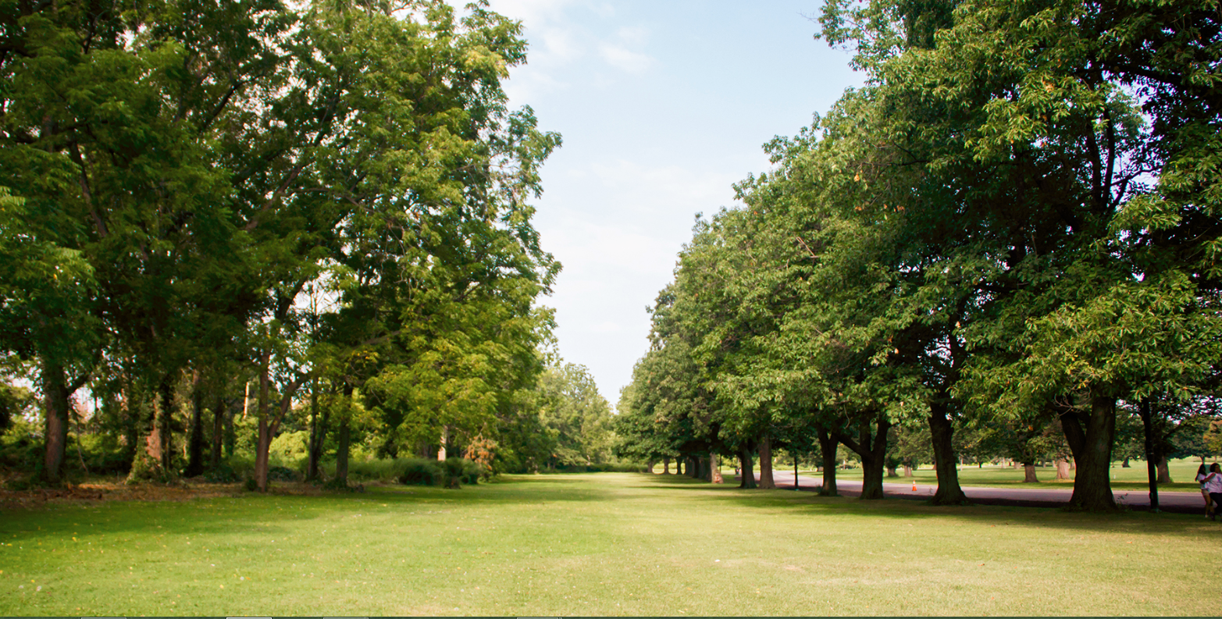
New Park Location Suitability in Buffalo, NY
Amelia Lesniak
GEO 559

Slide 12

Objective: find a suitable location for a potential new park in the city of Buffalo
Tasks:
Generate presence and absence data for park locations
Run logistic binary regression utilizing dependent and independent variables
Producing a final park location suitability map to display areas of high and low suitability

Slide 13

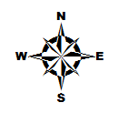
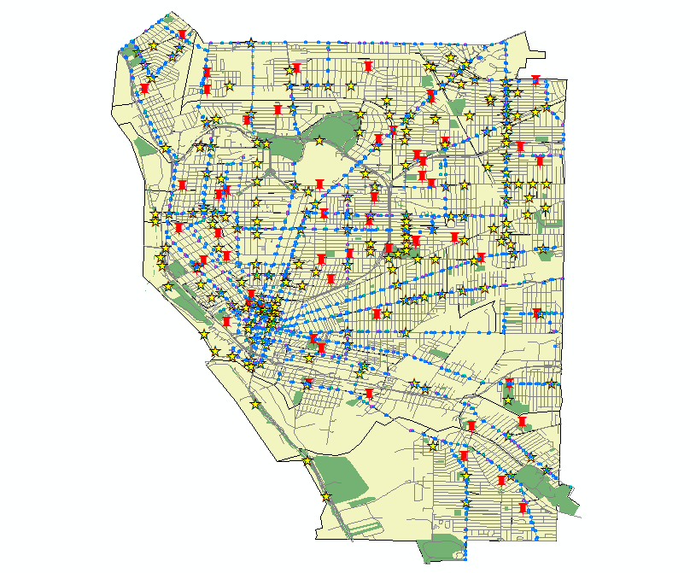
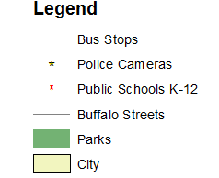


Study Area:
City of Buffalo, NY located in Erie County
City population: appx. 256,000, MS population: appx. 1,135,000
City size: 52.5 sq miles
59 total public schools K-12
Buffalo Police Department cameras located throughout the city
NFTA public transportation bus stops throughout the city
Typically experiences extreme weather seasonally, making for short spring and fall seasons
Very hot summers, freezing winters = short bouts of enjoyable outdoor recreation time

Slide 14
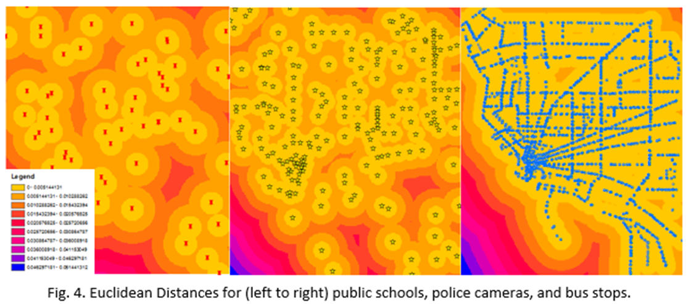
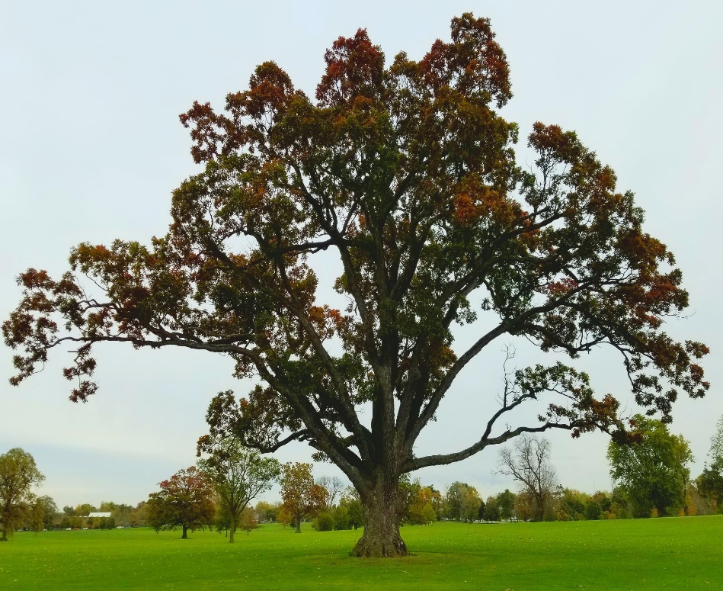
Method
Use of logistic regression to determine suitability
Statistical method to utilize independent variables to determine an outcome measured with a dichotomous variable
Dependent variable: Presence/absence of a park
Independent variables: Euclidean distances of schools, police cameras, and bus stops
Y = a + b1 * [ind. var.] + b2 * [ind. var.] + b3 * [ind. var.] then P(Y) = (e^Y)/(1+e^Y)

Slide 15
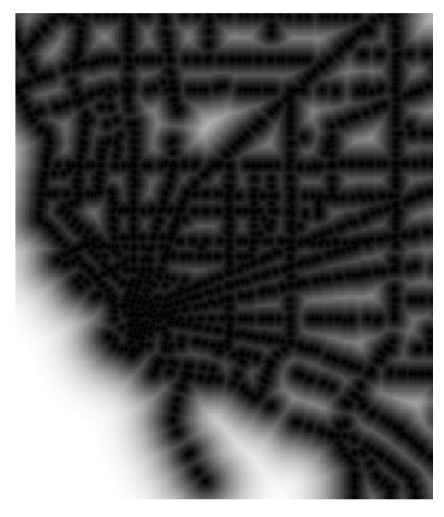

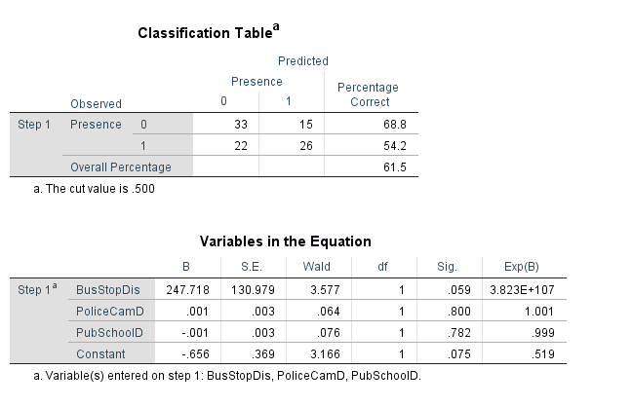
Results
Highest suitability value in South Buffalo and just below Delaware Park
Least suitability in central downtown and up towards the Elmwood Village area
Makes sense logically due to distribution of schools, BPD cameras, and bus stops in Buffalo

Slide 16
Day Zero: Finding A Desalination Plant Site for Cape Town
Jessica Bowers
GEO479
5/10/2018

Slide 17
Objective
Locate an area in Cape Town that would serve best for one of the temporary desalination plants in terms of money and efficiency
Factors
Coastline that is available for public space
Property size (~150,000 sq ft)
Impact on Wildlife
Employment rates
Proximity to Municipalities

Slide 18
Methods
Overlay
To show land use/size
Not in the way of wildlife
Network Analysis
Find the cheapest routes
Help the most municipalities

Slide 19
Resulting Lands and Work to Do
1)South of Khayelitsha
2)Rietvlei
3) Gordons Bay
Compare coastal wildlife with opendata sources first
-Network analysis/least cost route

Slide 20
Environmental Justice, Brooklyn New York
Study on inequitable distribution of environmental burden
Garrett Augustyn

Slide 21
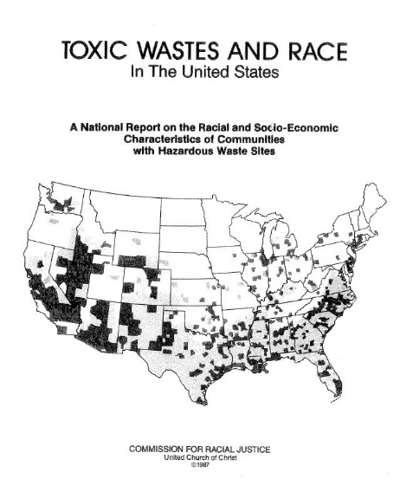
Objectives
Determine presence of Environmental Justice Issue in Brooklyn, New York
Determine which Socioeconomic strata is impacted most by polluted land use
Determine if there is racial disparity in the distribution of polluted lands

Slide 22
Data and Methods
Census Tract
Remediation Sites from NYS Clearinghouse
ACS Data on Race and Income
Various Shapefiles from TIGER LINE
Unit Hazard Coincidence
Logistic Regression
Methods

Slide 23
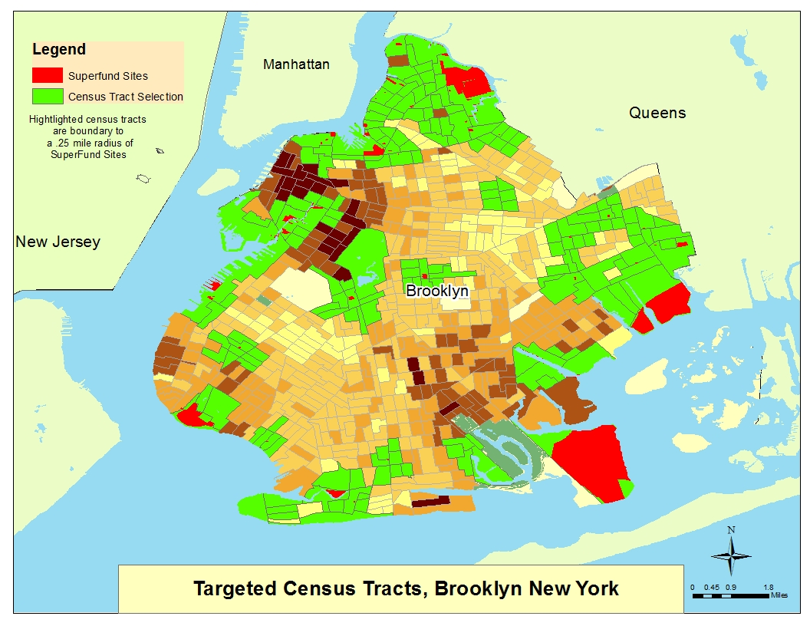
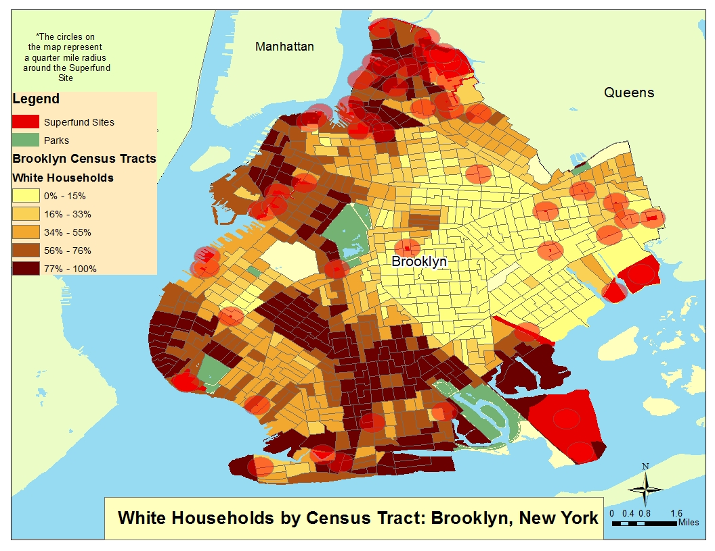
Unit Hazard Coincidence in Brooklyn, New York

Slide 24
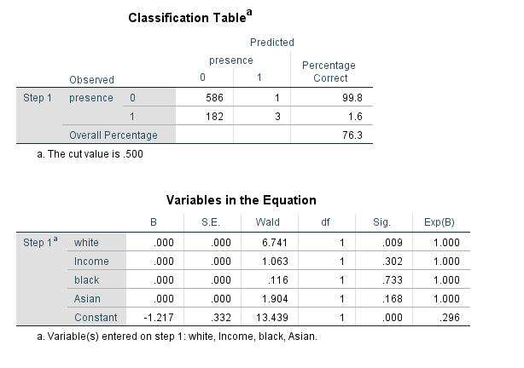
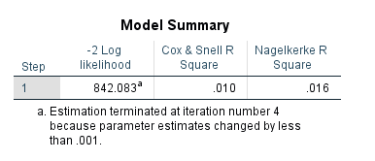
Results
Logistic Regression to determine racial and economic make up of influenced area
Lack of statical significance
Further study and data acquisition required for significant results

Slide 25
Application of GIS Mapping Software for Placement of Wastewater Treatment Facilities
Warren Bautista
GEO 479

Slide 26
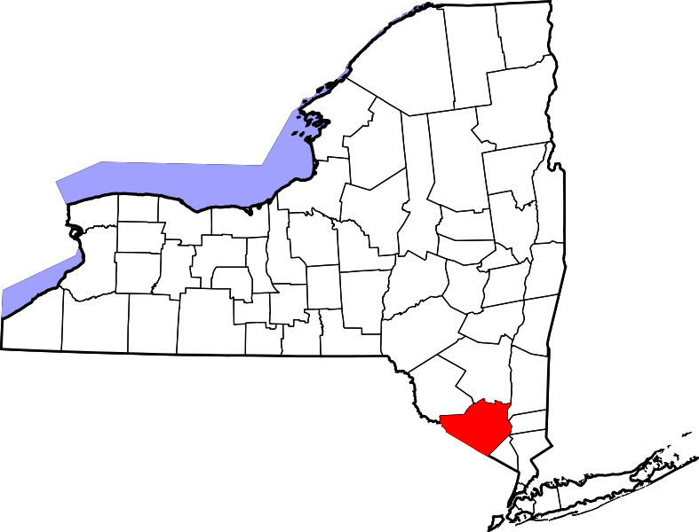
Objective
Create a suitability map for wastewater facility placement in Orange County, New York.

Slide 27
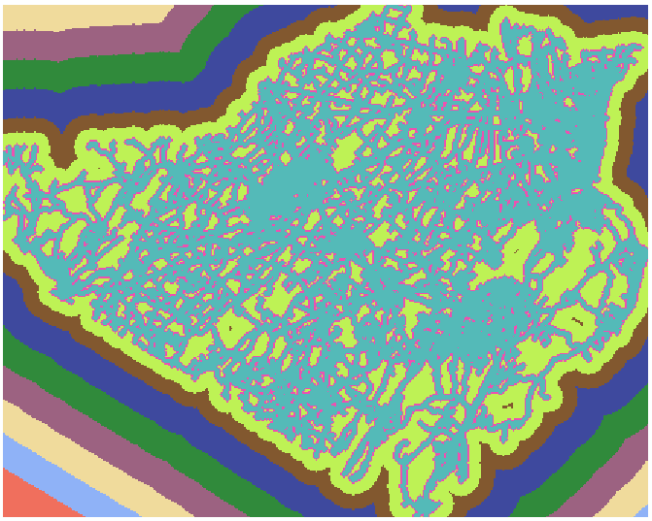
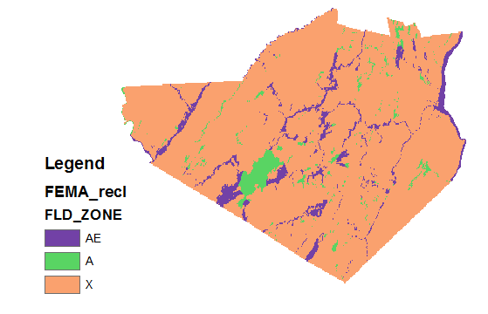
Considerations
Isolation from existing buildings
Distance to roads
Distance to streams/rivers
FEMA Floodzone locations
Prevailing wind patterns

Slide 28
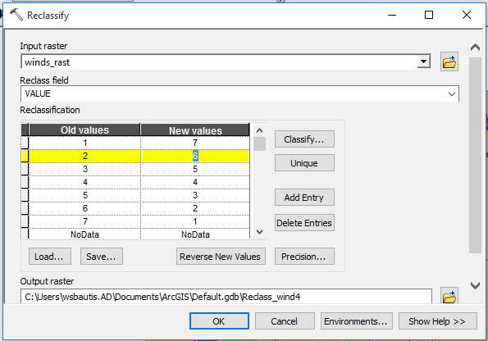
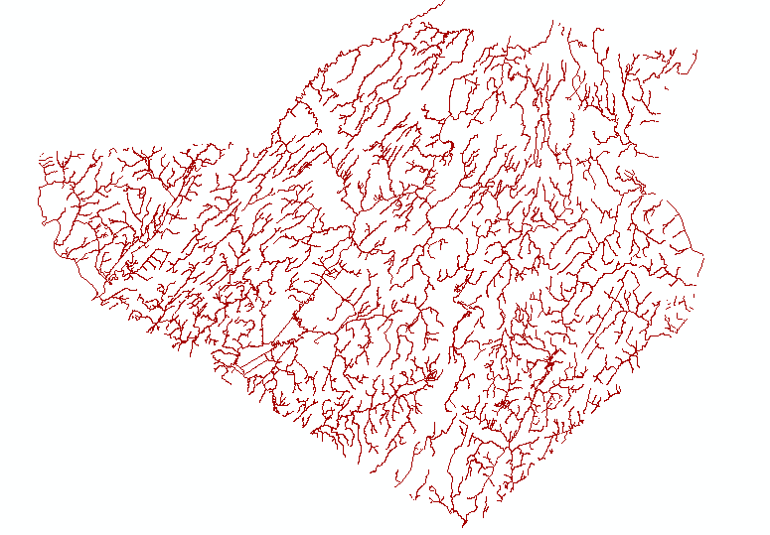
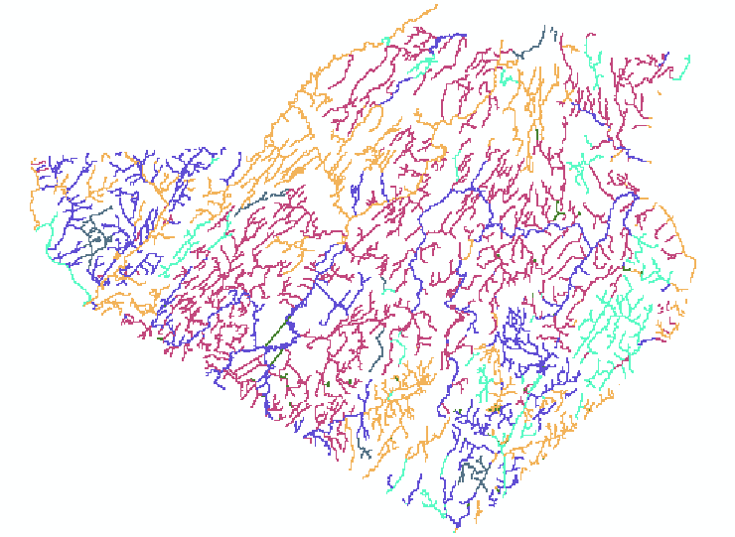
Methodology
Convert shapefiles to raster for use in spatial analysis
Use Euclidean Distance to rank proximity to roads, streams, and buildings
Close proximity for roads and streams, far proximity for existing buildings
Rank floodzones and windspeed by class
Rank all layers against each other accordingly

Slide 29
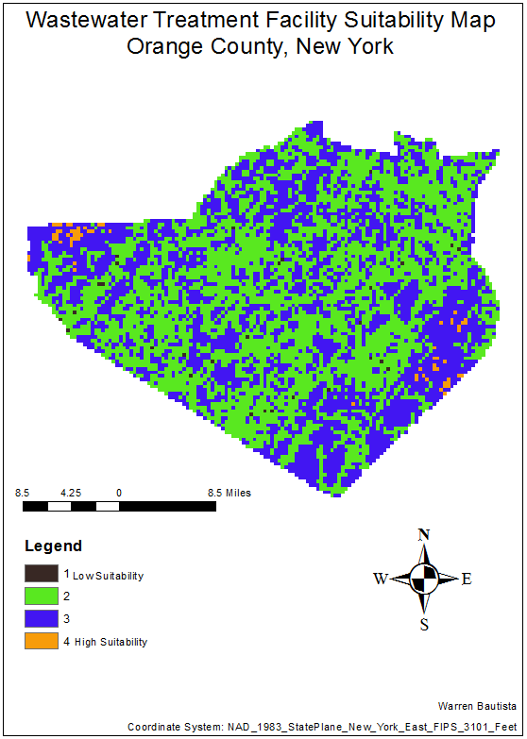
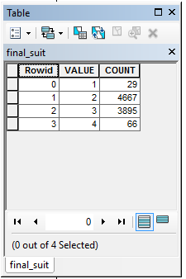

Slide 30
Finding Suitable Land in Buffalo, NY for a Tropical Biodome
Kodiak Allan
GEO 479

Slide 31
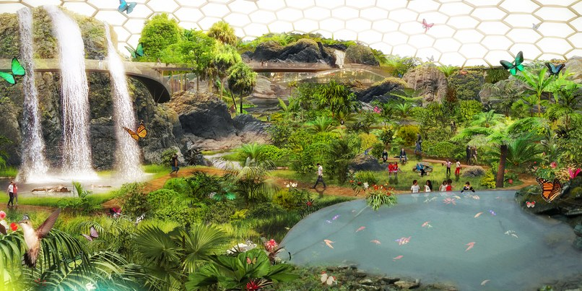
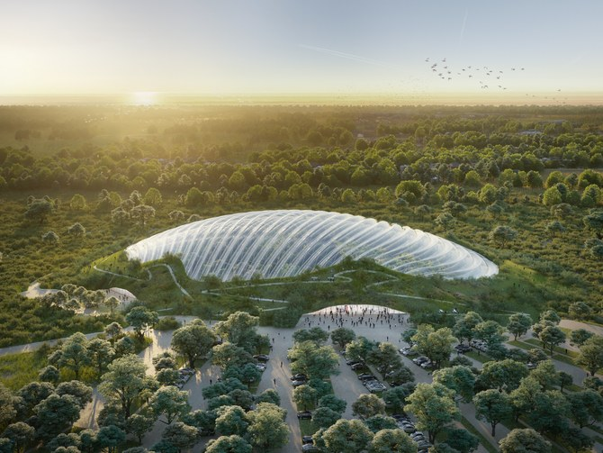
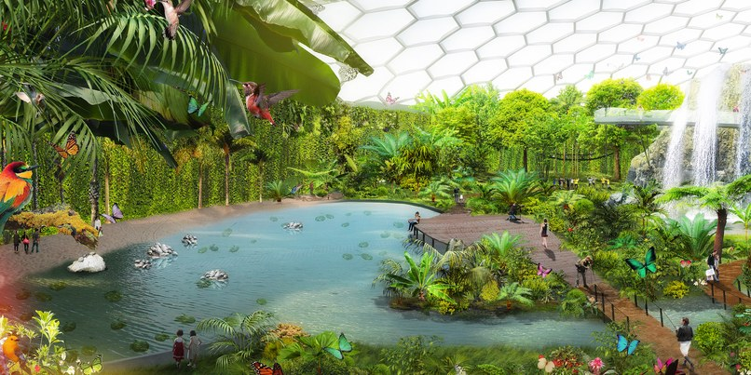
Objective
Find suitable land for a biodome
- A dome-shaped artificial structure enclosing one or more self-contained ecosystems or living environments.

Slide 32
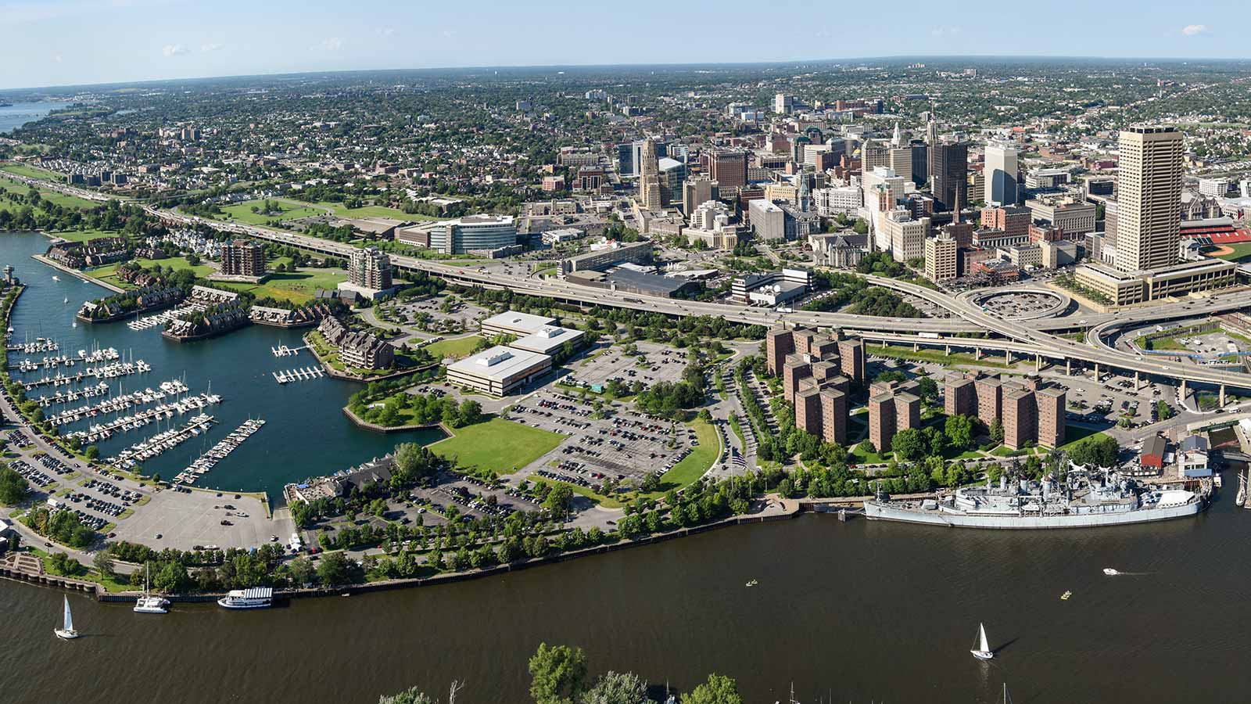
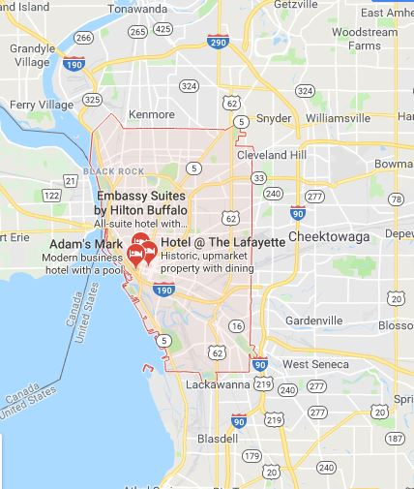
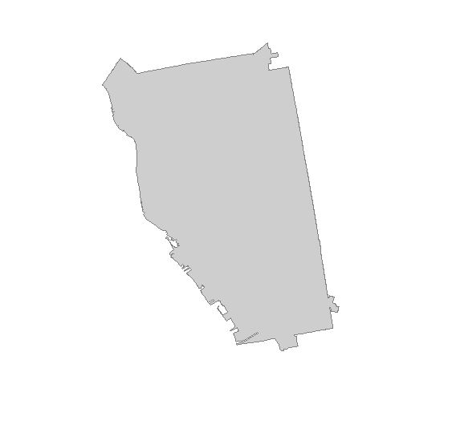
Study Area
Buffalo, New York

Slide 33
Data Layers/Methods
- LULC - finding suitable land (open, not forest or agriculture) National Land Cover Database
- Euclidian Distance - How accessible is the location, walking and driving
- Cloud Cover – mean annual cloud cover, earthenv.org

Slide 34
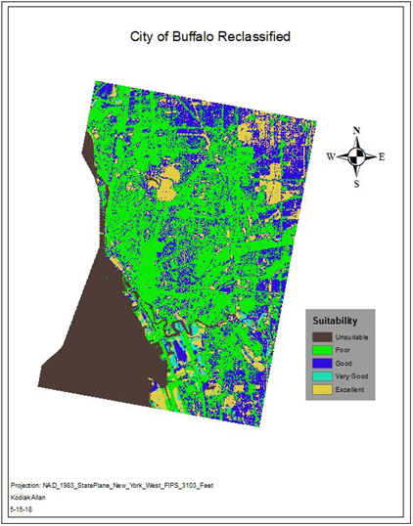
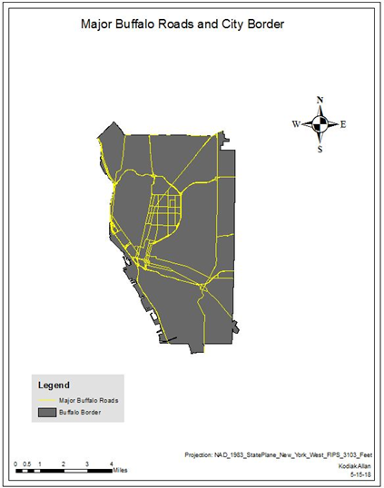
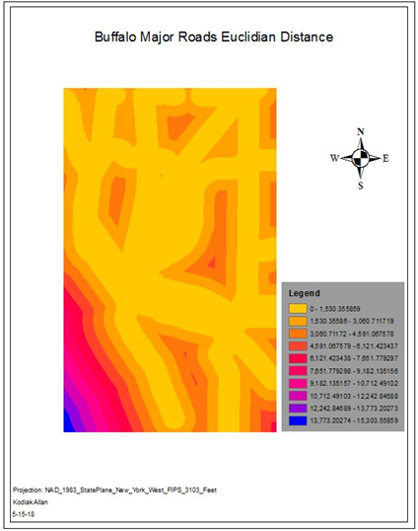
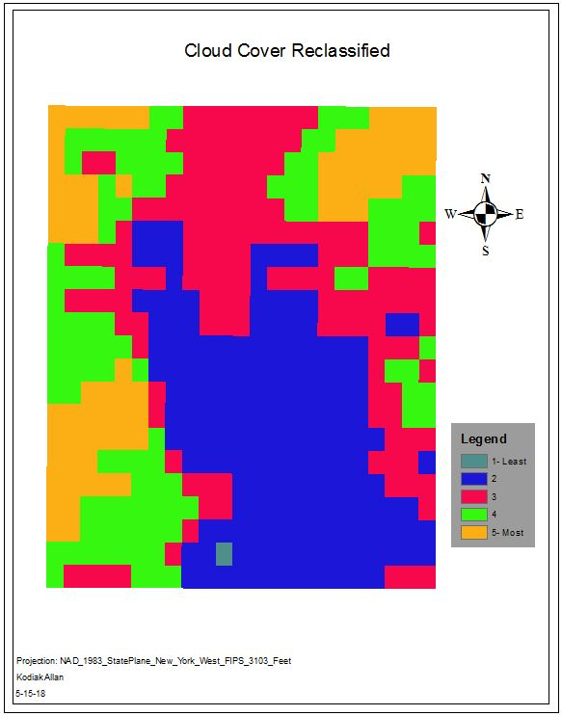

Slide 35

Result

Slide 36


SuitabilityAnalysis: Potential Park Sites in Washington, D.C
By Abdullahi Mohamed
GEO 479

Slide 37

OBJECTIVE
Washington D.C is the nation’s capital and one of the best planned and designed cities of the United States, as the city already hosts a fair amount of public parks, and one of the best in the nation such as the National Mall, I believe the nation’s capital should also set a precedent on building more upon the green infrastructure across major cities in the United States, and having more parks in Washington D.C
My objective in this report is focusing on developing a potential park site in Washington D.C by conducting a suitability analysis with GIS tools to find sites that best fit the criteria that I set to have the highest potential for a new park site in city.

Slide 38
Study area/data
I conducted my study specifically in the city of Washington DC .
The data I used for the factors were from Washington’s D.C official municipal website http://opendata.dc.gov from there I picked out the data I needed for my project. The data I used included Address Points (residential areas), Bike Trail shapefile, Major Roads shapefile, and National Parks shapefile.
Range of Suitability Values
1 = lowest suitability
2 = very low suitability
3 = low suitability
4 = moderately low suitability
5 = moderate suitability
6 = moderately high suitability
7 = high suitability
8 = very high suitability
9 = highest suitability

Slide 39


Method design
The methods I used to establish a potential park site based on a suitability analysis came down to four main factors that I deemed were the most important to establish a park regardless of socioeconomic status, race or age were: Population Density, Bike Path Distance, Main Road Distance, and Existing Park Distance, and creating a Weighted Overlay , these four factors will serve as the suitability factors in my project to construct my model builder and to find the most favorable areas for a potential park

Slide 40


Final Suitability Map
White areas show lowest Suitability for a potential park sites, and the brown shoes the highest

Slide 41
Predicting the Price of Total Natural Gas Production by Seasonal Temperatures in Supply and Demand Locations
Alex Tan
GEO 559

Slide 42
Objective
Investigate Factors for Analysis (Multiple Regression)
Identify Study Area
Identify the Locations
Validating with a Benchmark

Slide 43






Study Area
Erath, Louisiana | Los Angeles, CA | Chicago, IL | Permian Basin, TX
Pictures Courtesy to Respective Owners of Images Syndicated by Google Images Aggregator

Slide 44
Data
National Weather Service Temperature Data (Aggregated)
TIGER Data
Temporal Range of 1997-2016

Slide 45
Method
Statistic Method:
Contextual Multiple Regression:
Total Production Quantity = ax + (b1 * Respective Location’s Summer Temperature) + (b2 * Respective Location’s Winter Temperature) + (b3 * Respective Location’s Squared Temperature Differences)
Multiple Regression:
Total Production Quantity = ax + (b1 * Los Angeles’ Summer Temperature) + (b2*Los Angeles’ Winter Temperature) + (b3*Los Angeles’ Squared Temperature Differences) + (b4*Chicago’s Summer Temperature) + (b5*Chicago’s Winter Temperature) + (b6*Chicago’s Squared Temperature Differences) + (b7*Midlands’ Summer Temperature) + (b8*Midlands’ Winter Temperature) + (b9*Midlands’ Squared Temperature Differences)

Slide 46


Results
Output using Price
as Dependent Variable:
Output using Total Production Quantity
as Dependent Variable:
R-Squared = 0.598
R-Squared = 0.6023

Slide 47

Potential Locations for a New Homeless Shelter in Buffalo, NY
By Angie Quilla
Geo 479

Slide 48
Goal:
-Find a new location for a potential homeless shelter in the City of Buffalo, NY:
Criterias:
-In an open location
-Lower Income/Area of Poverty
-Near Soup Kitchens and Food Pantries
-In an area that is in need of a shelter

Slide 49
Data Needed:
Data that I need to collect:
-Land Use in Buffalo
-Residential Income of households from Census (or poverty in households)
-Current Locations of Food Pantries and Soup Kitchens
-Current locations of homeless shelters.

Slide 50

Layered Data:
-Current Homeless Shelters in the City of Buffalo
-Soup Kitchens and Food Pantries in the City of Buffalo
-Selected Land use area where the future homeless shelter can be located at.

Slide 51

Results:
Raster the point layers
Euclidean Distance
Factor Ranking
Map Algebra- Raster Calculator: Top Locations for future Homeless Shelter
1-Worst and 6-Best for new homeless shelter

Slide 52
Using ArcGIS to Model the Movement of a Uranium Contamination in Lockport, NY
Anthony Ebron

Slide 53


Background
The Guterl Site is home to an old steel mill, formally known as Simmonds Saw and Steel
Simmonds was under contract by the Atomic energy commission to produce Atomic Weapons
From 1948 to 1956, Simmonds produced at atomic weapons for this project
Multiple former employees developed cancer from the exposure to radioactive material

Slide 54

Methods
Groundwater tools in spatial analysis were used to visualize the aquifer throughout the site
Input Groundwater Head Raster = Water Table Raster
Effective Formation Porosity = Porosity Raster
Saturated Thickness Raster (b) = water table – groundwater bottom
Formation Tramsissivity Raster (T) = Kb

Slide 55

Methods
Any particle within the site can be tracked
The aquifer movement can be visualized using particle track in the groundwater tools

Slide 56

Methods
Any particle within the site can be tracked
The aquifer movement can be visualized using particle track in the groundwater tools
The next step is to simulate a trench
Dynamite will be inserted into the ground to create the trench
A well will be placed in the center of the trench and will pump
uranium out of the aquifer

Slide 57

Suitability for Bog Turtle Habitat in Erie County
Christopher Mussachio
Geo 479

Slide 58
Objective
Create a suitability map for a Bog Turtle habitat within Erie County based on 3 factors:
Land Cover
Soil
Distance from water sources

Slide 59
Method
Convert vector data into raster
Use Euclidean Distance tool to create distance from hydrography
Reclassify raster data
Apply weights for suitability analysis through weighted overlay
Use suitability to determine ideal locations for Bog Turtle habitats in study area of Erie County

Slide 60
Data
USGS – Land Cover, Hydrography
SSURGO – Soils
Ny.gov – Erie County Boundary

Slide 61

Results

Slide 62
Analysis of Water Level in Lake Erie based on VAR Model
GEO559 Danqing WANG

Slide 63

Objective
To establish a model to simulate the
change of water level in Lake Erie.
To predict the water level in the
future.

Slide 64



Causal Factors
Time series
Hot weather
Dry weather
Windy

Slide 65


Method-VAR model
VAR (Vector Autoregression)
The vector autoregression (VAR) model is one of the most successful, flexible, and easy to use models for the analysis of multivariate time series.
Let Yt = (y_{1t}, y_{2t}, . . . , y_{nt}) denote an (n×1) vector of time series variables. The basic p-lag vector autoregressive (VAR(p)) model has the form
Yt= c + Π1Yt−1+Π2Yt−2+· · · + ΠpYt−p + εt, t = 1, . . . , T

Slide 66
University at Buffalo Flood Risk
Emilio Petricola
GEO479

Slide 67
Objectives
Possibility of potential flooding at UB North Campus (125 buildings) more than$300million in building costs.
Ellicott Creek Gauge Water data to crate 500 year flood
Erie County DEM to find slope / Flow direction
Compare vs. Current Floodplain map

Slide 68



Study Area, Data Sources, Methods
UB North Campus, Ellicott Creek
USGS: Water data
GIS.NY.GOV: Municipal Boundaries
CUGIR: 8 Digit Watersheds, Census Hydrography
GIS.NY.GOV: Bare-Earth Digital Elevation Model
Flood Flow analysis, Rank Gauge height data, Logistical Regression
Hydrology: Flow Direction, Stream ranking and Flow Accumulation
Buffer, Clip town of Amherst, 3D Elevation Models
Potential flood zone risk map
Convert DEM to slope data Overlay 500 year floodplain zone

Slide 69




Flood Flow Frequency Analysis
Peak Stream flow: Max // Y=8357.81454c.f.s.
Y=1192.8ln(x)+945.03 // X=500 // Y=1192.8ln(500)+945.03
Gauge Height: Max // Y=16.3682 ft.
Y=1.6653ln(x)+6.0191 // X=500 // Y=1.6653ln(500)+6.0191

Slide 70



Slide 71
Simulating forest fire by cellular automata model
GEO559 Guoquan Feng

Slide 72


Objective
This project aims to create an ArcMap add-in for user to simulate forest fire of their own data.
Notes:
My objective is to create an ArcMap add-in for user

Slide 73
Introduction
Study Area: Great Smoky Mountains
Data:
Slope: DEM from USGS
Land Cover: from USGS
Wind: select by user

Slide 74


Method
Cellular automata
The cells’ states
The cells’ neighborhoods
A local transition rule
Time t
Time t+1
Notes:
In cellular automata model, each cell has state.
The state of a cell depends on a set of rules and the state of the neighboring cells.

Slide 75





Result
Fire spread without wind and no slope
Fire spread with wind(from North to South)
Fire spread with slope
Fire spread considering land cover.
Fire spread Considering all factors.

Slide 76
Modelling Dispersal Corridors for Canada Lynx in Adirondack Park Using Least-cost Path Method
for Connecting All Potential Habitats
GEO 559
Han Zhang

Slide 77

/ Objectives
/ Study Area
Build habitat suitability model for Canada lynx in the Adirondack Park.
Identify the highly suitable potential habitats for Canada lynx.
Modelling potential dispersal corridors based on Least-cost path (LCP) method that connect documented habitats and all potential habitats together.
03
/2

Slide 78

/ Study Area
/ Study Area
The boundary of the park encompasses more than six million acres.
Nearly half of which belongs to New York state and is constitutionally protected as a "forever wild" forest preserve.
The remaining half of the park is private land including settlements, farms, timberlands, businesses, homes and camps.
03
/3

Slide 79

/ Data & Methods
Data
Adirondack Park Boundary
Currently Documented Habitats of Canada lynx
10m DEM
Land cover
Human avoid
Road information
Stream
03
/4

Slide 80

/ Results
/ Study Area
The potential dispersal corridor that connect all the four potential habitats with documented habitats.
The total length for this dispersal corridor is 150.431km.
The dispersal corridor cross five roads only, and the stream densities is 77m/km2.
Forest/woodland represented 83.09% of the dispersal corridor and no disturbed land is crossed.
The value above indicates a highly suitable corridor for Canada lynx.
Improvement:
Python code too time-consuming: 35 min to calculate
Improve efficiency.
03
/5

