Slide 1
Mapping Potential of Radon levels in Erie County Geo 479 By: Nick Luh

Slide 2
objectives
Locate areas in Erie County with potentially high in home radon levels based on uranium concentration in bed rock and soil permeability.
Use three data sets to create suitability map for radon.
Compare map with actual data for average radon concentrations in Erie county.

Slide 3
Method design
Create 3 layers:
Uranium potential in bedrock geology (severity: high, medium, low)
Permeability of soil layers (permeability potential: high, medium, low)
Distance to primary aquifers ( distance: 0m, 610m, distance to edge of map)
Input layers into raster calculator and weight as follows to generate a suitability map: Uranium potential in bedrock geology *3, permeability of soil layers *1, distance to primary aquifers *2)

Slide 4
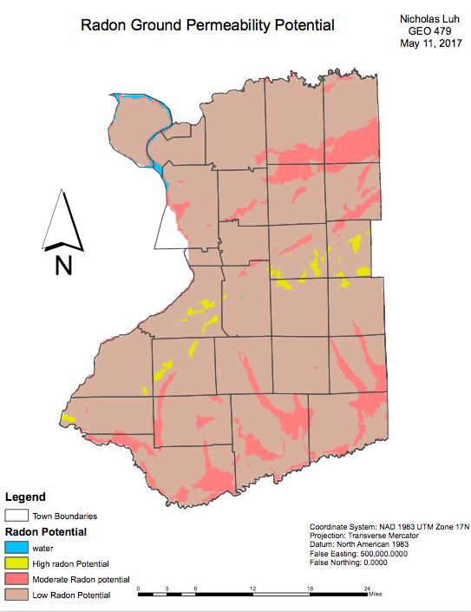
Conclusion
Radon ground permeability potential has similar correlation to the actual radon data based on concentration in homes. The highest radon levels recorded in homes in Erie county (left) were in the same town as the highest radon potential in radon groundwater permeability potential map (left). Radon Ground permeability potential map provides some insight as to where radon could be in high concentrations in homes

Slide 5
Integration of Remote sensing and Census data for Quality of life assessment in city of Buffalo
Geo 559
Presenter: Bowen Man

Slide 6
Objectives
Assess Quality of life from environmental and socioeconomic perspective based on remote sensing and census data.
Analyze the correlation between selected variables.
Derive Quality of Life index in city of Buffalo.

Slide 7
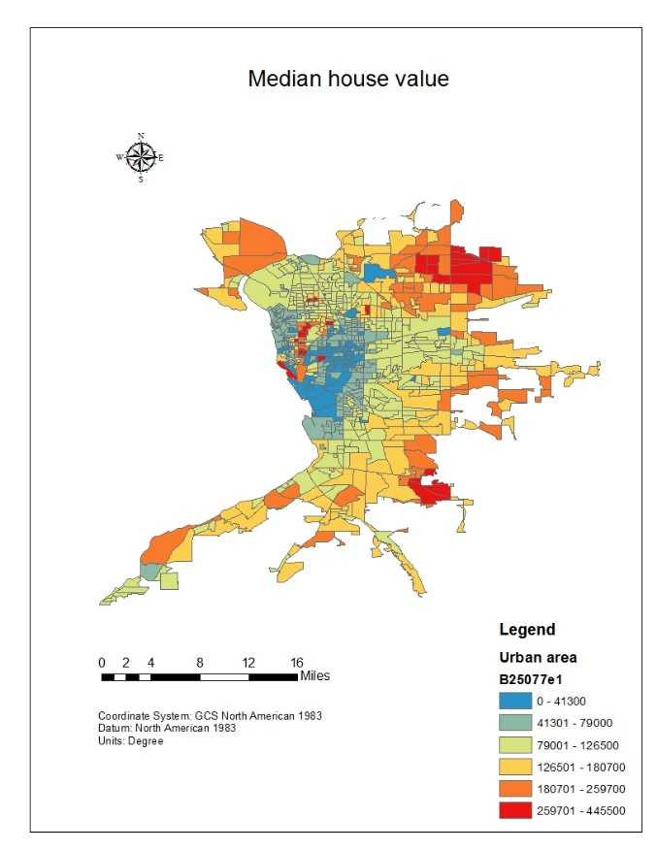
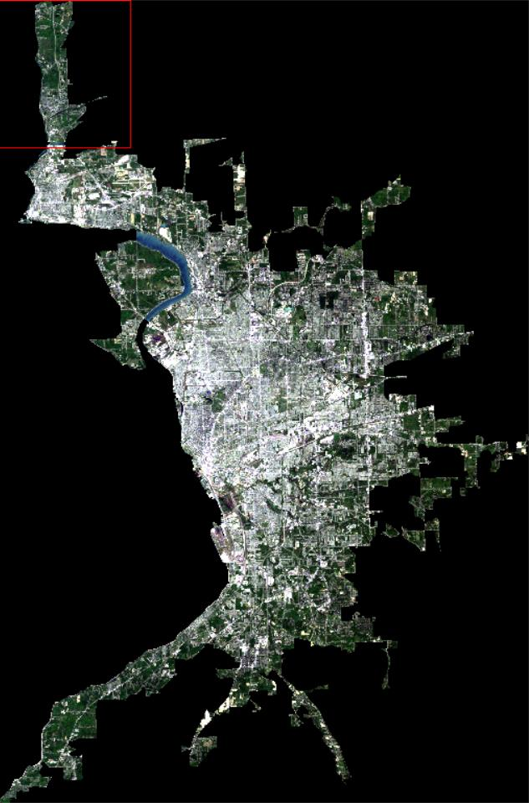
Data source
2010 Census data, Landsat 5 TM – Buffalo city

Slide 8
Landsat 5 band 1 through 5 and 7
Landsat 5 band 6
Census block group
SMA
Surface temperature
Green vegetation and impervious surface fractions
Aggregated to block group level
Socio-economic variables
Factor analysis
Factors
QQL index

Slide 9
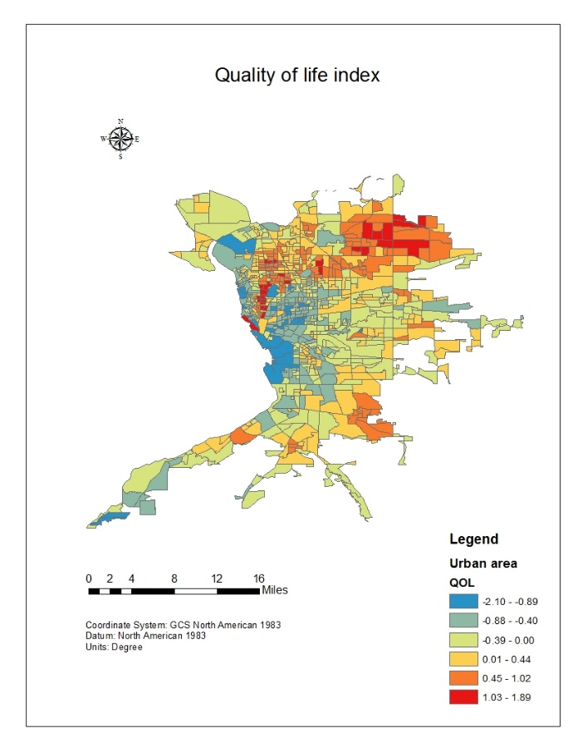
Conclusion
The higher the score the better the quality of life in that particular block group. From the map, we can get a direct feeling that most of the region in downtown buffalo has relatively poor quality of life condition, although some of the region still get red color which denotes higher quality of life. The northeastern of Buffalo urban area has the relatively higher quality of life, people there have higher income, bigger house, higher education level and better natural environment.

Slide 10
Wetland Suitability Map for Suffolk County, New York
Spencer Podsiadlo

Slide 11
Objectives
Create a suitability map for wetland construction and preservation.
Perform spatial statistics to assess spread and clusters of the most suitable areas.

Slide 12
Data
DEM – U.S Geological Survey
Hydrography – NRCS
Roads – U.S. Census Bureau
Land Use - U.S Geological Survey
Potential Biodiversity - Environmental Management Bureau, NYS Office of Parks, Recreation, and Historic Preservation

Slide 13
Methods
Convert vectors to rasters (DEM’s, roads, hydrography)
Perform Euclidean Distance on the roads and hydrography layers
Reclassify roads and hydrography
Reclassify DEM’s
Reclassify Biodiversity and Land Use
Weighted Overlay
Cluster Analysis (Anselin Local Morans I)

Slide 14
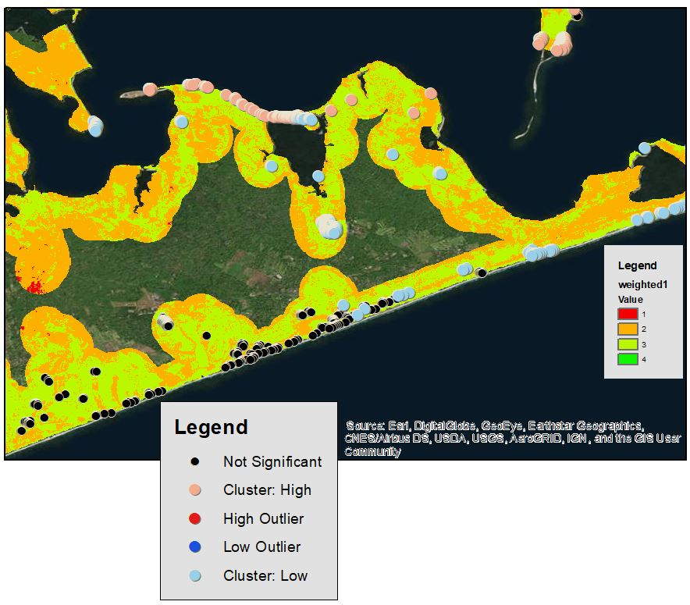

Slide 15
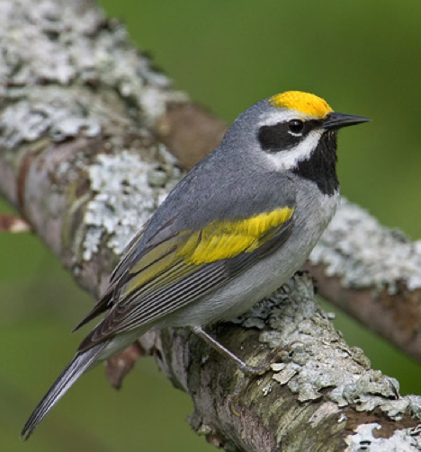
Mapping Habitat for Golden-winged Warbler (Vermivora chrysoptera) in Western New York.
Jesse Rubenstein
GEO 559

Slide 16
OBJECTIVES
Create a habitat suitability model that predicts where GWWA habitat should be found
Utilize GWWA MGMT plans, expert opinion, and literature review as the basis for the land cover requirements.
Validate model results by overlaying empirical sighting data
USGS Breeding Bird Survey (BBS)
Create a final map to be used for DEC’s Young Tree Initiative
Finger Lakes Region (DEC Region 8)
WMAs with the most GWWA habitat

Slide 17
DATA SETS: Habitat Suitability Model
County Borders: 2010 U.S. Census Bureau (Vector)
Study area boundaries
Land Cover / Land Use
2011 National Land Cover Database (Raster)
Identify upland and wetland shrubs
2008 National Wetlands Inventory (Vector)
U.S. Fish and Wildlife Services
Hybridization with Blue-winged Warbler unlikely in wetland shrubs
Breeding Bird Survey (Vector)
Validate Model
Routes remain unchanged since 1960s
Broad scale analysis
Absence/presence on routes
Routes are 24.5 miles long
NYS DEC Wildlife MGMT Areas (Vector)
Analyzed to see if GWWA habitat intersects with WMAs
Used for recommendations for “Young Tree Initative”
DEM Data
Areas >390 meters
Hybridization with Blue-winged Warbler unlikely at high elevations

Slide 18
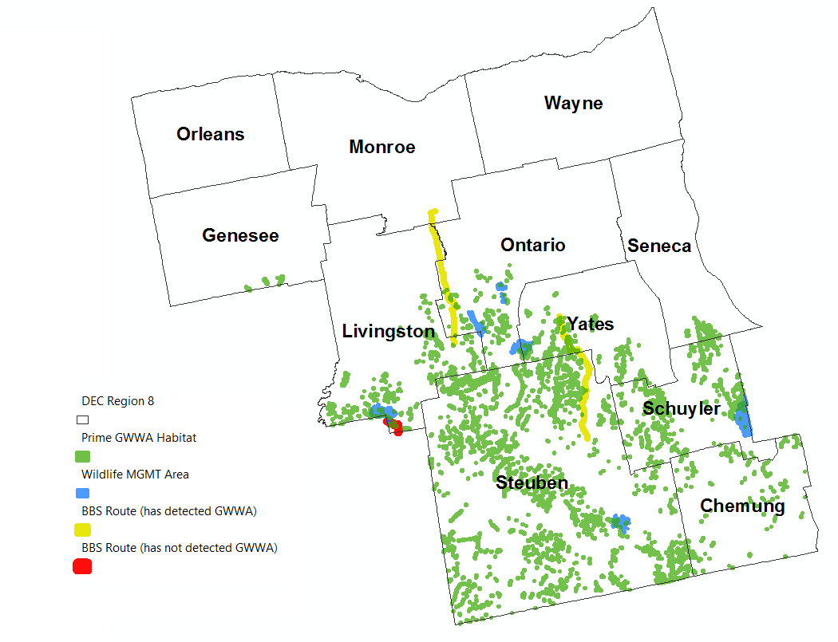
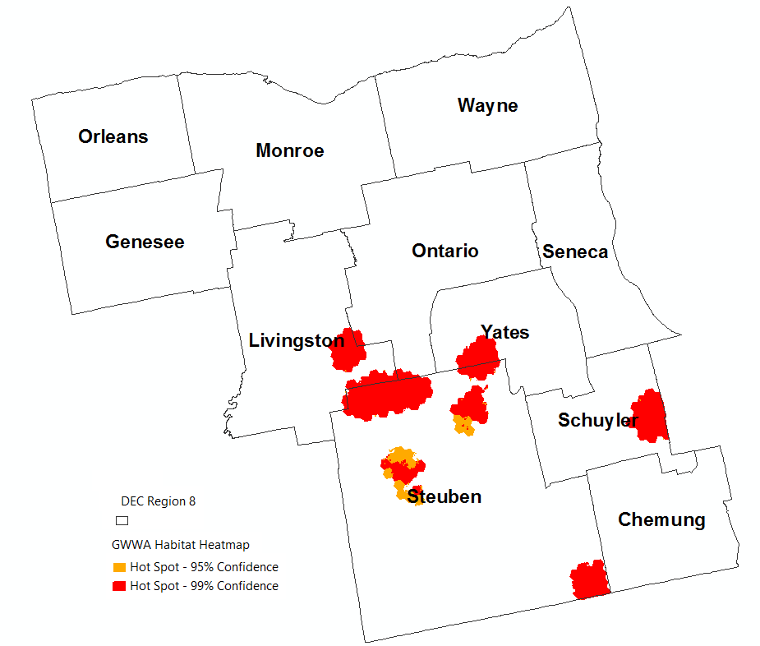
RESULTS
Habitat Suitability Map
Heat Map of GWWA Habitat
Ratios of bird habitat in WMAs & BBS Routes

Slide 19
Which is the most influential factor of car accidents?
Geo 559 Xiaohan, Rui

Slide 20
Project Goals
Use daily data to find the clustered locations where there are high probabilities of car accidents happening;
Analyze three factor layers respectively and use statistic method to calculate the relationship between them;
Compare the result and find which is the most influential factor and explain the potential reasons;
Use the weighted linear combination to predict where is the place that may likely to have car accidents;

Slide 21
Influential factors:
Road
Distance between car crash locations and crossroads
Wine Bars
Distance between Wine bars & liquor stores locations and car crash locations
Drivers fall asleep
Night time driving accidents (from 11:00 p.m. to 6:00 a.m.)

Slide 22
Model:
All factors has been added into the attribute table of car accidents
IBM SPSS: regression model
Car accidents= (23.711)*crossroad + (-36.647)*wine bar + (-1.34)*nighttime + 3.0

Slide 23
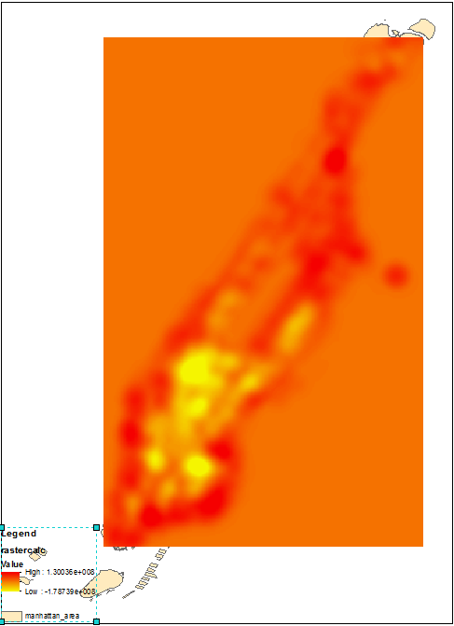
Result:
Use raster calculator to get the final map that shows the locations

Slide 24
Erie County Crime Analysis
By: Jarred Santoni
GEO 479
Professor Bian
04/25/17

Slide 25
Objectives
Can we predict where crime will happen in the future?
Identify Safe and Dangerous Areas
Find ways to lower crime rate

Slide 26
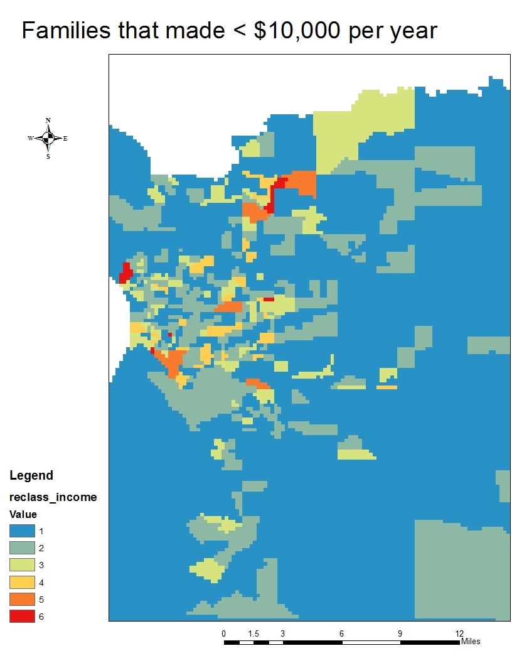
Income:

Slide 27
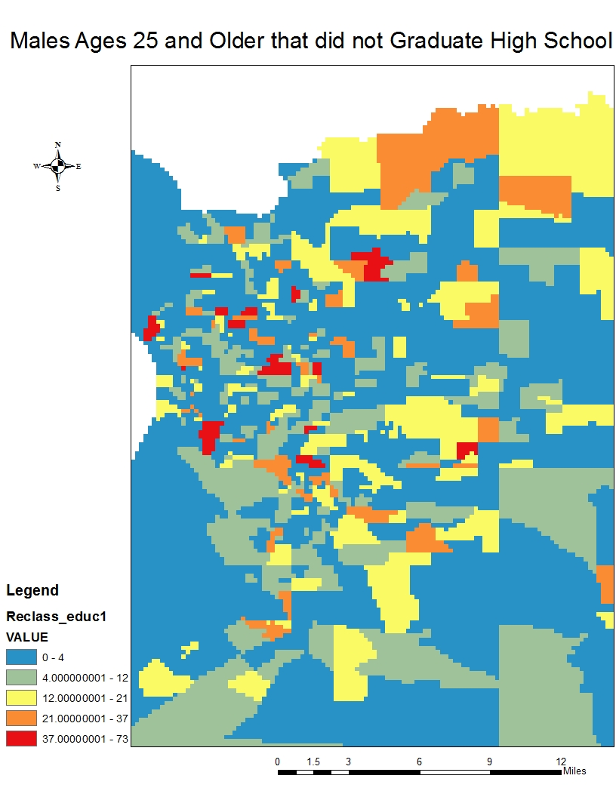
Education

Slide 28
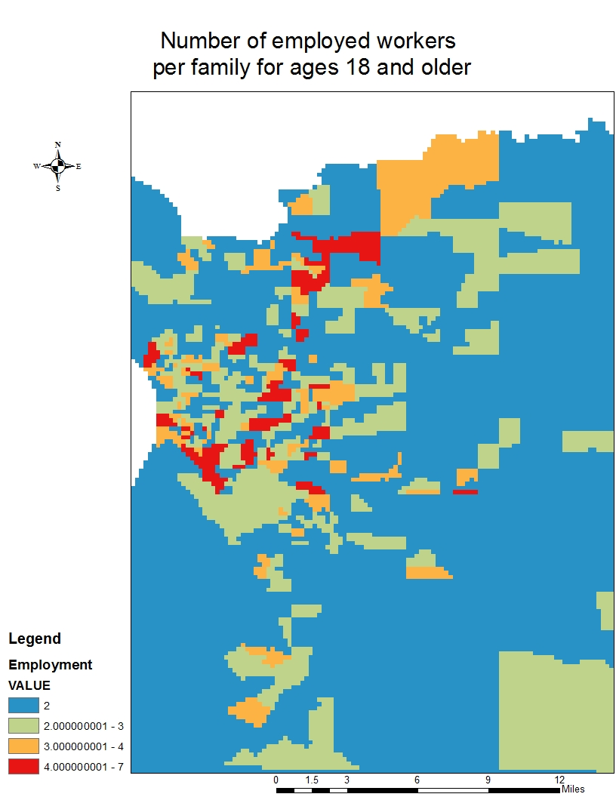
Employment Status

Slide 29
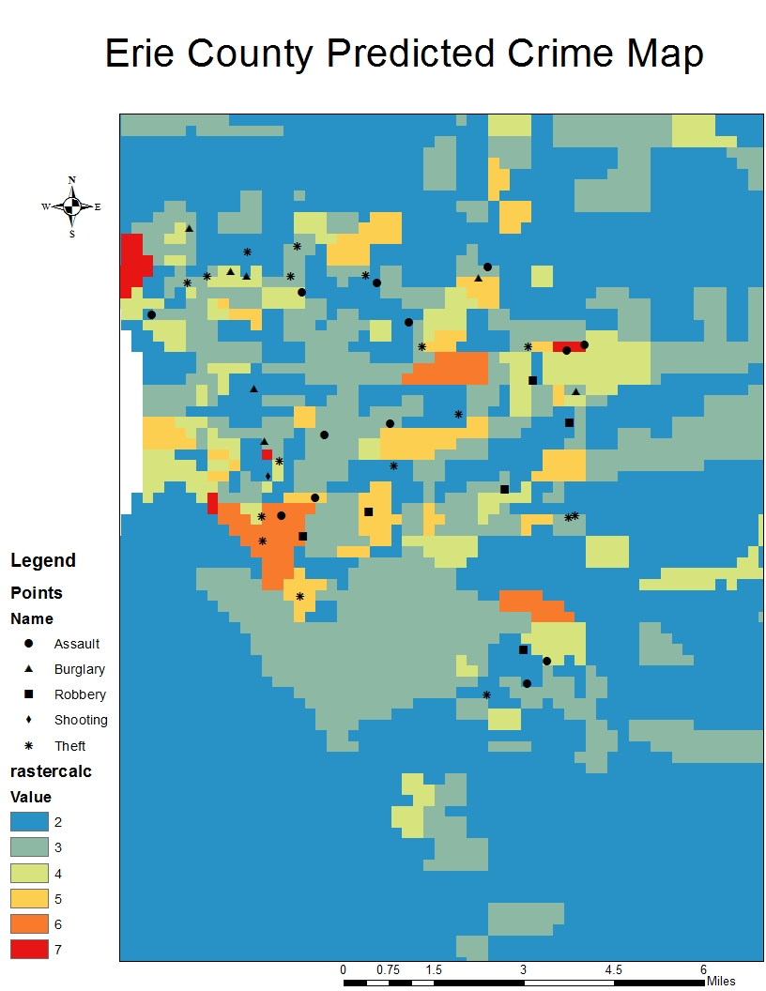
Results
By no means does this map mean any of these areas are dangerous or safe. But these areas with high values (red) are areas where there is a high concentration of people with income <$10,000 per year, males that could not graduate high school, and the number of people working per family. Most of these crimes fall within the yellow, orange, and red areas.

Slide 30
Geographic Location Estimates of Sandbian Graptolite Species
Erin Schuster
GEO 559

Slide 31
Purpose
Statistically generate estimates of geographic locations for species of graptolites that lived during the Sandbian Age.

Slide 32
Methods
Indicator Kriging
Applied to variables that are binary
Presence/absence

Slide 33
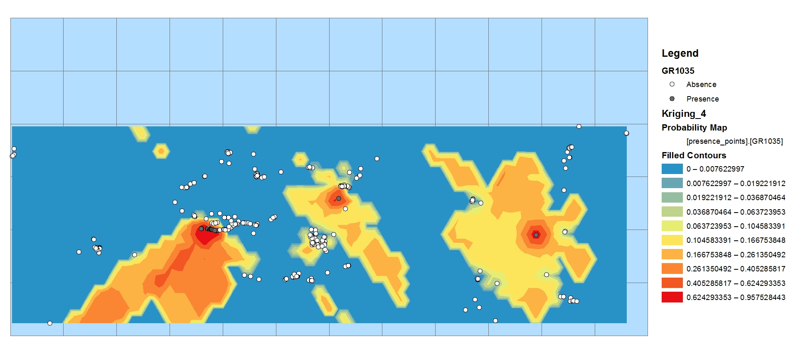

Slide 34
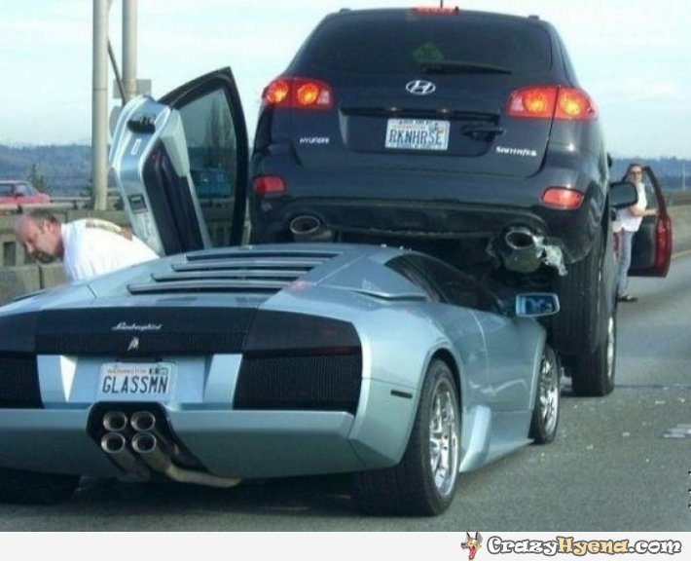
Automobile Accidents
Geo 479
Are Certain Areas At Risk More Than Others
In New York State?
By: Jasper Swiezy

Slide 35
Objectives
Hypothesis Model:
1.) To create a weighing scheme to determine which areas are most likely to produce car crashes.
2.) Produce a map which represents high risk areas based on model.
Real Data:
Car accident data from 2015
Validation:
If there are areas that are high risk, then they will probably be comparable with the areas where car crashes have already occurred.
I want to find out whether or not there is a higher likelihood for certain areas to have accidents than others.

Slide 36
Data
Population 2015: US Census Bureau
Average Precipitation 2015: National Weather Service
Average Traffic Density 2015: NYS GIS Clearinghouse
Automobile Accident locations: National Highway Traffic Safety Administration

Slide 37
Method design
For Example: Population 2015
Ranking these into 5 distinct classes
-Rank 1 for lowest Jenks Natural Breaks Class
-Rank 2 for med-low Jenks Natural Breaks Class
-Rank 3 for medium Jenks Natural Breaks Class
-Rank 4 for med-high Jenks Natural Breaks Class
-Rank 5 for high Jenks Natural Breaks Class
Similar idea for Average Precipitation 2015 data and traffic density.
Then I will weight all of these data layers into one layer. This layer will have 40% population, 40% traffic density, and 20% average precipitation.

Slide 38
Validation
Once I have created my high risk location allocation map for automobile accidents, I can compare it to the actual data that I have collected.
If the model is accurate, then I can assume that these factors play a significant role on the driving public in general, rather than the assumptions that an accident is caused purely by negligence.
The conclusion therefore, would be that places which are most affected by these external driving conditions are the areas which should be avoided while driving.

Slide 39
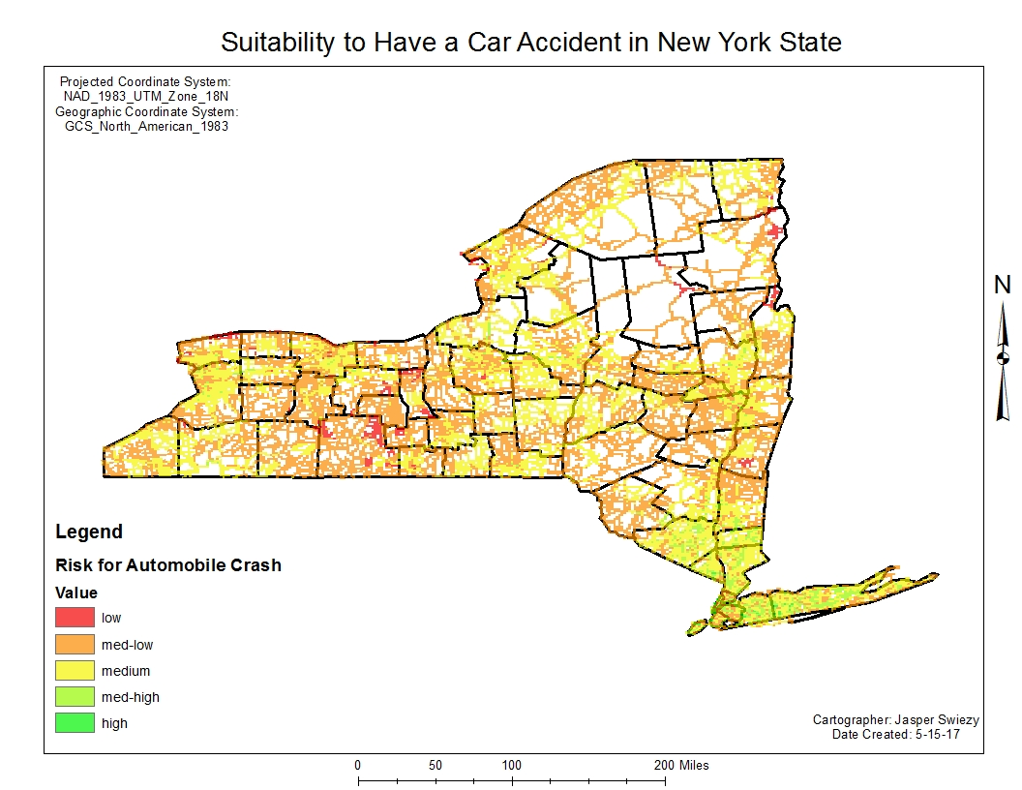
Conclusion
The three data layers that I have used for this project are 60% accurate compared to the 982 initial car crash areas at the high, med-high, and medium levels.

Slide 40
Ideal Location for “Fitness Mecca”
Presenter: Kevin Tan
GEO 479

Slide 41
Objectives
To locate a outdoor gym facility
Promote healthy lifestyle choices and outdoor physical activities
Examine criteria that will help derive a new location in New York City

Slide 42
Method Design
Using ArcGIS Online and its Derive a New Location function
With the following criteria:
Open Space
Parks
Subway/Transportation
Hurricane Data
Flooding Incident
Crime Data

Slide 43
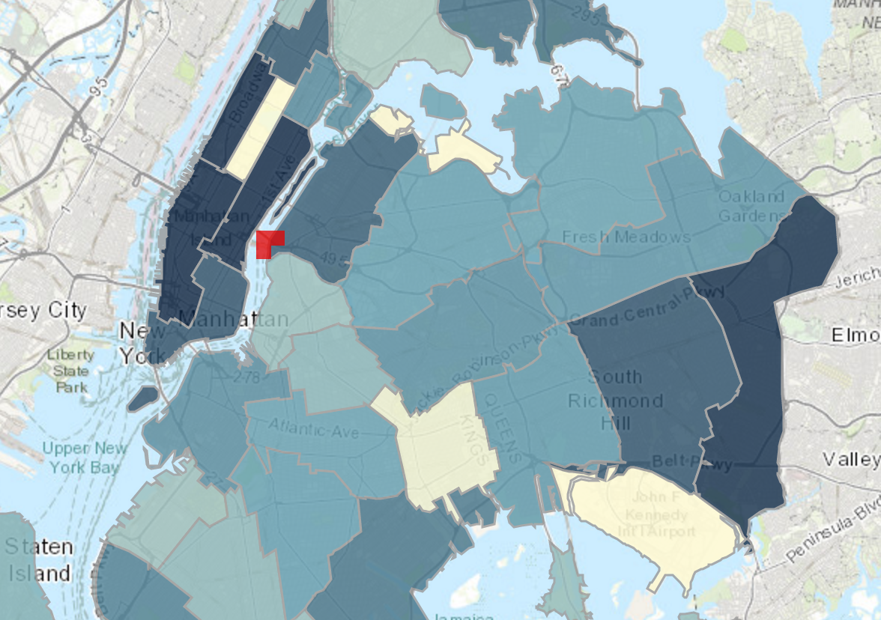
Conclusion
The red shape indicates the result of the Derive a New Location function
In order to promote healthy living, efforts need to be made to create a new culture for exercising and physical activity

Slide 44
Bison Habitat Selection: Yellowstone National Park
Jessica Wood
GEO 559

Slide 45
Objective
Use current bison observations
Yellowstone National Park
Determine important environmental factors
Create suitability map to test factor selection

Slide 46
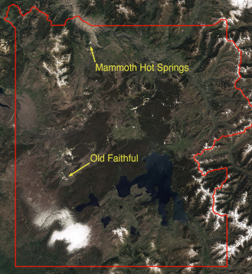
Study Area
34,375 square miles
Wyoming
Multiple habitat types
Largest free-roaming bison population

Slide 47
Precipitation
LULC
SSURGO
DEM
Slope
Observations
Convert To Raster
Reclassify
1-4
T-test
Regression
Suitability Map
Observation Data
Pseudo-Absence Data
Verify

Slide 48
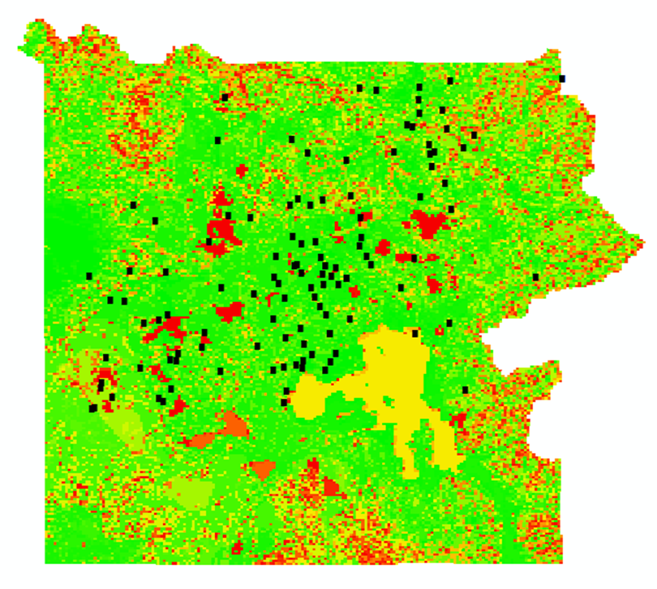
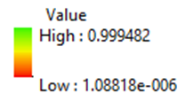
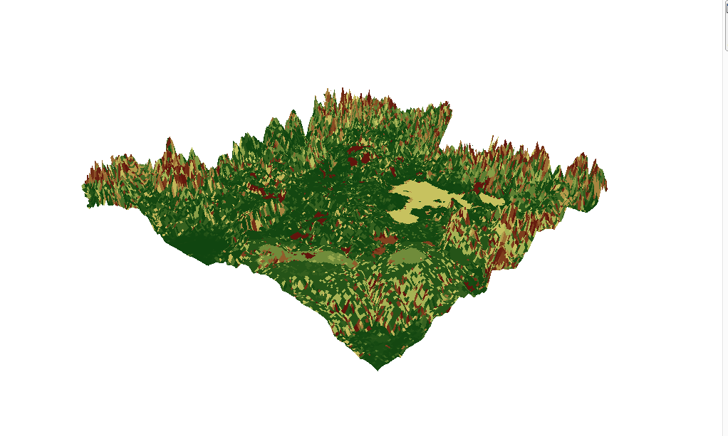

Slide 49
Bike Trails in the Everglades: Finding Impact Factors and Planning for New Trails
Spring 2017
GEO559
Lingtao Xie

Slide 50
Objectives
Determine Impact Factors of the Bike Trails
Create a Suitability Map
Find New Bike Trails

Slide 51
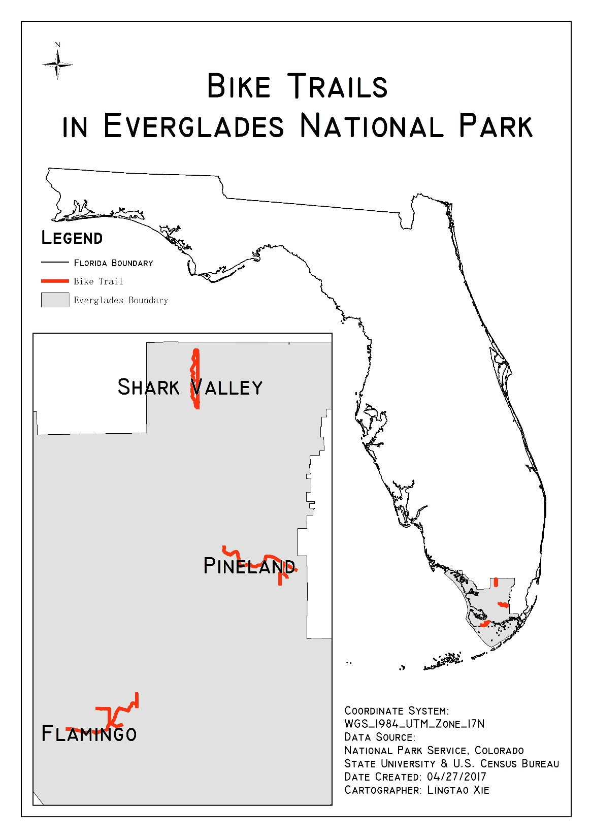
Study Area & Data
1) Florida Boundary Lines
2) Everglades National Park Boundary
3) Florida Roads
4) DEM (Digital Elevation Model)
5) LCLU (Land Use Land Cover)

Slide 52
Multiple Linear Regression
Dependent Variable
Frequency of Visits
Independent Variable * 5
Distance to Road/ Water/ Forest, Elevation, Slope
Suitability = 8.930 + distance to forest ∗ .001 + distance to roads ∗ .011 + distance to water ∗ .003 + slope ∗ .024 + elevation ∗ .010

Slide 53
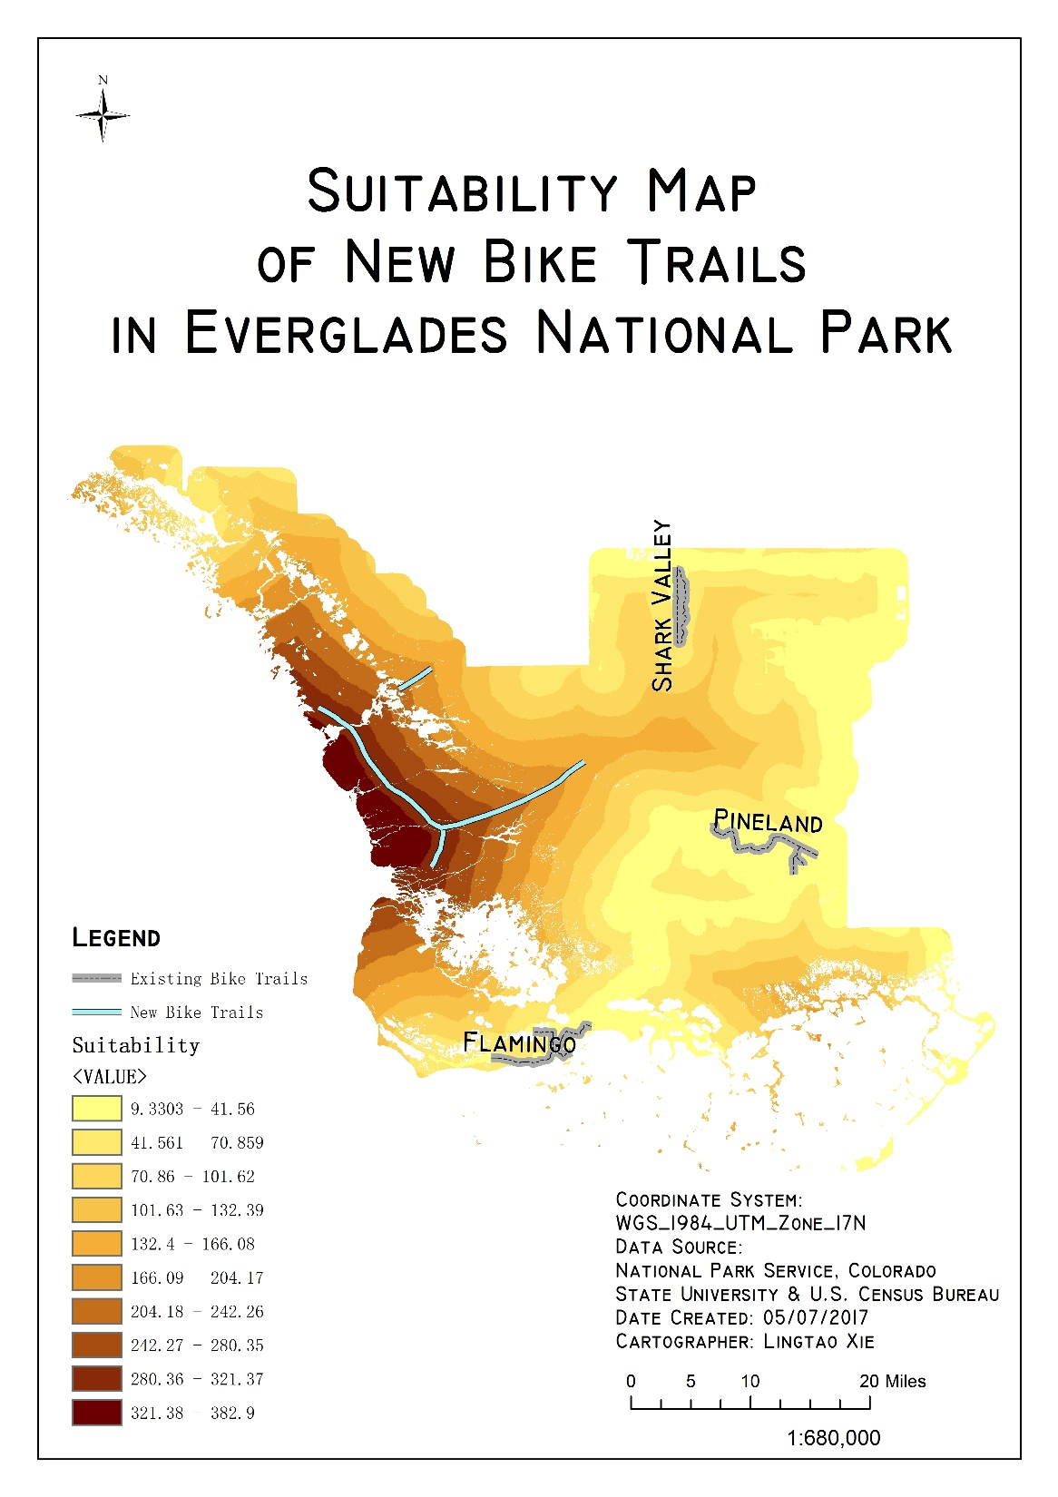
Suitability Map & New Trails
Higher suitability - > deeper colors
New trails are set within locations with high suitability
New bike trails would be more suitable
New trails would be at the west part of the Everglades, where no bike trail is currently in use.

Slide 54
Where is the best location for Restaurant in Buffalo based on YELP reviews and other criteria
UB Department of Geology
Geo559
Fangyu Zeng

Slide 55
Method: Pairwise Comparison and AHP
Extract the pairwise comparison of each criterion using pairwise comparisons
Normalizing the matrix means to divide each element in every column by the sum of that column
Average each row in the normalized matrix, this average is called the Criteria weights {W}
Aggregating the criteria using the Weighted Linear Combination (WLC)
Criteria | weight
land use | 0.13995661
population | 0.222933405
passenger station | 0.295004062
vacancy | 0.243400658
Rail | 0.098705264

Slide 56
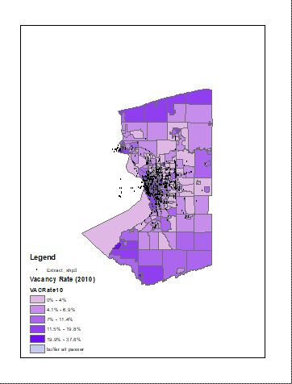
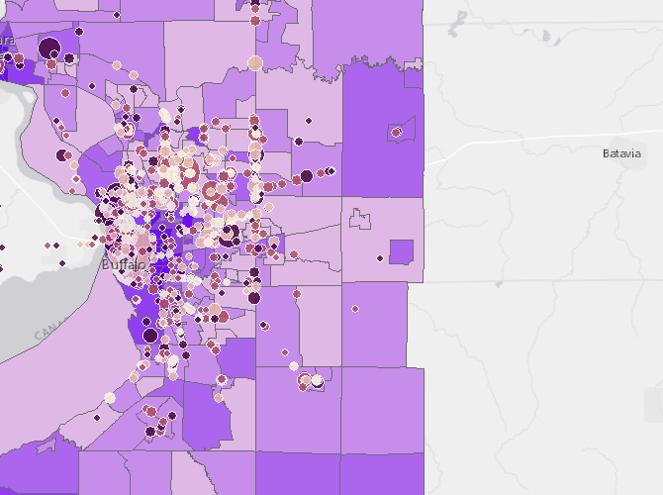
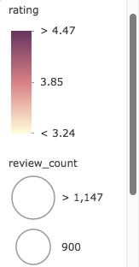
Yelp review counts and rating with vacancy rate in buffalo

Slide 57
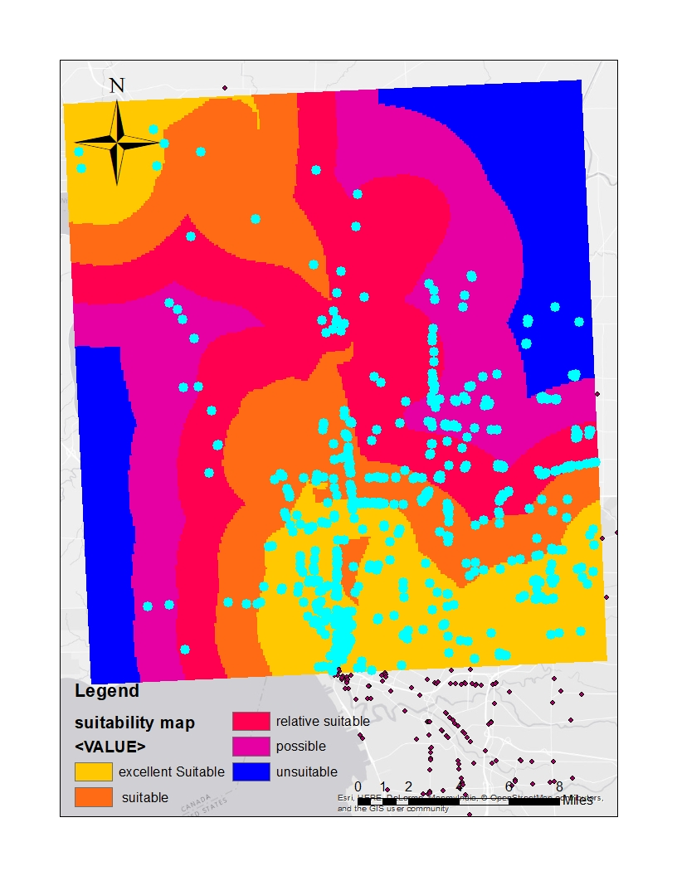
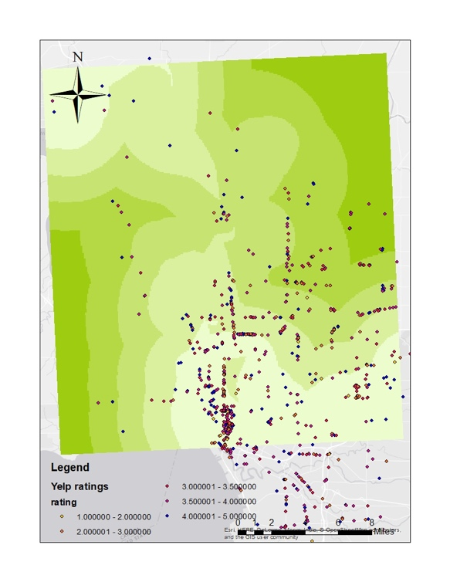
Suitability map of the best location for restaurants in buffalo
The Yelp rating over the suitability map

Slide 58
conclusion
The yelp review count and rating shows the most of restaurant are located in the suitable region in suitability map, however, there are few high score restaurants are outside of the suitable region, so it is worth to try. The estimate price of the meal in the expensive restaurants are very good corresponded to the suitable location for restaurants. The criterion in this study should be added more to improve the results to find the best location in buffalo for restaurant. And the results are corresponded with the vacancy rate in buffalo area.
In future, I may use other data to continue study on the location of restaurants which may depend on google map review, a large quantity is good to use in this study and I may use the income and more social factors to study on the topic, they may have more interesting findings.
The yelp review may tend to young people, most of old people may not use that. So I can compare the review with the population density of old people.

Slide 59
Evaluating the impact of public transport on nearby Residential Property Values
Li Zhang
GEO 559

Slide 60
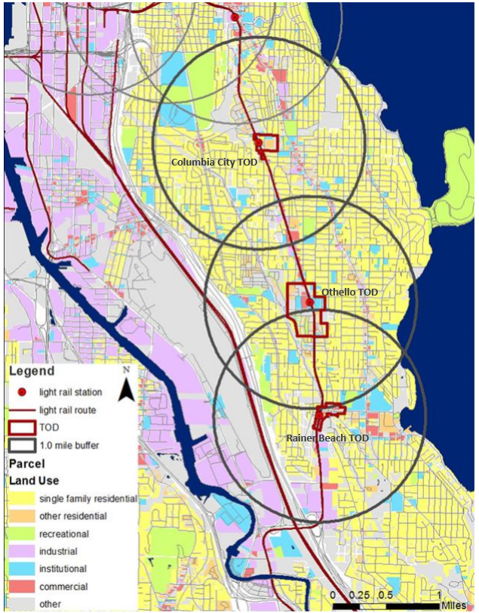
The main objectives of this project is:
Estimate the capitalization of light rail impact on nearby house prices in different time periods(before-construction, after-construction).
.
The study area are three TODs(Columbia City, Othello and Rainer Beach TOD) and their impacting area along Link Light Rail . This light rail was proposed in 1996 and started to build in 2001. By the late 2009, the construction was completed.

Slide 61
Data and Method
Method:The study applies regression models as :
P = c0 +∑αi Ti + ∑βi Li +∑μi Si +∑υi Ei + ε
where Ti is TOD proximity and characteristics, Si are structural characteristics ,Li are locational conditions and Ei are economic attributes.
Variables:
1.Explanatory TOD Variables:
The impact of TOD is measured by distance from properties to the nearest station. Set distance bands and apply
dummy variables in regression models.
2.Control variables
Locational variables:
Economy variables:
Structural Variables:
D_DUMMY1 | 1, if property is located within 0.25 mile distance from light rail station. 0, otherwise
D_DUMMY2 | 1, if property is located within 0.25-0.5 mile distance from light rail station. 0, otherwise
D_DUMMY3 | 1,if property is located within 0.5-0.75 mile distance from light rail station.0, otherwise.
D_PARK | Distance to nearest park
D_COMUSE | Distance to nearest commercial land use
M_INCOME | Median household income in block-group level
AGE | Building age
LOT SIZE | Square footage of lot

Slide 62
Results and Discussion
The adjusted R square is 0.589.
After-construction period(2010-2016) | Coefficients | Std.Error | t | Sig | VIF
Constant | -231643.552 | 88459.807 | -6.914 | 0.000
TOD Explanatory Variables
D_Dummy 1 | 6273.131 | 26902.199 | .233 | .814 | 1.239
D_Dummy 2 | 33432.630 | 16714.555 | 2.012 | .045 | 1.807
D_Dummy 3 | 15333.548 | 14482.530 | 1.159 | .256 | 1.617
Locational Variables
D_PARK | -9.794 | 9.757 | -1.004 | .316 | 1.133
D_COMUSE | 11.045 | 9.80 | 3.147 | .002 | 1.435
Economic Variables
M-INCOME | .248 | .318 | 1.722 | .086 | 1.669
Structural Variables
AGE | -1460.216 | 1697.98 | -0.844 | .399 | 1.874
LOT SIZE | 110.972 | 9.042 | 13.250 | .000 | 1.303
In after construction period, Light rail has significant positive impacts on values of houses located within 0.25-0.50 mile
from the station
Notes:
in after construction period, Light rail
has significant positive impacts on values of houses located within 0.25-0.50 mile
from the station

Slide 63
Conclusion
Model results suggest that TOD has significant positive impacts on values of residential properties that are located within 0.25-0.50 mile from the station and relatively strong impact on properties that are located within 0.5-0.75 mile from the station.
mean value of house price is $38647 higher than that of properties located within the distance 0.75-1 mile from the station.

Slide 64
Ski Resort Suitability of Erie County, NY
Borui Zhu
2017 Spring GEO479
Professor Bian

Slide 65
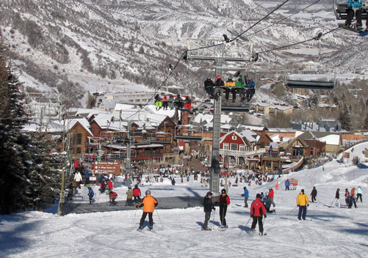
Objective
Determine the best location for a new ski resort in Erie County

Slide 66
Weighted Overlay
Slope 45%
Higher is better
Land Use 20%
Distance to Roads 15%
Closer is better
Distance to Existing Resort 20%

Slide 67
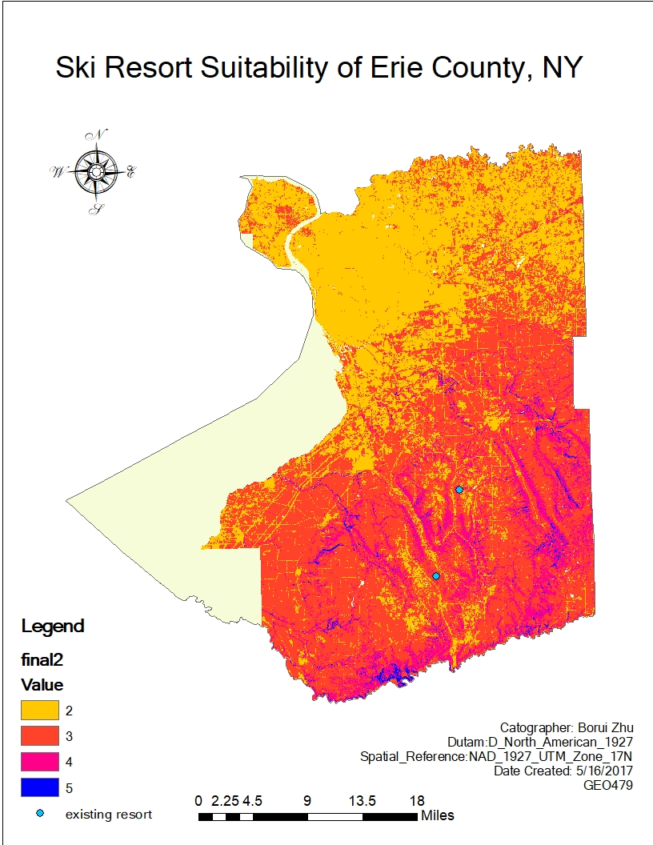

Slide 68

Mapping Food Deserts in Buffalo NY
Yasmin Abdul Malik
5/2/2017
Geo 479

Slide 69


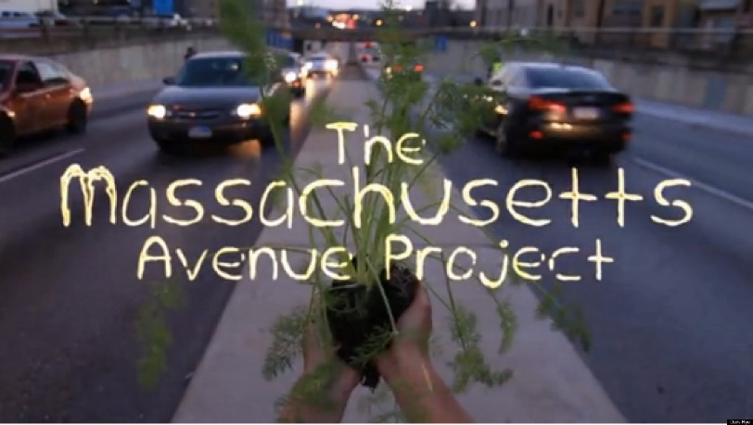
Background:
Food Desert: areas that have low access to supermarkets/grocery stores that provide access to healthy eating options
-Distance
-Income
-Vehicle/Public Transportation*
Food Deserts Cardiovascular Disease
Obesity
Diabetes
Diseases related to eating habits
-Buffalo has been noted to be a good example of what urban food deserts can look like
-There have been several interventions attempting to addresses the issue of food inequalities

Slide 70
Objectives:
Part 1
Locate food deserts at the census tract level in Buffalo NY
Part 2
Determine if food deserts are hotspots for fast food restaurants

Slide 71
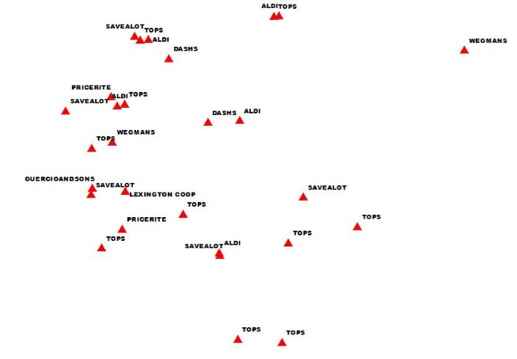
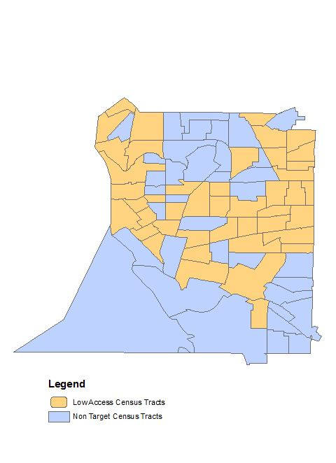
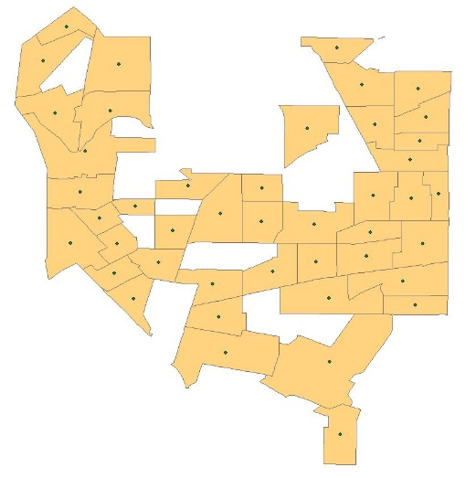
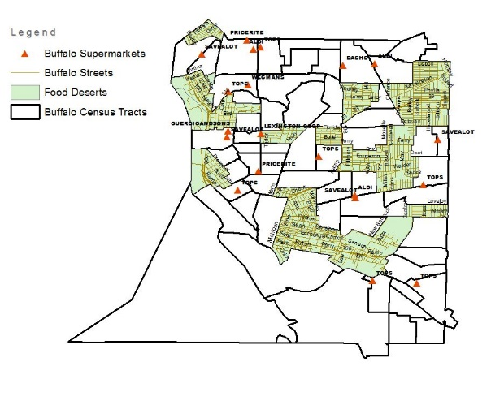
Methods
Collect supermarket and fast food
restaurant data
(30 supermarkets and 23 fast food res were sampled)
Locate low access census tracts
(poverty > 20% and >100 persons taking public transportation)
Locate census tract centroids
Locate food deserts using distance
(>.05 miles to supermarket)
Use cluster analysis to determine if
fast food restaurants are clustered in food deserts

Slide 72

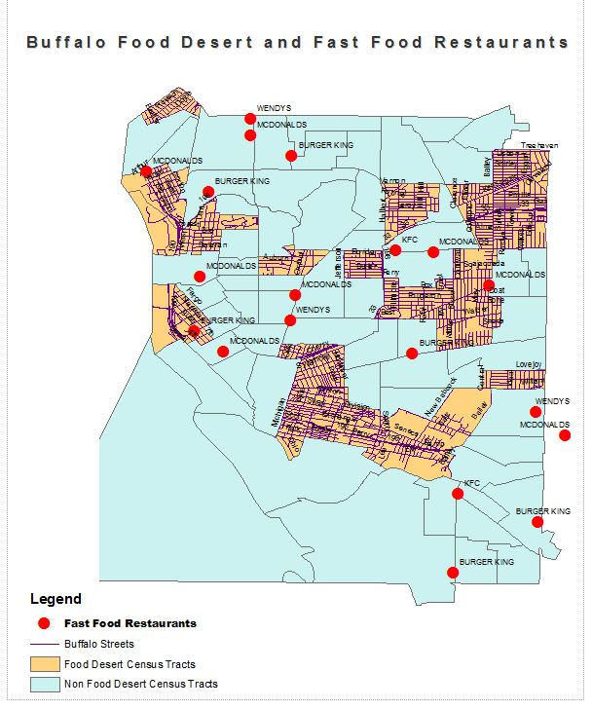
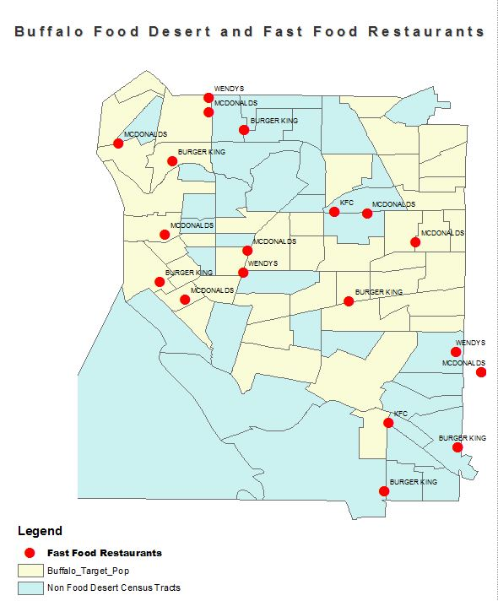
Results
Figure 1 shows food deserts in Buffalo NY. As shown, most of the food desert census tracts fall on the east side of Main St.
Figure 2 shows that most fast food restaurants do NOT fall within food desert census tracts .
Figure 3 shows that while food deserts are not hotspots for fast food restaurants, low access census tracts contain the majority of the fast food restaurants sampled.

