Slide 1
Landslide Susceptibility Analysis for Rensselaer County
By Brittany O’Brien
April 20th, 2017
GEO 559

Slide 2
Objectives
Develop a susceptibility model
Logistic Regression
Weighted overlay
Use known landslide locations for validation
Rensselaer County with parts of Albany, Washington, Saratoga, Schenectady, Columbia, and Greene Counties

Slide 3
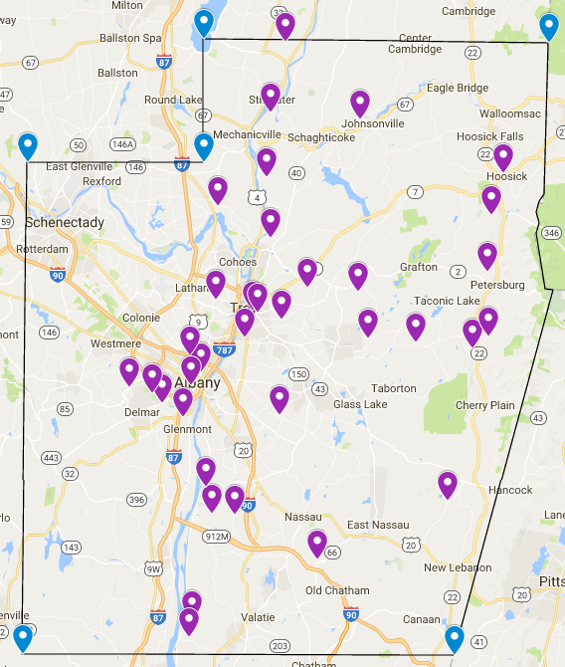
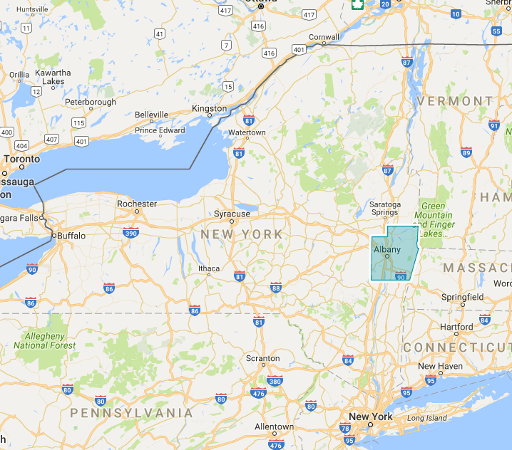
Study Area

Slide 4
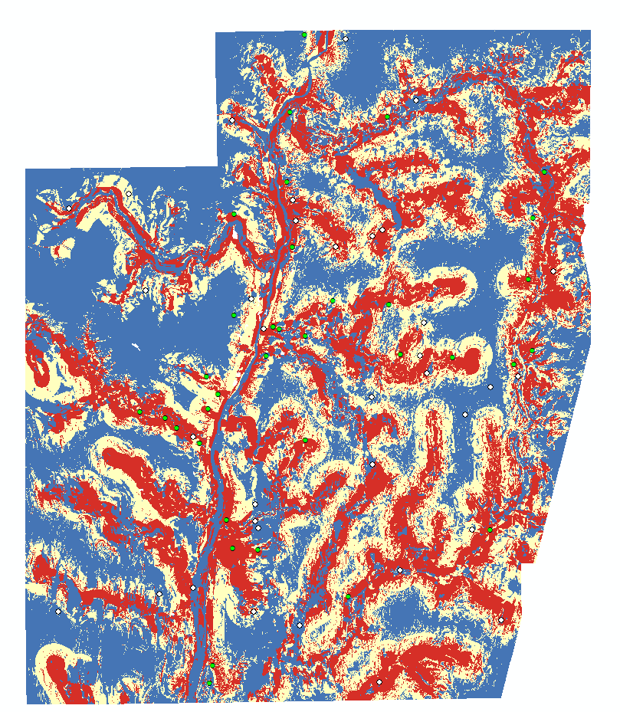

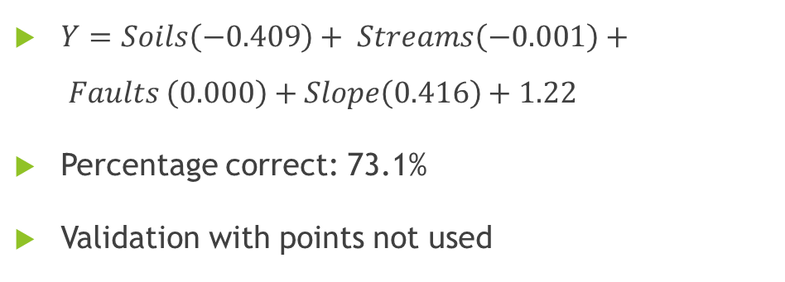
Best Regression
High
$Y=Soils\left(−0.409\right)+ Streams\left(−0.001\right)+ Faults \left(0.000\right)+Slope\left(0.416\right)+1.22$
Percentage correct: 73.1%
Validation with points not used
Low
Truth | Modeled
 |  | Presence | Absence |  | Total Accuracy
 | Presence | 6 | 3 | 9 | 66.67%
 | Absence | 3 | 6 | 9 | 66.67%
 |  |  |  |  | 66.67%
Presence
Absence

Slide 5
Conclusions
Logistic Regression was much more effective in mapping landslide susceptibility zones than the Weighted Overlay
More factors may be considered in the future for further improvement
Apply this model in other regions to see if it is applicable

Slide 6
Most Cost Efficient Route to Buffalo Iron Works
Sarah Butler

Slide 7
Methods
Buffalo Streets Shapefile
ArcCatalogue, created new Network Dataset, focused on cost attribute
Loaded new ND → ArcMap enabled network analysis extension
Created New Shapefile (point), used editing toolbar to create points of interest (Heath St → Illinois St)
Selected New Route under Network Analyst & loaded point Shapefile
Solved route, only one route given that was not usual route taken

Slide 8
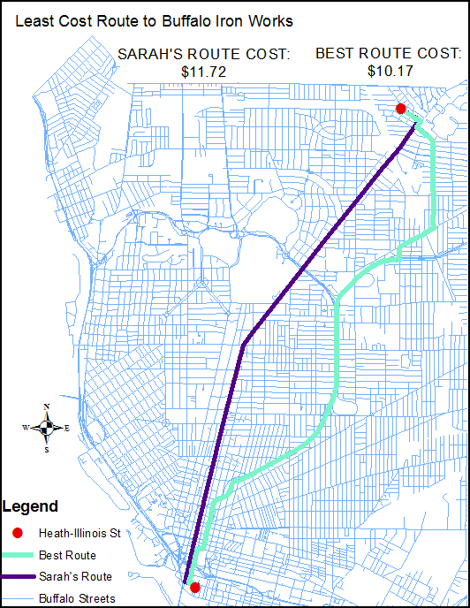
CONCLUSION:
ArcGIS route overtime will save $$$ (more drinks?), better route, saves time (more time to watch bands)

Slide 9

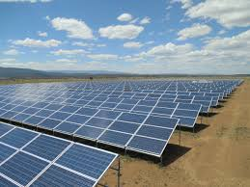
Photovoltaic Solar Suitability Map WSU Pullman Campus
Matthew Amara
GEO 479

Slide 10
Problem Statement/Objective
To assist WSU’s new Renewable Energy Organization in preliminary mapping of potential photovoltaic solar array locations.
Create a final solar suitability map for Pullman Campus.

Slide 11
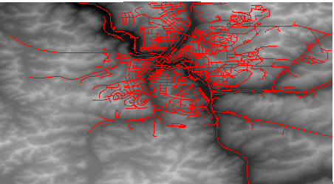
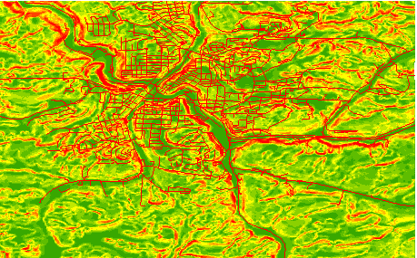
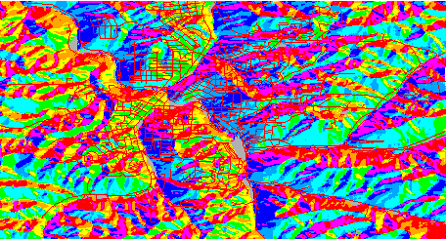
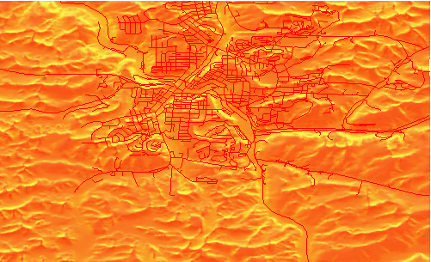
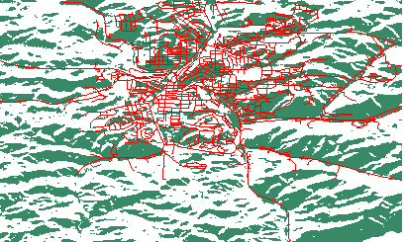
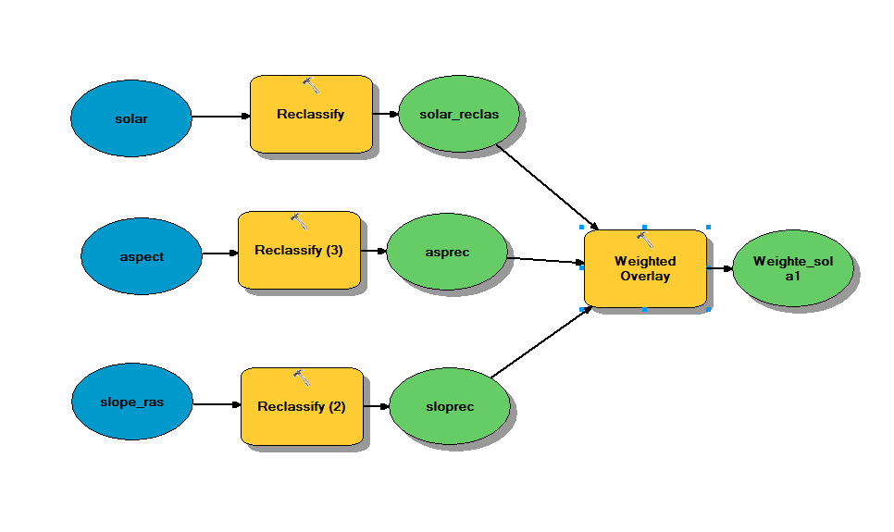
Layers
DEM 10-meter - Slope Layer- Aspect Layer
Solar Radiation Layer Reclassification of each layer (Binary)
Reclassified layers put into model-

Slide 12
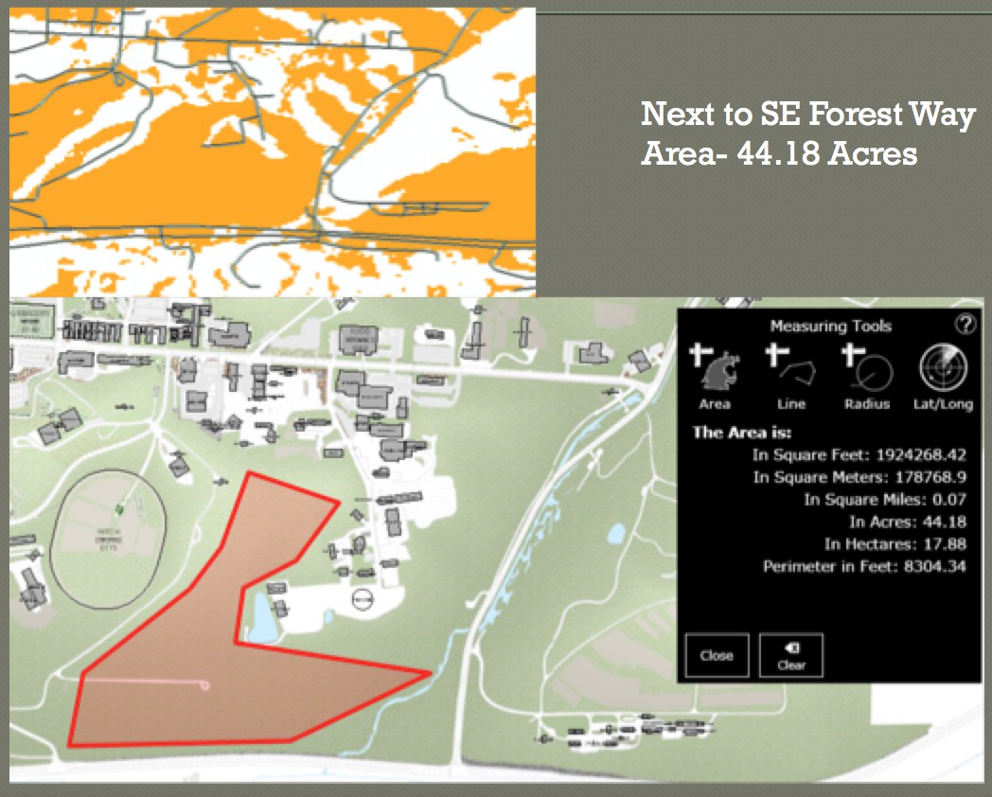
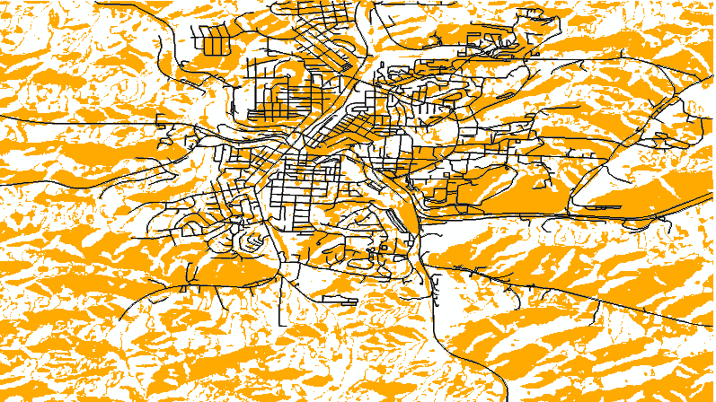
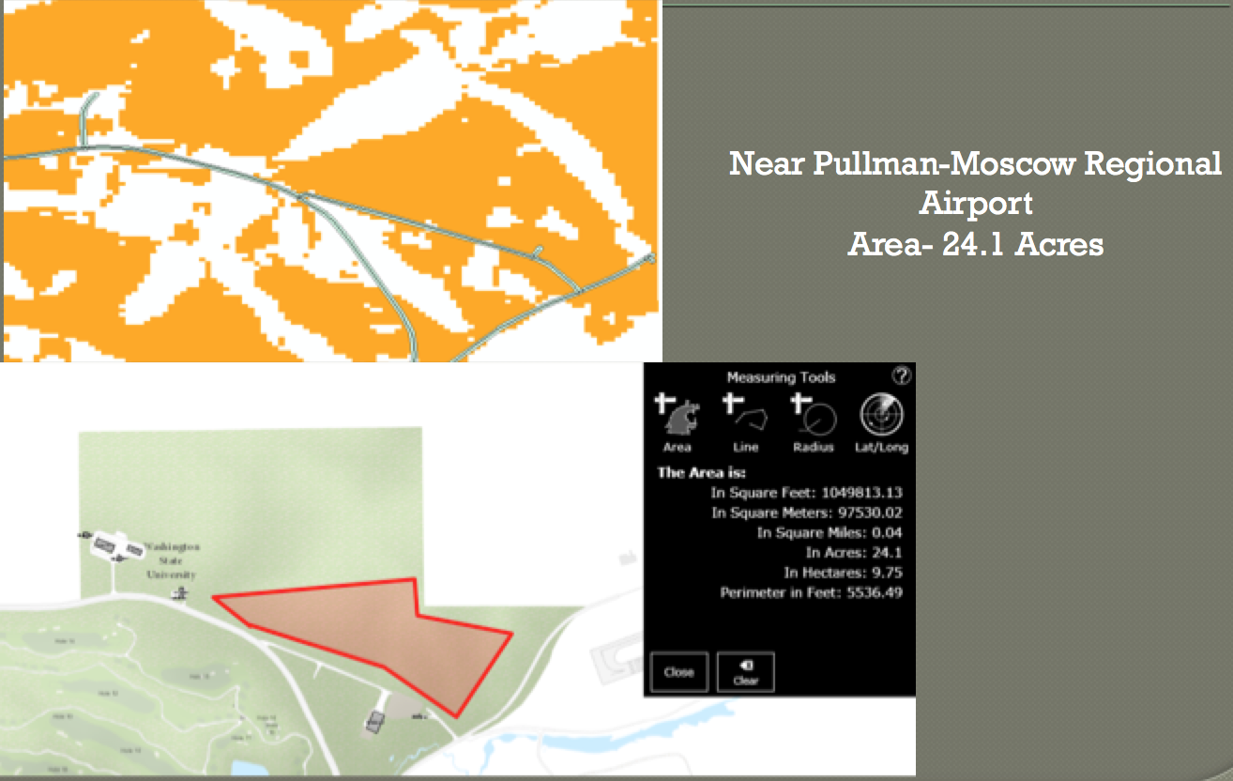
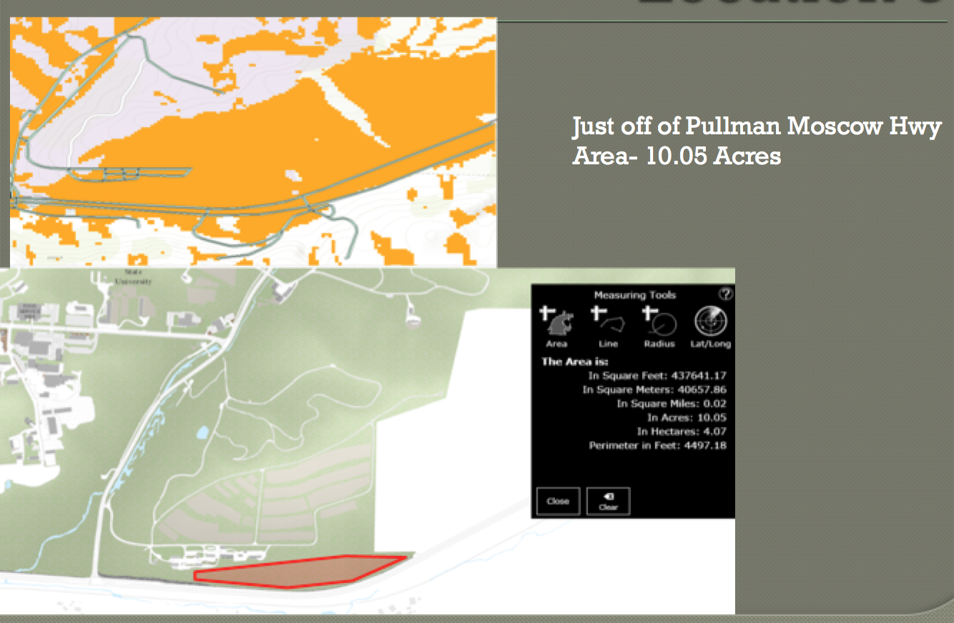
Final Output- 3 Identified Locations 5-meter buffer around roads

Slide 13
Mapping Preferred Canada Goose Habitat
By: Brooke Chamberlain
GEO 559

Slide 14
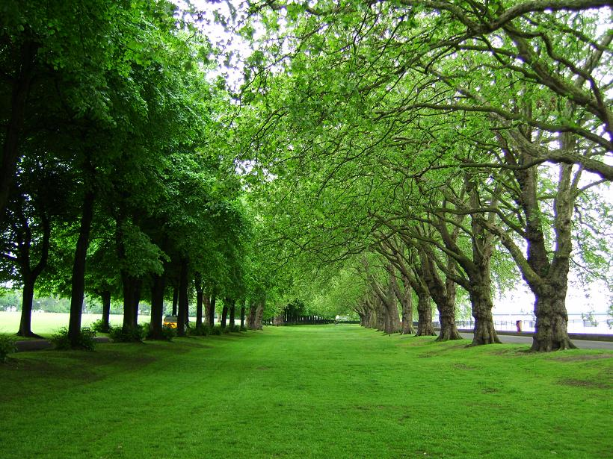
Objective
Locate areas that can be further developed or altered to decrease Canada goose habitation
Examples include Adding medium sized shrubbery and/or trees can decrease incidences of goose habitation

Slide 15
Data Used
LULC – from USGS
Water bodies data – from USGS
Wetlands Data – ArcGIS Online
State Park Data – ArcGIS Online
Erie County Map – from CUGIR
Road map data – from USGS
Study Area – Erie County

Slide 16
Conclusion
Preferred habitat buffers correlate with Canada Goose sightings and research data that specifies preferred habitat
Some popular parks and residential areas do overlap with preferred Canada Goose habitat
Online ArcGIS application created for users to view and add habitat data for the Canada Goose
Habitat applications can be a useful tool for those highly interested in wildlife, and those who desperately wish to avoid wildlife

Slide 17
Fixing the Parking Problem at North Campus with Bikes!
Lucas Chapin

Slide 18
Created 3 ND’s for Comparison
Direct Route Biking
(No Intersections, straight line there)
Current Driving
Current Biking
Compare route “cost” using
Network Analysis

Slide 19
Results
 | Cost in Minutes of:
Location | Car | Car w/ Parking | Bike | Bike w/ intersections | Direct Route
Amherst Manor Apartments | 5 | 9 | 7 | 10 | 5
Villas at Chestnut Ridge | 5 | 9 | 7 | 10 | 5
University Village at Sweethome | 6 | 10 | 8 | 11 | 7
N. Forest Rd. Apts | 5 | 9 | 12 | 15 | 11.2
Lake Tree Village | 8 | 12 | 9 | 12 | 10.2
Triad Apts | 4 | 8 | 6 | 9 | 6.4

Slide 20
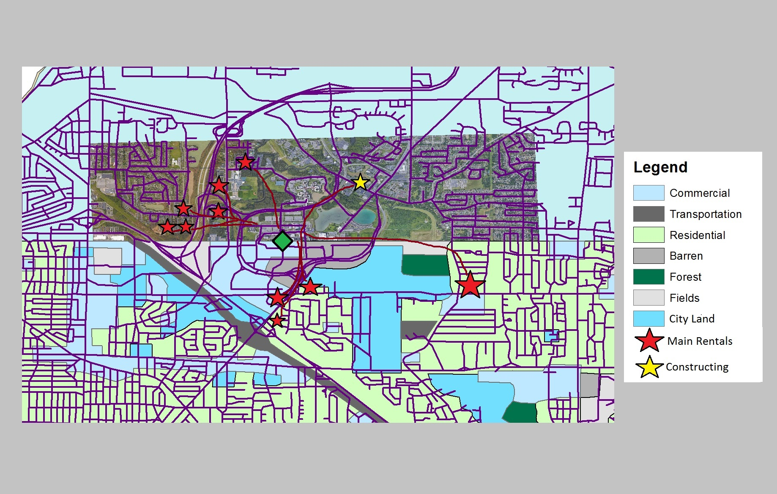

Slide 21
Most suitable Hospitals for Motor Vehicle Accident Rescue in Erie County
QIWEI CHEN
GEO479

Slide 22
Objectives
To find the Most suitable hospitals for post car accident rescue in Erie County
To find the shortest time to rescue victims from the accident location to the hospital

Slide 23
Method design
Kernel density tools to work out the car crash density maps from 2013 to 2015.
Map algebra tool to combine three density maps into one layer.
Reclassify the density map into 3 rank.
ArcGIS online, travel time distance in Analysis to work out the 5 and 10 minute drive-time area from the center point of each area.
Hospital in the 5 minutes’ drive time area will be ranked Most suitable, hospitals in the 10 minutes’ drive time are will be ranked Suitable, the others will be ranked not suitable.

Slide 24
Conclusion
MOST SUITABLE | SUITABLE | NOT SUITABLE
Erie County Medical Center | Buffalo General Medical Center | Bertrand Chaffee Hospital
 | Buffalo Veterans Administration | Women and children hospital of Buffalo
 | Sisters of Charity Hospital | Kenmore hospital
 | Brylin Hospital | Mercy Hospital of Buffalo
 | Millard Fillmore Suburban
In conclusion, hospitals that are more than suitable for receiving car crash injurers should develop on facilities and technology in order to make faster rescue and more efficient rescue.

Slide 25
Possible Locations for a Solar Farm in Monroe County
Bradley Colby

Slide 26
Objectives
Create a suitability map for where a solar farm can go

Slide 27
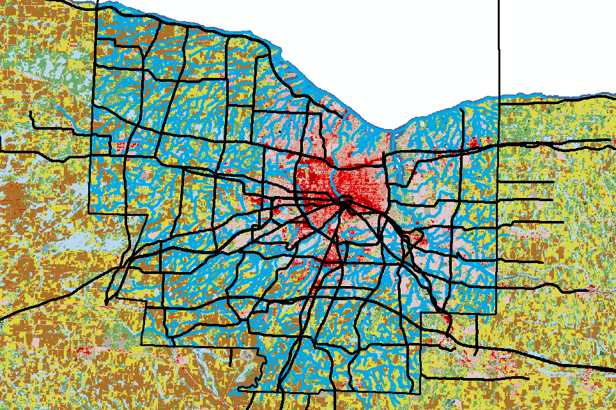
Data
Road Shape File
Land Use Raster
Hydrography Shape File
https://datagateway.nrcs.usda.gov/

Slide 28
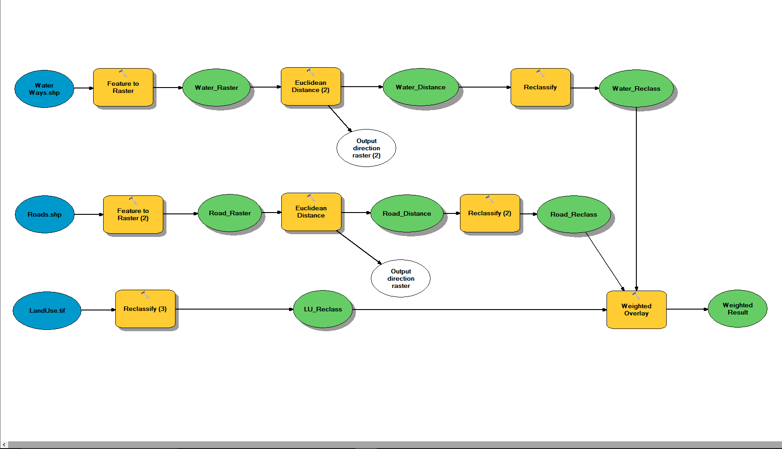
Method

Slide 29
Suitability Areas in Western New York for Wind Turbines
By: Maciej P. Deptula
GEO: 479

Slide 30
Objective
Analyzing the most suitable location for wind farm construction in Western New York

Slide 31
Data Collection
Physical:
Slope: USGS – data derived form EDNA
Economical:
Distance to roads: Lab 3 folder
Distance to electric transition lines: NYS GIS Clearinghouse
Wind Power Class (WPC): NREL

Slide 32
Data Collection
Environmental:
Parks, historical grounds: NYS GIS Clearinghouse
DEC lands: NYS GIS Clearinghouse
Social:
Distance to urban areas: TIGER
Extras:
Existing Wind Turbines Locations: USGS

Slide 33
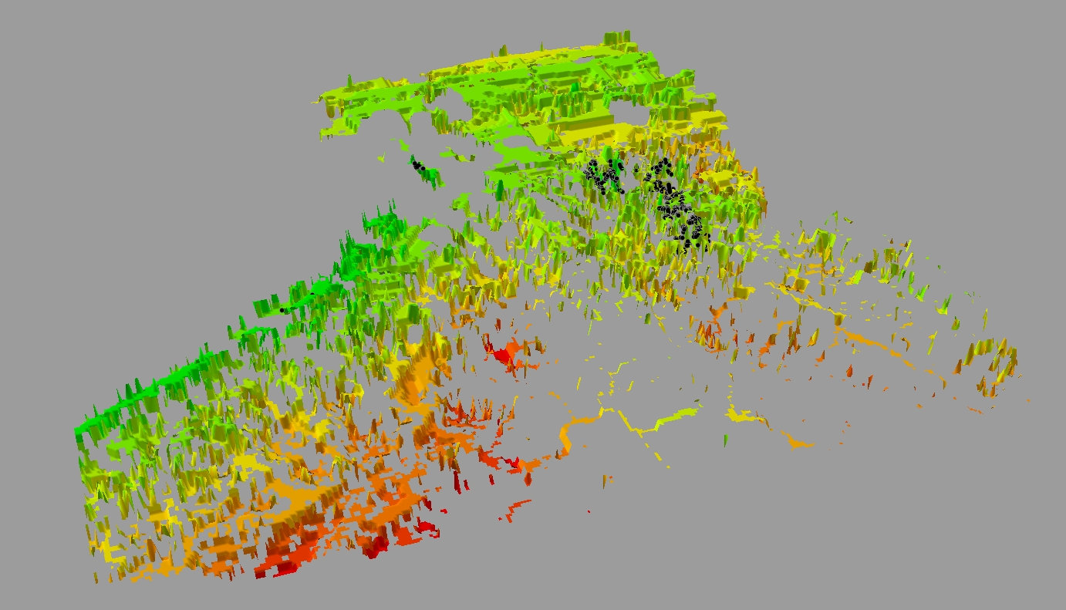
Results
Suitable areas for Western New York along with already existing wind turbines

Slide 34
Landscape Analysis of Seneca Lake Wine Trail
By: Gavin Guild

Slide 35
Approach and Methods
Model simplifications:
Assume climate throughout wine region is relatively constant
Wineries are represented by point data
Main factors that affect suitability of a wine region:
Landscape (Slope, Curvature, Aspect, Elevation)
Distance to body of water
Soil type / composition
Data
10m DEM data for 4 NY Counties (Seneca, Yates, Ontario, Schuyler)
SSURGO data for 4 NY Counties (Seneca, Yates, Ontario, Schuyler)
Point data for current wineries (kmz files created in google earth -> shapefiles)

Slide 36
Data Processing Flow Chart
Winery Point Data
Collect DEM data
Spatial Analyst >
Surface > Aspect
DEM
Aspect
Reclassify
Aspect suit.
From Google Earth KMZ > Shapefile
Spatial Analyst >
Surface > Slope
DEM
Slope
Add up suit. ranks
(raster calc.)
Suitability Model
Reclassify
Slope suit.
Spatial Analyst >
Surface > Curvature
DEM
Curvature
DEM
Elev.
Reclassify
Elev. Suit.
Create 0.5 km buffer zones around lake (where elev. Is lowest)
Distance to Lake
Vineyard Soil Types
Data
From Google Earth KMZ > Shapefile
Intermediate Steps
Model Output
Winery Point Data
SSURGO soil data

Slide 37
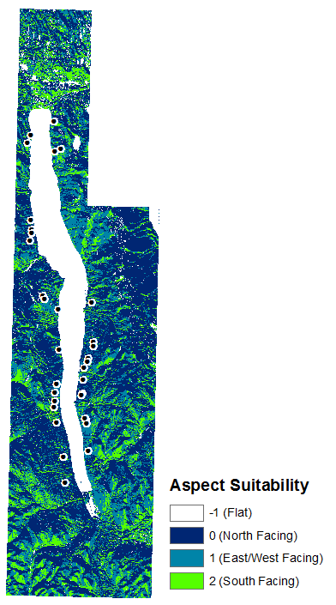
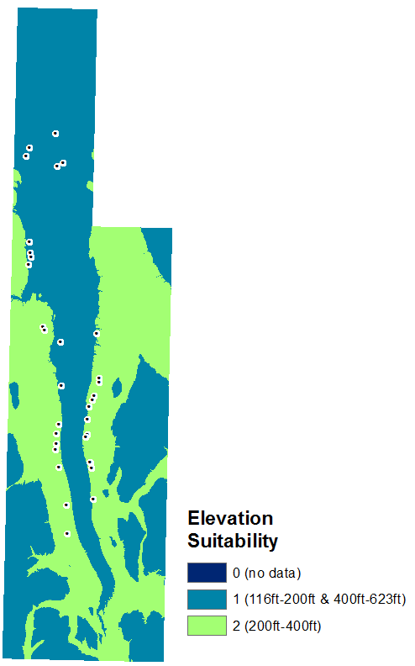
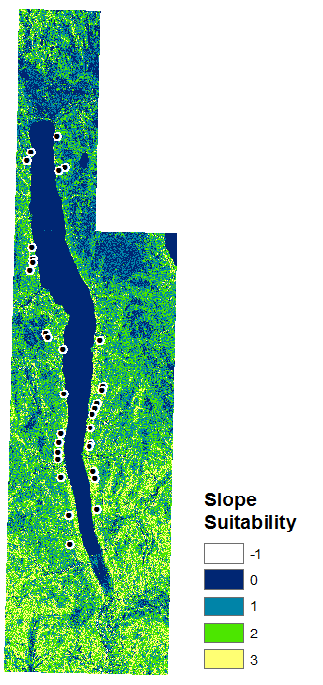
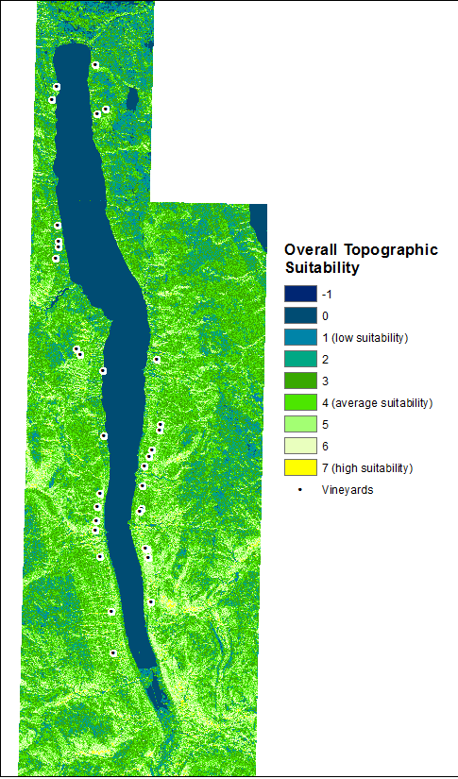
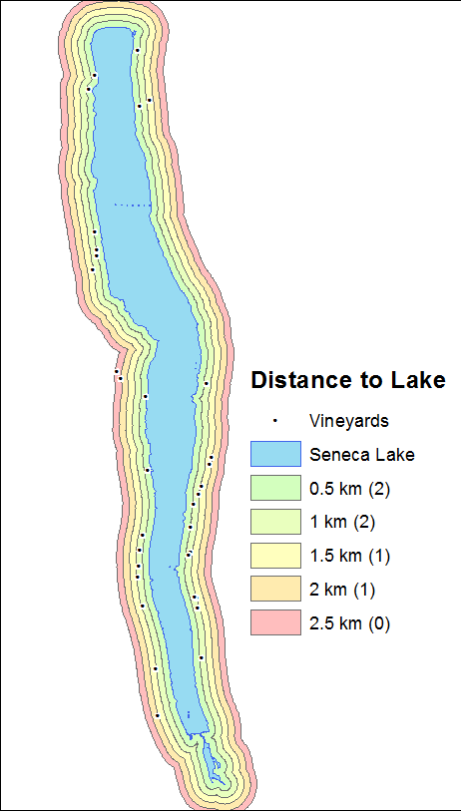
Results: Suitability

Slide 38
New Location for Mountain Bike Trails in New York
Raymond Latimer
GEO479

Slide 39
Objectives
Determine location for mountain biking trails
Determine what would be used to rank suitability of potential locations
Analyze DEM of selected location for suitability of trail building

Slide 40
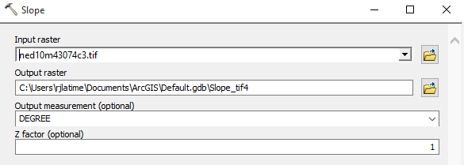
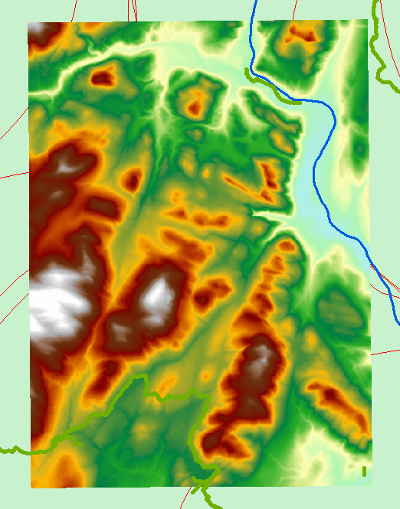
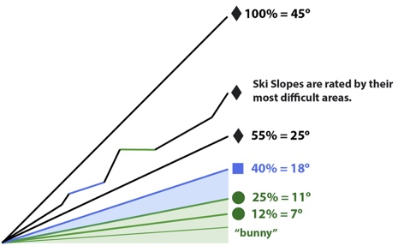
Method Design
Project each set of data using Projected Coordinate System NAD_1983_UTM_ZONE_18N
Use Selection by Location to find join of NY Roads and DEC roads and trails within Hamilton County, observe where this falls in Cathead Mountain
Slope Analysis of Cathead Mountain
Rank suitability for trails by slope degrees

Slide 41
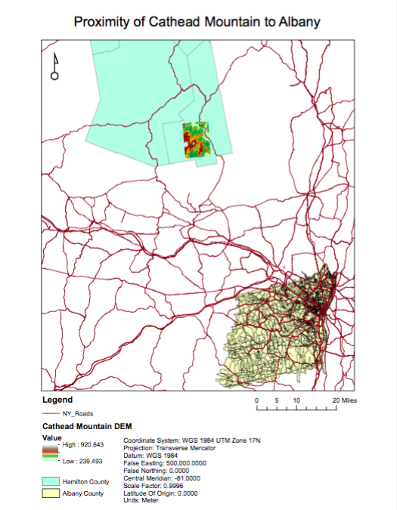

Conclusions
Slope 15 degrees and less is suitable for all types of riding
Cathead Mountain is ideal with approximately 75% of area suitable
Location is close to Albany and would see use
Meets all criteria, not on critical environmental areas, at intersection of DEC roads and trails and NY roads, majority of slope meets IMBA suggestions for trail building

Slide 42
Garden and Apiary Site Suitability
Jacob Leale
Geo 479

Slide 43
Objectives
Create a site suitability model for a new gardening space
Create a site suitability model for a new apiary site to re-establish the honey bee population that is now endangered

Slide 44
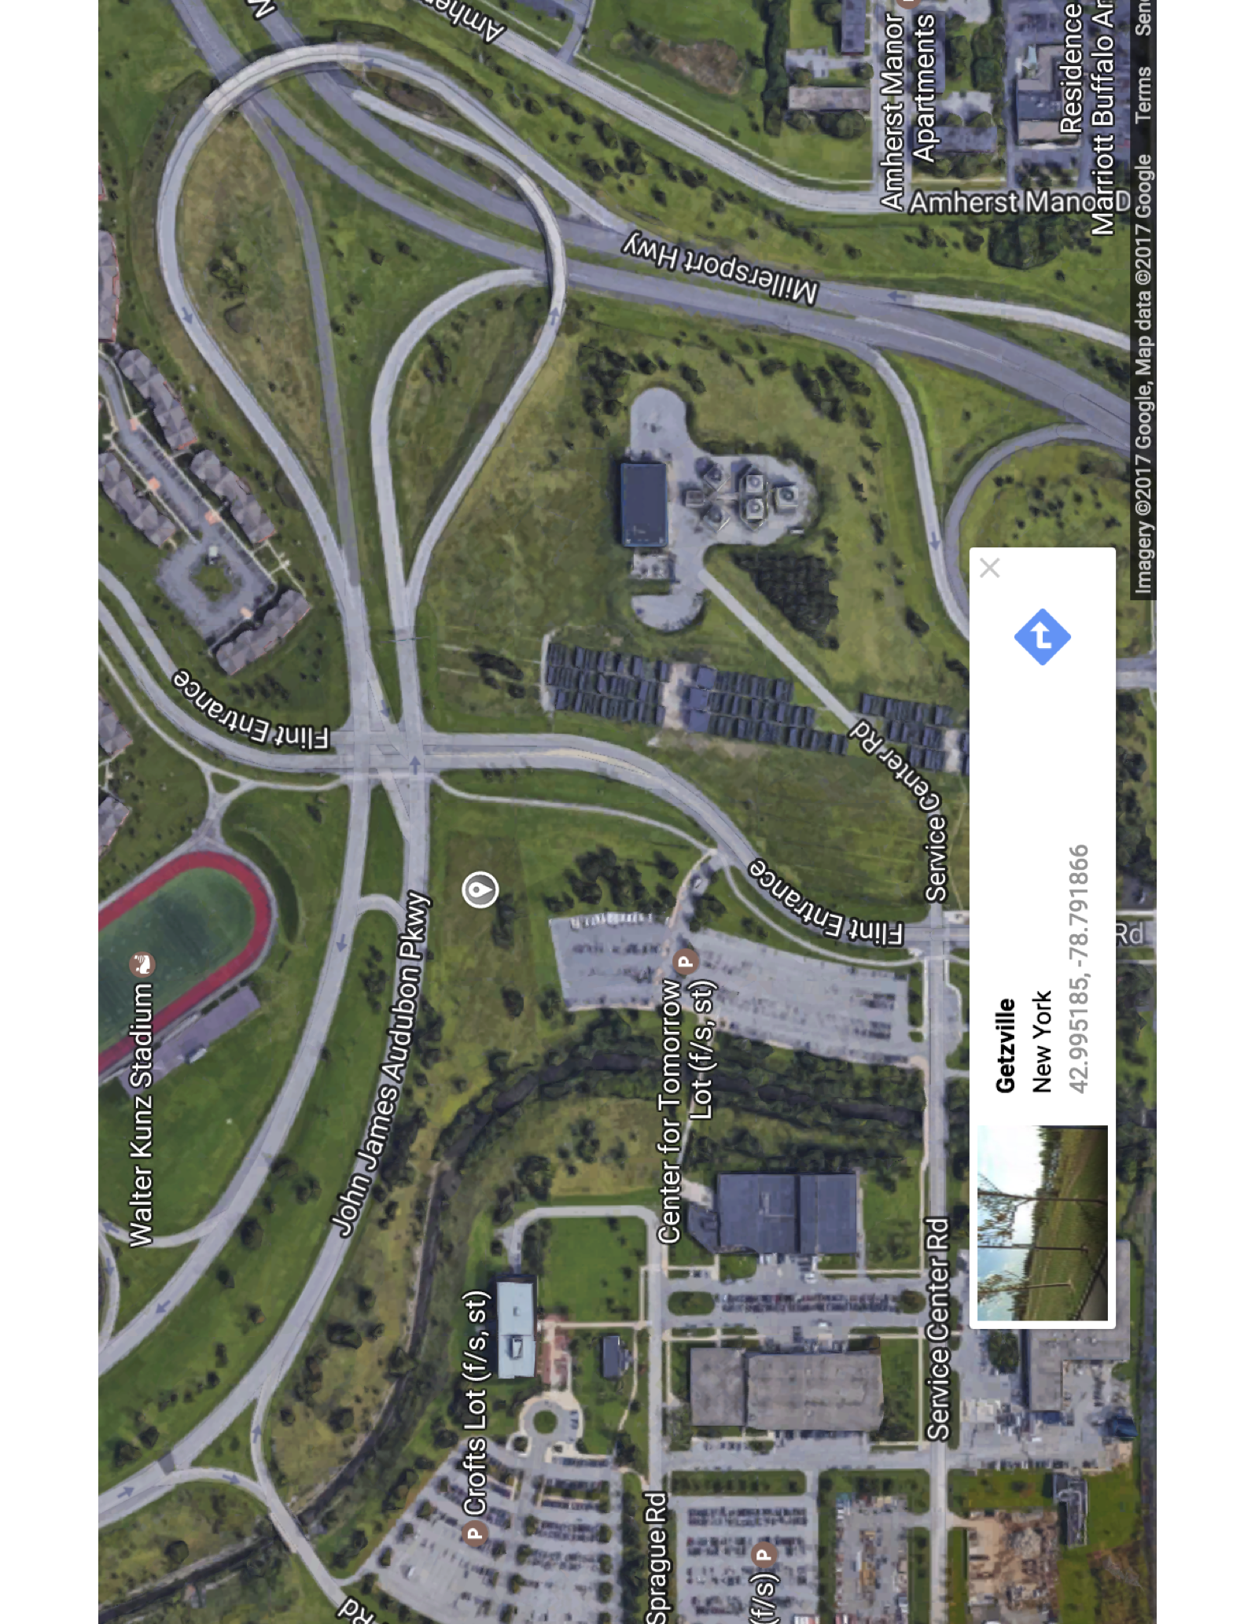
Study area

Slide 45
Methodology
4.1 Digitizing
The Orthos data collected provided raster layer of about 4 Hectares. The study area is much smaller than this, so the 136-yard by 83-yard plot was digitized for future model creation.
4.2 Slope
In order to proceed with all future terrain modeling, ‘Fill’ is applied to the 2m DEM data from NYS Orthos Online (New York State et al., 2017). The ‘Fill’ function fills in inconsistencies in data resolution, known as ‘Sinks.’ This is necessary to ensure proper delineation of basins and streams (ArcGIS Pro et al., 2017) This was then was then used to form the slope model. Slope is calculated using the source layer of the DEM through Arc Hydro Tools on Arcmap’s Slope tool. This tool takes the raw Dem raster values and allows it to generate the slope grid in percent or degree for a given DEM. Slope was applied to the digitized AOI.
2.3 Flow Direction
Flow direction was derived from the input function of the slope model to the terrain modeling function ‘Flow Direction’. The symbology was changed to ‘Single Arrow’ using the thinning method of vector average in order to visualize the direction of runoff water in the area.
2.4 Flow Accumulation
Flow accumulation takes flow direction as the input to compute the accumulated number of cells upstream of a cell for each cell in the input raster grid. In doing so, the model created reveals the areas that will be subjected to high saturation.
2.5 Slope with Accumulation Model
In order to see the areas that will be most affected by water accumulation during rainstorms, an algorithm was created using ‘Map Algebra’ under ‘Spatial Analyst Tools’: ‘Slope’+ ‘Flow Accumulation’. This new model highlights areas with a high slope and high flow, fig 2.
2.6 Soil type
Data from the Web Soil Survey (USDA) provided a .shp file which contained all of the soil classifications of UB’s North campus. Using the knowledge from Chris Renschler’s Introduction to Soils course with the database provides a great means to understand slope aspect and water accumulation as well without creating a model. Again, given the fact that this variable isn’t weighted as much as slope, water accumulation, and hill-shade value, this is the approach of evaluating soil quality.
2.7 Aspect
Aspect is the slope direction of the terrain. According to Akıncı, “However, in general, most cultigens exhibit optimum growth in the southern and western aspects that receive sunlight for a substantial portion of the day. For this reason, aspect is taken into consideration as an assessment criterion for selecting the land to be used for agriculture.” (Akıncı). By taking the 2m DEM digitized raster as the input function in ‘Surface’ under ‘Spatial Analyst Tools’, aspect was created. It was then reclassified to five new values 0, 90, 180, 270 and 360. This being the standard North, East, South and West respectively. In this way, it is better to visualize and pinpoint the aspect of the area.
2.8 Site Suitability model
This model is derived from an algorithm of the reclassified aspect model and the Slope with Accumulation model. In ‘Map Algebra’ the inputs were: ‘Reclassed_Aspect’+ ‘Slope_Accumulation’, as seen in figure 2 are the results.
2.9 Distance to Stream, walkway and wind cover
Using the base map from ArcMap as the layer for reference, it is with an holistic approach that Bizer Creek and the public walkways are the lines to which the buffers will be used to see if any intersections occur visually. It was also determined using the visual aid from the base map, to have wind cover be provided by an already established tree line on site.
2.10 Sites
A point.shp file was created using ArcCatalog in order to create an editable point raster layer. The points were determined holistically on site with members from the UB Campus Garden Club. It is through this project that those points will be analyzed

Slide 46
Conclusion
The area of interest holds great promise for establishing an apiary, garden plot and permaculture implementation that the UB Campus Garden Club will be using in the projected future. When establishing a garden, many factors have to be considered such as sunlight exposer, soil type, topography of the area, and water accumulation dynamics. When establishing an apiary factors such as distance from a water source, regulations from the county, and windbreakers are considered. Using ArcGIS software, suitability maps can be made using models, algorithms and preprogrammed statistical analyses. In this case, a more holistic approach was used for the apiary sites. It was found that site 3, figure 2, is the best location for a new garden plot and site 3 as well, as seen in figure 5, is the best location for an apiary. It is recommended that when establishing this new area for these purposes that permaculture methods are used to not only improve upon the soil quality and buffering implications to reduce the flow accumulation for decreasing the saturation, but also for the honeybees to have a source of flora for honey production. The club plans on coinciding with UB’s 2020 plan while trying to establish a hub of sustainability. The stakeholders involved are optimistic about this project, as this will be used in support for the garden club’s efforts in getting their project approval in the up coming semester.

Slide 47
Misogyny on Twitter
By: Li Tong

Slide 48
Data
Data collection: twitter api stored on servers at Oxford Internet Institute (oii).
key words: *****, ***** ****, ****
map of tweets
Income, education, unemployment rate data are from U.S. Census Buruea.

Slide 49
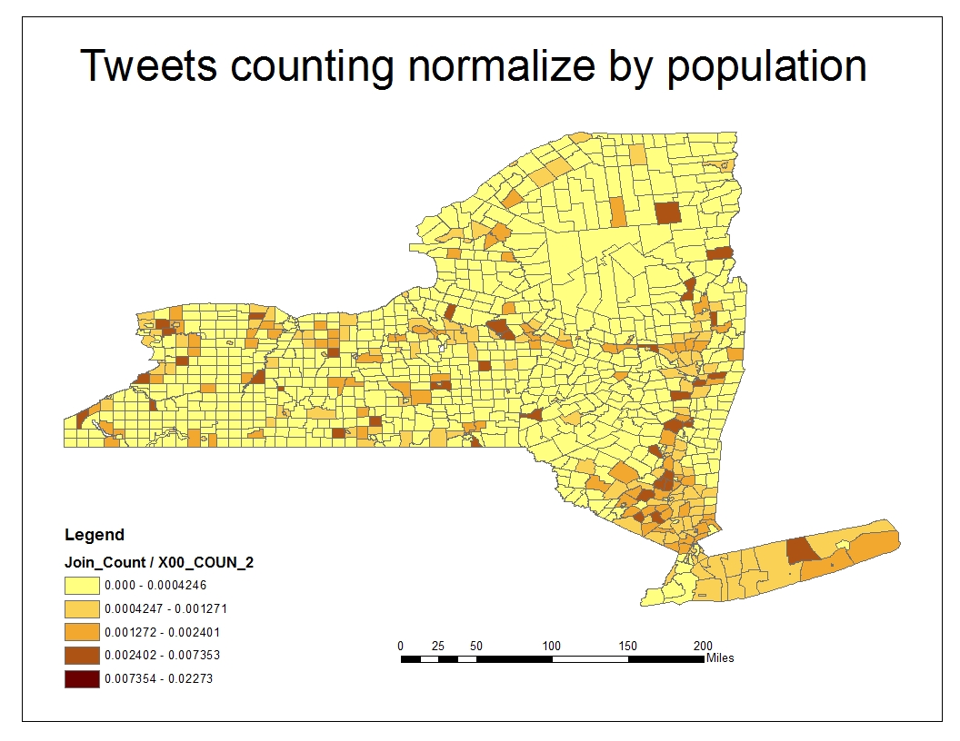
The misogynic tweets distribution

Slide 50
result
Cnt = 9.568 * income + 0.008242 * edu ^2 - 186/unep^2
R square = 0.5102
Cnt = the count of the tweet with misogyny words
Income ---- the median income in each county
Edu ----- the population of people who have experienced bachelor or higher education.
Unep ---- the unemployment rate of each county

Slide 51
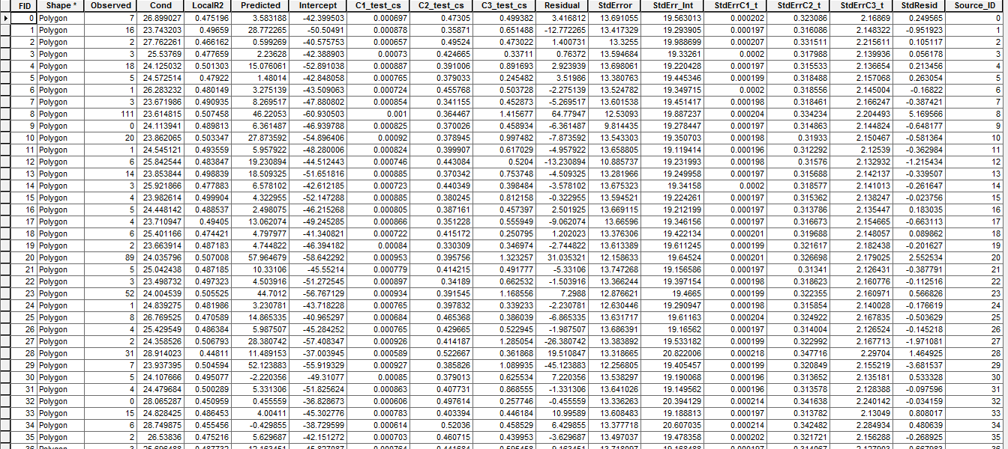
Spatial weighted regression

Slide 52
Investigation of the relationship between climate change and population change
Presented by: Xinghe Liu
GEO 559
Professor Bian

Slide 53
Objective
- Finding out the relationship between climate change and population change in Erie county and Cattaraugus county
(why these two?)
- Figuring out how different factors affect different counties

Slide 54
Regression
Dependent Variable | Independent Variables
Population | Temperature Precipitation Snowfall Growing Degree-Day Accumulation(GDD) Growing Season Length(above 32℉) Heating Degree-Day Accumulation Cooling Degree-Day Accumulation(CDD)
Ratio!
Population₂₀₁₀ / Population₂₀₀₀

Slide 55
Results
- For Erie county
Population change ratio = -1.9297 + 0.5247* Temperature change ratio
- 0.7953 * Precipitation change ratio
+ 6.8138 * GDD change ratio
- 3.6272 * CDD change ratio
R² = 0.8613
- For Cattaraugus county
Population change ratio = 0.5028 – 0.5421x10⁻⁵ * Temperature change ratio
- 4.136x10⁻³ * Precipitation change ratio
+ 1.251 * GDD change ratio
- 0.5519 * CDD change ratio
R² = 0.6257

