Slide 1
Spatial Interpretation

Slide 2
1. Definition
A procedure of estimating the values of properties at un-sampled sites
The property may be interval/ratio values, can be nominal and ordinal
The rational behind is that points close together in space are more likely to have similar values than points far apart

Slide 3
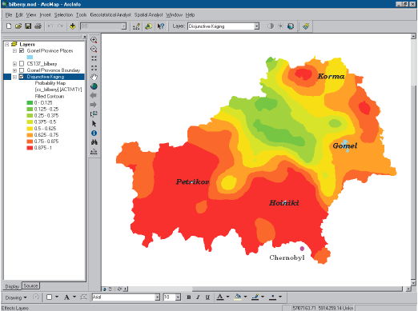
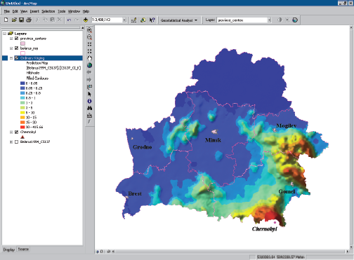

Slide 4
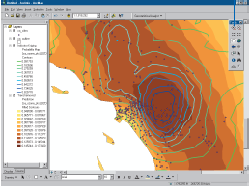
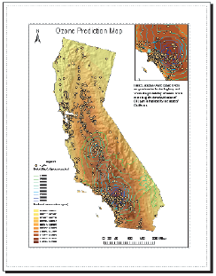
2. Terminology
Point vs. line vs. areal interpolation
point - point, point - line, point - areal

Slide 5
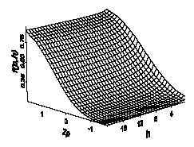
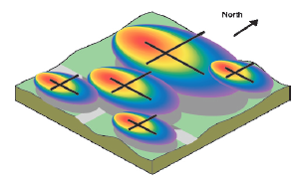
2. Terminology …
Global vs. local interpolation
  Global - apply a single function across the entire region
  Local - apply an algorithm to a small portion at a time

Slide 6
2. Terminology …
Exact vs. approximate interpolation
  exact - honor the original points
  approximate - when uncertainty is involved in the data
Gradual vs. abrupt

Slide 7
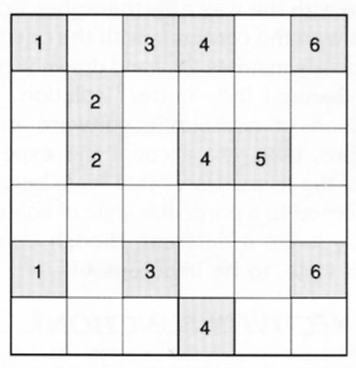
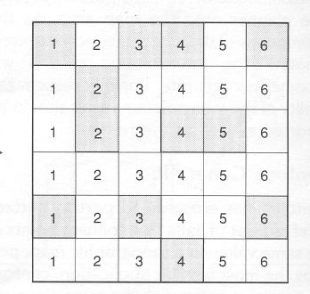
3. Interpolation - Linear
Linear interpolation
Known and predicted values after interpolation
Known values

Slide 8
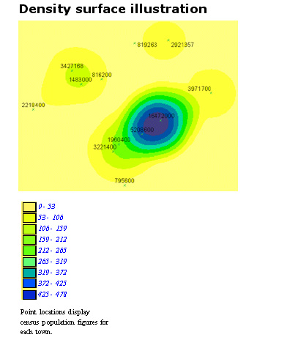
3. Interpolation - Linear
Assume that changes between two locations are linear

Slide 9
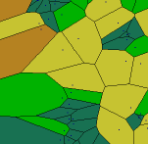
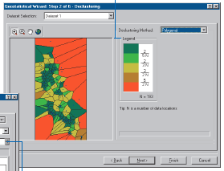
3. Interpolation - Proximal
Thiesson polygon approach
Local, exact, abrupt
Perpendicular bisector of a line connecting two points
Best for nominal data

Slide 10
Construction of Polygon
+ 130
+ 200
+ 180
+ 150
+ 130
Polygon of influence for x=180

Slide 11
Construction of Polygon..
+ 130
+ 200
+ 180
+ 150
+ 130
Draw line segments between x and other points

Slide 12
Construction of Polygon..
+ 130
+ 200
+ 180
+ 150
+ 130
Find the midpoint and bisect the lines.

Slide 13
Construction of Polygon..
+ 130
+ 200
+ 180
+ 150
+ 130
Extend the bisecting lines till adjacent ones meet.

Slide 14
Construction of Polygon..
+ 130
+ 200
+ 180
+ 150
+ 130
Continue this process.

Slide 15
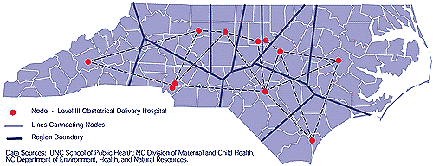
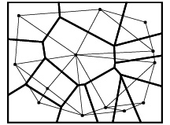
3. Interpolation - Proximal

Slide 16
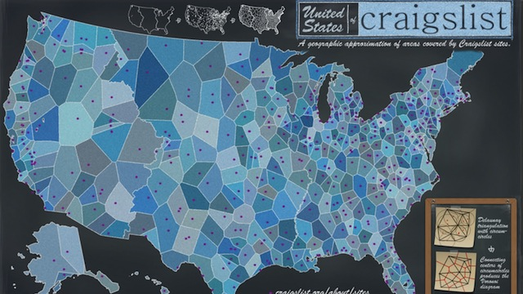
3. Interpolation – Proximal ..
http://gizmodo.com/5884464/

Slide 17


Slide 18
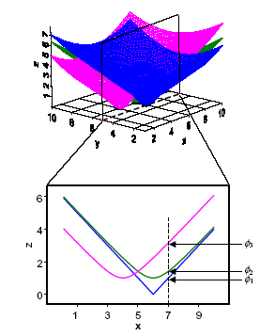
3. Interpolation – B-spline
Local, exact, gradual
Pieces a series of smooth patches into a smooth surface that has continuous first and second derivatives
Best for very smooth surfaces e.g. French curves

Slide 19
3. Interpolation – Trend Surface
Trend surface - polynomial approach
Global, approximate, gradual
Linear (1st order): z = a₀ + a₁x + a₂y
Quadratic (2nd order):
z = a₀ + a₁x + a₂y + a₃x²
+ a₄xy + a₅y²
Cubic etc.
Least square method

Slide 20
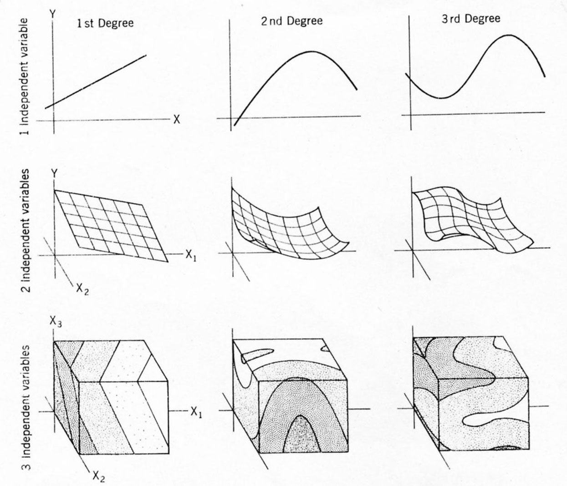
Trends of one, two, and three independent variables for polynomial equations of the first, second, and third orders (after Harbaugh, 1964).

Slide 21
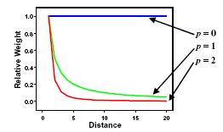
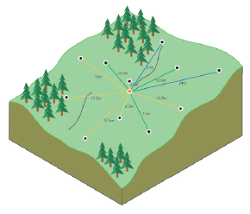
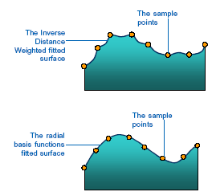
3. Interpolation – Inverse Distance
Local, approximate, gradual
Σ w_{i}z_{i} 1
z = --------, w_{i} = -----, or w_{i} = e ^{-pd}_{i} etc.
Σ w_{i} d_{i}^{p}

Slide 22
3. Interp – Fourier Series
Sine and cosine approach
Global, approximate, gradual
Overlay of a series of sine and cosine curves
Best for data showing periodicity

Slide 23
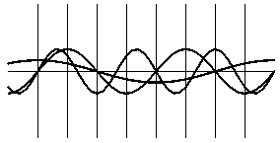
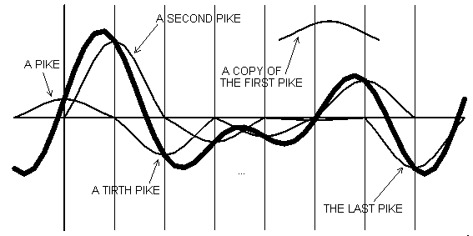
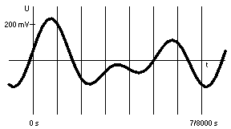
3. Interp – Fourier Series

Slide 24
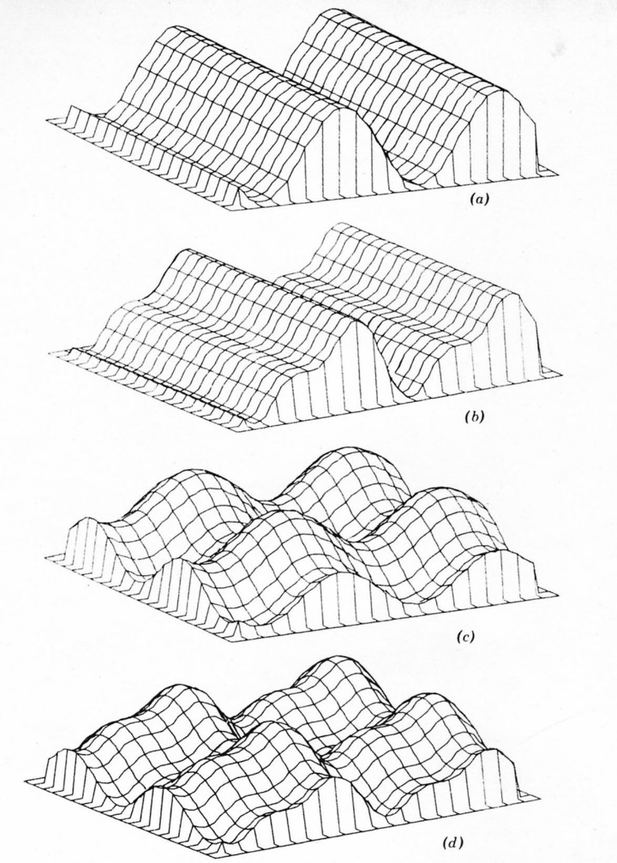
3. Interp – Fourier Series
Fourier series
Single harmonic in X₁ direction
Two harmonics in X₁ direction
Single harmonic in both X₁ and X₂ directions
Two harmonics in both directions

Slide 26
3. Interp - Kriging
Kriging - semivariogram approach, D.G. Krige
Local, exact, gradual
Spatial dependence (spatial autocorrelation)
Regionalized variable theory,
by Georges Matheron
A situation between truly random and deterministic
Stationary vs. non-stationary

Slide 27

3. Kriging
First rule of geography:
Everything is related to everything else. Closer things are more related than distant things
By Waldo Tobler

Slide 28
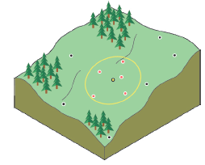

Slide 29
3. Interp - Kriging
Semivariogram
1 n
γ(h) = ------ Σ (Z_{i} - Z_{i+h})²
2n i=1
Sill, range, nugget
Semivariance
Sill
Range
Lag distance (h)

Slide 30
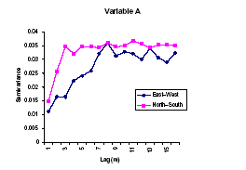
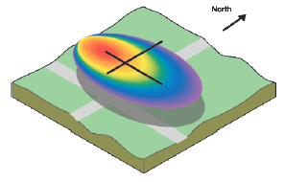
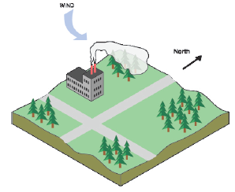
3. Kriging
Isotropy vs. anisotropy

Slide 31
4. Summary Statistics
Parameters (for populations) m, s², s
Statistics (for samples), x, S², S

Slide 32
4. Basic Statistics
Measures of location
mean, median, mode, minimum,
maximum, lower and upper quartiles
Measures of spread
variance, standard deviation
Correlation
covariance, correlation coefficient

