Slide 1
Environmental Modeling
Weighting GIS Layers

Slide 2
1. A Hydrologic Model
To estimate groundwater recharge in order to issue water pump permission
Statistics: Multiple Regression
Sophocleous, M., 1992. Groundwater recharge estimation and regionalization: the Great Bend Prairie of central Kansas and its recharge statistics. Journal of Hydrology, 137:113-140.

Slide 3
2. Variables
Dependent variable:
groundwater recharge

Slide 4
2. Variables
Independent variables:
1. annual precipitation
2. soil-profile water storage during spring
3. depth to water table in spring
4. spring precipitation rate
= spring precip/# of spring precip days
5. number of precip days during the year

Slide 5
At each location, collect values for both the dependent variable and the independent variables

Slide 6
3. Regression
Independent variables 1-4 are included in the regression
Variable 5 is excluded because
the level of sig> 0.05 for F test
Recharge = -48.8347 + 0.1917X₁ - 0.0829X₂
- 4.9594X₃ + 5.3639X₄
R² = 0.76

Slide 7
3. Regression
Recharge = -145.6206 + 0.3449 precip
R² = 0.5793
Recharge = -48.2453 + 0.2869 precip - 0.1097 soil water
R² = 0.6895
Recharge = -9.3727 + 0.2459 precip - 0.0819 soils water
– 5.2387 water level
R² = 0.7381
Recharge = -48.8347 + 0.1917 precip - 0.0829 soil water
– 4.9594 water level +5.3639 precip rate
R² = 0.7575

Slide 8
Regression Results
Analysis of variance
DF Sum of Squares Mean Square
Regression 3 97747.09184 32583.03061
Residual 36 7061.68316 196.15787
F = 166.10616 Signif F = 0.0000
Multiple r 0.87328
R Square 0.76262
Adjusted R Square 0.75701
Standard Error 14.00564

Slide 9
Regression Results
Variables in the Equation
Variable b Se b Beta t Sig t
X₁ 0.1917 0.001715 0.725998 6.262 0.0000
X₂ -0.0829 0.001219 -0.994050 -16.161 0.0000
X₃ -4.9594 11.079785 -0.052423 -0.4841 0.0310
X₄ 5.3639 7.3908 7.9273 -0.932 0.0926
Recharge =
-48.8347 + 0.1917prcip - 0.0829soil water - 4.9594water level + 5.3639precip rate

Slide 10
4. GIS Overlay
Extend the site-specific relationship to the entire study area
The regression establishes a quantitative relationship between recharge and the independent variables
Recharge = -48.8347 + 0.1917X₁ - 0.0829X₂
- 4.9594X₃ + 5.3639X₄
Recharge(σ) = -48.8347 + 0.725998X₁
- 0.994050X₂ - 0.052423X₃ + 7.9273X₄

Slide 11
4. GIS Overlay
This result is derived from point locations. We need to estimate recharge for the entire study area

Slide 13
4. GIS Overlay
For any location that has values for the four independent variables, we can calculate the recharge for that location
The values of the four independent variables can be obtained from GIS layers, one layer for each independent variable

Slide 14
4. GIS Overlay
GIS layers
1. annual precipitation, NCDC, spatial
interpolation
2. spring soil storage, data?
3. depth to water table, well log, spatial
interpolation
4. spring precipitation rate, climatic
stations

Slide 15
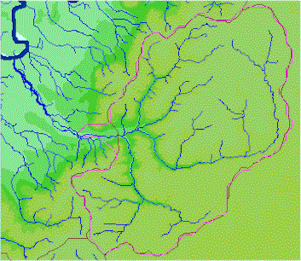
X₁: Annual Precipitation

Slide 16
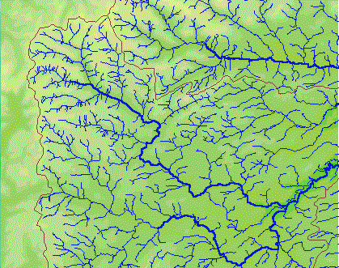
X₂: Spring Soil Storage

Slide 17
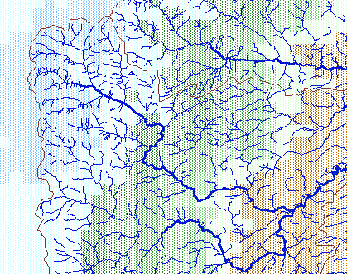
X₃: Depth to Water Table

Slide 18
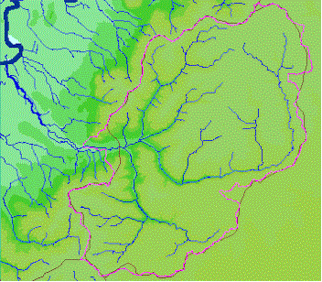
X₄: Spring precipitation Rate

Slide 19
4. GIS Overlay
Recharge potential =
- 48.8347
+ 0.1917 X₁ (annual precip)
- 0.0829 X₂ (spring soil storage)
- 4.9594 X₃ (depth to water table)
+ 5.3639 X₄ (spring precip rate)
The result is a potential groundwater recharge map with a 0.76 accuracy

Slide 20
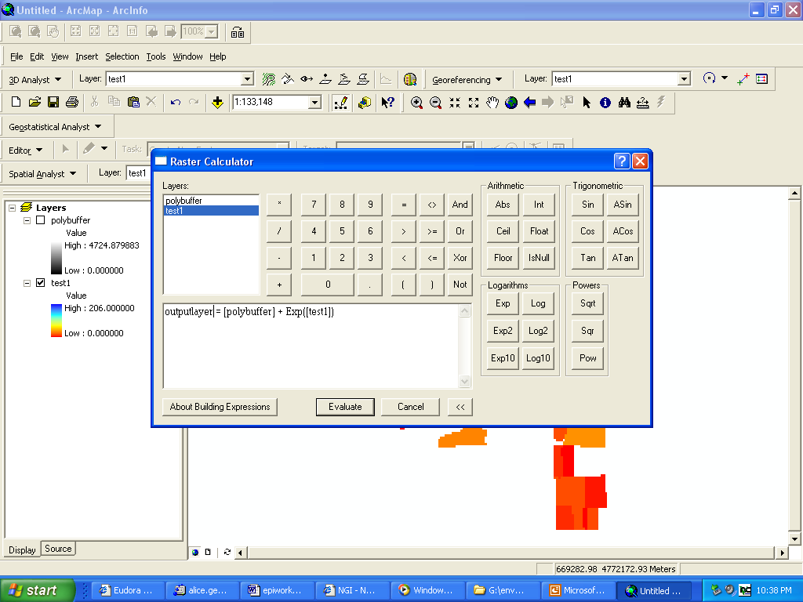

Slide 21
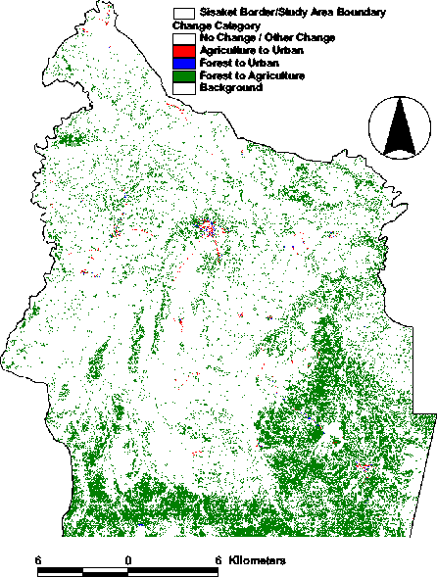
Independent Variable 1: Land Cover Change

Slide 22
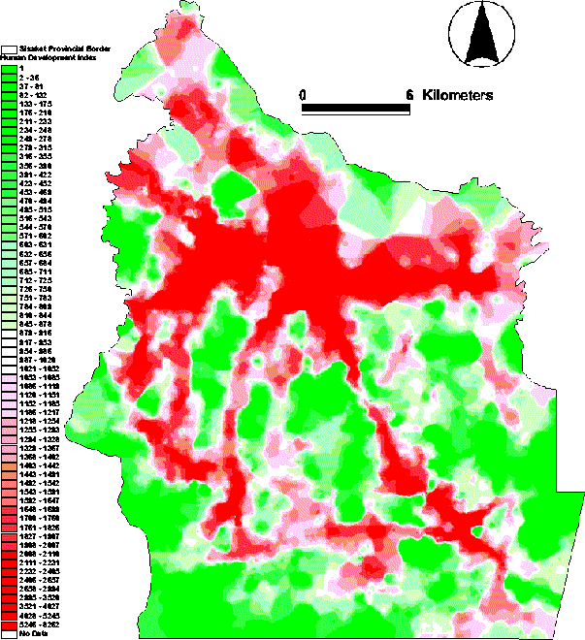
Independent Variable 2: Human Development Index

Slide 23
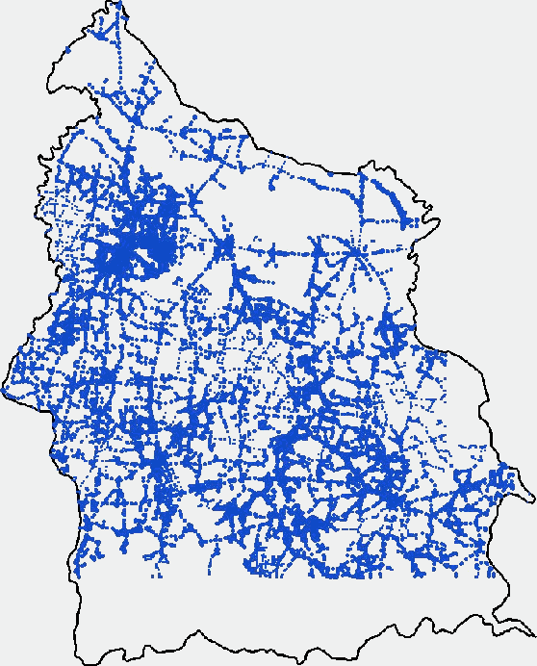
Independent Variable 3: Population Value

Slide 24
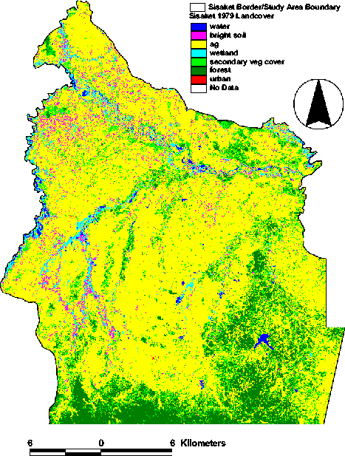
Independent Variable 4: Land Cover

Slide 25
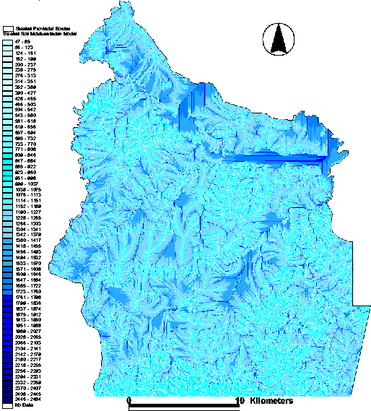
Independent Variable 5: Soil Moisture

Slide 26
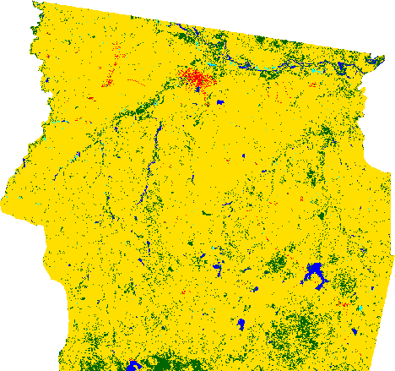
Dependent Variable: Predicted Land Cover

Slide 27
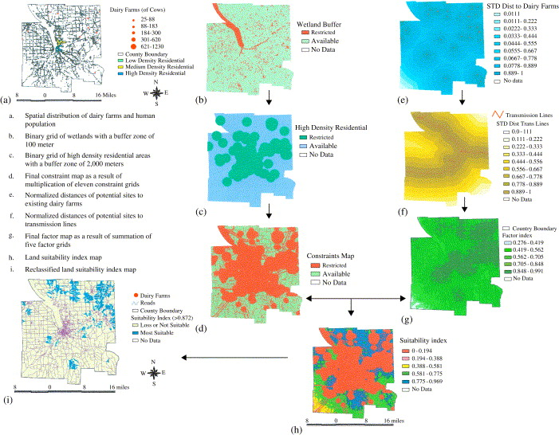
Results

