Slide 1
Environmental Modeling
Validating GIS Models

Slide 2
1. A Habitat Model
Issues:
Mapping Florida Scrub Jay habitat
in the Kennedy Space Center
Breininger, D.R., M.J. Provancha, and R.B. Smith, 1991. Mapping Florida Scrub Jay habitat for purposes of land-use management. Photogrammetric Engineering and Remote Sensing, 57(11):1467-1474.

Slide 3
1. A Habitat Model
Factors
Primary habitat:
Oak forest on well drained soils
Secondary habitat:
Oak forest on poorly drained soils, and within 300m from the primary habitat
Non-habitat
Oak forest on poorly drained soils and 300m
away from the primary habitat, or non-oak

Slide 4
2. Data
Soil, well or poorly drained
Data source:
Vegetation, oak forest or non-oak
Data source:

Slide 5
3. GIS Analysis
Overlay: vegetation + soils =
1. oak & well drained soils (primary),
2. oak & poorly drained soils (secondary),
3. Non-oak (non-habitat, well or poorly drained).
Proximity: 300m buffer around the primary
Overlay:
1. oak&welldrainedsoil = primary
2. oak&poor & inside_buffer_zone = secondary
3. oak&poor & outside_buffer = non-habitat

Slide 6
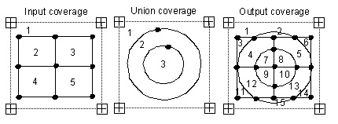
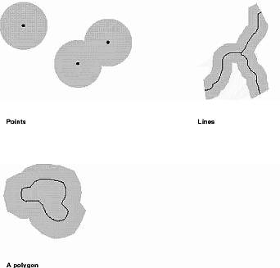

Slide 8
4. Model Validation
Validate the GIS model (veg+soil+300m buffer)
Is the model correct in locating the primary,
secondary, and non-habitat?
Collect data in the field at 75 sites
independent of the mapped data
Variables:
density of the oak trees,
presence/absence of the Jay.

Slide 10
4. Model Validation
Habitat, using data collected from the 75 sites
H1: oak density = normal;
K-S test for normality
accept or reject the null hypothesis
H2: oak in primary habitat = oak in secondary
t-test or Mann-Whitney
accept or reject the null hypothesis
H3: oak in secondary = oak in non-habitat
t-test or Mann-Whitney
accept or reject the null hypothesis

Slide 11
4. Model Validation
Jay, using the data collected from the 75 sites
H1: Jay counts = normal
K-S test for normality
accept or reject the null hypothesis
H2: Jay in primary habitat = in secondary
t-test or Mann-Whitney
accept or reject the null hypothesis
H3: Jay in secondary = in non-habitat
t-test or Mann-Whitney
accept or reject the null hypothesis

Slide 12
4. Model Validation
Conclusion
Is the GIS model correct in locating primary,
secondary, and non habitats?

Slide 13
5. Error Matrix
A.K.A. a confusion matrix or a contingency table.
It compares, on a category by category basis, the relationship between known reference data (truth) and the corresponding results of a classification.
Each matrix is square, with the number of rows and columns equal to the number of categories.
It is used here to assess whether oaks in the primary habitat have a high density and the secondary habitat has a low density.

Slide 14
5. Error Matrix
Mapped Category
True Category Primary Secondary Total
Oak >= 50% 15 5 20
Oak < 50% 3 52 55
Total 18 57 75
Accuracy of the oak forest map: 89%

Slide 15
5. More on Error Matrix
Reference Classified Data
Data Water Forest Urban Grassland Row Total
Water 30 5 5 0 40
Forest 5 65 0 10 80
Urban 0 5 40 5 50
Grassland 0 0 5 25 30
Col Total 35 75 50 40 200
Overall accuracy = 160/200 = 80%
Commission error for forest = 10/75 = 13.3%
Omission error for forest = 15/80 = 19.8%

Slide 16
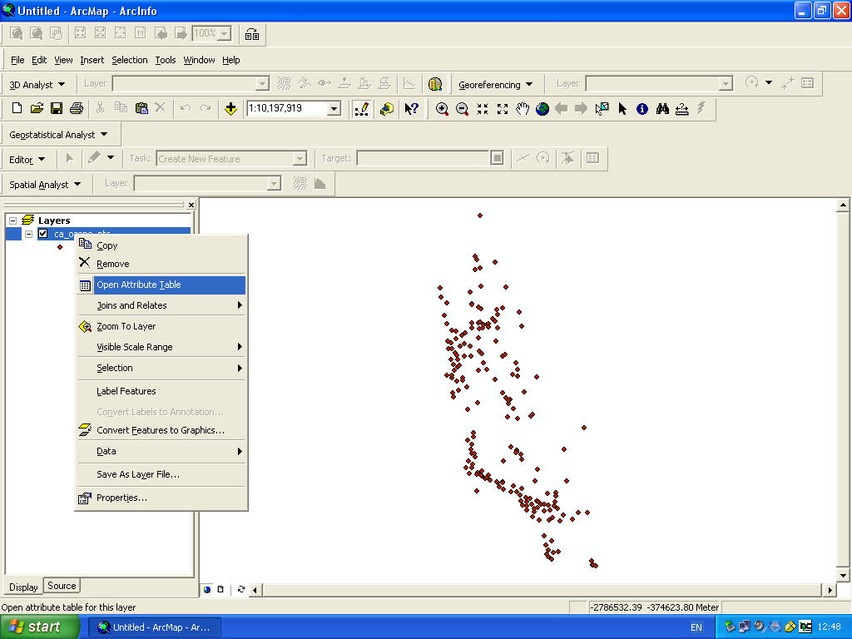

Slide 17
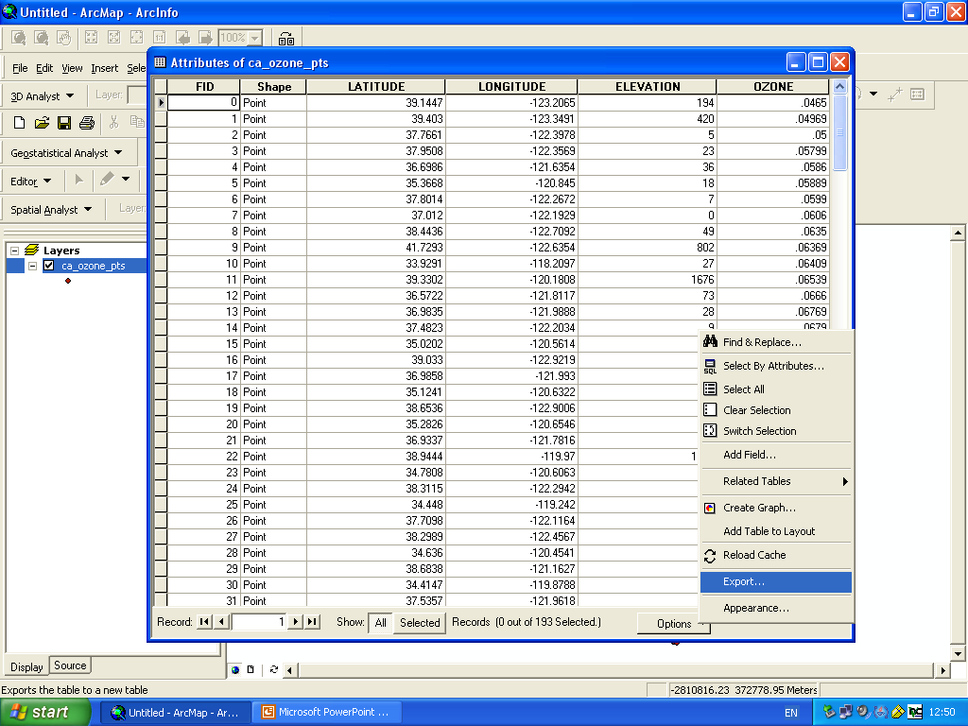

Slide 18
