Slide 1
Environmental Modeling Basic Testing Methods - Statistics II

Slide 2
4. Χ² Test
Test for goodness of fit between the distribution of a sample and a predefined distribution
can be used for nominal and ordinal data, i.e. count data
divide a distribution into k categories
can be used for nonparametric statistics

Slide 3
Χ² Test
Null hypothesis: the sample has a known distribution
k (O_{j} - E_{j})² O_{j}- number of observed
X² = Σ ------------- E_{j}- number of expected
1 E_{j}

Slide 4
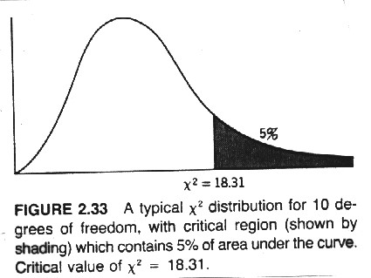
If X² value > critical value, reject the null hypothesis
Check whether p<α, if so, reject the null Hyp
Otherwise accept the null that the sample has an expected distribution

Slide 5
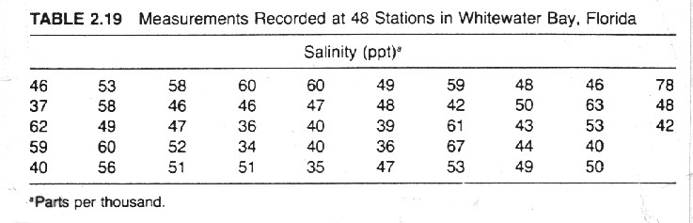
Null hypothesis: the sample has a normal distribution
Standardize the data:
X_{i} - X
Z_{i} = --------
S

Slide 6
Χ² Test - normal distribution
Divide the normal distribution evenly into n categories
Assign the sample into the n categories
Compare the computed Χ² value to the Χ² critical values (one-tailed) for specified degrees of freedom and level of significance

Slide 7
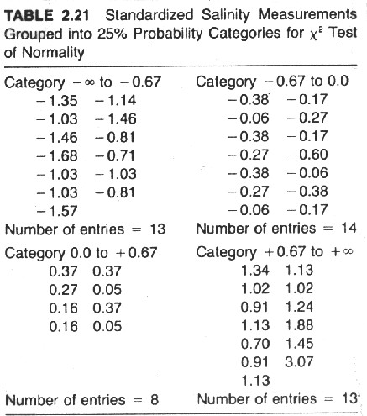
t Calculation

Slide 8
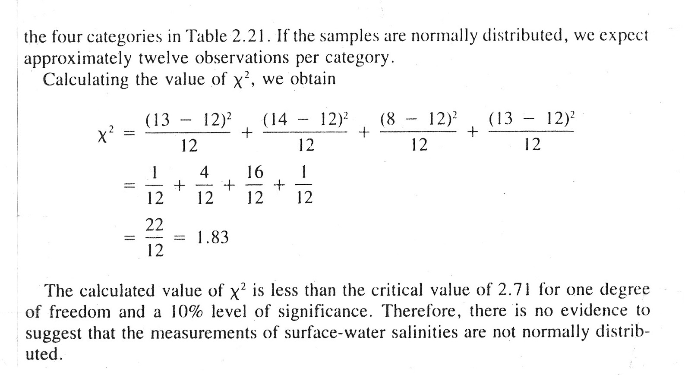

Slide 9
If X² value > critical value, reject the null hypothesis, check whether p<α
otherwise accept the null that the sample has a normal distribution

Slide 10
5. Kolmogorov-Smirnov Test
Nonparametric substitute for X² test
It does not group data into categories
It is more sensitive to deviations in the tails

Slide 11
Fit a sample to a normal distribution of unspecified m and s
Null hypothesis: the sample has a normal distribution
Standardize the data:
X_{i} - X
Z_{i} = ---------
S

Slide 12
Plot a normal distribution and the sample in cumulative form
Find the maximum absolute difference between the two curves
K-S = |normal - sample|

Slide 13
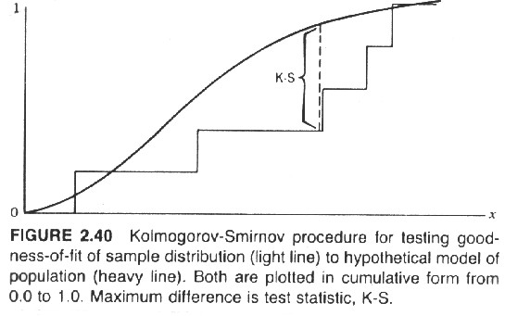
:

Slide 14
Compare the computed K-S value to K-S critical values (one/two-tailed) for specified sample size and level of significance
If the K-S value > critical value, reject the null hypothesis
Check whether p<α, if so, reject the null hypothesis

Slide 15
t Calculation

Slide 16
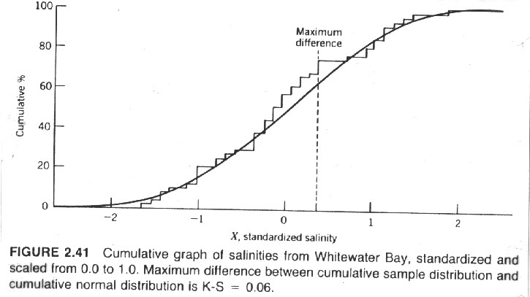

Slide 17
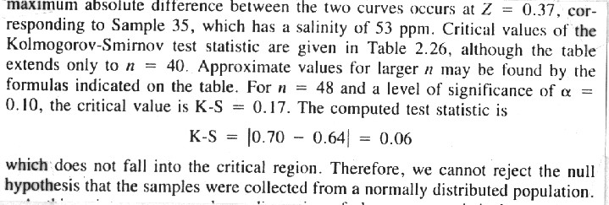

Slide 18
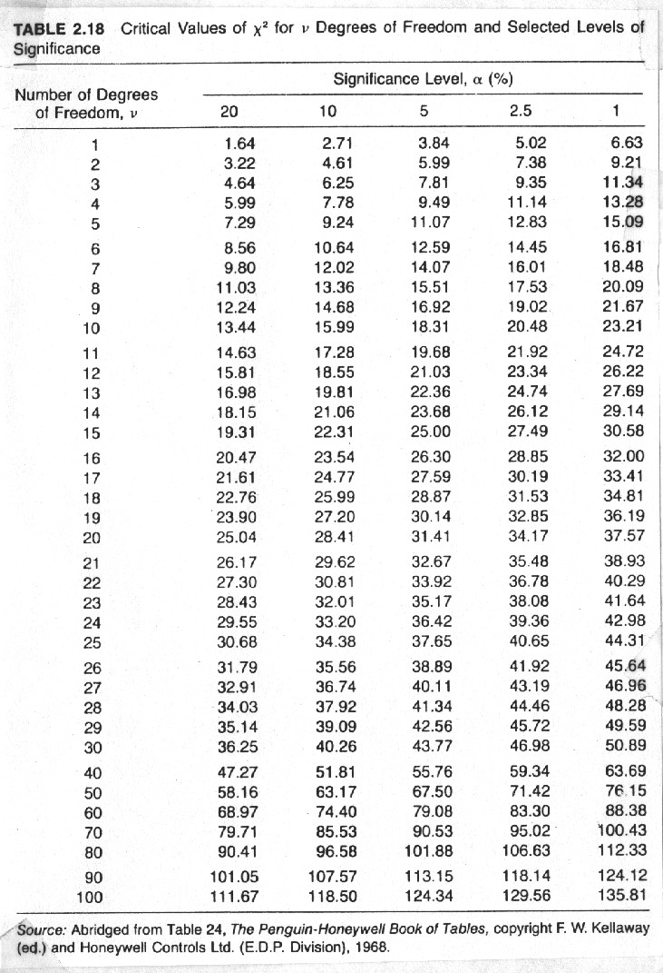
Χ² Test

Slide 19
