Slide 1
Environmental Modeling Basic Testing Methods - Statistics

Slide 2
ESRI Annual Recruit
ESRI recruiters coming to town Feb 24, 25 (Mon-Tue)
- Mon Feb 24, 6:00-8:00pm, 144 Wilkeson
Info Session
- Tue Feb 25, interview,
Apply by sending resume, cover letter, and
availability to nkelch@esri.com by Wed Feb 19.

Slide 3
1. Basic Statistics
Parameters (for populations) μ, σ², σ
Statistics (for samples) x, S², S
Variance S²
Standard deviation S
Normal distribution
Significance α

Slide 4
Basic Statistics
Parametric statistics
- for test distributions with known parameters
Non-parametric statistics
- parameters are unknown
- non-normal distributions, small sample sizes
- use low rank data such as nominal and ordinal

Slide 5
Basic Statistics
Parametric is more powerful when the parameters are known
Otherwise non-parametric is more powerful

Slide 6

2. t Test
Test for equality of means of two samples
Assumptions: random samples, normal distribution, and equal variance
Null hypothesis: h₀: X₁ = X₂
t =$\frac{X₁−X₂}{Se}$, $Se=Sp\sqrt{\frac{1}{n₁}+\frac{1}{n₂} }$, ${ Sp}^{2}=\frac{\begin{aligned} \\ {(n₁−1)S₁}^{2}+(n₂−1){S₂}^{2}\end{aligned}}{\left(n₁−1\right)+(n₂−1)}$

Slide 7
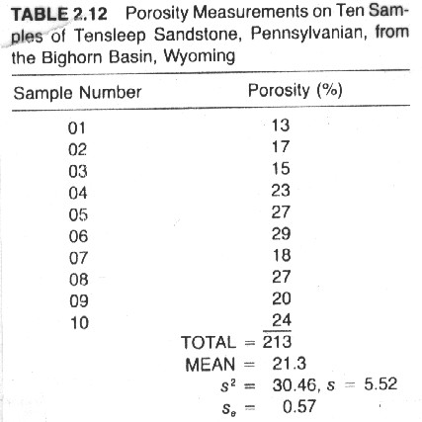
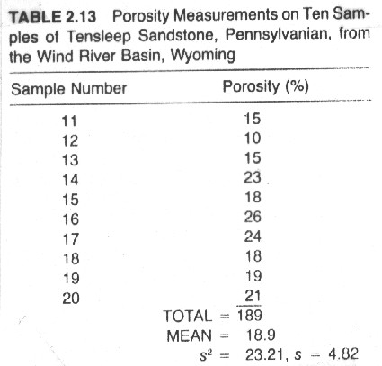
t Calculation

Slide 8
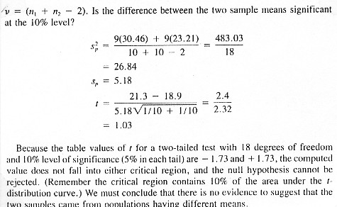
t Calculation

Slide 9
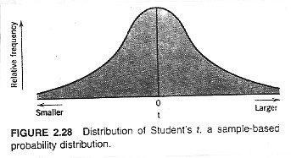
t Distribution

Slide 10
t test:
Compare the computed t value to the t table value (two-tailed) for specified degrees of freedom and level of significance
If the t > +critical value or t < -critical value, reject the H₀
The computer output will provide a p value. If p<α, reject the H₀
Otherwise accept the null hypothesis that the two means are from the same population

Slide 11
3. Mann-Whitney Test
Nonparametric substitute for t test of the equality of two means
Null hypothesis:
Combine the two sets (n,m) of data and rank them from 1 to n+m
n n(n + 1)
T = Σ R(X_{i}) - -------------, R(X_{i}) R(Y_{i}) are the ranks of X_{i}, Y_{i}
1 2

Slide 12
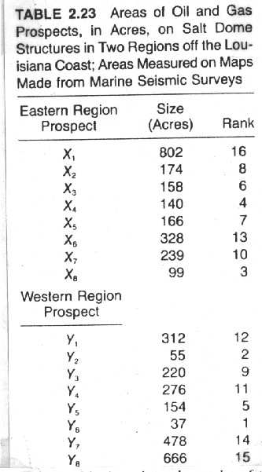
Mann-Whitney Test

Slide 13
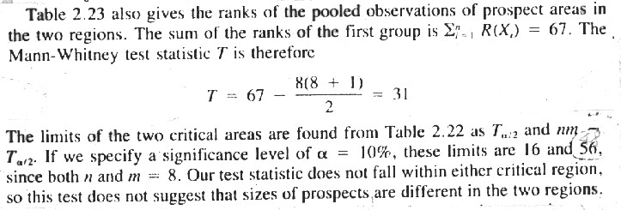
Mann-Whitney Test

Slide 14
Mann-Whitney Test
Compare the computed T value to the T table values (two-tailed)
for specified sample size (n) and level of significance
For the upper critical value
T_{1-a} = nm - T_{a}
Tied data are assigned averaged ranks, e.g. R(Xi)=R(Yi)=(8+9)/2=8.5
If T falls outside critical values, reject the H₀, or p<α

Slide 15
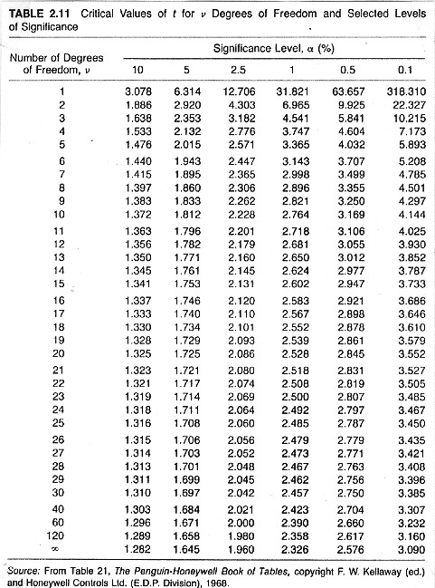

Slide 16
