Slide 1
Environmental Modeling
Testing GIS Layer Relevancy

Slide 2
1. A Habitat Model/Factors
Determine potential sighting locations of Grizzly bear in a park
Factors 1. Land cover types 2. Species richness 3. Species interspersion
Agee, J.K., S.C.F. Stitt, M. Nyquist, and R. Root, 1989. A geographic analysis of historical Grizzly Bear sightings in the North Cascades. Photogrammetric Engineering and Remote Sensing, 55(11):1637-1642.

Slide 3
2. Raw Data
Land cover
Source: satellite images, digital aerial photos, land cover data, GAP data
Existing bear sighting data: 91 locations

Slide 4
3. Data Layer Preparation
1. Land cover
22 types identified
2. Species richness
The total number of unique land cover types in a 3x3 or larger window
3. Species interspersion
The number of cells with land cover types different from the center cell

Slide 5
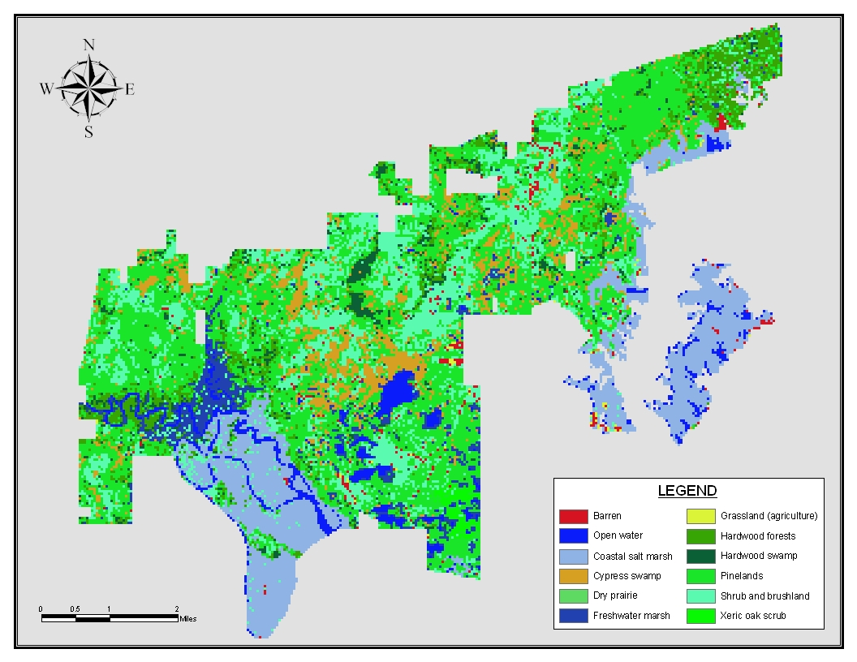

Slide 6
3. Data Layer Preparation
Moving windows
Richness
Interspersion
3 4 5 0 1
6 8 3 1 5
3 4 0 2 1
3 8 0 5 1
6 7 5
5 7 5
8 8 6
8 7 8
These result in three raster layers

Slide 7
3. Data Layer Preparation
4. The window size can be 5x5, 7x7, 9x9, .....
The optimal window size is the one with the greatest difference in richness or interspersion
The "difference" can be absolute value range or variance for richness or interspersion
5. In addition to the 91 sightings sites, generate another set of 91 random locations

Slide 9
4. Statistical Analysis
Determine whether each of the three variables is relevant
For each of the 91 sighting sites and
each of the 91 random sites, record
1. Land cover types (nominal)
2. Species richness (ratio) 3. Species interspersion (ratio)

Slide 10
4. Statistical Analysis
Determine whether each of the three variables is statistically the same between the 91 bear sighting sites and the 91 random sites.
1. Land cover types (nominal)
2. Species richness (ratio) 3. Species interspersion (ratio)

Slide 11
4. Statistical Analysis ..
Develop the raster layers first
Then generate the 91 random sites
Lastly, extract values from the three layers (land cover, spp richness, spp interspersion) for the two sets of 91 sites

Slide 12
Tech Tips
To generate random points, use
Hawth's tools
http://www.spatialecology.com/htools/tooldesc.php
If Hawth’s tools does not work for ArcGIS Pro,
try the following:
ArcToolBox - Data Management Tools –
Sampling - Create Random Points

Slide 13
Tech Tips ..
To extract values from the raster layers and
export to point shapefiles, use
Spatial Analyst Tools -> Extraction -> Extract Values to Points

Slide 14
4. Statistical Analysis
1. Does the allocation of land cover types differ between the bear sighting sites and the random sites
Null H₁: the number of each cover type used by bear = that of each type of the random sites
Assuming that the random sites represent the entire area
Χ² test Accept or reject the null
This could have been the case, but the paper tested it in a different way

Slide 15
4.1 Stats
Null H_{1paper}: % of each cover type used by bear =
% of each type in the random sites
Χ² test
number of categories?
in each category
number of observed?
number of expected (91sites/22types)?

Slide 16
Land cover types of the area and at bear sighting sites
Cover type %Area Expected# Actual#
Douglas Fir 10.1 9.2 7
Subalpine fir 10.2 9.3 10
Whitebark pine 2.2 1.5 8
Mountain hemlock 3.8 3.5 5
Pacific silver fir 8.4 7.7 4
Western hemlock 10.1 9.2 7
Hardwood forest 1.2 1.1 0
Tall shrub 4.9 4.5 4
Lowland herb 8.5 7.7 12
…… ….. ….. ….
Total (22 types) 100% 91 91

Slide 17
4.1 Stats
Null H_{1paper}: % of each cover type used by bear =
% of each type in the random sites
Χ² test
reject the null hypothesis
- land cover makes a difference in bear’s sighting

Slide 18
4. Statistic Analysis
2. Does species richness differ between the sighting sites and the random sites? Or whether richness makes a difference?
Null H₂: richness of sighting sites =
richness of random sites, Test ?
Accept or reject the null
richness of sighting sites = random sites?

Slide 19
4. Statistic Analysis
Null H₂: richness of sighting sites =
richness of random sites, Test ?
t test
Accept the null
mean richness of sighting sites = random sites
- spp richness dose not make a difference in bear’s sighting

Slide 20
4. Statistic Analysis
3. Does species interspersion differ between the sighting sites and the random sites? Or whether interspersion makes a difference?
Null H₃: interspersion of sighting sites =
interspersion of random sites, Test ?
Accept or reject the null
Mean interspersion sighting sites = random sites?

Slide 21
4. Statistic Analysis
Null H₃: interspersion of sighting sites =
interspersion of random sites, Test ?
t test
reject the null
- spp interspersion makes a difference in bear’s sighting

Slide 22
5. GIS Overlay
Keep the variables that are tested significantly different between sighting sites and random sites
cover type: ?
richness?
interspersion?
Prepare a data layer for each significant variable

Slide 23
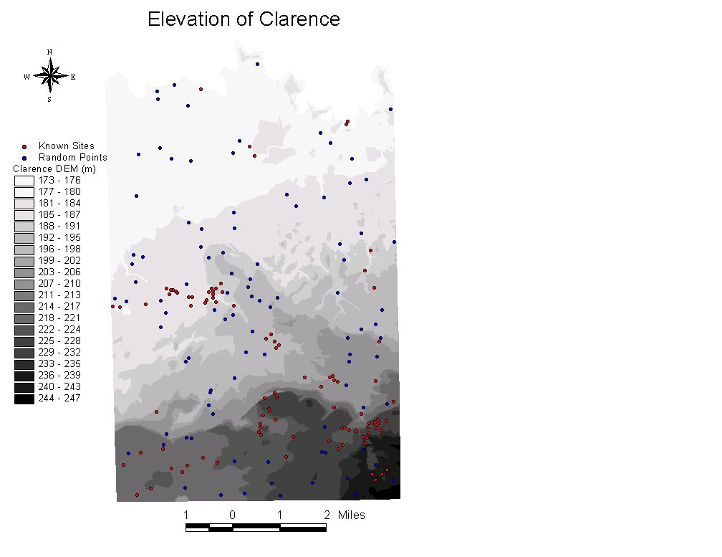
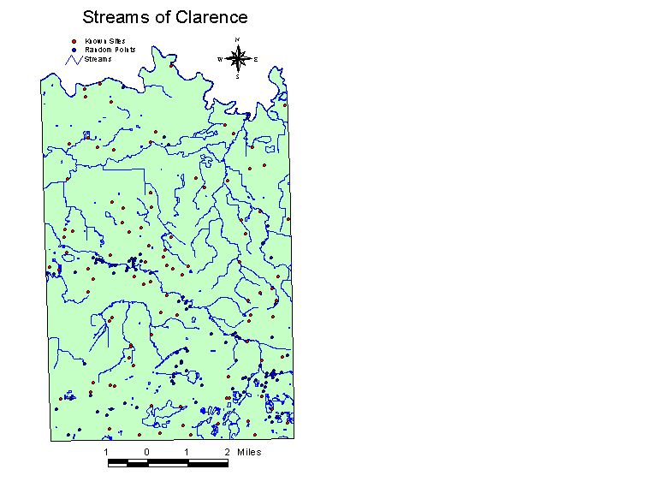

Slide 24
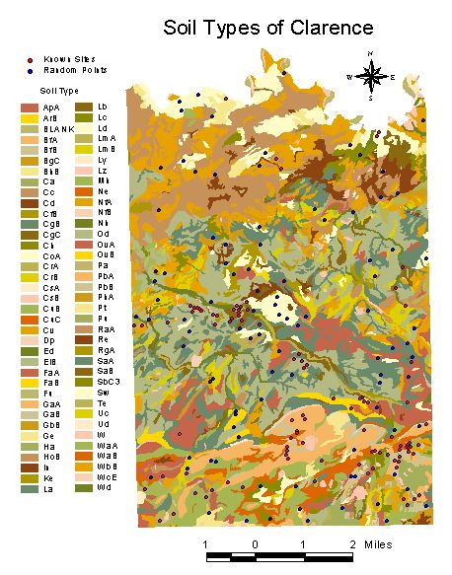

Slide 25
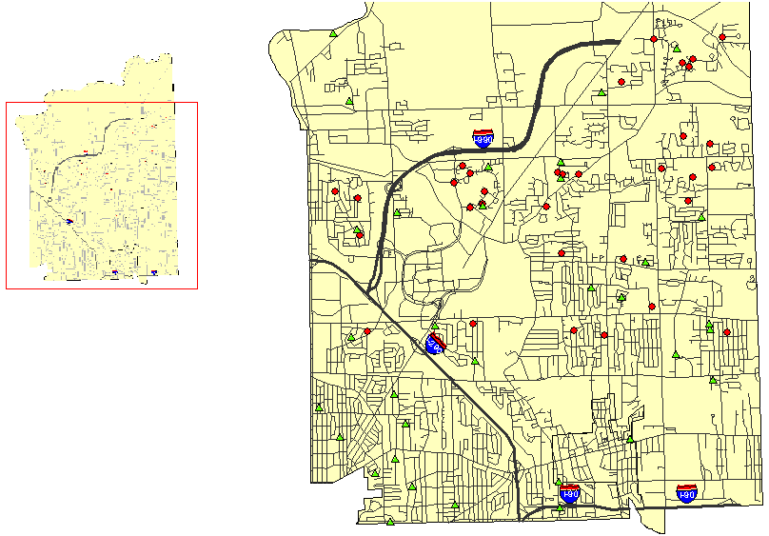

Slide 26
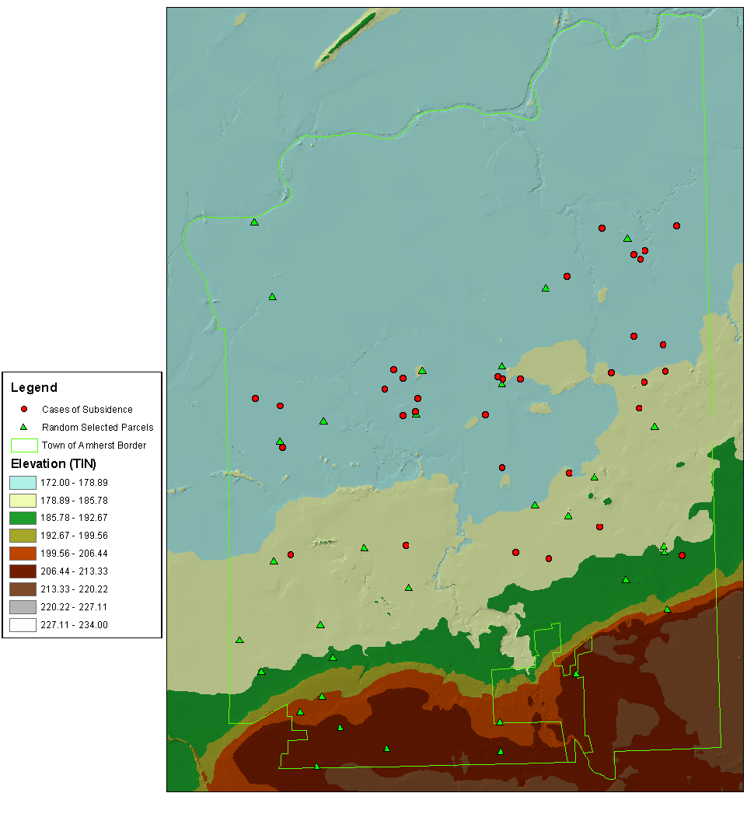

Slide 27
Tech Tips ..
To extract centroids of a polygon shapefile,
Spatial Analyst Tools -> Zonal -> Zonal
Geometry on the polygon shapefile
In Zonal Geometry, input your polygon data, the
"zone field" can be anything, and make sure the
"geometry type" is centroid
The output is a raster that contains all the
centroids of the input polygons. Then convert
the "point" raster into a point feature class

Slide 28
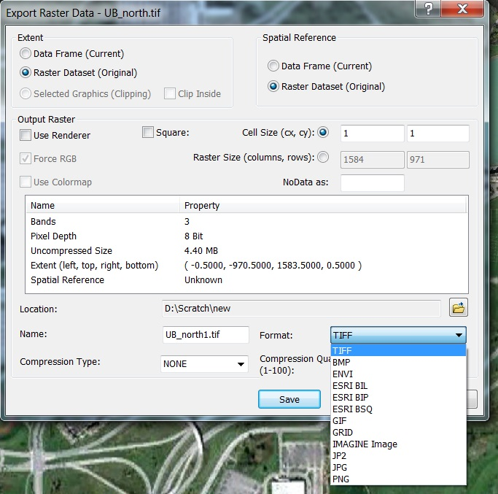
Tech Tips ..

Slide 29
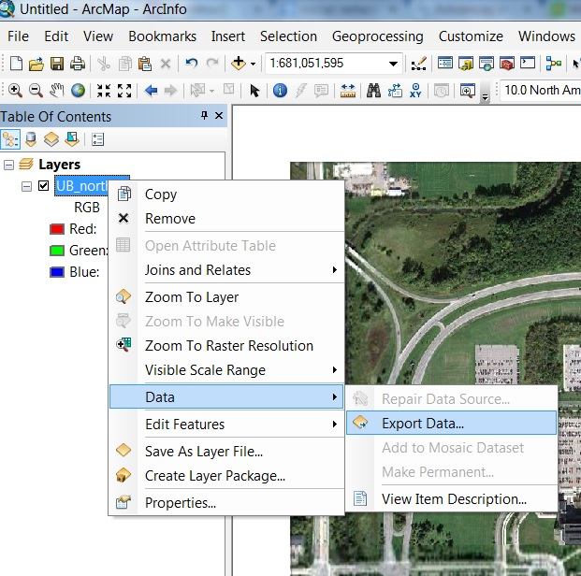
Tech Tips ..

Slide 30
4.1 Stats
Null H_{1paper}: % of each cover type of random sites = % of type in the entire study area
Χ² test
number of categories?
in each category
number of expected?
number of observed?

