Slide 1
Environmental Modeling
Advanced Weighing of
GIS Layers

Slide 2
1. Issue
Modeling the habitat of red squirrel in the Mt. Graham area
Red squirrel prefer a shaded and humid environment and feed on pine cones, that are offered by Mt. Graham
The issue is whether the construction of an astronomy observatory will affect the habitat
Pereira, J.M.C., and R.M. Itami, 1991. GIS-based habitat modeling using logistic multiple regression: a study of the Mt. Graham Red Squirrel. Photogrammetric Engineering and Remote Sensing, 57(11):1475-1486.

Slide 3
2. Factors
a. Topography: b. Vegetation:
Elevation Land cover
Slope Canopy closure
Aspect (e-w) Food productivity
Aspect (n-s) Tree diameter
c. Distance to openness (canopy closure and roads)

Slide 4
3. Raw Data
DEM
Vegetation cover
Roads
200 presence sites (observed)
200 absence sites (randomly located)

Slide 5
4. Logistic Regression
The dependent variable is dichotomous (on/off, 1/0, presence/absence)
The independent variable can be numeric (ratio data) or categorical (nominal data), ranking (ordinal data), or interval (interval data)
The method is widely used in natural resources and human impact related projects

Slide 6
At each of the 400 locations, collect both dependent and the independent variables

Slide 7
4. LR - dependent variable
Dependent variable: presence/absence
A total of 400 sites
for the 200 presence sites: dep value = 1
for the 200 absence sites: dep value = 0

Slide 8
4. LR - independent variables
Independent variables (14)
the continuous variables (1-5, ratio data)
1. Elevation
2. slope
3. aspect (e-w)
4. aspect (n-s)
5. distance to openness (buffer to roads or to land cover)

Slide 9
4. LR - circular var
45~135⁰(e) vs. 225⁰~315⁰(w)
-45⁰~45⁰(n) vs.135⁰~225⁰(s)
Sin0 = 0
Cos0 = 1
Sin270 = -1
Cos270 = 0
Sin90 = 1
Cos90 = 0
Variables 3. 4. Aspect is a circular variable. To differentiate its circular values, divide it into e-w and n-s directions, or use sin or cos.
Sin180 = 0
Cos180 = -1

Slide 10
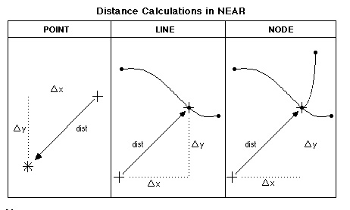
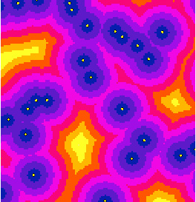
Extract Distance Info
1. Calculate the distance
The vector way
  use point-to-line distance,
  or point-to-point distance
The raster way
use “distance”
in Spatial Analyst

Slide 11
4. LR - categorical ind var
The categorical ind variables 6-14 (nominal, ordinal, or interval data)
6-8. Food productivity
9-11. Canopy closure
12-14. Tree diameter

Slide 12
4. LR - categorical ind var
Food productivity: variable 6-8
four categories: high, medium, low, none
each is 1 or 0
for sites that have a high productivity, high = 1,
for the same site, medium=0, low=0
for sites that have a medium productivity,
high=0, medium=1, low=0,
...
Only three of the four variables will show in the regression. The remaining one is used as a reference

Slide 13
4. LR - categorical ind var
Canopy closure: variable 9-11
Four categories: high, medium, low, and none
Three variables: high, medium, low
Tree dbh: variable 12-14
Four categories:
> 25cm, 15-25cm, 0-15cm, no trees
Three variables

Slide 14
5. Statistical Testing
t test for continuous ind variables
for each variable, say elevation
H₀: mean1 = mean2
Χ² test for categorical ind variables, say food productivity
four categories
observed count, expected count.

Slide 15
Land cover types of the area and at bear
sighting sites
Cover type %Area Expected# Actual#
Douglas Fir 10.1 9.2 7
Subalpine fir 10.2 9.3 10
Whitebark pine 2.2 1.5 8
Mountain hemlock 3.8 3.5 5
Pacific silver fir 8.4 7.7 4
Western hemlock 10.1 9.2 7
Hardwood forest 1.2 1.1 0
Tall shrub 4.9 4.5 4
Lowland herb 8.5 7.7 12
…… ….. ….. ….
Total 100% 91 91

Slide 16
6. Data Partition
Data partition for model development and model validation
75% of sites are used to develop the logistic model
150 presence sites and 150 absence sites
25% for model validation
50 presence sites and 50 absence sites

Slide 17
7. The Logistic Model
Logistic model is sensitive to the middle range values of an ind var
Y = b₀ + b₁X₁ + b₂X₂ + … + b_{n}X_{n}
P(Y) = 1/[1 + exp ^{(-Y})]

Slide 18
7. The Logistic Model
Y = 0.002ele - 0.228slope + 0.685canopy(high)
+ 0.443canopy(medium) + 0.481canopy(low)
+ 0.009aspect(e-w)
P (Y) = 1/[1 + exp ^{(-Y})]
P - The probability of red squirrel habitat

Slide 19
8. Accuracy Assessment
Decide a cut-off value for P
The convention is 0.5
Convert the P values into two categories
site value < 0.5: unsuitable
site value ≥ 0.5: suitable

Slide 20
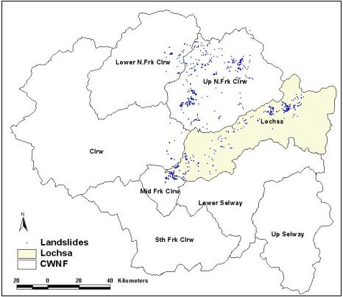

Slide 21
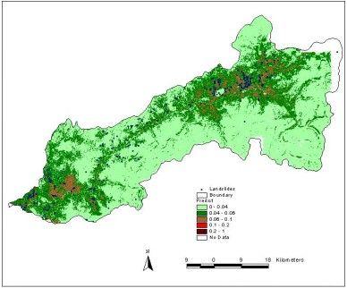
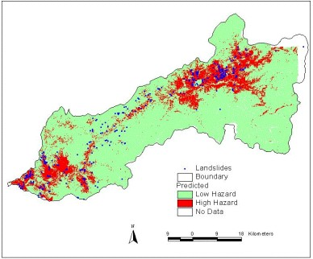

Slide 22
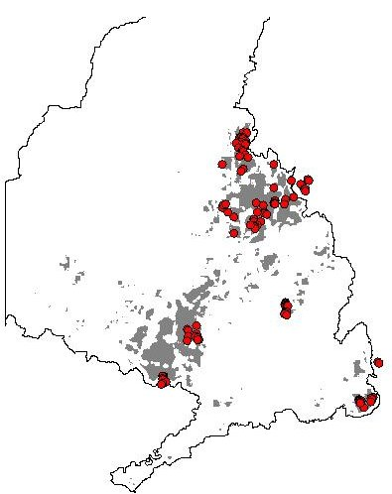
8. Accuracy Assessment

Slide 23
Error Matrix
Mapped Category
True Category Primary Secondary Total
Oak >= 50% 15 5 20
Oak < 50 3 52 55
Total 18 57 75
Accuracy of the oak forest map: 89%

Slide 24
8. Accuracy Assessment
Error Matrix
for the 150 presence and 150 absence sites that are used to develop the logistic model
Modeled
presence absence total accuracy
presence 123 27 150
absence 36 114 150
300
82%
Truth
76%
Overall accuracy = (123+114)/300 = 79%

Slide 25
8. Model Validation
Error Matrix
for the 50 presence and 50 absence sites that are put aside for model validation
Modeled
presence absence total accuracy
presence 37 13 50
absence 16 34 50
100
74%
Truth
68%
71%

Slide 26
9. GIS Overlay
Y= elevation*0.002 + slope*-0.228 +
canopy closure (assign 0.685 for all cells=high, 0.443 for cells=medium, 0.481 for cells=low) +
aspect (e-w)*0.009
P(Y) = 1/[1 + exp ^{(-Y})]
Keep the output as a continuous probability map or a suitable/unsuitable map

Slide 27
