Slide 1
Environmental Modeling Application of Suitability Index

Slide 2
1. The Issue
To simulate caribou migration of the Paleo-Indian period to validate locations of archaeological sites, in order to understand the Paleo-Indian hunting activities
Archaeological data are scarce, and GIS gives additional evidence
Krist, F.J., and D. G. Brown, 1994. GIS modeling of paleo-Indian period Caribu migrations and viewsheds in Northern Lower Michigan. Photogrammetric Engineering and Remote Sensing, 60(9): 1129-1137.

Slide 3
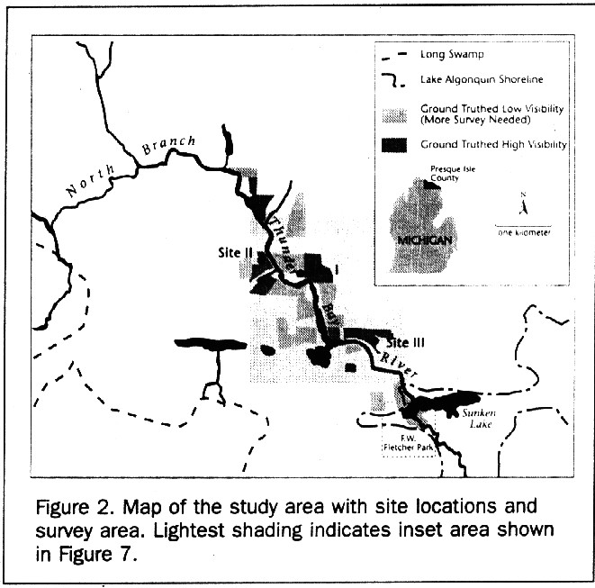

Slide 4
2. Major Factors:
Where caribou are
Caribou can be intercepted at natural traps or from watercraft at lacustrine or riverine environments
Where people are
People live near waters: lake benches, beaches, shallow bays, lagoons, lake inlets or outlets, lake beds, shorelines

Slide 5
3. Major Factors ..
How caribou move
Follow contours in hilly areas
e.g. ridgelines, valley bottom, gentle slopes, and hillsides
Pass water bodies
e.g. lakes, swamps, rivers, creeks, etc.

Slide 6
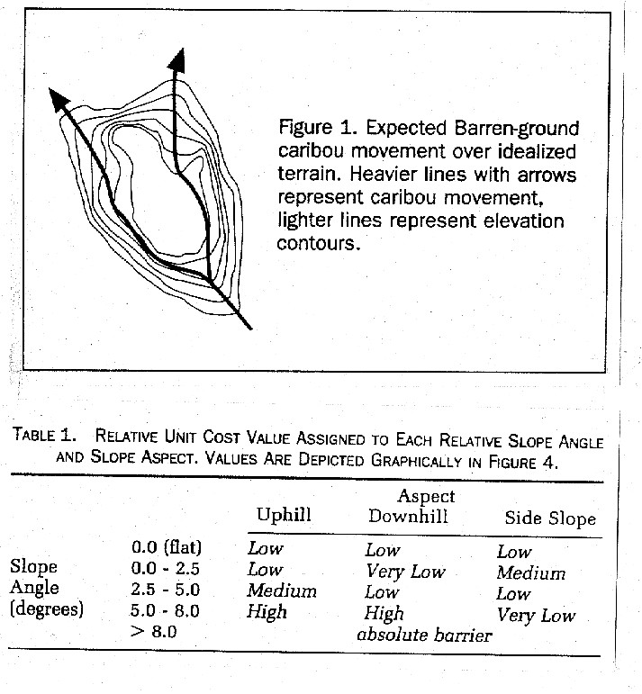

Slide 7
4. Data
Slope angle (15 classes) and slope aspect (10 classes) - Contour maps
Lakes, swamps, creeks, marshes, lake inlets and outlets - 1:24,000 quadrangles
Swamps - Soil maps
Ancient lakes - Contour maps (10ft interval)
Archaeological sites - Field survey

Slide 8
5. Operation - Simulating Migration Pathways
Friction Surface
- Terrain factors
- Hydrography factors

Slide 9
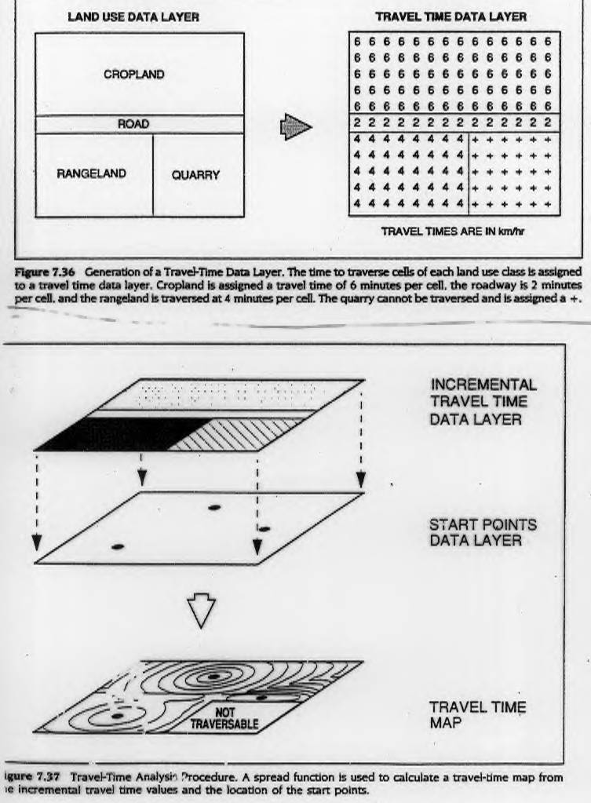
Friction Surface

Slide 10
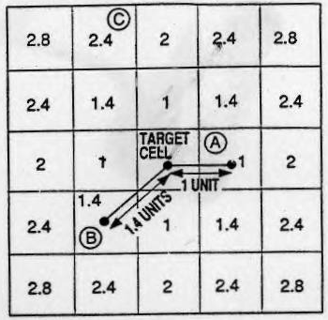
Friction Surface
Travel Time Calculation
Notes:
Fig 7.32 The Calculation of Distance Using a Spread Function

Slide 11
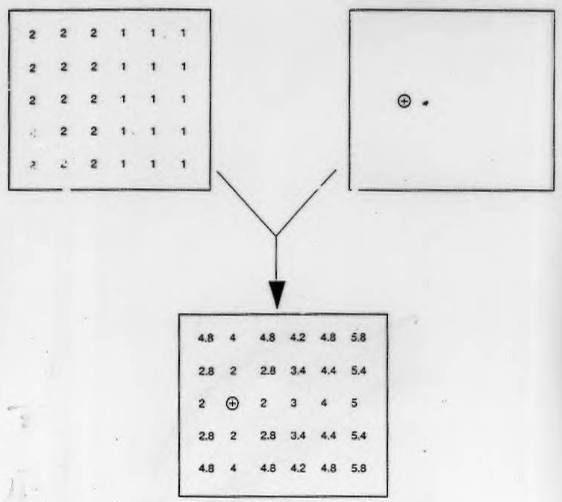
Friction Surface
Friction Surface Data Layer
Start Point
Data Layer
Cumulative Travel Time Data Layer
Notes:
Fig. 7.38 Spread Function Sample Calculations. The rate of travel across each unit of the terrain is stored in the travel time data layer or friction surface. The time required to trave to the adjacent cell is caculated by multiplying the rate of travel by the distance. The distance between cell centers is 1 unit in the horizonatl or vertical direcetion and 1.4 units across the diagonal. The travel time to reach any cell from the startting point is found by moving outward from the start point summing the individual trave times at each step. Where there is more than one route to reach a cell, the lower value is used.
Spread Functions
The Spread Function is simply the "best" way to get from point A to point B. "Best" can be fastest, it can be most the most economical, or a subjective measurement such as most scenic. It is an evaluation of phenomena that accumulates with distance.
Imagine a square and you are going to travel from the lower left corner to the upper right corner. The straight line distance is 1.414 times the side of the square, and the distance across the sides is 2.0 times the length of a side. If this square represented a pasture containing angry buffaloes it would probably beneficial to walk around the fenced perimeter and go the extra distance.
Output of this particular GIS functions is sometimes referred to as ACCUMULATION SURFACE or FRICTION SURFACE. These concepts refer to the "effort it takes to get from A to B, such as the square traversed was knee deep mud (or a lake) across the diagonal but dry at the perimeter. It would be farther, but easier to again go the extra distance.

Slide 12
Friction Surface
Notes:
Fig. 7.37 Travel-Time Analysis Procedure. A spread function is used to calculate a travel-time map from the incremental travel time values and the location of the start points.

Slide 13
Friction Surface - Terrain Factors
Evaluated based in travel directions, NW or SE
- Slope angle
- Slope aspect
to represent uphill, down hill, and slope side
Scores 0-100

Slide 14
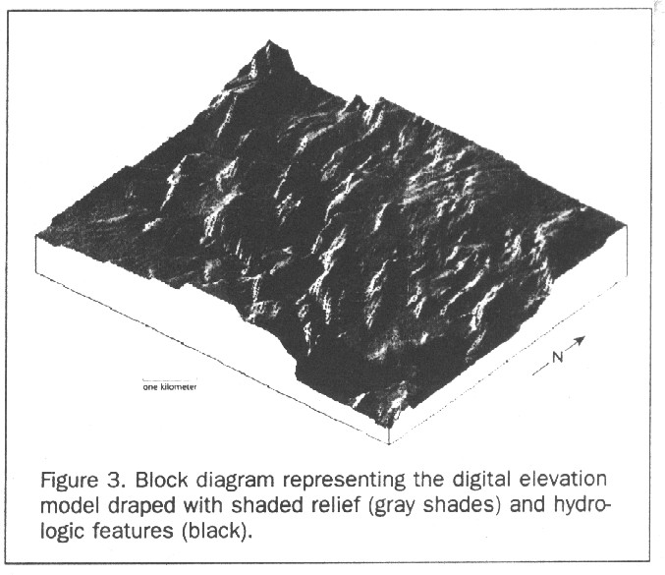
Terrain Factors

Slide 16
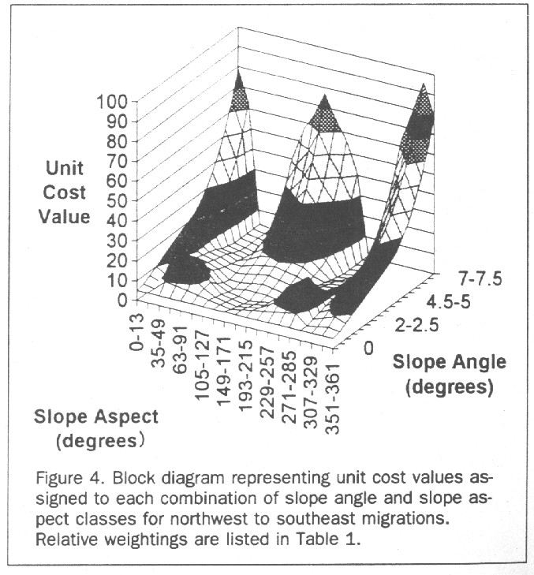
Terrain Factors

Slide 17
Friction surface - Hydrography Factors
Relative barriers
- lakes (120) vs. swamps (80)
- rivers (160) vs. creeks (107)
- deep water (240), intermediate (200), shallow (120)
Hydrography barriers are deemed more difficult than terrain factors

Slide 18
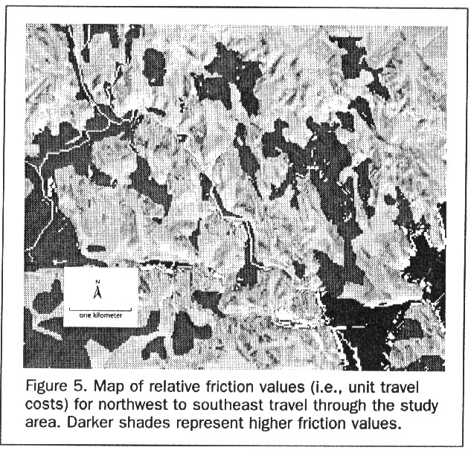
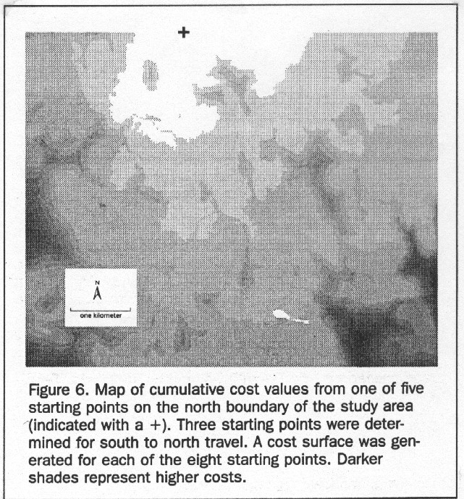
Friction Surface

Slide 19
Optimal Routes
Compute the cumulative travel cost from 8 starting points to determine the most likely migration trails
Five from north and three from south

Slide 20
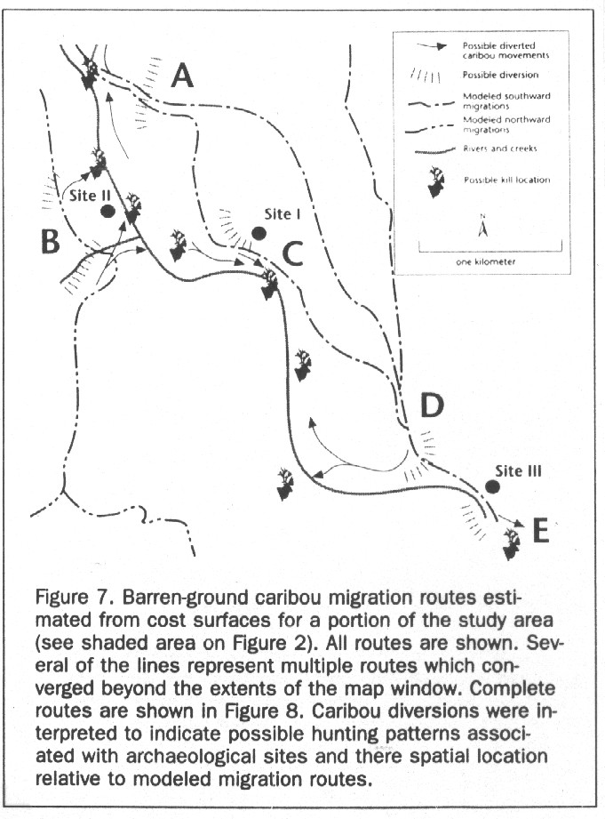
Terrain Factors

Slide 21
6. Operation - Viewshed Analysis
To evaluate the relationship between the location of the archaeological sites and the routes:
Viewshed (vs. buffer)
- from the highest point within 0.4km of each site
- view height 1.4m above the ground

Slide 22
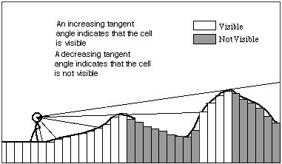
Viewshed analysis
Line of sight

Slide 23
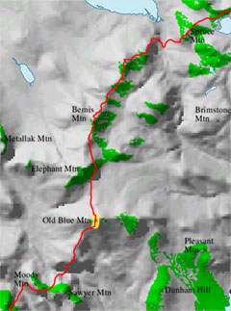
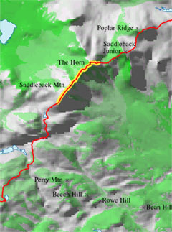
Viewshed
The above maps show the results of analyses around Saddleback (left) and Old Blue (right) mountains. On the maps, green areas are visible from the location cited (shown in yellow), while gray areas are obstructed from view. The Appalachian Trail is shown in red.
http://www.northgeo.com/services/carto/projects/LURCViewshed.htm

Slide 24
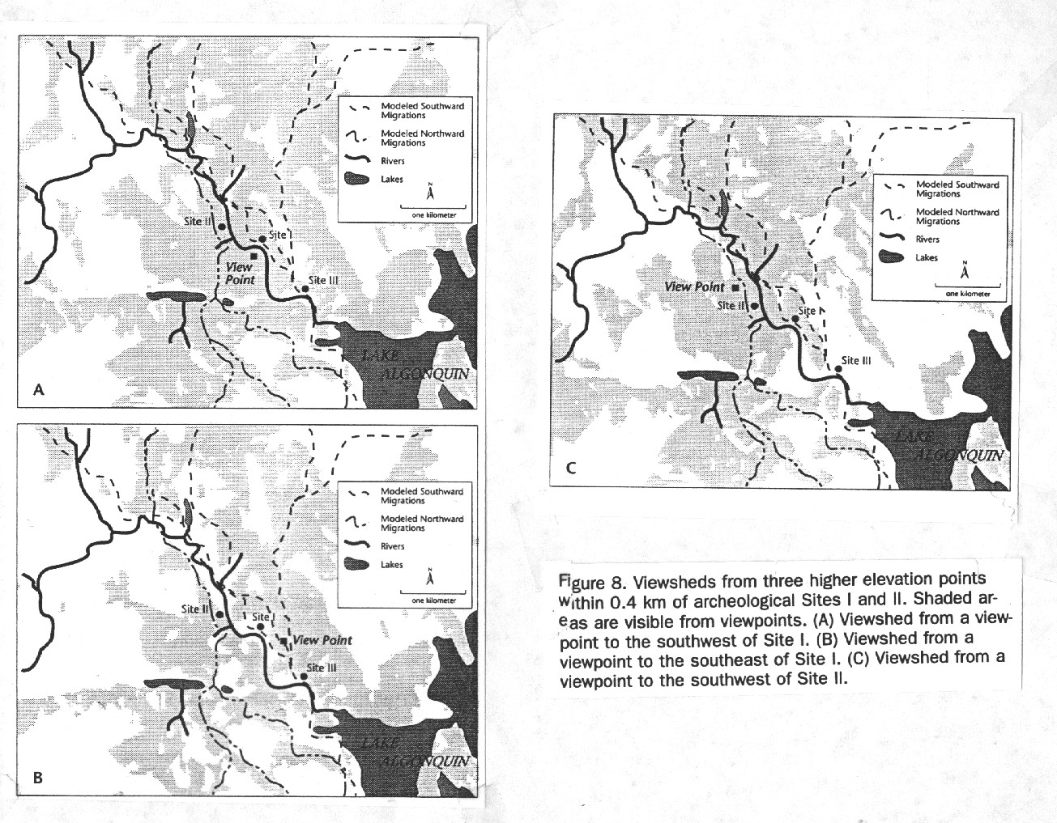
Terrain Factors

Slide 25
7. Results
Several migration routes converged near the three sites
Each site has visibility of
(1) lowland bordering rivers
(2) visibility of caribou migration trails, and
(3) natural features to divert caribou to traps
or to intercept caribou near creeks/river valleys

Slide 26
8. Further Development
Need more archaeological data
Test against modern caribou trails
Spatial analysis for other human activities

