Slide 1
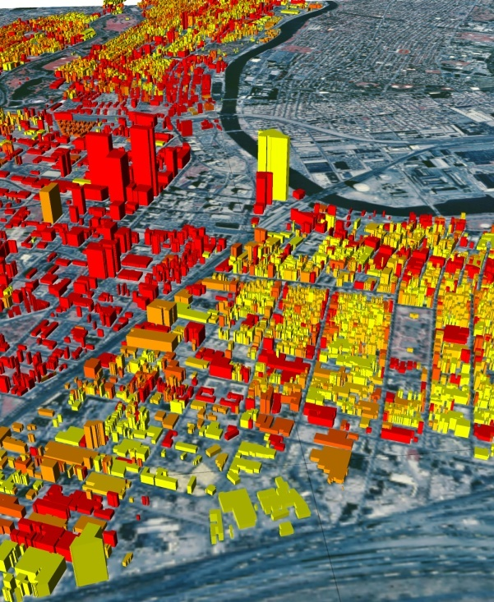
GIS for Environmental Modeling http://www.acsu.buffalo.edu/~lbian/GEO479_559.html
GEO 479/559 Spring 2020
T M 5:00-6:20pm, 355 Fillmore
Instructor: Ling Bian
Office: 301 Wilkeson Quad
Office Hours: T R 6:30-7:30pm or by appts
Labs: W 4:30am-5:50pm; R 11:00am-12:20pm
TA: Qiang Pu

Slide 2
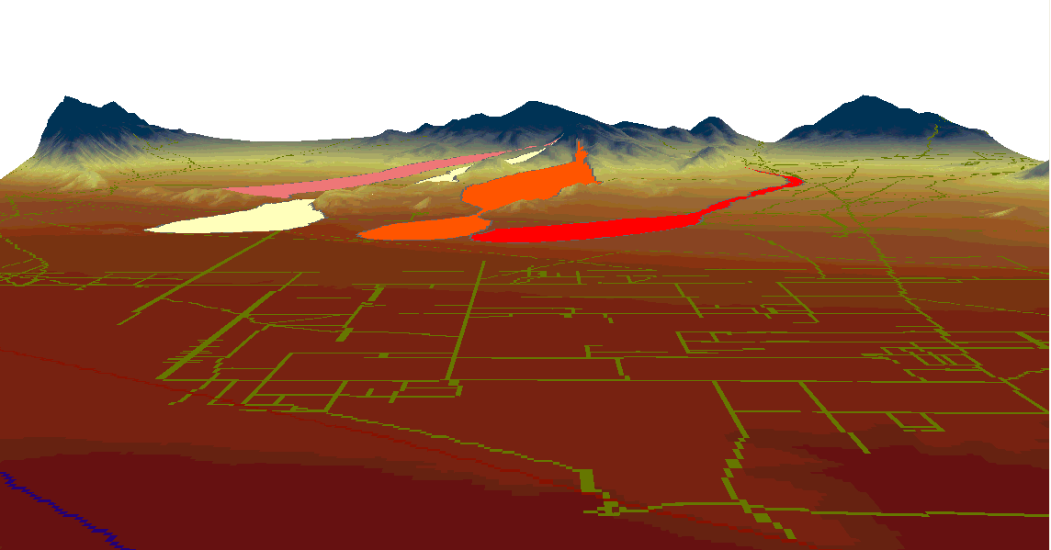
What is it ...
This is an intermediate level GIS course designed for senior undergraduate students and graduate students at all levels. Students are expected to have basic knowledge of GIS through either completing an introductory level GIS course or having entry level work experiences with GIS.
The course emphasizes GIS applications for environmental modeling, which is loosely defined as any projects that contain environmental elements.

Slide 3
What is it ...
The course has a lecture and a lab component.
The lecture will focus on Methodology Design by introducing a series of GIS methods and their intended use in order to help students select appropriate GIS methods for a project.
Research design
Methodology design
Method implementation

Slide 4
What is it ...
The topics of methodology design are covered under the following sections:
Basic GIS methods
Testing and validating GIS methods
Integrating GIS with environmental models

Slide 5
What is it ...
The hands-on labs will focus on Method implementation. Students will learn GIS tools in order to complete a GIS project.
Guest speakers from GIS firms will talk about real-world GIS applications
The course should benefit students specialized in environment, natural resources, and any disciplines that are concerned with environmental issues.
Research design
Methodology design
Method implementation

Slide 6
The Project
Students are expected to complete a project that uses GIS to address an environmental issue.
The topical area is flexible. Some of past students' projects will be briefly introduced in the class to provide a reference. Projects related to students' potential thesis or dissertation, current job or RA duties, and students' personal interests are strongly encouraged.
Small and Nice vs. Big and Flat
Plan A, B, C …

Slide 7
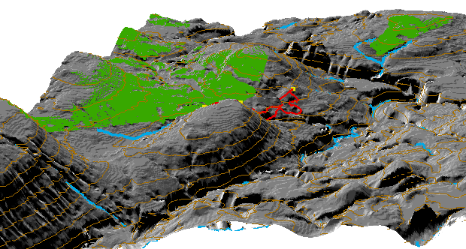
Presentation
Towards the end of the semester, students are expected to report their projects through a classroom presentation and a written project report.

Slide 8
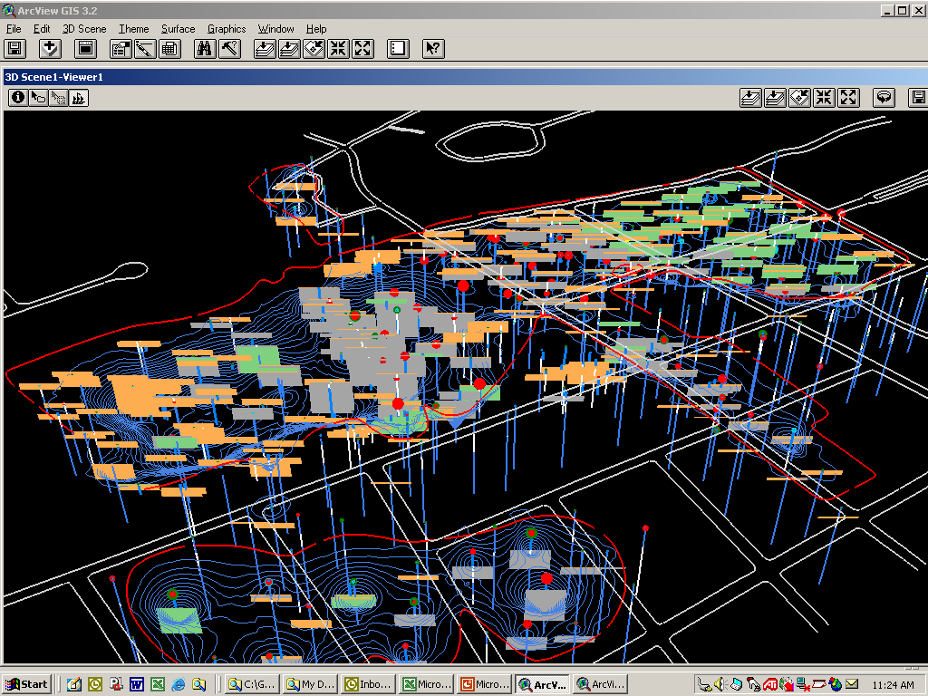
Literature Review
All students submit a short weekly literature review of a article, on the theme of your semester project, focusing on its GIS methodThe first weekly review is due Feb 27 (Thur).
Graduate students are expected to re-write a short literature review and submit it by the 9th week of the semester.

Slide 9
Labs
A series of laboratory exercises will provide students with hands-on experience in GIS application.
ArcGIS Pro will be the primary GIS software for the labs.
NO lab in the first week.
NO lab in the first week.
NO lab in the first week.

Slide 10
Labs ...
The exercises are designed to support many aspects of environmental modeling and to offer students with opportunities to practice the following techniques:
Spatial data entry and editing
Spatial file management and map making
Attribute data manipulation and transition
Overlay, buffering, and network analysis
Topographic analysis, grid modeling, 3-D
GIS and statistics integration, web GIS,
More …

Slide 11
Other Things before “Grading”
Textbook
No required textbooks.
Prerequisite
Intro to GIS such as GEO 506/481 or the equivalents, basic statistics, or the consent of instructor.

Slide 12
Grading
Undergraduate Graduate
Project Report 50% 40%
Literature Review 10% 20%
Lab assignments 30% 30%
Classroom involvement 10% 10%
--------------------------------------------------------------
Total 100% 100%

Slide 13
Grad cut-off
A 93.33-100.0
A- 90.00-93.32
B+ 86.67-89.99
B 83.33-86.66
B- 80.00-83.32
C+ 76.67-79.99
C 73.33-76.66
C- 70.00-73.32
D+ 66.67-69.99
D 60.00-60.66
F <60

Slide 14
Tentative Schedule
I. Basic GIS Methods
1/28 Introduction
1/30 Environmental modeling and GIS models
2/04 GIS data sources
2/06 Basic GIS modeling - suitability index
2/11 GIS functions for suitability index
2/13 Applications of suitability index

Slide 15
Tentative Schedule ...
II. Testing and Validating GIS methods
2/18 Basic testing methods
2/20 Basic testing methods
2/25 Basic testing methods
2/27 Validating GIS models
3/03 Testing relevancy of GIS layers
3/05 Weighing GIS layers
3/10 Weighing GIS layers
3/12 Project report development
Spring Break

Slide 16
Tentative Schedule ...
III. Integrating GIS with Environmental Models
3/24 Weighing GIS layers
3/26 GIS applications, Greg Coniglio, LaBalla
3/31 Integration of GIS and models
4/02 GIS applications, Bill Trask, Fisher Associates
4/14 Class presentations
4/16 UAV and GIS
4/21 Class presentations
4/23 GIS applications, Aaron Lee, WiredScore
4/28, 4/30, 5/05 Class presentations
5/07 Conclusions

Slide 17
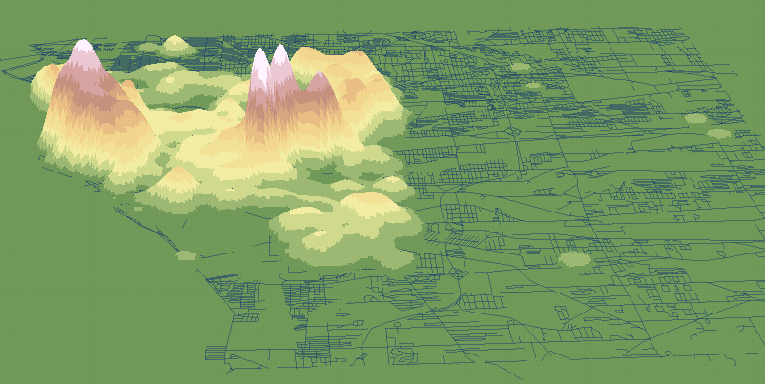
Major Events in This Semester
Ad hoc job announcements
ESRI recruiters coming to town Feb 24, 25 (Mon-Tue)

Slide 18
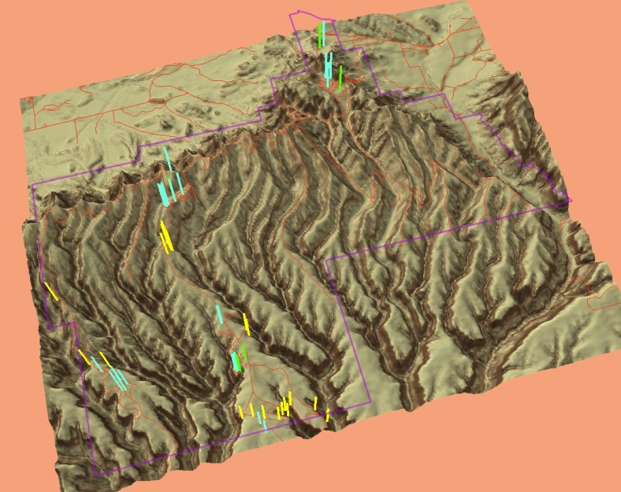
Recommended Data Sources
http://cugir.mannlib.cornell.edu
http://gis.ny.gov
http://nationalmap.gov/viewer.html
http://datagateway.nrcs.usda.gov
http://data.buffalony.gov

Slide 19
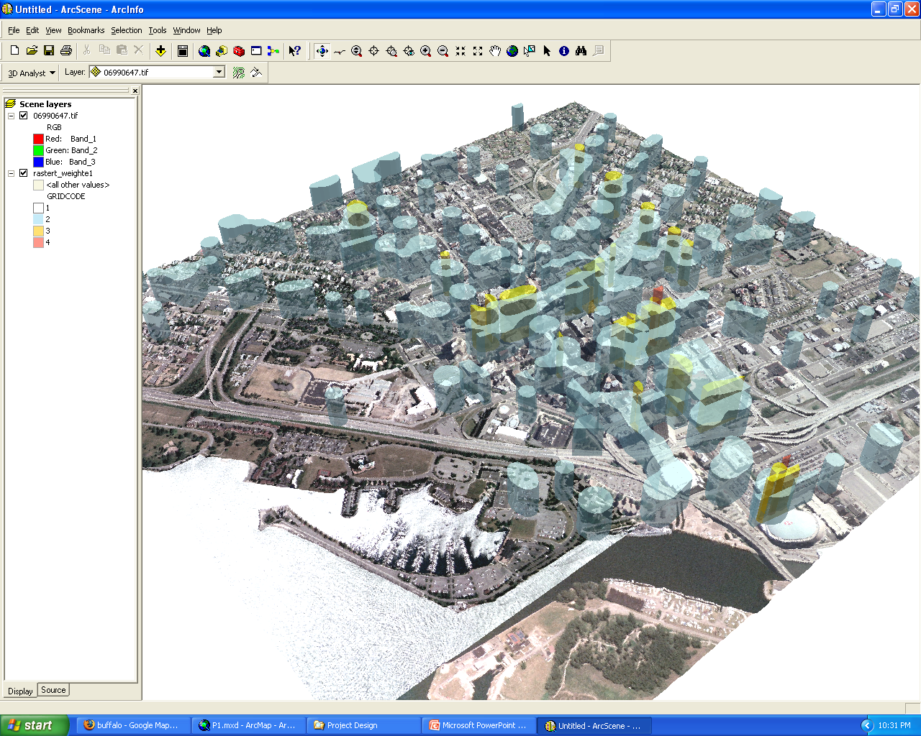
On-line Notes
On-line notes in PowerPoint slides Will be available before the lecture
http://www.acsu.buffalo.edu/~lbian/GEO479_559.html

Slide 20
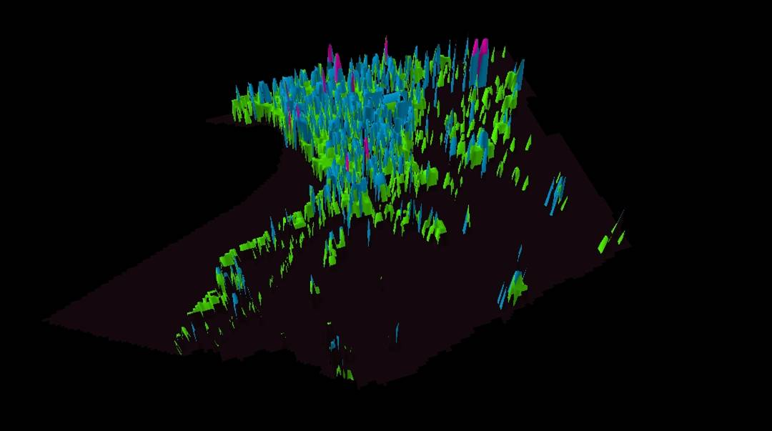
Expectations
High level interns or fulltime GIS employees
Spatial part of your MA or PhD research projects

