Slide 1
Environmental Modeling Basic GIS Functions for Suitability Index Modeling

Slide 2
GIS Functions for Suitability Index
Overlay and buffer
The fundamental difference between GIS and other computer mapping

Slide 3
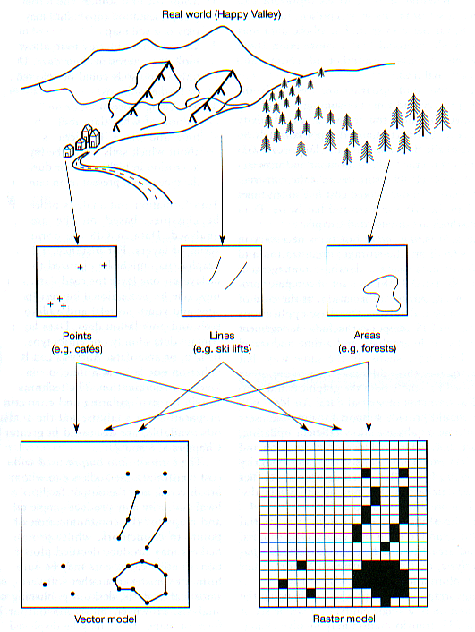
Vector Raster
courtesy: Mary Ruvane, http://ils.unc.edu/

Slide 4
1. Overlay
Union, Intersect, and Identity
Clip, Erase, and Update

Slide 5
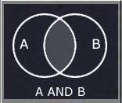
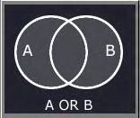
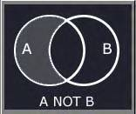
Logic Overlay
Finding areas where certain conditions occur
Boolean logic
Mary Ruvane, UNC –Chapel Hill

Slide 6
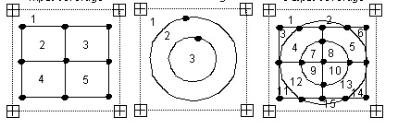
Union
INPUT Feature UNION Feature
# ATTRIBUTE # ATTRIBUTE
1 0 1 0
2 A 2 102
3 B 3 103
4 C
5 D
OUT INPUT Feature UNION Feature
# # ATTRIBUTE # ATT
1 1 0 1 0
2 1 0 2 102
3 2 A 1
4 2 A 2 102
5 3 B 2 102
6 3 B 1
7 2 A 3 103
8 3 B 3 103
9 4 C 3 103
10 5 D 3 103
11 4 C 1
12 4 C 2 102
13 5 D 2 102
14 5 D 1
15 1 2 102

Slide 7
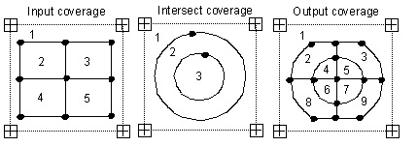
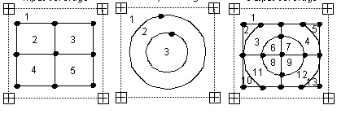
Intersect and Identity
Intersect
Identity

Slide 8
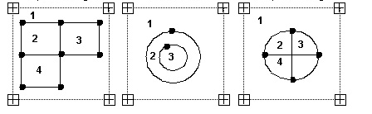
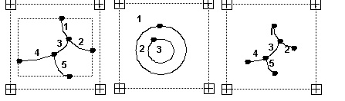
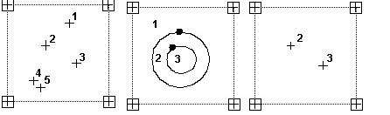
Clip

Slide 9
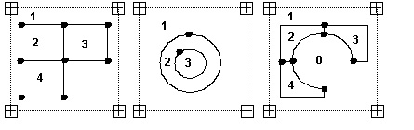
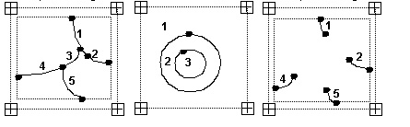
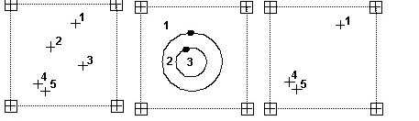
Erase

Slide 10
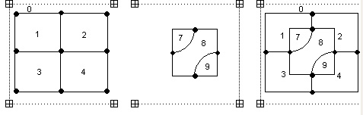
Update

Slide 11
Intersect
OUT Pop Elev PopRank PopWeight PopW*R EleRank EleWeight EleW*R Sum
# # ATT # ATT
1 1 1
2 2 E 2 100
3 3 V 2 100
4 2 E 3 150
5 3 V 3 150
6 4 G 3 150
7 5 S 3 150
8 4 G 2 100
9 5 S 2 100

Slide 12
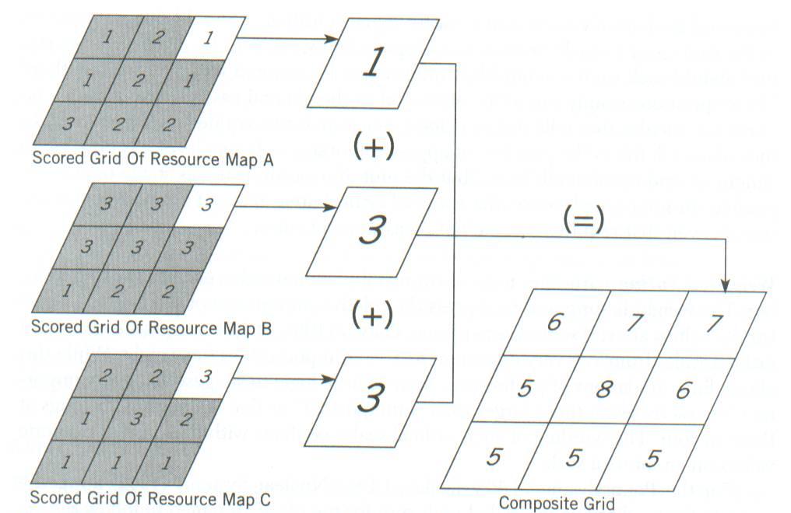
Cell Statistics
Notes:
Ratings assigned to categories for a county Solid Waste Plan. Ratings for grid cells were added to obtain a composite ranking.
It is possible to make direct calculation on the raster data layers.

Slide 13
2. Approximation
Buffer and Buffer Region
Near and Point Distance

Slide 14
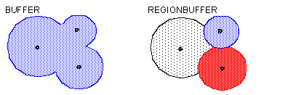
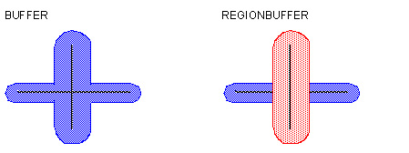
Buffer and Buffer Region

Slide 15
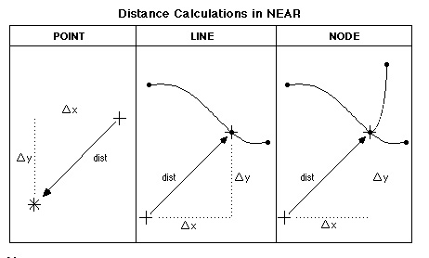
Near

Slide 16
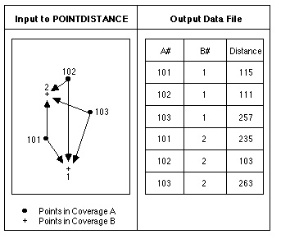
Point Distance

Slide 17
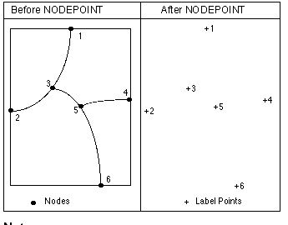
Nodepoint

Slide 18
GRID Functions - Spatial Analyst
Distance, Density, Surface Analysis,
Cell Statistics, Neighborhood Statistics, Zonal Statistics

Slide 19
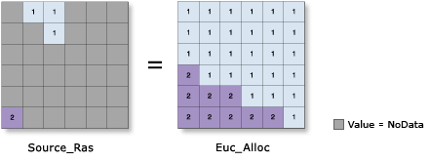
1. Distance - Allocation

Slide 20
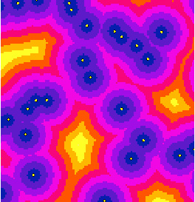
Straight Line Distance

Slide 21
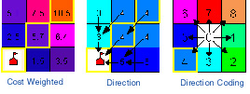


Cost Weighted Distance

Slide 22
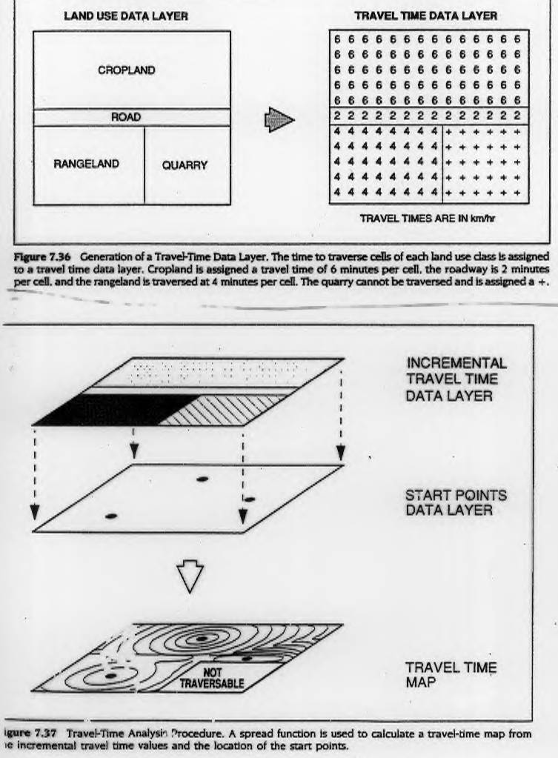
Friction Surface

Slide 23
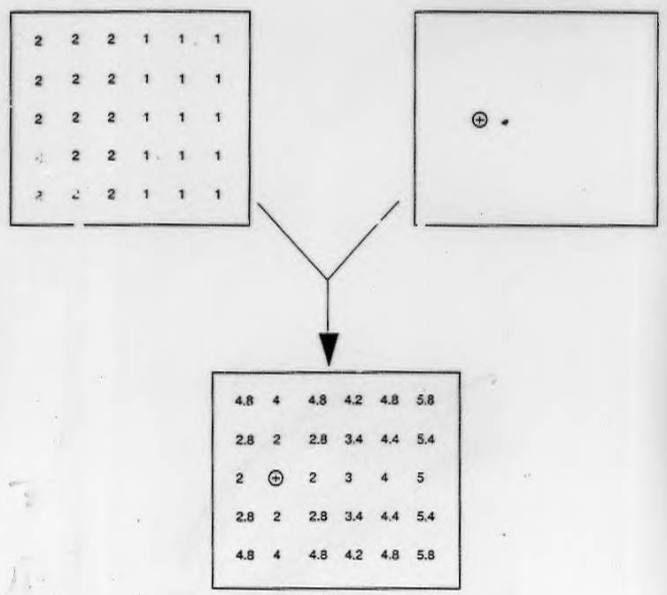
Cumulative Travel Cost
Friction Surface Data Layer
Start Point
Data Layer
Cumulative Travel Time Data Layer

Slide 24
Cumulative Travel Cost Contours

Slide 25
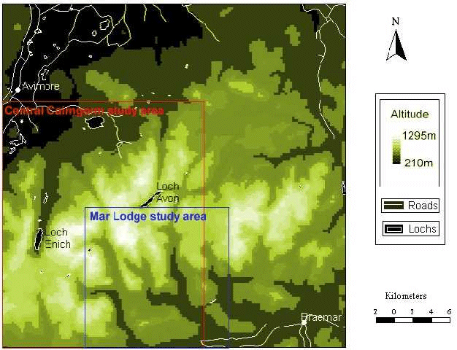
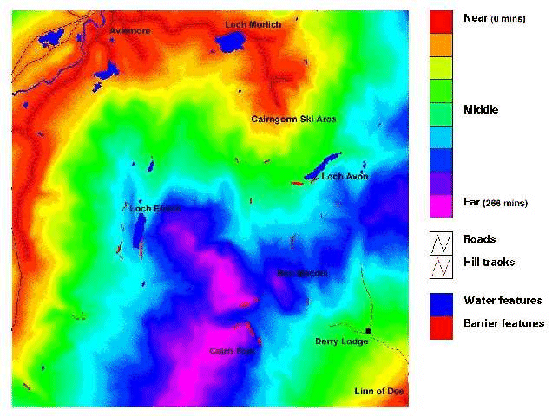
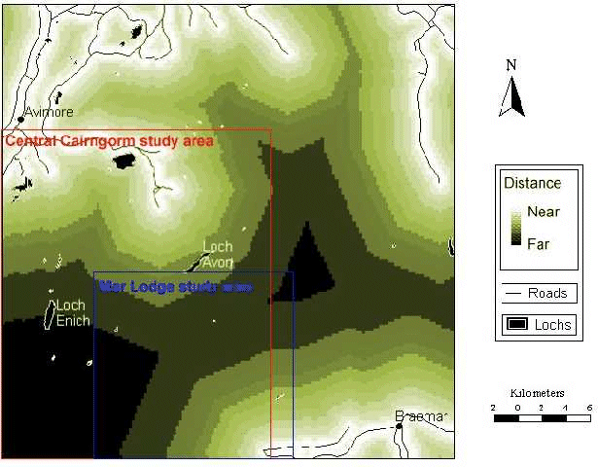
Cost Weighted Distance
DEM
Friction surface
Cost weighted distance
S. Fritz and S. Carver GIS/EM4 2000

Slide 26
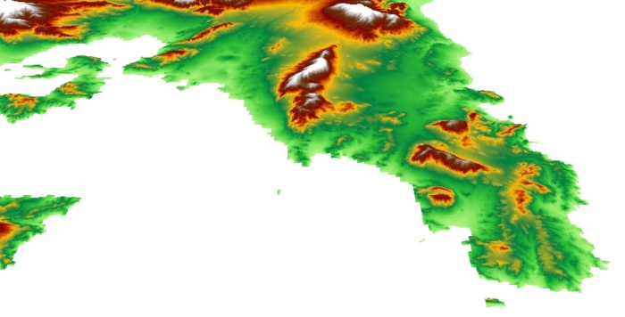
Athens
Sounion

Slide 27
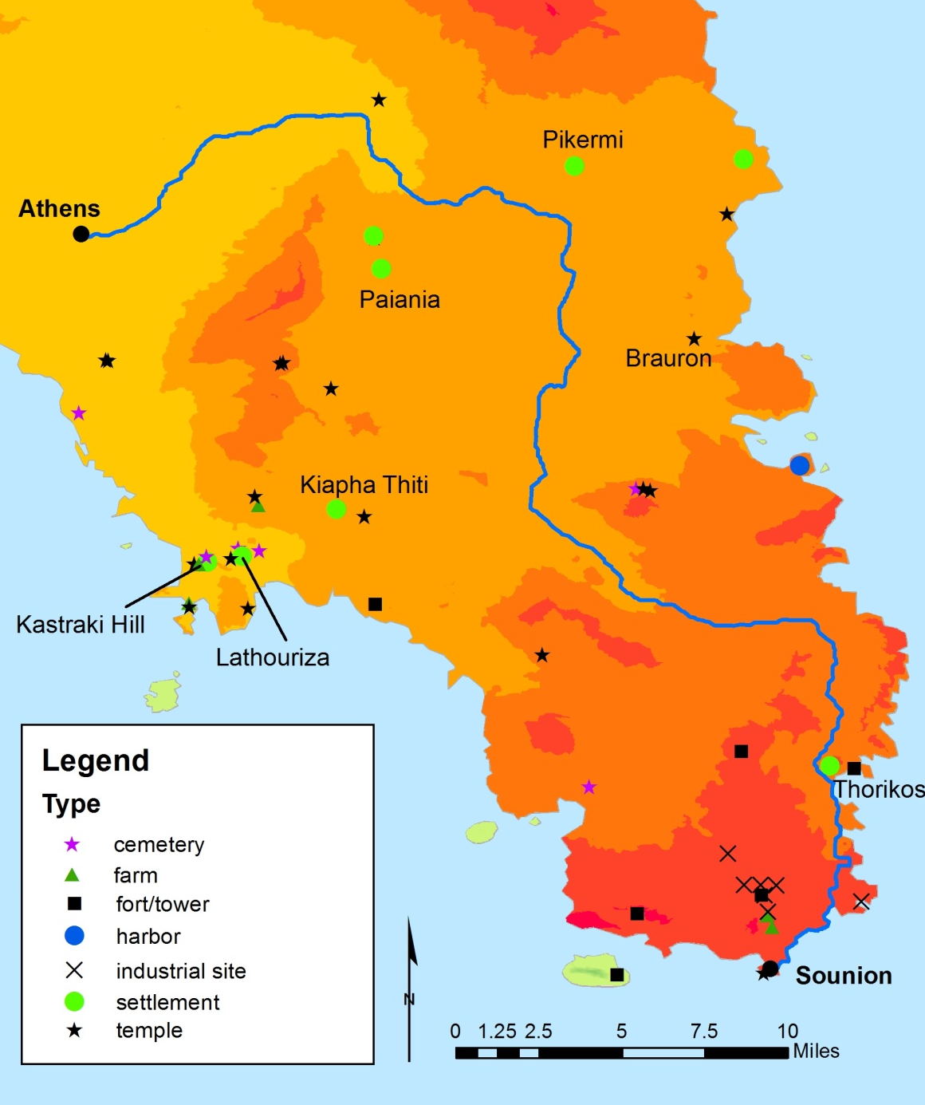
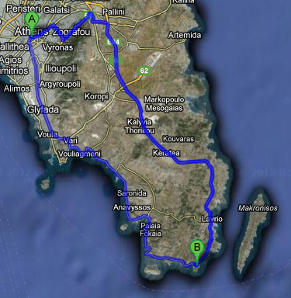
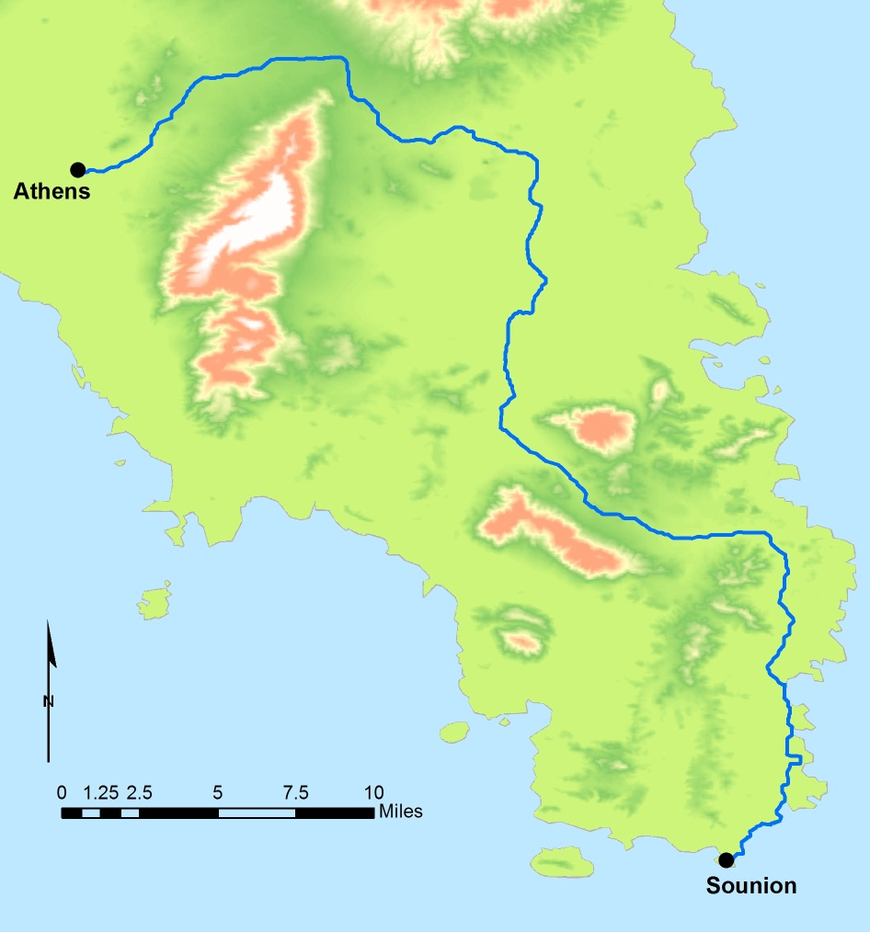
Least-Cost Analysis: Path 1
Path 1 with topography (above) and archaeologically-known sites (left). The background (left) is the cost layer—the darker color = higher cost Distance: about 69 km (42 mi)

Slide 28
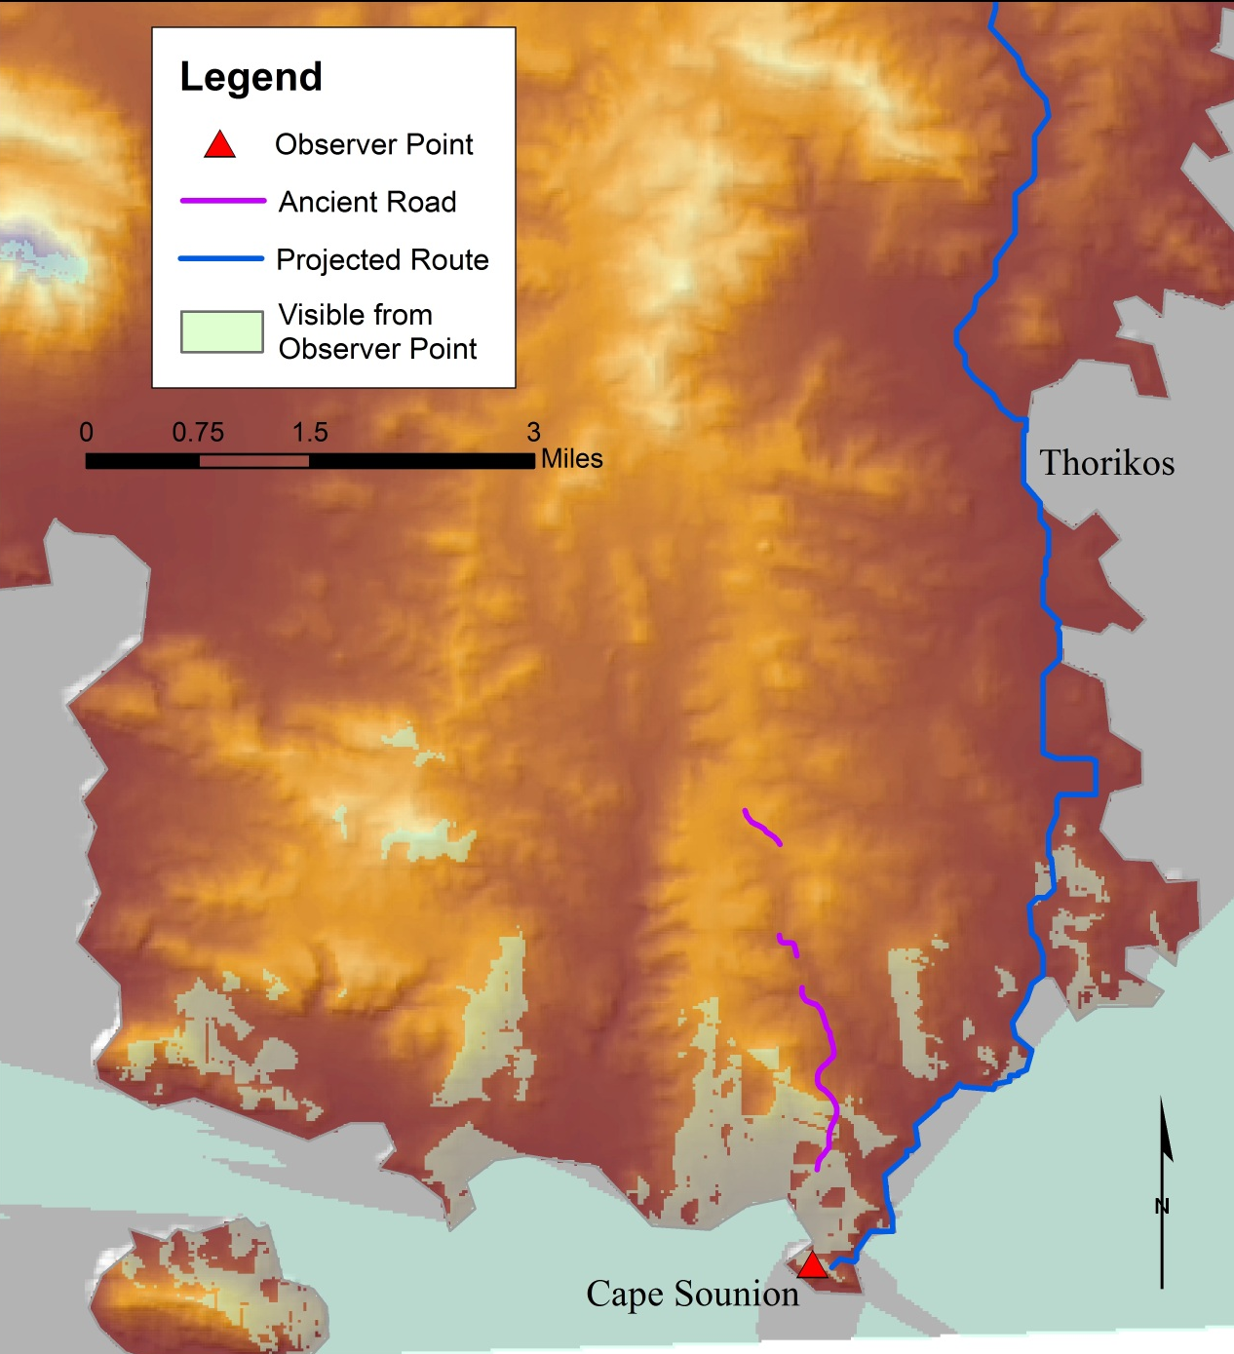
Viewshed analysis

Slide 29
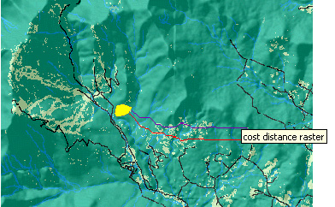
Shortest Path

Slide 30
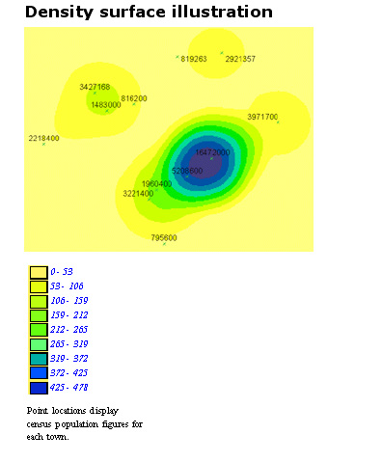
2. Density

Slide 31
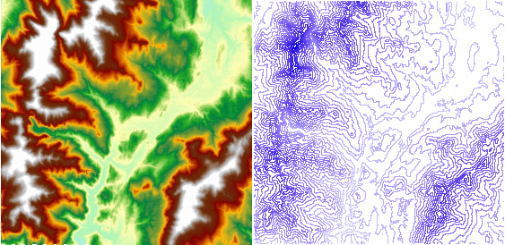
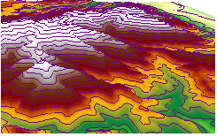
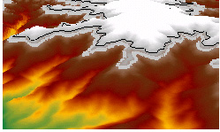
3. Surface analysis - Contour

Slide 32
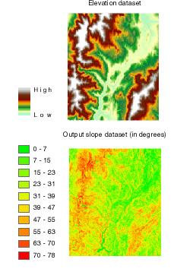
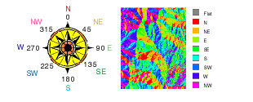
Slope and Aspect

Slide 33
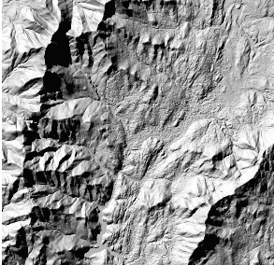
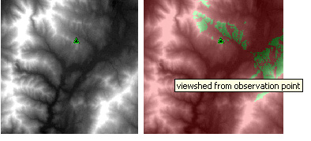
Hillshade and Viewshed

Slide 34
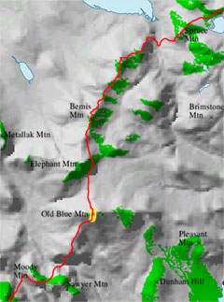
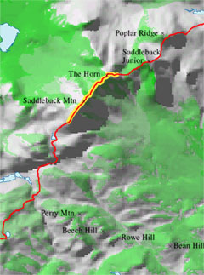
Viewshed

Slide 35
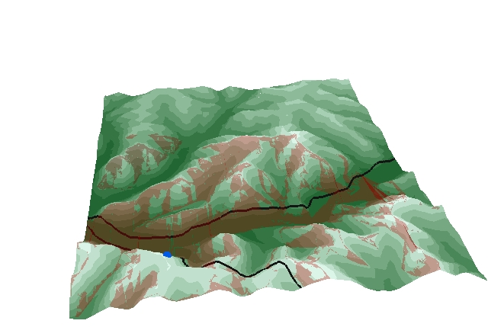
View Shed Analysis
Highways and towers clipped to study area.
DEM converted to grid in ArcToolbox and a TIN was constructed with 3D Analyst.
Cell towers and highways overlaid in 3D visualization in ArcScene.
Viewshed performed from cell tower location and overlaid on TIN.

Slide 36
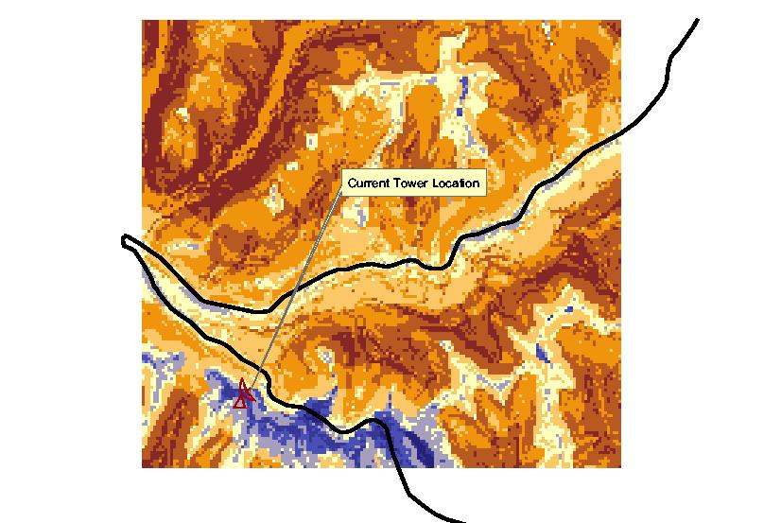
Suitability Analysis
Elevation, Slope, Proximity to Road were variables chosen.
Grids were created based on these variables and reclassified.
Combined through raster calculations in Spatial Analyst to compute a final suitability analysis.

Slide 37
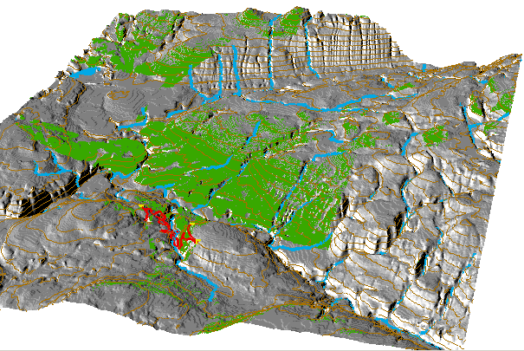
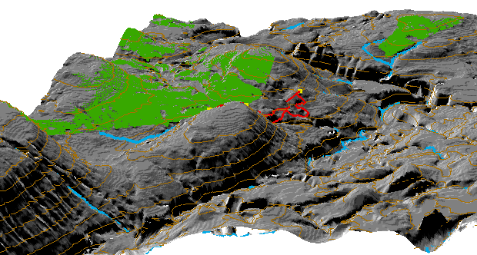
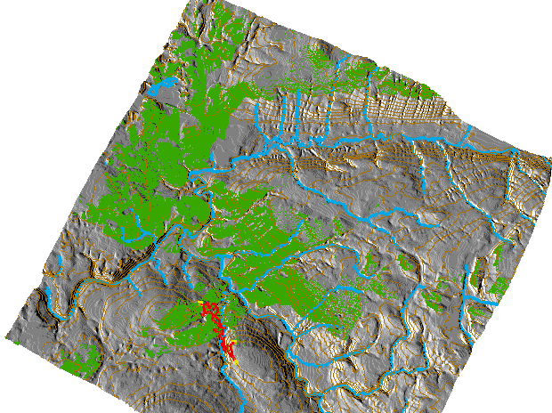
Viewshed Analysis
3 scenic lookouts
Field verify – may be natural or man made elements obstructing view

Slide 38
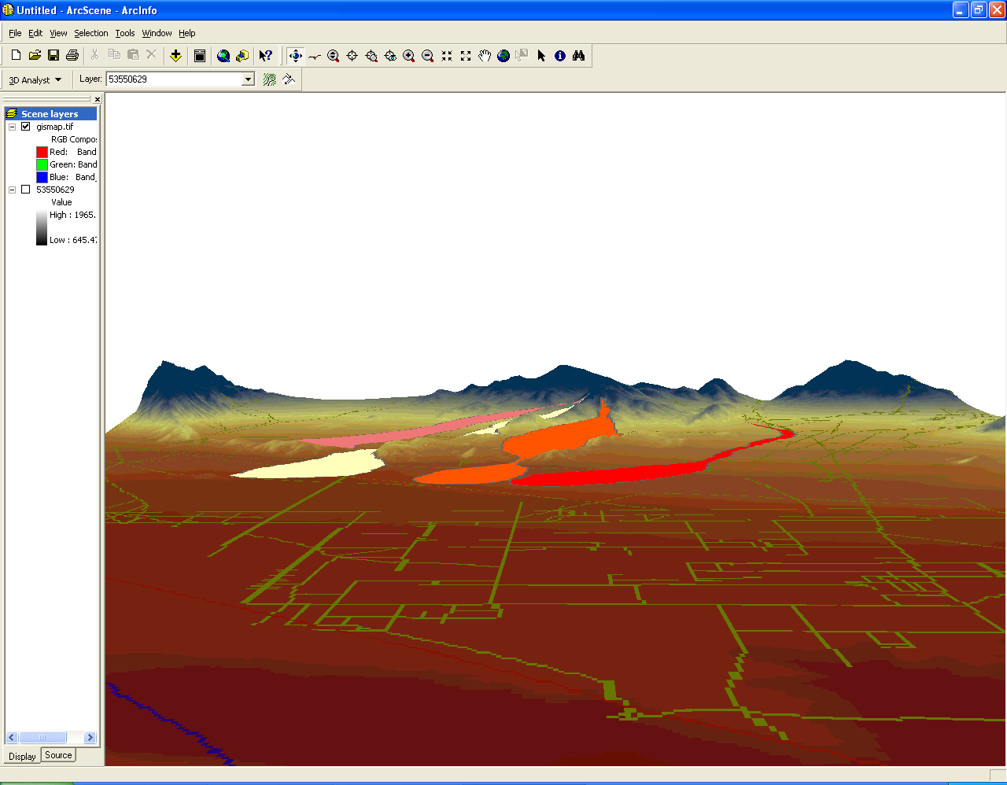
Viewshed
A. Toy, SUNY BUffalo

Slide 39

3-D Draping
Superimposed with other thematic layers
Bowling Green
Z=10

Slide 40



Crime Mapping

Slide 41



Cut/Fill

Slide 42

Cave modeling
Fisher, Erich , 2005. 3D GIS archaeology in South Africa: archeologists working along the South African southern coast use multidimensional GIS applications to model Pleistocene caves and paleo-environments reconstructing the landscape CA. 420,000 to 30,000 BP. GEO:connexion, 4 (5): 40

Slide 43
4. Statistics - Cell Statistics
Calculate stats for multiple layers
Majority, Minority, Maximum, Minimum, Mean, Medium, Range, Standard deviation, Sum, Variety

Slide 44


Majority
Minimum

Slide 45


Mean
Median

Slide 46

Sum

Slide 47
Neighborhood Statistics
Moving windows
Richness
Interspersion
3 4 5 0 1
6 8 3 1 5
3 4 0 2 1
3 8 0 5 1
6 7 5
5 7 5
8 8 6
8 7 8

Slide 48



Neighborhood Statistics

Slide 49

Zonal Statistics

Slide 50

Zonal Statistics

Slide 51
Cell Statistics
Notes:
Ratings assigned to categories for a county Solid Waste Plan. Ratings for grid cells were added to obtain a composite ranking.
It is possible to make direct calculation on the raster data layers.

Slide 52


Slide 53

Markus Erhard et al. GIS/EM4 2000

