Slide 1
GIS Data and Data Sources
DEM, TIGER, DLG, LULC, Soils,
DOQQ, DRG

Slide 2
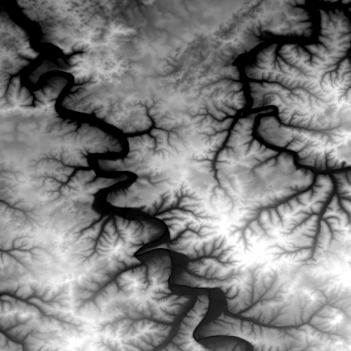
1. Digital Elevation Models (DEM)
The elevation value are stored as a matrix of regularly spaced ground positions
Each data point represents the elevation of the grid cell in which it is located

Slide 3
1. DEM 1:24,000
1:24,000 DEM http://edc.usgs.gov/guides/images/dem/utm.gif
- Produced and distributed by USGS
- regular grids in UTM coordinates system
- 7.5 minute quadrangle coverage
- 30 meter by 30 meter resolution
- elevation unit is meter
- profiles do not always have the same number of elevations
- vertical RMS is 7 or 15 meter

Slide 4
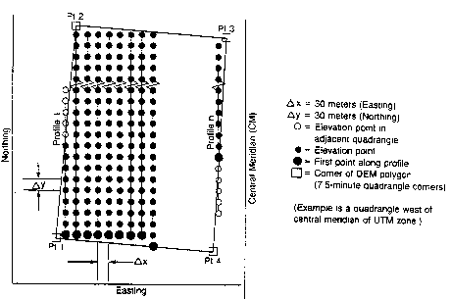
1. DEM 1:24,000…
The profiles do not always have the same number of elevation points

Slide 5
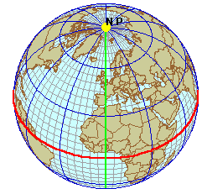
Geographic Coordinate System
90⁰ latitude
Lines of Latitude
(East/West - parallels)
Prime
Meridian 0⁰
Lines of Longitude
(North/South - meridians)
Central Parallel 0⁰
courtesy: Mary Ruvane, http://ils.unc.edu/

Slide 6
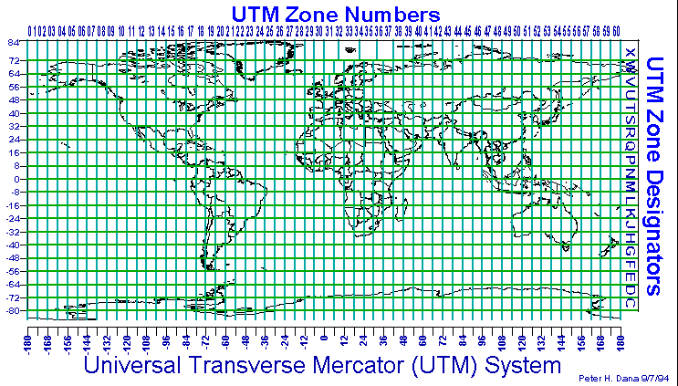
UTM Zones of the World
courtesy: http://www.colorado.edu/geography/gcraft/

Slide 7
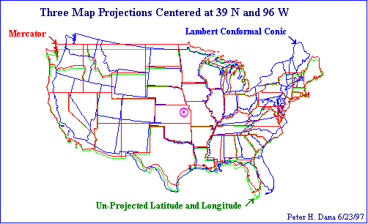
Difference between Systems
UTM and many other coordinate systems are defined based on the geographic coordinate system

Slide 8
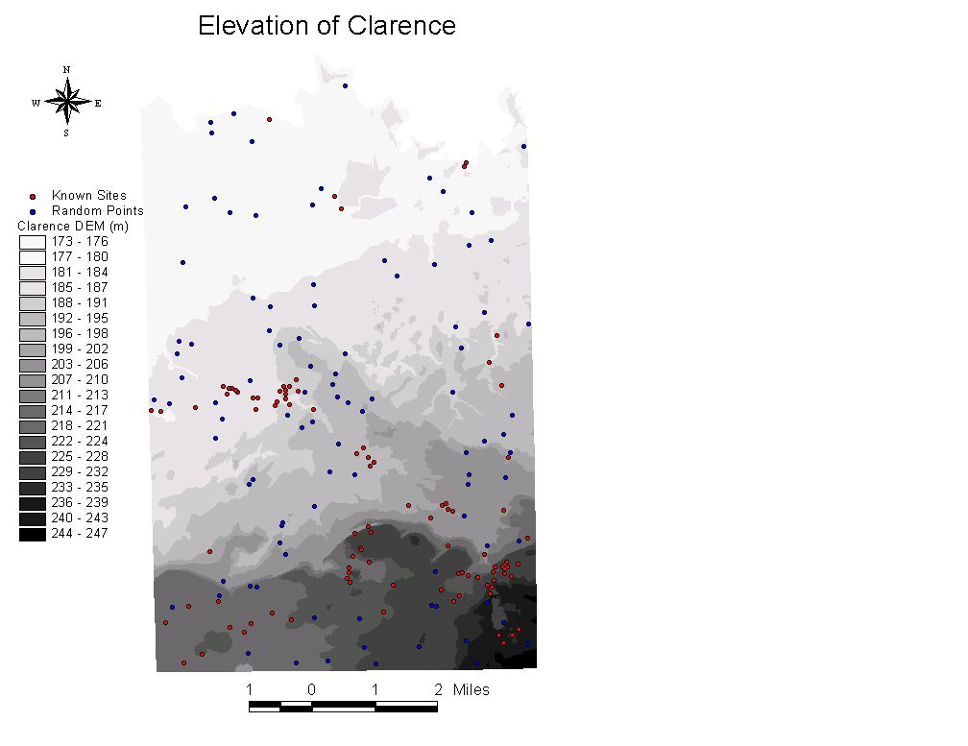

Slide 9
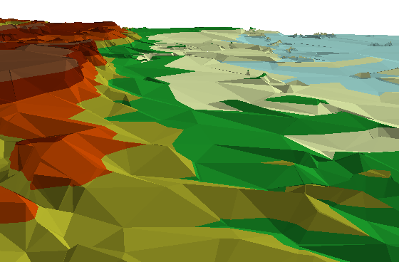
A 2D view of the Onondaga Escarpment that occupies the southern portion of the town of
Amherst. The view is looking east with the south to the left of the image.

Slide 10
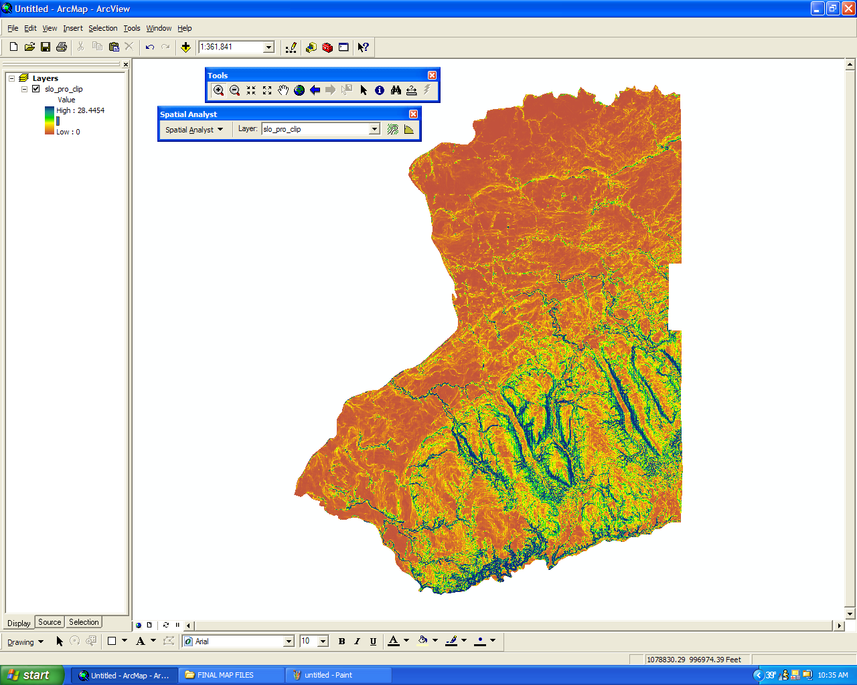
Slope angle

Slide 11
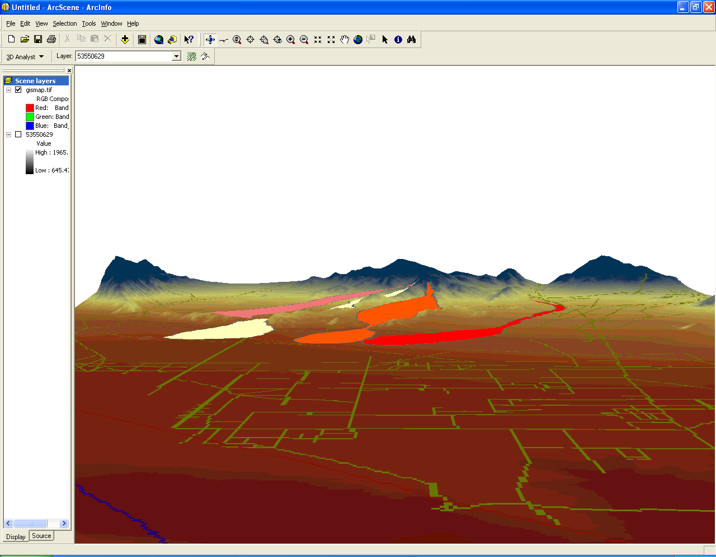
3D
A. Toy, SUNY BUffalo

Slide 12
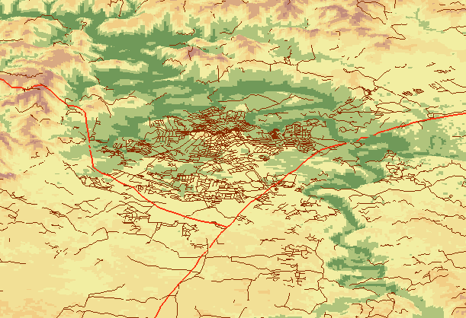
3D Display
Bowling Green
Z=10
J. Yan, SUNY Buffalo

Slide 13
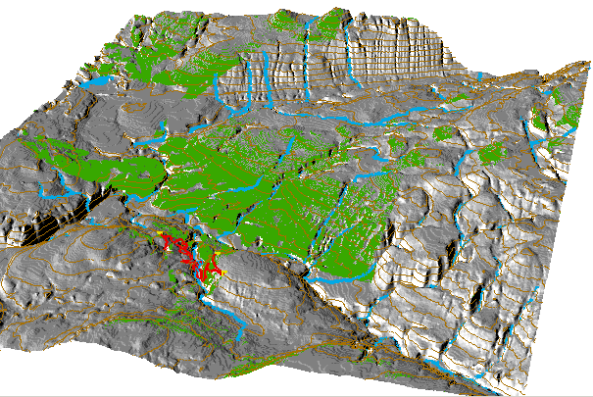
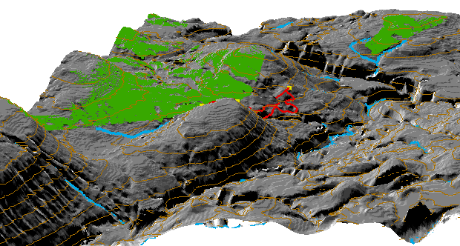
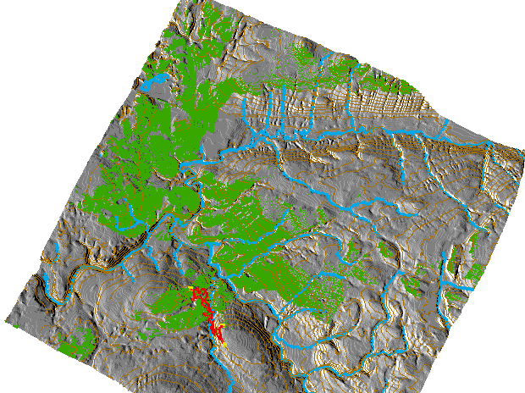
Visibility
3 scenic lookouts
M. Dolce, Buffalo State College

Slide 14
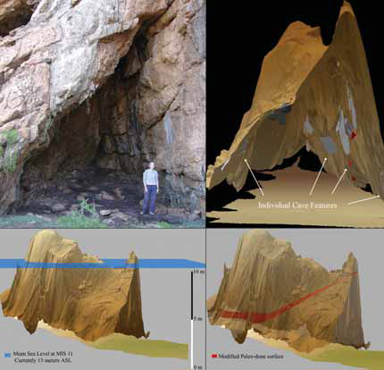
Cave modeling
Fisher, Erich , 2005. 3D GIS archaeology in South Africa: archeologists working
along the South African southern coast use multidimensional GIS applications to
model Pleistocene caves and paleo-environments reconstructing the landscape CA.
420,000 to 30,000 BP. GEO:connexion, 4 (5): 40

Slide 15
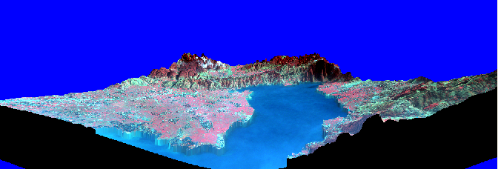
Color infrared composite of the IKONOS draped over the DEM as viewed from the west side of the study area to the east from an elevation of 10,000 m, Xichang, China
Xu, University of Utah, Gong, UC-Berkeley

Slide 16
2. Census Data - TIGER
Census units
Census tracts
- defined by the U.S. Census Bureau for statistical reporting of socio-economic data
- their boundaries follow major streets or natural features
- each tract comprises a population of approximately 4,000-5,000
- census tracts are numbered consecutively and unique within the jurisdiction

Slide 17
2. Census Data
Census units
Block groups
- comprise a population of approximately 1,000
- boundaries coterminous with tract boundaries
Blocks
- smallest geographic area formed by street segments
- coded by 3 digit numbers, the first one represents the block group, the last two are unique within the block group

Slide 18
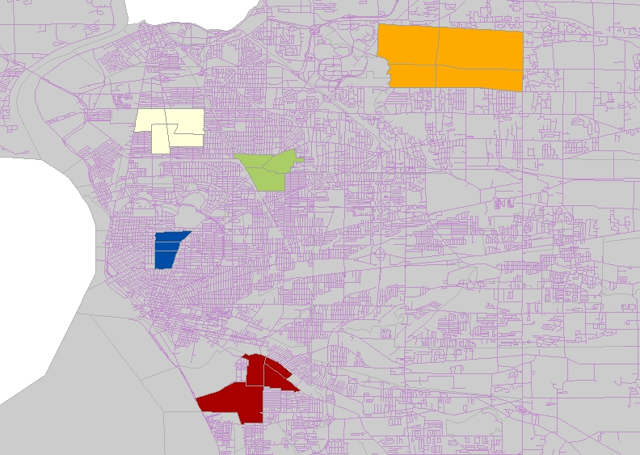
2 Census Data…
Census tracts

Slide 19
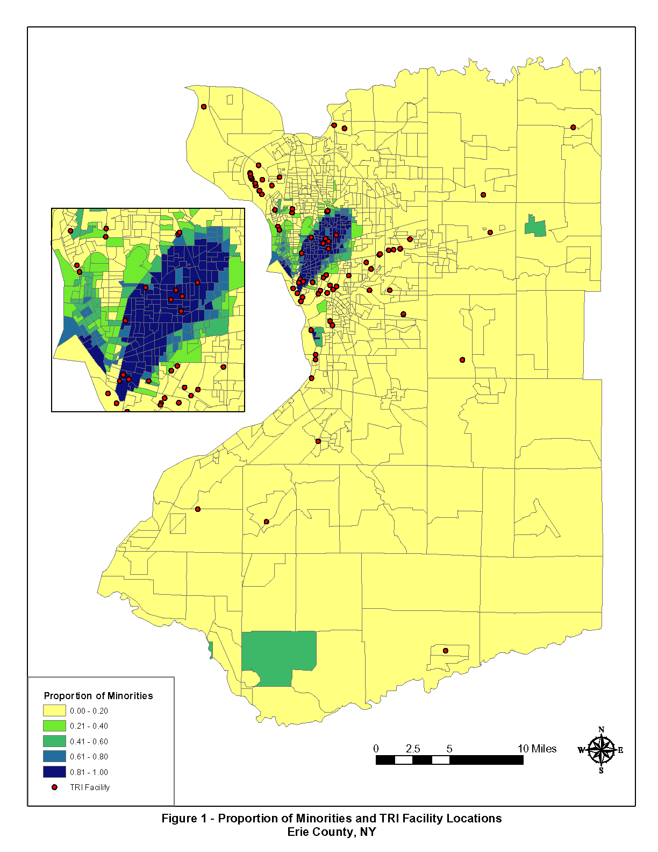
Proportion of Minorities and TRI Facility Locations
Erie County, NY

Slide 20
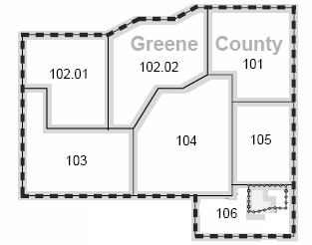

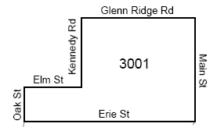
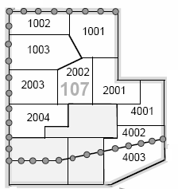
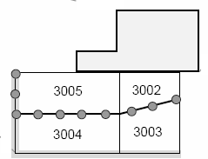
Census Units
County
Block
Census tract
Block group
http://www.census.gov/geo/www/tiger/tiger2002/tgr2002.pdf Page 4-17

Slide 21
2. Census Data - TIGER…
GBF/DIME Files (for 1970, 1980 census)
Geographic Base Files (GBF)
- Computerized data files that contain addresses, census tracts, x and y coordinates, political boundaries, etc.
Dual Independent Map Encoding system (DIME)
- Developed by the Bureau of Census for 1970, 1980 census topologically structured

Slide 22
2. TIGER…
Topologically Integrated Geographic Encoding and Referencing (TIGER) Files
- developed by the US Census Bureau for 1990, 2000, 2010 census
- the spatial and attribute data were combined into one system, and it is topologically structured
- combined DIME files and USGS 1:100,000 Digital Line Graph (DLG) files

Slide 23
2. TIGER…
- Geographic features:
Polygons: geographic area codes (county, city, census tract, block numbers, etc.)
Lines: roads, hydrography, railroads, utilities, etc.
- Attributes:
feature names, address range, etc.
- additional attributes:
population, housing unit counts, income, occupation, racial distribution, housing values, etc.

Slide 24
2. TIGER…
- block level contains aggregated information
- All variables are available at the block group level and the tract level

Slide 25
TIGER ..
American Community Survey
1-year estimate for areas with a population of at least 65,000, suitable for study of short-term changes at medium to large geographic scales.
5-year estimate for all areas down to the block geographic scale, suitable for study long-term changes at small scales
https://en.wikipedia.org/wiki/American_Community_Survey

Slide 26
3. Digital Line Graph (DLG)
Base cartographic data, distributed by USGS
Topographic data - data that portray relief. e.g. DEM
Planimetric data - data that include transportation, hydrography, and administrative and political boundaries
include spatial data, attribute data, and topology

Slide 27
3. DLG
Data Content: 1:24k 1:100k 1:2,000k 7.5'x7.5' 30'x30' multi-state
boundaries x x x
  state, county, city, park
hydrography x x x
streams and water bodies
public land survey system x x x
rectangular system
transportation x x x
roads/trails, railroads, pipelines

Slide 28
3. DLG
Data Content: 1:24k 1:100k 1:2,000k 7.5'x7.5' 30'x30' multi-state
other man-made struc x
  ski lift, fences
hyposography x x x
contour lines
veg surface cover x
non- veg surface cover x
survey control and markers x
positions and elevations

Slide 29
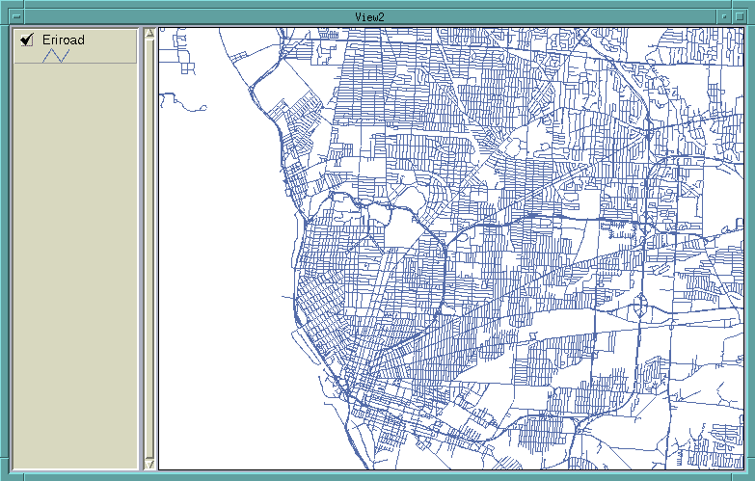

Slide 30
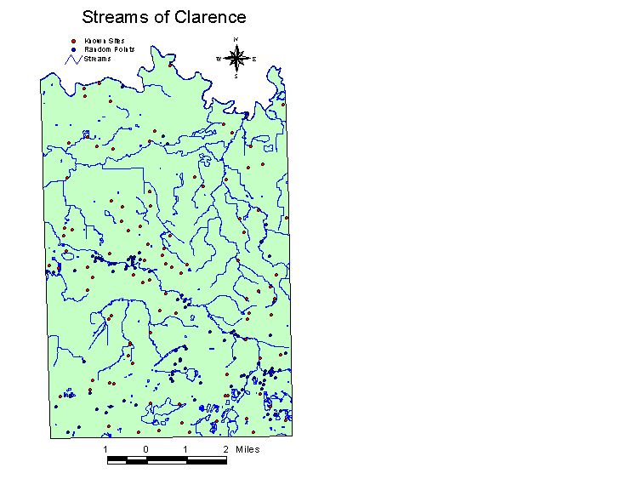
Streams layer of Clarence

Slide 31
4. Land Use Land Cover (LULC)
Distributed by USGS
1:250,000 – 1⁰x2⁰, 1:100,000 - 30'x60'
Data content
Land use and land cover
- Anderson classification system level II
Political unit
- state, county, city boundaries, census tracks, etc.
Hydrologic unit
- 8 digits HUC, region, subregion, acct. cataloging
Federal land ownership

Slide 32
Anderson LULC Classification System
Level I and Level II
1 Urban or Built-up Land
  11 Residential
  12 Commercial and Services
  13 Industrial
  14 Transportation, Communications, and Utilities
  15 Industrial and Commercial Complexes
  16 Mixed Urban or Built-up Land
  17 Other Urban or Built-up Land
2 Agricultural Land
  21 Cropland and Pasture
  22 Orchards, Groves, Vineyards, Nurseries, and Ornamental Horticultural
  areas
  23 Confined Feeding Operations
  24 Other Agricultural Land

Slide 33
Anderson LULC Classification System…
3 Rangeland
  31 Herbaceous Rangeland
  32 Shrub and Brush Rangeland
  33 Mixed Rangeland
4 Forest Land
  41 Deciduous Forest Land
  42 Evergreen Forest Land
  43 Mixed Forest Land
5 Water
  51 Streams and Canals
  52 Lakes
  53 Reservoirs
  54 Bays and Estuaries
6 Wetland
  61 Forested Wetland
  62 Nonforested Wetland

Slide 34
Anderson LULC Classification System…
7 Barren Land
  71 Dry Salt Flats
  72 Beaches
  73 Sandy Areas other than Beaches
  74 Bare Exposed Rock
  75 Strip Mines Quarries, and Gravel Pits
  76 Transitional Areas
  77 Mixed Barren Land
8 Tundra
  81 Shrub and Brush Tundra
  82 Herbaceous Tundra
  83 Bare Ground Tundra
  84 Wet Tundra
  85 Mixed Tundra
9 Perennial Snow or Ice
  91 Perennial Snowfield
  92 Glaciers

Slide 35
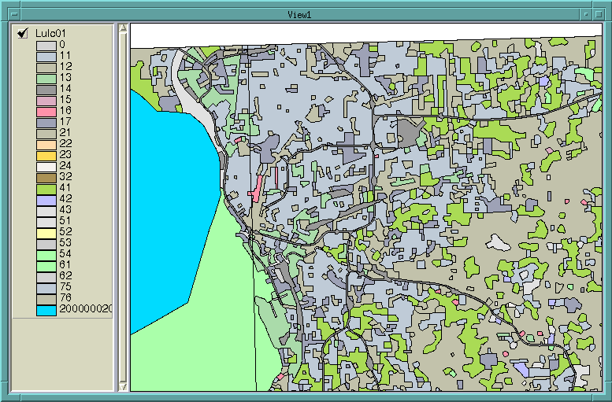

Slide 36
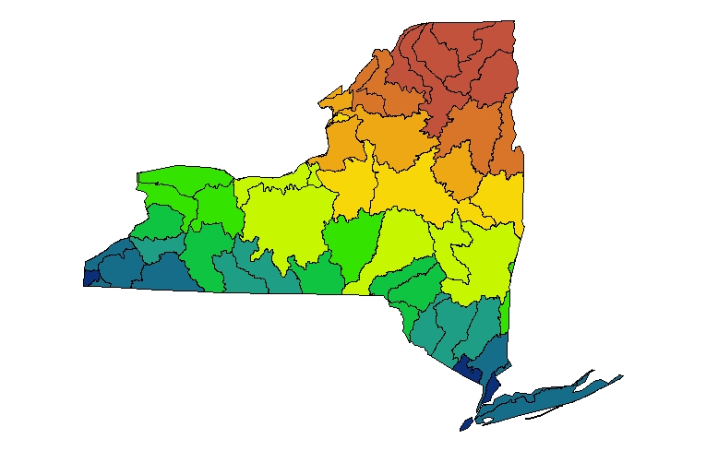

Slide 37
5. Soils
Developed by USDA Natural Resource Conservation Service (NRCS)
Soil Survey Geographic Data Base (SSURGO)
- 1:24,000, 7.5x7.5 minute quads
- based on aerial photographs and field survey
- map unit and soil classification: soil series
- attributes: physical, chemical, biological, land use

Slide 38
5. Soils
State Soil Geographic Data Base (STATSGO)
- 1:250,000, 1x2 degree
- map unit: soil association
- attribute: 60 soil properties
- attribute structure
- map unit and code
- components and their properties
- layers and their properties
National Soil Geographic Data Base (NATSGO)
- 1:7,500,000

Slide 39
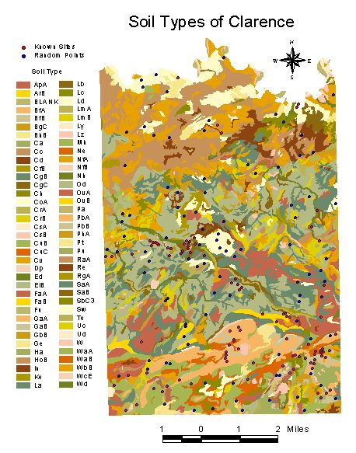
Soil layer of Clarence

Slide 40
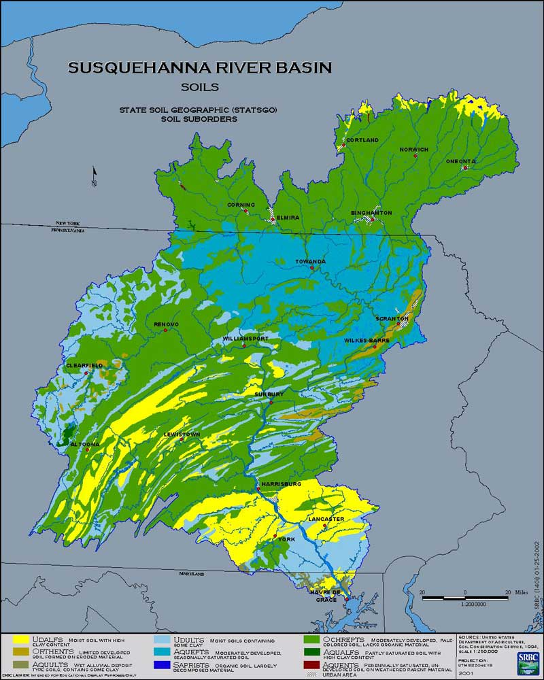
http://www.srbc.net/gis/map_gallery.html

Slide 41
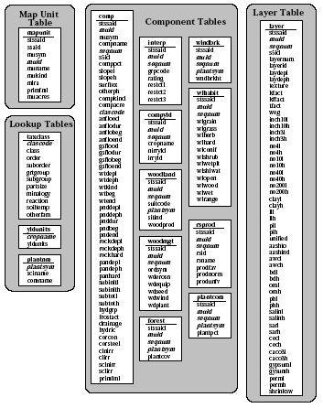
STATSGO Attributes
A set of relational tables is used to store the attributes for the Map Unit and its Components
http://www.ncgc.nrcs.usda.gov/products/datasets/statsgo/data/ny.html

Slide 42
6. Digital Orthophoto Quarter Quad (DOQQ)
Developed by USGS and state and local governments
Digital aerial photographs without geometric errors introduced by tilt or relief displacement

Slide 43
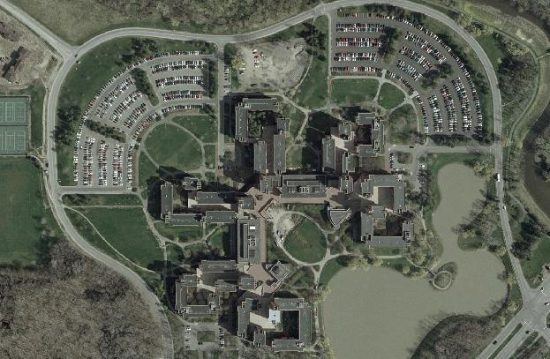

Slide 44
7. Digital Raster Graphics
Developed by USGS
A raster image of a scanned USGS topographic map georeferenced to the UTM grid
Useful as a background layer in a GIS, or to be merged with other digital data to produce a hybrid digital file

Slide 45
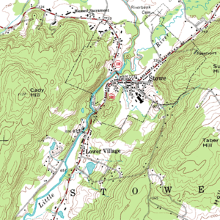
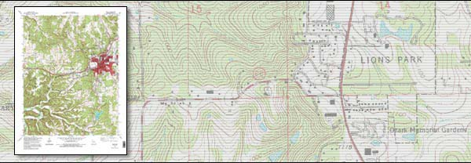
http://en.wikipedia.org/wiki/Digital_raster_graphic
http://topomaps.usgs.gov/drg/

Slide 46
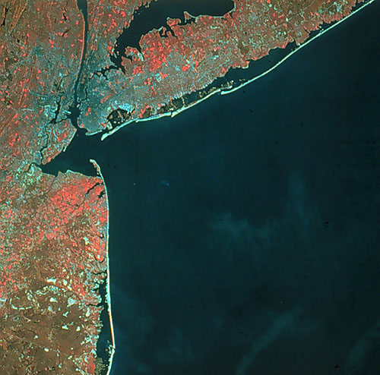
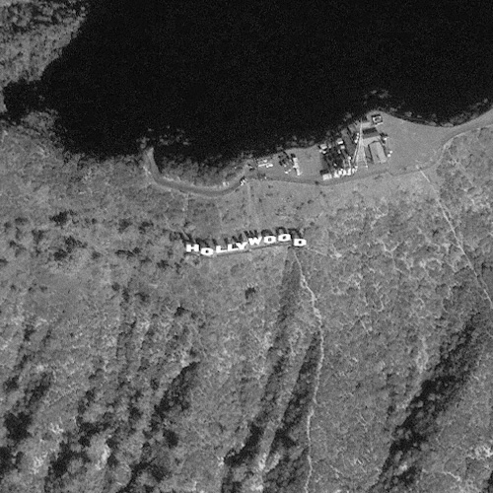
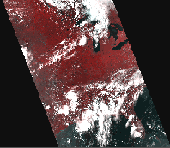
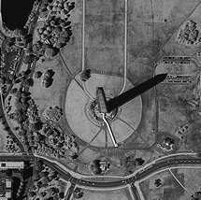
8. Remote Sensing

Slide 47
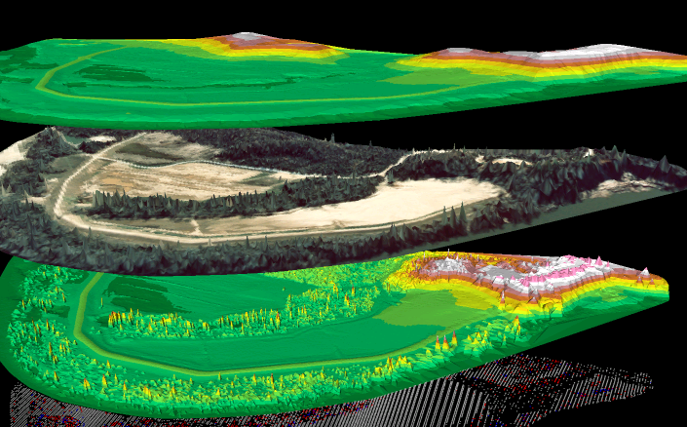

Slide 48
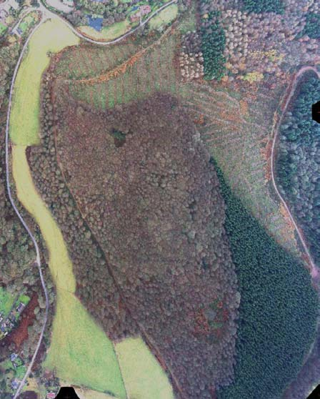
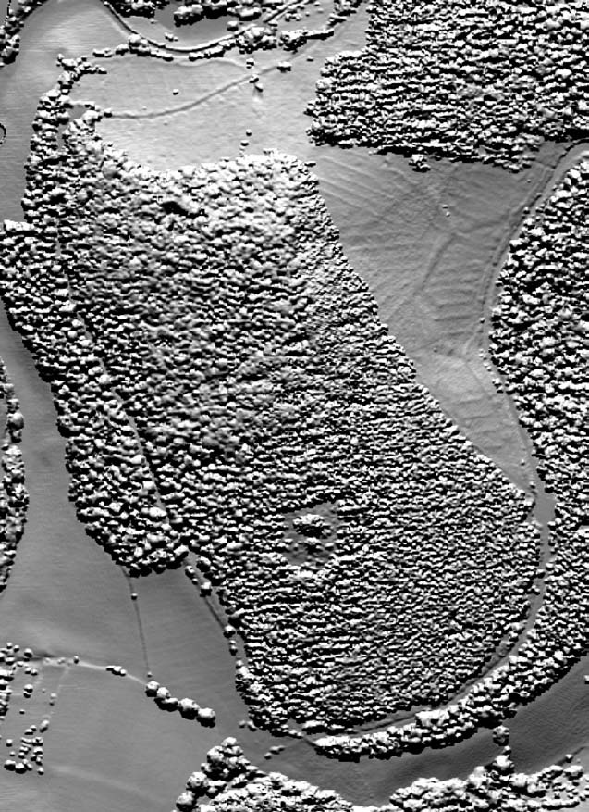
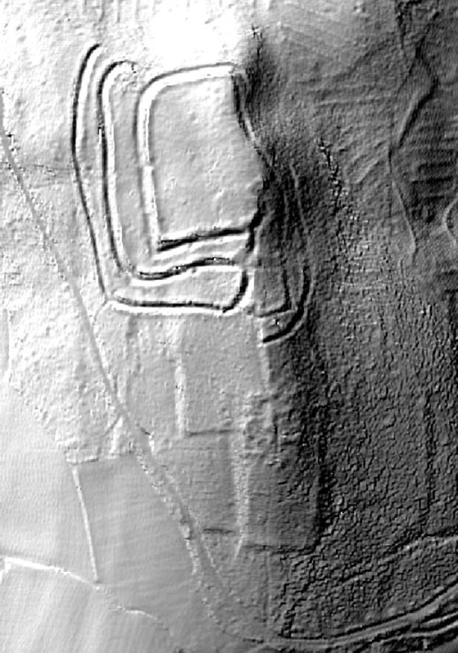

Slide 49
NYS GIS Data Depository
http://cugir.mannlib.cornell.edu
http://gis.ny.gov
http://nationalmap.gov/viewer.html
http://datagateway.nrcs.usda.gov
http://data.buffalony.gov

Slide 50
Major Events in This Semester
Ad hoc job announcements
ESRI recruiters coming to town Feb 24, 25 (Mon-Tue)
- Mon Feb 24, 6:00-8:00pm, 144 Wilkeson
Info Session
- Tue Feb 25, interview,
Apply by sending resume, cover letter, and
availability to nkelch@esri.com by Wed Feb 19.

