Slide 1
Environmental Modeling Environmental Modeling and GIS Models

Slide 2
Access to
Wilkeson
GIAL
Computer account
Pro account
Let me know if there are problems

Slide 3
1. Purpose of Models
Simulate the real world
Simplify the complex reality
Explain underlying principles and relationships
Predict the unknown in space or time
Test hypothesis and scenarios

Slide 4
2. Components of a Model
Assumptions – starting conditions
Elements - variables
Function - relationships between variables
Explanation - logic behind the functions
Prediction – using functions to assess a situation under different conditions and at other locations or time

Slide 5
3. Type of Models
Research models
a research tool
Management models
a management tool
Conceptual models
no numeric values or formula
Theoretical models
with numeric values or formula

Slide 6
3. Type of Models ..
Physical models
based on physical laws, first principle
Empirical models
based on observations, mechanism unknown
Deterministic models
based on known physical laws
Stochastic models
based on the concept of randomness and probability

Slide 7
3. Type of Models ..
Differential models
based on differential equations
Matrix models
based on matrix algebra
Reductionistic models
include as many details as possible
Holistic models
use general principles

Slide 8
3. Type of Models ..
Static models
variables not depend on time or space
Dynamic models
variables are a function of time and space
Distributed models
parameters depend on space and time
Lumped models
parameters are constants over an area

Slide 9
3. Type of Models ..
Linear models
first degree equations
Non-linear models
one or more equations not first degree
Causal models
input, logic, output are related to physics laws
Black box models
input and output are statistically related

Slide 10
4. Scales of Model
Binary/Nominal
no quantity, names
yes/no, presence/absence, on/off, true/false, 1/0
Ranking/Ordinal
high/medium/low
excellent/very good/good/fair/poor
Quantitative/Interval/Ratio
absolute values, actual amount

Slide 11
5. Performance of Models
Calibration
calibrate model parameters based on the data that are used to develop the model
Validation
validate a model using independent data

Slide 12
5. Performance of Models ..
Sensitivity analysis
sensitivity of model output to changes in model input
Error propagation
error and uncertainty in input data transmitted to results through the modeling process

Slide 13
6. Link GIS and Models
Direct use of GIS functions
suitability index models and the Delphi approach
Integrate GIS with statistical analysis
use statistics to test a GIS model or use GIS to spatialize a statistical model
Interface GIS with process models
GIS provides input for models and displays the model output

Slide 14
6. Link GIS and Process Models ..
Develop models in GIS
Develop GIS in a model
Interface GIS with a model
Then and now

Slide 15
6. Link GIS and Process Models
Technical interoperation
Semantics interoperation
Institutional interoperation

Slide 16
1. What is GIS?
G: maps
I: spreadsheets
S: the system that puts the maps and spreadsheets together

Slide 17
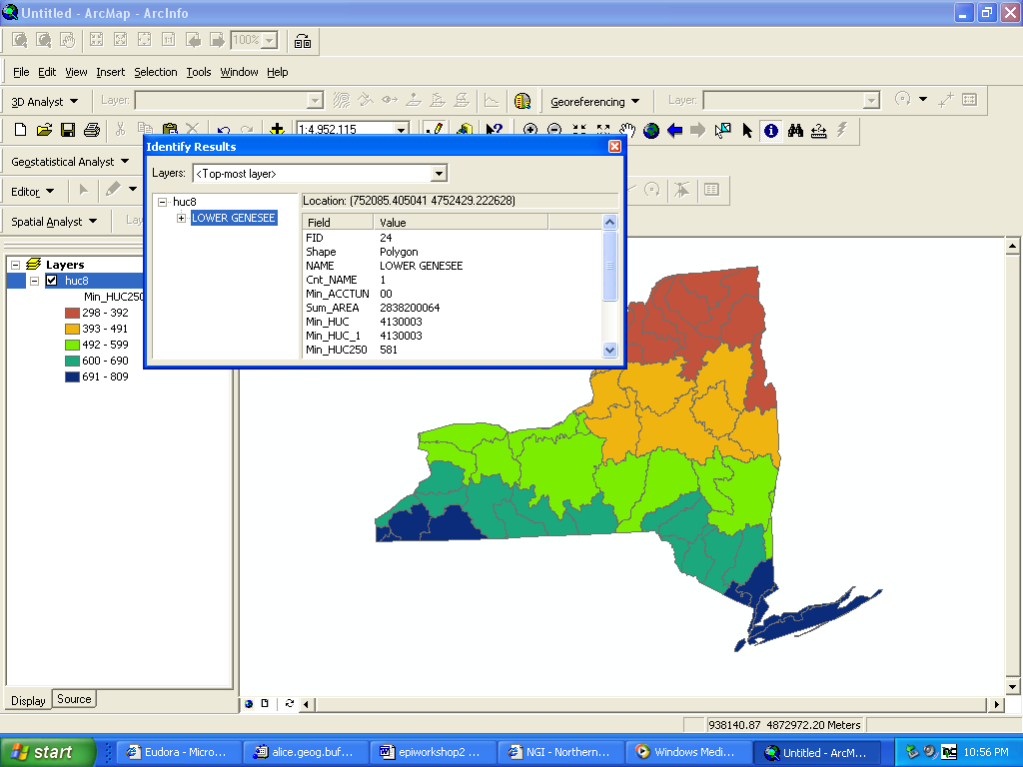

Slide 18
Formal Definition of GIS
A GIS is a computer-based system that provides for the collection, storage, analysis, and display of geo-referenced data
A decision support system involving the integration of spatially referenced data in a problem solving environment

Slide 19
GIS Is Important
Locations
Networks
Areas
Because most information has a spatial component
ESRI, GE SmallWorld

Slide 20
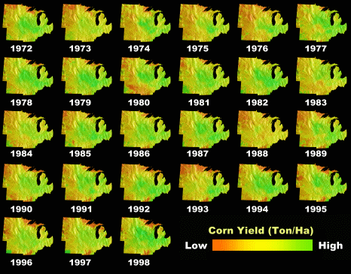
GIS Is Important…
It helps temporal reasoning as well
S. H. Gage, J. Helly and M. Colunga, GIS/EM4 2000

Slide 21
GIS Integrates Various Information
Social Factors
Biodiversity
Engineering
Land Use
Environmental
Considerations
It allows us to see the “whole”
Courtesy: USGS

Slide 22
GIS and GIS
GISystems
Geographic Information Systems
It refers to software, hardware
It is used as a tool to support other research
GIScience
Geographic Information Science
Study ‘on’ GIS vs. study ‘with’ GIS

Slide 23
Components in GIS
Spatial locations
Attributes
Topology

Slide 24
Spatial Locations
Specified with reference to a common coordinate system
Geographic coordinate system (lat and long)
UTM (Universal Transverse Mercator)
State Plane

Slide 25
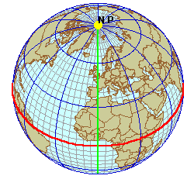
Geographic Coordinate System
90⁰ latitude
Lines of Latitude
(East/West - parallels)
Prime
Meridian 0⁰
Lines of Longitude
(North/South - meridians)
Central Parallel 0⁰
courtesy: Mary Ruvane, http://ils.unc.edu/

Slide 26
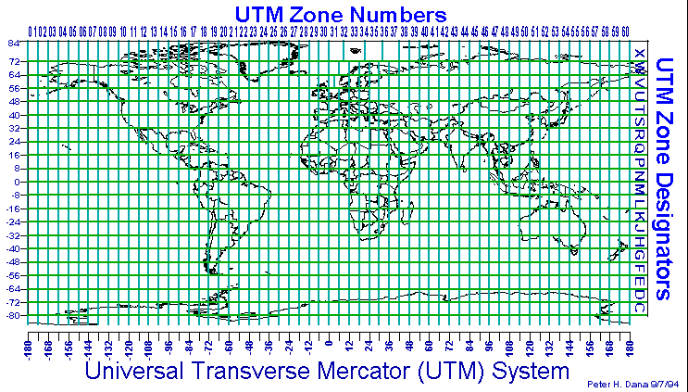
UTM Zones
courtesy: http://www.colorado.edu/geography/gcraft/

Slide 27
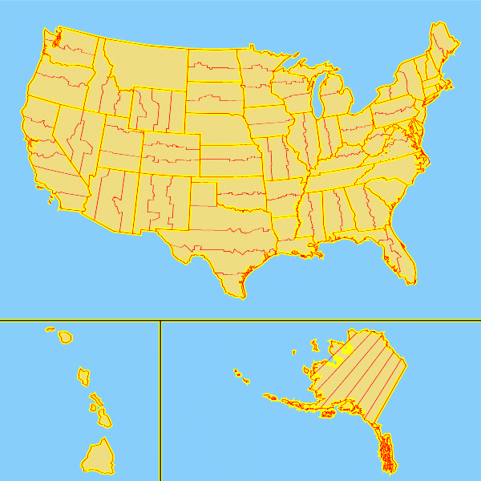
State Plane Zones
courtesy: http://www.cnr.colostate.edu/class_info/nr502/lg3/datums_coordinates/spcs.html/

Slide 28
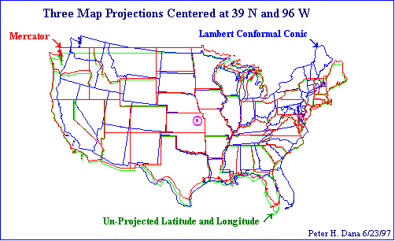
Difference between Systems
UTM and many other coordinate systems are defined based on the geographic coordinate system

Slide 29
Attributes
Attributes = variables, properties, etc.
Four types of attribute values
Nominal (river, grass, ..)
Ordinal (high, medium, low)
Interval (10ºC, 20ºC)
Ratio (2.19, -96.57, ..)

Slide 30
Topology
Spatial relationship between geographic features (points, lines, polygons)
Adjacency
Containment
Connectivity
and so on

Slide 31
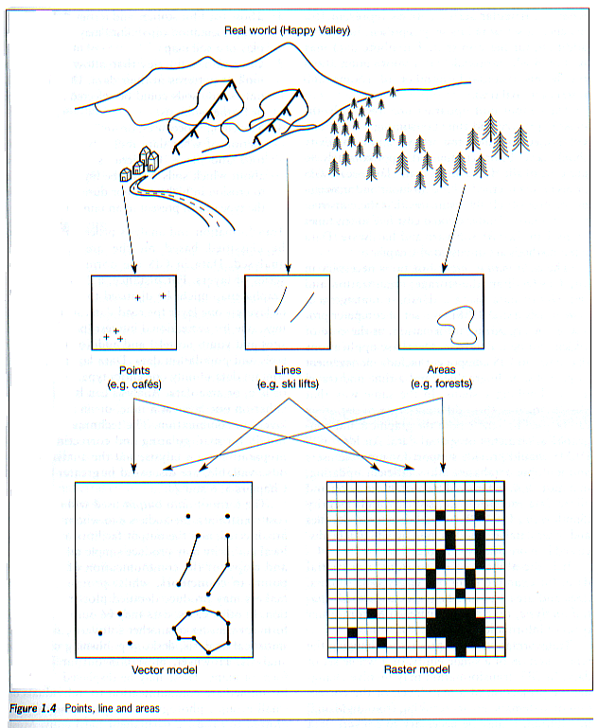
GIS Data Models
Vector
points
lines
polygons
networks
Raster
grids
courtesy: Mary Ruvane, http://ils.unc.edu/

Slide 32
How GIS Is Used
GIS by itself
GIS = 100%
We will discuss some of this
Integrated with statistics
GIS = 50%, statistics = 50%
We will discuss some of this
Integrated with process models
GIS=10%, process models = 90%

Slide 33
2. GIS Modeling
Conceptualize the Model
Formulate the Model
Implement the Model
Calibrate, Validate, and Refine Models

Slide 34
2. GIS Modeling
Conceptualize the Model
– Project Design
(1) Identify the goal first
- What is the problem
e.g., where to put ATM machines
e.g., where are the most appropriate places to cut old trees in a state park

Slide 35
2. GIS Modeling
Conceptualize the Model..
– Project Design
(2) Identify the factors that affect the solution
For the location of ATM machines
factor 1:
factor 2:
factor 3:
For cutting old trees in a state park?

Slide 36
2. GIS Modeling
Formulate the Model
– Methodology Design
(1) Find the spatial data for each factor. Use surrogate data if direct data are not available
For the location of the ATM machines
Factor 1: data =
Factor 2: data =
Factor 3: data =

Slide 37
2. GIS Modeling
Formulate the Model..
– Methodology Design..
(2) Identify spatial operators
e.g., overlay, buffering
neighborhood analysis, topographic analysis, spread function, stream function, viewshed analysis, network analysis, etc.
For the location of the ATM machines
Operator 1, 2, …

Slide 38
2. GIS Modeling
Implement the Model
– Methodology implementation
Collect the data
Run spatial operations
Map the results

Slide 39
2. GIS Modeling
Calibrate, Validate, and Refine Models
The output is nothing more than a pretty picture without acceptability assessment
- Go to field or use actual decision records as evidence
- Use aerial photo or satellite images as surrogate evidence
- Set a small set of data aside and use it later to validate the model results

Slide 40
2. GIS Modeling
Calibrate, Validate, and Refine Models
If all of above are impossible,
Make sure all variables are significant for the model
Make sure the model is appropriate

Slide 41
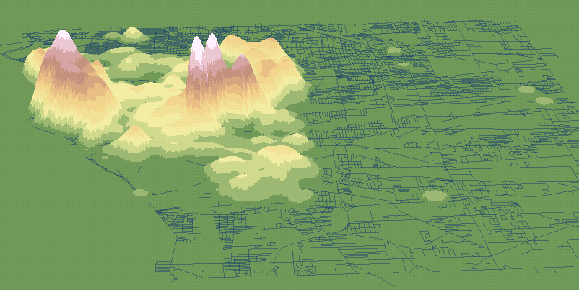
Major Events in This Semester
Ad hoc job announcements
ESRI recruiters coming to town Feb 24, 25 (Mon-Tue)

Slide 42
Positive Snail Prediction of Xichang Study Site
using the land-cover map and field snail survey including 93 positive snail sites and 800 non-positive snail sites
Positive snail
0.00 - 0.03
0.04 - 0.13
0.14 - 0.23
0.24 - 0.33
0.34 - 0.60
Lake
±
0
1,650
3,300
6,600
Meters

