Slide 1
Environmental Modeling
Basic GIS Modeling
Suitability Index Modeling

Slide 2
GIS Modeling Approaches
GIS by itself
GIS integrated with statistics
GIS integrated with process models

Slide 3
1. The Delphi Approach
A procedure for obtaining and processing expert judgments to maximize the accuracy of the resulting estimates
Main considerations
- Data, budget, and time can be constrained for a scientific evaluation
- Human mind is capable of making quite accurate judgments

Slide 4
1. Delphi
Experts' role
1. select appropriate variables
2. estimate the magnitude of ranking
3. assign weights to variables

Slide 5
1. Delphi
The Delphi steps
1. ask each expert for an independent opinion on carefully prepared questions
2. calculate the median and range of opinions and feed these back to the experts for another round of estimate
3. repeat step 1 and 2 for a few rounds
4. use the median of the final round as the best answer
* time and cost factors

Slide 6
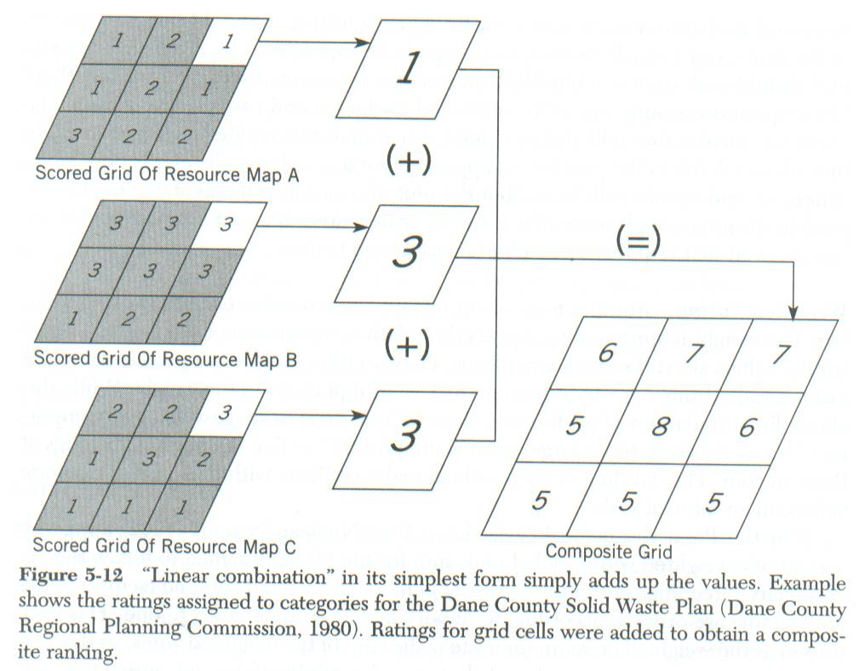
Simple Modeling
Ranking and weighting
M Ruvane, UNC Chapel Hill

Slide 7
2. Land Suitability Analysis
Richmond Parkway, NY evaluation
McHarg, I.L., 1969. Design with Nature
Korean War Veterans Parkway, in Staten Island http://en.wikipedia.org/wiki/Richmond_Parkway_%28Staten_Island%29

Slide 8
2. Land Suitability Analysis
A total of 16 land variables
e.g. slope, drainage, land values, etc.
Each variable is ranked from 1 to 3
e.g. slope<2.5%,3; 2.5%<slope<10%,2; slope>10%,1
The grand index
= summation of ranking * weighting

Slide 9
Ian McHarg Richmond Parkway
Slope
zone 1: slope > 10%
zone 2: 2.5% < slope < 10%
zone 3: slope < 2.5%
Surface drainage
zone 1: streams, lakes, and ponds
zone 2: natural drainage channels
zone 3: absence of surface water

Slide 10
Ian McHarg Richmond Parkway
Soil drainage
Bedrock foundation
Soil foundation
Susceptibility to erosion
Land values
Tidal inundation

Slide 11
Ian McHarg Richmond Parkway
Historic values
Scenic values
Recreation values
Water values
Forest values
Wildlife values
Residential values
Institutional values

Slide 12

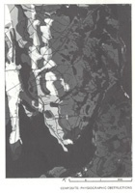
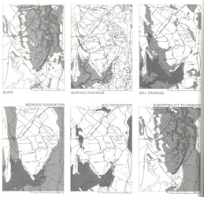

Slide 13
Ranking and Weighting
1.0
0.8
0.6
0.4
0.2
1.0
0.8
0.6
0.4
0.2
20 40 60 80 100%
20 40 60 80 100%
Carrying capacity for grazers
Man-made water loss/total
1.0
0.8
0.6
0.4
0.2
1.0
0.8
0.6
0.4
0.2
20 40 60 80 100%
20 40 60 80 100%
Dissolved Oxygen
Density of man-made structures

Slide 14
3. The DRASTIC Model
Development
- By the National Water Well Association in 1987 for US EPA to evaluate groundwater pollution potential.
- It used the Delphi method to design parameters by compiling responses from more than 40 of the nation's leading groundwater scientists.

Slide 15
3. DRASTIC
The model
D - Depth to water table
R - Recharge
A - Aquifer media
S - Soil media
T - Topography
I - Impact of vadoes zone
C - Conductivity of the aquifer

Slide 16
Ranges and Ratings
for Depth to Water
Depth to Water (Feet)
Ranges and Ratings
for Net Recharge
Net Recharge (inches)
Range Rating
0-5 10
5-15 9
15-30 7
30-50 5
50-75 3
75-100 2
100+ 1
Range Rating
0-2 1
2-4 3
4-7 6
7-10 8
10+ 9

Slide 17
Ranges and Ratings
for Aquifer Media
Aquifer Media
Ranges and Ratings
for Soil Media
Soil Media
Ranges Rating
Massive Shale 2
Metamorphic/Igneous 3
Weathered Metamorphic/
Igneous 4
Glacial Till 5
Bedded Sandstone, Limestone
And Shale Sequences 6
Massive Sandstone 6
Massive Limestone 6
Sand and Gravel 8
Basalt 9
Karst Limestone 10
Ranges Rating
Thin or Absent 10
Gravel 10
Sand 9
Peat 8
Shrinking and/or
Aggregated Clay 7
Sandy Loam 6
Loam 5
Silty Loam 4
Clay Loam 3
Muck 2
Nonshrinking and
Nonaggregated Clay 1

Slide 18
Ranges and Ratings
for Topography
Topography (Percent Slope)
Ranges and Ratings
for Impact of the Vadose Zone Impact of the Vadose Zone Media
Range Rating
0-2 10
2-6 9
6-12 5
12-18 3
18+ 1
Range Rating
Confining Layer 1
Silt/Clay 3
Shale 3
Limestone 6
Sandstone 6
Bedded Limestone,
Sandstone, Shale 6
Sand and Gravel with
significant Silt and Clay 6
Metamorphic/Igneous 4
Sand and Gravel 8
Basalt 9
Karst Limestone 10

Slide 19
Ranges and Ratings
for Hydraulic Conductivity
Hydraulic Conductivity (GPD/FT²)
Range Rating
1-100 1
100-300 2
300-700 4
700-1000 6
1000-2000 8
2000+ 10

Slide 20
4. The Judgment Impact Matrix
It suits for evaluation of complex systems
Estimation structure
components -> environmental elements -> societal elements -> grand index
The matrix
components x link (0,1) x element set1 x element set2 x weights (for element 2)
The links, environmental, societal and weights can be determined by the Delphi method

Slide 21
4. JIM
Component 1
Element 1
Element 1
Component 2
Element 2
Element 2
Policy
Component i
Element i
Element i
Component m
Element m
Element m

Slide 22
5. A Mock Project
What is the problem
Where to spray to control mosquito pop
Factors that affect spray
1: areas of high human pop density
2: adjacent to water bodies
3: low elevation
Find data for each factor
Apply functions to the data

Slide 23
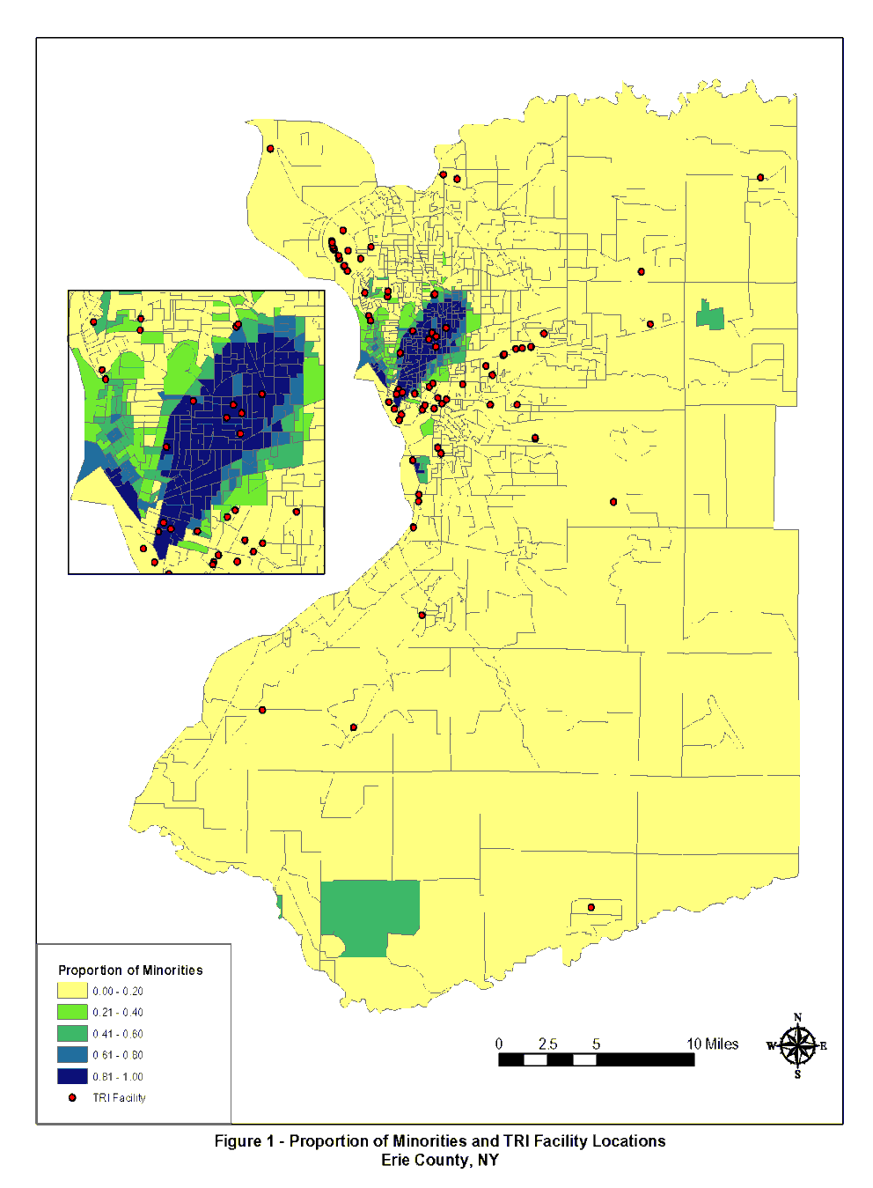
Find Data
Factor 1:
areas of high
population
density
R Brancoto, SUNY Buffalo

Slide 24
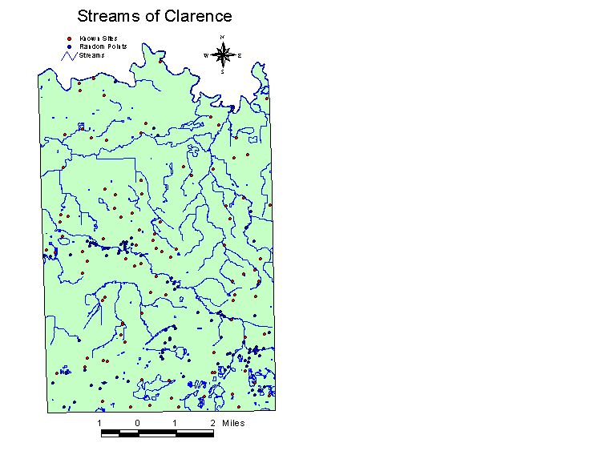
Find Data
Factor 2:
adjacent to
water
Function:
buffer
T Tatignani, SUNY BUffalo

Slide 25
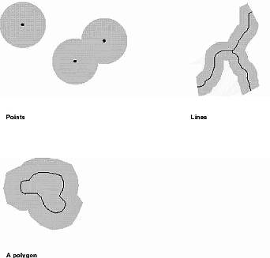
Function
Points Lines Polygons
Function: Buffer width =
M Ruvane, UNC Chapel Hill
Notes:
Buffer: A zone constructed outward from an isolated object (point or line) to a specific distance.
Setback: A zone inside a POLYGON constructed by a fixed distance from the edge of the polygon; typically used to restrict building or activities too close to the edge of a property parcel.

Slide 26
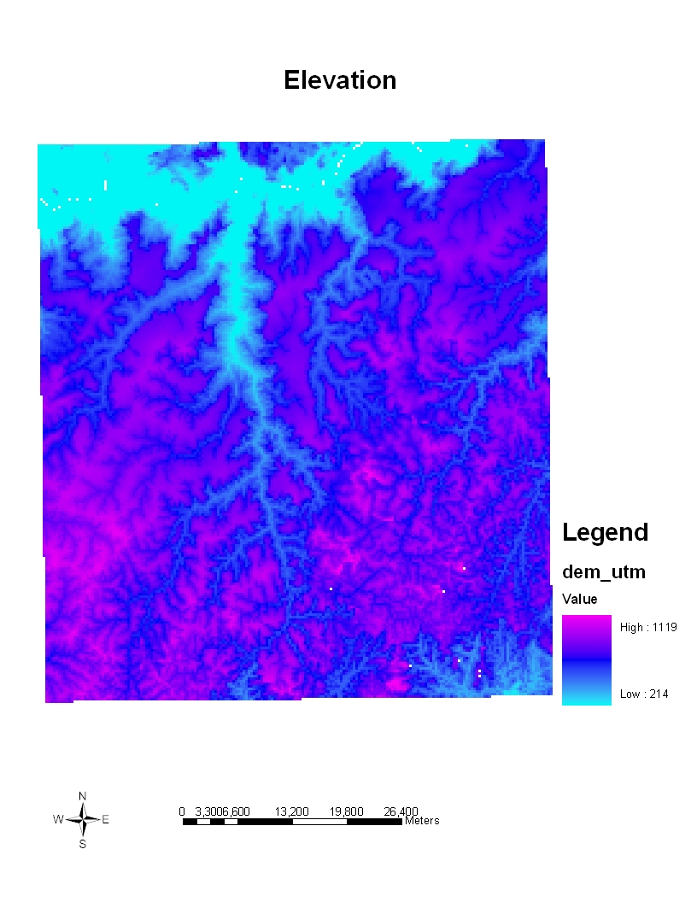
Find Data
Factor 3:
low elevation
NIMA & NASA

Slide 27
Ranking and Weighting
Suitability = Layer1*1 + Layer2*3 + layer3*3
M Ruvane, UNC Chapel Hill

Slide 28
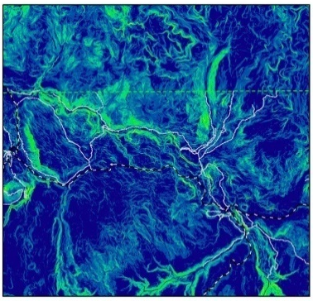
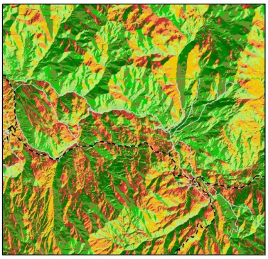
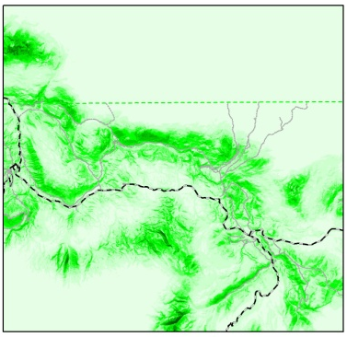
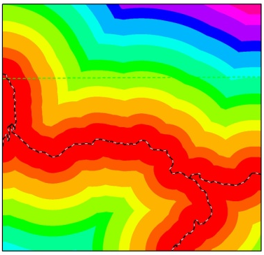
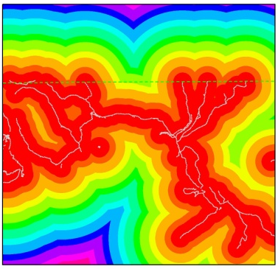
Slope
Aspect
Distance to roads
From Richard Aspinall
Distance to trails

Slide 29
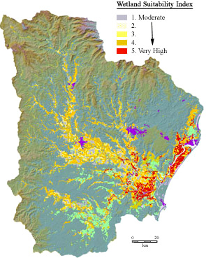
Suitability Index Modeling
Owen Earley, GIS/EM4 2000

