Slide 1
Geo597 Geostatistics
Ch9 Random Function Models (II)

Slide 2
Spatial Stochastic Process
Spatial stochastic process (referred to as “random function” in the text book) is a set of random variables that have spatial locations and whose dependence on each other is specified by some probabilistic mechanism.
x is a location whose value is 0,1.
V(0) means x=0, the initial location.
with probability 1/2
with probability 1/2
with probability 3/4
with probability 1/4

Slide 3
Spatial Stochastic Process ...
Like random variables, stochastic processes also have possible outcomes, called “realizations”.
The random variables
V(0), V(1), V(2), V(3),… V(x_{i})
The pairs of random variables
(V(0),V(1)), (V(1),V(2)), (V(2),V(3)),…, (V(x),V(x+1))

Slide 4
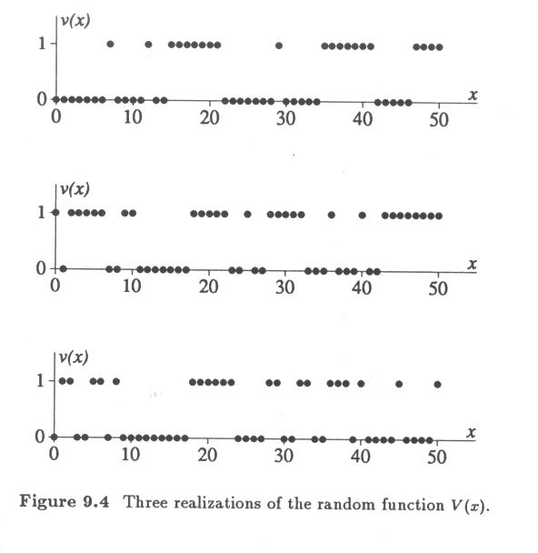

Slide 5
Spatial Stochastic Process ...
The possible outcomes of (V(x),V(x+1)) and their corresponding probabilities (joint distribution)
{(0,0), (0,1), (1,0), (1,1)}
3/8 1/8 1/8 3/8
(0,0) 1/2*3/4= 3/8
(0,1) 1/2*1/4= 1/8
(1,0) 1/2*1/4= 1/8
(1,1) 1/2*3/4= 3/8

Slide 6
Spatial Stochastic Process ...
What about the possible outcomes of pairs (V(x),V(x+2)) and their corresponding probabilities?
Let’s begin with triples (V(x),V(x+1),V(x+2))
{(0,0,0), (0,0,1), (0,1,0), (0,1,1), (1,0,0), (1,0,1), (1,1,0), (1,1,1)}
(0,0,0) (1,1,1) p=1/2*3/4*3/4=9/32
(0,0,1) (1,1,0) p=1/2*3/4*1/4=3/32
(1,0,0) (0,1,1) p=1/2*1/4*3/4=3/32
(0,1,0) (1,0,1) p=1/2*1/4*1/4=1/32

Slide 7
Spatial Stochastic Process ...
(0,0,0) (1,1,1) p=1/2*3/4*3/4=9/32
(0,0,1) (1,1,0) (1,0,0) (0,1,1) p=1/2*3/4*1/4=3/32
(0,1,0) (1,0,1) p=1/2*1/4*1/4=1/32
Now, (V(x),V(x+2))
P{V(x),V(x+2) = (0,1)} = 3/32+3/32=6/32
P{V(x),V(x+2) = (1,0)} = 3/32+3/32=6/32
P{V(x),V(x+2) = (1,1)} = 9/32+1/32=10/32
P{V(x),V(x+2) = (0,0)} = 9/32+1/32=10/32

Slide 8
Stationarity
Define pair of random variables separated by distance h: (V(x),V(x+h)).
Then the probability of staying at the same value would decrease, asymptotically approaching ½.
P{V(x),V(x+1) = (0,0) (1,1)} =3/8+3/8=3/4=24/32
P{V(x),V(x+2) = (0,0) (1,1)} = 10/32+10/32=20/32

Slide 9
Stationarity ...
The univariate probability law of V(x) does not depend on the location of x; 0 and 1 have an equal probability of occurring at all locations.
Similarly, the bivariate probability law of (V(x), V(x+h)) does not depend on the location x, but only on the separation of h; all pairs of random variables separated by a particular distance h have the same joint probability distribution.

Slide 10
Stationarity ...
This univariate and bivariate probability laws from the locations x is referred to as “stationarity”.
A spatial process is stationary, if its statistical properties such as mean and variance are independent of absolute location.
E{ V_{(x)} } = E{V_{(x+h)}}, Var{V_{(x)} } = Var{V_{(x+h)} }
for all x when assuming stationary process.

Slide 11
Stationarity ...
Stationarity also implies that the covariance between two sites depends only on the relative locations of their sites, the distance and direction between them, but not on their absolute location x.

Slide 12
Parameters of Random Functions
If the random function (spatial stochastic process) is stationary, the univariate parameters, the expected value, and the variance can be used to summarize the univariate behavior of the set of random variables.
For stationary random function,

Slide 13
Parameters of Random Functions ...
Also assuming stationarity for correlation coefficient,

Slide 14
Parameters of Random Functions ...
Variogram

Slide 15
Parameters of Random Functions ...
Relationship between covariance and variogram
The covariance function and the correlogram eventually reach zero, while the variogram ultimately reaches a maximum value (sill) which is also the variance of the random function.

Slide 16
Parameters of Random Functions ...
The correlogram and the covariance have the same shape, with the correlogram being scaled to the range between 1 and –1.
The variogram can also be obtained by flipping the covariance function upside-down with respect to the line

Slide 17
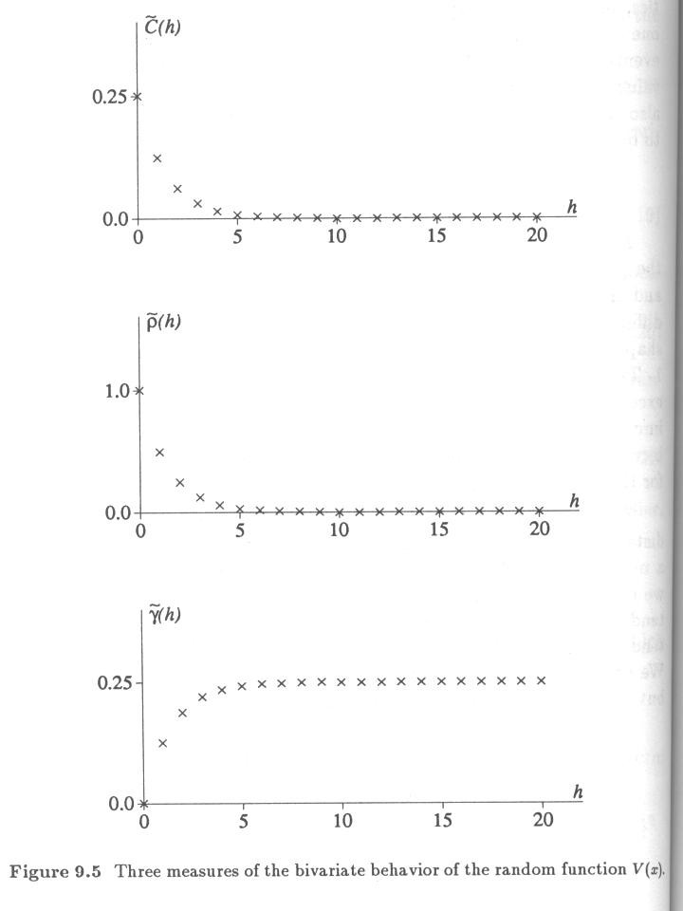

Slide 18
Parameters of Random Functions ...
A random function U(x) similar to V(x) but with a greater probability to stay the same Fig 9.6.
with probability 1/2
with probability 1/2
with probability 7/8
with probability 1/8

Slide 19
Parameters of Random Functions ...
Another similar random function W(x) with a smaller (1/2,1/2) probability to stay similar Fig 9.7.
with probability 1/2
W
with probability 1/2

Slide 20
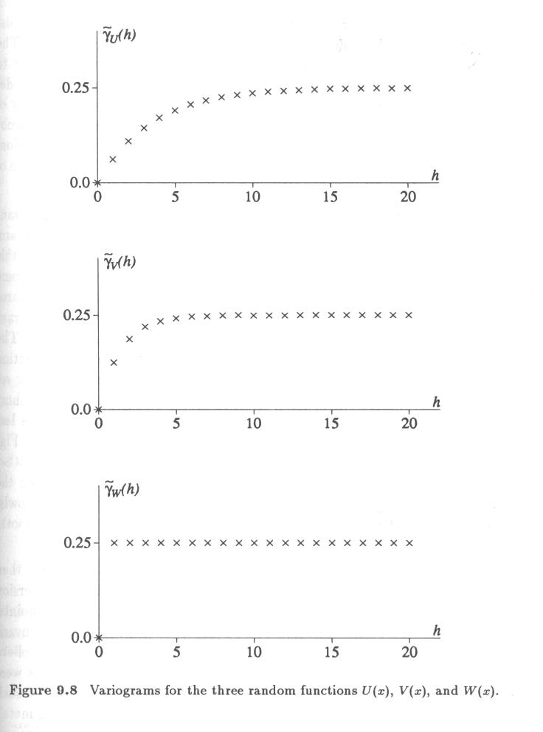
7/8, 1/8
3/4, 1/4
1/2, 1/2

Slide 21
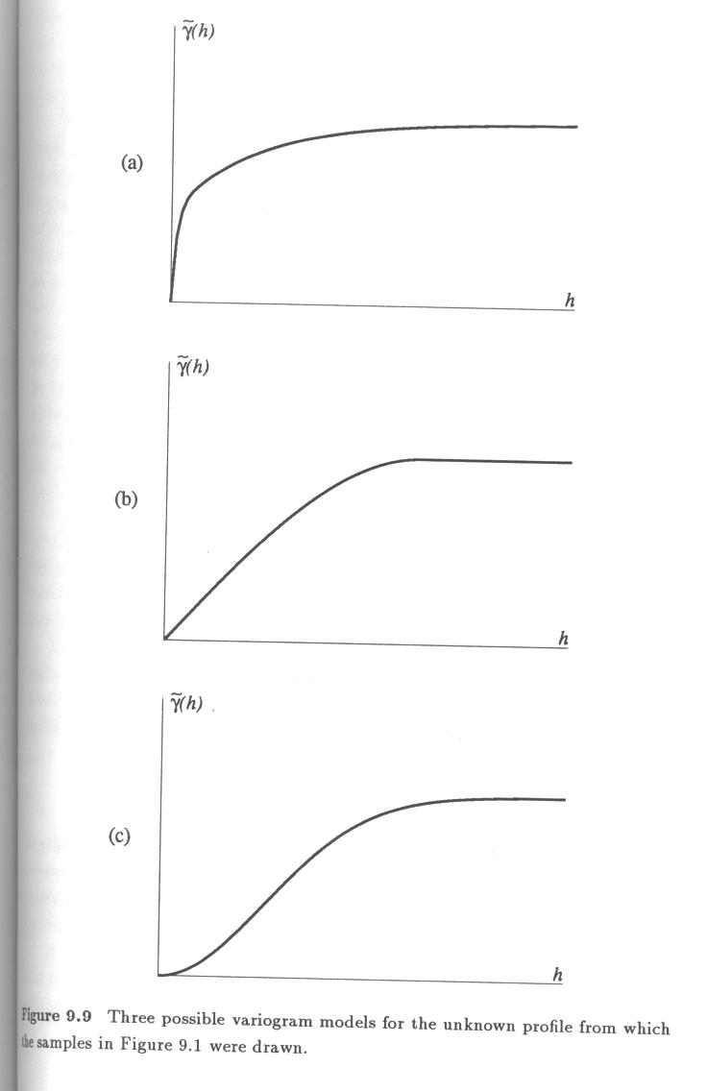
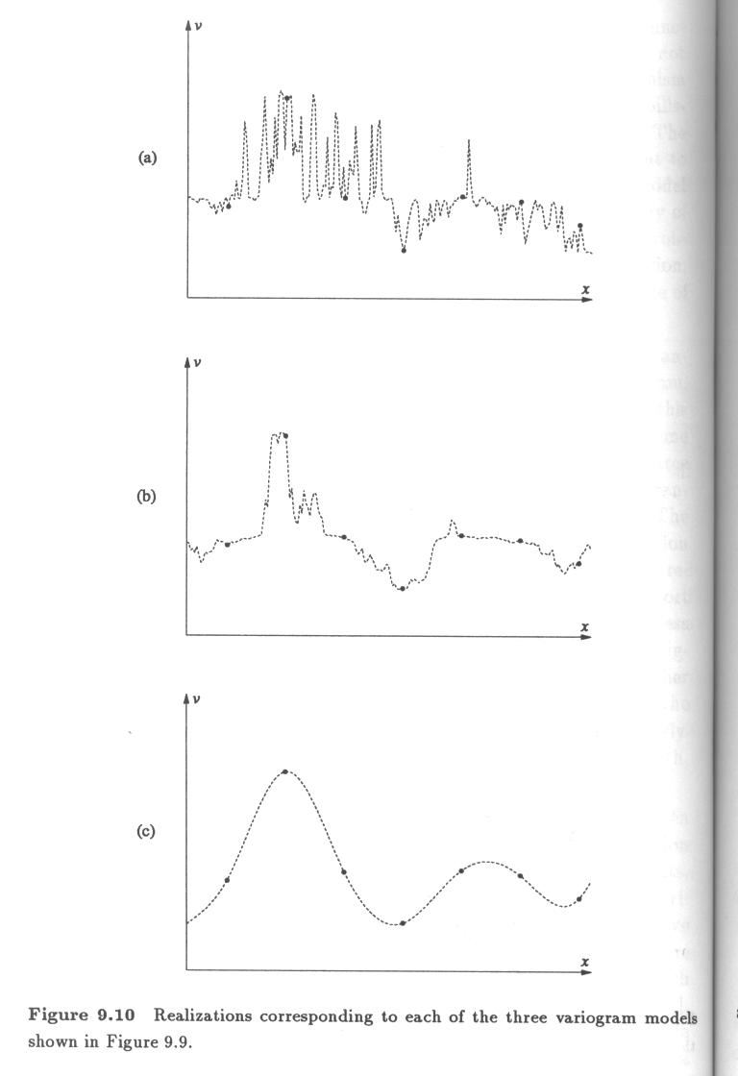
Estimations requires more samples beyond the closest ones.
Estimates based on closest samples is reliable.

Slide 22
Implication of Unbiased Estimates
Suppose we wish to estimate the unknown true value using a weighted linear combination of p available points.
Question 1: How can we choose the weights so that the average estimation error is zero in order to get unbiased estimate?
Average error =

Slide 23
Implication of Unbiased Estimates ...
However, we do not know the true values , so Average Error = does not help.
As a probabilistic solution to this problem, we consider a stationary random function consisting of p+1 random variables:
Each has E(V). Any pair of them has a joint distribution that depends on the separation h, not their locations. Each has a C_{v}(h).

Slide 24
Implication of Unbiased Estimates ...
All p samples (plus the unknown true value) are outcomes of random variables
Each estimate is also a random variable; some of its parameters are known since it is a linear combination of known random variables:
The estimation error is also a random variable:

Slide 25
Implication of Unbiased Estimates ...
The estimation error is also a random variable:
,
Average error= ,

Slide 26
Implication of Unbiased Estimates ...

Slide 27
Implication of Unbiased Estimates ...
This result, referred to as the unbiasedness condition, makes such obvious common sense that it is often taken for granted. This is an important condition that you will see in the following chapters.

