Slide 1
Geo597 Geostatistics
Ch9 Random Function Models

Slide 2
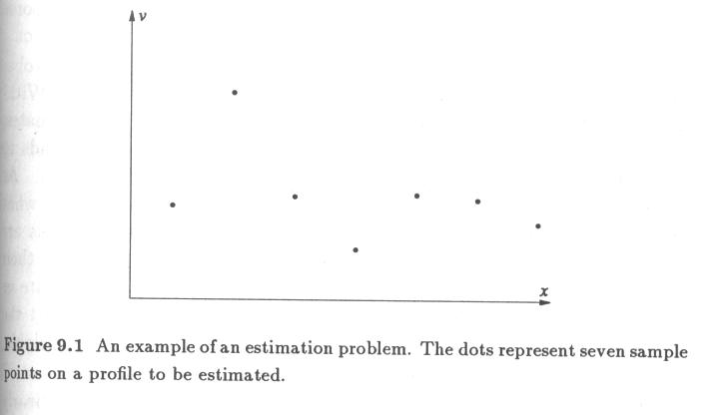

Slide 3
The Necessity of Modeling
Estimation needs a model of how the phenomenon behaves at locations where it has not been sampled.
Geostatistics emphasize on the underlying model in order to infer the unknown values at locations where the phenomenon is not sampled.

Slide 4
The Necessity of Modeling ...
If we know the physical or chemical processes that generate the data, deterministic models help describe the behavior of a phenomenon based on a few samples.
In most earth sciences, data are results of a vast number of processes whose complex interactions we are not yet able to describe quantitatively.
The random function models recognize this uncertainty and estimate values at unknown locations based on assumptions about the statistical characteristics of the phenomenon.

Slide 5
The Necessity of Modeling ...
Without an exhaustive data set to check the estimations, it is impossible to prove whether the model is right or wrong.
The judgment of the goodness is largely qualitative and depends on the appropriateness of the underlying model.
This judgement, which must take into account the goals of the study, will benefit considerably from a clear statement of the model.

Slide 6
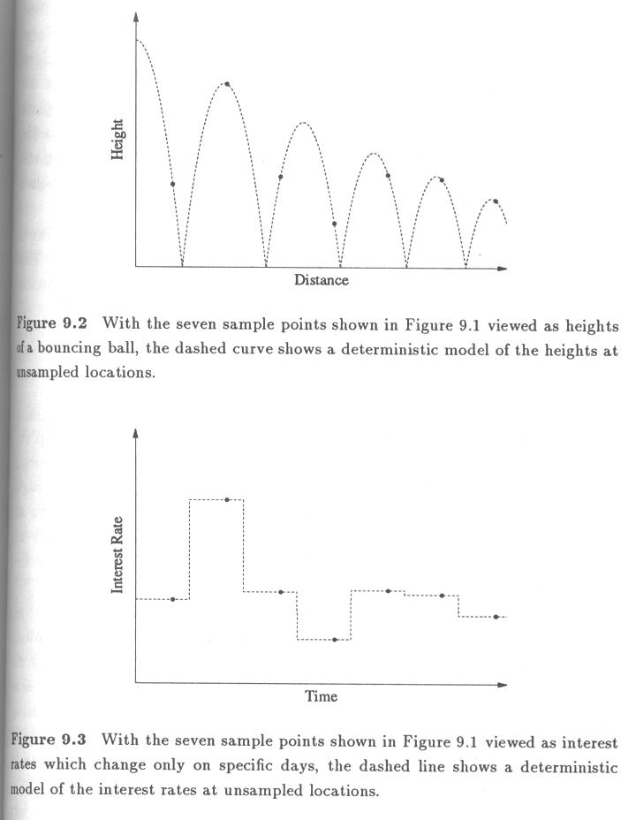

Slide 7
Deterministic Models
Examples: the height of a bouncing ball vs. Interest rates of a bank (Fig 9.2, 9.3).
Based on simplifying assumptions, deterministic models can capture the overall char. of a phenomenon and extrapolate beyond the available sampling.
Deterministic modeling is possible only if the context of the data values is well understood. The data values, by themselves, do not reveal what the appropriate model should be.

Slide 8
Probabilistic Models
In earth sciences, the available sample data are viewed as the result of some random process. Though they may not be the result of random processes, this approach helps predict unknown values.
Therefore, geostatistical approach to estimation is based on a probabilistic model.
It also enables us to gauge the accuracy of our estimates and to assign confidence intervals to them.

Slide 9
Probabilistic Models ...
Most commonly used geostatistical estimation requires only certain parameters of a random process.
Most frequently used:
The mean and variance of a linear combination of random variables.

Slide 10
Random Variables
A random variable is a variable whose values are randomly generated according to some probabilistic mechanism.
Random variables V vs. actual outcomes v
All possible outcomes:
Actually observed outcomes:
A set of corresponding probabilities

Slide 11
Random Variables ...
Results of throwing a die
Random variable: D
Possible outcomes:
d₍₁₎=1, d₍₂₎=2, d₍₃₎=3, d₍₄₎=4, d₍₅₎=5, d₍₆₎=6
Probability of each outcome:
p₁=p₂=p₃=p₄=p₅=p₆=1/6
Observed outcomes: 4,5,3,3,2,4,3,5,5,6,6,2,5,2,1,4
d₁=4, d₂=5, …, d₁₀=6, …, d₁₆=4

Slide 12
Random Variables ...
Possible outcomes of a random variable need not all have equal probability
Throwing two dies and taking the larger of the two
4,5,3,3,2,4,3,5,5,6,6,2,5,2,1,4
1,4,4,3,1,3,5,2,3,2,3,3,4,6,5,4
Observed outcomes:
l_{i} 4,5,4,3,2,4,5,5,5,6,6,3,5,6,5,4
Probability of each outcome:
l_{(I)} (p_{i}) 1(1/36), 2(3/36), 3(5/36), 4(7/36), 5(9/36), 6(11/36)

Slide 13
Functions of Random Variables
It is also possible to define other random variables by performing mathematical operations on the outcomes of a random variable.
e.g. 2D: d={1,2,3,4,5,6}, 2d={2,4,6,8,10,12}, p_{i}=1/6
e.g. L²+L: l={1,2,3,4,5,6}, l²+l={2,6,12,20,30,42}
l²+l_{i}(p_{i}): 2(1/36),6(3/36),12(5/36),20(7/36),30(9/36),42(11/36)

Slide 14
Functions of Random Variables
Or on the outcomes of several random variables.
e.g.T=(D₁+D₂) t_{i}=5,9,7,6,3,7,8,7,8,8,9,5,9,8,6,8
t_{i}(p_{i}): 2(1/36),3(2/36),4(3/36),5(4/36),6(5/36),7(6/36)
8(5/36),9(4/36),10(3/36),11(2/36),12(1/36)

Slide 15
Functions of Random Variables ...
For a random variable V with values , and probability , the random variable f(V) has a possible outcome
It is difficult to define the complete set of possible outcomes for random var that are functions of other random var. Fortunately we never have to deal with anything more complicated than a sum of several random var.

Slide 16
Functions of Random Variables …
We often use transformation functions to satisfy the assumption that the underlying distribution of the random variable of our interest is close to normal distribution.

Slide 17
Parameters of a Random Variable
The set of outcomes and their corresponding probabilities is referred to probability distribution of a random variable.
If the probability distribution is known, one can calculate parameters that describe features of the random variable.
Examples of parameters: min, max, mean, and standard deviations.

Slide 18
Parameters of a Random Variable ...
The complete distribution cannot be determined from a few parameters, but Gaussian distribution can be determined by a mean and a variance.
Parameters cannot be obtained by calculating sample statistics of the outcomes of a random variable.
The statistical mean of the 16 die outcomes is 3.75, but the mean, as the parameter of the die population, is 3.5.

Slide 19
Parameters of a Random Variable ...
Parameters of a conceptual model:
Statistics from a set of observations:

Slide 20
Parameters of a Random Variable ...
Expected value:
Expected value of L
E{L} =1/36(1)+3/36(2)+5/36(3)+7/36(4)+9/36(5)+11/36(6)
=4.47

Slide 21
Parameters of a Random Variable ...
Variance:
Variance of L
Var(L) = 1/36(1²)+3/36(2²)+…- {[1/36(1)]+[3/36(2)]+… }²=1.97

Slide 22
Joint Random Variables
Random variables can be generated in pairs by some probabilistic mechanism - the outcome of one may influence the outcome of the other.
The possible outcomes of (U,V)
With the corresponding probabilities
Where there are n possible outcomes for U and m for V

Slide 23
Joint Random Variables …
e.g. L,S
L: the larger of two throws;
S: the smaller of the two;
l_{i},s_{i}: (4,1) (5,4) (4,3) (3,3) (2,1) (4,3) (5,3) (5,2)
(5,3) (6,2) (6,3) (3,2) (5,4) (6,2) (5,1) (4,4)

Slide 24
Joint Random Variables ...
l_{i},s_{i}: (4,1) (5,4) (4,3) (3,3) (2,1) (4,3) (5,3) (5,2)
(5,3) (6,2) (6,3) (3,2) (5,4) (6,2) (5,1) (4,4)
Possible outcomes of s_{(j)}
p _{ij} 1 2 3 4 5 6
Possible 1 1/36 0 0 0 0 0
outcomes 2 2/36 1/36 0 0 0 0
of l_{(i)} 3 2/36 2/36 1/36 0 0 0
4 2/36 2/36 2/36 1/36 0 0
5 2/36 2/36 2/36 2/36 1/36 0
6 2/36 2/36 2/36 2/36 2/36 1/36

Slide 25
Marginal Distributions
Marginal distribution is the distribution of a single random variable regardless of the other random variable.
Discrete case:
P{L=5} = p5 =
= 2/36+2/36+2/36+2/36+1/36 =9/36
The same as table 9.1(p204)

Slide 26
Conditional Distributions
Using the joint distribution of two random variables, we can calculate a distribution of one variable given a particular outcome of the other random variable.
Discrete case:

Slide 27
Conditional Distributions …
Conditional distribution
Discrete case:
P{L=3|S=3}=
=(1/36)/(2/36+2/36+2/36+1/36+0+0)=1/7

Slide 28
Parameters of Joint Random Variables
Covariance

Slide 29
Parameters of Joint Random Variables
Correlation coefficient

Slide 30
Weighted Linear Combinations of Random Variables
(9.14, p216)

Slide 31
Weighted Linear Combinations of Random Variables
if u and v are independent
if V_{i} are independent

