Slide 1
Chapter 8 - Estimation

Slide 2
Estimation
Beginning the second part of the book: all chapters from now on deal in some way with estimation
Estimation: use sample information to predict values in unsampled areas

Slide 3
Considerations
Global vs. Local Estimation
What do we want to estimate?
  Just means?
  Or the complete distribution of values
Point vs. Block Estimation

Slide 4
Weighted Linear Combinations
Where is an estimate
is a surrounding data value
is a weight assigned to the
data value. These weights
usually sum to 1.

Slide 5
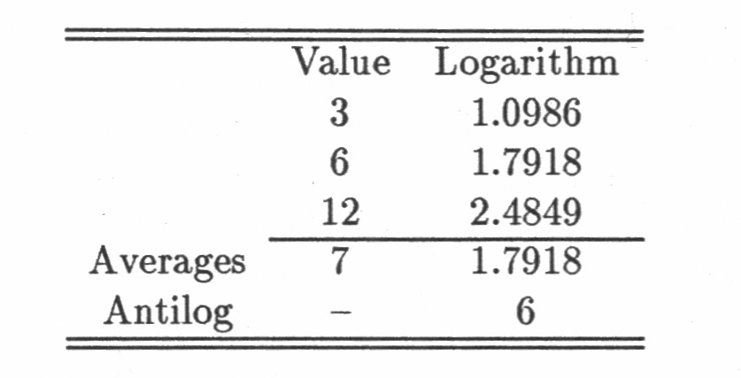
Transformed estimate
T is a function of the data value.
Be careful:

Slide 6
Transformed estimate
 | Value | Squared
 | 3 | 9
 | 6 | 36
 | 12 | 144
Average | 7 | 63
Back Transform (Square Root) | -------------- | 7.937

Slide 7
Transformed estimate
 | Value | +3
 | 3 | 6
 | 6 | 9
 | 12 | 15
Average | 7 | 10
-3 | --------------- | 7
The function T doesn’t have to be an analytical expression,
It could be a graphical transformation.

Slide 8
Global vs. Local Estimation
Global: large area, many samples
  Often used in early stage to obtain broad characteristics
Local: small area, few samples
  Have to use nearby samples outside the area
  Results in detailed local information

Slide 9
Global vs. Local Estimation
Global:
  Clustered samples should have a reduced weight
Local:
  Samples closer to the target get more weight
  Local estimate should account for both the distance to the samples and also the possible redundancy between samples

Slide 10
Means and distributions
Mean is most often used statistic to summarize a distribution
Skewed distributions: mean can be misleading
  Median and quartile information can be helpful

Slide 11
Means and distributions
If we want to know more about a complete distribution, we have to estimate the entire distribution, not just its mean.
Parametric method: make assumptions about distribution; estimate model parameters
non-Parametric method: estimate points along histogram and interpolate between these points

Slide 12
Drawbacks
Parametric approach: results depend heavily on assumptions which are difficult to verify
Non-Parametric approach: having to extrapolate beyond the last estimated point

Slide 13
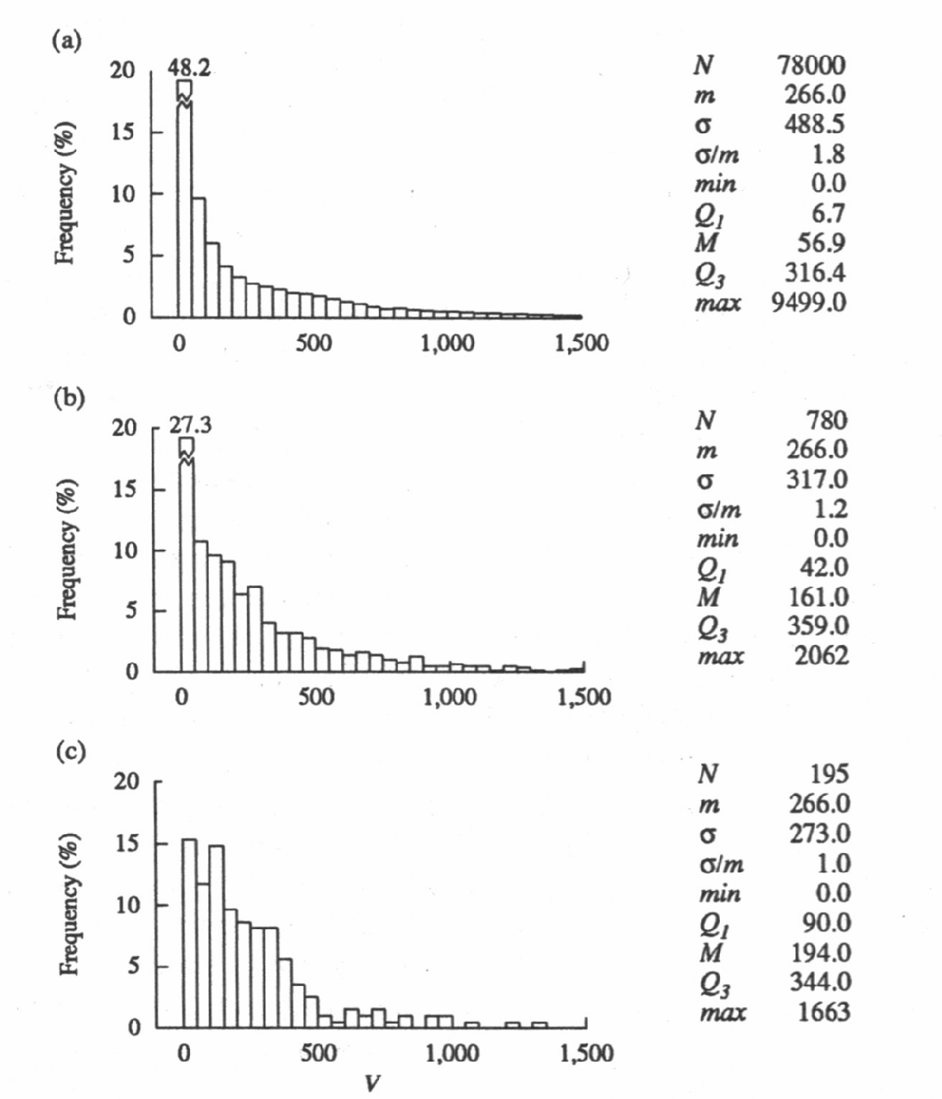
Total Pop
10x10 Window
20x20 Window

Slide 14
Conclusion
The size of support affects the variance but not the grand mean of the data.
A larger support normally leads a reduced variance.
It also affects the max and min values. A larger support normally leads to a reduced maximum.

Slide 15
Conclusion
Averaging tends to smooth the data. Averaging over a larger support enhances the smoothing.
One of the biggest problems in estimation is that there is a discrepancy between the support of the samples and the intended support of the estimates.

