Slide 1
Geo479/579: Geostatistics
Ch7. Spatial Continuity

Slide 2
Objective
Exploratory analysis of sample data by describing spatial continuity of two continuous variables and their cross-continuity

Slide 3
h-Scatterplot Tolerance in Sample
Very few pairs of samples are separated exactly by h, because there is inevitable randomness in the sample locations for any chosen h.
In practice, tolerances are specified both on the distance of h and on its direction.
Figure 7.1 shows a tolerance of 1 m on the distance and 20 degrees on the direction of h.

Slide 4
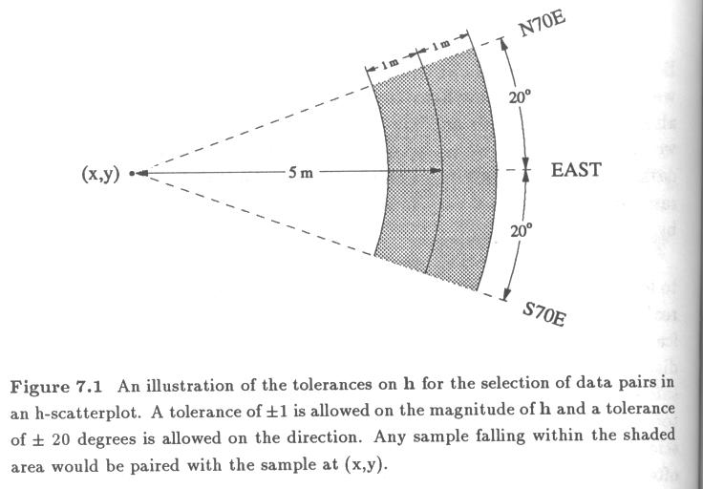

Slide 5
Some Terminologies of Variogram
Variogram is the most traditional choice to summarize spatial continuity, in comparison to correlation function and covariance.

Slide 6
Some Terminologies of Variogram…
Range is the distance (h) at which the variogram reaches its plateau.
Sill is the plateau that the variogram reaches at the range.
Nugget effect is the vertical jump from the value of zero at the origin to the value of variogram at extremely small separation distances, due to sampling error or short scale variability.

Slide 7
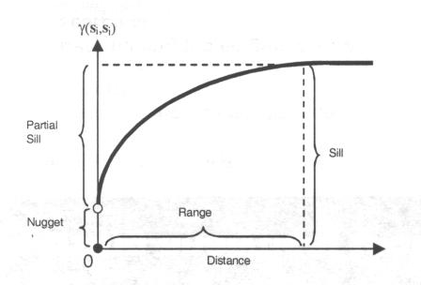
Variogram

Slide 8
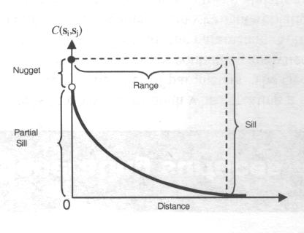
Covariance Function

Slide 9
Omnidirectional Variogram
“Omnidirectional” means all directions. It combines all directional variograms into a single semivariogram.
Omnidirectinal variogram can be loosely thought of as an average of the various directional variograms.
However, the calculation of omnidirectional variogram does not imply that spatial continuity is the same in all direction.

Slide 10
Purpose of Omnidirectional Variogram
It serves as a useful starting point for producing a clear structure of overall spatial continuity.
Since the omnidirectional variogram contains more sample pairs than any directional variogram, it is more likely to show a clearly interpretable structure.
It can help detect some erratic directional variograms if an omnidirectional variogram is messy.

Slide 11
Choosing the Distance Parameters
Two distance parameters need to be chosen
Lag spacing (lag increment)
- Assuming the samples are regularly spaced over the study area, set the initial spacing as:
sqrt (study area/total number of points)
Lag tolerance = ½ lag spacing

Slide 12
Choosing the Distance Parameters…
Distance parameters can be set differently according to directions, if the sampling pattern is noticeably anisotropic.
For samples located close to each other, it is possible to include an additional lag with small separations and a small tolerance for this first lag. E.g. 0.5m, 1m, 2m, 3m…

Slide 13
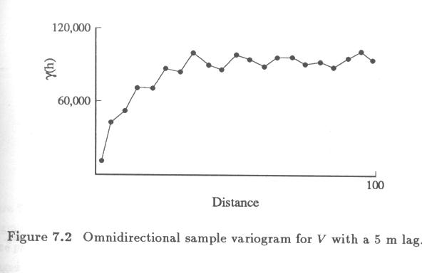
This omni-variogram has a clear structure but has a jagged appearance.

Slide 14
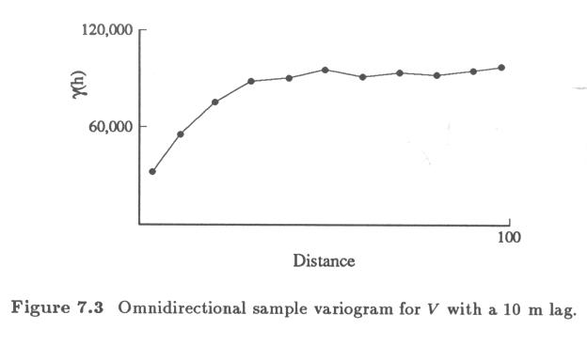

Slide 15
Pattern of Anisotropy
After having an acceptable omnidirectional variogram, we can explore the pattern of anisotropy with various directional variograms.
Isotropy vs. anisotropy.
The direction of maximum spatial continuity and the direction of minimum spatial continuity.

Slide 16
Pattern of Anisotropy…
Choose a directional tolerance that is large enough to allow sufficient pairs for a clear variogram, yet small enough that the character of the variograms for separate directions is not blurred beyond recognition.

Slide 17
Finding the Anisotropy Axes
Figure 7.4: Tolerance on h is defined in a rectangular coordinate system.
Figure 7.5: Posting of a semivariogram surface.
Figure 7.6: A contour map of the variogram surface.

Slide 18
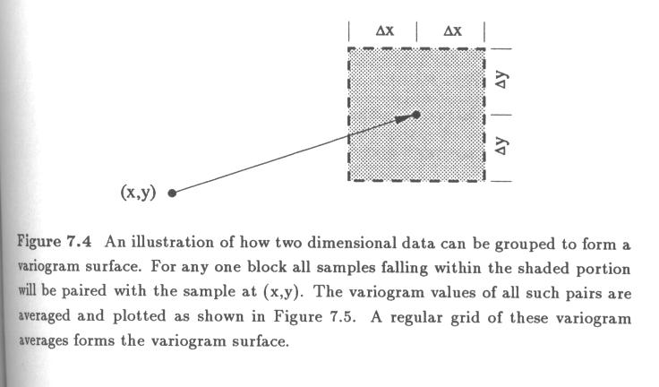

Slide 19
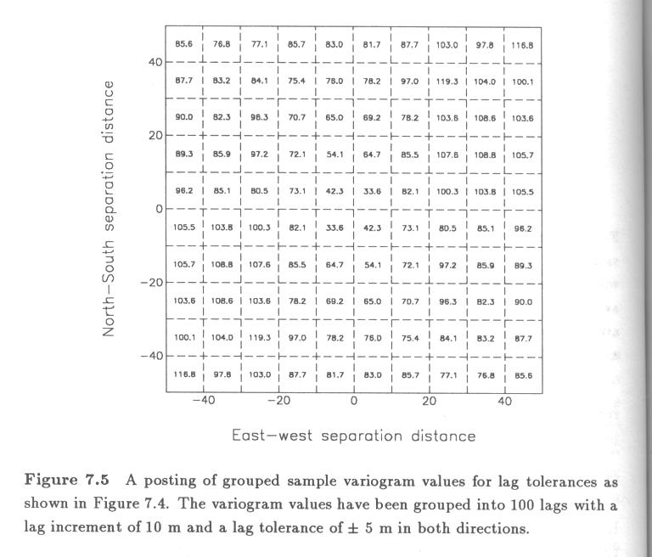

Slide 20
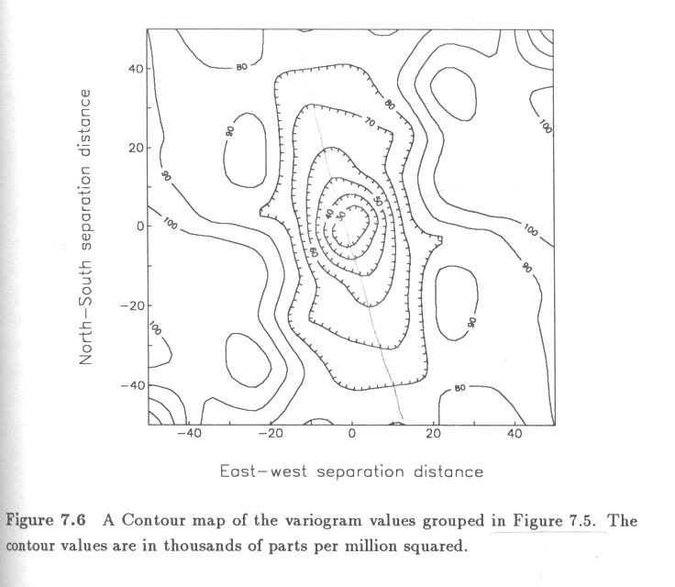

Slide 21
Finding the Anisotropy Axes…
Figure 7.7: Nine directional sample variogram each showing the lag distance corresponding to a value of 80,000ppm².
Figure 7.8: A “rose diagram” of the nine ranges.
Figure 7.9: An ellipse fit to the rose diagram of nine ranges.
The major and minor axes of the ellipse represent the axes of a geometric anisotropy.

Slide 22
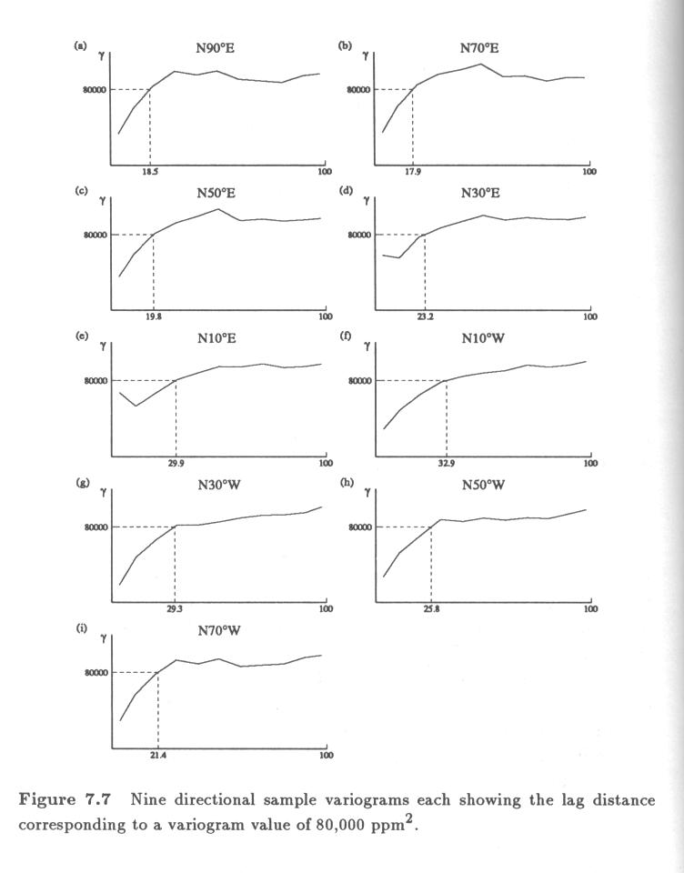

Slide 23
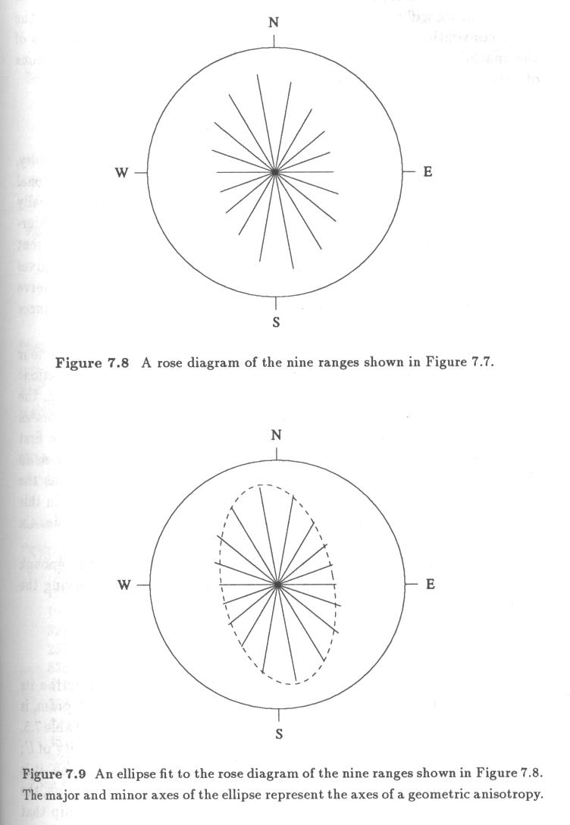

Slide 24
Choosing the Directional Tolerance
After identifying directions, it is time to choose directional tolerance.
Directional tolerance should be large enough to contain enough pairs and small enough to avoid blurring the anisotropy resulted from combining pairs of different directions.
Try several tolerances and use the smallest one that still produces good results.

Slide 25
Choosing the Directional Tolerance...
Figure 7.10: A directional tolerance of 40º is large enough to allow a clear directional variogram while still preserving the evident anisotropy.
Figure 7.3

Slide 26
Sample Variograms for U
Hole effect is a certain dip that occurs in a sample variogram.
It happens when there is a natural cyclicity or repetition in a data set.

Slide 27
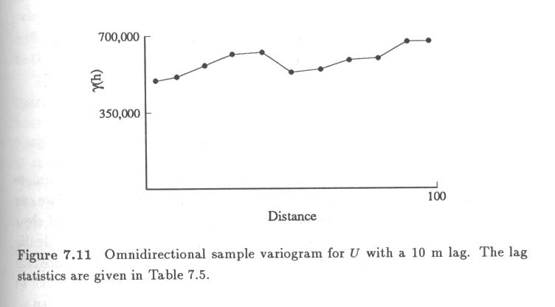

Slide 28
Sample Variograms for U
Presence of outliers can result in poor behavior of a variogram.
One can try removing the most erratic samples in order to retain the useful contribution of large sample values. Fig 7.13-7.15.

Slide 29
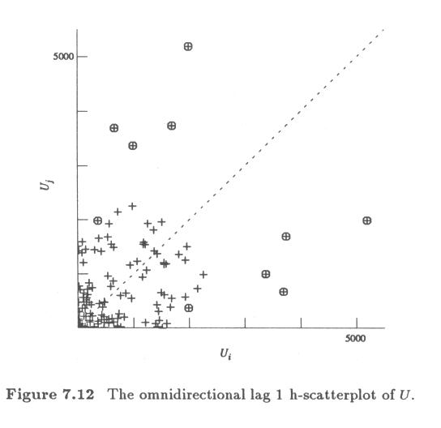

Slide 30
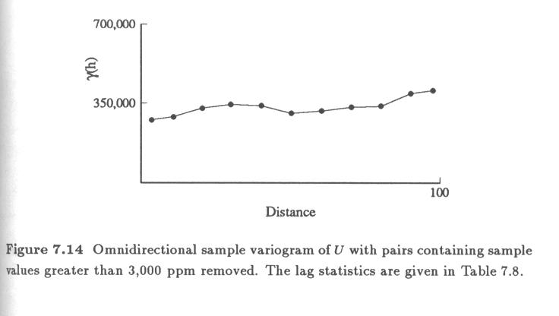

Slide 31
Sample Variograms for U …
There are many data sets for which the sample variogram is simply inappropriate as a descriptive tool.
The variogram works well when there is no proportional effect or no obvious clusters in a data.
Fluctuation in the lag means is a problem. Table 7.5.

Slide 32
Relative Variogram
To account for varying means, relative variograms scale the original variogram to some local mean value.
Local Relative Variogram
General Relative Variogram
Pairwise Relative Variogram

Slide 33
Local Relative Variogram
Local relative variogram divides an area in regions and treats data in each region a separate population, Fig 7.16.
A local variogram is scaled by the local mean. Then the local variograms are summed to form the overall variogram

Slide 34
General Relative Variogram
General relative variogram does not require small populations which may cause local variograms to be erratic.
Instead, the semivariance for each h is adjusted by the mean of all the data values that are used to calculate the semivariance.

Slide 35
Pairwise Relative Variogram
Pairwise relative variogram also adjusts the variogram calculation by a squared mean.
This adjustment, however, is done separately for each pair of sample values, using the average of the two values as the local mean:

Slide 36
Covariance Function and Correlogram
The covariance function and correlogram are likely to be more resistant to erratic values since they account for lag means (in case of covariance) and lag variance (in case of correlogram).
The relationship between covariance to variogram, between correlogram and variogram
C(0) - C(h) = γ(h), ρ(0) - ρ(h) = γ(h)/γ(0)

Slide 37
Directional Covariance
Functions for U

Slide 38
Cross-Variograms

Slide 39
Summary of Spatial Continuity

Slide 40
