Slide 1
Geo479/579: Geostatistics
Ch4. Spatial Description

Slide 2
What is GIS?
G: maps
I: spreadsheets
S: the system that puts the maps and spreadsheets together

Slide 3
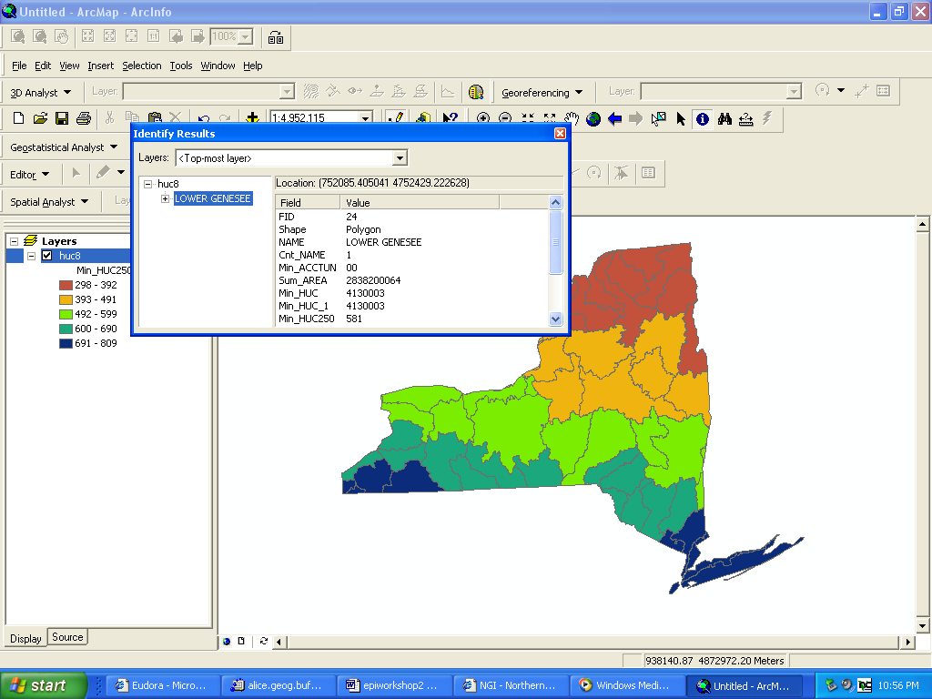

Slide 4
Components in GIS
Spatial locations
Attributes
Topology

Slide 5
Spatial Locations
Specified with reference to a common coordinate system
Geographic coordinate system (lat and long)
UTM (Universal Transverse Mercator)
State Plane

Slide 6
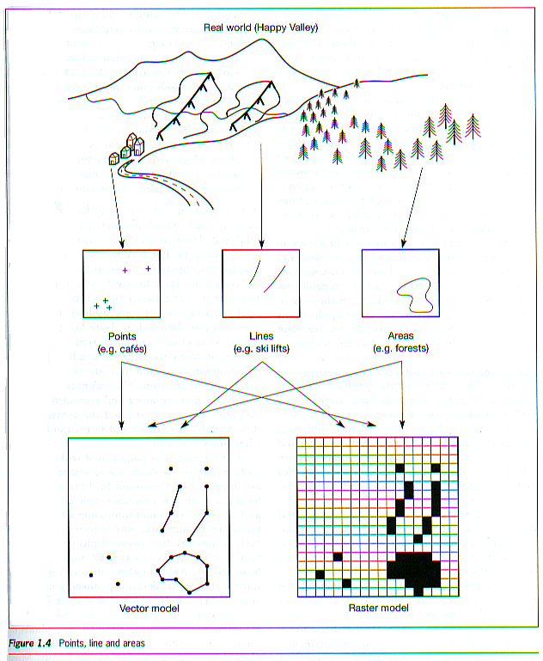
GIS Data Models
Vector
points
lines
polygons
networks
Raster
grids
courtesy: Mary Ruvane, http://ils.unc.edu/

Slide 7
Difference from Other Statistics
Geostatistics explicitly consider the spatial nature of the data: such as location of extreme values, spatial trend, and degree of spatial continuity
If we rearrange the data points, do the mean and standard deviation change? Do the geostatistical measurements change?
Statistics, geostatistics, spatial statistics

Slide 8
Data Posting
A map on which each data location is plotted, along with its corresponding data value.
Data posting is an important initial step for detecting outliers or errors in the data.
(A single high value surrounded by low values are worth rechecking)
Data posting gives an idea of how data are sampled, and it may reveal some trends in the data.

Slide 9
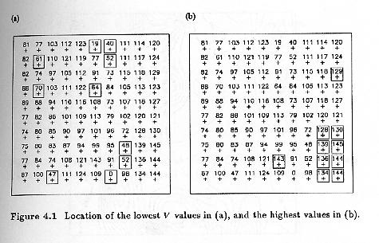

Slide 10
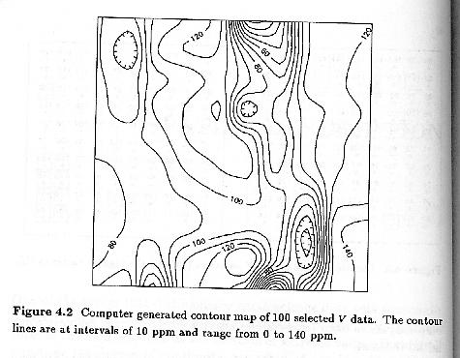
Contour Maps
Contour maps show trends and outliers

Slide 11
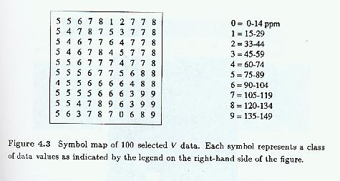
Symbol Maps
Symbol map use color and other symbols to show values in classes and the order between classes

Slide 12
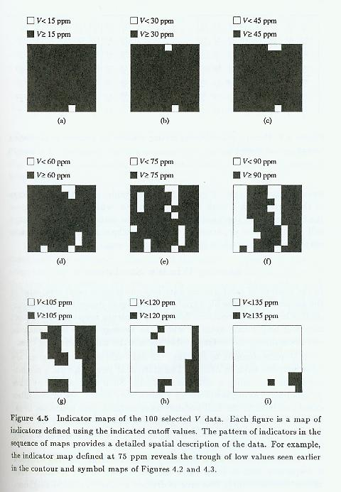
Indicator Maps
They show where values are above or below a threshold. A series of indicator maps can be used to show a phenomenon

Slide 13
Moving Window Statistics
Implication of anomalies in the data.
Summary statistics within a moving window is used to investigate anomalies both in the average value and in the variability within regions (windows)

Slide 14
Moving Window Statistics…

Slide 15
Neighborhood Statistics…
Moving windows
Richness
Interspersion
3 4 5 0 1
6 8 3 1 5
3 4 0 2 1
3 8 0 5 1
6 7 5
5 7 5
8 8 6
8 7 8

Slide 16
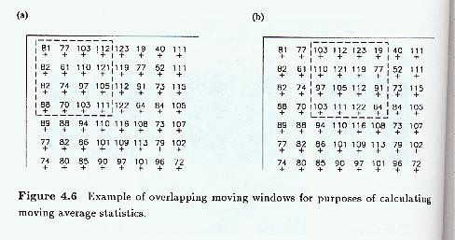
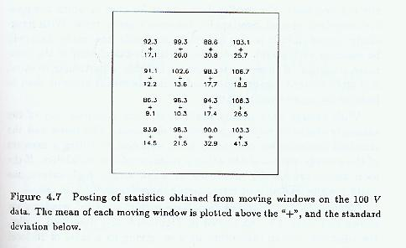

Slide 17
Moving Window Statistics…
The size of the window depends on average spacing between point locations and on the overall dimensions of the study area.
Size of the window should be large enough to obtain reliable statistics, and small enough to capture local details.
Overlapping moving windows can have both worlds. If have to choose, reliable statistics is preferred.

Slide 18
Proportional Effect
Proportional effect refers to the relationship between the local means and the local standard deviations from the moving window calculations.
Four relationships between local average and local variability (Figure 4.8).
- a stable local mean and a stable variability
- a varying mean but a stable variability
- a stable mean but a varying variability
- the local mean and variability change together

Slide 19
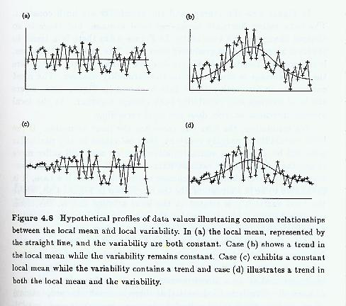

Slide 20
Proportional Effect…
The first two cases are preferred because of a low variability in standard deviation.
The next best thing is case (d) because the mean is related to the variability in a predictable fashion.
A scatterplot of mean vs. standard deviation helps detect the trend.

Slide 21
Spatial Autocorrelation
First law of geography: “everything is related to everything else, but near things are more related than distant things” – Waldo Tobler
Also known as spatial dependence

Slide 22
Spatial Autocorrelation…
Spatial Autocorrelation is a correlation of a variable with itself through space.
  If there is any systematic pattern in the spatial distribution of a variable, it is said to be spatially autocorrelated.
  If nearby or neighboring areas are more alike, this is positive spatial autocorrelation.
  Negative autocorrelation describes patterns in which neighboring areas are unlike.
  Random patterns exhibit no spatial autocorrelation.

Slide 23
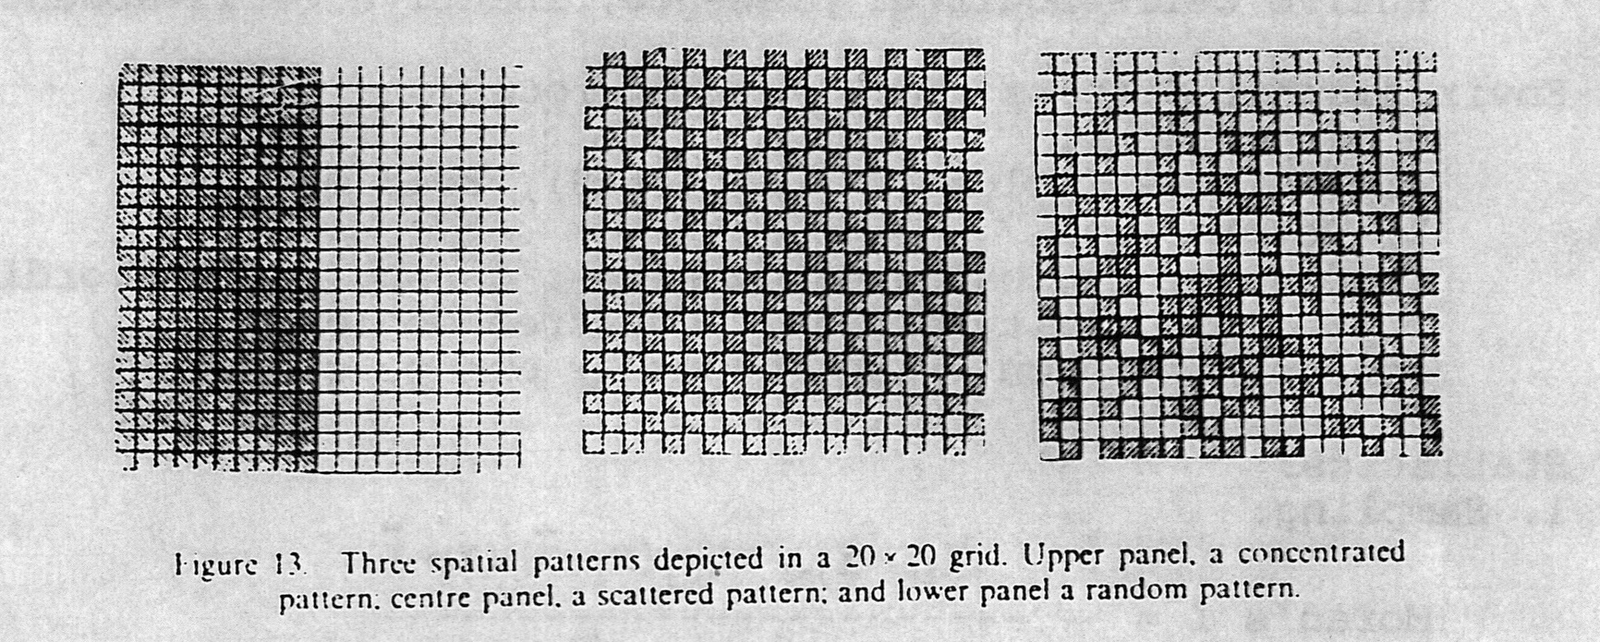

Slide 24
Spatial Autocorrelation…
First order effects relate to the variation in the mean value of the process in space – a global or large scale trend.
Second order effects result from the correlation of a variable in reference to spatial location of the variable – local or small scale effects.

Slide 25
Spatial Autocorrelation…
A spatial process is stationary, if its statistical properties such as mean and variance are independent of absolute location, but dependent on the distance and direction between two locations.

Slide 26
H-Scatterplots
An h-scatterplot shows all possible pairs of data values whose locations are separated by a certain distance h in a particular direction.
The location of the point at is denoted as , and the separation between two points i and j can be denoted as or .

Slide 27
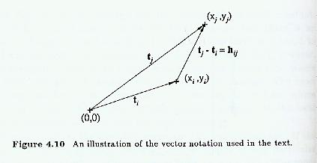
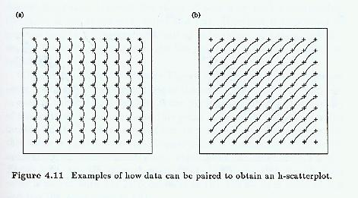

Slide 28
H-Scatterplots…
X-axis is labeled V(t), which refers to the value at a particular location t; Y-axis is labeled V(t+h), which refers to the value a distance and direction h away.
The shape of the cloud of points on an h-scatterplot tells us how continuous the data values are over a certain distance in a particular direction.

Slide 29
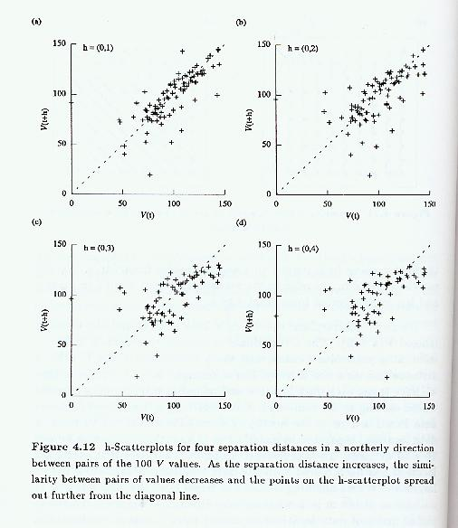

Slide 30
H-Scatterplots…
If the data values at locations separated by h are very similar then the pairs will plot close to the line x=y, a 45-degree line passing through the origin.
As the data values become less similar, the cloud of points on the h-scatterplot becomes wider and more diffuse.

Slide 31
H-Scatterplots…
In Figure 4.12, the similarity between pairs of values decreases as the separation distance increases.
Presence of outliers may considerably influence the summary statistics.

Slide 32
Correlation Functions, Covariance Functions, and Variograms
Similarity between V(t) and V(t+h) (fatness of the cloud of points on an h-scatterplot) can be summarized in several ways.
These include
covariance
  correlation function or correlogram
  variogram

Slide 33
Correlation Functions, Covariance Functions and Variograms…
The relationship between the covariance of an h-scatterplot and h is called the covariance function, denoted as (Equation 4.2).

Slide 34
Correlation Functions, Covariance Functions and Variograms…
The relationship between the correlation coefficient of an h-scatterplot and h is called the correlation function or correlogram, often denoted as (Equation 4.5).

Slide 35
Correlation Functions, Covariance Functions and Variograms…
The variogram, is half the average squared difference between the paired data values (Equation 4.8).

Slide 36
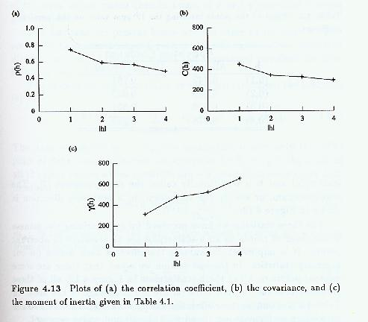

Slide 37
Cross h-Scatterplots
Instead of paring the value of one variable with the value of the same variable at another location, we can pair values of a different variable at another location.
Plot V value at a particular data location against U value at a separation distance h to the east. Figure 4.14.

Slide 38
Cross h-Scatterplots
Cross-covariance function (Eq 4.12)
Cross-correlation function (Eq 4.15)
Cross-semivariogram (Eq 4.18)

Slide 39
(4.3)
(4.4)
(4.5)

Slide 40
(4.6)
(4.7)
(4.2)

Slide 41
(4.8)
(4.9)
(4.10)
(4.11)

Slide 42
(4.12)
(4.15)
(4.18)

Slide 43
Spatial Continuity
Two data close to each other are more likely to have similar values than two data that are far apart.
Relationship between two variables.
Relationship between the value of one variable and the value of the same variable at nearby locations.

