Slide 1
Geo479/579: Geostatistics
Ch12. Ordinary Kriging (2)

Slide 2
Ordinary Kriging and
Model of Spatial Continuity
Weights of ordinary kriging and the resulting minimized error variance directly depend on the choice of a covariance (variogram) for the C and D matrices
To choose a covariance model, a sample variogram is calculated, then a model is fit to it. It is the model, not the sample variogram, that is used as the covariance model

Slide 3
Ordinary Kriging and
Model of Spatial Continuity …
The sample variogram cannot be used directly due to two reasons.
First,the sample variogram does not always provide semivariance for those distances in the D matrix.
Second, the sample variogam does not guarantee the existence and uniqueness of the solution to the ordinary kriging system (the n+1 equations and n+1 unknowns)

Slide 4
Ordinary Kriging and
Model of Spatial Continuity …
Sometimes, the sample variogram does not show any clear pattern of spatial continuity due to insufficient number of samples
Clustering could cause problems as well
Anisotropy may not be adequately captured by sample variogram

Slide 5
An Intuitive Look at Ordinary Kriging (OK)
Two important aspects of estimation in the OK system: distance (D) and clustering (C)
The D matrix represents the (statistical) distance between each sample point and the unknown
By recording the covariance between sample points, the C matrix represents the information on the clustering between the sample points

Slide 6
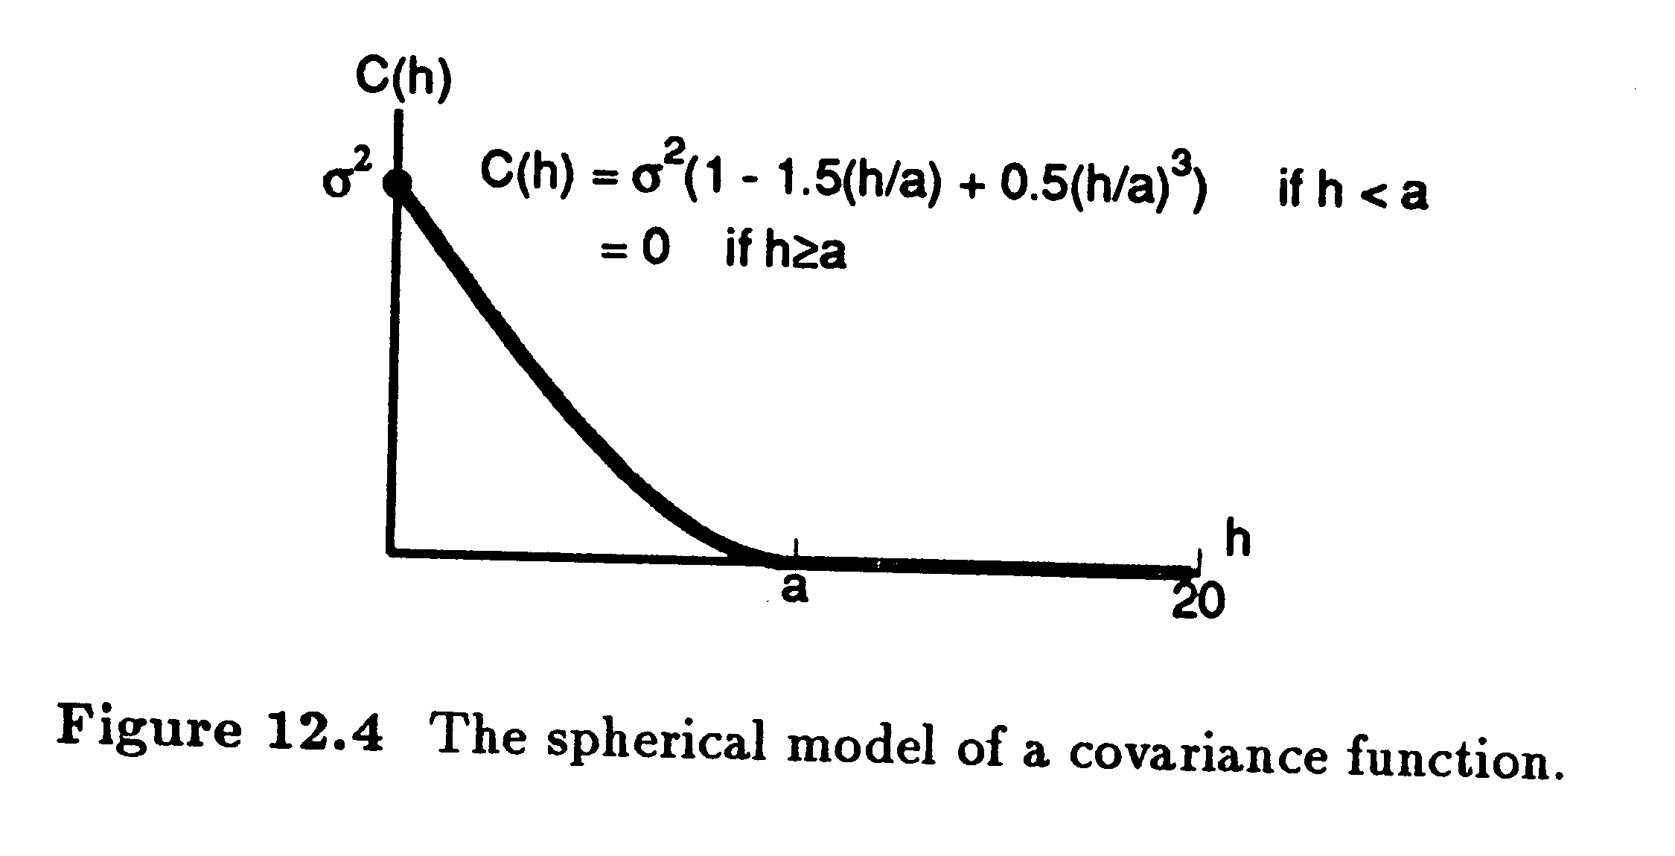
Similar to inverse distance weighting, OK gives far away samples less weights, sample 2 vs. 7

Slide 7
Variogram Models
OK also considers the clustering between sample points (C), Sample 5 vs. 6
Both the D ad C matrices represent statistical distances because they consider spatial continuity

Slide 8
Variogram Model Parameters
We now look at how parameters of a variogram (covariance) model affect the OK weights
Scale, shape, nugget, range, and anisotropy

Slide 9
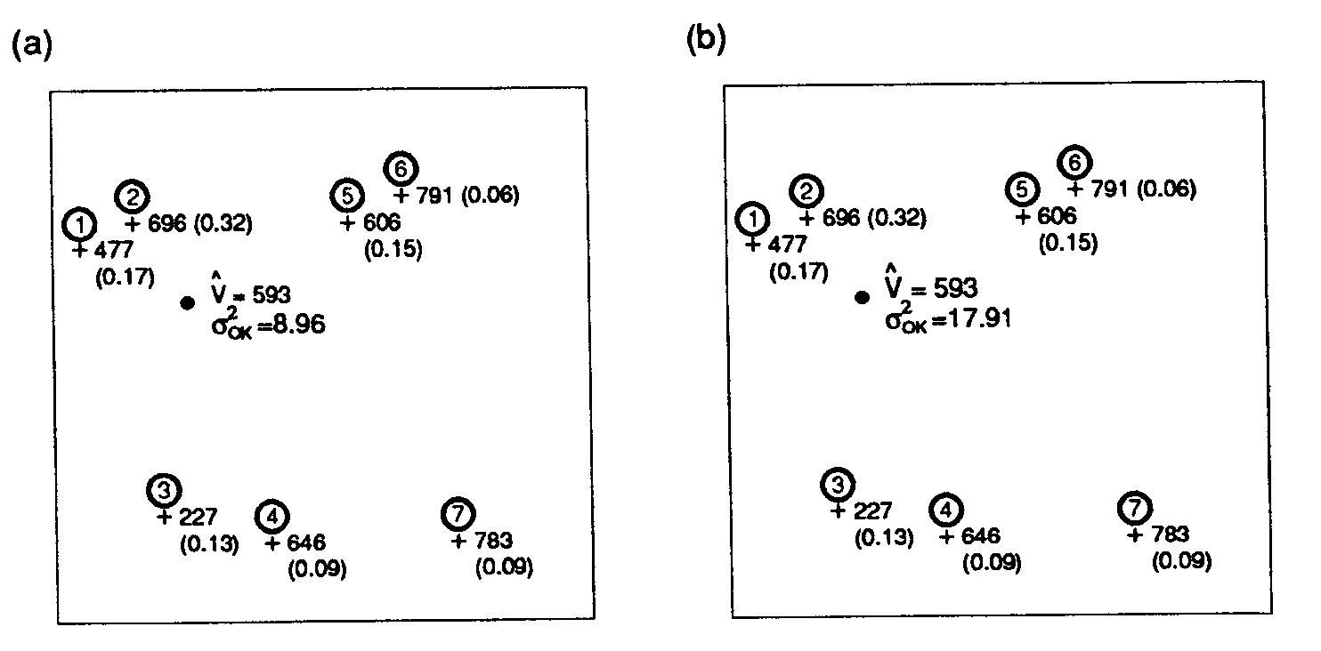
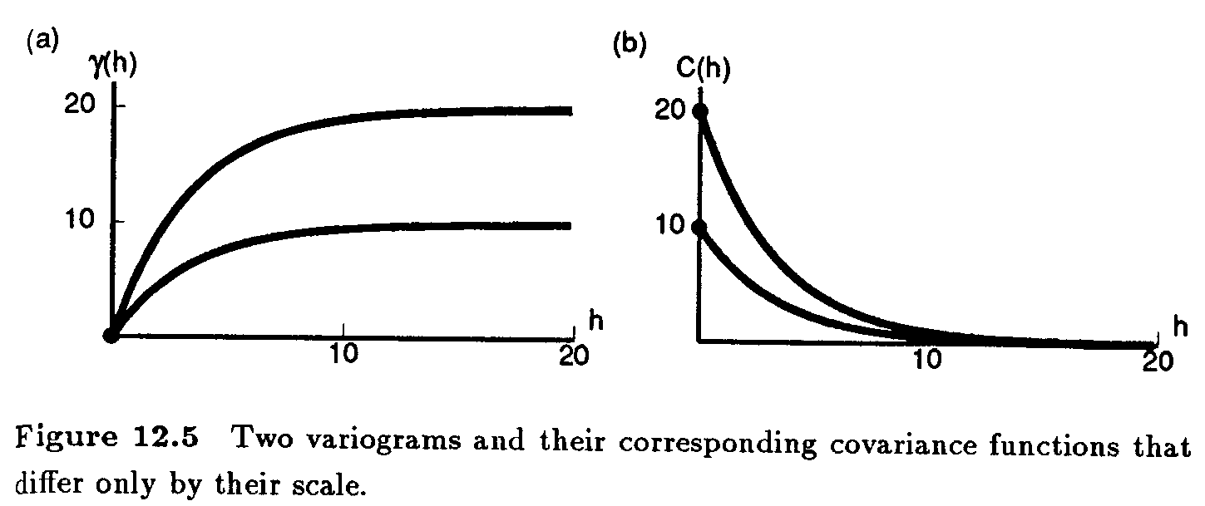
Scale
Sill of10 vs. 20
Sill = 10
Sill = 20

Slide 10
The Effect of Scale
With any rescaling of the variogram, neither the Kriging weights nor the estimate are changed while the variance increases by the same factor used to scale the variogram

Slide 11
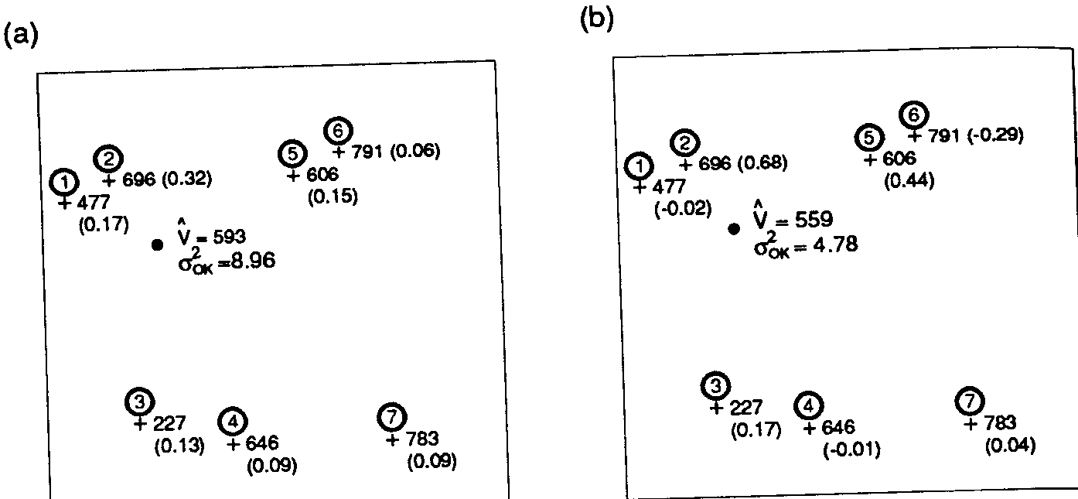
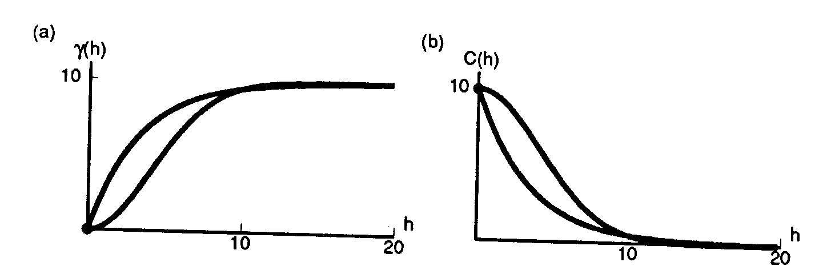
Shape
Exponential
Gaussian
Exponential vs.
Gaussian model

Slide 12
The Effect of Shape
Exponential (Eq1) vs. Gaussian (Eq2) variogram model
The Gaussian variogram model assigns more weight to the closer samples

Slide 13
The Effect of Shape
Screen effect - a sample falls behind another sample that is closer to the unknown. It receives less (or negative) weights, sample 5 vs. 6
The Gaussian models has a stronger screen effect than the exponential model

Slide 14
The Effect of Shape
Weights that are less than 0 or greater than 1 can produce estimates larger than the largest sample value or smaller than the smallest. Weights within [0,1] produce estimates only within the min and max of sample values
Negative weights may produce negative estimates, although in most science applications values should be positive

Slide 15
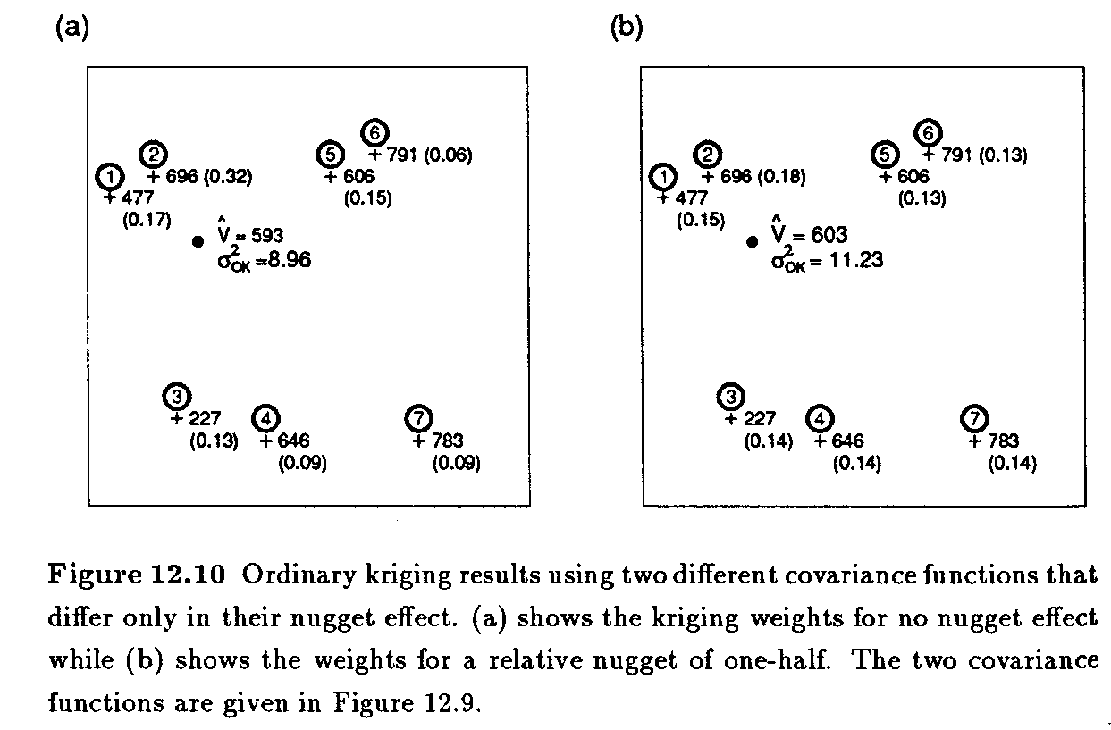

Nugget
Nugget = 0 vs. =1/2 sill

Slide 16
The Nugget Effect
The nugget effect makes weights become more similar to each other and results in higher kriging variance
A pure nugget effect model entails a complete lack of spatial correlation

Slide 17
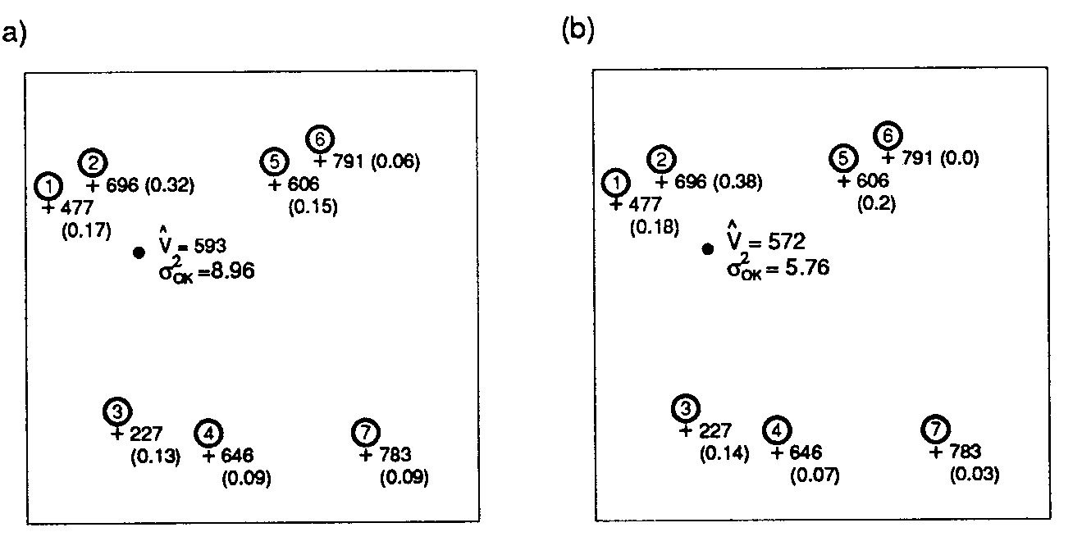

Range
Range of h vs. 1/2h
Range = 10
Range = 20

Slide 18
The Effect of Range
A decrease in the range raises the kriging variance
If the range becomes too small, then all samples appear to be equally far away from the point being estimated. Then the estimation becomes similar to the simple average of the samples with same weight, 1/n

Slide 19
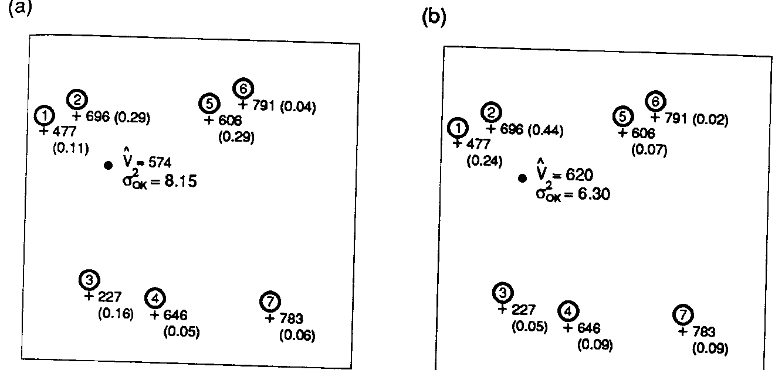
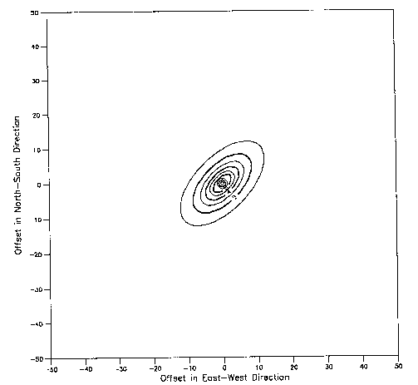
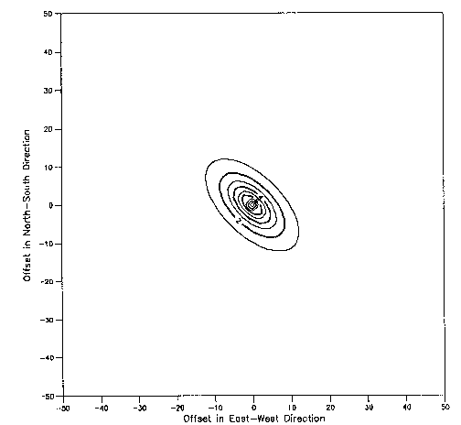
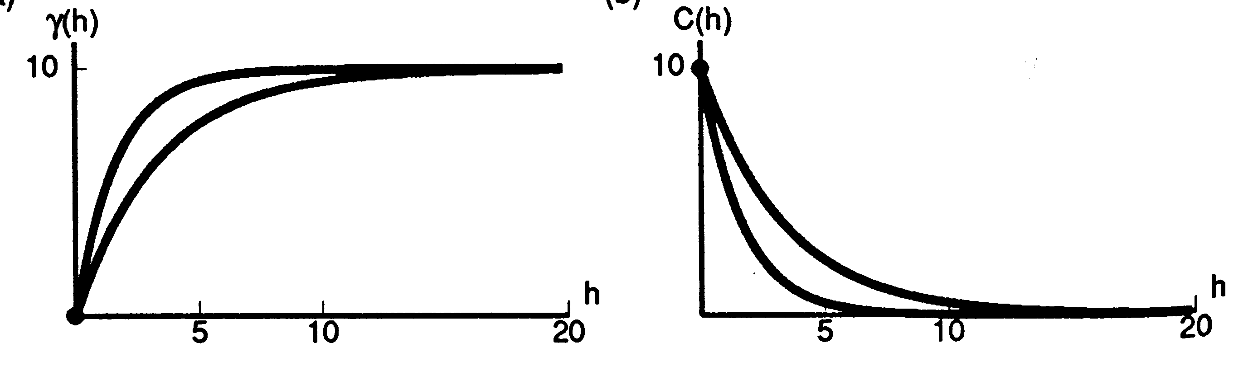
Anisotropy
Directional variograms and covariance functions

Slide 20
Effect of Anisotropy
More weights are given to samples lie in the direction of maximum continuity
Weights given to the samples in the maximum spatial continuity would increase as the anisotropy ratio becomes larger

Slide 21
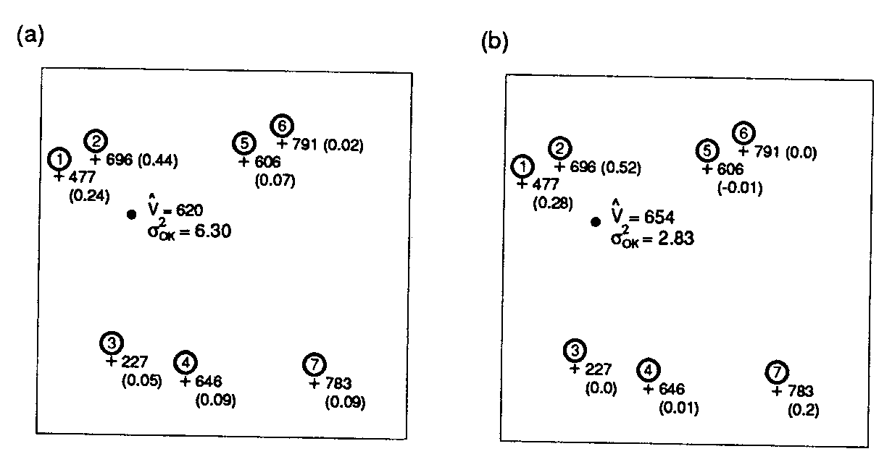


Anisotropy Ratio

Slide 22
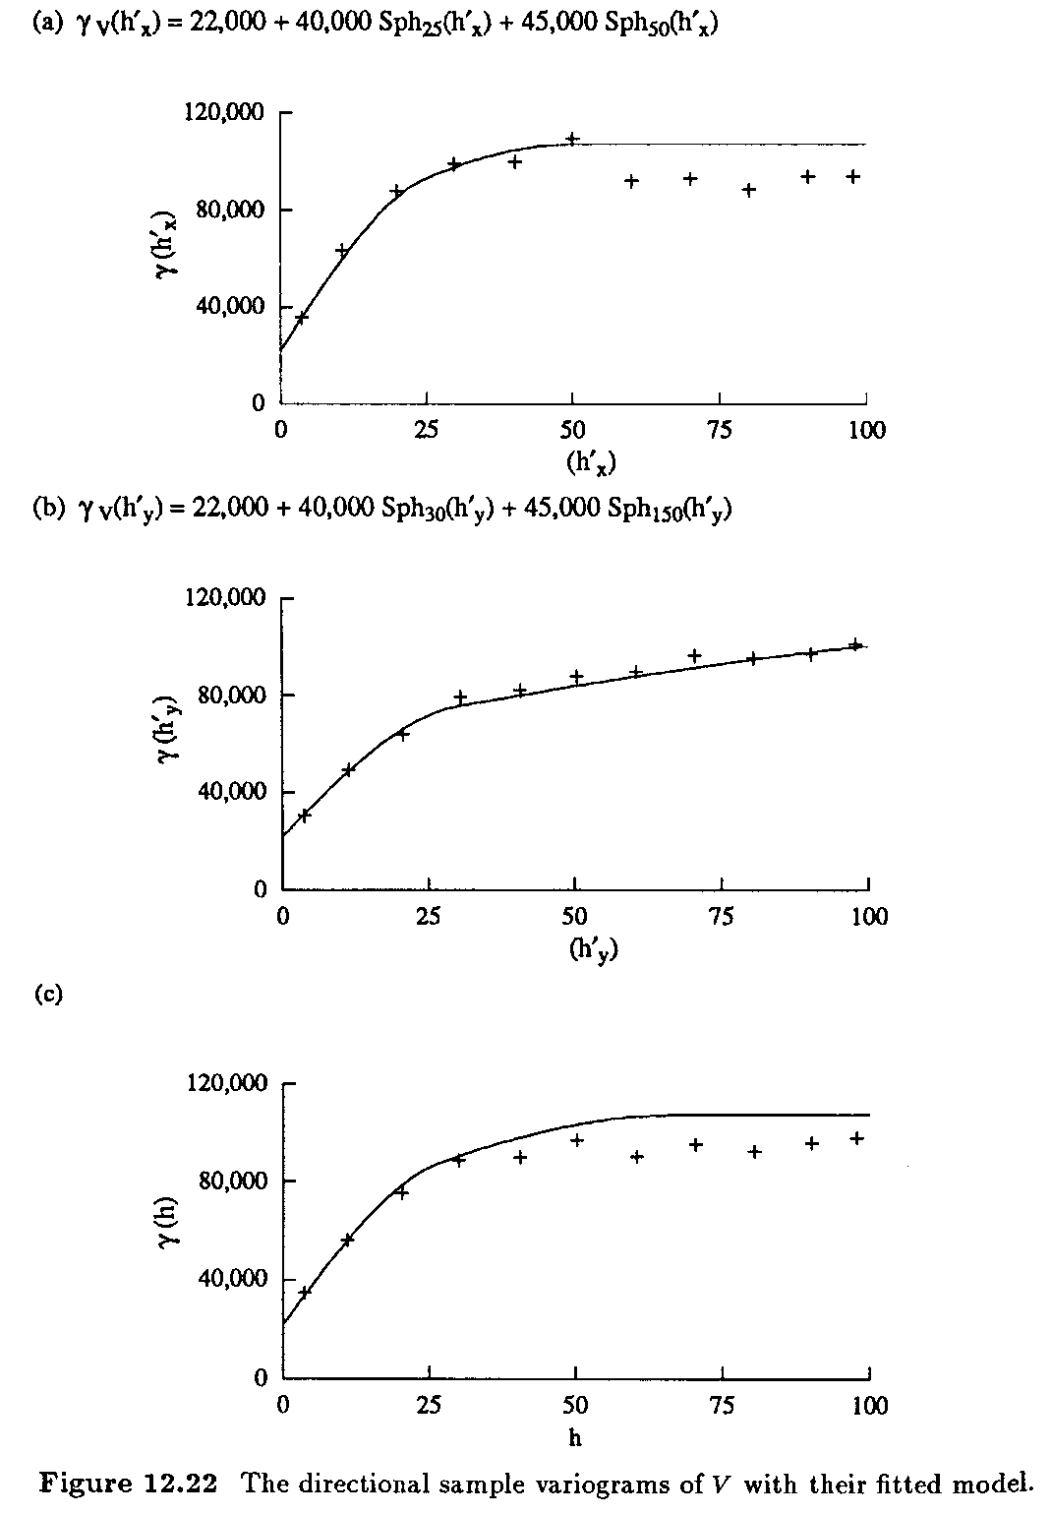
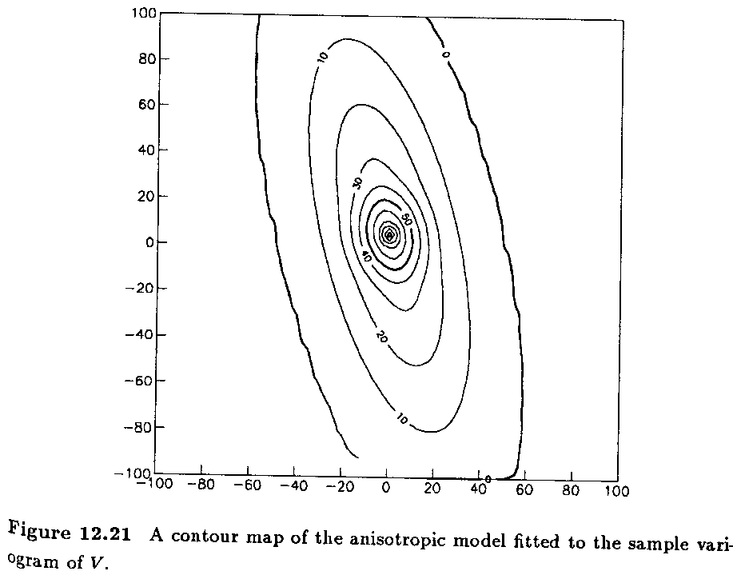
N76E
N14W
Omni
(Fig 7.3
P148)

Slide 23
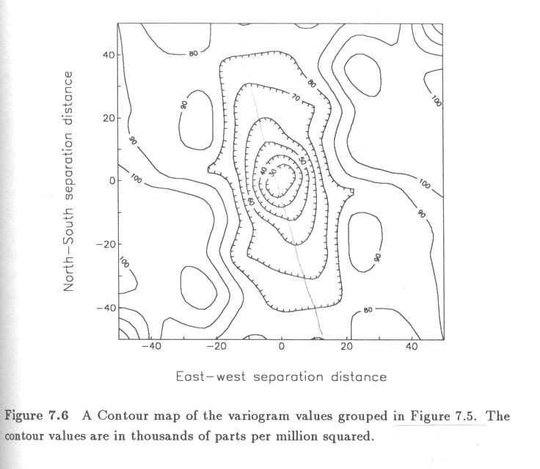

Slide 24
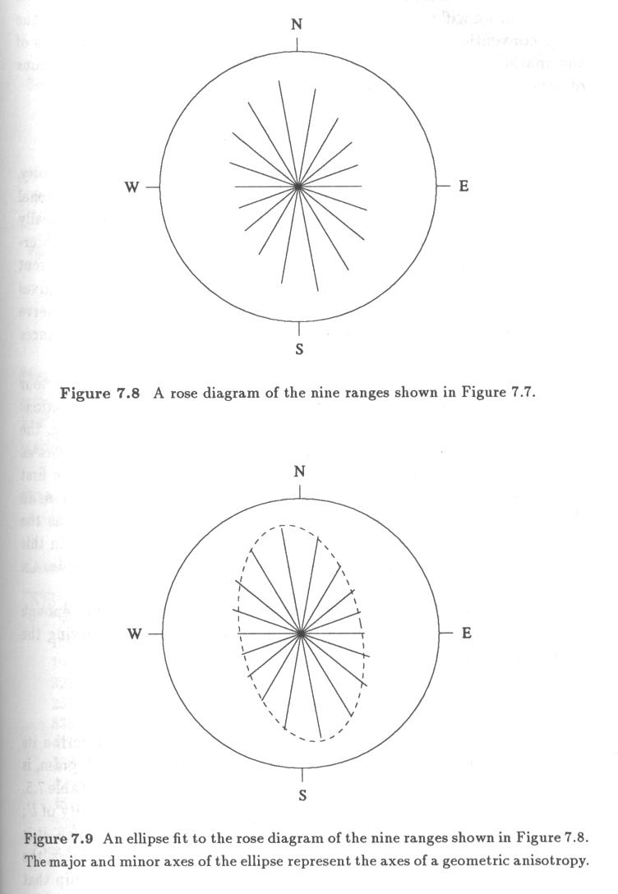

Slide 25

Estimate distribution
Error Distribution (T12.4, p317)

Slide 26
Comparison of Ordinary Kriging to Other Estimation Methods
In general, OK estimates are less variable than other estimation methods such as polygonal or triangulation (smoothing effect)
This is because OK is designed to minimize the error variance
OK usually produces the lowest MAE and MSE because of the unbiased design

Slide 27
Comparison of Ordinary Kriging to Other Estimation Methods
OK is good at handling clustering effect
The strengths of OK come from its use of a customized statistical distance and its attempt to decluster the available sample data

