Slide 1
Geo479/579: Geostatistics
Ch12. Ordinary Kriging (1)

Slide 2
Ordinary Kriging
Objective of the Ordinary Kriging (OK)
Best: minimize the variance of the errors
Linear: weighted linear combinations of the data
Unbiased: mean error equals to zero
Estimation

Slide 3
Ordinary Kriging
Since the actual error values are unknown, the random function model are used instead
A model tells us the possible values of a random variable, and the frequency of these values
The model enables us to express the error, its mean, and its variance
If normal, we only need two parameters to define the model, and

Slide 4
Unbiased Estimates
In ordinary kriging, we use a probability model in which the bias and the error variance can be calculated
We then choose weights for the nearby samples that ensure that the average error for our model is exactly 0, and the modeled error variance is minimized
n
ˆ
=
∑
v
w
v
j
•
j
=
1

Slide 5
The Random Function and Unbiasedness
A weighted linear combination of the nearby samples
Error of ith estimate =
Average error = 0
This is not useful because we do not know the actual
n
ˆ
=
∑
v
w
•
v
j
j
=
1

Slide 6
The Random Function and Unbiasedness …
n
ˆ
=
∑
v
w
•
v
j
j
=
1
Solution to error problem involves conceptualizing the unknown value as the outcome of a random process and solving for a conceptual model
For every unknown value, a stationary random function model is used that consists of several random variables
One random variable for the value at each sample locations, and one for the unknown value at the point of interest

Slide 7
The Random Function and Unbiasedness …
Each random variable has the expected value of
Each pair of random variables has a joint distribution that depends only on the separation between them, not their locations
The covariance between pairs of random variables separated by a distance h, is

Slide 8
The Random Function and Unbiasedness …
Our estimate is also a random variable since it is a weighted linear combination of the random variables at sample locations
The estimation error is also a random variable
The error at is an outcome of the random variable
n
ˆ
=
∑
V
(
x
)
w
•
V
(
x
)
0
i
i
=
i
1

Slide 9
The Random Function and Unbiasedness …
For an unbiased estimation
If stationary

Slide 10
The Random Function and Unbiasedness …
We set error at as 0:

Slide 11
The Random Function Model and Error Variance (Best Estimate)
The error variance
We will not go very far because we do not know

Slide 12
Best Estimates …
The random function model (Ch9) allows us to express the variance of a weighted linear combination of random variables
We then develop ordinary kriging by minimizing the error variance
Refer to the “Example of the Use of a Probabilistic Model” in Chapter 9

Slide 13
The Random Function Model and Error Variance …
We will turn to random function models
n
ˆ
=
∑
V
(
x
)
w
•
V
(
x
)
0
i
i
=
i
1

Slide 14
The Random Function Model and Error Variance …
Ch9 gives a formula for the variance of a weighted linear combination (Eq 9.14, p216):
See 2/18 lecture Slide 30.
(12.6)

Slide 15
Weighted Linear Combinations of Random Variables
See 2/18 lecture Slide 30.
(9.14, p216)

Slide 16
The Random Function Model and Error Variance …
We now express the variance of the error as the variance of a weighted linear combination of other random variables
Stationarity condition

Slide 17
The Random Function Model and Error Variance …

Slide 18
Parameters of Joint Random Variables
Covariance
Slide 28 in 2/18 lecture

Slide 19
The Random Function Model and Error Variance …
We now express the variance of the error as the variance of a weighted linear combination of other random variables
Covariances
between
samples
Covariances
between
samples and
the target
Variance

Slide 20
The Random Function Model and Error Variance
If we have , , and , we can estimate the
To solve
(12.8)

Slide 22
The Random Function Model and Error Variance
Minimizing the variance of error requires to set n partial first derivatives to 0. This produces a system of n simultaneous linear equations with n unknowns
In our case, we have n unknowns for the n sample locations, but n+1 equations. The one extra equation is the unbiasedness condition

Slide 23
The Lagrange Parameter
To avoid this awkward problem, we introduce another unknown into the equation, μ, the Lagrange parameter, without affecting the equality
(12.9)

Slide 24
The derivative of Equation 12.9 with respect to

Slide 25
Minimization of the Error Variance
The set of weights that minimize the error variance under the unbiasedness condition satisfies the following n+1 equations - ordinary kriging system:
(12.11)
(12.12)

Slide 26
The derivative of Equation 12.9 with respect to
i=1, C1j, C10
i=2, C2j, C20
i=3, C3j, C30
…...................... ……….
i=n, Cnj, Cn0

Slide 27
Minimization of the Error Variance
The ordinary kriging system expressed in matrix
(12.13)
(12.14)

Slide 28
Ordinary Kriging Variance
Calculate the minimized error variance by using the resulting to plug into equation (12.8)
As

Slide 29
Ordinary Kriging Variance
Calculate the minimized error variance by using the resulting to plug into equation (12.8)

Slide 30
Ordinary Kriging Using or
Refer to Ch9
(12.20)

Slide 31
Ordinary Kriging Using or …
(12.22)

Slide 32
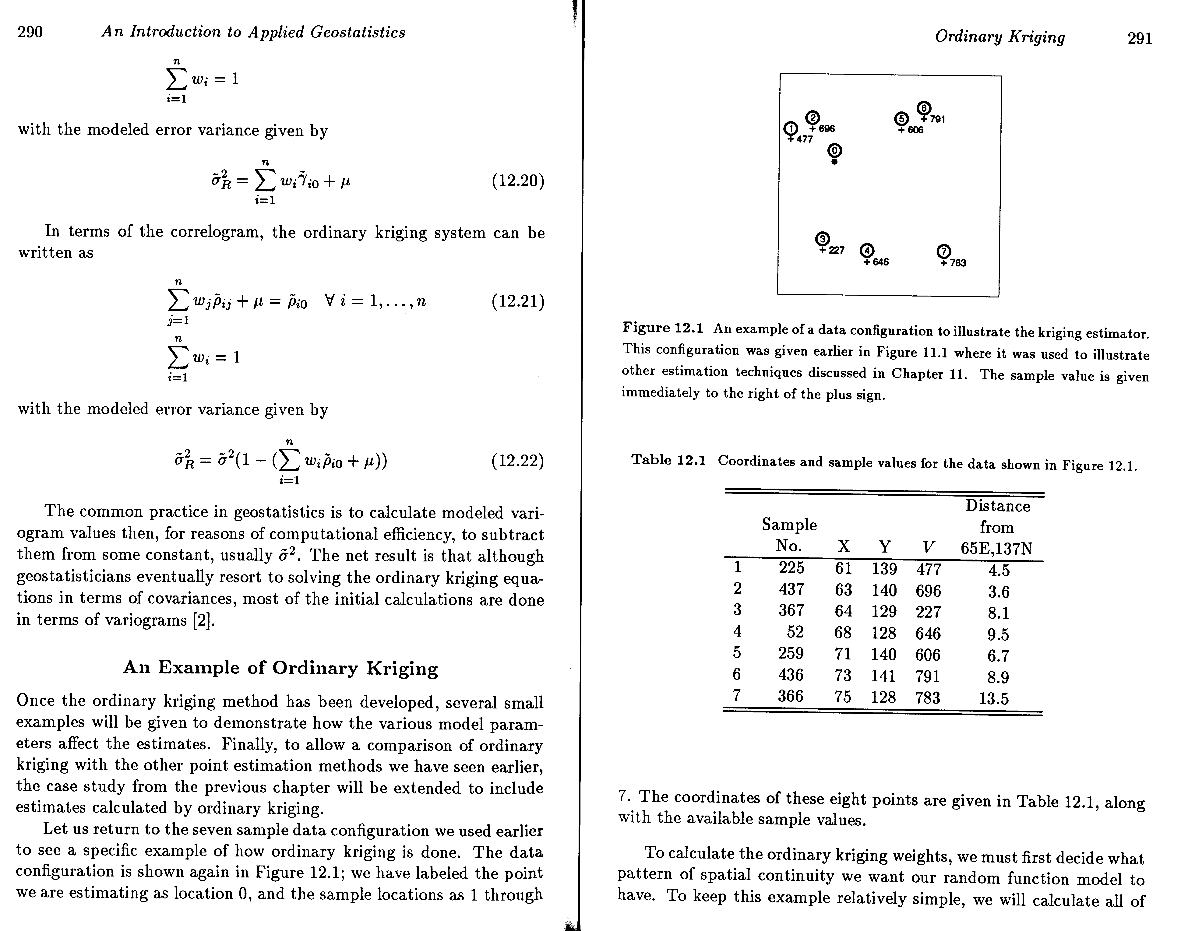
An Example of Ordinary Kriging

Slide 33
+791
140
+696
+606
+477
=?
130
+227
+783
+646
60
70
80

Slide 34
We can compute and based on data in order to solve
(12.11)
(12.12)

Slide 35
The derivative of Equation 12.9 with respect to
i=1, C1j, C10
i=2, C2j, C20
i=3, C3j, C30
…...................... ……….
i=n, Cnj, Cn0

Slide 36
nugget effect, range, sill

Slide 37
nugget effect, range, sill

Slide 39
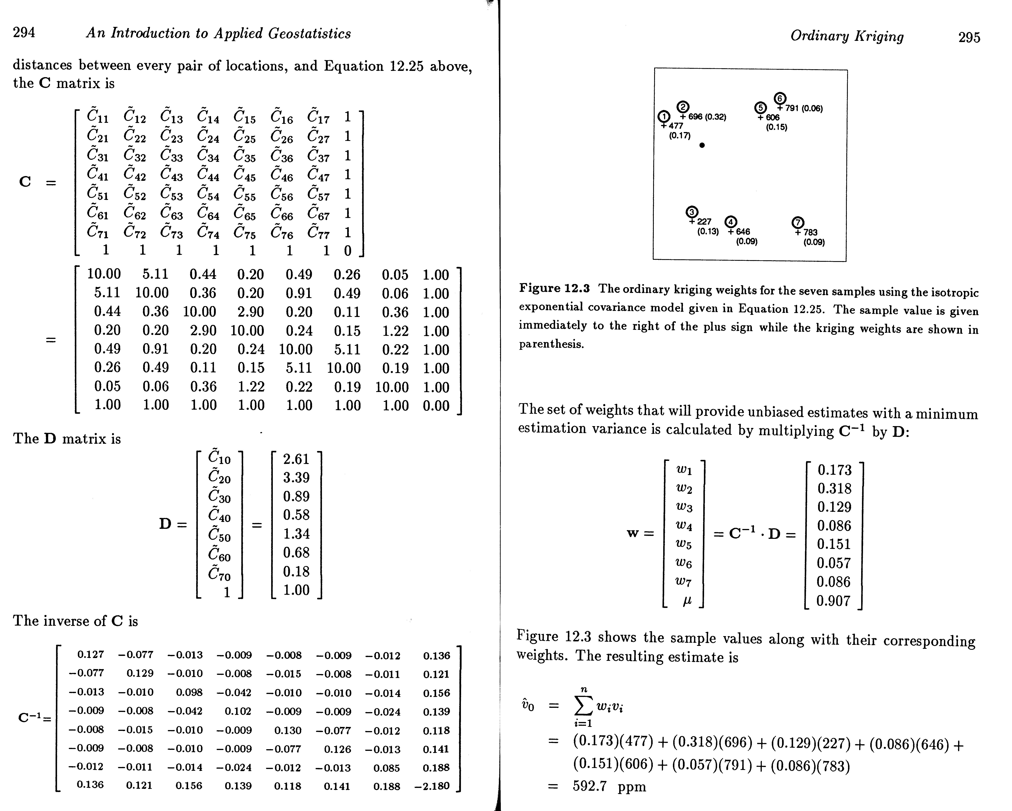

Slide 40
Estimation

Slide 41
Error Variance
(12.15)

