Slide 1
Geo597 Geostatistics
Ch11 Point Estimation

Slide 2
Point Estimation
In the last chapter, we looked at estimating a mean value over a large area within which there are many samples.
Eventually we need to estimate unknown values at specific locations, using weighted linear combinations.
In addition to clustering, we have to account for the distance to the nearby samples.

Slide 3
In This Chapter
Four methods for point estimation, polygons, triangulation, local sample means, and inverse distance.
Statistical tools to evaluate the performance of these methods.

Slide 4
+791
140
+696
+606
+477
=?
130
+227
+783
+646
60
70
80

Slide 5
Polygon
Same as the polygonal declustering method for global estimation.
The value of the closest sample point is simply chosen as the estimate of the point of interest.
It can be viewed as a weighted linear combination with all the weights given to a single sample, the closest one.

Slide 6
Construction of Polygon..
+
+
+ 696
+ 477
= 696
+
Continue this process.

Slide 7
+791
140
+696
+606
+477
=696
130
+227
+783
+646
60
70
80

Slide 8
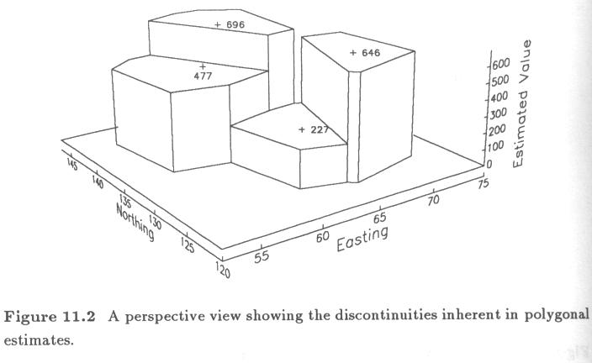

Slide 9
Triangulation
Discontinuities in the polygonal estimation are often unrealistic.
Triangulation methods remove the discontinuities by fitting a plane through three samples that surround the point being estimated.

Slide 10
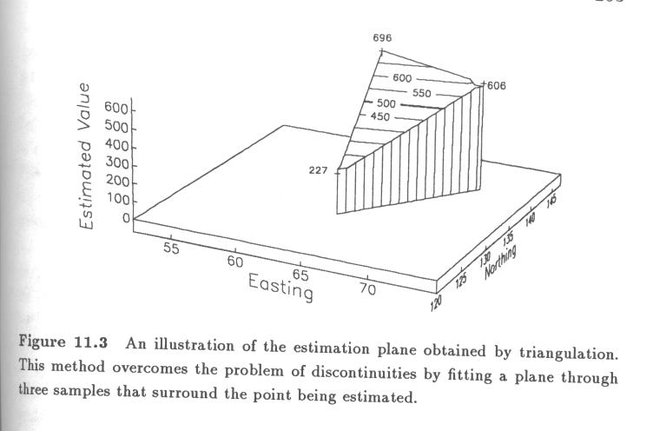

Slide 11
Triangulation ...
Equation of the plane:
(z is the V value, x is the easting, and y is the northing)
Given the coordinates and V value of the 3 nearby samples, coefficients a, b, and c can be calculated by solving the following system equations:

Slide 12
Triangulation ...
63a + 140b + c = 696
64a + 129b + c = 227
71a + 140b + c = 606
a = -11.250, b = 41.614, c = -4421.159
= -11.250x + 41.614y - 4421.159
This is the equation of the plane passing through the three nearby samples.
We can now estimate the value of any location in the plane as long as we have the x, y.

Slide 13
+791
140
+696
+606
+477
?=548.7 = -11.25*65 +41.614*137-4421.159
130
+227
+783
+646
60
70
80

Slide 14
Triangulation ...
Triangulation estimate depends on which three nearby sample points are chosen to form a plane.
Delaunay triangulation, a particular triangulation, produces triangles that are as close to equilateral as possible.
Three sample locations form a Delaunay triangle if their polygons of influence share a common vertex.

Slide 15
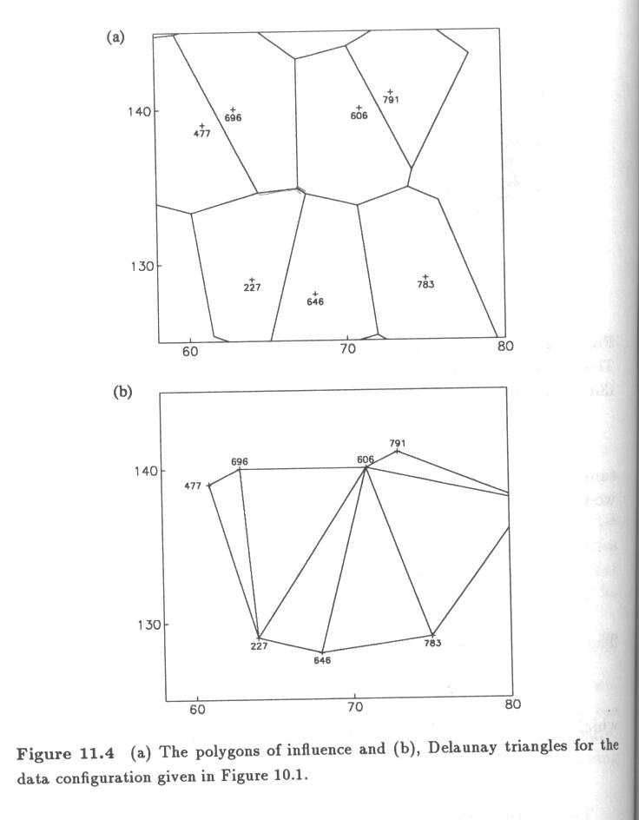

Slide 16
Triangulation ...
Triangulation is not used for extrapolation beyond the edges of the triangle.
Triangulation estimate can also be expressed as a weighted linear combination of the three sample values.
Each sample value is weighted according to the area of the opposite triangle.

Slide 17
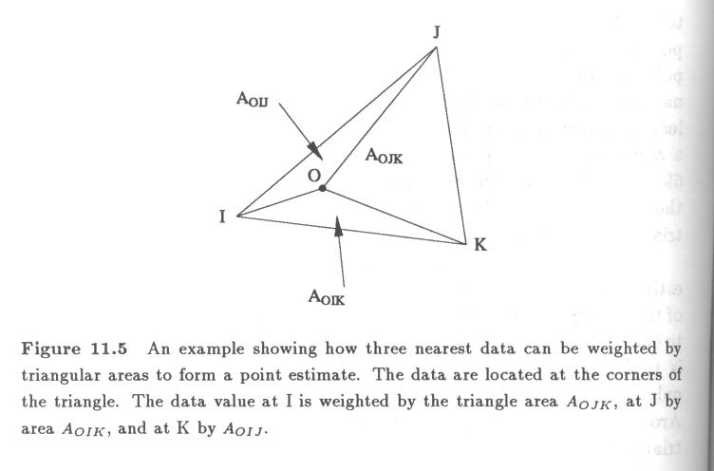

Slide 18
+791
140
+696
+606
+477
?=548.7=[(22.5)(696)+(12)(227)+(9.5)(606)]/44
130
+227
+783
+646
60
70
80

Slide 19
Local Sample Mean
This method weights all nearby samples equally, and uses the sample mean as the estimate. It is a weighted linear combination of equal weights.
This is the first step in the cell declustering in ch10.
This approach is spatially naïve.

Slide 20
+791
140
+696
+606
+477
?=603.7=(477+696+227+646+606+791+783)/7
130
+227
+783
+646
60
70
80

Slide 21
Inverse Distance Methods
Weight each sample inversely proportional to any power of its distance from the point being estimated:
It is obviously a weighted linear combination

Slide 22
ID SAMP# X Y V Dist 1/d_{i} (1/d_{i})/( 1/d_{i})
1 225 61 139 477 4.5 0.2222 0.2088
2 437 63 140 696 3.6 0.2778 0.2610
3 367 64 129 227 8.1 0.1235 0.1160
4 52 68 128 646 9.5 0.1053 0.0989
5 259 71 140 606 6.7 0.1493 0.1402
6 436 73 141 791 8.9 0.1124 0.1056
7 366 75 128 783 13.5 0.0741 0.0696
1/d_{i} = 1.0644
Mean is 603.7
Table 11.2

Slide 23
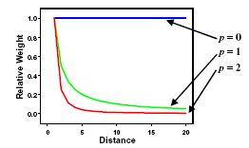
# V p=0.2 p=0.5 p=1.0 p=2.0 p=5.0 p=10.0
1 477 0.1564 0.1700 0.2088 0.2555 0.2324 0.0106
2 696 0.1635 0.1858 0.2610 0.3993 0.7093 0.9874
3 227 0.1390 0.1343 0.1160 0.0789 0.0123 <.0001
4 646 0.1347 0.1260 0.0989 0.0573 0.0055 <.0001
5 606 0.1444 0.1449 0.1402 0.1153 0.0318 0.0010
6 791 0.1364 0.1294 0.1056 0.0653 0.0077 <.0001
7 783 0.1255 0.1095 0.0696 0.0284 0.0010 <.0001
V 601 598 594 598 637 693
p = exponent
Local sample mean = 603.7
Polygonal estimate = 696
Triangulation estimate = 548.7
Table 11.3

Slide 24
+791
140
+696
+606
+477
?=594 (p=1)
=477*0.2088+696*0.261+227*0.116
+646*0.0989+606*0.1402+791*0.1056+783*0.0696
130
+227
+783
+646
60
70
80

Slide 25
Inverse Distance Methods ...
As p approaches 0, the weights become more similar and the estimate approaches the simple local sample mean,d⁰=1.
As p approaches , the estimate approaches the polygonal estimate, giving all of the weight to the closest sample.

Slide 26
Estimation Criteria
Best and unbiased
MAE and MSE
Global and conditional unbiased
Smoothing effect

Slide 27
Estimation Criteria
Univariate Distribution of Estimates
The distribution of estimated values should be close to that of the true values.
Compare the mean, medians, and standard deviation between the estimated and the true.
The q-q plot of the estimated and the true distributions often reveal subtle differences that are hard to detect with only a few summary statistics.

Slide 28
Estimation Criteria ...
Univariate Distribution of Errors
Error (residuals) =
Preferable conditions of the error distribution
1. Unbiased estimate
the mean of the error distribution is referred to as bias
unbiased:
Median(r) = 0; mode(r) = 0 (balanced over- and under-estimates, and symmetric error distribution).

Slide 29
Estimation Criteria ...
Univariate Distribution of Errors ...
Preferable conditions of the error distribution
2. Small spread
Small standard deviation or variance of errors
A small spread is preferred to a small bias (remember the proportional effect?)

Slide 30
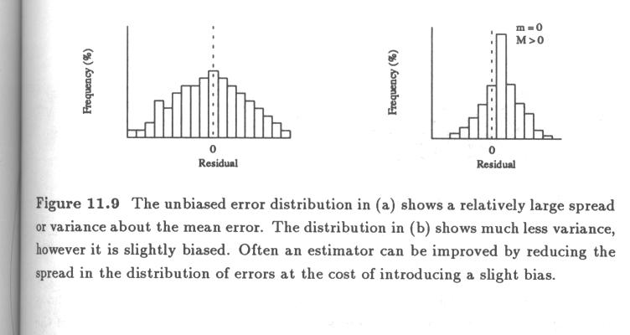
Less variability is preferred to a small bias
Remember a similar concept when we discussed something similar in proportional effect?

Slide 31
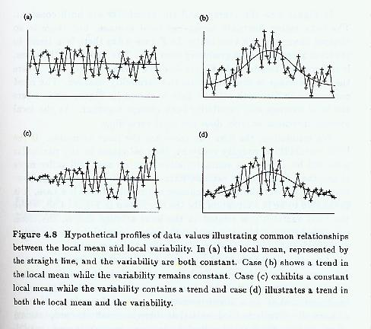

Slide 32
Estimation Criteria ...
Summary statistics of bias and spread
- Mean Absolute Error (MAE) =
- Mean Squared Error (MSE) =

Slide 33
Estimation Criteria
Ideally, it is desirable to have unbiased distribution for each of the many subgroups of estimates (conditional unbiasedness, Fig 3.6, p36).
A set of estimates that is conditionally unbiased is also globally unbiased, however the reverse is not true.
One way of checking for conditional bias is to plot the errors against the estimated values.

Slide 34
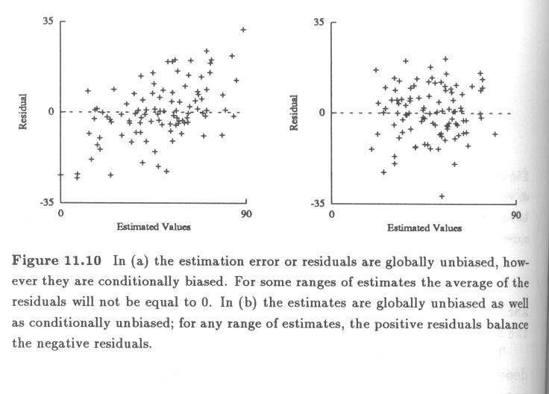
Conditional Unbiasedness

Slide 35
Estimation Criteria ...
Bivariate Distribution of Estimated and True Values
Scatter plot of true versus predicted values.
The best possible estimates would always match the true values and would therefore plot on the 45-degree line on a scatterplot.

Slide 36
Estimation Criteria ...
Bivariate Distribution of Estimated and True Values ...
If the mean error is zero for any range of estimated values, the conditional expectation curve of true values given estimated ones will plot on the 45-degree line.

Slide 37
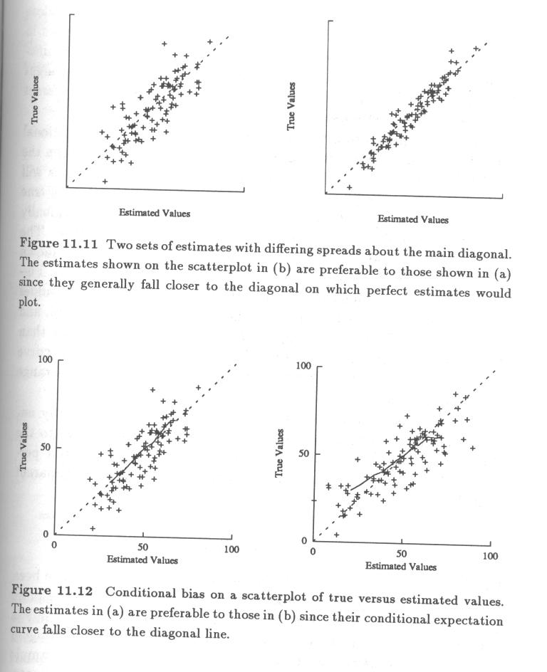

Slide 38
Case Studies
Different estimation methods have different smoothing effects (reduced variability of estimated values).
The more sample points are used for an estimation, the smoother the estimate would become (ch14).
The polygonal method uses only one sample, thus un-smoothed.
Smoothed estimates contain fewer extreme values.

Slide 39
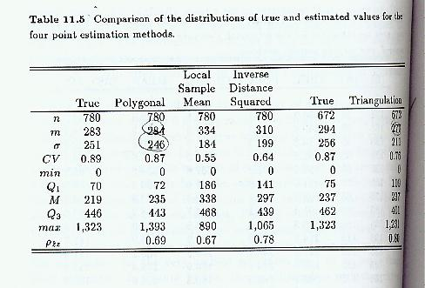

Slide 40
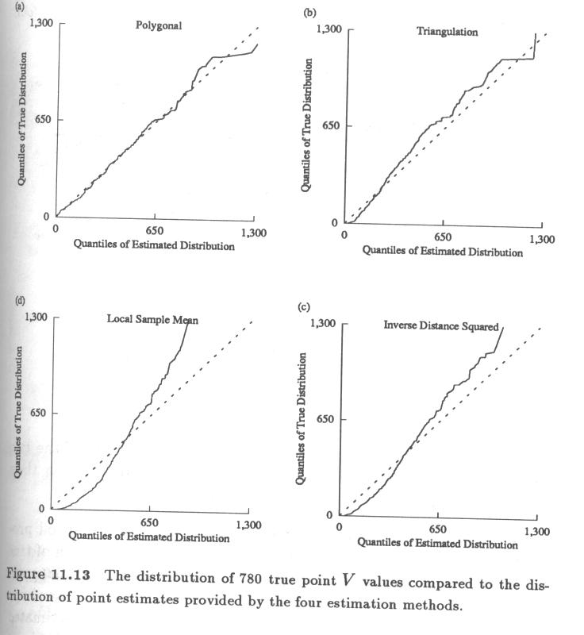
Distribution of estimated vs. true values

Slide 41
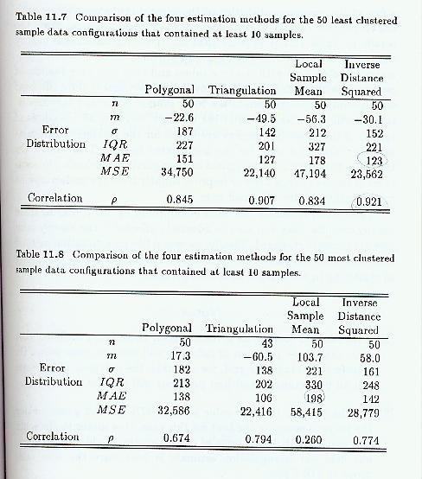
Effect of clustered data on global estimates

Slide 42
Which is the best?
We like to have a method that uses the nearby samples and also accounts for the clustering in the samples configuration

Slide 43
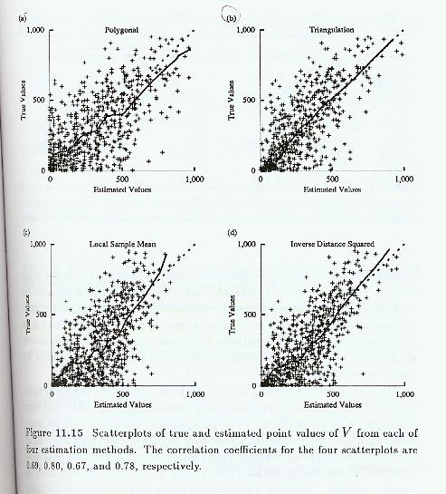
Detecting Conditional Biasedness

