Slide 1
Geo479/579: Geostatistics
Ch10. Global Estimation

Slide 2
Goal
We use a weighted linear combination of all available samples to estimate the locally exhaustive mean
We use two declustering methods to assign different weights to all available samples
To obtain a good estimate of mean so that clustered samples do not have an undue influence on the estimate

Slide 3
Optimal Sample
. | . | . | . | . | . | . | . | . | . | . | .
. | . | . | . | . | . | . | . | . | . | . | .
. | . | . | . | . | . | . | . | . | . | . | .
. | . | . | . | . | . | . | . | . | . | . | .
. | . | . | . | . | . | . | . | . | . | . | .
. | . | . | . | . | . | . | . | . | . | . | .
. | . | . | . | . | . | . | . | . | . | . | .
. | . | . | . | . | . | . | . | . | . | . | .
. | . | . | . | . | . | . | . | . | . | . | .
. | . | . | . | . | . | . | . | . | . | . | .

Slide 4
Sampling Bias
……. |  | . |  | . |  |  | . |  |  | . | ………...
. |  | . | . |  |  | . | . |  |  |  | .
. |  | ……… |  |  | . |  | . |  |  | . | .
. |  | . | . | ……… | . | . | . | . | . | ……… | .

Slide 5
Two Declustering Methods
  Polygonal declustering assigns a polygon of influence to each sample. Areas of the polygons are used as the declustering weights
  Cell declustering uses the moving window concept to calculate how many samples fall within particular regions (cells)

Slide 6
Polygonal Declustering
Each sample can have a polygon of influence within which all locations are closer to this sample than any other sample
Perpendicular bisection method
Clustered samples will have smaller weights corresponding to their small polygons of influence

Slide 7
Construction of Polygon
+ 130
+ 200
+ 180
+ 150
+ 130
Polygon of influence for x=180

Slide 8
Construction of Polygon..
+ 130
+ 200
+ 180
+ 150
+ 130
Draw line segments between x and other points

Slide 9
Construction of Polygon..
+ 130
+ 200
+ 180
+ 150
+ 130
Find the midpoint and bisect the lines.

Slide 10
Construction of Polygon..
+ 130
+ 200
+ 180
+ 150
+ 130
Extend the bisecting lines till adjacent ones meet.

Slide 11
Construction of Polygon..
+ 130
+ 200
+ 180
+ 150
+ 130
Continue this process.

Slide 12
Cell Declustering
Entire area is divided into rectangular cells
Each sample receives a weight inversely proportional to the number of samples that fall with the same cell, thus clustered samples receive lower weights
Each cell receives a total weight of 1

Slide 13
Cell Declustering..
20
15
40
19
Mean of all samples = 430/17 =25
Cell declustering mean =
{(1/3(20+15+19))+ (40) + (1/4(5+27+30+32))+ (5) + (6)+(7)+ (5) +(1/5(20+18+23+19+40))}/8
=(18+40+23.5+5+6+7+5+24)/8 = 16
5
27
5
30
32
7
6
20
18
19
5
23
40

Slide 14
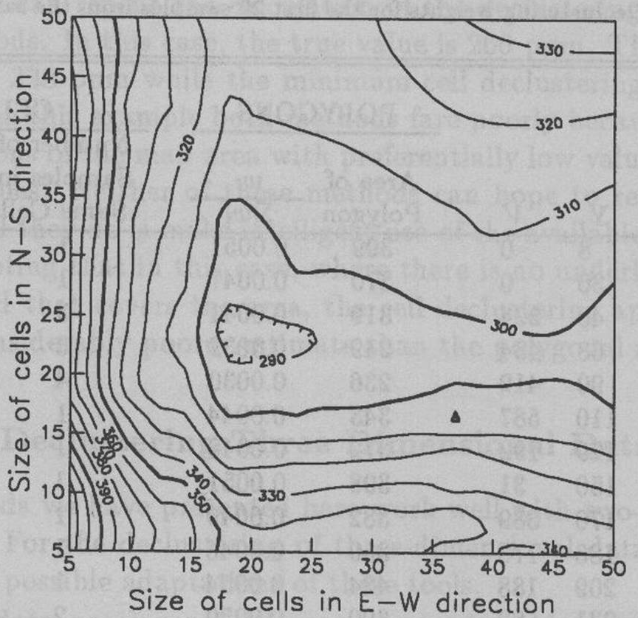
Cell Declustering..
Cell declustering estimation highly depends on the cell size
Try a natural cell size suggested by the sampling pattern
Otherwise try several cell sizes and choose the one that gives the lowest or highest global mean estimate (Fig 10.6)

Slide 15
Cell Declustering..
Contours corresponding to different cell sizes
Best choice 20 X 23
That gives the lowest mean value

Slide 16
Three Dimensional Data
Polygon and cell declustering does not work well with three dimensions
Try reducing to two dimensional layers
For the cell declustering approach, one needs to decide the cell dimension (width, height, and depth) that optimize the global mean estimate

Slide 17
Three Dimensional Data
The three-dimensional analog of the polygonal approach consists of dividing the space into polyhedran; the volume of the polyhedran can be used as a declustering weight

Slide 18
Comparison
The polygonal method has the advantage over the cell declustering method of producing a unique estimate (Fig 10.5, p244)
The cell declustering approach produces a considerably poorer estimate than the polygonal approach where there is no underlying pseudo regular grid that covers the area

