Slide 1
Geo 597: Geostatistics Lab 1
Data Preparation and Exploration

Slide 2
GIAL
Your GIAL access is 24/7
We will go to GIAL again for Labs 2 and 3 on 4/14 and 4/16
You can work on your lab assignments on your own computer
ArcMap, ArcGIS Online, ArcGIS Pro
We are developing a docu to sort out what format works and what not in Pro

Slide 3
Outline
1. Preparing the Data File
2. Converting Table into Point Shapefile
3. Projection
4. Displaying the Point Data
5. Generating a Histogram
6. Generating a Normal QQ Plot
7. Generating a Subset
8. Saving and Re-opening
Note:
If you already have the point data in a GIS shapefile, you may skip to Section 3 to define the coordinate system.
If you shapefile is already in UTM or State Plane, go to Section 4.

Slide 4
1. Preparing the Data File
The point data have to be prepared in table format.
Header should be in the first row including: x-coordinate (or longitude), y-coordinate (or latitude), and attributes (values).
For accuracy, coordinates in longitude and latitude must be specified in decimal degrees at least down to 6 decimal points.
Data entry can be easily done in Excel spreadsheet. After finishing the data entry, save the table in either Excel 1997-2003 version format.
X | Y | Attribute1 | Attribute2
-123.202600 | 39.144700 | 33 | 45
-120.180800 | 39.929100 | 40 | 75

Slide 5
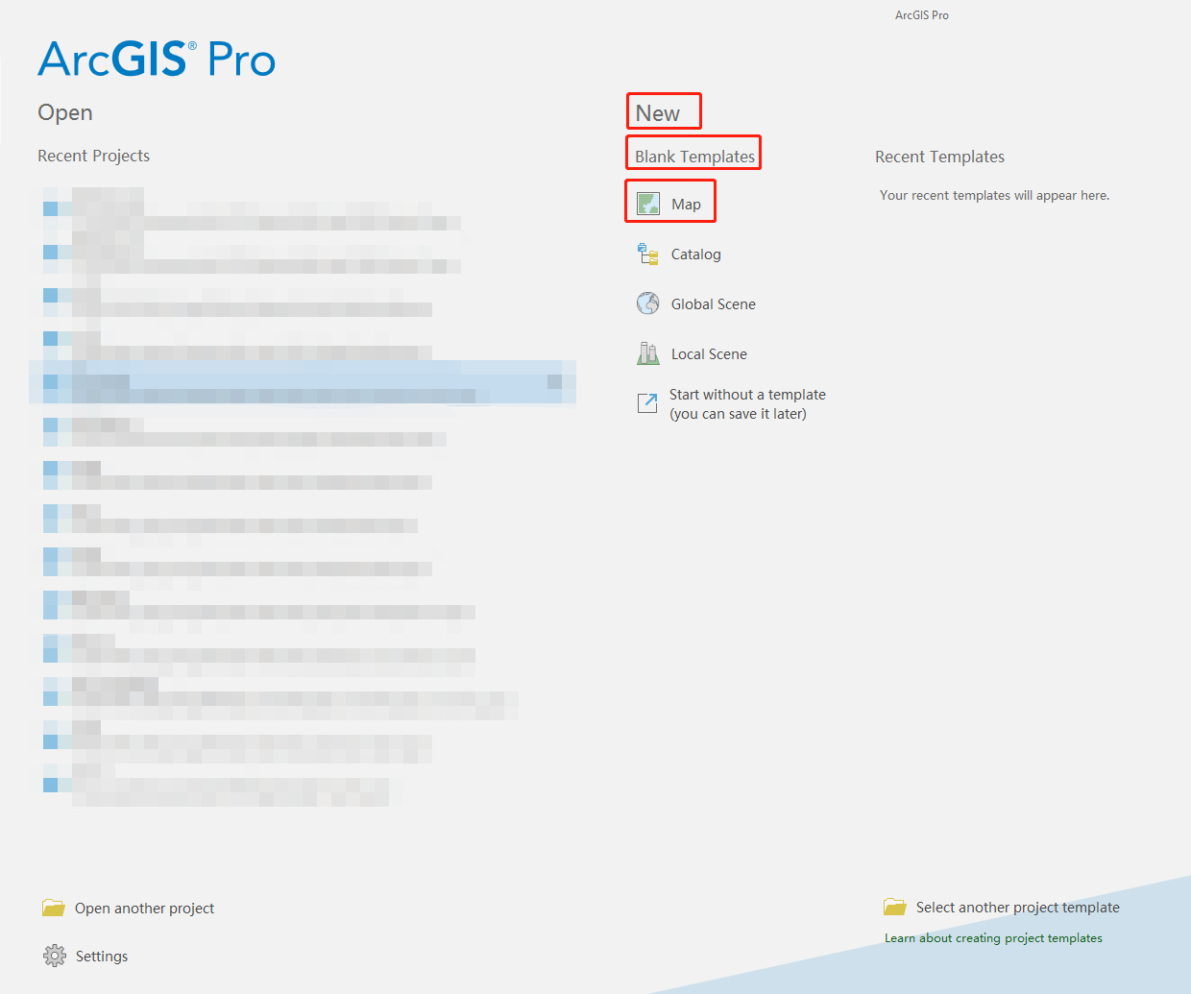
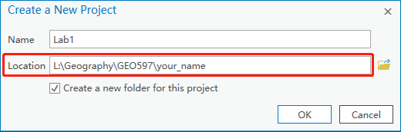
2. Converting Table into Point Shapefile
Launch ArcGIS Pro by the following path: Start -> ArcGIS -> ArcGIS Pro.
Create a blank map: Under New -> Blank Templates, click Map
Specify the Name and the save Location of the map( L: (or M:)\Geography\GEO597\your name).

Slide 6
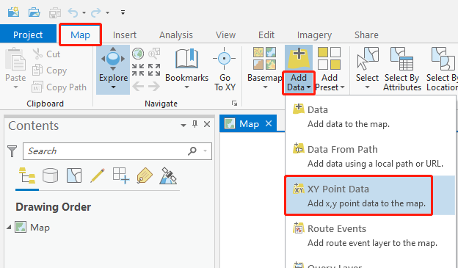
2. Converting Table into Point Shapefile (cont.)
Add your table into the map to create a point shapefile.
Go to the menu -> Map -> Add Data (click the text , NOT the icon) -> XY Point Data.

Slide 7
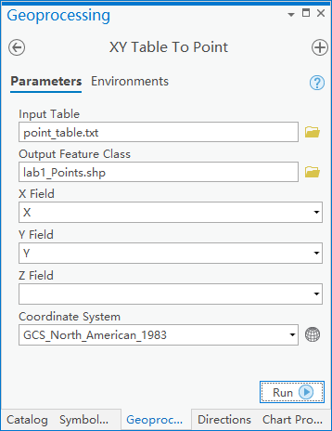
2. Converting Table into Point Shapefile (cont.)
On the Geoprocessing panel on the right, choose your Input Table and specify the name of the Output Feature Class (shapefile). Then specify the X Field, the Y Field, and the Coordinate System (choose Geographic Coordinate System -> North America -> USA and territories -> NAD1983).
Click Run and you will see new points in the Map View area and the output point shapefile is created. You can see the shapefile layer in the Content Panel on the left.

Slide 8
3. Projection
It is important to have your point shapefile in a rectangular projection system (UTM or State Plane), because we need to calculate distances between points in actual length measures.
If the point shapefile is in decimal degrees (longitude/latitude), it must be projected to a rectangular coordinate system.
If your point data is already projected, just check if they are defined properly.

Slide 9
3. Projection (cont.)
How to project into a rectangular coordinate system:
Determine an appropriate projected coordinate system for your data. If your study area is smaller than a state, it is recommended to use local projected coordinate system such as State Plane Coordinate System (SPCS) or Universal Transverse Mercator (UTM) system. Refer to the following link to find out the corresponding zone for your study area:
http://www.avenza.com/sites/default/files/flashmaps/spsc/

Slide 10
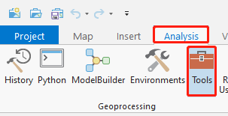
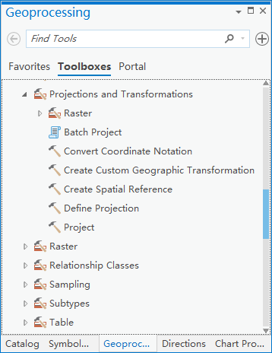
3. Projection (cont.)
How to project into a rectangular coordinate system (cont.):
Go to the menu Analysis -> Tools. On the Geoprocessing panel -> Toolboxes, go to Data Management Tools -> Projections and Transformations -> Project.

Slide 11
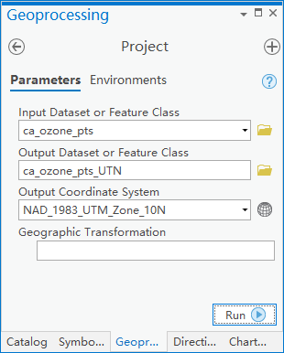
3. Projection (cont.)
How to project into a rectangular coordinate system (cont.):
On the Geoprocessing Panel on the right, select the shapefile you want to project, and specify the saving path and name of the output shapefile.
For Output Coordinate System, click button, select Projected Coordinate System -> UTM or State Plane.
Click Run.

Slide 12
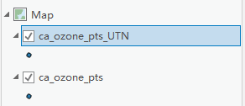
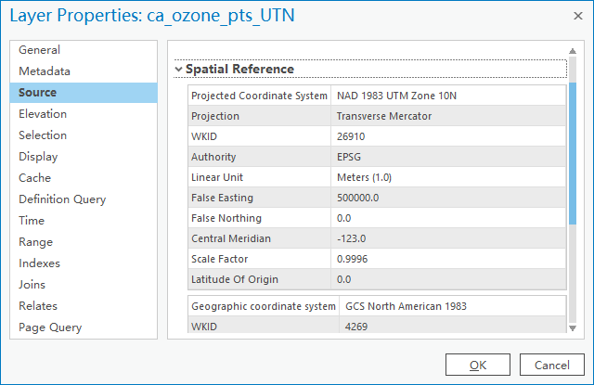
3. Projection (cont.)
How to project into a rectangular coordinate system (cont.):
The projected point layer will show on the Content Panel on the left. Right click the layer -> Properties -> Source -> Spatial Reference to check the projected coordinate system of the layer.

Slide 13
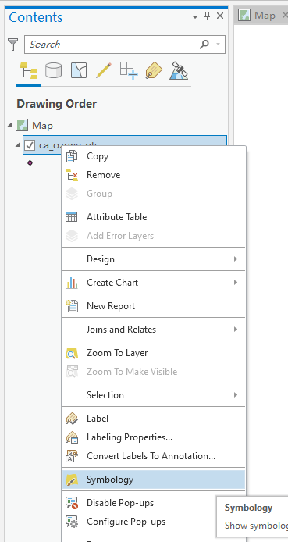
4. Displaying the Point Data
You can modify the display of the points (symbol, color, etc.)
On the Content Panel on the left, right-click the point layer -> Symbology, then a Symbology Panel will appear on the right.

Slide 14
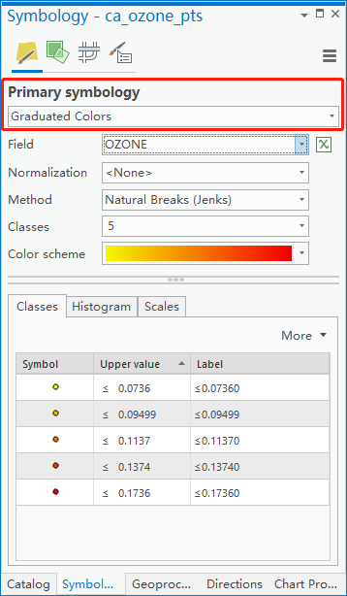
4. Displaying the Point Data (cont.)
Under Primary symbology, choose Graduated Color. This option allows the color changes based on points’ attribute.
Specify the Field to an attribute of the point data. The color of the points will indicate the value of that attribute.
Explore other options: Method, Classes, Color scheme, etc. to see how they affect the display of the points.

Slide 15
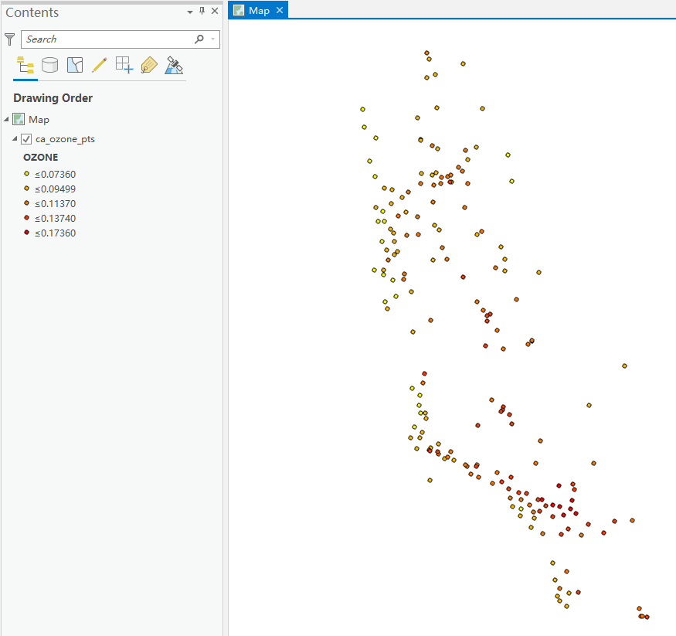
4. Displaying the Point Data (cont.)
The CA ozone data is displayed in 5 classes using a yellow-orange-red color scheme. The value interval for each class/color is posted on the Content Panel on the left

Slide 16
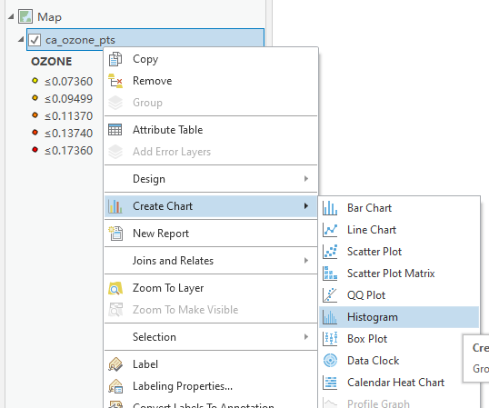
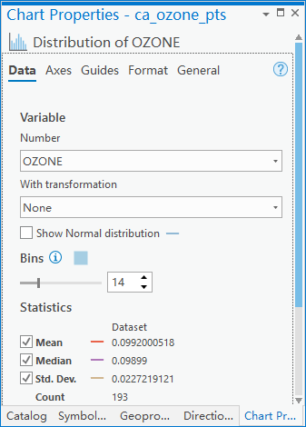
5. Generating a Histogram
Display the histogram of your data:
In the Content Panel, right-click the point layer -> Create Chart -> Histogram.
On the Chart Properties Panel on the right, select the appropriate Number (attribute name) for generating histogram. Change the number of bins of the histogram using the Bin slider. Choose a Transformation method to change the data to a normal distribution if the data are not normal. Check all summery statistics (Mean, Median, Std. Dev.). The statistics will show within the histogram frame.

Slide 17
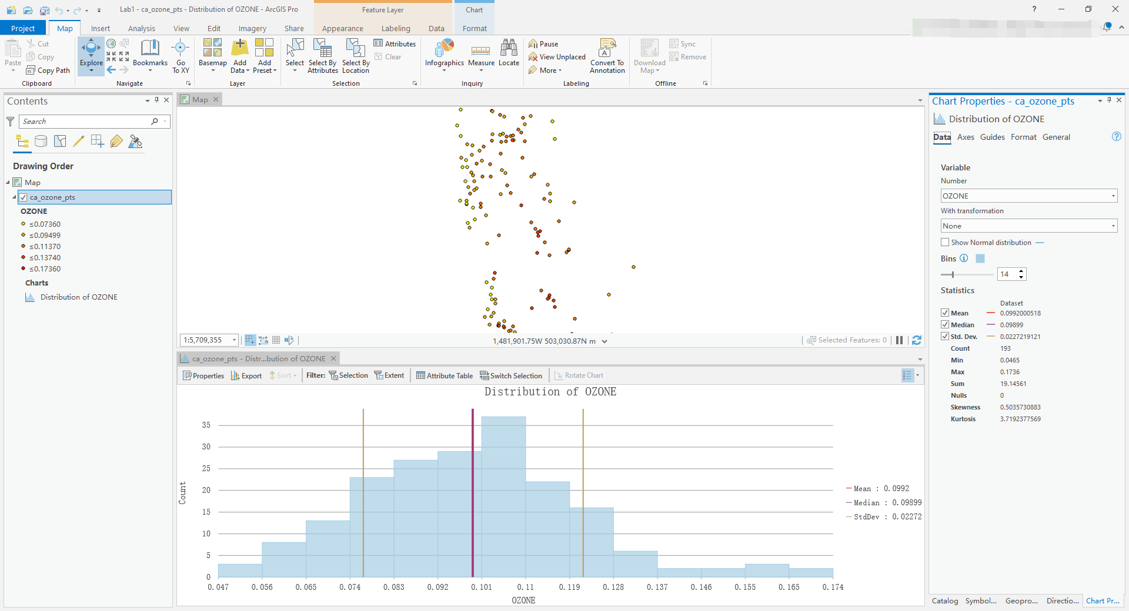
5. Generating a Histogram (cont.)
This is the histogram of the CA ozone data. It shows the distribution of OZONE with 14 bins. No transformation is used.

Slide 18
6. Generating a QQ Plot
A QQ Plot is a graph on which the quantiles from two distributions are plotted versus each other. For two identical distributions, the QQ Plot will be a straight line.
Therefore, it is possible to check the normality of your data by plotting its quantiles versus the quantiles of a standard normal distribution. The closer the points are to form a straight line, the closer the distribution of your data is close to a normal distribution.
If the data do not exhibit a normal distribution in either the Histogram or the Normal QQ Plot, it may be necessary to transform the data to make it conform to a normal distribution before using certain kriging interpolation techniques.

Slide 19
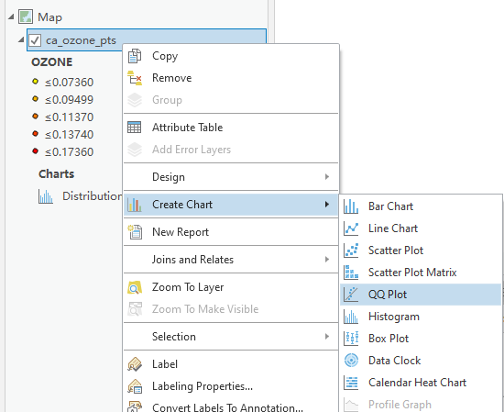
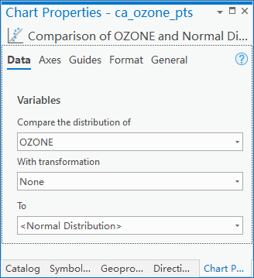
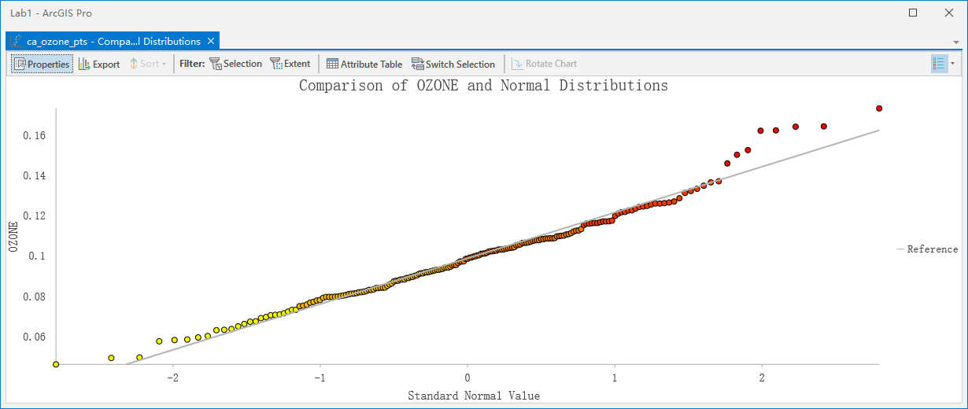
6. Generating a Normal QQ Plot (cont.)
Display the QQ Plot of your data:
In the Content Panel, right-click the point layer-> Create Chart-> QQ Plot.
On the Chart Properties Panel on the right, select the appropriate attribute name for generating histogram.

Slide 20
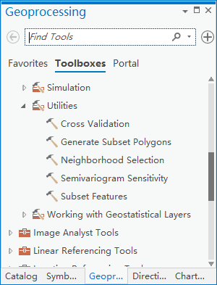
7. Generating a Subset
If you have a large number of data points and would like to set aside a subset of data for independent validation, you may use the Subset Features tool to generate a subset of your data.
Go to the menu Analysis -> Tools. On the Geoprocessing panel -> Toolboxes, go to Geostatistical Analyst Tools -> Utilities -> Subset Features.

Slide 21
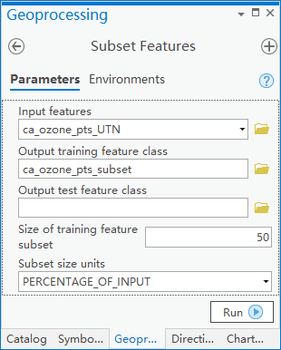
7. Generating a Subset (cont.)
On the Geoprocessing Panel on the right, select Input features (your point shapefile) to generate a subset, and specify Output training feature class (the subset shapefile) and the Size of training subset (50% of the original points).
Click Run.

Slide 22
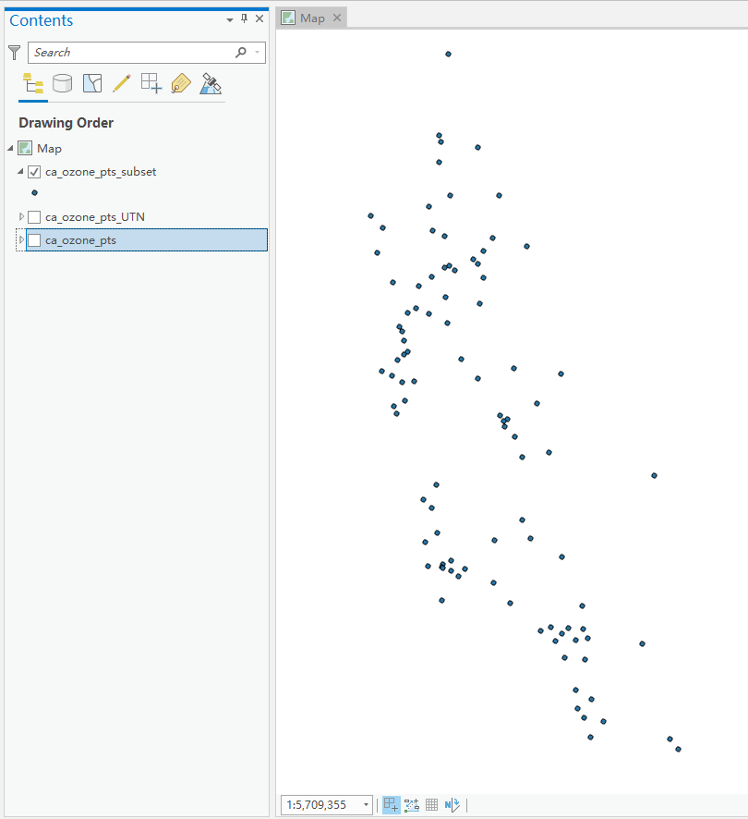
7. Generating a Subset (cont.)
The subset point layer will show on the Content Panel on the left.
Uncheck the box before the original point layer to display the subset point layer.

Slide 23

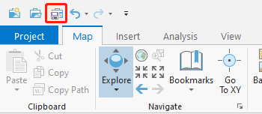
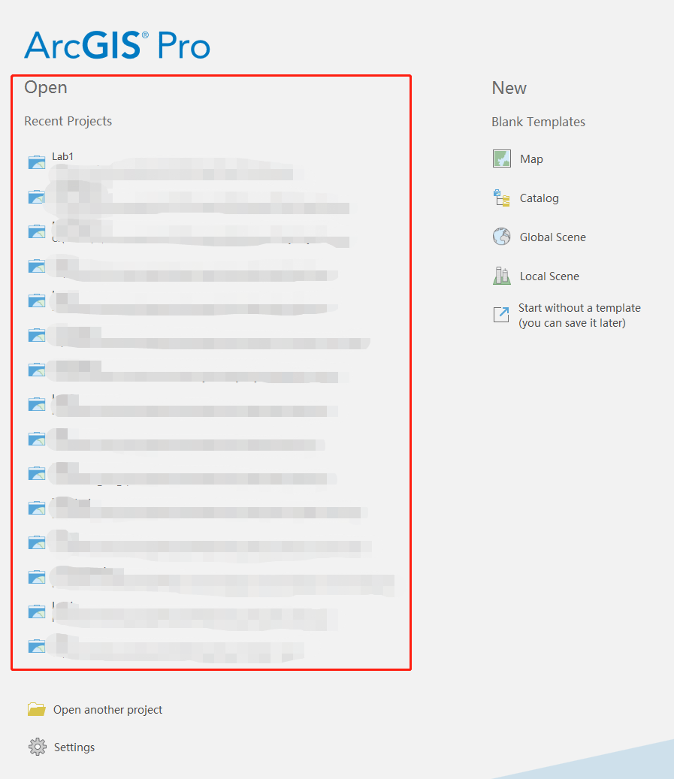
8. Saving and Re-opening Your Work
To save your work, click the icon on the menu.
To re-open your work, launch ArcGIS Pro. You may find your saved work (file name and the associated path) on the left column under Open -> Recent Projects.
Click on the file name, you will see your work is opened (the shapefile layer in the Content Panel and the points in the Map View).

Slide 24
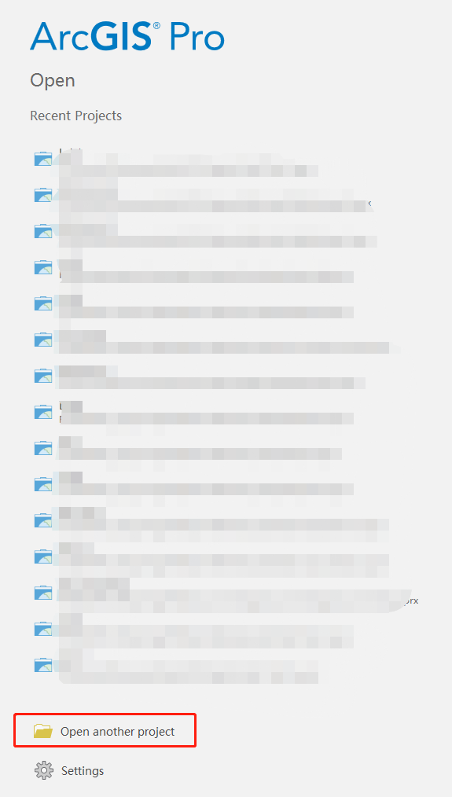
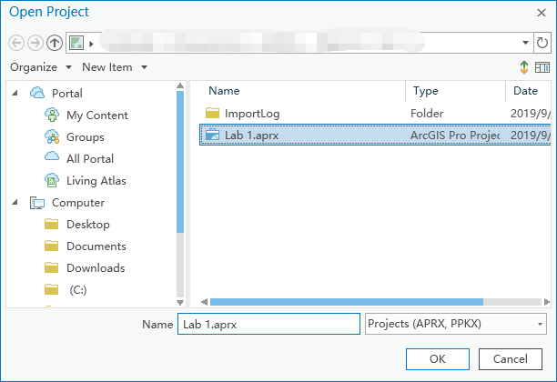
8. Saving and Re-opening Your Work (cont.)
If your work is not there, click Open another project at the bottom of the column. In the pop-up window, direct to your folder (L: (or M:)\Geography\GEO597\your name) and find your saved work.
Click OK, you will see your work is opened.

Slide 25
Assignments
Due: March 10 by submitting to the ‘Lab 1’ Folder in UBLearns
Save screens and put in a Word or PDF file.
I. Data distribution.
I.1. Display the histogram of your data. Include the summary statistics as well.
I.2. Describe the distribution: Whether it looks close to normal distribution, and whether it is symmetric or skewed.
I.3. Do you think any transformation is necessary? If so, what kind of transformation would you use?

Slide 26
Assignments (cont.)
II. Display a map of your data.
II.1. Display the value intervals with color (data posting).
II.2. Report any outliers (e.g. a single high value surrounded by low values or the opposite).
II.3. Report any spatial trend in data values. Whether high or low values are concentrated in certain areas, and whether the changes between the high and low values are abrupt or gradual.

Slide 27
Assignments (cont.)
III. Generate a subset of your data that is 50% of the original data.
III.1. Display the histogram of the subset. Include the summary statistics.
III.2. Display the value of the subset using the same color schedule as in II.1.; then display a map of your data.

