Slide 1
Chapter Twenty One
Option Valuation

Slide 2
Option Values
Intrinsic value - profit that could be made if the option was immediately exercised
Call: stock price - exercise price
Put: exercise price - stock price
Time value - the difference between the option price and the intrinsic value, given immediate expiration

Slide 3
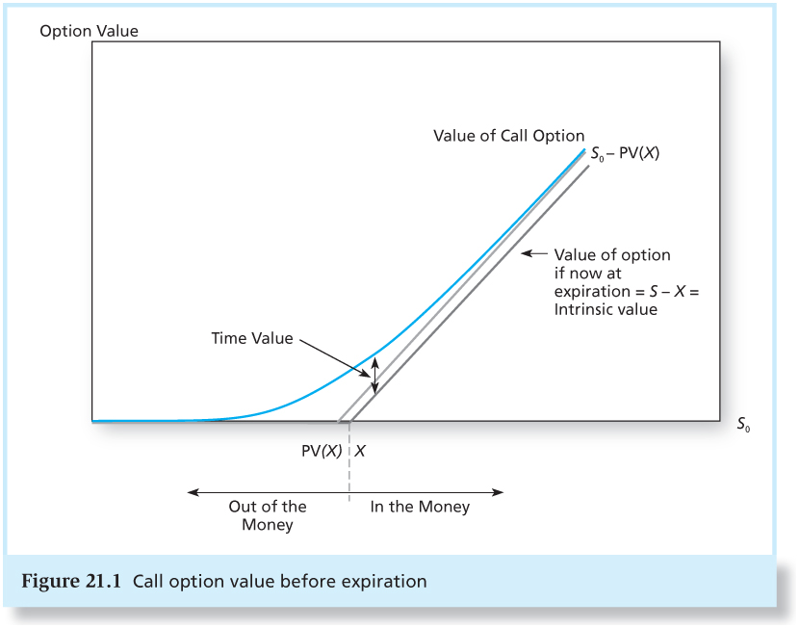
Figure 21.1 Call Option Value before Expiration

Slide 4
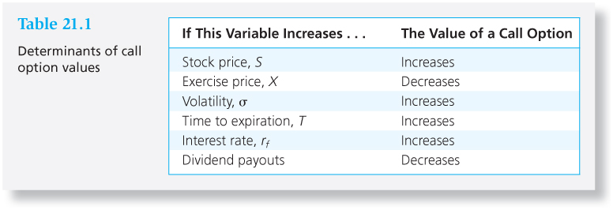
Table 21.1 Determinants of Call Option Values
Payoff to Call Holder
(S_{T} - X) if S_{T} >X
0 if S_{T} < X
Call value = Present value of (S_{T} – X)
≈ S₀ – X / (1 + r_{f})^{T}

Slide 5
Binomial Option Pricing: Text Example
u = 1.20
d = 0.9
120
10
100
C
90
0
Call Option Payoff
X = 110
Stock Price

Slide 6
Binomial Option Pricing: Text Example
30
Alternative Portfolio
Buy 1 share of stock at $100
Borrow $81.82 (10% Rate)
Net outlay $18.18
Payoff
Value of Stock 90 120
Repay loan - 90 - 90
Net Payoff 0 30
18.18
0
Payoff Structure
is exactly 3 times
the Call

Slide 7
Binomial Option Pricing: Text Example
30
30
18.18
3C
0
0
3C = $18.18
C = $6.06

Slide 8
Replication of Payoffs and Option Values
Alternative Portfolio - one share of stock and 3 calls written (X = 110)
Portfolio is perfectly hedged:
Stock Value 90 120
Call Obligation 0 -30
Net payoff 90 90
Hence 100 - 3C = 90/(1 + r_{f}) = 90/(1.1) = 81.82
3C = 100 – 81.82 = 18.18
Thus C = 6.06

Slide 9
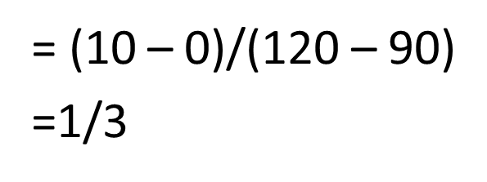
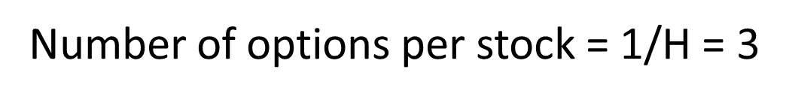
Hedge Ratio
In the example, the hedge ratio = 1 share to 3 calls or 1/3.
Generally, the hedge ratio is:

Slide 10
Generalizing the Two-State Approach
Assume that we can break the year into two six-month segments
In each six-month segment the stock could increase by 10% or decrease by 5%
Assume the stock is initially selling at 100
Possible outcomes:
Increase by 10% twice
Decrease by 5% twice
Increase once and decrease once (2 paths)

Slide 11
Generalizing the Two-State Approach Continued
121
110
104.50
100
95
90.25

Slide 12
Expanding to Consider Three Intervals
Assume that we can break the year into three intervals.
For each interval the stock could increase by 20% or decrease by 10%.
Assume the stock is initially selling at $100.

Slide 13
Expanding to Consider Three Intervals
S + + +
S + +
S +
S + + -
S + -
S
S + - -
S -
S - -
S - - -

Slide 14
Possible Outcomes with Three Intervals
Event | Probability | Final Stock Price
3 up | 1/8 | 100 (1.20)³ = $172.80
2 up 1 down | 3/8 | 100 (1.20)² (.90) = $129.60
1 up 2 down | 3/8 | 100 (1.20) (.90)² = $97.20
3 down | 1/8 | 100 (.90)³ = $72.90

Slide 15
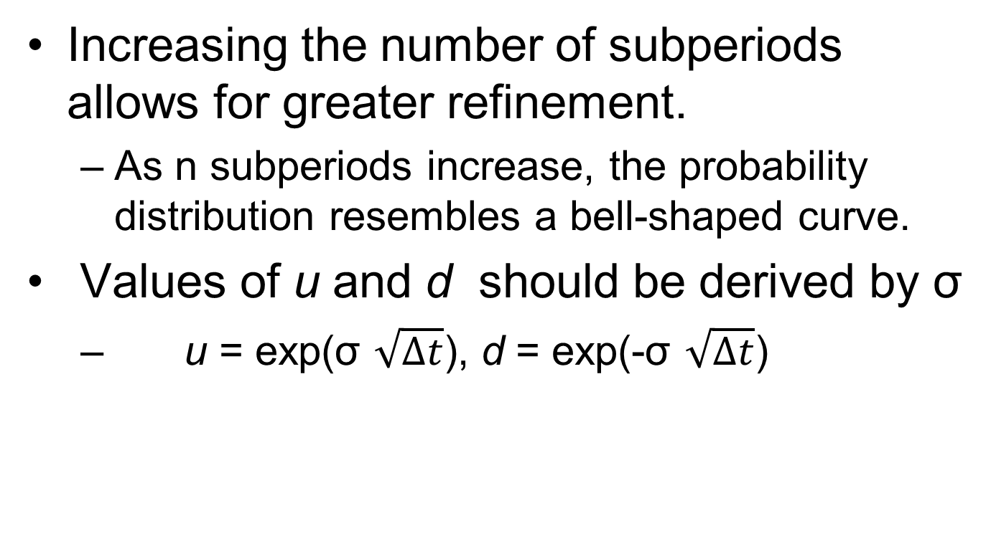
Making the Valuation Model Practical

Slide 16
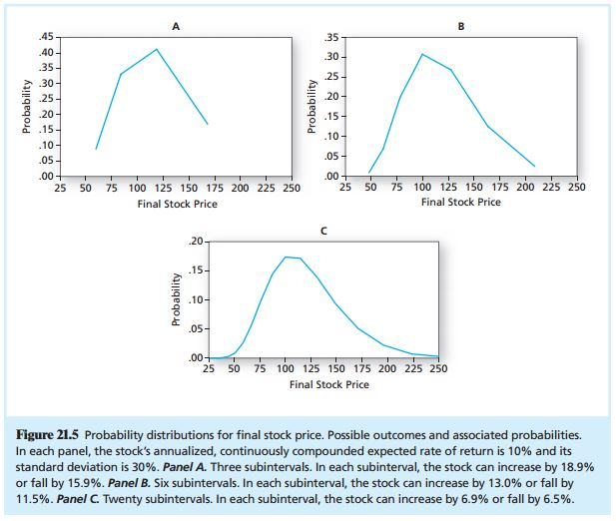
Probability Distribution

Slide 17
Black-Scholes Option Valuation
C_{o} = S_{o}N(d₁) - Xe^{-rT}N(d₂)
d₁ = [ln(S_{o}/X) + (r + σ²/2)T] / (σ T^{1/2})
d₂ = d₁ - (σ T^{1/2})
where
C_{o} = Current call option value
S_{o} = Current stock price
N(d) = probability that a random draw from a normal distribution will be less than d

Slide 18
Black-Scholes Option Valuation
X = Exercise price
e = 2.71828, the base of the natural log
r = Risk-free interest rate (annualized, continuously compounded with the same maturity as the option)
T = time to maturity of the option in years
ln = Natural log function
σ = Standard deviation of annualized continuously compounded rate of return on the stock

Slide 19
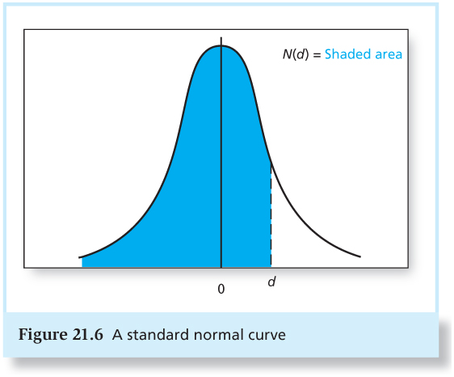
Figure 21.6 A Standard Normal Curve

Slide 20
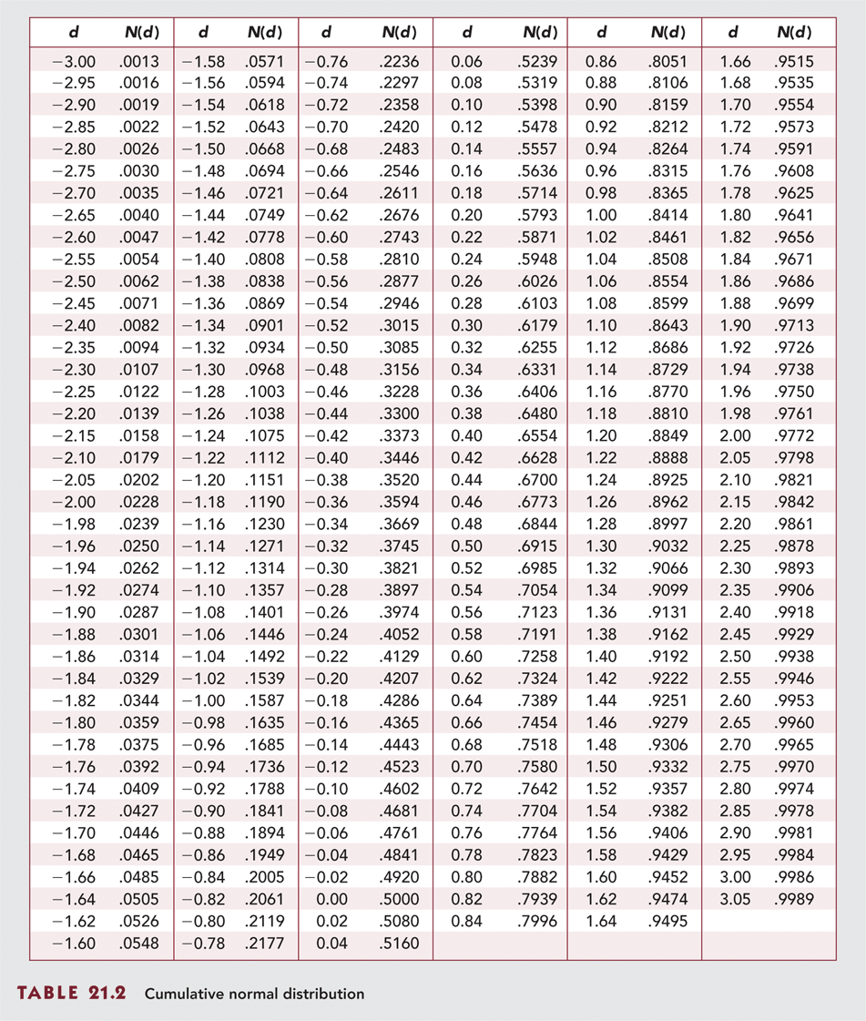
Cumulative Normal Distribution

Slide 21
Example 21.4 Black-Scholes Valuation
S_{o} = 100 X = 95
r = .10 T = .25 (quarter)
σ = .50 (50% per year) 5² 0.5² instead
Thus:

Slide 22
Probabilities from Normal Distribution
N (.43) = .6664
d N(d)
.42 .6628
.43 .6664 Interpolation
.44 .6700

Slide 23
Probabilities from Normal Distribution Continued
N (.18) = .5714
d N(d)
.16 .5636
.18 .5714
.20 .5793

Slide 24
Probabilities from Normal Distribution
Using a table or the NORM.S.DIST function in Excel, we find that N (.43) = .6664 and N (.18) = .5714.
Therefore:
C_{o} = S_{o}N(d₁) - Xe^{-rT}N(d₂)
C_{o} = 100 X .6664 - 95 e^{- .10 X .25} X .5714
C_{o} = $13.70
To go to NORM.S.DIST, select Formulas, More functions, and Statistical

Slide 25
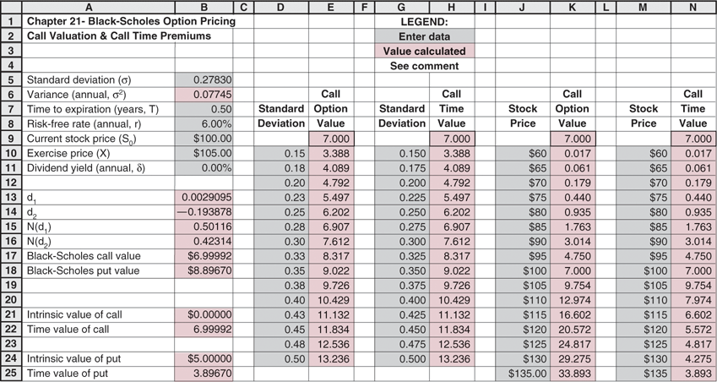
Spreadsheet to Calculate Black-Scholes Option Values http://highered.mheducation.com/sites/0077861671/student_view0/chapter21/excel_templates.html

Slide 26
Why higher volatility increases the value of a call option?
Volatility means more uncertainty — the stock could swing higher or lower.
For a call option, which profits when the stock price goes up, more volatility means a greater chance of large upward moves.
Since the downside is limited (you can’t lose more than what you paid for the option), but the upside is unlimited, higher volatility increases potential payoff without increasing potential loss.

Slide 27
Call Option Value
Implied Volatility
Implied volatility is volatility for the stock implied by the option price.
Using Black-Scholes and the actual price of the option, solve for volatility.
Is the implied volatility consistent with the stock?

Slide 28
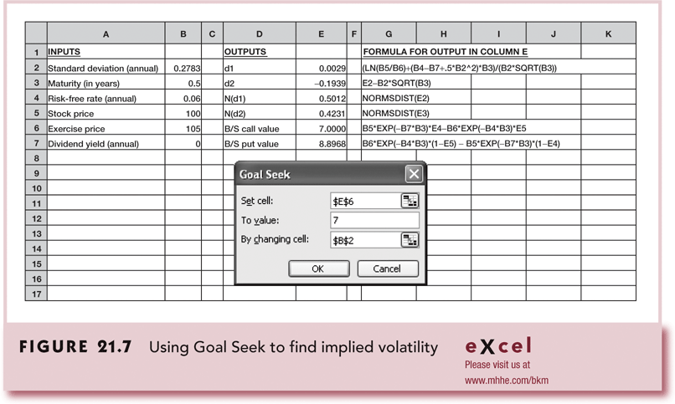
Using Goal Seek to Find Implied Volatility

Slide 29
Calculation of Implied Volatility
Go to http://highered.mheducation.com/sites/0077861671/student_view0/chapter21/excel_templates.html
Select Spreadsheets (29.0K)
Select Data, What-if-Analysis, Goal Seek
Set cell and To value: Option price (i.e., E6 = 9)
By changing cell: standard deviation (B2)
You want to find out implied volatility (B2) for a given option value (E6)!

Slide 30
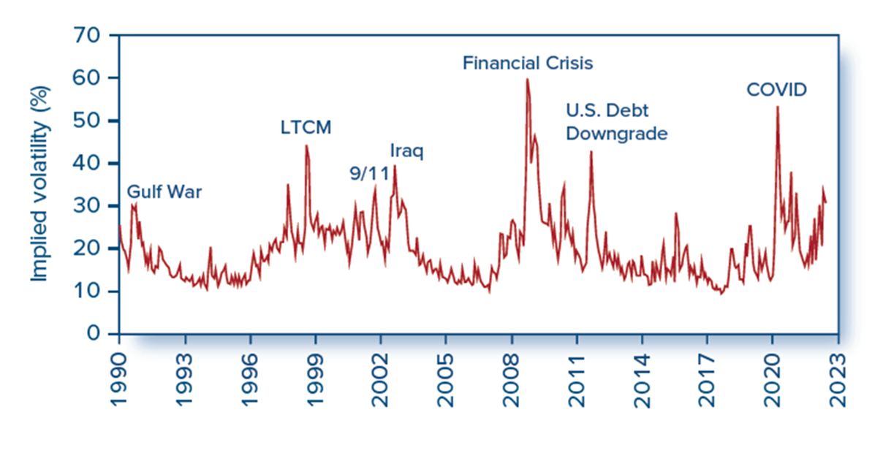
Figure 21.8 Implied Volatility of the S&P 500 (VIX Index)
Figure 21.8 Implied volatility of the S&P 500 (V I X index).
Source: Chicago Board Options Exchange, www.cboe.com.
Access the text alternative for slide images.

Slide 31
Black-Scholes Model with Dividends
The Black Scholes call option formula applies to stocks that do not pay dividends.
What if dividends ARE paid?
One approach is to replace the stock price with a dividend adjusted stock price
Replace S₀ with S₀ - PV (Dividends)

Slide 32
Example 21.5 Black-Scholes Put Valuation
P = Xe^{-rT} [1-N(d₂)] - S₀ [1-N(d₁)]
Using Example 21.4 data:
S = 100, r = .10, X = 95, σ = .5, T = .25
We compute:
$95e^{-10x.25}(1-.5714)-$100(1-.6664) = $6.35

Slide 33
Put Option Valuation: Using Put-Call Parity
P = C + PV (X) - S_{o}
= C + Xe^{-rT} - S_{o}
Using the example data
C = 13.70 X = 95 S = 100
r = .10 T = .25
P = 13.70 + 95 e ^{-.10 X .25} - 100
P = 6.35

Slide 34
Using the Black-Scholes Formula
Hedging: Hedge ratio or delta
The number of stocks required to hedge against the price risk of holding one option
Call = N (d₁)
Put = N (d₁) - 1
Option Elasticity
Percentage change in the option’s value given a 1% change in the value of the underlying stock

Slide 35
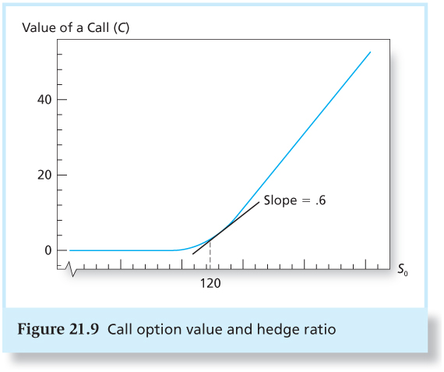
Figure 21.9 Call Option Value and Hedge Ratio

Slide 36
Portfolio Insurance
Buying Puts - results in downside protection with unlimited upside potential
Limitations
Maturity of puts may be too short
Hedge ratios or deltas change as stock values change

Slide 37
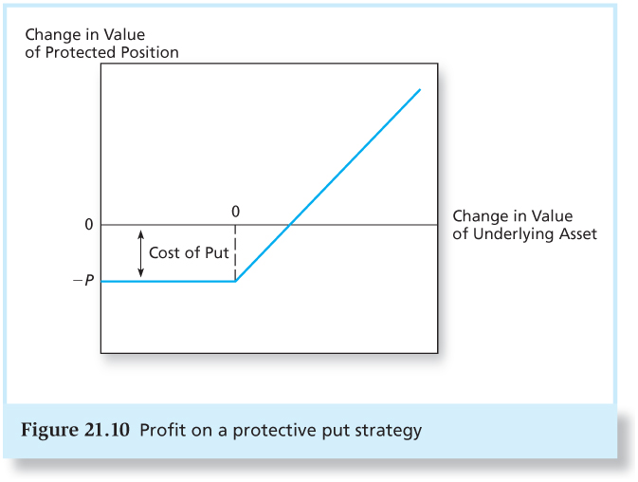
Figure 21.10 Profit on a Protective Put Strategy

Slide 38
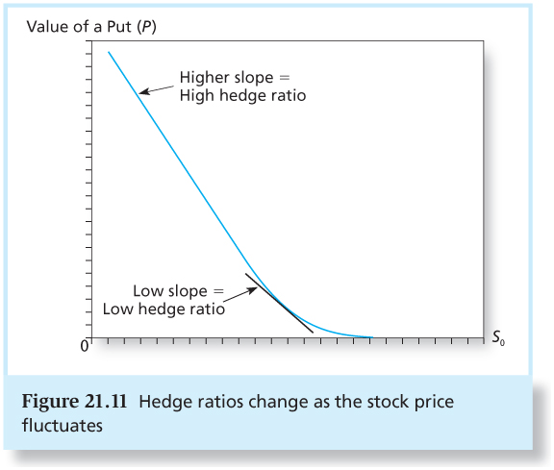
Figure 21.11 Hedge Ratios Change as the Stock Price Fluctuates

Slide 39
Hedging On Mispriced Options
Option value is positively related to volatility.
If an investor believes that the volatility that is implied in an option’s price is too low, a profitable trade is possible.
Profit must be hedged against changes in the value of the stock.
Performance depends on option price relative to the implied volatility.

Slide 40
Story goes like this
You think that IBM put option is underpriced (because you believe its implied volatility is smaller than its true volatility).
Hence, you buy IBM put option because you believe its price will go up.
However, you realize that if IBM stock price goes up, you’ll lose from your put investment, because put option value decreases with stock price.
You could hedge your put investment against this adverse situation (stock price going up), if you also buy IBM stock.
If stock price goes up, the decrease in put price will be offset by the increases in stock price.
If stock price goes down, the increase in put price will be offset by the decrease in stock price.
You just wait for correction of mispricing in put option.
Question: how many shares of IBM stock do you need to buy to hedge your put investment?

Slide 41
Hedging and Delta
The appropriate hedge will depend on the delta.
Delta (hedge ratio) is the change in the value of the option relative to the change in the value of the stock, or the slope of the option pricing curve.
Change in the value of the option
Change of the value of the stock
Delta =

Slide 42
Example 21.8 Speculating on Mispriced Options
Implied volatility = 33%
Investor’s estimate of true volatility = 35%
Option maturity = 60 days
Put price P = $4.495
Exercise price and stock price = $90
Risk-free rate = 4%
Delta = 1- N(d₁) = -.453

Slide 43
Calculation of Hedge Ratio (Delta)
S_{o} = 90, X = 90, r = 0.04, T = 60/365, σ = 0.35 (35% per year)
N(d₁) = N(0.1169) = 0.547
Put Delta (Hedge Ratio) = N(d₁) – 1 = 0.547 – 1 = -0.453

Slide 44
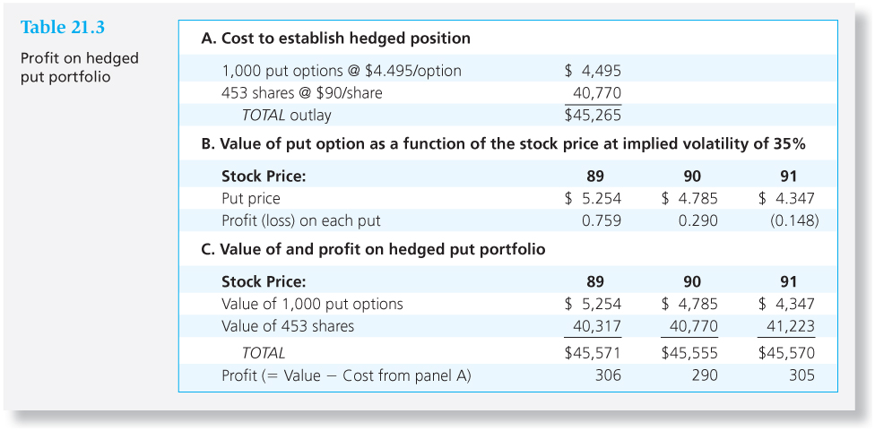
Table 21.3 Profit on a Hedged Put Portfolio

Slide 45
Example 21.8 Conclusions
As the stock price changes, so do the deltas used to calculate the hedge ratio.
Gamma = sensitivity of the delta to the stock price.
Gamma is similar to bond convexity.
The hedge ratio will change with market conditions.
Rebalancing is necessary.

Slide 46
Delta Neutral
When you establish a position in stocks and options that is hedged with respect to fluctuations in the price of the underlying asset, your portfolio is said to be delta neutral.
The portfolio does not change value when the stock price fluctuates.

Slide 47
Another example
Consider two call options with different exercise prices for the same stock (IBM). S₀ = $90, r = 0.04, T = 45/365
Option A’s (X = $90) implied volatility is 27% and Option B’s (X = $95) implied volatility is 33%.
Hence, Option A is relatively undervalued than Option B.
Therefore, you’ll buy Option A and write Option B.
Question: How many Option A you’ll buy and how many Option B you’ll write to hedge your investment? It depends on hedge ratio:
Hedge ratio = Hedge ratio of Option A/Hedge ratio of Option B = 0.5396/0.3395 = 1.589; Hence, you buy 1,000 Option A and write 1,589 Option B. See the next slide.

Slide 48
Calculation of Hedge Ratio
Option A
N(d₁) = 0.5396
Option B
N(d₁) = 0.3395

Slide 49
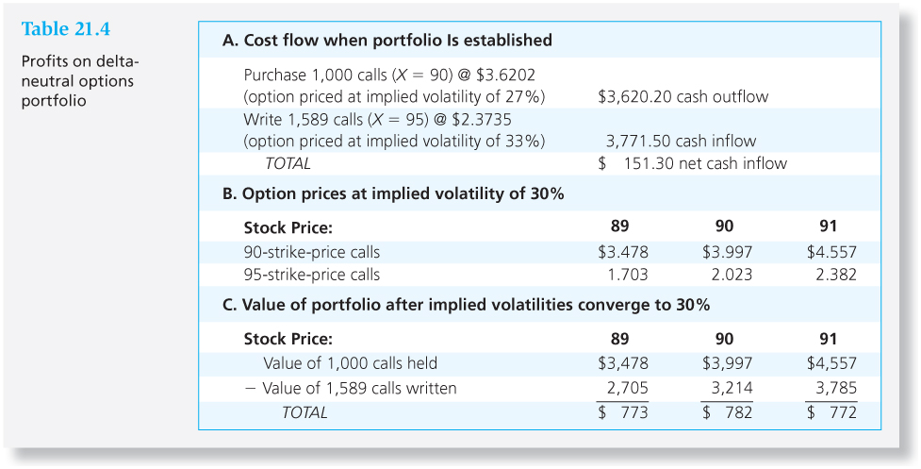
Table 21.4 Profits on Delta-Neutral Options Portfolio

Slide 50
Empirical Evidence on Option Pricing
B-S model generates values fairly close to actual prices of traded options.
Biggest concern is volatility
The implied volatility of all options on a given stock with the same expiration date should be equal.
Empirical test show that implied volatility actually falls as exercise price increases.
This may be due to fears of a market crash.

Slide 51
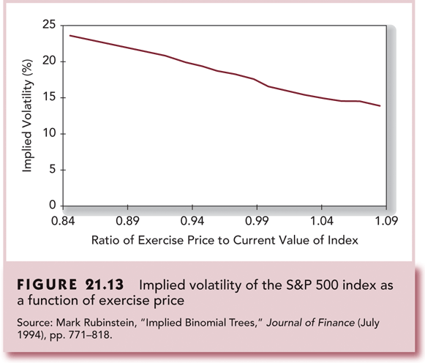
Figure 21.13 Implied Volatility of the S&P 500 Index as a Function of Exercise Price

