Slide 1
Chapter Twenty
Options Markets: Introduction

Slide 2
Options
Derivatives are securities that get their value from the price of other securities.
Can be powerful tools for hedging and speculation.
Options are traded both on organized exchanges and OTC.

Slide 3
The Option Contract: Calls
A call option gives its holder the right to buy an asset:
At the exercise or strike price
On or before the expiration date
Exercise the option to buy the underlying asset if market value > strike price.

Slide 4
The Option Contract: Puts
A put option gives its holder the right to sell an asset:
At the exercise or strike price
On or before the expiration date
Exercise the option to sell the underlying asset if market value < strike price.

Slide 5
The Option Contract
The purchase price of the option is called the premium.
Sellers (writers) of options receive premium income.
If holder exercises the option, the option writer must make (call) or take (put) delivery of the underlying asset.
https://en.wikipedia.org/wiki/Option_symbol
http://finance.yahoo.com/quote/AAPL/options?p=AAPL&date=1492732800

Slide 6
Example 20.1a Profit and Loss on a Call
A January 2010 call on IBM with an exercise price of $130 was selling on December 2, 2009, for $2.18.
The option expires on the third Friday of the month, or January 15, 2010.
If IBM remains below $130, the call will expire worthless.

Slide 7
Example 20.1b Profit and Loss on a Call
A January 2015 call on ABC with an exercise price of $195 was selling on December 2, 2014, for $3.65.
Suppose ABC sells for $197 on the expiration date.
Option value = stock price-exercise price
$197- $195= $2
Profit = Final value – Original investment
$2.00 - $3.65 = -$1.65
Option will be exercised to offset loss of premium.
Call will not be strictly profitable unless ABC’s price exceeds $198.65 (strike + premium) by expiration.

Slide 8
Example 20.2 Profit and Loss on a Put
Consider a February 2013 put on IBM with an exercise price of $195, selling on January 18, for $5.00.
Option holder can sell a share of IBM for $195 at any time until February 15.
If IBM goes above $195, the put is worthless.

Slide 9
Example 20.2 Profit and Loss on a Put
Suppose IBM’s price at expiration is $188.
Value at expiration = exercise price – stock price:
$195 - $188 = $7
Investor’s profit:
$7.00 - $5.00 = $2.00
Holding period return = 40% over 28 days!

Slide 10
Market and Exercise Price Relationships
In the Money - exercise of the option produces a positive cash flow
Call: exercise price < asset price
Put: exercise price > asset price
Out of the Money - exercise of the option would not be profitable
Call: asset price < exercise price.
Put: asset price > exercise price.
At the Money - exercise price and asset price are equal

Slide 11
American vs. European Options
American - the option can be exercised at any time before expiration or maturity
European - the option can only be exercised on the expiration or maturity date
In the U.S., most options are American style, except for currency and stock index options.

Slide 12
Different Types of Options
Stock Options
Index Options
Futures Options
Foreign Currency Options
Interest Rate Options

Slide 13
Payoffs and Profits at Expiration - Calls
Notation
Stock Price = S_{T} Exercise Price = X
Payoff to Call Holder
(S_{T} - X) if S_{T} >X
0 if S_{T} < X
Profit to Call Holder
Payoff - Purchase Price

Slide 14
Payoffs and Profits at Expiration - Calls
Payoff to Call Writer
- (S_{T} - X) if S_{T} >X
0 if S_{T} < X
Profit to Call Writer
Payoff + Premium

Slide 15
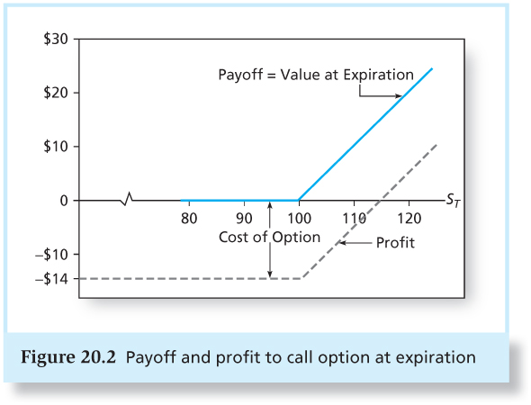
Figure 20.2 Payoff and Profit to Call Option at Expiration

Slide 16
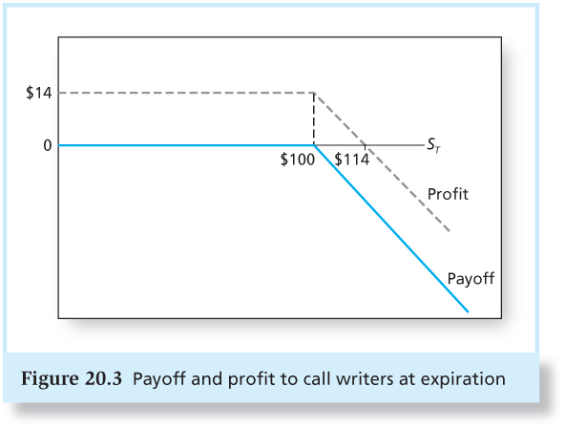
Figure 20.3 Payoff and Profit to Call Writers at Expiration

Slide 17
Payoffs and Profits at Expiration - Puts
Payoffs to Put Holder
0 if S_{T} > X
(X - S_{T}) if S_{T} < X
Profit to Put Holder
Payoff - Premium

Slide 18
Payoffs and Profits at Expiration – Puts
Payoffs to Put Writer
0 if S_{T} > X
-(X - S_{T}) if S_{T} < X
Profits to Put Writer
Payoff + Premium

Slide 19
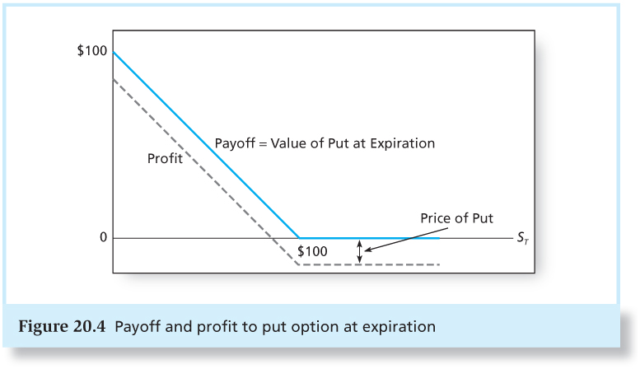
Figure 20.4 Payoff and Profit to Put Option at Expiration

Slide 20
Option versus Stock Investments
Could a call option strategy be preferable to a direct stock purchase?
Suppose you think a stock, currently selling for $100, will appreciate.
A 6-month call costs $10 (contract size is 100 shares).
You have $10,000 to invest.

Slide 21
Option versus Stock Investments
Strategy A: Invest entirely in stock. Buy 100 shares, each selling for $100.
Strategy B: Invest entirely in at-the-money call options. Buy 1,000 calls, each selling for $10. (This would require 10 contracts, each for 100 shares.)
Strategy C: Purchase 100 call options for $1,000. Invest your remaining $9,000 in 6-month T-bills, to earn 3% interest. The bills will be worth $9,270 at expiration.

Slide 22
Option versus Stock Investment
Investment Strategy Investment
Equity only Buy stock @ 100 100 shares $10,000
Options only Buy calls @ 10 1000 options $10,000
Calls plus Buy calls @ 10 100 options $1,000
Bills Buy T-bills @ 3% $9,000
Yield

Slide 23
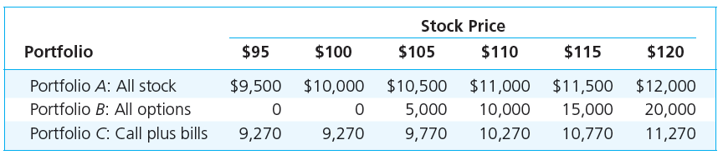
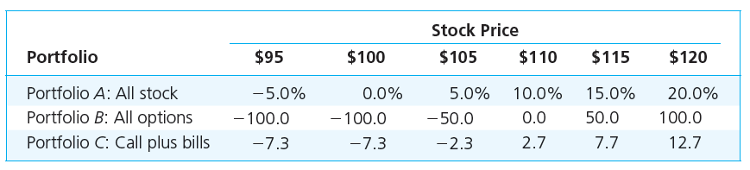
Strategy Payoffs

Slide 24
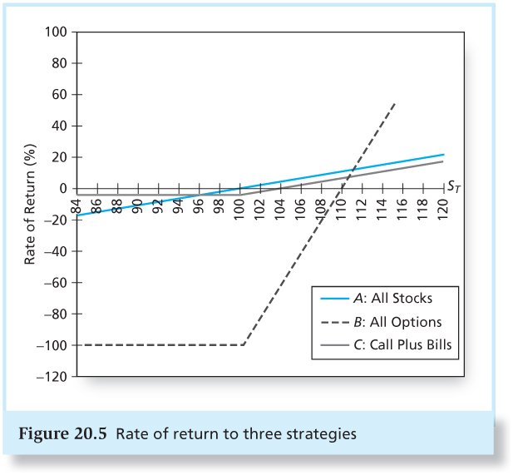
Figure 20.5 Rate of Return to Three Strategies

Slide 25
Strategy Conclusions
Figure 20.5 shows that the all-option portfolio, B, responds more than proportionately to changes in stock value; it is levered.
Portfolio C, T-bills plus calls, shows the insurance value of options.
C ‘s T-bill position cannot be worth less than $9270.
Some return potential is sacrificed to limit downside risk.

Slide 26
Protective Put
Purchase stock and put simultaneously

Slide 27
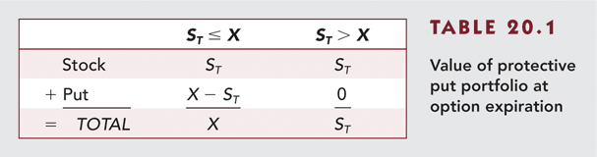
Table 20.1 Value of Protective Put Portfolio at Option Expiration

Slide 28
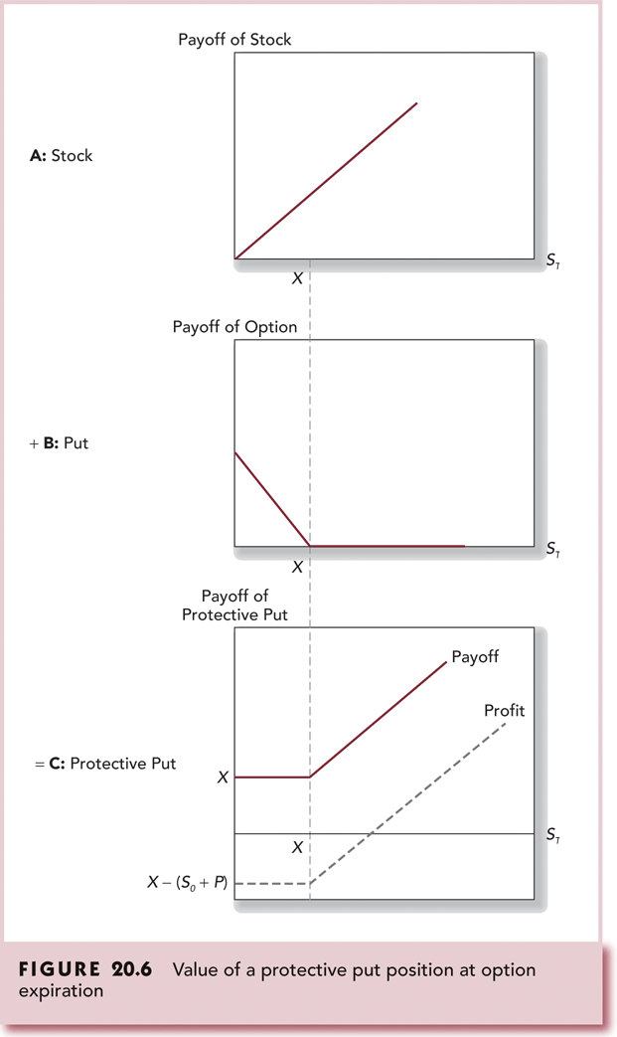
Figure 20.6 Value of a Protective Put Position at Option Expiration

Slide 29
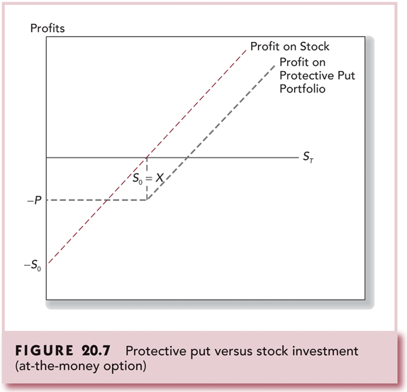
Figure 20.7 Protective Put versus Stock Investment (at-the-money option)

Slide 30
Protective Put Conclusions
Puts can be used as insurance against stock price declines.
Protective puts lock in a minimum portfolio value.
The cost of the insurance is the put premium.
Options can be used for risk management, not just for speculation.

Slide 31
Covered Calls
Purchase stock and write calls against it.
Call writer gives up any stock value above X in return for the initial premium.
If you planned to sell the stock when the price rises above X anyway, the call imposes “sell discipline.”

Slide 32
Sell Discipline
If your plan is to sell the stock once it hits a certain price (say, price X), then selling a call option with a strike price at or near X effectively forces you to sell if the price reaches that level, because the option may be exercised.
This acts as a “discipline” mechanism—you’re less likely to get greedy or second-guess your original plan, because the terms of the option contract will automatically result in a sale if the price goes above X.

Slide 33
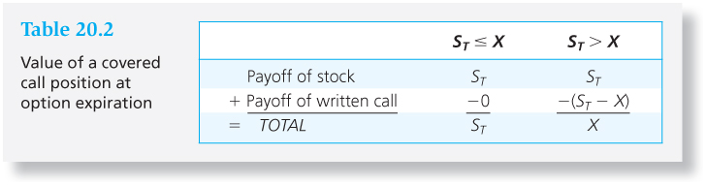
Table 20.2 Value of a Covered Call Position at Expiration

Slide 34
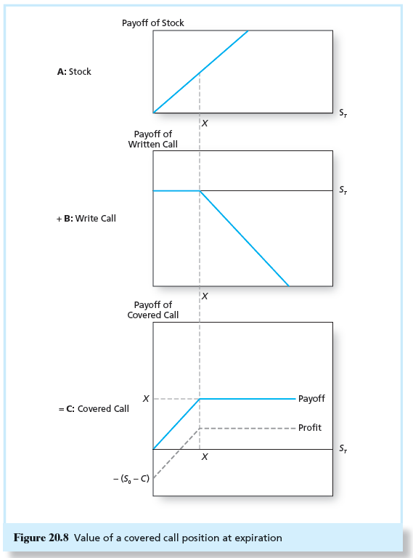
Figure 20.8 Value of a Covered Call Position at Expiration

Slide 35
Option Strategies
Straddle (Same Exercise Price)
Long Call and Long Put
Spreads - A combination of two or more call options or put options on the same asset with differing exercise prices or times to expiration.
Vertical or money spread:
Same maturity
Different exercise price
Horizontal or time spread:
Different maturity dates

Slide 36
Straddle
Long straddle: Buy call and put with same exercise price and maturity.
The straddle is a bet on volatility.
To make a profit, the change in stock price must exceed the cost of both options.
You need a strong change in stock price in either direction.
The writer of a straddle is betting the stock price will not change much.

Slide 37
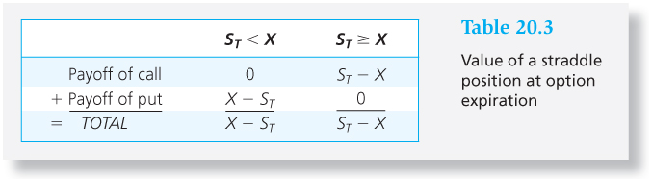
Table 20.3 Value of a Straddle Position at Option Expiration

Slide 38
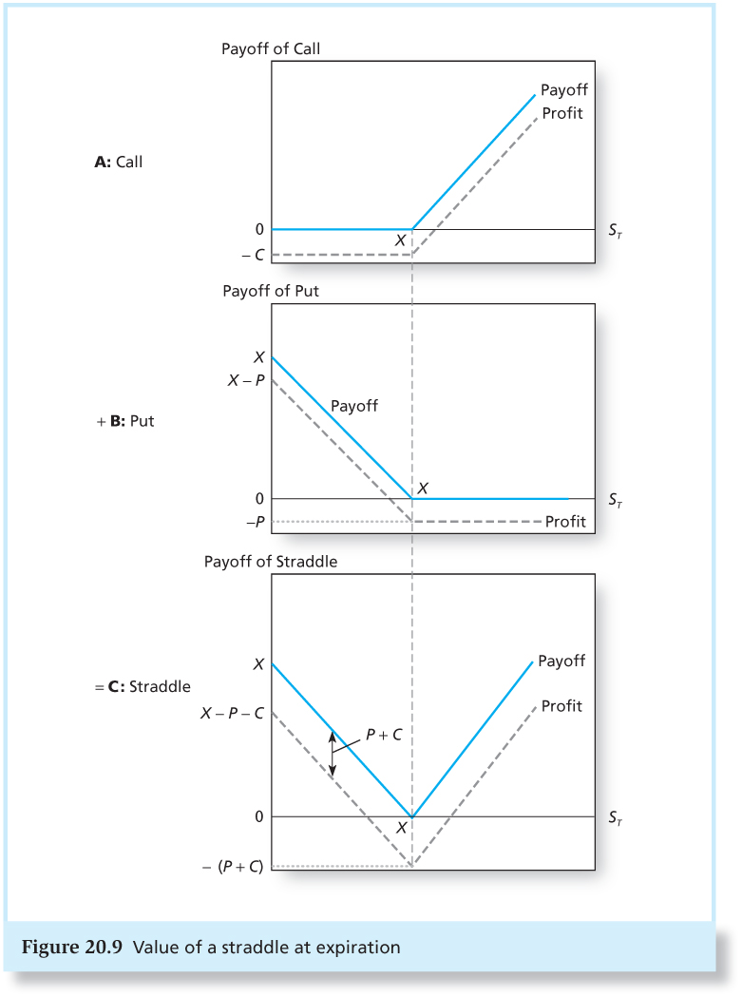
Figure 20.9 Value of a Straddle at Expiration

Slide 39
Spreads
A spread is a combination of two or more calls (or two or more puts) on the same stock with differing exercise prices or times to maturity.
Some options are bought, whereas others are sold, or written.
A bullish spread is a way to profit from stock price increases.

Slide 40
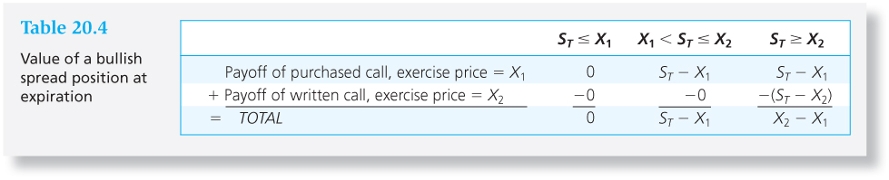
Table 20.4 Value of a Bullish Spread Position at Expiration

Slide 41
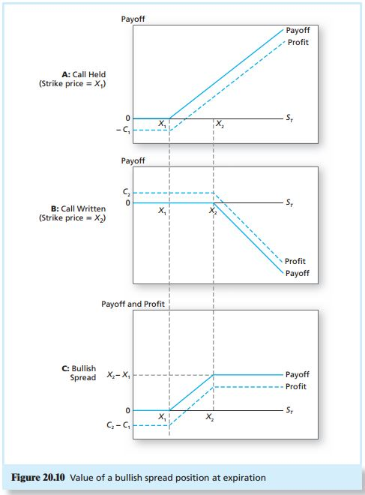
Figure 20.10 Value of a Bullish Spread Position at Expiration

Slide 42
Put Call Parity Derivation
Buy one call and write one put
Payoff S_{T} < X S_{T} > X
Call owned 0 S_{T} – X
Put written -(X – S_{T}) 0
Total payoff S_{T} – X S_{T} – X
Since the payoff on (call + put) options is equal to leveraged equity, their prices must be equal:
C – P = S₀ – X/(1 + r_{f})^{T}

Slide 43
Put Call Parity
If the prices are not equal arbitrage will be possible
or
C – P = S₀ – X/(1 + r_{f})^{T}

Slide 44
Put Call Parity - Disequilibrium Example
Stock Price = 110 Call Price = 17
Put Price = 5 Risk Free = 5%
Maturity = 1 yr X = 105
C – P = S₀ – X/(1 + r_{f})^{T}
17 – 5 > 110 – 105/(1 + 0.05)
Since the leveraged equity is less expensive, acquire the low cost alternative and sell the high cost alternative

Slide 45
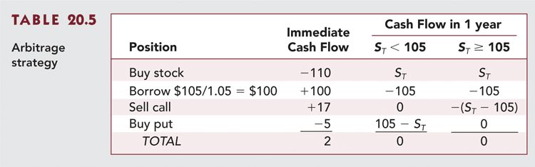
Table 20.5 Arbitrage Strategy

Slide 46
Optionlike Securities
Callable Bonds
Convertible Securities
Warrants
Collateralized Loans

Slide 47
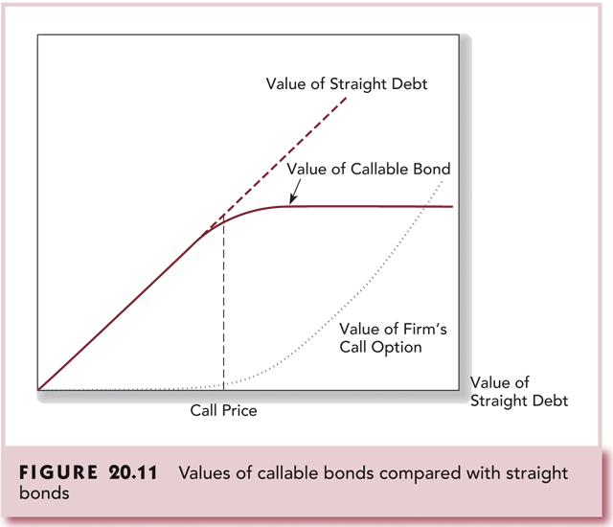
Figure 20.11 Values of Callable Bonds Compared with Straight Bonds

Slide 48
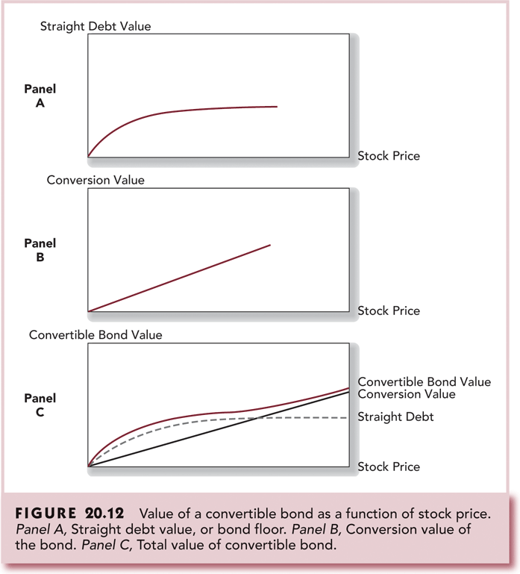
Figure 20.12 Value of a Convertible Bond as a Function of Stock Price

Slide 49
In convertible bonds, the conversion value represents the value of the bond
if it were converted into common stock at the current market price of the stock.
Conversion Value = Conversion Ratio x Current Stock Price
where Conversion Ratio is the number of shares the bondholder can receive
upon conversion = Par Value of Bond / Conversion Price
Example
Par value = $1,000
Conversion price = $50
Current stock price = $60
Then:
Conversion ratio = 1,000 / 50 = 20 shares
Conversion value = 20 × 60 = 1,200
So, the bond is worth $1,200 if converted into stock, above its par value, making conversion attractive.

Slide 50
Exotic Options
Asian Options C = Max[mean S – X, 0]
Look-back Options C = Max [S_{max} – X, 0]
Digital Options C = $100 if S_{T} > X
0 if S_{T} < X

Slide 51
Barrier Options
Down-and-Out Barrier Options
C = Max[S_{T} – X, 0] if S_{t} > B
0 if S_{t} < B
Down-and-In Barrier Options
C = Max[S_{T} – X, 0] if S_{t} < B
0 if S_{t} > B

