Slide 1
Chapter Sixteen
Managing Bond Portfolios

Slide 2
Chapter Overview
Interest rate risk
Interest rate sensitivity of bond prices
Duration and its determinants
Convexity
Passive and active management strategies

Slide 3
Interest Rate Risk
Interest Rate Sensitivity
Bond prices and yields are inversely related
An increase in a bond’s yield to maturity results in a smaller price change than a decrease of equal magnitude (convexity)
Long-term bonds tend to be more price sensitive than short-term bonds: Bond A vs. Bond B in Fig. 16.1.

Slide 4
Interest Rate Risk
Interest Rate Sensitivity
As maturity increases, price sensitivity increases at a decreasing rate
Interest rate risk is inversely related to the bond’s coupon rate: Bond B vs. Bond C in Fig. 16.1.
Price sensitivity is inversely related to the yield to maturity at which the bond is selling (convexity)

Slide 5
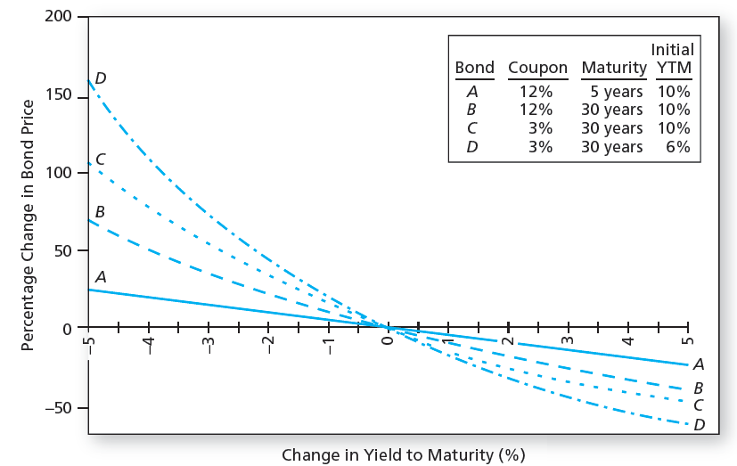
Figure 16.1 Change in Bond Price as a Function of Change in Yield to Maturity

Slide 6
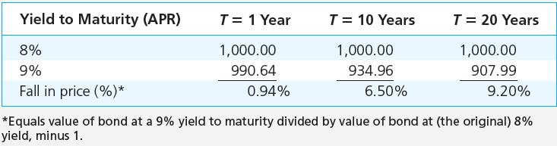
Table 16.1 Prices of 8% Coupon Bond (Coupons Paid Semiannually)

Slide 7
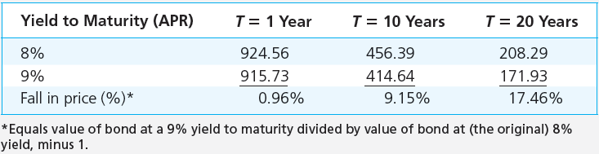
Table 16.2 Prices of Zero-Coupon Bond (Semiannually Compounding)

Slide 8
Interest Rate Risk
Duration
A measure of the effective maturity of a bond
The weighted average of the times until each payment is received, with the weights proportional to the present value of the payment
It is shorter than maturity for all bonds, and is equal to maturity for zero coupon bonds

Slide 9
Bond Duration
CF_{t} = Cash flow at time t (i.e., coupons and
par value)
http://highered.mheducation.com/sites/0077861671/student_view0/chapter16/excel_templates.html
https://dqydj.com/bond-convexity-calculator/

Slide 11
Interest Rate Risk
Duration-Price Relationship
Price change is proportional to duration and not to maturity
D* = Modified duration [D* = D/(1 + y)]

Slide 12
Example 16.1 Duration and Interest Rate Risk
Two bonds have duration of 1.8852 years
One is a 2-year, 8% coupon bond with YTM=10%
http://highered.mheducation.com/sites/0077861671/student_view0/chapter16/excel_templates.html
The other bond is a zero coupon bond with maturity of 1.8852 years
Duration (D) of both bonds is 1.8852 x 2 = 3.7704 semiannual periods
Modified Duration: D* = 3.7704/(1+0.05) = 3.591 periods

Slide 13
Example 16.1 Duration and Interest Rate Risk
Suppose the semiannual interest rate increases by 0.01%. Bond prices fall by
= -3.591 x 0.01%
= -0.03591%
Bonds with equal D have the same interest rate sensitivity

Slide 14
Example 16.1 Duration and Interest Rate Risk
Coupon Bond
Zero
The 2-year, 8% coupon bond with YTM=10% which initially sells at $964.540, falls to $964.1942, when its yield increases to 5.01%
https://dqydj.com/bond-pricing-calculator/
Percentage decline of 0.0359%
(964.1942 – 964.540) / 964.540
= -0.0359
The zero-coupon bond (with D = 3.7704) initially sells for $1,000/1.05^{3.7704} = $831.9704
At the higher yield, it sells for $1,000/1.0501^{3.7704} = $831.6717, therefore its price also falls by 0.0359%

Slide 15
Interest Rate Risk
What Determines Duration?
Rule 1
The duration of a zero-coupon bond equals its time to maturity
Rule 2
Holding maturity constant, a bond’s duration is higher when the coupon rate is lower
Rule 3
Holding the coupon rate constant, a bond’s duration generally increases with its time to maturity

Slide 16
Interest Rate Risk
What Determines Duration?
Rule 4
Holding other factors constant, the duration of a coupon bond is higher when the bond’s yield to maturity is lower
Rules 5
The duration of a level perpetuity is equal to:
(1 + y) / y

Slide 17
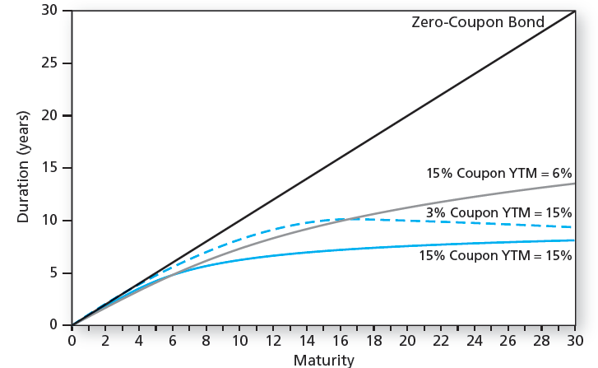
Figure 16.2 Bond Duration versus Bond Maturity

Slide 18
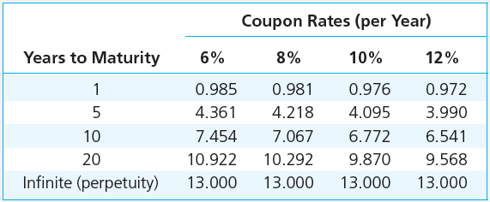
Table 16.3 Bond Durations (Yield to Maturity = 8% APR; Semiannual Coupons)

Slide 19
Convexity
The relationship between bond prices and yields is not linear
Duration rule is a good approximation for only small changes in bond yields
Bonds with greater convexity have more curvature in the price-yield relationship

Slide 20
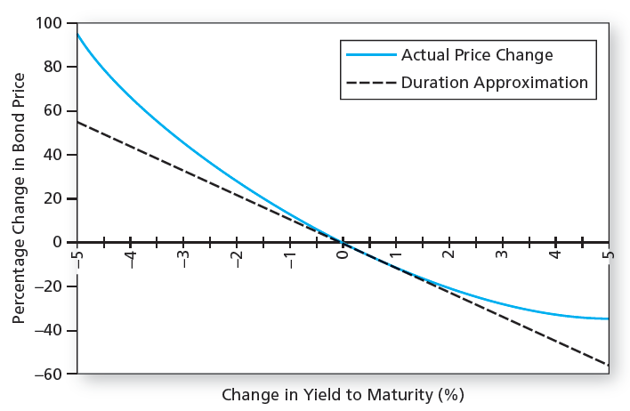
Figure 16.3 Bond Price Convexity: 30-Year Maturity, 8% Coupon; Initial YTM = 8%

Slide 21
Convexity
Correction for Convexity:

Slide 22
Examples
T = 30 years, 8% coupon rate (annual payment), initial YTM = 8%, selling at par $1,000, D* = 11.26, and convexity = 212.4
https://dqydj.com/bond-convexity-calculator/
(1) If YTM increases from 8% to 10%,
(2) If YTM increases from 8% to 8.01%,

Slide 23
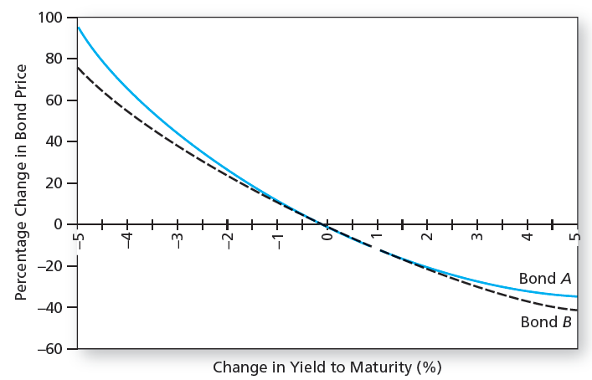
Figure 16.4 Convexity of Two Bonds

Slide 24
Why Do Investors Like Convexity?
Bonds with greater curvature gain more in price when yields fall than they lose when yields rise
The more volatile interest rates, the more attractive this asymmetry
Bonds with greater convexity tend to have higher prices and/or lower yields, all else equal

Slide 25
Duration and Convexity
Callable Bonds
As rates fall, there is a ceiling on the bond’s market price, which cannot rise above the call price
Negative convexity (Bad!)
Use effective duration:

Slide 26
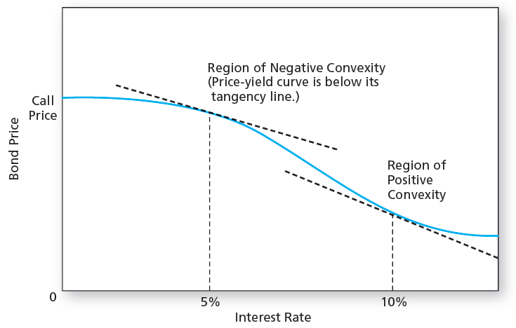
Figure 16.5 Price –Yield Curve for a Callable Bond

Slide 27
Effective Duration Example
Consider a callable bond with a call price of $1,050 selling at $980 today. If yield curve shifts up by 0.5%, the bond price will go down to $930. If it shifts down by 0.5%, the bond price will go up to $1,010.

Slide 28
Modified Duration vs. Effective Duration
Modified Duration
ΔP/P = - D* Δy → D* = (- ΔP/P) / Δy
Effective Duration
Effective Duration = (- ΔP/P) / Δr

Slide 29
Passive Management
Two passive bond portfolio strategies:
Indexing
Immunization
Both strategies see market prices as being correct, but the strategies are very different in terms of risk

Slide 30
Passive Management
Bond Index Funds
Bond indexes contain thousands of issues, many of which are infrequently traded
Bond indexes turn over more than stock indexes as the bonds mature
Therefore, bond index funds hold only a representative sample of the bonds in the actual index

Slide 31
Passive Management
Immunization
A way to control interest rate risk that is widely used by pension funds, insurance companies, and banks
In a portfolio, the interest rate exposure of assets and liabilities are matched
Match the duration of the assets and liabilities
Price risk and reinvestment rate risk exactly cancel out
As a result, value of assets will track the value of liabilities whether rates rise or fall

Slide 32
Immunization Example
Obligation/Liability: GIC (Guaranteed Investment Contract) $10,000 with r = 8% annual interest rate and T = 5 years
$10,000 (1.08)⁵ = $14,693.28 (liability/obligation)
To meet this obligation/liability, suppose you invest $10,000 in 8% coupon bond selling at par with maturity of 6 years.
(Confirm that this bond has D = 5 years!)

Slide 33
Cash flows from the 6-year maturity bond 0
Reinvestment of coupon payment ($800) at the end of year 1 for four years
Reinvestment of coupon payment ($800) at the end of year 2 for three years
Reinvestment of coupon payment ($800) at the end of year 3 for two years
Reinvestment of coupon payment ($800) at the end of year 4 for one year
At the end of year 5, coupon payment ($800) and sale of bond at $10,800 / (1 + r)

Slide 34
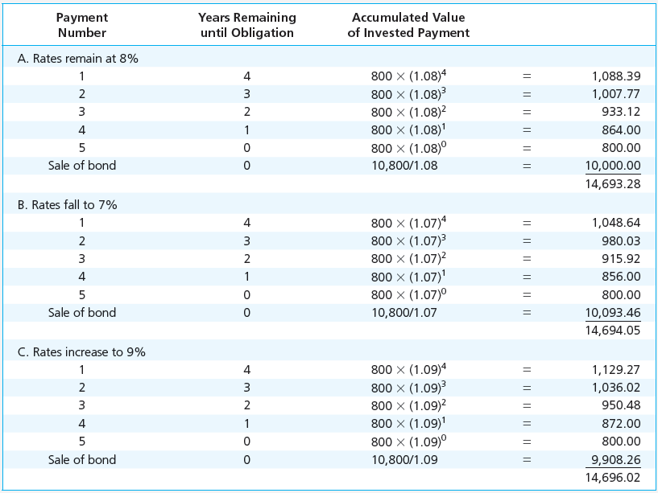
Table 16.4 Terminal value of a Bond Portfolio After 5 Years

Slide 35
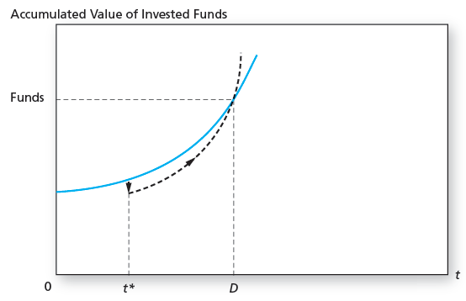
Figure 16.9 Growth of Invested Funds

Slide 36
Figure 16.9 Interpretation
The y-axis represents the accumulated value of invested funds. The x-axis represents time 𝑡.
The blue curve shows the expected or planned growth of the invested funds over time (at a given interest rate).
At time 𝑡∗, the interest rate increases (e.g., from 8% to 9%), thus the bond price decreases. The dashed black curve shows a temporary dip or shortfall compared to the expected growth path.
However, investors can reinvest coupons at the higher interest rate from this time.
At time D, the total accumulated value is the same as the total accumulated value with the original interest rate (8%).

Slide 37
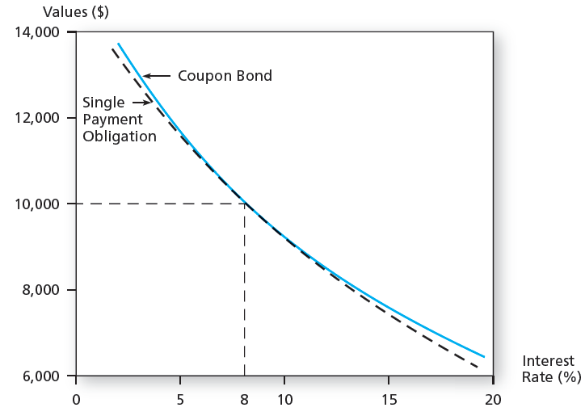
Figure 16.10 Immunization

Slide 38
Construction of an Immunized Portfolio
Obligation/Liability: A payment of $19,487 in 7 years. Market interest is 10%. Hence the present value is $10,000 (= $19,487/1.10⁷).
To meet this obligation/liability, suppose you want to fund this obligation using a 3-year zero-coupon bond and a perpetuity paying annual coupons.
Then you need to find a mix of zero-coupon bond and perpetuity that has the same duration as the obligation.
Duration of the liability is 7 years. Duration of the zero-coupon bond is 3 years. Duration of the perpetuity is (1 + y)/y = 1.10/0.10 = 11 years.
Solving 7 = w*3 + (1 – w)*11, we find w = 0.5.
Hence, invest $5,000 in the zero-coupon bond and $5,000 in the perpetuity!
(Par value of the zero coupon bond is $5,000*1.10³ = $6,655).

Slide 39
Rebalancing
Suppose that 1 year has passed and the interest rate remains at 10%.
Obligation/Liability: A payment of $19,487 in 6 years. Market interest is 10%. Hence the present value is $11,000 (= $19,487/1.10⁶).
To meet this obligation/liability, you need to rebalance the mix of zero-coupon bond and perpetuity so that its duration is 6. Note that the price of the zero-coupon bond is now $5,500 (= 6,655/1.10²)
Duration of the zero-coupon bond is now 2 years. Duration of the perpetuity is (1 + y)/y = 1.10/0.10 = 11 years.
Solving 6 = w*2 + (1 – w)*11, we find w = 5/9.
New positons: $11,000*5/9 = $6,111.11 in the zero-coupon bond and $4,888.89 in the perpetuity!
How to do it?
$6,111.11 = $5,500 (price of the zero coupon bond) + $500 (coupon from perpetuity) + $111.11 (selling part of the perpetuity) TRADING COSTS! COMPROMISE

