Slide 1
Chapter Fifteen
The Term Structure of Interest Rates

Slide 2
Chapter Overview
The yield curve
Interest rates under certainty
Interest rates under uncertainty
Theories of the term structure
The expectation hypothesis
Liquidity preference
Interpreting the term structure

Slide 3
The Yield Curve
The yield curve is a graph that displays the relationship between YTM and time to maturity
https://www.gurufocus.com/yield_curve.php
Information on expected future short-term rates can be implied from the yield curve

Slide 4
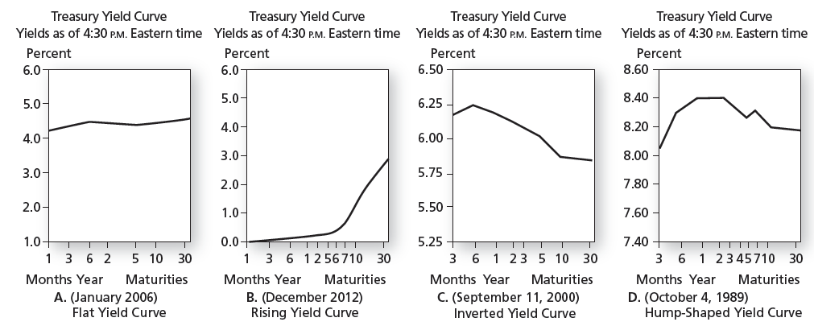
Figure 15.1 Treasury Yield Curves

Slide 5
Yield Curve: Bond Pricing
Yields on different maturity bonds are not all equal
We need to consider each bond cash flow as a stand-alone zero-coupon bond
The value of the bond should be the sum of the values of its parts

Slide 6
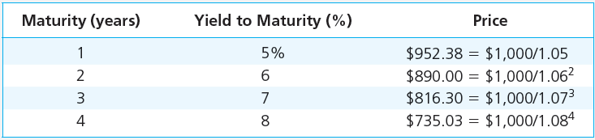
Table 15.1 Prices and Yields to Maturities on Zero-Coupon Bonds ($1,000 Face Value)

Slide 7
Example 15.1 Valuing Coupon Bonds
Value a 3 year, 10% coupon bond using discount rates from Table 15.1:
Price = $1082.17 and YTM = 6.88%
6.88% is less than the 3-year rate of 7%

Slide 8
Using Spot Rates to Price Coupon Bonds
A coupon bond can be viewed as a series of zero coupon bonds.
To find the value each payment is discount at the zero coupon rate.
Once the bond value is found, one can solve for the yield.
It’s the reason that similar maturity and default risk bonds sell at different yields to maturity.

Slide 9
Sample Bonds
A B
Maturity 4 years 4 years
Coupon Rate 6% 8%
Par Value 1,000 1,000
Cash Flow in 1-3 60 80
Cash Flow in 4 1,060 1,080
Assuming Annual compounding

Slide 10
Price Using Spot Rates Bond A
Period | Spot Rate | Cash Flow | PV of Flow
1 | .05 | 60 | 57.14
2 | .0575 | 60 | 53.65
3 | .063 | 60 | 49.95
4 | .067 | 1,060 | 817.80
Total |  |  | 978.54

Slide 11
Price Using Spot Rates Bond B
Period | Spot Rate | Cash Flow | PV of Flow
1 | .05 | 80 | 76.19
2 | .0575 | 80 | 71.54
3 | .063 | 80 | 66.60
4 | .067 | 1,080 | 833.23
Total |  |  | 1,047.56

Slide 12
Solving For Yield to Maturity
Bond A
Bond Price 978.54
YTM 6.63%
Bond B
Price 1,047.56
YTM 6.61%
https://dqydj.com/bond-yield-to-maturity-calculator/

Slide 13
Bond Pricing: Two Types of Yield Curves
Pure Yield Curve
On-the-Run Yield Curve
Uses stripped or zero coupon Treasuries
May differ significantly from the on-the-run yield curve
Uses recently-issued coupon bonds selling at or near par
The one typically published by the financial press

Slide 14
The Yield Curve and Future Interest Rates
Yield Curve Under Certainty
Suppose you want to invest for 2 years
Buy and hold a 2-year zero
or
Rollover a series of 1-year bonds
Equilibrium requires that both strategies provide the same return

Slide 15
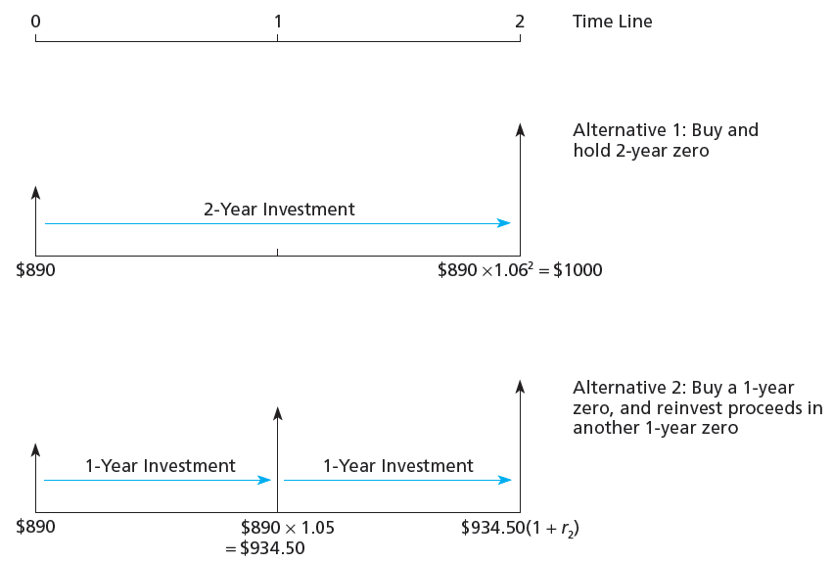
Figure 15.2 Two 2-Year Investment Programs

Slide 16
The Yield Curve and Future Interest Rates
Yield Curve Under Certainty
Buy and hold vs. rollover:
Next year’s 1-year rate (r₂) is just enough to make rolling over a series of 1-year bonds equal to investing in the 2-year bond:
(1 + r₂) = (1 + y₂)²/(1 + r₁) = (1.06)²/(1.05) = 1.0701
Thus, r₂ = 0.0701 = 7.01%

Slide 17
The Yield Curve and Future Interest Rates
Yield Curve Under Certainty
Spot rate
The rate that prevails today for a given maturity
Short rate
The rate for a given maturity (e.g. one year) at different points in time
A spot rate is the geometric average of its component short rates

Slide 18
The Yield Curve and Future Interest Rates
Short Rates and Yield Curve Slope
When next year’s short rate, r₂ , is greater than this year’s short rate, r₁, the yield curve slopes up
May indicate rates are expected to rise
When next year’s short rate, r₂ , is less than this year’s short rate, r₁, the yield curve slopes down
May indicate rates are expected to fall

Slide 19
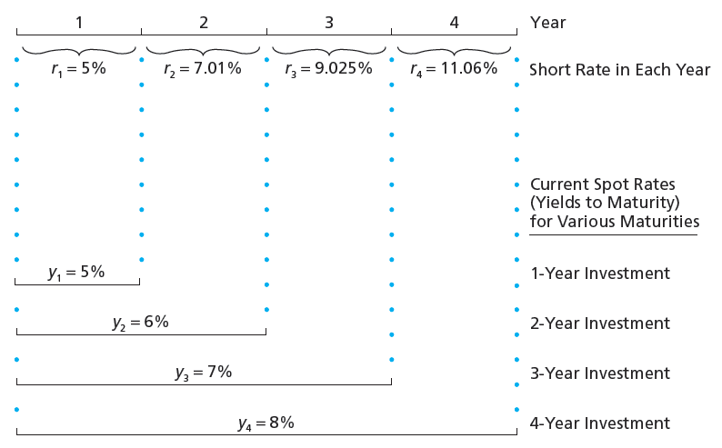
Figure 15.3 Short Rates versus Spot Rates

Slide 20
The Yield Curve and Future Interest Rates
Forward rates
f_{n} = One-year forward rate for period n
y_{n} = Yield for a security with a maturity of n

Slide 21
Example 15.4 Forward Rates
The forward interest rate is a forecast of a future short rate.
Rate for 4-year maturity = 8%, rate for 3-year maturity = 7%.

Slide 22
Interest Rate Uncertainty and Forward Rates
Suppose that today’s rate is 5% and the expected short rate for the following year is E(r₂) = 6%. The value of a 2-year zero is:
The value of a 1-year zero is:

Slide 23
Interest Rate Uncertainty and Forward Rates
The investor wants to invest for 1 year
Buy the 1-year bond today and hold to maturity (will get 5% risk-free return) or
Buy the 2-year bond today and plan to sell it at the end of the first year for $1000/1.06 =$943.40
943.40/898.47 – 1 = 0.05 = 5%
What if next year’s interest rate is more (or less) than 6%?
The actual return using the 2-year bond is uncertain!

Slide 24
Interest Rate Uncertainty and Forward Rates
Investors require a risk premium to hold a longer-term bond
This liquidity premium compensates short-term investors for the uncertainty about future prices

Slide 25
Theories of Term Structure
The Expectations Hypothesis Theory
Observed long-term rate is a function of today’s short-term rate and expected future short-term rates
f_{n} = E(r_{n}) and liquidity premiums are zero

Slide 26
Theories of Term Structure
Liquidity Preference Theory
Long-term bonds are more risky; therefore, f_{n} generally exceeds E(r_{n})
The excess of f_{n} over E(r_{n}) is the liquidity premium
f_{n} = E(r_{n}) + liquidity premium
The yield curve has an upward bias built into the long-term rates because of the liquidity premium

Slide 27
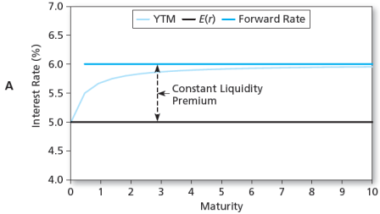
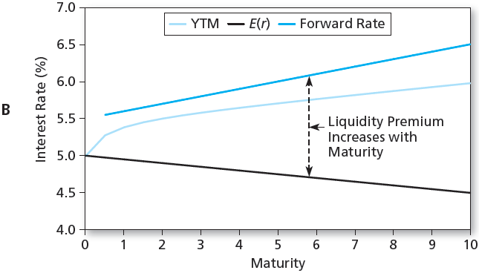
Figure 15.4A-B Yield Curves

Slide 28
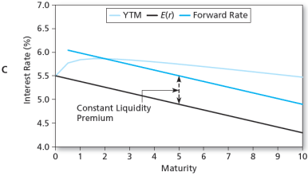
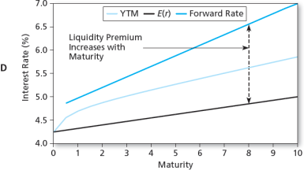
Figure 15.4C-D Yield Curves

Slide 29
Interpreting the Term Structure
The yield curve reflects expectations of future interest rates
The forecasts of future rates are clouded by other factors, such as liquidity premiums
An upward sloping curve could indicate:
Rates are expected to rise
and/or
Investors require large liquidity premiums to hold long term bonds

Slide 30
Interpreting the Term Structure
The yield curve is a good predictor of the business cycle
Long term rates tend to rise in anticipation of economic expansion
Inverted yield curve may indicate that interest rates are expected to fall and signal a recession

Slide 31
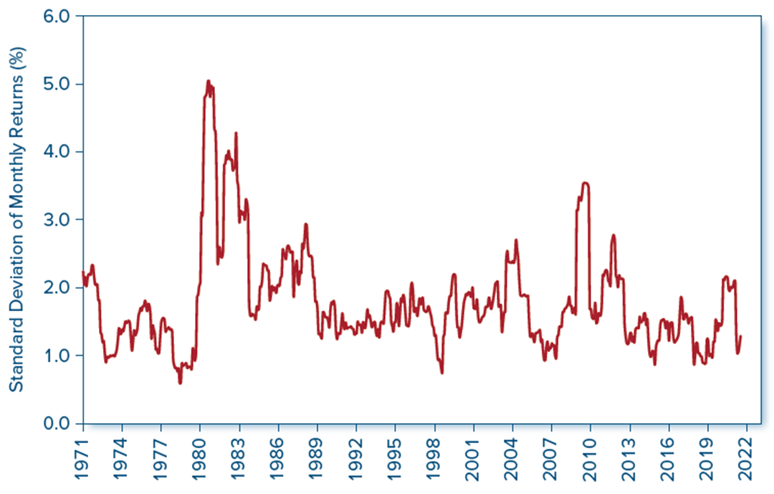
Figure 15.5 Price Volatility of Long-Term Treasury Bonds
Access the text alternative for slide images.

Slide 32
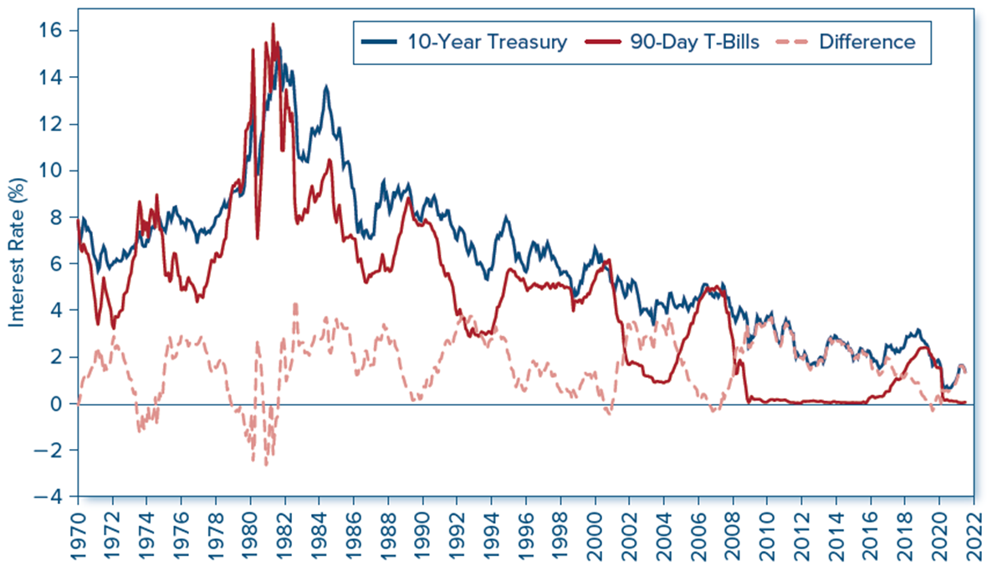
Figure 15.6 Term Spread: Yields on 10-year Versus 90-day Treasury Securities
Access the text alternative for slide images.

