Slide 1
Chapter Fourteen
Bond Prices and Yields

Slide 2
Chapter Overview
Debt (Fixed-Income) securities characteristics
Types of bonds
Bond pricing
Prices and yield
Prices over time
Impact of default and credit risk on bond pricing
Credit default swaps

Slide 3
Bond Characteristics
Bonds are debt obligations of issuers (borrowers) to bondholders (creditors)
Face or par value is the principal repaid at maturity, typically $1000
The coupon rate determines the interest payment (“coupon payments”) paid semiannually
The indenture is the contract between the issuer and the bondholder that specifies the coupon rate, maturity date, and par value

Slide 4
U.S. Treasury Bonds
Bonds and notes may be purchased directly from the Treasury
Note maturity is 1-10 years; Bond maturity is 10-30 years
Denomination can be as small as $100, but $1,000 is more common
Bid price of 100:08 means 100 8/32 [= (100 + 8/32) = 100.25] or $1002.50

Slide 5
Table 14.1 Prices and Yields of U.S. Treasury Bonds, August 15, 2021
U.S. Treasury Quotes
Maturity | Coupon | BID | Ask | Change | Asked Yield (%)
Aug 15 24 | 2.375 | 105.8188 | 105.8313 | 0.030 | 0.417
Aug 15 26 | 1.500 | 103.4563 | 103.4750 | 0.064 | 0.790
Aug 15 30 | 0.625 | 94.6938 | 94.7250 | 0.186 | 1.246
Aug 15 40 | 1.125 | 88.4125 | 88.4750 | 1.002 | 1.847
Nov 15 44 | 3.000 | 120.4500 | 120.5125 | 1.830 | 1.904
Feb 15 47 | 3.000 | 121.9750 | 122.0375 | 1.280 | 1.905
Aug 15 49 | 2.250 | 106.6625 | 106.7250 | 1.948 | 1.938

Slide 6
Corporate Bonds
Callable bonds
Can be repurchased before the maturity date
Convertible bonds
Can be exchanged for shares of the firm’s common stock
Puttable Bonds
Give the holder an option to retire or extend the bond
Floating-rate bonds
Have adjustable coupon rate

Slide 7
Table 14.2 Listing of Corporate Bonds
Issuer Name | Symbol | Coupon | Maturity | Moody’s ®/S&P | High | Low | Last | Change | Yield %
Amazon Com Inc | AMZN5182954 | 0.450% | May 12.24 | /AA | 99.913 | 99.739 | 99.913 | −0.176 | 0.482282
Hormel Foods Corp | HRL5193038 | 0.650% | June 03.24 | /A | 100.193 | 99.622 | 100.122 | −0.061 | 0.491393
General Mtrs Finl Co Inc | GM5198643 | 1.500% | June 10 26 | /BBB | 100.822 | 99.811 | 99.903 | −0.872 | 1.520917
BP Cap Mkts Amer Inc | BP4763976 | 3.790% | Feb 06 24 | A1/ | 107.388 | 107.34 | 107.34 | −0.116 | 0.655786
Glaxo Smithlinke Cap Inc | GSK4632356 | 3.375% | May 15 23 | A2/ | 105.279 | 105.214 | 105.228 | −0.028 | 0.328114
Intel Corp | INTC4969549 | 4.750% | Mar 25 50 | A1/A+ | 134.693 | 134.275 | 134.596 | 0.365 | 2.933182
Figure 4.2 Listing of corporate bonds.
Source: F I NRA (Financial Industry Regulatory Authority), August 24, 2021

Slide 8
Preferred Stock
Considered to be equity, but often included in the fixed-income universe.
Like bonds
Promises to pay a specified cash flow stream.
Commonly pays a fixed dividend.
Rarely gives holders full voting privileges in firm.
Unlike bonds
Failure to pay the promised dividend does not result in corporate bankruptcy.
Dividends owed cumulate.

Slide 9
Bond Pricing
P_{B} = Price of the bond
C_{t} = Interest or coupon payments
T = Number of periods to maturity
r = Semi-annual discount rate or the semi-annual yield to maturity

Slide 10
Example 14.2: Bond Pricing
Price of a 30 year, 8% coupon bond. Market rate of interest is 10%.
= 40 PVAF(5%, 60) + 1000 PVDF(5%, 60)
= $810.71
https://dqydj.com/bond-pricing-calculator/
http://www.mrzeno.com/Present-Value-Annuity-Factor-PVAF.php
https://www.wallstreetmojo.com/present-value-formula/

Slide 11
Accrued Interest and Quoted Bond Price
Quoted price does not include interest that accrues between coupon payments.
Buyer pays seller for accrued interest, the prorated share of the upcoming semiannual coupon:
The sale, or invoice, price of the bond would equal the stated price (flat price) plus the accrued interest:

Slide 12
Invoice Pricing
What is the invoice price of an 8% semiannual coupon, 30-year maturity bond with par value of $1,000 is interest rates are 8%? Thirty days have passed since the last coupon payment (assume 182 days in each period).
Invoice price = Flat price + Accured interest
= $1,000 + $6.59 = $1,006.59

Slide 13
Bond Prices and Yields
Prices and yields (required rates of return) have an inverse relationship
The bond price curve (Figure 14.3) is convex
The longer the maturity, the more sensitive the bond’s price to changes in market interest rates

Slide 14
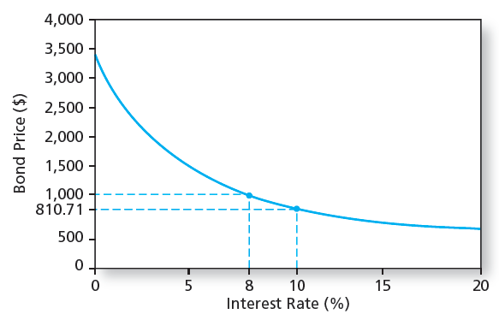
Figure 14.3 The Inverse Relationship Between Bond Prices and Yields

Slide 15
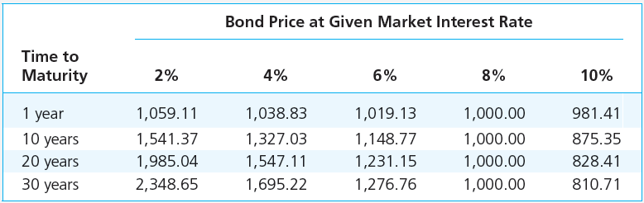
Table 14.2 Bond Prices at Different Interest Rates

Slide 16
Bond Yields: Yield to Maturity
Interest rate that makes the present value of the bond’s payments equal to its price is the yield to maturity (YTM)
Solve the bond formula for r

Slide 17
Yield to Maturity Example
Suppose an 8% coupon, 30 year bond is selling for $1276.76. What is its average rate of return?
r = 3% per half year, YTM = 6%
EAR = ((1.03)²) – 1 = 6.09%

Slide 18
Bond Yields: YTM vs. Current Yield
Yield to Maturity
Bond’s internal rate of return
The interest rate that makes the PV of a bond’s payments equal to its price; assumes that all bond coupons can be reinvested at the YTM
Current Yield
Bond’s annual coupon payment divided by the bond price
For premium bonds
Coupon rate > Current yield > YTM
For discount bonds, relationships are reversed

Slide 19
Bond Yields: Yield to Call
If interest rates fall, price of straight bond can rise considerably
The price of the callable bond is flat over a range of low interest rates because the risk of repurchase or call is high
When interest rates are high, the risk of call is negligible and the values of the straight and the callable bond converge

Slide 20
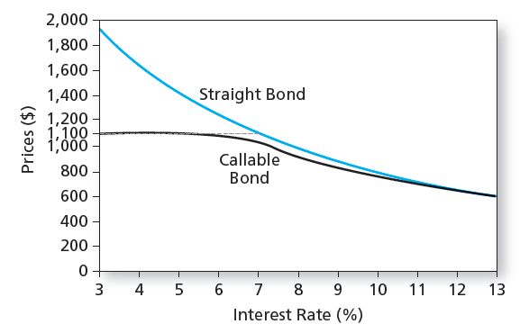
Figure 14.4 Bond Prices: Callable and Straight Debt

Slide 21
Bond Yields: Realized Yield versus YTM
Reinvestment Assumptions
Holding Period Return
Changes in rates affect returns
Reinvestment of coupon payments
Change in price of the bond

Slide 22
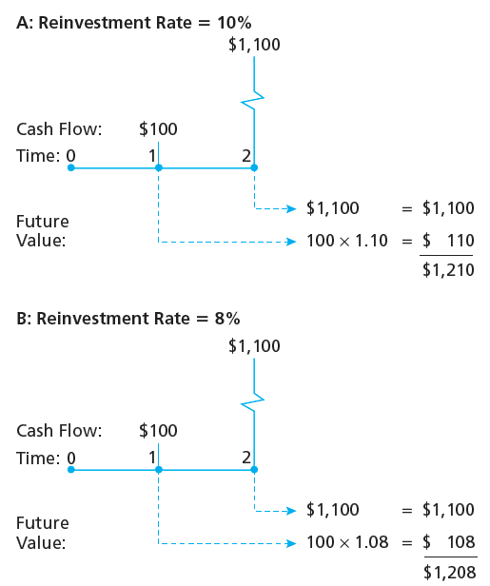
Figure 14.5 Growth of Invested Funds

Slide 23
Realized Compound Return from Figure 14.5
V₀(1 + r)² = V₂
A: 1000(1 + r)² = 1,210 → (1 + r)² = 1,210/1,000,
Thus, r = 10%.
B: 1000(1 + r)² = 1,208 → (1 + r)² = 1,208/1,000,
Thus, r = 9.91%.

Slide 24
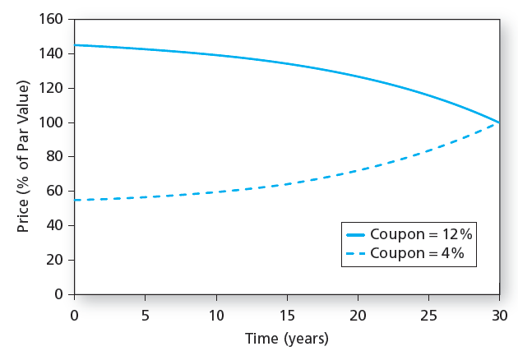
Figure 14.6 Prices over Time of 30-Year Maturity Bonds selling at 8% YTM

Slide 25
Bond Prices Over Time: YTM vs. HPR
YTM
HPR
It is the average return if the bond is held to maturity
Depends on coupon rate, maturity, and par value
All of these are readily observable
It is the rate of return over a particular investment period
Depends on the bond’s price at the end of the holding period, an unknown future value
Can only be forecasted

Slide 26
Holding-Period Return: Single Period
HPR = [ I + ( P₁ – P₀ )] / P₀
where
I = interest payment
P₁ = price in one period
P₀ = purchase price

Slide 27
Holding-Period Return Example
CR = 8% YTM = 8% N=10 years
Semiannual Compounding P₀ = $1,000
In six months the rate falls to 7%
P₁ = 40 PVAF(3.5%, 19) + 1000 PVDF(3.5%, 19)]
= $1,068.55
https://dqydj.com/bond-pricing-calculator/
HPR = [40 + ( 1,068.55 – 1,000)] / 1,000
HPR = 10.85% (semiannual)

Slide 28
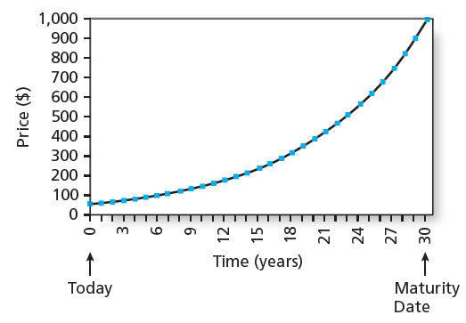
Figure 14.7 The Price of a 30-Year Zero-Coupon Bond over Time

Slide 29
Default Risk and Bond Pricing
Rating companies
Moody’s Investor Service, Standard & Poor’s, Fitch
Rating Categories
Highest rating is AAA or Aaa
Investment grade bonds are rated BBB or Baa and above
Speculative grade/junk bonds have ratings below BBB or Baa

Slide 30
Default Risk and Bond Pricing
Determinants of bond Safety
Coverage ratios
Leverage ratios, debt-to-equity ratio
Liquidity ratios
Profitability ratios
Cash flow-to-debt ratio

Slide 31
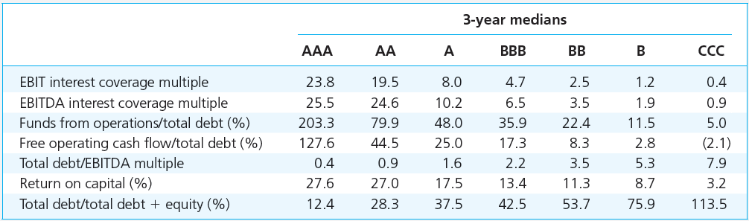
Table 14.3 Financial Ratios and Default Risk by Rating Class, Long-Term Debt

Slide 32
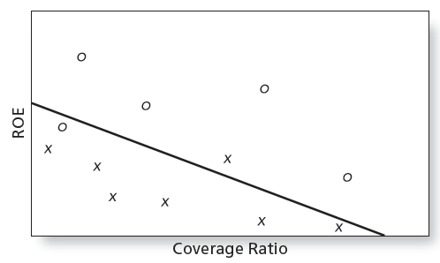
Figure 14.9 Discriminant Analysis

Slide 33
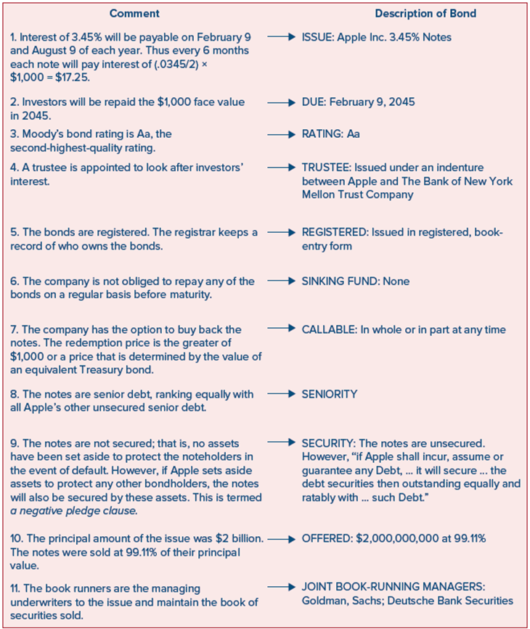
Figure 14.10 Apple’s 2015 Bond Issue
Access the text alternative for slide images.

Slide 34
Default Risk and Bond Pricing: Bond Indentures
Sinking funds: A way to call bonds early
Subordination of future debt: Restrict additional borrowing
Dividend restrictions: Force firm to retain assets rather than paying them out to shareholders
Collateral: A particular asset bondholders receive if the firm defaults

Slide 35
YTM and Default Risk
The risk structure of interest rates refers to the pattern of default premiums
There is a difference between the yield based on expected cash flows and yield based on promised cash flows
The difference between the expected YTM and the promised YTM is the default risk premium

Slide 36
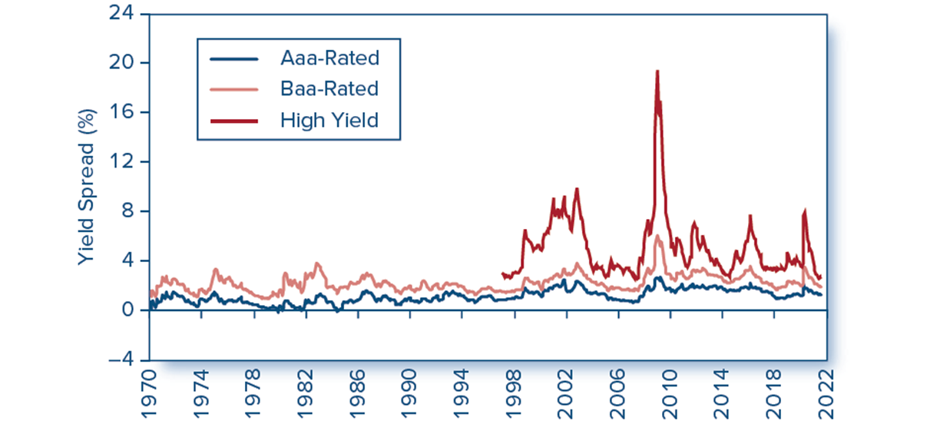
Figure 14.11 Yield Spreads
Figure 14.11 Yield spreads between corporate and 10-year Treasury bonds
Source: Federal Reserve Bank of St. Louis.
Access the text alternative for slide images.

Slide 37
What is a Credit Default Swap (CDS)?
A Credit Default Swap is a contract between two parties where:
One party (the buyer) pays a regular fee (like an insurance premium)
In exchange, the other party (the seller) agrees to compensate the buyer if a credit event (like default, bankruptcy, or restructuring) happens to a reference entity (such as a corporation or government).
The reference entity is the borrower (e.g., a company or country) whose debt (e.g., bonds, loans) is being insured.

Slide 38
A CDS Example
Suppose you own $10 million worth of bonds issued by Company XYZ (the reference entity).
You're worried about XYZ defaulting.
You buy a 5-year CDS on XYZ from a bank.
The annual premium (CDS spread) is 2% of the insured amount, so you pay $200,000 per year to the bank.
If XYZ defaults, the bank (seller) pays you the loss you suffered on the bonds (e.g., if bonds are now worth 40%, the bank pays you 60% of $10 million = $6 million).
If XYZ doesn’t default, you keep paying the $200,000 annually for 5 years, and the contract ends without a payout.

Slide 39
Default Risk and Bond Pricing
Credit Default Swaps
Institutional bondholders, e.g. banks, used CDS to enhance creditworthiness of their loan portfolios, to manufacture AAA debt

Slide 40
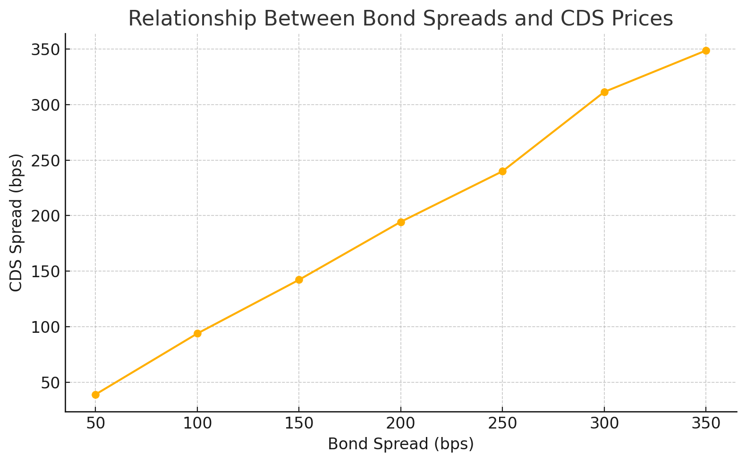
CDS spread is the annual cost (premium), quoted in basis points (bps), that a CDS buyer pays to the CDS seller for protection against a credit event (like default) on a reference entity (e.g., a corporation or sovereign).
Bond spread is the difference in yield between a corporate bond (or any risky bond) and a risk-free government bond of the same maturity.

Slide 41
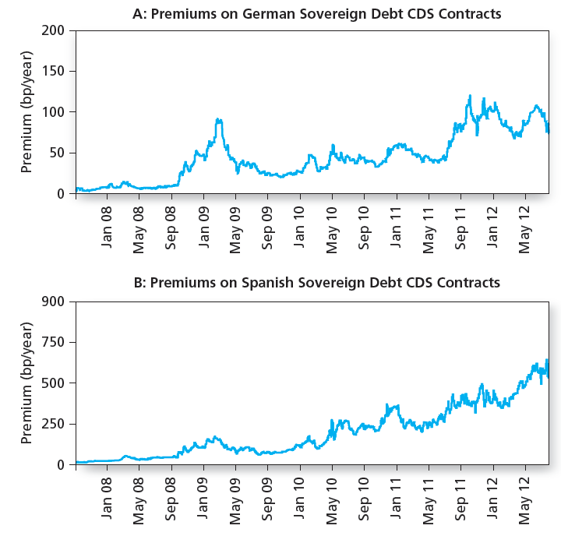
Figure 14.12 Prices of Credit Default Swaps

