Slide 1
Chapter Nine
The Capital Asset Pricing Model

Slide 2
Capital Asset Pricing Model (CAPM)
It is the equilibrium model that underlies all modern financial theory
Derived using principles of diversification with simplified assumptions
Markowitz, Sharpe, Lintner and Mossin are researchers credited with its development
Notes:
2

Slide 3
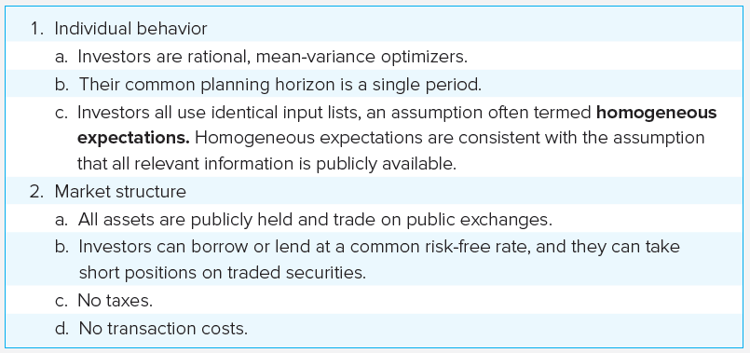
Assumptions

Slide 4
Resulting Equilibrium Conditions
All investors will hold the same portfolio for risky assets – market portfolio
Market portfolio contains all securities and the proportion of each security is its market value as a percentage of total market value

Slide 5
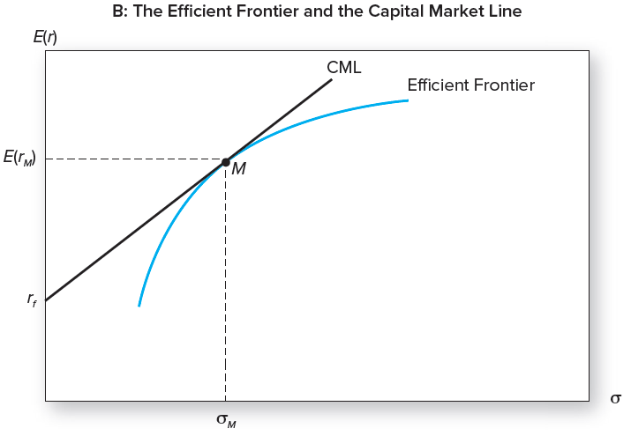
The Efficient Frontier and the Capital Market Line

Slide 6
Capital Market Line (CML)
E(r_{c}) = r_{f} +[(E(r_{M}) – r_{f})/σ_{M}]σ_{c}
CML describes return and risk for portfolios on efficient frontier

Slide 7
Return and Risk For Individual Securities
The risk premium on individual securities is a function of the individual security’s contribution to the risk of the market portfolio.
An individual security’s risk premium is a function of the covariance of returns with the assets that make up the market portfolio.

Slide 8
Economic Intuition Behind the CAPM
Observation: Each investor holds the market portfolio and thus the risk of his/her portfolio is σ_{M}²
σ_{M}² = Σ_{i} Σ_{j}W_{i}W_{j}σ_{ij} = W₁ Cov(r₁, r_{M}) + W₂ Cov(r₂, r_{M}) + …. + W_{n} Cov(r_{n}, r_{M})
Conclusion I: Security i’s contribution to the risk of the market portfolio is measured by Cov(r_{i}, r_{M}).
Dividing both sides by σ_{M}², we obtain
1 = W₁ Cov(r₁, r_{M})/σ_{M}² + W₂ Cov(r₂, r_{M})/σ_{M}² + …. + W_{n} Cov(r_{n}, r_{M})/σ_{M}².
= W₁ β₁ + W₂ β₂ + .…. + W_{n} β_{n}.
Conclusion II: The risk of the market portfolio can be viewed as the weighted sum of individual stock betas. Hence, for those who hold the market portfolio, the proper measure of risk for individual stocks is beta.

Slide 9
Key Implication: The risk premium for an individual security must be determined by its beta.
E(r_{i}) = r_{f} +{E(r_{M}) - r_{f}}β_{i}
Security Market Line (SML)

Slide 10
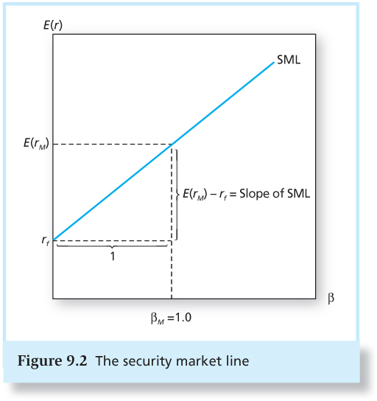
Figure 9.2 The Security Market Line

Slide 11
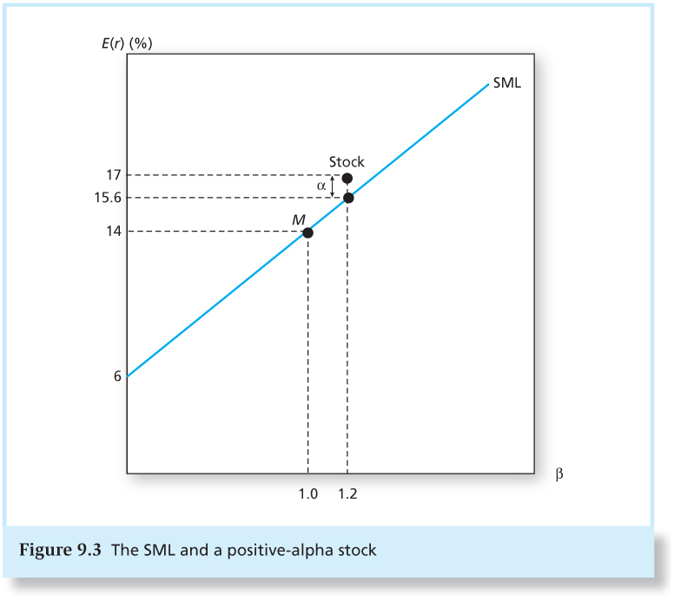
Figure 9.3 The SML and a Positive-Alpha Stock

Slide 12
The Index Model and Realized Returns
To move from expected to realized returns—use the index model in excess return form:
R_{it} = α_{i} + β_{i} R_{Mt} + e_{it}
where R_{it} = r_{it} – r_{ft} and R_{Mt} = r_{Mt} – r_{ft}
α_{i} = Jensen’s alpha for stock i
The index model beta coefficient turns out to be the same beta as that of the CAPM expected return-beta relationship

Slide 13
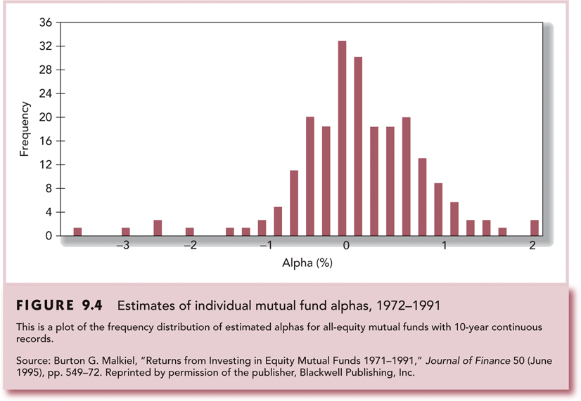
Estimates of Individual Mutual Fund Alphas, 1972-1991

Slide 14
The CAPM and Reality
Is the condition of zero alphas for all stocks as implied by the CAPM met
Not perfect but one of the best available
Is the CAPM testable
Proxies must be used for the market portfolio
CAPM is still considered the best available description of security pricing and is widely accepted

Slide 15
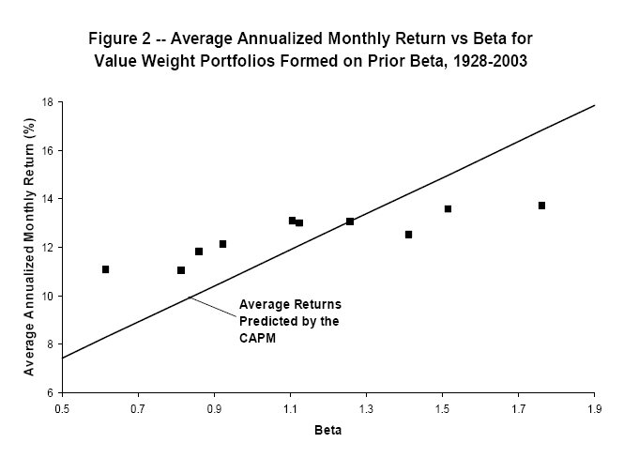

Slide 16
Assumptions of the CAPM
Individuals
Mean-variance optimizers
Homogeneous expectations
All assets are publicly traded
Markets
All assets are publicly held
All information is available
No taxes
No transaction costs

Slide 17
Extensions of the CAPM
Zero-Beta Model
Helps to explain positive alphas on low beta stocks and negative alphas on high beta stocks
Consideration of labor income and non-traded assets

Slide 18
Black’s Zero Beta Model
Absence of a risk-free asset
Combinations of portfolios on the efficient frontier are efficient.
All frontier portfolios have companion portfolios that are uncorrelated.
Returns on individual assets can be expressed as linear combinations of efficient portfolios (see the next slide).

Slide 19
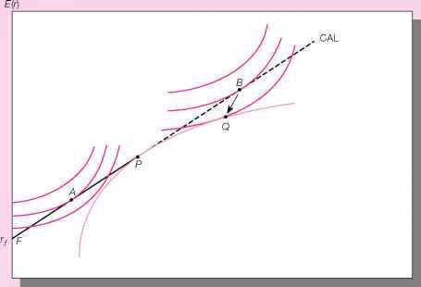
Portfolio selection with risk free asset

Slide 20
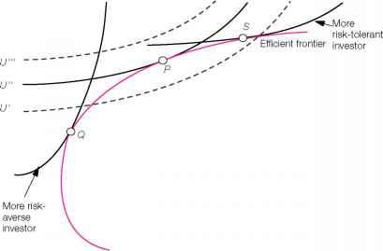
Portfolio selection without risk free asset

Slide 21
Efficient Portfolios and Zero Companions
E(r)
Q
P
E[r_{z (Q)}]
Z(Q)
E[r_{z (P)}]
Z(P)
σ

Slide 22
Black’s Zero Beta Model Formulation for any two efficient portfolios (P and Q)

Slide 23
Zero Beta Market Model
Let P = M and Z(P) = Z(M). Then Cov(r_{M}, r_{Z(M)}) = 0. Thus we have:
CAPM with E(r_{z (m)}) replacing r_{f}

Slide 24
Liquidity and the CAPM
Liquidity: The ease and speed with which an asset can be sold at fair market value
Illiquidity Premium: Discount from fair market value the seller must accept to obtain a quick sale.
Measured partly by bid-asked spread
As trading costs are higher, the illiquidity discount will be greater.

Slide 25
CAPM with a Liquidity Premium
f (c_{i}) = liquidity premium for security i
f (c_{i}) increases at a decreasing rate
https://papers.ssrn.com/sol3/papers2.cfm?abstract_id=2638442

Slide 26
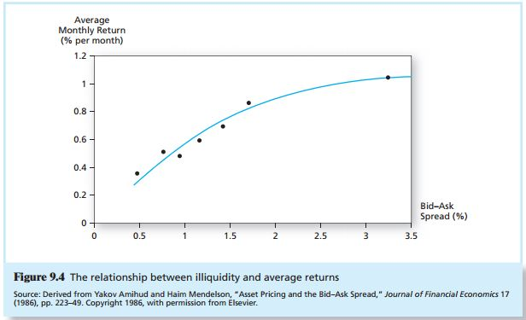
Figure 9.4 The Relationship Between Illiquidity and Average Returns

Slide 27
Liquidity Risk
In a financial crisis, liquidity can unexpectedly dry up.
When liquidity in one stock decreases, it tends to decrease in other stocks at the same time.
Investors demand compensation for liquidity risk
Liquidity betas

Slide 28
The CAPM and Investment Industry
Testing the CAPM is surprisingly difficult
Cannot observe all tradable assets
Impossible to pin down market portfolio
Both alpha and beta, as well as residual variance, are likely time varying
Most tests of the CAPM are directed at the mean-beta relationship as applied to assets with respect to an observed, but perhaps inefficient, stock index portfolio

Slide 29
The CAPM and Investment Industry
Portfolio theory and the CAPM have become accepted tools in the practitioner community
Many professionals are comfortable with the use of beta to measure systematic risk
Most investors don’t beat the index portfolio

