Slide 1
Chapter Eight
Index Models

Slide 2
Chapter Overview
Advantages of a single-factor model
Risk decomposition
  Systematic vs. firm-specific
Single-index model and its estimation

Slide 3
Single-Index Model (Market Model)
r_{i} = α_{i} + β_{i} r_{M} + e_{i} ,
  r_{i} = stock i’s return
  r_{M} = market return
  β_{i} = sensitivity of stock i’s return to the market
  return
  e_{i} = return component due to stock specific events

Slide 4
Single-Index Model
Regression Equation:
R_{it} = α_{i} + β_{i} R_{Mt} + e_{it}
where R_{it} = r_{it} – r_{ft} and R_{Mt} = r_{Mt} - r_{ft}

Slide 5
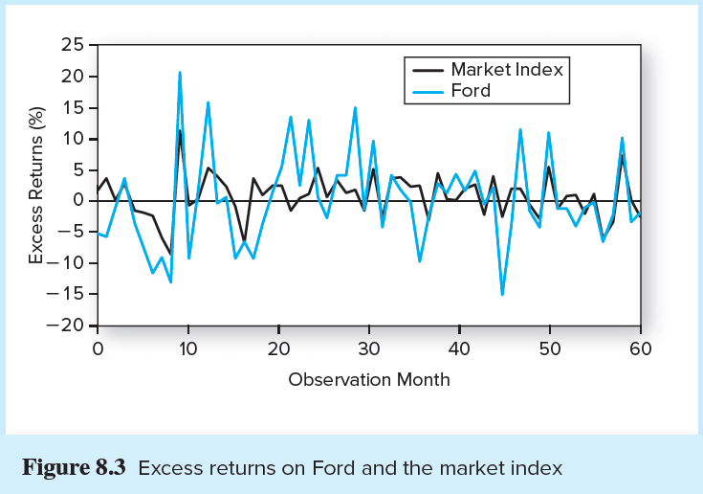
Figure 8.3 Excess Returns on
Ford and S&P 500

Slide 6
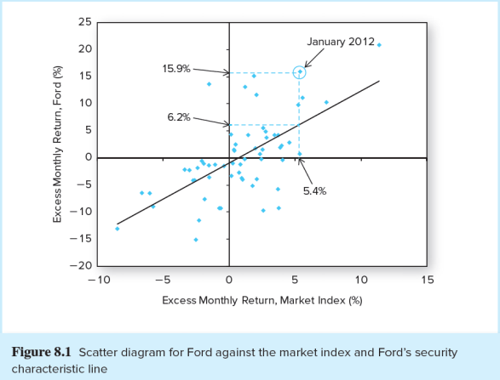
Scatter Diagram of Ford, the S&P 500, and Ford’s SCL

Slide 7
Index Model Regression Equation
Excess return of security i
Expected excess return when the market excess return is zero
Zero-mean, firm-specific surprise in security i‘s return in month t.
(the residual)
Sensitivity of security i‘s return to changes in the return of the market
Expected excess return of the market

Slide 8
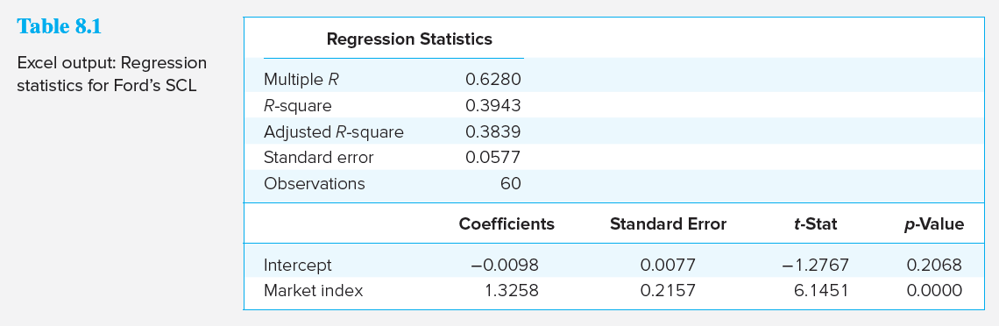
Table 8.1 Excel Output: Regression Statistics for the SCL of Ford
https://www.gurufocus.com/economic_indicators/286/3month-treasury-constant-maturity-rate
https://wrds-www.wharton.upenn.edu/classroom/security-betas/

Slide 9
Interpreting the Output
Correlation of Ford with the S&P 500 is 0.6280
The model explains about 38% of the variation in Ford
Ford's alpha is -0.98% per month, but not statistically significant
Ford's beta is 1.3258, but the 95% confidence interval is 0.90 to 1.75

Slide 10
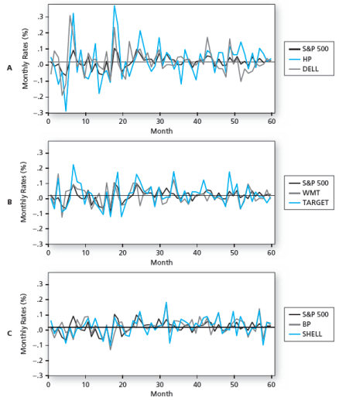
Excess Returns on Other Stocks

