Slide 1
Chapter Seven
Efficient Diversification

Slide 2
Chapter Overview
The investment decision:
Capital allocation (risky vs. risk-free)
Asset allocation (construction of the risky portfolio)
Security selection
Optimal risky portfolio
Efficient diversification
The Markowitz portfolio optimization model

Slide 3
Portfolios of Two Risky Assets
Portfolio risk (variance) depends on the correlation between the returns of the assets in the portfolio
Covariance and the correlation coefficient provide a measure of the way returns of two assets move together (covary)

Slide 4
Portfolios of Two Risky Assets: Return
Portfolio return: r_{p} = w_{D}r_{D} + w_{E}r_{E}
w_{D} = Bond weight
r_{D} = Bond return
w_{E} = Equity weight
r_{E} = Equity return
E(r_{p}) = w_{D} E(r_{D}) + w_{E}E(r_{E})

Slide 5
Portfolios of Two Risky Assets: Risk
Portfolio variance:
= Bond variance
= Equity variance
= Covariance of returns for bond and equity

Slide 6
Portfolios of Two Risky Assets: Covariance
Covariance of returns on bond and equity:
Cov(r_{D,}r_{E}) = ρ_{DE}σ_{D}σ_{E}
ρ_{D,E} = Correlation coefficient of returns
σ_{D} = Standard deviation of bond returns
σ_{E} = Standard deviation of equity returns

Slide 7
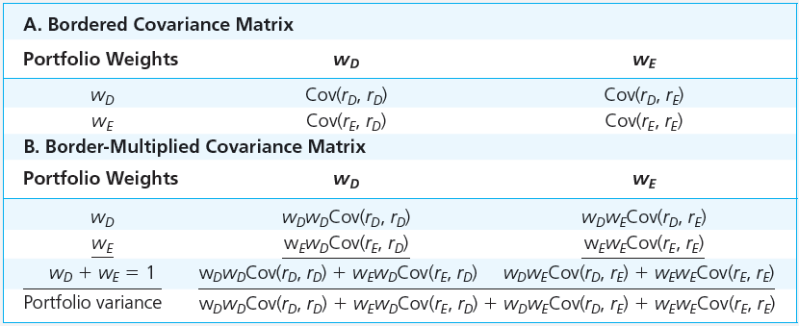
Table 7.2 Computation of Portfolio Variance From the Covariance Matrix
Variance of the portfolio: General

Slide 8
Three-Security Portfolio
σ²_{p} = w₁²σ₁²
+ w₂²σ₁²
+ w₃²σ₃²
+ 2w₁w₂
Cov(r_{1,}r₂)
Cov(r_{1,}r₃)
+ 2w₁w₃
+ 2w₂w₃
Cov(r_{2,}r₃)

Slide 9
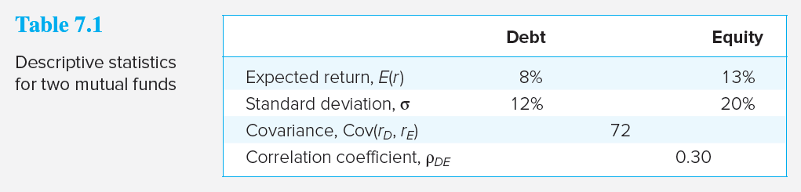
Portfolios of Two Risky Assets: Example — 50%/50% Split
Expected Return:
Variance:

Slide 10
Another numerical example
http://www.acsu.buffalo.edu/~keechung/CU%20Lecture%20Notes%20and%20Syllabus/Chapter%206%20-%20Risk%20and%20Return.doc

Slide 11
Portfolios of Two Risky Assets: Correlation Coefficients
Range of values for ρ_{1,2}
- 1.0 > ρ > +1.0
If ρ = 1.0, the securities are perfectly positively correlated
If ρ = - 1.0, the securities are perfectly negatively correlated

Slide 12
Portfolios of Two Risky Assets: Correlation Coefficients
When ρ_{DE} = 1, there is no diversification
When ρ_{DE} = -1, a perfect hedge is possible

Slide 13
Case I: ρ_{DE} = 1
σ_{p}² = w_{D}² σ_{D}² + w_{E}²σ_{E}² + 2 w_{D}w_{E} COV(r_{D}, r_{E})
= w_{D}² σ_{D}² + w_{E}²σ_{E}² + 2 w_{D}w_{E} ρ_{DE} σ_{D} σ_{E}
If ρ_{DE} = 1
σ_{p}² = w_{D}² σ_{D}² + w_{E}²σ_{E}² + 2 w_{D}w_{E} σ_{D} σ_{E}
= (w_{D} σ_{D} + w_{E}σ_{E})²
Hence, σ_{p} = w_{D} σ_{D} + w_{E}σ_{E}

Slide 14
Case II: ρ_{DE} = -1
If ρ_{DE} = -1
σ_{p}² = w_{D}² σ_{D}² + w_{E}²σ_{E}² - 2 w_{D}w_{E} σ_{D} σ_{E}
= (w_{D} σ_{D} - w_{E}σ_{E})²
Hence, σ_{p} = w_{D} σ_{D} - w_{E}σ_{E}
We can make σ_{p} = 0 by w_{D} σ_{D} – w_{E}σ_{E} = 0
→ w_{D} σ_{D} = w_{E}σ_{E} → (1 – w_{E}) σ_{D} = w_{E}σ_{E}
→ w_{E} = σ_{D} / (σ_{D} + σ_{E})

Slide 15
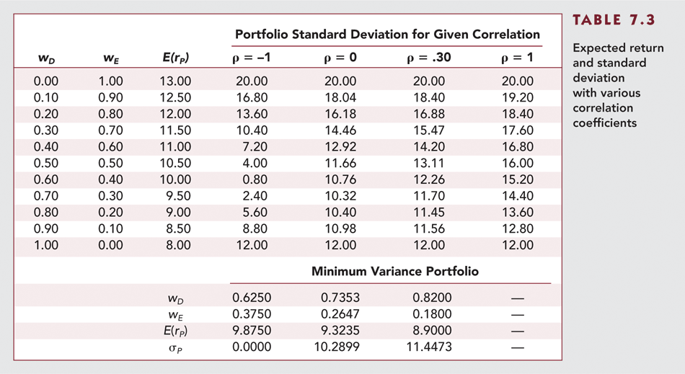
Table 7.3 Expected Return and Standard Deviation with Various Correlation Coefficients

Slide 16
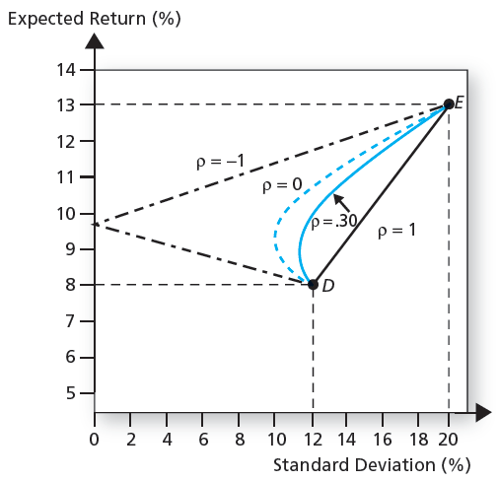
Figure 7.5 Portfolio Expected Return as a Function of Standard Deviation

Slide 17
The Minimum Variance Portfolio
The minimum variance portfolio is the portfolio composed of the risky assets that has the smallest standard deviation; the portfolio with least risk
The amount of possible risk reduction through diversification depends on the correlation:
If ρ = +1.0, no risk reduction is possible
If ρ = 0, σ_{P} may be less than the standard deviation of either component asset
If ρ = -1.0, a riskless hedge is possible

Slide 18
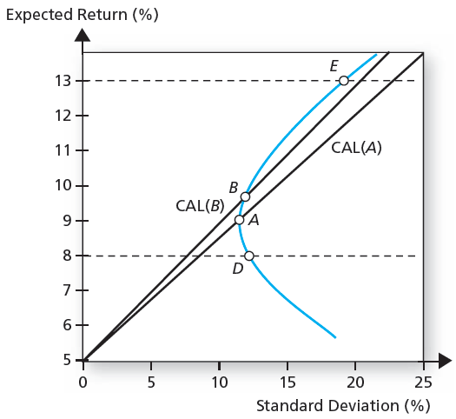
Figure 7.6 The Opportunity Set of the Debt and Equity Funds and Two Feasible CALs

Slide 19
The Sharpe Ratio
Maximize the slope of the CAL for any possible portfolio, P
The objective function is the slope:
The slope is also the Sharpe ratio

Slide 20
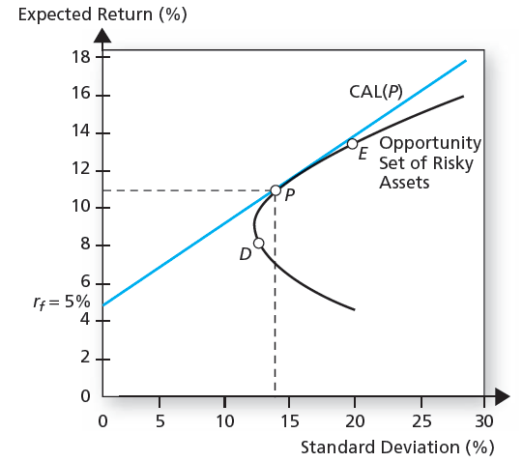
Figure 7.7 Debt and Equity Funds with the Optimal Risky Portfolio

Slide 21
Excel Application for two securities case
http://highered.mheducation.com/sites/dl/free/0077861671/1018534/BKM_10e_Ch07_Two_Security_Model.xls

Slide 22
Analytical Solution for two securities case
Minimum Variance Portfolio &
Optimal Risky Portfolio
http://www.acsu.buffalo.edu/~keechung/Lecture%20Notes%20and%20Syllabus%20(MGF633)/Chapter%207%20-%20MVP%20and%20P%20Numerical%20Examples.doc

Slide 23
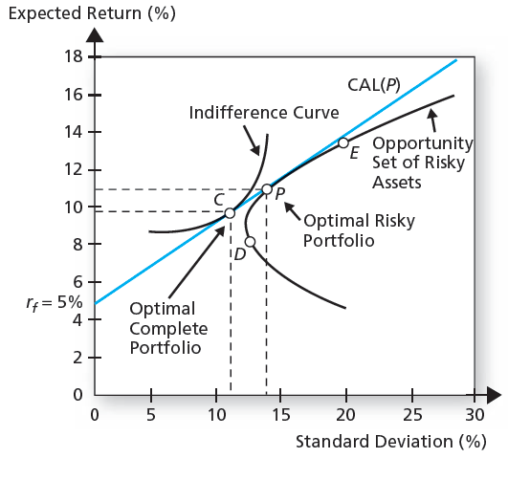
Figure 7.8 Determination of the Optimal Overall Portfolio

Slide 24
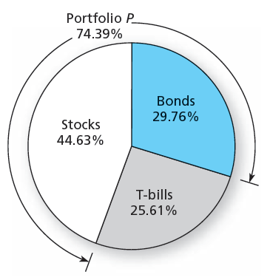
Figure 7.9 The Proportions of the Optimal Complete (Overall) Portfolio

Slide 25
Markowitz Portfolio Optimization Model
Security selection
The first step is to determine the risk-return opportunities available
All portfolios that lie on the minimum-variance frontier from the global minimum-variance portfolio and upward provide the best risk-return combinations

Slide 26
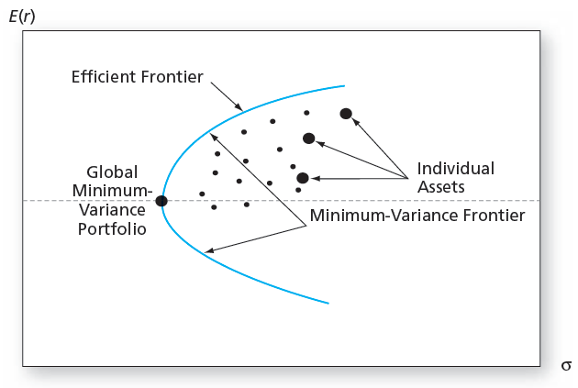
Figure 7.10 The Minimum-Variance Frontier of Risky Assets

Slide 27
Markowitz Portfolio Optimization Model
Search for the CAL with the highest reward-to-variability ratio
Everyone invests in P, regardless of their degree of risk aversion
More risk averse investors put more in the risk-free asset
Less risk averse investors put more in P

Slide 28
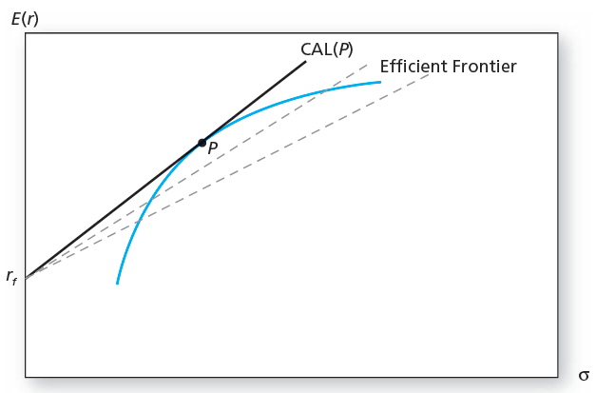
Figure 7.11 The Efficient Frontier of Risky Assets with the Optimal CAL

Slide 29
Markowitz Portfolio Optimization Model
Capital Allocation and the Separation Property
Portfolio choice problem may be separated into two independent tasks
Determination of the optimal risky portfolio is purely technical
Allocation of the complete portfolio to risk-free versus the risky portfolio depends on personal preference

Slide 30
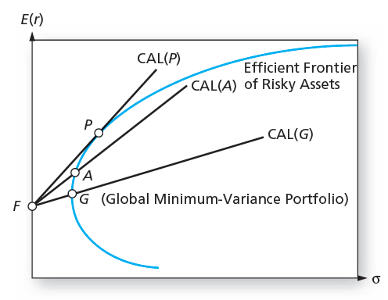
Figure 7.13 Capital Allocation Lines with Various Portfolios from the Efficient Set

Slide 31
Excel Application for Multiple Securities
http://highered.mheducation.com/sites/dl/free/0077861671/1018535/BKM_10e_Ch07_Appendix_Spreadsheets.xls
WRDS Efficient Frontier Application with real data Output Example

Slide 32
Markowitz Portfolio Optimization Model
The Power of Diversification
Remember:
If we define the average variance and average covariance of the securities as:

Slide 33
Markowitz Portfolio Optimization Model
The Power of Diversification
We can then express portfolio variance as
Portfolio variance can be driven to zero if the average covariance is zero (only firm specific risk)
The irreducible risk of a diversified portfolio depends on the covariance of the returns, which is a function of the systematic factors in the economy

Slide 34
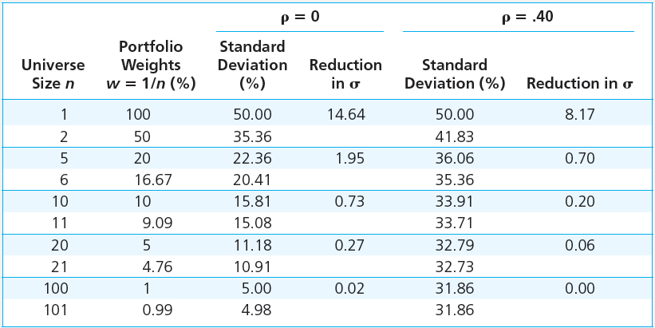
Table 7.4 Risk Reduction of Equally Weighted Portfolios

Slide 35
Diversification and Portfolio Risk
Market risk
Risk attributable to marketwide risk sources and remains even after extensive diversification
Also call systematic or nondiversifiable
Firm-specific risk
Risk that can be eliminated by diversification
Also called diversifiable or nonsystematic

Slide 36
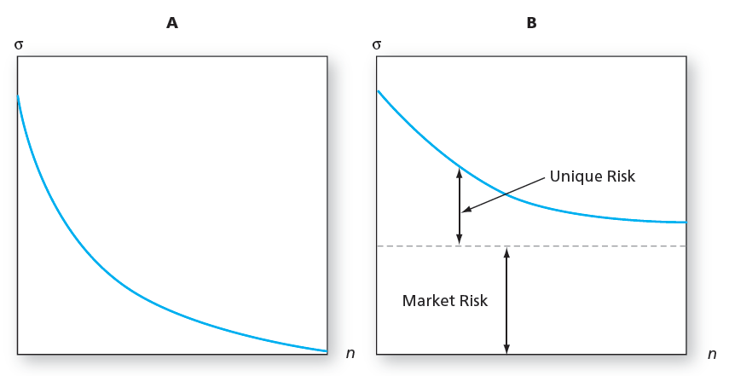
Figure 7.1 Portfolio Risk and the Number of Stocks in the Portfolio
Panel A: All risk is firm specific. Panel B: Some risk is systematic or marketwide.

Slide 37
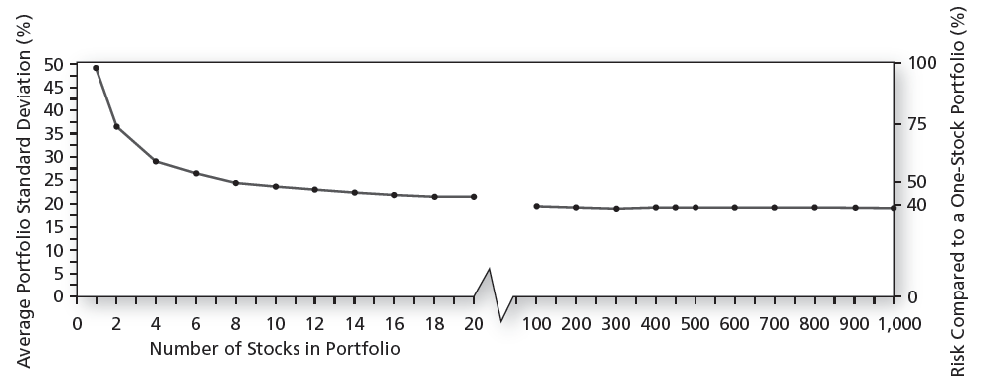
Figure 7.2 Portfolio Diversification

