Slide 1
Chapter Six
Capital Allocation to Risky Assets

Slide 2
Three Steps in Investment Decisions – Top-down Approach
I. Capital Allocation Decision
Allocate funds between risky and risk-free assets
Made at higher organization levels
II. Asset Allocation Decision
Distribute risky investments across asset classes – small-cap stocks, large-cap stocks, bonds, & foreign assets
III. Security Selection Decision
Select particular securities within each asset class
Made at lower organization levels

Slide 3
Chapter Overview
Risk aversion and its estimation
Two-step process of portfolio construction
Composition of risky portfolio
Capital allocation between risky and risk-free assets
Passive strategies and the capital market line (CML)

Slide 4
Risk and Risk Aversion
Speculation
Gamble
Taking considerable risk for a commensurate gain
Parties have heterogeneous expectations
Bet on an uncertain outcome for enjoyment
Parties assign the same probabilities to the possible outcomes

Slide 6
Risk and Risk Aversion
Utility Values
Investors are willing to consider:
Risk-free assets
Speculative positions with positive risk premiums
Portfolio attractiveness increases with expected return and decreases with risk
What happens when return increases with risk?

Slide 7
Example

Slide 8
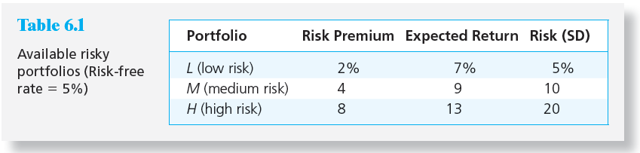
Table 6.1 Available Risky Portfolios
Each portfolio receives a utility score to assess the investor’s risk/return trade off

Slide 9
Risk Aversion and Utility Values
Utility Function
U = Utility
E(r) = Expected return on the asset or portfolio
A = Coefficient of risk aversion
σ² = Variance of returns
½ = A scaling factor

Slide 10
Investor Types
Risk Averse Investors:
Risk-Neutral Investors:
Risk Lovers:
Where A = Coefficient of risk aversion
Notes:
Risk Averse: Rejects investment portfolios that are fair games or worse
Risk-neutral: Judges risky prospects solely by their expected returns
Risk Lover: Accepts a fair game or gamble; the investor adjusts the expected return upward to take into account the “fun” of confronting the prospect’s risk

Slide 11
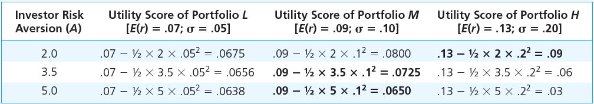
Table 6.2 Utility Scores of Portfolios with Varying Degrees of Risk Aversion

Slide 12
Estimating Risk Aversion
Use questionnaires PDF
Observe individuals’ decisions when confronted with risk
Observe how much people are willing to pay to avoid risk

Slide 13
Capital Allocation Across Risky and Risk-Free Portfolios
Asset Allocation
The choice among broad asset classes that represents a very important part of portfolio construction
The simplest way to control risk is to manipulate the fraction of the portfolio invested in risk-free assets versus the portion invested in the risky assets

Slide 14
Basic Asset Allocation Example
Total market value | $300,000
Risk-free money market fund | $90,000
Equities | $113,400
Bonds (long-term) | $96,600
Total risk assets | $210,000

Slide 15
Basic Asset Allocation Example
Let
y = Weight of the risky portfolio, P, in the complete portfolio
(1-y) = Weight of risk-free assets

Slide 16
The Risk-Free Asset
Only the government can issue default-free securities
A security is risk-free in real terms only if its price is indexed and maturity is equal to investor’s holding period
T-bills viewed as “the” risk-free asset
Money market funds also considered risk-free in practice

Slide 17
Portfolios of One Risky Asset and a Risk-Free Asset
It’s possible to create a complete portfolio by splitting investment funds between safe and risky assets
Let
y = Portion allocated to the risky portfolio, P
(1 - y) = Portion to be invested in risk-free asset, F

Slide 18
Example
r_{f} = 7%
σ_{rf} = 0%
E(r_{p}) = 15%
σ_{p} = 22%
y = % in p
(1-y) = % in r_{f}

Slide 19
Expected Returns for Combinations
r_{c} = complete or combined portfolio
For example, y = .75
E(r_{c}) = .75(.15) + .25(.07)
= .13 or 13%

Slide 20
Standard Deviation of
Complete Portfolio
σ_{c} = yσ_{p}

Slide 21
Combinations Without Leverage
Combinations Without Leverage
If y = .75, then
σ
= .75(.22) = .165 or 16.5%
c
If y = 1
σ
= 1(.22) = .22 or 22%
c
If y = 0
σ
= (.22) = .00 or 0%
c

Slide 22
Capital Allocation Line (CAL)
E(r_{c}) = yE(r_{p}) + (1 – y)r_{f}
= r_{f} +[(E(r_{p}) – r_{f})]y (1)
σ_{c} = yσ_{p} → y = σ_{c}/σ_{p} (2)
From (1) and (2)
E(r_{c}) = r_{f} +[(E(r_{p}) - r_{f})/σ_{p}]σ_{c} (CAL)

Slide 23
One Risky Asset and a Risk-Free Asset: Example
E(r_{c}) = r_{f} +[(E(r_{p}) - r_{f})/σ_{p}]σ_{c}
= 7 + [(15 – 7)/22] σ_{c}
= 7 + (8/22) σ_{c}

Slide 24
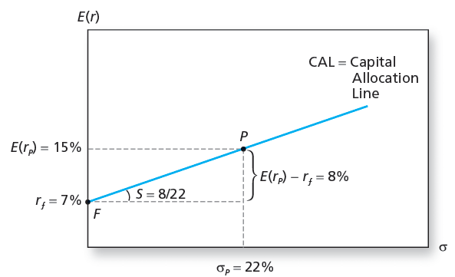
Figure 6.3 The Investment Opportunity Set

Slide 25
Capital Allocation Line with Leverage
Borrow at the Risk-Free Rate and invest in stock.
Using 50% Leverage,
r_{c} = (-.5) (.07) + (1.5) (.15) = .19
σ_{c} = (1.5) (.22) = .33

Slide 26
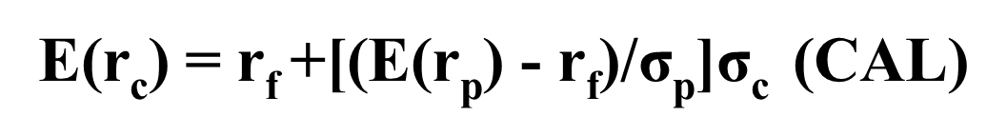
The Opportunity Set with Differential Borrowing and Lending Rates
Capital allocation line with leverage
Lend at r_{f} = 7% and borrow at r_{f} = 9%
Lending range slope = 8/22 = 0.36
Borrowing range slope = 6/22 = 0.27
CAL kinks at P

Slide 27
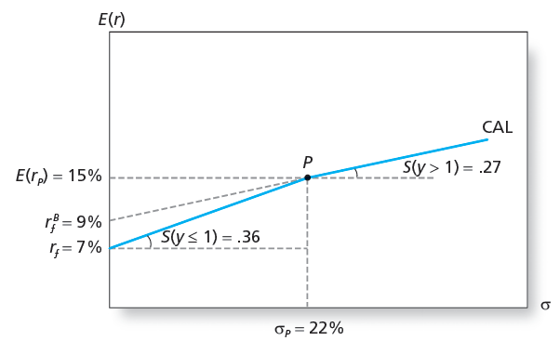
Figure 6.4 The Opportunity Set with Differential Borrowing and Lending Rates

Slide 28
Risk Tolerance and Asset Allocation
The investor must choose one optimal portfolio, C, from the set of feasible choices
Expected return of the complete portfolio:
Variance:

Slide 29
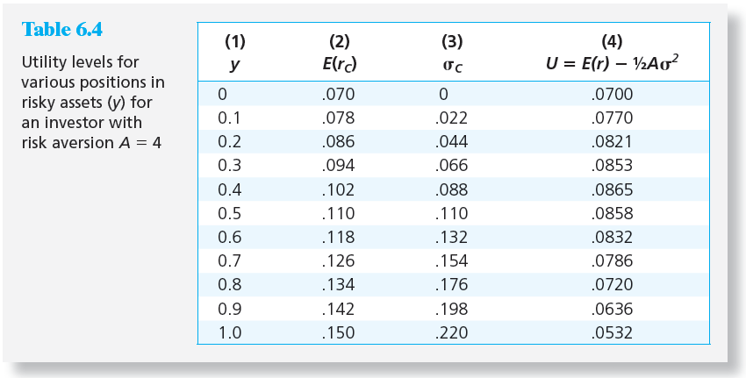
Table 6.4 Utility Levels for Various Positions in Risky Assets

Slide 30
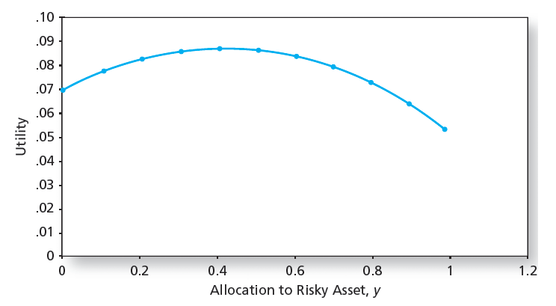
Figure 6.5 Utility as a Function of Allocation to the Risky Asset, y

Slide 31
Analytical Solution
U = E(r_{c}) – (1/2)Aσ_{c}² (1)
where E(r_{c}) = yE(r_{p}) + (1-y)r_{f} (2) σ_{c} = yσ_{p} (3)
Substituting (2) and (3) into (1), we obtain
U = yE(r_{p}) + (1-y)r_{f} – (1/2)A(yσ_{p})²
From dU/dy = E(r_{p}) – r_{f} – Ayσ_{p}² = 0,
y* = (E(r_{p}) – r_{f})/Aσ_{p}²

Slide 32
y* = (E(r_{p}) – r_{f})/Aσ_{p}²
= (0.15 – 0.07)/4(0.22)²
= 0.41
E(r_{c}) = y*E(r_{p}) + (1-y*)r_{f}
= 0.41(0.15) + (1-0.41)(0.07) = 0.1028
σ_{c} = y*σ_{p} = 0.41(0.22) = 0.0902
Hence, U = E(r_{c}) – (1/2)Aσ_{c}²
= 0.1028 – (1/2)4(0.0902)² = 0.08653

Slide 33
Indifference curve
We can trace combinations of E(r_{c}) and σ_{c}
for given values of U and A.
From U = E(r_{c}) – (1/2)Aσ_{c}²
E(r_{c}) = U + (1/2)Aσ_{c}²
Example: E(r_{c}) = 0.05 + (1/2)(2)σ_{c}²

Slide 34
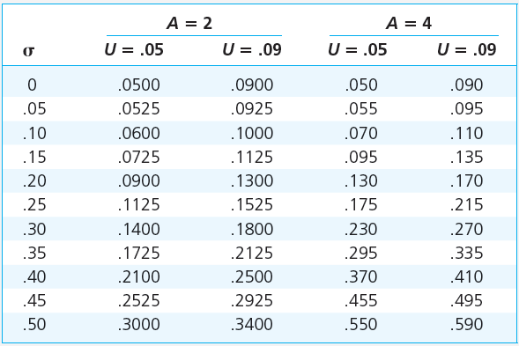
Table 6.5 Spreadsheet Calculations of Indifference Curves

Slide 35
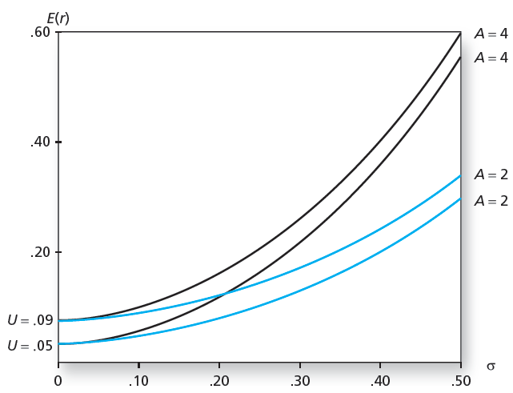
Figure 6.6 Indifference Curves for U = .05 and U = .09 with A = 2 and A = 4

Slide 36
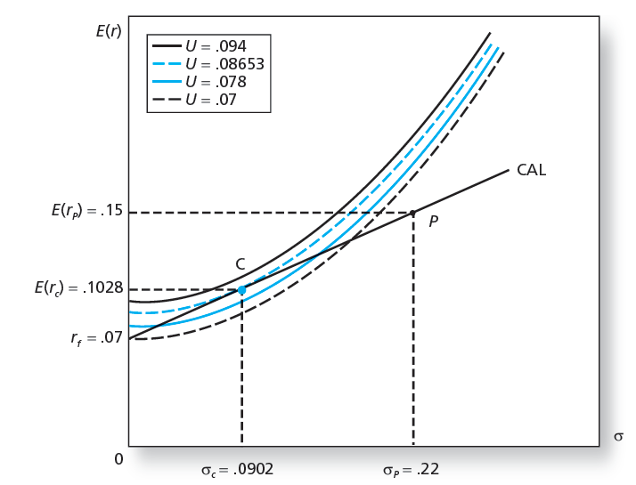
Figure 6.7 Finding the Optimal Complete Portfolio (A = 4)

Slide 37
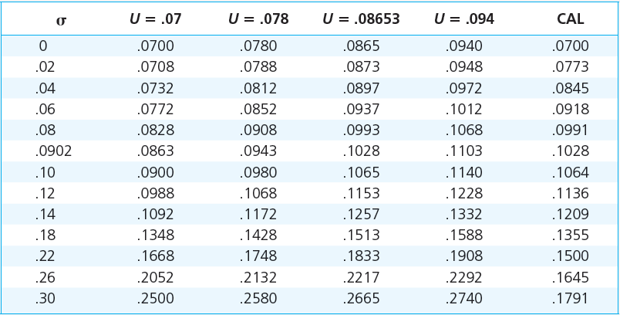
Table 6.6 Expected Returns on Four Indifference Curves and the CAL

Slide 38
Passive Strategies: The Capital Market Line
E(r_{c}) = r_{f} +[(E(r_{M}) - r_{f})/σ_{M}]σ_{c}
The passive strategy avoids any direct or indirect security analysis
Supply and demand forces may make such a strategy a reasonable choice for many investors
A natural candidate for a passively held risky asset would be a well-diversified portfolio of common stocks such as the S&P 500

Slide 39
Passive Strategies: The Capital Market Line
The Capital Market Line (CML)
Is a capital allocation line formed investment in two passive portfolios:
Virtually risk-free short-term T-bills (or a money market fund)
Fund of common stocks that mimics a broad market index

Slide 40
Passive Strategies: The Capital Market Line
From 1926 to 2018, the passive risky portfolio offered an average risk premium of 8.34% with a standard deviation of 20.36%, resulting in a reward-to-volatility ratio of .41
Index Funds
https://www.fool.com/investing/how-to-invest/index-funds/average-return/

